Slide 1
CSE 373 Topological Sort Graph Traversals
Spring 2015
Yanling He

Slide 2
Graphs
A Graph G = (V, E)
Represents relationships among items
Can be directed or undirected
Complexity is O(|E|+|V|) is O(|V|^2)

Slide 3
Graph Data Structure
Adjacency Matrix
Assign each node a number from 0 to |V|-1
A |V| x |V| matrix of booleans
If M is the matrix, then M[u][v] being true means there is an edge from u to v
Adjacency List
Assign each node a number from 0 to |V|-1
An array of length |V| in which each entry stored a list of all adjacent vertices

Slide 4
Topological Sort
Given a DAG, output all vertices in an order so that no vertex appears before another vertex that points to it

Slide 5
Topological Sort
Why do we perform topological sorts only on DAGs?
Is there always a unique answer?
Do some DAGs have exactly 1 answer?

Slide 6
Topological Sort
Why do we perform topological sorts only on DAGs?
Because a cycle means there is no correct answer
Is there always a unique answer?
No, there can be 1 or more answers; depends on the graph
Do some DAGs have exactly 1 answer?
Yes, including all lists

Slide 7
Topological Sort
Algorithm
Keep track of the in-degree of each node
Use a queue to ensure the proper ordering of nodes (from least to greatest in-degree)
Every time an in-degree is 0, enqueue it.
Every time a node is processed, decrement it’s adjacents’ in-degree.

Slide 8
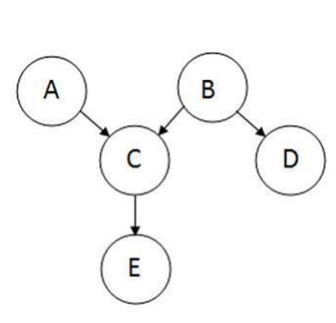
Topological Sort
Example

Slide 9
Topological Sort
 | A | B | C | D | E | Queue Contents
Step 1 | 0 | 0 | 2 | 1 | 1 | (A, B)
Step 2 | 0 | 0 | 1 | 1 | 1 | (B)
Step 3 | 0 | 0 | 0 | 0 | 1 | (C, D)
Step 4 | 0 | 0 | 0 | 0 | 0 | (D, E)
Step 5 | 0 | 0 | 0 | 0 | 0 | (E)
Step 6 | 0 | 0 | 0 | 0 | 0 | ()

Slide 10
Topological Sort
Running Time
Initialization: O(|V|+|E|) (assuming adjacency list)
Sum of all enqueues and dequeues: O(|V|)
Sum of all decrements: O(|E|) (assuming adjacency list)
So total is O(|E|+|V|) – much better for sparse graphs

Slide 11
Graph Traversals
Depth-First Search
Recursively explore one part before going back to the other parts not yet explored
Typically use a stack to keep track of which nodes to process next (non-recursive)
Breadth-First Search
Explore areas closer to the start node first
Typically use a queue to keep track of which nodes to process next

Slide 12
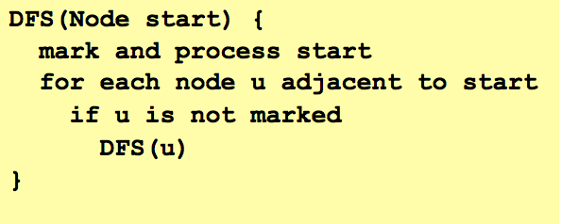
Graph Traversals
Depth First Search

Slide 13
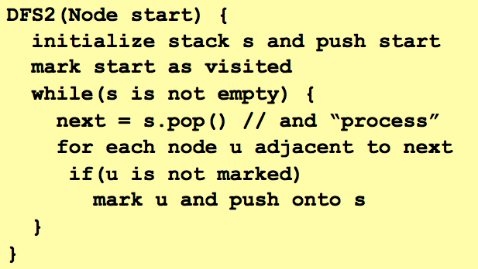
Graph Traversals
Depth First Search

Slide 14
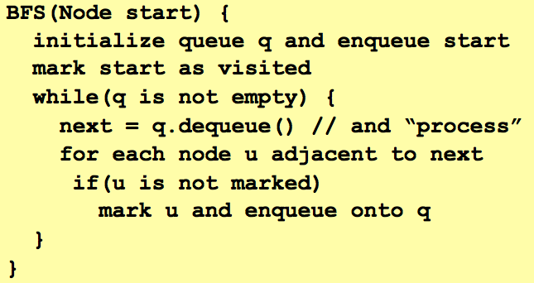
Graph Traversals
Breadth First Search

Slide 15
Graph Traversals
Comparison
Breath first finds shortest paths
Better for “what is the shortest path from x to y”
But depth-first can use less space in finding a path

