Slide 1
CSE373: Data Structures and Algorithms Lecture 4: Asymptotic Analysis
Lauren Milne
Summer 2015

Slide 2
Administrivia
Questions on Homework 1? Due Wednesday at 10:59 pm.
TA Session tomorrow, mostly on induction
Today
Algorithmic Analysis!

Slide 3
Algorithm Analysis
As the size of an algorithm’s input grows, we want to know
How long it takes to run (time)
How much room it takes to run (space)
We use Big-O notation to compare algorithm runtimes
Ignore constants and lower order terms
Independent of implementation
Big-O of (n³ + 10nlog²n + 5)?
Make assumptions
“basic” operations take constant time
Always analyze worst possible case
Slower branch of conditional
Worst possible input

Slide 4
Example
2
3
5
16
37
50
73
75
126
Find an integer in a sorted array
// requires array is sorted
// returns whether k is in array
boolean find(int[]arr, int k){
???
}
Notes:
What are some ways we can do this? What are some algorithms?

Slide 5
Linear search
2
3
5
16
37
50
73
75
126
Find an integer in a sorted array
Best case?
k is in arr[0]
c1 steps
= O(1)
Worst case?
k is not in arr
c2*(arr.length)
= O(arr.length)
// requires array is sorted
// returns whether k is in array
boolean find(int[]arr, int k){
for(int i=0; i < arr.length; ++i)
if(arr[i] == k)
return true;
return false;
}
Notes:
Naïve or silly way to do this—only way to do it with an unsorted array

Slide 6
Binary search
2
3
5
16
37
50
73
75
126
Find an integer in a sorted array
// requires sorted array
// returns whether k is in array
boolean find(int[]arr, int k){
return help(arr,k,0,arr.length);
}
boolean help(int[]arr, int k, int lo, int hi) {
int mid = (hi+lo)/2; // i.e., lo+(hi-lo)/2
if(lo==hi) return false;
if(arr[mid]==k) return true;
if(arr[mid]< k) return help(arr,k,mid+1,hi);
else return help(arr,k,lo,mid);
}
Notes:
Can also be done non-recusively
Example, walk through binary search trying to find 5
mid = (0+8)/2 = 4

Slide 7
Binary search
Best case:
c1 steps = O(1)
Worst case:
T(n) = c2 + T(n/2) where c2 is constant and n is hi-lo O(log n) where n is arr.length (recurrence equation)
// requires sorted array
// returns whether k is in array
boolean find(int[]arr, int k){
return help(arr,k,0,arr.length);
}
boolean help(int[]arr, int k, int lo, int hi) {
int mid = (hi+lo)/2;
if(lo==hi) return false;
if(arr[mid]==k) return true;
if(arr[mid]< k) return help(arr,k,mid+1,hi);
else return help(arr,k,lo,mid);
}
Notes:
Worst case is much trickier
Turns out with recursion we have to solve recurrance relation
To run algorithm on array of size n, takes a constant amount of time plus the amount of time it takes to run on array of size n/2 (that’s the size of the array in our recursive call)

Slide 8
Solving Recurrence Relations
Determine the recurrence relation and the base case.
T(n) = c2 + T(n/2) T(1) = c1
What is T(n/2)?
What is T(n/4)?
Notes:
Base case: get to array of size 1, takes constant time to check if the element is there or not
What is T(n/2) equal to? Plug in n/2 to original equation

Slide 9
Solving Recurrence Relations
Determine the recurrence relation and the base case.
T(n) = c2 + T(n/2) T(1) = c1
“Expand” the original relation to find an equivalent general expression in terms of the number of expansions “k”.
T(n) = c2 + c2 + T(n/4)
= c2 + c2 + c2 + T(n/8)
= …
= c2(k) + T(n/(2^{k}))
Find a closed-form expression: find the number of expansions to reach the base case
n/(2^{k}) = 1 means n = 2^{k} means k = log₂ n
So T(n) = c2 log₂ n + T(1)
So T(n) = c2 log₂ n + c1
So T(n) is O(log n)
Notes:
Plug in the value we just found for T(n/2) into original recurrence relation
and keep expanding until we get the general expression
So we are coming up with a general expression in terms of the number of expansions in order to figure out the number of expansions to reach the base case

Slide 10
Ignoring constant factors
So binary search is O(log n) and linear is O(n)
But which is faster?
Depends on constant factors
How many assignments, additions, etc. for each n
E.g. T(n) = 5,000,000n vs. T(n) = 5n²
And could depend on overhead unrelated to n
E.g. T(n) = 5,000,000 + log n vs. T(n) = 10 + n
But there exists some n₀ such that for all n > n₀ binary search wins
Notes:
No matter what the constants are, there exists some n so
Let’s play with some graphs to get intution

Slide 11
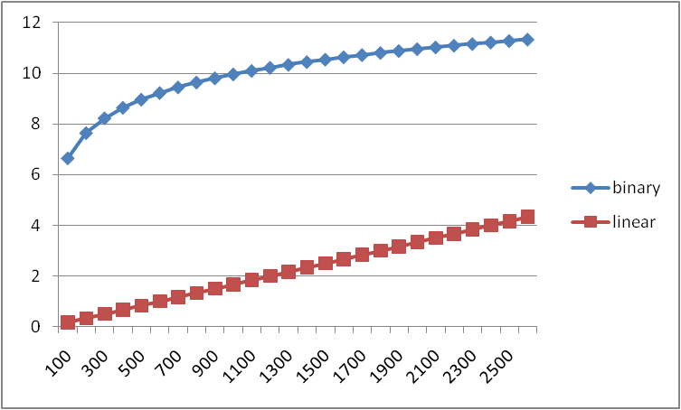
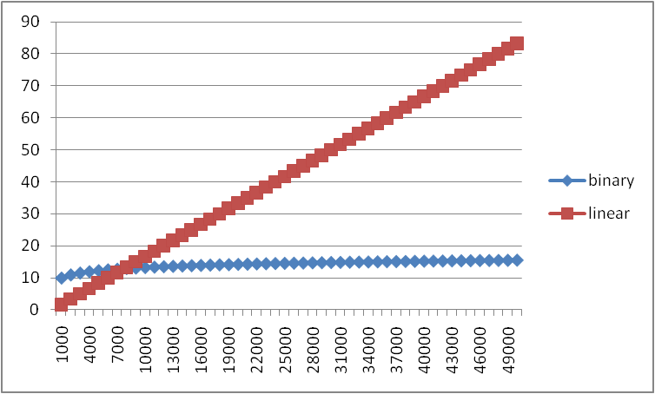
Example
Let’s try to “help” linear search
100x faster computer
3x faster compiler/language
2x smarter programmer (eliminate half the work)
Each iteration is 600x as fast as in binary search
Notes:
We really want linear search to win
So we are going to play around with those constants
X axis is size of input
Y axis is time

Slide 12
Big-O, formally
Definition:
g(n) is in O( f(n) ) if there exists
positive constants c and n₀ such that
g(n) ≤ c f(n) for all n ≥ n₀

Slide 13
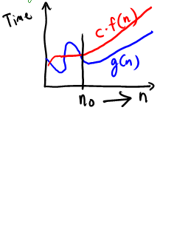
Big-O, formally
Definition:
g(n) is in O( f(n) ) if there exists
positive constants c and n₀ such that
g(n) ≤ c f(n) for all n ≥ n₀
To show g(n) is in O( f(n) ),
pick a c large enough to “cover the constant factors”
n₀ large enough to “cover the lower-order terms”
Example:
Let g(n) = 3n²+17 and f(n) = n²
What could we pick for c and n₀?
c = 5 and n₀ = 10
(3*10²)+17 ≤ 5*10² so 3n²+17 is O(n²)
Notes:
This is “less than or equal to”
So 3n²+17 is also O(n⁵) and O(2^{n}) etc.
But usually we’re interested in the tightest upper bound

Slide 14
Example 1, using formal definition
Let g(n) = 1000n and f(n) = n²
To prove g(n) is in O(f(n)), find a valid c and n₀
The “cross-over point” is n=1000
g(n) = 1000*1000 and f(n) = 1000²
So we can choose n₀=1000 and c=1
Many other possible choices, e.g., larger n₀ and/or c
Definition: g(n) is in O( f(n) ) if there exist
positive constants c and n₀ such that
g(n) ≤ c f(n) for all n ≥ n₀

Slide 15
Example 2, using formal definition
Let g(n) = n⁴ and f(n) = 2^{n}
To prove g(n) is in O(f(n)), find a valid c and n₀
We can choose n₀=20 and c=1
g(n) = 20⁴ vs. f(n) = 1*2²⁰
Definition: g(n) is in O( f(n) ) if there exist
positive constants c and n₀ such that
g(n) ≤ c f(n) for all n ≥ n₀
Notes:
Note: There are many correct possible choices of c and n₀

Slide 16
What’s with the c?
The constant multiplier c is what allows functions that differ only in their largest coefficient to have the same asymptotic complexity
Consider:
g(n) = 7n+5
f(n) = n
These have the same asymptotic behavior (linear)
So g(n) is in O(f(n)) even through g(n) is always larger
The c allows us to provide a coefficient so that g(n) ≤ c f(n)
In this example:
To prove g(n) is in O(f(n)), have c = 12, n₀ = 1
(7*1)+5 ≤ 12*1

Slide 17
What you can drop
Eliminate coefficients because we don’t have units anyway
3n² versus 5n² doesn’t mean anything when we have not specified the cost of constant-time operations
Eliminate low-order terms because they have vanishingly small impact as n grows
Do NOT ignore constants that are not multipliers
n³ is not O(n²)
3^{n} is not O(2^{n})
Notes:
(This all follows from the formal definition)

Slide 18
More Asymptotic Notation
Upper bound: O( f(n) ) is the set of all functions asymptotically less than or equal to f(n)
g(n) is in O( f(n) ) if there exist constants c and n₀ such that
g(n) ≤ c f(n) for all n ≥ n₀
Lower bound: Ω( f(n) ) is the set of all functions asymptotically greater than or equal to f(n)
g(n) is in Ω( f(n) ) if there exist constants c and n₀ such that
g(n) ≥ c f(n) for all n ≥ n₀
Tight bound: θ( f(n) ) is the set of all functions asymptotically equal to f(n)
g(n) is in θ( f(n) ) if both g(n) is in O( f(n) ) and
g(n) is in Ω( f(n) )
Notes:
Omega and theta

Slide 19
Correct terms, in theory
A common error is to say O( f(n) ) when you mean θ( f(n) )
A linear algorithm is in both O(n) and O(n⁵)
Better to say it is θ(n)
That means that it is not, for example O(log n)
Less common notation:
“little-oh”: intersection of “big-Oh” and not “big-Theta”
For all c, there exists an n₀ such that… ≤
Example: array sum is o(n²) but not o(n)
“little-omega”: intersection of “big-Omega” and not “big-Theta”
For all c, there exists an n₀ such that… ≥
Example: array sum is ω(log n) but not ω(n)

Slide 20
Summary
Analysis can be about:
The problem or the algorithm (usually algorithm)
Time or space (usually time)
Best-, worst-, or average-case (usually worst)
Upper-, lower-, or tight-bound (usually upper or tight)
We generally will give an O upper bound to the worst-case running time of an algorithm

Slide 21
Big-O Caveats
Asymptotic complexity focuses on behavior for large n
You can be misled about trade-offs using it
Example: n^{1/10} vs. log n
Asymptotically n^{1/10} grows more quickly
“Cross-over” point is around 5 * 10¹⁷
So for any smaller input, prefer n^{1/10}
For small n, an algorithm with worse asymptotic complexity might be faster
Notes:
If you care about performance for small n then the constant factors can matter

Slide 22
Addendum: Timing vs. Big-O Summary
Big-O
Examine the algorithm itself, not the implementation
Reason about performance as a function of n
Timing
Compare implementations
Focus on data sets other than worst case
Determine what the constants actually are

Slide 23
Bubble Sort
private static void bubbleSort(int[] intArray) {
int n = intArray.length;
int temp = 0;
for(int i=0; i < n; i++){
for(int j=1; j < (n-i); j++){
if(intArray[j-1] > intArray[j]){
//swap the elements!
temp = intArray[j-1];
intArray[j-1] = intArray[j];
intArray[j] = temp;
}
}
}
}
i j
0 n-1
1 n-2
2 n-3
… …
n-2 1
n-1 0
Number of iterations
0+1+2+3+..+(n-2)+(n-1)
= n(n-1)/2
Each iteration takes c1
O(n²)

