Slide 1
CSE373: Data Structures & Algorithms Lecture 28: Final review and class wrap-up
Catie Baker
Spring 2015

Slide 2
Final Exam
As also indicated on the web page:
Bring your student ID
Next Tuesday, 2:30-4:20 in this room
Cumulative but topics post-midterm about 2/3 of the questions
See information on course web-page
Not unlike the midterms in style, structure, etc.

Slide 3
Terminology
Abstract Data Type (ADT)
Mathematical description of a “thing” with set of operations
Not concerned with implementation details
Algorithm
A high level, language-independent description of a step-by-step process
Data structure
A specific organization of data and family of algorithms for implementing an ADT
Implementation of a data structure
A specific implementation in a specific language

Slide 4
Asymptotic and Algorithm Analysis
Add up time for all parts of the algorithm
e.g. number of iterations = (n²+ n)/2
Eliminate low-order terms i.e. eliminate n: (n²)/2
Eliminate coefficients i.e. eliminate 1/2: (n²)
Examples:
4n + 5
0.5n log n + 2n + 7
n³ + 2^{n} + 3n
n log (10n² )
2n log (10n)
= O(n)
= O(n log n)
= O(2^{n})
= O(n log n)

Slide 5
Amortized Analysis
In amortized analysis, the time required to perform a sequence of data structure operations is averaged over all the operations performed.
Typically used to show that the average cost of an operation is small for a sequence of operations, even though a single operation can cost a lot

Slide 6
The Queue ADT
Operations
create
destroy
enqueue
dequeue
is_empty
F E D C B
G
enqueue
dequeue
A
Back
Front

Slide 7
The Stack ADT
A
E D C B A
Operations:
create
destroy
push
pop
top
is_empty
F
B
C
D
E
F

Slide 8
The Dictionary (a.k.a. Map) ADT
Data:
set of (key, value) pairs
keys must be comparable
Operations:
insert(key,value)
find(key)
delete(key)
…
catie Catie Baker
OH: Wed 11.00-12.00
…
rama Rama Gokhale
OH: Fri 3.30-4.30
…
conrad Conrad Nied
OH: Wed 4:00-5:00
…
insert(catie, ….)
find(rama)
Rama Gokhale, …
Will tend to emphasize the keys; don’t forget about the stored values

Slide 9
Trees
Binary tree: Each node has at most 2 children (branching factor 2)
n-ary tree: Each node has at most n children (branching factor n)
Perfect tree: Each row completely full
Complete tree: Each row completely full except maybe the bottom row, which is filled from left to right

Slide 10
Tree Calculations
Recall: Height of a tree is the maximum number of edges from the root to a leaf.
Height = 4
A
What is the height of this tree?
A
B
C
A
Height = 0
B
Height = 1
D
E
F
G
What is the depth of node G?
H
I
Depth = 2
What is the depth of node L?
J
K
L
M
N
Depth = 4

Slide 11
Tree Traversals
A traversal is an order for visiting all the nodes of a tree
Pre-order: root, left subtree, right subtree
+ * 2 4 5
In-order: left subtree, root, right subtree
2 * 4 + 5
Post-order: left subtree, right subtree, root
2 4 * 5 +
+
*
5
2
4
(an expression tree)

Slide 12
Binary Search Tree (BST) Data Structure
Structure property (binary tree)
Each node has ≤ 2 children
Result: keeps operations simple
Order property
All keys in left subtree smaller than node’s key
All keys in right subtree larger than node’s key
Result: easy to find any given key
Operations
Find, insert, delete, BuildTree
8
5
11
2
6
10
12
4
7
9
14
13

Slide 13
The AVL Tree Data Structure
An AVL tree is a self-balancing binary search tree.
Structural properties
Binary tree property (same as BST)
Order property (same as for BST)
Balance property: balance of every node is between -1 and 1
Result: Worst-case depth is O(log n)
Operations
find
insert: First BST insert, then check balance and potentially “fix” the AVL tree (4 cases).
Notes:
So, AVL trees will be Binary Search Trees with one extra feature:
They balance themselves!
The result is that all AVL trees at any point will have a logarithmic asymptotic bound on their depths

Slide 14
Priority Queues and Binary Heaps
Priority Queue ADT:
insert comparable object,
deleteMin
Binary heap data structure:
Complete binary tree
Each node has less important
priority value than its parent
insert and deleteMin operations = O(height-of-tree)=O(log n)
insert: put at new last position in tree and percolate-up
deleteMin: remove root, put last element at root and percolate-down
6 2
15 23
12 18
45 3 7
insert
deleteMin
10
20
80
40
60
85
99
700
50

Slide 15
Union-Find ADT
Given an unchanging set S, create an initial partition of a set
Typically each item in its own subset: {a}, {b}, {c}, …
Give each subset a “name” by choosing a representative element
Operations
find takes an element of S and returns the representative element of the subset it is in
union takes two subsets and (permanently) makes one larger subset
Up-tree data structure
With path compression and union by size

Slide 16
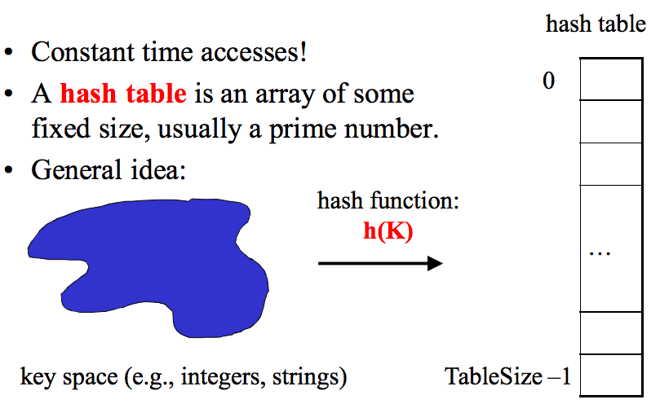
Hash Tables
Collision: when two keys map to the same location in the hash table.
Two ways to resolve collision:
Separate chaining
Open Addressing (linear probing, quadratic probing, double hashing.)

Slide 17
Memory Locality
Temporal Locality (locality in time)
If an item (a location in memory) is referenced, that same location will tend to be referenced again soon.
Spatial Locality (locality in space)
If an item is referenced, items whose addresses are close by tend to be referenced soon.

Slide 18
Graphs
Vertex, node, edge
Directed, undirected
Weighted, unweighted
Connected, disconnected, strongly/weakly connected
Paths, cycles
DAGs
Adjacency lists and matrices

Slide 19
Topological Sort
Problem: Given a DAG G=(V,E), output all vertices in an order such that no vertex appears before another vertex that has an edge to it
One example output:
126, 142, 143, 374, 373, 417, 410, 413, XYZ, 415
CSE 374
XYZ
CSE 410
CSE 142
CSE 143
CSE 373
CSE 413
MATH 126
CSE 415
CSE 417

Slide 20
Graph Traversals
For an arbitrary graph and a starting node v, find all nodes reachable from v (i.e., there exists a path from v)
Basic idea:
Keep following nodes
But “mark” nodes after visiting them, so the traversal terminates and processes each reachable node exactly once
Important Graph traversal algorithms:
“Depth-first search” “DFS”: recursively explore one part before going back to the other parts not yet explored
“Breadth-first search” “BFS”: explore areas closer to the start node first

Slide 21
Dijkstra’s Algorithm: Lowest cost paths
0
2
2
4
∞
B
2
3
A
F
H
1
10
1
4
3
∞
C
1
G
2
11
4
D
E
7
12
Initially, start node has cost 0 and all other nodes have cost ∞
At each step:
Pick closest unknown vertex v
Add it to the “cloud” of known vertices
Update distances for nodes with edges from v
That’s it!

Slide 22
Minimum Spanning Trees
The minimum-spanning-tree problem
Given a weighted undirected graph, compute a spanning tree of minimum weight

Slide 23
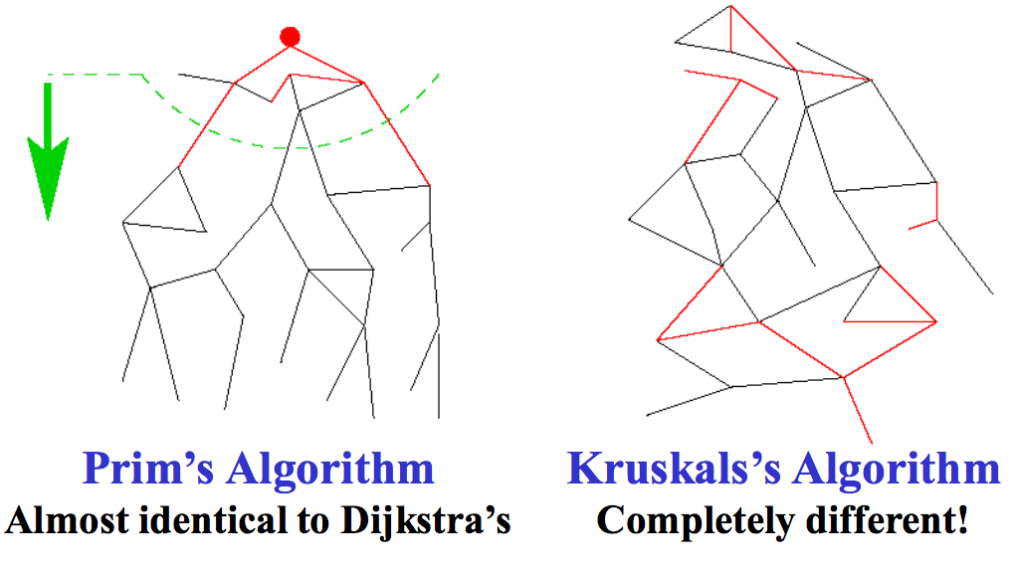
Two different approaches

Slide 24
Sorting: The Big Picture
Surprising amount of neat stuff to say about sorting:
Simple
algorithms:
O(n²)
Fancier
algorithms:
O(n log n)
Comparison
lower bound:
Ω(n log n)
Specialized
algorithms:
O(n)
Handling
huge data
sets
Insertion sort
Selection sort
Shell sort
…
Heap sort
Merge sort
Quick sort
…
Bucket sort
Radix sort
External
sorting

Slide 25
Preserving Abstractions
Need to deep-copy data passed into abstractions to avoid pain and suffering
Need to deep-copy data passed out of abstractions to avoid pain and suffering (unless data is “new” or no longer used in abstraction)
If objects are immutable (no way to update fields or things they refer to), then copying unnecessary

Slide 26
Algorithm Design Techniques
Greedy (Shortest path, minimum spanning tree, …)
Divide and Conquer
Divide the problem into smaller subproblems, solve them, and combine into the overall solution
Often done recursively
Quick sort, merge sort are great examples
Dynamic Programming
Brute force through all possible solutions, storing solutions to subproblems to avoid repeat computation
Backtracking (A clever form of exhaustive search)
P vs. NP (Know what it means for an algorithm to be in NP, in P.)
Parallelism
Use threads to split work among many processors.

Slide 27
Phew! That’s it.
Good luck ☺

Slide 28
Victory Lap
A victory lap is an extra trip
around the track
By the exhausted victors
(that’s us) ☺
Review course goals
Slides from Lecture 1
What makes CSE 373 special

Slide 29
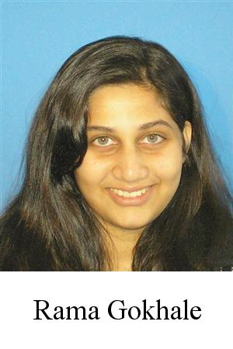
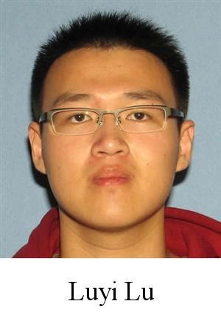
Thank you!
Big thank-you to your TAs
Amazingly cohesive “big team”
Prompt grading and question-answering
Optional TA sessions weren’t optional for them!
Andy Li Cyndi Ai

Slide 30
Thank you!
And huge thank you to all of you
Great attitude
Showed up to class (most of the time)
Occasionally laughed at stuff ☺

Slide 31
Now a few slides from Lecture 1
Hopefully they make more sense now
Hopefully we succeeded

Slide 32
Data Structures
Introduction to Algorithm Analysis
Lists, Stacks, Queues
Trees, Hashing, Dictionaries
Heaps, Priority Queues
Sorting
Disjoint Sets
Graph Algorithms
Introduction to Parallelism and Concurrency

Slide 33
Goals
Be able to make good design choices as a developer, project manager, etc.
Reason in terms of the general abstractions that come up in all non-trivial software (and many non-software) systems
Be able to justify and communicate your design decisions
You will learn the key abstractions used almost every day in just about anything related to computing and software.
This is not a course about Java! We use Java as a tool, but the data structures you learn about can be implemented in any language.

Slide 34
Last slide
I had a lot of fun and learned a great deal this quarter.
You have learned the key ideas for organizing data, a skill that far transcends computer science.

