Slide 1
CSE373: Data Structures & Algorithms Lecture 24: The P vs. NP question, NP-Completeness
Catie Baker
Spring 2015

Slide 2
Admin
Homework 5 due TONIGHT at 11pm!
Homework 6 is posted
Due one week from today, June 3rd at 11pm
No partners

Slide 3
The $1M question
The Clay Mathematics Institute
Millenium Prize Problems
Birch and Swinnerton-Dyer Conjecture
Hodge Conjecture
Navier-Stokes Equations
P vs NP
Poincaré Conjecture
Riemann Hypothesis
Yang-Mills Theory

Slide 4
The P versus NP problem
Is one of the biggest open problems in computer science (and mathematics) today
It’s currently unknown whether there exist polynomial time algorithms for NP-complete problems
That is, does P = NP?
People generally believe P ≠ NP, but no proof yet
But what is the P-NP problem?

Slide 5
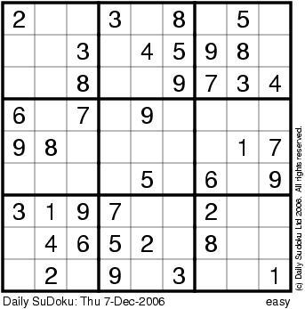
Sudoku
3x3x3

Slide 6
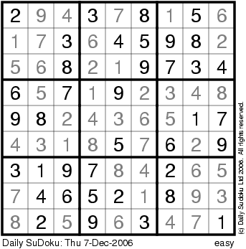
Sudoku
3x3x3

Slide 7
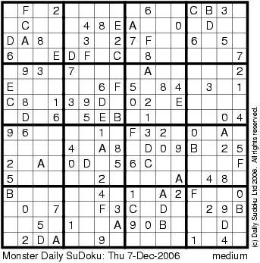
Sudoku
4x4x4

Slide 8
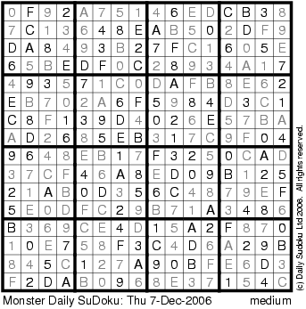
Sudoku
4x4x4

Slide 9
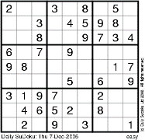
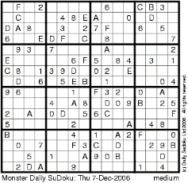
Sudoku
Suppose you have an algorithm S(n) to solve n x n x n
V(n) time to verify the solution
Fact: V(n) = O(n² x n²)
Question: is there some constant such that
...
S(n) = O(n^{constant})?
n x n x n

Slide 10
Sudoku
P vs NP problem
=
Does there exist an algorithm for solving n x n x n Sudoku that runs in time p(n) for some polynomial p( ) ?
...
n x n x n

Slide 11
The P versus NP problem (informally)
Is finding an answer to a problem much more difficult than verifying an answer to a problem?

Slide 12
Hamilton Cycle
Given a graph G = (V,E), is there a cycle that visits all the nodes exactly once?
YES if G has a Hamilton cycle
NO if G has no Hamilton cycle
The Set “HAM”
HAM = { graph G | G has a Hamilton cycle }

Slide 13
Circuit-Satisfiability
Input: A circuit C with one output
Output:
YES if C is satisfiable
NO if C is not satisfiable
AND
NOT
The Set “SAT”
SAT = { all satisfiable circuits C }
AND

Slide 14
Sudoku
Input: n x n x n sudoku instance
Output:
YES if this sudoku has a solution
NO if it does not
The Set “SUDOKU”
SUDOKU = { All solvable sudoku instances }

Slide 15
Polynomial Time and The Class “P”

Slide 16
What is an efficient algorithm?
Is an O(n) algorithm efficient?
How about O(n log n)?
polynomial time
O(n^{c}) for some
constant c
O(n²) ?
O(n¹⁰) ?
O(n^{log n}) ?
non-polynomial
time
O(2^{n}) ?
O(n!) ?

Slide 17
What is an efficient algorithm?
Does an algorithm running in O(n¹⁰⁰) time count as efficient?
Asking for a poly-time algorithm for a problem sets a (very) low bar when asking for efficient algorithms.
We consider non-polynomial time algorithms to be inefficient.
And hence a necessary condition for an algorithm to be efficient is that it should run in poly-time.

Slide 18
The Class P
The class of all sets that can be verified in polynomial time.
AND
The class of all decision problems that can be decided in polynomial time.
Binary Search
Dijkstra’s Algorithm
Breadth-First Search
P
Sorting Algorithms

Slide 19
The question is: can we achieve even this for
HAM? SAT?
Sudoku?

Slide 20
Onto the new class, NP (Nondeterministic Polynomial Time)

Slide 21
Verifying Membership
Is there a short “proof” I can give you to verify that:
G ∈ HAM?
G ∈ Sudoku?
G ∈ SAT?
Yes: I can just give you the cycle, solution, circuit

Slide 22
The Class NP
The class of sets for which there exist “short” proofs of membership (of polynomial length) that can “quickly” verified (in polynomial time).
Recall: The algorithm doesn’t have to find the proof; it just needs to be able to verify that it is a “correct” proof.
Fact: P ⊆ NP

Slide 23
P ⊆ NP
NP
Hamilton Cycle
Sudoku
P
Binary Search
SAT
Dijkstra’s Algorithm
Breadth-First Search
…
Sorting Algorithms
…

Slide 24
Summary: P versus NP
NP: “proof of membership” in a set can be verified in polynomial time.
P: in NP (membership verified in polynomial time)
AND membership in a set can be decided in polynomial time.
Fact: P ⊆ NP
Question: Does NP ⊆ P ?
i.e. Does P = NP?
People generally believe P ≠ NP, but no proof yet

Slide 25
Why Care?

Slide 26
NP Contains Lots of Problems We Don’t Know to be in P
Classroom Scheduling
Packing objects into bins
Scheduling jobs on machines
Finding cheap tours visiting a subset of cities
Finding good packet routings in networks
Decryption
…
OK, OK, I care...

Slide 27
How could we prove that NP = P?
We would have to show that every set in NP has a polynomial time algorithm…
How do I do that?
It may take a long time!
Also, what if I forgot one of the sets in NP?

Slide 28
How could we prove that NP = P?
We can describe just one problem L in NP, such that if this problem L is in P, then NP ⊆ P.
It is a problem that can capture all other problems in NP.
The “Hardest” Set in NP
We call these problems NP-complete

Slide 29
Theorem [Cook/Levin]
SAT is one problem in NP, such that if we can show SAT is in P, then we have shown NP = P.
SAT is a problem in NP that can capture all other languages in NP.
We say SAT is NP-complete.

Slide 30
Poly-time reducible to each other
Answer
Takes polynomial time
Instance of problem Y
Map instance of Y into instance of X
Oracle for problem Y
Oracle for problem X
Answer
can be reduced (in polytime to)
an instance of
can be reduced (in polytime to)
an instance of
Any problem in NP
SAT
Sudoku
hence SAT is NP-complete
hence Sudoku is NP-complete

Slide 31
NP-complete: The “Hardest” problems in NP
Sudoku
Clique
SAT
Independent-Set
3-Colorability
HAM
These problems are all “polynomial-time equivalent”
i.e., each of these can be reduced to any of the others in polynomial time
If you get a polynomial-time algorithm for one, you get a polynomial-time algorithm for ALL.
(you get millions of dollars, you solve decryption, … etc.)

