Slide 1
CSE373: Data Structures & Algorithms Lecture 23: Course Victory Lap
Dan Grossman
Fall 2013

Slide 2
Today
Finish parallel-program analysis
Rest-of-course logistics: exam, etc.
Review of main course themes
Course evaluations
Thoughtful and constructive feedback deeply appreciated
(Including what you liked)

Slide 3
Final Exam
As also indicated on the web page:
Next Tuesday, 2:30-4:20
Cumulative but topics post-midterm-2 worth about 2/3 of the points
See information on course web-page
Not unlike the midterms in style, structure, etc.
Tough-but-fair exams are the most equitable approach
And/but 110 minutes will make a big difference

Slide 4
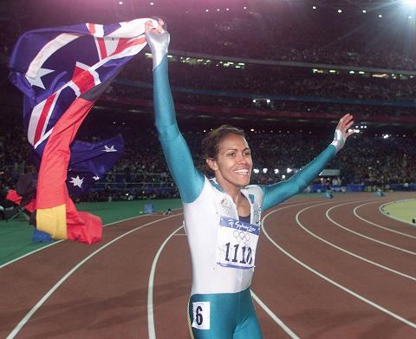
Victory Lap
A victory lap is an extra trip
around the track
By the exhausted victors
(that’s us) ☺
Review course goals
Slides from Lecture 1
What makes CSE373 special

Slide 5
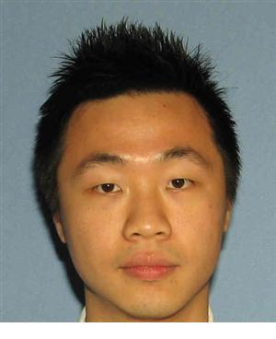
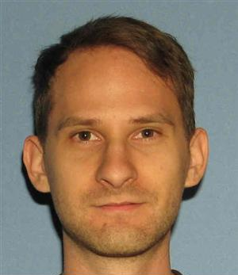
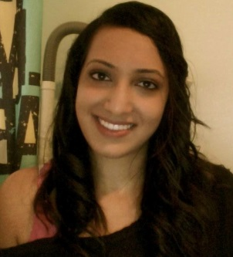
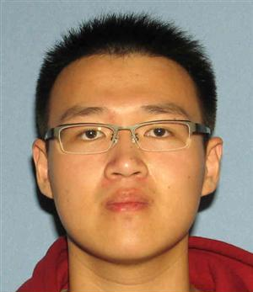
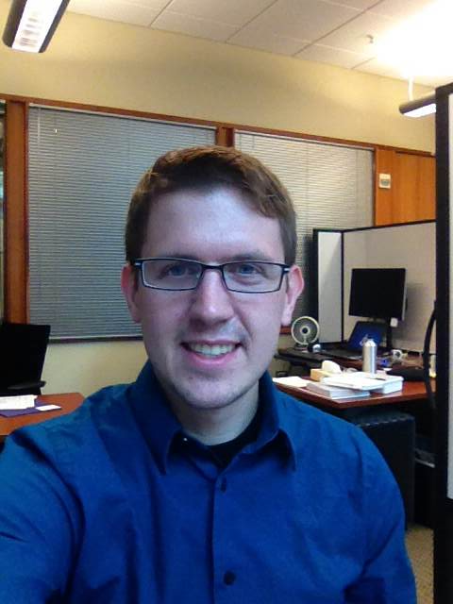
Thank you!
Big thank-you to your TAs
Amazingly cohesive “big team”
Prompt grading and question-answering
Optional TA sessions weren’t optional for them!

Slide 6
Thank you!
And huge thank you to all of you
Great attitude
Good class attendance and questions for the largest-ever (?) CSE373
Thoughts on how to “make it feel smaller” appreciated
Occasionally laughed at stuff ☺

Slide 7
Now three slides, completely unedited, from Lecture 1
Hopefully they make more sense now
Hopefully we succeeded

Slide 8
Data Structures
Introduction to Algorithm Analysis
Lists, Stacks, Queues
Trees, Hashing, Dictionaries
Heaps, Priority Queues
Sorting
Disjoint Sets
Graph Algorithms
May have time for other brief exposure to topics, maybe parallelism

Slide 9
What 373 is about
Deeply understand the basic structures used in all software
Understand the data structures and their trade-offs
Rigorously analyze the algorithms that use them (math!)
Learn how to pick “the right thing for the job”
More thorough and rigorous take on topics introduced in CSE143 (plus more new topics)
Practice design, analysis, and implementation
The elegant interplay of “theory” and “engineering” at the core of computer science
More programming experience (as a way to learn)

Slide 10
Goals
Be able to make good design choices as a developer, project manager, etc.
Reason in terms of the general abstractions that come up in all non-trivial software (and many non-software) systems
Be able to justify and communicate your design decisions
Dan’s take:
Key abstractions used almost every day in just about anything related to computing and software
It is a vocabulary you are likely to internalize permanently

Slide 11
Last slide
What do you think was good about 373?
What could be improved?
Advice:
Make the most of your time at UW and beyond
You have learned the key ideas for organizing data, a skill that far transcends computer science

