Slide 1
CSE 373: Data Structures and Algorithms
Lecture 6: Sorting

Slide 2
Why Sorting?
Practical application
People by last name
Countries by population
Search engine results by relevance
Fundamental to other algorithms
Different algorithms have different asymptotic and constant-factor trade-offs
No single ‘best’ sort for all scenarios
Knowing one way to sort just isn’t enough
Many to approaches to sorting which can be used for other problems

Slide 3
Problem statement
There are n comparable elements in an array and we want to rearrange them to be in increasing order
Pre:
An array A of data records
A value in each data record
A comparison function
<, =, >, compareTo
Post:
For each distinct position i and j of A, if i < j then A[i] ≤ A[j]
A has all the same data it started with

Slide 4
Sorting Classification
In memory sorting |  |  | External sorting
Comparison sorting Ω(N log N) |  | Specialized Sorting
O(N²) | O(N log N) | O(N) | # of tape accesses
Bubble Sort Selection Sort Insertion Sort Shellsort Sort | Merge Sort Quick Sort Heap Sort | Bucket Sort Radix Sort | Simple External Merge Sort Variations
in place? stable?

Slide 5
Comparison Sorting
comparison-based sorting: determine order through comparison operations on the input data:
<, >, compareTo, …

Slide 6
Bogo sort
bogo sort: orders a list of values by repetitively shuffling them and checking if they are sorted
more specifically:
scan the list, seeing if it is sorted
if not, shuffle the values in the list and repeat
This sorting algorithm has terrible performance!
Can we deduce its runtime?

Slide 7
Bogo sort code
public static void bogoSort(int[] a) {
while (!isSorted(a)) {
shuffle(a);
}
}
// Returns true if array a's elements
// are in sorted order.
public static boolean isSorted(int[] a) {
for (int i = 0; i < a.length - 1; i++) {
if (a[i] > a[i+1]) {
return false;
}
}
return true;
}

Slide 8
Bogo sort code, helpers
// Shuffles an array of ints by randomly swapping each
// element with an element ahead of it in the array.
public static void shuffle(int[] a) {
for (int i = 0; i < a.length - 1; i++) {
// pick random number in [i+1, a.length-1] inclusive
int range = a.length-1 - (i + 1) + 1;
int j = (int)(Math.random() * range + (i + 1));
swap(a, i, j);
}
}
// Swaps a[i] with a[j].
private static void swap(int[] a, int i, int j) {
if (i == j)
return;
int temp = a[i];
a[i] = a[j];
a[j] = temp;
}

Slide 9
Bogo sort runtime
How long should we expect bogo sort to take?
related to probability of shuffling into sorted order
assuming shuffling code is fair, probability equals 1 / (number of permutations of n elements)
bogo sort takes roughly factorial time to run
note that if array is initially sorted, bogo finishes quickly!
it should be clear that this is not satisfactory...

Slide 10
O(n²) Comparison Sorting

Slide 11
Bubble sort
bubble sort: orders a list of values by repetitively comparing neighboring elements and swapping their positions if necessary
more specifically:
scan the list, exchanging adjacent elements if they are not in relative order; this bubbles the highest value to the top
scan the list again, bubbling up the second highest value
repeat until all elements have been placed in their proper order

Slide 12
"Bubbling" largest element
Traverse a collection of elements
Move from the front to the end
"Bubble" the largest value to the end using pair-wise comparisons and swapping
Swap
1 2 3 4 5 6
42
77
77
42
35
12
101
5

Slide 13
"Bubbling" largest element
Traverse a collection of elements
Move from the front to the end
"Bubble" the largest value to the end using pair-wise comparisons and swapping
1 2 3 4 5 6
Swap
35
77
42
77
35
12
101
5

Slide 14
"Bubbling" largest element
Traverse a collection of elements
Move from the front to the end
"Bubble" the largest value to the end using pair-wise comparisons and swapping
1 2 3 4 5 6
Swap
12
77
42
35
77
12
101
5

Slide 15
"Bubbling" largest element
Traverse a collection of elements
Move from the front to the end
"Bubble" the largest value to the end using pair-wise comparisons and swapping
1 2 3 4 5 6
42
35
12
77
101
5
No need to swap

Slide 16
"Bubbling" largest element
Traverse a collection of elements
Move from the front to the end
"Bubble" the largest value to the end using pair-wise comparisons and swapping
1 2 3 4 5 6
Swap
5
101
42
35
12
77
101
5

Slide 17
"Bubbling" largest element
Traverse a collection of elements
Move from the front to the end
"Bubble" the largest value to the end using pair-wise comparisons and swapping
1 2 3 4 5 6
101
42
35
12
77
5
Largest value correctly placed

Slide 18
Bubble sort code
public static void bubbleSort(int[] a) {
for (int i = 0; i < a.length; i++) {
for (int j = 1; j < a.length - i; j++) {
// swap adjacent out-of-order elements
if (a[j-1] > a[j]) {
swap(a, j-1, j);
}
}
}
}

Slide 19
Bubble sort runtime
Running time (# comparisons) for input size n:
number of actual swaps performed depends on the data; out-of-order data performs many swaps

Slide 20
Selection sort
selection sort: orders a list of values by repetitively putting a particular value into its final position
more specifically:
find the smallest value in the list
switch it with the value in the first position
find the next smallest value in the list
switch it with the value in the second position
repeat until all values are in their proper places

Slide 21
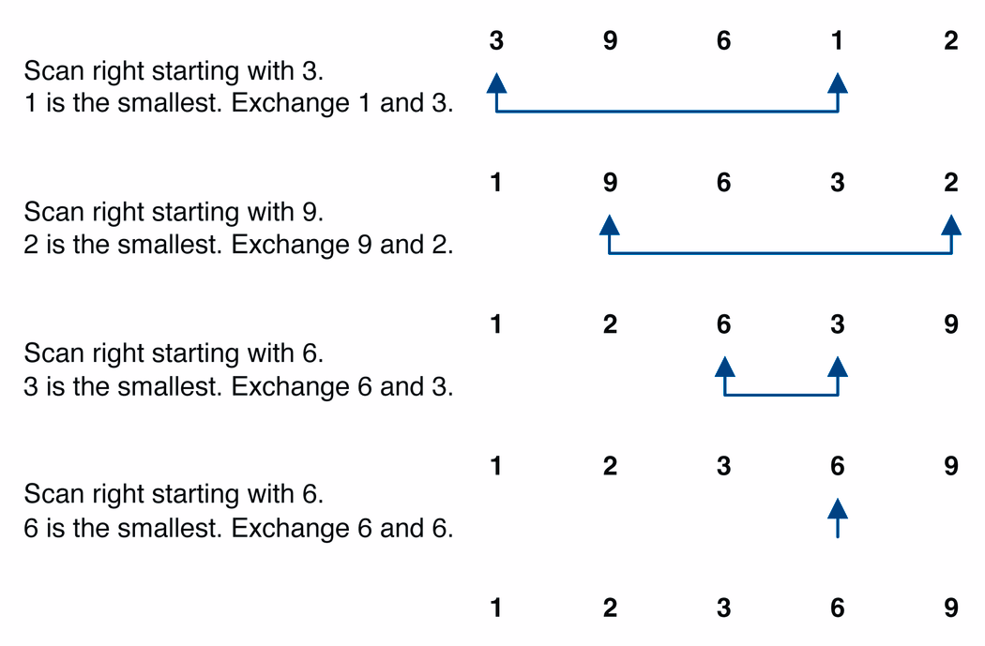
Selection sort example

Slide 22
Selection sort example 2
Index | 0 | 1 | 2 | 3 | 4 | 5 | 6 | 7
Value | 27 | 63 | 1 | 72 | 64 | 58 | 14 | 9
1st pass | 1 | 63 | 27 | 72 | 64 | 58 | 14 | 9
2nd pass | 1 | 9 | 27 | 72 | 64 | 58 | 14 | 63
3rd pass | 1 | 9 | 14 | 72 | 64 | 58 | 27 | 63
…
Notes:
The selection sort marks the first element (27). It then goes through the remaining
data to find the smallest number(1). It swaps this with the first element and the smallest element is now in its correct position. It then marks the second element (63) and looks through the remaining data for the next smallest number (9). These two numbers are then swapped. This process continues until n-1 passes have been made.

Slide 23
Selection sort code
public static void selectionSort(int[] a) {
for (int i = 0; i < a.length; i++) {
// find index of smallest element
int min = i;
for (int j = i + 1; j < a.length; j++) {
if (a[j] < a[min]) {
min = j;
}
}
// swap smallest element with a[i]
swap(a, i, min);
}
}

Slide 24
Selection sort runtime
Running time for input size n:
in practice, a bit faster than bubble sort. Why?
Notes:
faster because fewer swaps are made. (Constant c is smaller on O(n^2).)

Slide 25
Insertion sort
insertion sort: orders a list of values by repetitively inserting a particular value into a sorted subset of the list
more specifically:
consider the first item to be a sorted sublist of length 1
insert the second item into the sorted sublist, shifting the first item if needed
insert the third item into the sorted sublist, shifting the other items as needed
repeat until all values have been inserted into their proper positions

Slide 26
Insertion sort
Simple sorting algorithm.
n-1 passes over the array
At the end of pass i, the elements that occupied A[0]…A[i] originally are still in those spots and in sorted order.
2 | 15 | 8 | 1 | 17 | 10 | 12 | 5
0 | 1 | 2 | 3 | 4 | 5 | 6 | 7
after
pass 2
2 | 8 | 15 | 1 | 17 | 10 | 12 | 5
0 | 1 | 2 | 3 | 4 | 5 | 6 | 7
after
pass 3
1 | 2 | 8 | 15 | 17 | 10 | 12 | 5
0 | 1 | 2 | 3 | 4 | 5 | 6 | 7

Slide 27
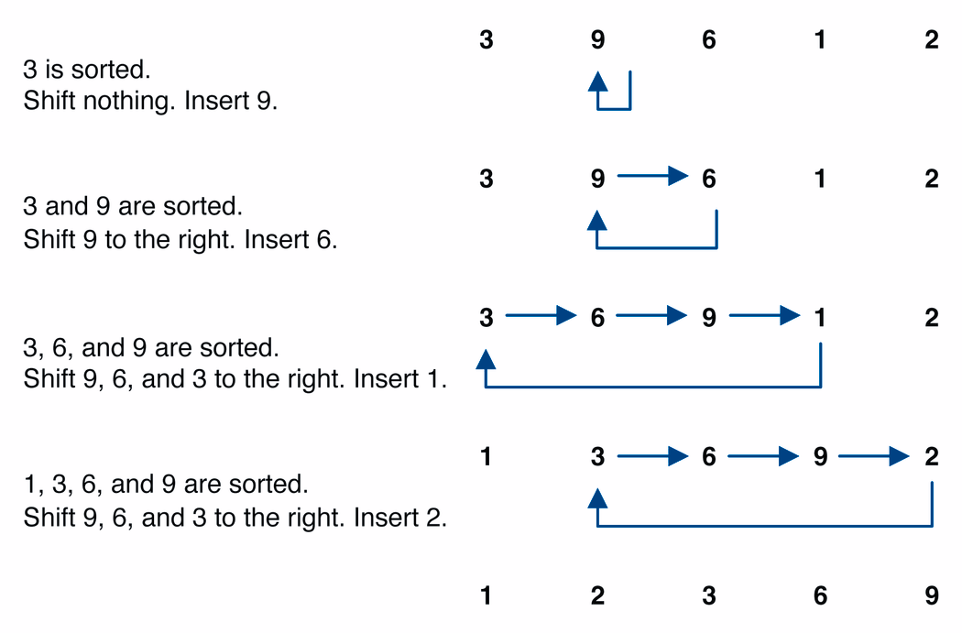
Insertion sort example

Slide 28
Insertion sort code
public static void insertionSort(int[] a) {
for (int i = 1; i < a.length; i++) {
int temp = a[i];
// slide elements down to make room for a[i]
int j = i;
while (j > 0 && a[j - 1] > temp) {
a[j] = a[j - 1];
j--;
}
a[j] = temp;
}
}

Slide 29
Insertion sort runtime
worst case: reverse-ordered elements in array.
best case: array is in sorted ascending order.
average case: each element is about halfway in order.

Slide 30
Comparing sorts
We've seen "simple" sorting algos. so far, such as:
selection sort
insertion sort
They all use nested loops and perform approximately n² comparisons
They are relatively inefficient
 | comparisons | swaps
selection | n²/2 | n
insertion | worst: n²/2 best: n | worst: n²/2 best: n

Slide 31
Average case analysis
Given an array A of elements, an inversion is an ordered pair (i, j) such that i < j, but A[i] > A[j]. (out of order elements)
Assume no duplicate elements.
Theorem: The average number of inversions in an array of n distinct elements is n (n - 1) / 4.
Corollary: Any algorithm that sorts by exchanging adjacent elements requires O(n²) time on average.

Slide 32
Shell sort description
shell sort: orders a list of values by comparing elements that are separated by a gap of >1 indexes
a generalization of insertion sort
invented by computer scientist Donald Shell in 1959
based on some observations about insertion sort:
insertion sort runs fast if the input is almost sorted
insertion sort's weakness is that it swaps each element just one step at a time, taking many swaps to get the element into its correct position

Slide 33
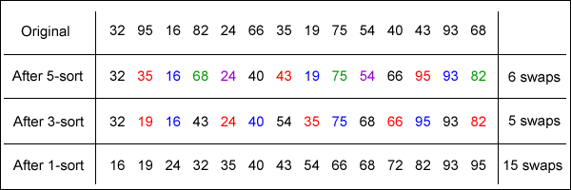
Shell sort example
Idea: Sort all elements that are 5 indexes apart, then sort all elements that are 3 indexes apart, ...

Slide 34
Shell sort code
public static void shellSort(int[] a) {
for (int gap = a.length / 2; gap > 0; gap /= 2) {
for (int i = gap; i < a.length; i++) {
// slide element i back by gap indexes
// until it's "in order"
int temp = a[i];
int j = i;
while (j >= gap && temp < a[j - gap]) {
a[j] = a[j – gap];
j -= gap;
}
a[j] = temp;
}
}
}

Slide 35
Sorting practice problem
Consider the following array of int values.
[22, 11, 34, -5, 3, 40, 9, 16, 6]
(a) Write the contents of the array after 3 passes of the outermost loop of bubble sort.
(b) Write the contents of the array after 5 passes of the outermost loop of insertion sort.
(c) Write the contents of the array after 4 passes of the outermost loop of selection sort.
(d) Write the contents of the array after a pass of bogo sort. (Just kidding.)

Slide 36
O(n log n) Comparison Sorting

Slide 37
Merge sort
merge sort: orders a list of values by recursively dividing the list in half until each sub-list has one element, then recombining
Invented by John von Neumann in 1945
more specifically:
divide the list into two roughly equal parts
recursively divide each part in half, continuing until a part contains only one element
merge the two parts into one sorted list
continue to merge parts as the recursion unfolds
This is a "divide and conquer" algorithm.

Slide 38
Merge sort
Merge sort idea:
Divide the array into two halves.
Recursively sort the two halves (using merge sort).
Use merge to combine the two arrays.
mergeSort(0, n/2-1)
mergeSort(n/2, n-1)
sort
sort
merge(0, n/2, n-1)

Slide 39
98
23
45
14
6
67
33
42

Slide 40
98
23
45
14
6
67
33
42
98
23
45
14
6
67
33
42

Slide 41
98
23
45
14
6
67
33
42
98
23
45
14
6
67
33
42
98
23
45
14

Slide 42
98
23
45
14
6
67
33
42
98
23
45
14
6
67
33
42
98
23
45
14
98
23

Slide 43
98
23
45
14
6
67
33
42
98
23
45
14
6
67
33
42
98
23
45
14
98
23
Merge

Slide 44
98
23
45
14
6
67
33
42
98
23
45
14
6
67
33
42
98
23
45
14
98
23
23
Merge

Slide 45
98
23
45
14
6
67
33
42
98
23
45
14
6
67
33
42
98
23
45
14
98
23
23
98
Merge

Slide 46
98
23
45
14
6
67
33
42
98
23
45
14
6
67
33
42
98
23
45
14
98
23
45
14
23
98

Slide 47
98
23
45
14
6
67
33
42
98
23
45
14
6
67
33
42
98
23
45
14
98
23
45
14
23
98
Merge

Slide 48
98
23
45
14
6
67
33
42
98
23
45
14
6
67
33
42
98
23
45
14
98
23
45
14
23
98
14
Merge

Slide 49
98
23
45
14
6
67
33
42
98
23
45
14
6
67
33
42
98
23
45
14
98
23
45
14
23
98
14
45
Merge

Slide 50
98
23
45
14
6
67
33
42
98
23
45
14
6
67
33
42
98
23
45
14
98
23
45
14
23
98
14
45
Merge

Slide 51
98
23
45
14
6
67
33
42
98
23
45
14
6
67
33
42
98
23
45
14
98
23
45
14
23
98
14
45
14
Merge

Slide 52
98
23
45
14
6
67
33
42
98
23
45
14
6
67
33
42
98
23
45
14
98
23
45
14
23
98
14
45
14
23
Merge

Slide 53
98
23
45
14
6
67
33
42
98
23
45
14
6
67
33
42
98
23
45
14
98
23
45
14
23
98
14
45
14
23
45
Merge

Slide 54
98
23
45
14
6
67
33
42
98
23
45
14
6
67
33
42
98
23
45
14
98
23
45
14
23
98
14
45
14
23
45
98
Merge

Slide 55
98
23
45
14
6
67
33
42
98
23
45
14
6
67
33
42
98
23
45
14
6
67
33
42
98
23
45
14
23
98
14
45
14
23
45
98

Slide 56
98
23
45
14
6
67
33
42
98
23
45
14
6
67
33
42
98
23
45
14
6
67
33
42
98
23
45
14
6
67
23
98
14
45
14
23
45
98

Slide 57
98
23
45
14
6
67
33
42
98
23
45
14
6
67
33
42
98
23
45
14
6
67
33
42
98
23
45
14
6
67
23
98
14
45
14
23
45
98
Merge

Slide 58
98
23
45
14
6
67
33
42
98
23
45
14
6
67
33
42
98
23
45
14
6
67
33
42
98
23
45
14
6
67
23
98
14
45
6
14
23
45
98
Merge

Slide 59
98
23
45
14
6
67
33
42
98
23
45
14
6
67
33
42
98
23
45
14
6
67
33
42
98
23
45
14
6
67
23
98
14
45
6
67
14
23
45
98
Merge

Slide 60
98
23
45
14
6
67
33
42
98
23
45
14
6
67
33
42
98
23
45
14
6
67
33
42
98
23
45
14
6
67
33
42
23
98
14
45
6
67
14
23
45
98

Slide 61
98
23
45
14
6
67
33
42
98
23
45
14
6
67
33
42
98
23
45
14
6
67
33
42
98
23
45
14
6
67
33
42
23
98
14
45
6
67
14
23
45
98
Merge

Slide 62
98
23
45
14
6
67
33
42
98
23
45
14
6
67
33
42
98
23
45
14
6
67
33
42
98
23
45
14
6
67
33
42
23
98
14
45
6
67
33
14
23
45
98
Merge

Slide 63
98
23
45
14
6
67
33
42
98
23
45
14
6
67
33
42
98
23
45
14
6
67
33
42
98
23
45
14
6
67
33
42
23
98
14
45
6
67
33
42
14
23
45
98
Merge

Slide 64
98
23
45
14
6
67
33
42
98
23
45
14
6
67
33
42
98
23
45
14
6
67
33
42
98
23
45
14
6
67
33
42
23
98
14
45
6
67
33
42
14
23
45
98
Merge

Slide 65
98
23
45
14
6
67
33
42
98
23
45
14
6
67
33
42
98
23
45
14
6
67
33
42
98
23
45
14
6
67
33
42
23
98
14
45
6
67
33
42
14
23
45
98
6
Merge

Slide 66
98
23
45
14
6
67
33
42
98
23
45
14
6
67
33
42
98
23
45
14
6
67
33
42
98
23
45
14
6
67
33
42
23
98
14
45
6
67
33
42
14
23
45
98
6
33
Merge

Slide 67
98
23
45
14
6
67
33
42
98
23
45
14
6
67
33
42
98
23
45
14
6
67
33
42
98
23
45
14
6
67
33
42
23
98
14
45
6
67
33
42
14
23
45
98
6
33
42
Merge

Slide 68
98
23
45
14
6
67
33
42
98
23
45
14
6
67
33
42
98
23
45
14
6
67
33
42
98
23
45
14
6
67
33
42
23
98
14
45
6
67
33
42
14
23
45
98
6
33
42
67
Merge

Slide 69
98
23
45
14
6
67
33
42
98
23
45
14
6
67
33
42
98
23
45
14
6
67
33
42
98
23
45
14
6
67
33
42
23
98
14
45
6
67
33
42
14
23
45
98
6
33
42
67
Merge

Slide 70
98
23
45
14
6
67
33
42
98
23
45
14
6
67
33
42
98
23
45
14
6
67
33
42
98
23
45
14
6
67
33
42
23
98
14
45
6
67
33
42
14
23
45
98
6
33
42
67
6
Merge

Slide 71
98
23
45
14
6
67
33
42
98
23
45
14
6
67
33
42
98
23
45
14
6
67
33
42
98
23
45
14
6
67
33
42
23
98
14
45
6
67
33
42
14
23
45
98
6
33
42
67
6
14
Merge

Slide 72
98
23
45
14
6
67
33
42
98
23
45
14
6
67
33
42
98
23
45
14
6
67
33
42
98
23
45
14
6
67
33
42
23
98
14
45
6
67
33
42
14
23
45
98
6
33
42
67
6
14
23
Merge

Slide 73
98
23
45
14
6
67
33
42
98
23
45
14
6
67
33
42
98
23
45
14
6
67
33
42
98
23
45
14
6
67
33
42
23
98
14
45
6
67
33
42
14
23
45
98
6
33
42
67
6
14
23
33
Merge

Slide 74
98
23
45
14
6
67
33
42
98
23
45
14
6
67
33
42
98
23
45
14
6
67
33
42
98
23
45
14
6
67
33
42
23
98
14
45
6
67
33
42
14
23
45
98
6
33
42
67
6
14
23
33
42
Merge

Slide 75
98
23
45
14
6
67
33
42
98
23
45
14
6
67
33
42
98
23
45
14
6
67
33
42
98
23
45
14
6
67
33
42
23
98
14
45
6
67
33
42
14
23
45
98
6
33
42
67
6
14
23
33
42
45
Merge

Slide 76
98
23
45
14
6
67
33
42
98
23
45
14
6
67
33
42
98
23
45
14
6
67
33
42
98
23
45
14
6
67
33
42
23
98
14
45
6
67
33
42
14
23
45
98
6
33
42
67
6
14
23
33
42
45
67
Merge

Slide 77
98
23
45
14
6
67
33
42
98
23
45
14
6
67
33
42
98
23
45
14
6
67
33
42
98
23
45
14
6
67
33
42
23
98
14
45
6
67
33
42
14
23
45
98
6
33
42
67
6
14
23
33
42
45
67
98
Merge

Slide 78
98
23
45
14
6
67
33
42
98
23
45
14
6
67
33
42
98
23
45
14
6
67
33
42
98
23
45
14
6
67
33
42
23
98
14
45
6
67
33
42
14
23
45
98
6
33
42
67
6
14
23
33
42
45
67
98

Slide 79
98
23
45
14
6
67
33
42
6
14
23
33
42
45
67
98

Slide 80
Merge sort example 2
13 | 6 | 21 | 18 | 9 | 4 | 8 | 20
0 |  |  |  |  |  |  | 7
13 | 6 | 21 | 18
0 |  |  | 3
9 | 4 | 8 | 20
4 |  |  | 7
13 | 6
0 | 1
21 | 18
2 | 3
9 | 4
4 | 5
8 | 20
6 | 7
13
0
6
1
21
2
18
3
9
4
4
5
8
6
20
7
6 | 13
0 | 1
18 | 21
2 | 3
4 | 9
4 | 5
8 | 20
6 | 7
6 | 13 | 18 | 21
0 |  |  | 3
4 | 8 | 9 | 20
4 |  |  | 7
4 | 6 | 8 | 9 | 13 | 18 | 20 | 21
0 |  |  |  |  |  |  | 7

Slide 81
Merging two sorted arrays
merge operation:
Given two sorted arrays, merge operation produces a sorted array with all the elements of the two arrays
A | 6 | 13 | 18 | 21
B | 4 | 8 | 9 | 20
C | 4 | 6 | 8 | 9 | 13 | 18 | 20 | 21
Running time of merge: O(n), where n is the number of elements in the merged array.
when merging two sorted parts of the same array, we'll need a temporary array to store the merged whole

Slide 82
Merge sort code
public static void mergeSort(int[] a) {
int[] temp = new int[a.length];
mergeSort(a, temp, 0, a.length - 1);
}
private static void mergeSort(int[] a, int[] temp,
int left, int right) {
if (left >= right) { // base case
return;
}
// sort the two halves
int mid = (left + right) / 2;
mergeSort(a, temp, left, mid);
mergeSort(a, temp, mid + 1, right);
// merge the sorted halves into a sorted whole
merge(a, temp, left, right);
}

Slide 83
Merge code
private static void merge(int[] a, int[] temp,
int left, int right) {
int mid = (left + right) / 2;
int count = right - left + 1;
int l = left; // counter indexes for L, R
int r = mid + 1;
// main loop to copy the halves into the temp array
for (int i = 0; i < count; i++)
if (r > right) { // finished right; use left
temp[i] = a[l++];
} else if (l > mid) { // finished left; use right
temp[i] = a[r++];
} else if (a[l] < a[r]) { // left is smaller (better)
temp[i] = a[l++];
} else { // right is smaller (better)
temp[i] = a[r++];
}
// copy sorted temp array back into main array
for (int i = 0; i < count; i++) {
a[left + i] = temp[i];
}
}

Slide 84
Merge sort runtime
let T(n) be runtime of merge sort on n items
T(0) = 1
T(1) = 2*T(0) + 1
T(2) = 2*T(1) + 2
T(4) = 2*T(2) + 4
T(8) = 2*T(4) + 8
...
T(n/2) = 2*T(n/4) + n/2
T(n) = 2*T(n/2) + n

Slide 85
Merge sort runtime
T(n) = 2*T(n/2) + n
T(n/2) = 2*T(n/4) + n/2
T(n) = 2*(2*T(n/4) + n/2) + n
T(n) = 4*T(n/4) + 2n
T(n) = 8*T(n/8) + 3n
...
T(n) = 2^{k} T(n/2^{k}) + kn To get to a more simplified case, let's set k = log₂ n.
T(n) = 2^{log n} T(n/2^{log n}) + (log n) n
T(n) = n * T(n/n) + n log n
T(n) = n * T(1) + n log n
T(n) = n * 1 + n log n
T(n) = n + n log n
T(n) = O(n log n)

Slide 86
Sorting practice problem
Consider the following array of int values.
[22, 11, 34, -5, 3, 40, 9, 16, 6]
(e) Write the contents of the array after all the recursive calls of merge sort have finished (before merging).

