Slide 1
CSE 373: Data Structures and Algorithms
Lecture 5: Math Review/Asymptotic Analysis III

Slide 2
Growth rate terminology
T(N) = O(f(N))
f(N) is an upper bound on T(N)
T(N) grows no faster than f(N)
T(N) = Ω(g(N))
g(N) is a lower bound on T(N)
T(N) grows at least as fast as g(N)
T(N) = Θ(g(N))
T(N) grows at the same rate as g(N)
T(N) = o(h(N))
T(N) grows strictly slower than h(N)

Slide 3
More about asymptotics
Fact: If f(N) = O(g(N)), then g(N) = Ω(f(N)).
Proof: Suppose f(N) = O(g(N)). Then there exist constants c and n₀ such that f(N) ≤ c g(N) for all N ≥ n₀
Then g(N) ≥ (1/c) f(N) for all N ≥ n_{0,} and so g(N) = Ω(f(N))

Slide 4
Facts about big-Oh
If T₁(N) = O(f(N)) and T₂(N) = O(g(N)), then
T₁(N) + T₂(N) = O(f(N) + g(N))
T₁(N) * T₂(N) = O(f(N) * g(N))
If T(N) is a polynomial of degree k, then: T(N) = Θ(N^{k})
example: 17n³ + 2n² + 4n + 1 = Θ(n³)
log^{k} N = O(N), for any constant k

Slide 5
Complexity cases
Worst-case complexity: “most challenging” input of size n
Best-case complexity: “easiest” input of size n
Average-case complexity: random inputs of size n
Amortized complexity: m “most challenging” consecutive inputs of size n, divided by m
Notes:
We already discussed the bound flavor. All of these can be applied to any analysis case. For example, we’ll later prove that sorting in the worst case takes at least n log n time. That’s a lower bound on a worst case.
Average case is hard! What does “average” mean. For example, what’s the average case for searching an unordered list (as precise as possible, not asymptotic).
WRONG! It’s about n, not 1/2 n. Why? You have to search the whole thing if the elt is not there.
Note there’s two senses of tight. I’ll try to avoid the terminology “asymptotically tight” and stick with the lower def’n of tight. O(inf) is not tight!

Slide 6
Bounds vs. Cases
Two orthogonal axes:
Bound
Upper bound (O, o)
Lower bound (Ω)
Asymptotically tight (Θ)
Analysis Case
Worst Case (Adversary), T_{worst}(n)
Average Case, T_{avg}(n)
Best Case, T_{best}(n)
Amortized, T_{amort}(n)
One can estimate the bounds for any given case.
e.g., We’ll show sorting takes at least n log n. That’s a lower bound on a worst case.

Slide 7
Example
List.contains(Object o)
returns true if the list contains o; false otherwise
Input size: n (the length of the List)
T(n) = “running time for size n”
But T(n) needs clarification:
Worst case T(n): it runs in at most T(n) time
Best case T(n): it takes at least T(n) time
Average case T(n): average time

Slide 8
Complexity classes
complexity class: A category of algorithm efficiency based on the algorithm's relationship to the input size N.
Class | Big-Oh | If you double N, ... | Example
constant | O(1) | unchanged | 10ms
logarithmic | O(log₂ N) | increases slightly | 175ms
linear | O(N) | doubles | 3.2 sec
log-linear | O(N log₂ N) | slightly more than doubles | 6 sec
quadratic | O(N²) | quadruples | 1 min 42 sec
cubic | O(N³) | multiplies by 8 | 55 min
... | ... | ... | ...
exponential | O(2^{N}) | multiplies drastically | 5 * 10⁶¹ years

Slide 9
Recursive programming
A method in Java can call itself; if written that way, it is called a recursive method
The code of a recursive method should be written to handle the problem in one of two ways:
base case: a simple case of the problem that can be answered directly; does not use recursion.
recursive case: a more complicated case of the problem, that isn't easy to answer directly, but can be expressed elegantly with recursion; makes a recursive call to help compute the overall answer

Slide 10
Recursive power function
Defining powers recursively: pow(x, 0) = 1 pow(x, y) = x * pow(x, y-1), y > 0
// recursive implementation
public static int pow(int x, int y) {
if (y == 0) {
return 1;
} else {
return x * pow(x, y - 1);
}
}

Slide 11
Searching and recursion
Problem: Given a sorted array a of integers and an integer i, find the index of any occurrence of i if it appears in the array. If not, return -1.
We could solve this problem using a standard iterative search; starting at the beginning, and looking at each element until we find i
What is the runtime of an iterative search?
However, in this case, the array is sorted, so does that help us solve this problem more intelligently? Can recursion also help us?

Slide 12
Binary search algorithm
Algorithm idea: Start in the middle, and only search the portions of the array that might contain the element i. Eliminate half of the array from consideration at each step.
can be written iteratively, but is harder to get right
called binary search because it chops the area to examine in half each time
implemented in Java as method Arrays.binarySearch in java.util package

Slide 13
Binary search example
i = 16
0
1
2
3
4
5
6
4
7
16
20
37
38
43
min
mid (too big!)
max

Slide 14
Binary search example
i = 16
0
1
2
3
4
5
6
4
7
16
20
37
38
43
min
mid (too small!)
max

Slide 15
Binary search example
i = 16
0
1
2
3
4
5
6
4
7
16
20
37
38
43
min, mid, max (found it!)

Slide 16
Binary search pseudocode
binary search array a for value i:
if all elements have been searched,
result is -1.
examine middle element a[mid].
if a[mid] equals i,
result is mid.
if a[mid] is greater than i,
binary search left half of a for i.
if a[mid] is less than i,
binary search right half of a for i.

Slide 17
Runtime of binary search
How do we analyze the runtime of binary search and recursive functions in general?
binary search either exits immediately, when input size <= 1 or value found (base case), or executes itself on 1/2 as large an input (rec. case)
T(1) = c
T(2) = T(1) + c
T(4) = T(2) + c
T(8) = T(4) + c
...
T(n) = T(n/2) + c
How many times does this division in half take place?
Notes:
In binary sort, log n divisions take place.

Slide 18
Divide-and-conquer
divide-and-conquer algorithm: a means for solving a problem that first separates the main problem into 2 or more smaller problems, then solves each of the smaller problems, then uses those sub-solutions to solve the original problem
1: "divide" the problem up into pieces
2: "conquer" each smaller piece
3: (if necessary) combine the pieces at the end to produce the overall solution
binary search is one such algorithm

Slide 19
Recurrences, in brief
How can we prove the runtime of binary search?
Let's call the runtime for a given input size n, T(n).
At each step of the binary search, we do a constant number c of operations, and then we run the same algorithm on 1/2 the original amount of input. Therefore:
T(n) = T(n/2) + c
T(1) = c
Since T is used to define itself, this is called a recurrence relation.

Slide 20
Solving recurrences
Master Theorem:
A recurrence written in the form
T(n) = a * T(n / b) + f(n)
(where f(n) is a function that is O(n^{k}) for some power k)
has a solution such that
This form of recurrence is very common for divide-and-conquer algorithms

Slide 21
Runtime of binary search
Binary search is of the correct format:
T(n) = a * T(n / b) + f(n)
T(n) = T(n/2) + c
T(1) = c
f(n) = c = O(1) = O(n ⁰) ... therefore k = 0
a = 1, b = 2
1 = 2⁰, therefore: T(n) = O(n⁰ log n) = O(log n)
(recurrences not needed for our exams)

Slide 22
Which Function Dominates?
f(n) =
n³ + 2n²
n^{0.1}
n + 100n^{0.1}
5n⁵
n⁻¹⁵2^{n}/100
8^{2log n}
g(n) =
100n² + 1000
log n
2n + 10 log n
n!
1000n¹⁵
3n⁷ + 7n
What we are asking is: is f = O(g) ? Is g = O(f) ?
Notes:
Welcome, everyone, to the Silicon Downs. I’m getting race results as we stand here.
Let’s start with the first race. I’ll have the first row bet on race #1. Raise your hand if you bet on function #1 (the jockey is n^0.1)
So on.
Show the race slides after each race.

Slide 23
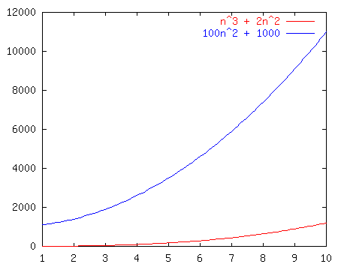
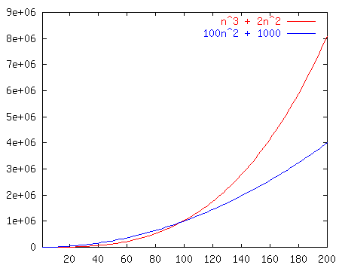
Race I
f(n)= n³+2n²
vs.
g(n)=100n²+1000

Slide 24
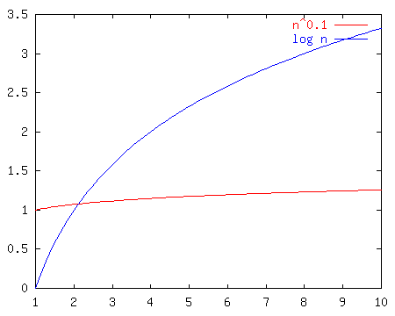
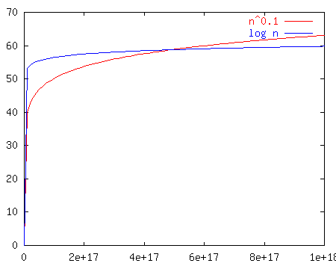
Race II
n^{0.1}
vs.
log n
Notes:
Well, log n looked good out of the starting gate and indeed kept on looking good until about n^17 at which point n^0.1 passed it up forever.
Moral of the story? N^epsilon beats log n for any eps > 0. BUT, which one of these is really better?

Slide 25
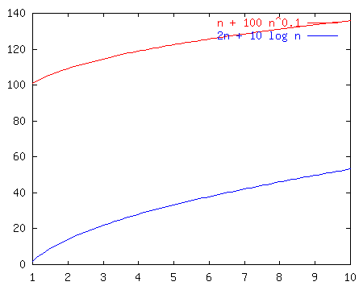
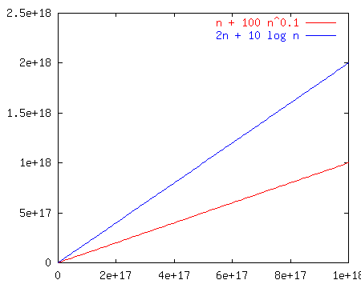
Race III
n + 100n^{0.1}
vs.
2n + 10 log n
Notes:
Notice that these just look like n and 2n once we get way out. That’s because the larger terms dominate. So, the left is less, but not asymptotically less.
It’s a TIE!

Slide 26
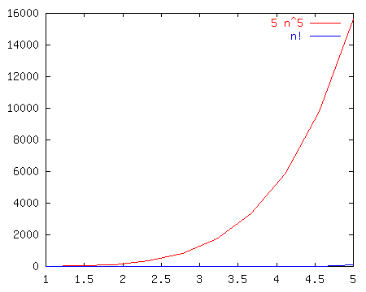
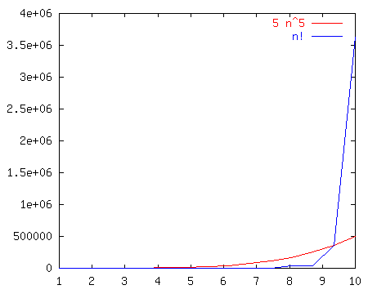
Race IV
5n⁵
vs.
n!
Notes:
N! is BIG!!!

Slide 27
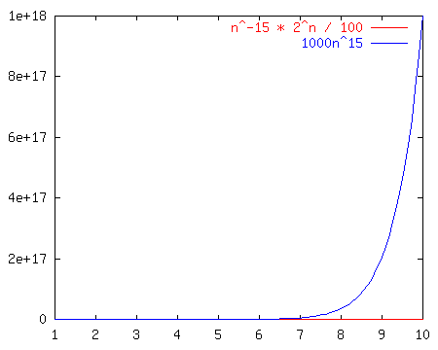
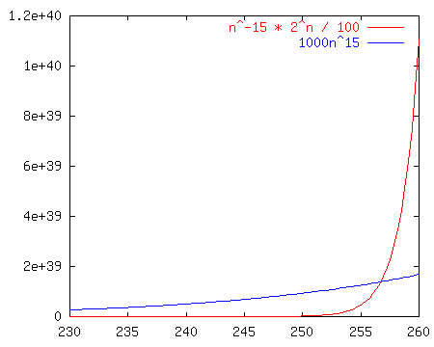
Race V
n⁻¹⁵2^{n}/100
vs.
1000n¹⁵
Notes:
No matter how you put it, any exponential beats any polynomial. It doesn’t even take that long here (~250 input size)

Slide 28
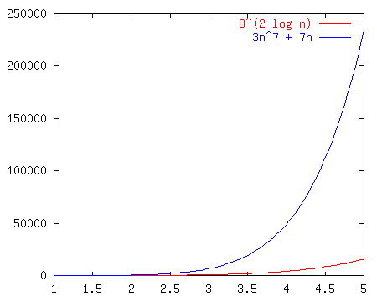
Race VI
8^{2log(n)}
vs.
3n⁷ + 7n
Notes:
We can reduce the left hand term to n^6, so they’re both polynomial and it’s an open and shut case.

Slide 29
A Note on Notation
You'll see...
g(n) = O(f(n))
and people often say...
g(n) is O(f(n)).
These really mean
g(n) ∈ O(f(n)).
That is, O(f(n)) represents a set or class of functions.

