Slide 1
CSE 373: Data Structures and Algorithms
Lecture 3: Math Review/Asymptotic Analysis

Slide 2
Announcements
Programming Project #1
Getting Help
General Questions → Message board
Feel free to answer/respond yourselves
Please no code/specifics – general ideas only
Specific/Implementation Questions → Office Hours (on course website) or email cse373-staff AT cs DOT washington DOT edu (read by myself and the three TAs)
No turnin yet
Using sox
Want to add CSE 373? See me after class.

Slide 3
Motivation
So much data!!
Human genome: 3.2 * 10⁹ base pairs
If there are 6.8 * 10⁹ on the planet, how many base pairs of human DNA?
Earth surface area: 1.49 * 10⁸ km²
How many photos if taking a photo of each m²?
For every day of the year (3.65 * 10²)?
But aren't computers getting faster and faster?

Slide 4
Why algorithm analysis?
As problem sizes get bigger, analysis is becoming more important.
The difference between good and bad algorithms is getting bigger.
Being able to analyze algorithms will help us identify good ones without having to program them and test them first.

Slide 5
Measuring Performance: Empirical Approach
Implement it, run it, time it (averaging trials)
Pros?
Cons?

Slide 6
Measuring Performance: Empirical Approach
Implement it, run it, time it (averaging trials)
Pros?
Find out how the system effects performance
Stress testing – how does it perform in dynamic environment
No math!
Cons?
Need to implement code
Can be hard to estimate performance
When comparing two algorithms, all other factors need to be held constant (e.g., same computer, OS, processor, load)

Slide 7
Measuring Performance: Analytical Approach
Use a simple model for basic operation costs
Computational Model
has all the basic operations: +, -, *, / , =, comparisons
fixed sized integers (e.g., 32-bit)
infinite memory
all basic operations take exactly one time unit (one CPU instruction) to execute
Notes:
analysis= determining run-time efficiency.
model = estimate, not meant to represent everything in real-world

Slide 8
Measuring Performance: Analytical Approach
Analyze steps of algorithm, estimating amount of work each step takes
Pros?
Independent of system-specific configuration
Good for estimating
Don't need to implement code
Cons?
Won't give you info exact runtimes optimizations made by the architecture (i.e. cache)
Only gives useful information for large problem sizes
In real life, not all operations take exactly the same time and have memory limitations

Slide 9
Analyzing Performance
General “rules” to help measure how long it takes to do things:
Basic operations
Consecutive statements
Conditionals
Loops
Function calls
Recursive functions
Constant time
Sum of timesx
Test, plus larger branch cost
Sum of iterations
Cost of function body
Solve recurrence relation…
Notes:
9
Okay, now that we have some algorithms to serve as examples, let’s analyze them! Here’s some hints before we begin …

Slide 10
Efficiency examples
statement1;
statement2;
statement3;
for (int i = 1; i <= N; i++) {
statement4;
}
for (int i = 1; i <= N; i++) {
statement5;
statement6;
statement7;
}
?
?
?
?

Slide 11
Efficiency examples
statement1;
statement2;
statement3;
for (int i = 1; i <= N; i++) {
statement4;
}
for (int i = 1; i <= N; i++) {
statement5;
statement6;
statement7;
}
3
N
4N + 3
3N

Slide 12
Efficiency examples 2
for (int i = 1; i <= N; i++) {
for (int j = 1; j <= N; j++) {
statement1;
}
}
for (int i = 1; i <= N; i++) {
statement2;
statement3;
statement4;
statement5;
}
?
?
?

Slide 13
Efficiency examples 2
for (int i = 1; i <= N; i++) {
for (int j = 1; j <= N; j++) {
statement1;
}
}
for (int i = 1; i <= N; i++) {
statement2;
statement3;
statement4;
statement5;
}
How many statements will execute if N = 10? If N = 1000?
N²
N² + 4N
4N

Slide 14
Relative rates of growth
most algorithms' runtime can be expressed as a function of the input size N
rate of growth: measure of how quickly the graph of a function rises
goal: distinguish between fast- and slow-growing functions
we only care about very large input sizes (for small sizes, most any algorithm is fast enough)
this helps us discover which algorithms will run more quickly or slowly, for large input sizes
most of the time interested in worst case performance; sometimes look at best or average performance
Notes:
Motivation:
we usually care only about algorithm performance when there are large number of inputs.
We usually don’t care about small changes in run-time performance. (inaccuracy of estimates
make small changes less relevant). Consider algorithms with slow growth rate better than
those with fast growth rates.

Slide 15
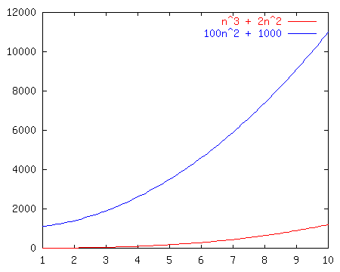
Growth rate example
Consider these graphs of functions.
Perhaps each one represents an algorithm:
n³ + 2n²
100n² + 1000
Which grows faster?

Slide 16
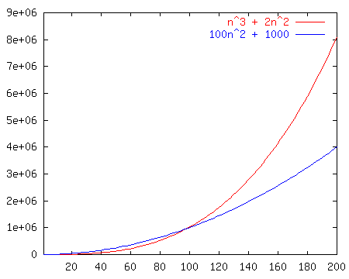
Growth rate example
How about now?

Slide 17
Big-Oh notation
Defn: T(N) = O(f(N)) if there exist positive constants c , n₀ such that: T(N) ≤ c · f(N) for all N ≥ n₀
idea: We are concerned with how the function grows when N is large. We are not picky about constant factors: coarse distinctions among functions
Lingo: "T(N) grows no faster than f(N)."
Notes:
Important (not in Lewis & Chase book). Write on board. (for next slide).

Slide 18
Big-Oh example problems
n = O(2n) ?
2n = O(n) ?
n = O(n²) ?
n² = O(n) ?
n = O(1) ?
100 = O(n) ?
214n + 34 = O(2n² + 8n) ?

Slide 19
Preferred big-Oh usage
pick tightest bound. If f(N) = 5N, then:
f(N) = O(N⁵)
f(N) = O(N³)
f(N) = O(N log N)
f(N) = O(N) ← preferred
ignore constant factors and low order terms
T(N) = O(N), not T(N) = O(5N)
T(N) = O(N³), not T(N) = O(N³ + N² + N log N)
Wrong: f(N) ≤ O(g(N))
Wrong: f(N) ≥ O(g(N))

Slide 20
Show f(n) = O(n)
Claim: n² + 100n = O(n²)
Proof: Must find c, n₀ such that for all n > n₀,
n² + 100n <= cn²

Slide 21
Efficiency examples 3
sum = 0;
for (int i = 1; i <= N * N; i++) {
for (int j = 1; j <= N * N * N; j++) {
sum++;
}
}
?
?
?

Slide 22
Efficiency examples 3
sum = 0;
for (int i = 1; i <= N * N; i++) {
for (int j = 1; j <= N * N * N; j++) {
sum++;
}
}
N³
N²
N⁵ + 1
So what is the Big-Oh?

Slide 23
Math background: Exponents
Exponents
X^{Y} , or "X to the Y^{th} power"; X multiplied by itself Y times
Some useful identities
X^{A} X^{B} = X^{A+B}
X^{A} / X^{B} = X^{A-B}
(X^{A})^{B} = X^{AB}
X^{N}+X^{N} = 2X^{N}
2^{N}+2^{N} = 2^{N+1}
Notes:
exponents grow really fast: use doubling salary example,
$1000 initial, yearly $1000 increase, vs $1 initial, doubles every year.
Which is better after 20 years?
logs grow really slow.
logs are inverses of exponents.

Slide 24
Efficiency examples 4
sum = 0;
for (int i = 1; i <= N; i += c) { sum++;
}
?
?

Slide 25
Efficiency examples 4
sum = 0;
for (int i = 1; i <= N; i += c) { sum++;
}
N/c
N/c + 1
What is the Big-Oh?
Intuition: Adding to the loop counter means that the loop runtime grows linearly when compared to its maximum value n.

Slide 26
Efficiency examples 5
sum = 0;
for (int i = 1; i <= N; i *= c) { sum++;
}
?
?
Intuition: Multiplying the loop counter means that the maximum value n must grow exponentially to linearly increase the loop runtime

Slide 27
Efficiency examples 5
sum = 0;
for (int i = 1; i <= N; i *= c) { sum++;
}
log_{c} N
log_{c} N + 1
What is the Big-Oh?

Slide 28
Math background: Logarithms
Logarithms
definition: X^{A} = B if and only if log_{X} B = A
intuition: log_{X} B means: "the power X must be raised to, to get B"
In this course, a logarithm with no base implies base 2. log B means log₂ B
Examples
log₂ 16 = 4 (because 2⁴ = 16)
log₁₀ 1000 = 3 (because 10³ = 1000)

Slide 29
Logarithm identities
Identities for logs with addition, multiplication, powers:
log (AB) = log A + log B
log (A/B) = log A – log B
log (A^{B}) = B log A
Identity for converting bases of a logarithm:
example: log₄32 = (log₂ 32) / (log₂ 4) = 5 / 2
Notes:
Proof: Let X = log A, Y = log B, and Z = log AB. Then 2^{X} = A, 2^{Y} = B, and 2^{Z} = AB.
So, 2^{X} 2^{Y} = AB = 2^{Z}.
Therefore, X + Y = Z.

Slide 30
Logarithm problem solving
When presented with an expression of the form:
log_{a}X = Y
and trying to solve for X, raise both sides to the a power.
X = a^{Y}
When presented with an expression of the form:
log_{a}X = log_{b}Y
and trying to solve for X, find a common base between the logarithms using the identity on the last slide.
log_{a}X = log_{a}Y / log_{a}b

Slide 31
Logarithm practice problems
Determine the value of x in the following equation.
log₇ x + log₇13 = 3
Determine the value of x in the following equation.
log₈ 4 - log₈ x = log₈ 5 + log₁₆ 6

