Slide 1
CSE 373: Data Structures and Algorithms
Lecture 1: Introduction; ADTs; Stacks; Eclipse

Slide 2
Course objectives
Learn basic data structures and algorithms
data structures – how data is organized
algorithms – unambiguous sequence of steps to compute something
algorithm analysis – determining how long an algorithm will take to solve a problem
Become a better software developer
"Data Structures + Algorithms = Programs" -- Niklaus Wirth, author of Pascal language

Slide 3
Abstract Data Types
abstract data type (ADT): A specification of a collection of data and the operations that can be performed on it.
Describes what a collection does, not how it does it
Described in Java with interfaces (e.g., List, Map, Set)
Separate from implementation
ADTs can be implemented in multiple ways by classes:
ArrayList and LinkedList implement List
HashSet and TreeSet implement Set
LinkedList , ArrayDeque, etc. implement Queue
They messed up on Stack; there's no Stack interface, just a class.

Slide 4
List ADT
An ordered collection the form A₀, A₁, ..., A_{N-1}, where N is the size of the list
Operations described in Java's List interface (subset):
add(el, index) | inserts the element at the specified position in the list
remove(index) | removes the element at the specified position
get(index) | returns the element at the specified position
set(index, el) | replaces the element at the specified position with the specified element
contains(el) | returns true if the list contains the element
size() | returns the number of elements in the list
ArrayList and LinkedList are implementations

Slide 5
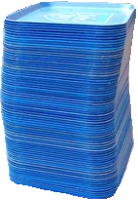
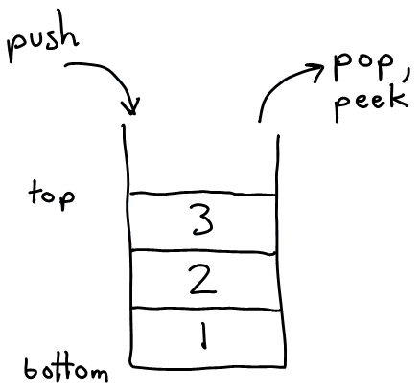
Stack ADT
stack: a list with the restriction that insertions/deletions can only be performed at the top/end of the list
Last-In, First-Out ("LIFO")
The elements are stored in order of insertion, but we do not think of them as having indexes.
The client can only add/remove/examine the last element added (the "top").
basic stack operations:
push: Add an element to the top.
pop: Remove the top element.
peek: Examine the top element.
Notes:
analogy: trays of food at the sizzler

Slide 6
Applications of Stacks
Programming languages and compilers:
method calls are placed onto a stack (call=push, return=pop)
compilers use stacks to evaluate expressions
Matching up related pairs of things:
find out whether a string is a palindrome
examine a file to see if its braces { } and other operators match
convert "infix" expressions to "postfix" or "prefix"
Sophisticated algorithms:
searching through a maze with "backtracking"
many programs use an "undo stack" of previous operations
method3 | return var local vars parameters
method2 | return var local vars parameters
method1 | return var local vars parameters

Slide 7
Class Stack
Stack<E>() | constructs a new stack with elements of type E
push(value) | places given value on top of stack
pop() | removes top value from stack and returns it; throws EmptyStackException if stack is empty
peek() | returns top value from stack without removing it; throws EmptyStackException if stack is empty
size() | returns number of elements in stack
isEmpty() | returns true if stack has no elements
Stack<Integer> s = new Stack<Integer>();
s.push(42);
s.push(-3);
s.push(17); // bottom [42, -3, 17] top
System.out.println(s.pop()); // 17

Slide 8
Stack limitations/idioms
Remember: You cannot loop over a stack like you do a list.
Stack<Integer> s = new Stack<Integer>();
...
for (int i = 0; i < s.size(); i++) {
do something with s.get(i);
}
Instead, you pull contents out of the stack to view them.
common idiom: Remove each element until the stack is empty.
while (!s.isEmpty()) {
do something with s.pop();
}

Slide 9
Exercise
Write a method symbolsBalanced that accepts a String as a parameter and returns whether or not the parentheses and the curly brackets in that String are balanced as they would have to be in a valid Java program.
Use a Stack to solve this problem.

Slide 10
Eclipse concepts
workspace: a collection of projects
stored as a directory
project: a Java program
must have your files in a project in order to be able to compile, debug and run them
by default stored in a directory in your workspace
perspective: a view of your current project using a set of pre-laid-out windows and menus
Java perspective
debugging perspective

