Slide 1
Processes II & Virtual Memory I
CSE 351 Summer 2024
Instructor:
Ellis Haker
Teaching Assistants:
Naama Amiel
Micah Chang
Shananda Dokka
Nikolas McNamee
Jiawei Huang

Slide 2
Administrivia
Today
HW20 due (11:59pm)
Lab4 due (11:59pm)
Friday, 8/9
RD23 due (1pm)
HW21 due (11:59pm)
Monday, 8/12
RD24 due (1pm)
HW22 due (11:59pm)
Quiz 3 out (11:59pm)

Slide 3
Lecture Topics
Processes and context switching
Creating new processes
fork() and exec*()
Ending a process
exit(), wait(), waitpid()
Zombies
Virtual Memory (VM)
Overview and motivation
VM as a tool for caching
Address translation
VM as a tool for memory management
VM as a tool for memory protection

Slide 4
fork Example
void fork1() {
int x = 1;
pid_t fork_ret = fork();
if (fork_ret == 0)
printf("Child has x = %d\n", ++x);
else
printf("Parent has x = %d\n", --x);
printf("Bye from process %d with x = %d\n", getpid(), x);
}
Both parent and child start/continue execution after fork
Child gets a copy of parent’s data - both processes start with x = 1
Subsequent changes to x are independent
Shared open files - stdout is the same for both
Can’t predict execution order of parent and child - up to the OS!
Notes:
fork returns child’s PID to parent, 0 to child
Child = if case, parent = else

Slide 5
Modeling fork with Process Graphs
A process graph is a useful tool for capturing the partial ordering of statements in a concurrent program
Each vertex is the execution of a statement
a → b means a happens before b
Edges can be labeled with current value of variables
printf vertices can be labeled with output
Each graph begins with a vertex with no in-edges
Any topological sort of the graph corresponds to a feasible total ordering
Total ordering of vertices where all edges point from left to right
Notes:
Topological sort = any sort where vertices come after any vertex with a path to it

Slide 6
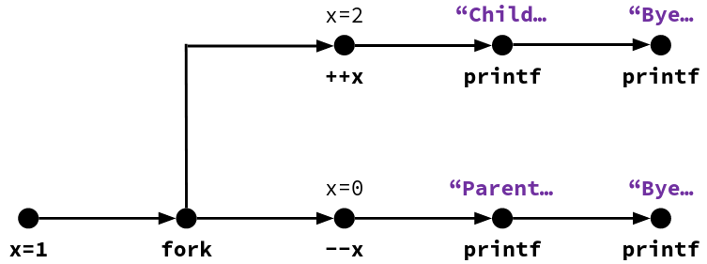
fork Example: Possible Output
void fork1() {
int x = 1;
pid_t fork_ret = fork();
if (fork_ret == 0)
printf("Child has x = %d\n", ++x);
else
printf("Parent has x = %d\n", --x);
printf("Bye from process %d with x = %d\n",
getpid(), x);
}
Notes:
Instructions within a branch must go in order, but CPU can switch between branches freely.
Child = if case = top line of diagram, parent = else case = bottom line of diagram

Slide 7
Polling Question
Which of the two sequences of outputs are possible?
Seq1 Seq2
L0 L0
L1 Bye
Bye L1
Bye L2
Bye Bye
L2 Bye
No No
No Yes
Yes No
Yes Yes
void nestedfork() {
printf("L0\n");
if (fork() == 0) {
printf("L1\n");
if (fork() == 0) {
printf("L2\n");
}
}
printf("Bye\n");
}
Notes:
Child 1 = first if case, child 2 = second if case (within first)
Parent: “L0”, fork child1, “Bye”
Child1: “L1”, fork child2, “Bye”
Child2: “L2”, “Bye”.
Seq1 impossible because “L2” cannot be the last thing printed
Seq2: parent, parent, child1, child2, child2, child1.
Answer: B

Slide 8
Fork-Exec
fork() creates a copy of the current process
exec*() replaces the current process’ code and address space with the code for a different program
Whole family of exec calls – see exec(3) and execve(2)
void fork_exec(char* path, char* argv[]) {
pid_t fork_ret = fork();
if (fork_ret != 0) {
printf("Parent: created a child %d\n", fork_ret);
} else {
printf("Child: about to exec a new program\n");
execv(path, argv);
}
printf("This line printed by parent only!\n");
}

Slide 9
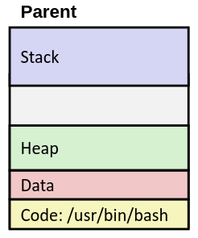
exec-ing a Program
Very high-level diagram of what happens when you run the command “ls” in a Linux shell
This is the loading part of CALL!

Slide 10
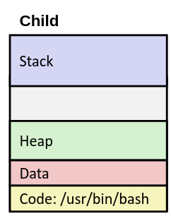
exec-ing a Program (pt 2)
Very high-level diagram of what happens when you run the command “ls” in a Linux shell
This is the loading part of CALL!
fork()

Slide 11
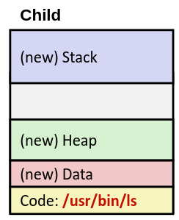
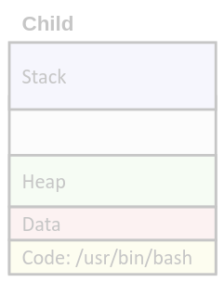
exec-ing a Program (pt 3)
Very high-level diagram of what happens when you run the command “ls” in a Linux shell
This is the loading part of CALL!
fork()
exec*()

Slide 12
Lecture Topics
Processes and context switching
Creating new processes
fork() and exec*()
Ending a process
exit(), wait(), waitpid()
Zombies
Virtual Memory (VM)
Overview and motivation
VM as a tool for caching
Address translation
VM as a tool for memory management
VM as a tool for memory protection

Slide 13
exit: Exiting a Process
void exit(int status)
Explicitly exits a process
Status code: 0 = normal exit, nonzero = abnormal exit
The return statement from main() also exits a process
The return value is the status code
Terminated processes still take up system resources
Data structures maintained by the OS
A process can’t clean up all of its own resources when it exits, so whose responsibility is it?

Slide 14
Zombies
A terminated process that is still consuming resources is called a zombie
Parent needs to reap its zombie children (i.e. clean up its resources)
Parent is given exit status information, then transfers control to the OS to delete zombie process
What if the parent exits before reaping the child?
Orphaned child is reaped by init process (process 1)
Note: on recent Linux systems, init has been renamed to systemd

Slide 15
wait: Synchronizing with Children
int wait(int* child_status)
Suspends the current process until one of its children terminates
Reaps that child, then returns its PID
If child_status != NULL, then the *child_status value indicates why the child process terminated
If NULL, that means the status was ignored
Special macros for interpreting this status – see man wait(2)
Note: If parent process has multiple children, wait will return when any of the children terminates
waitpid can be used to wait on a specific child process

Slide 16
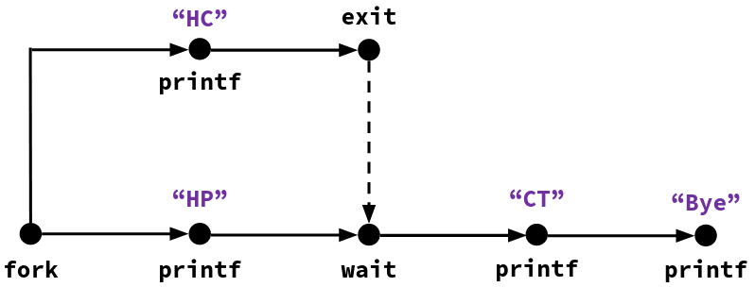
wait Example
void fork_wait() {
int child_status;
if (fork() == 0) {
printf("HC: hello from child\n");
exit(0);
} else {
printf("HP: hello from parent\n");
wait(&child_status);
printf("CT: child has terminated\n");
}
printf("Bye\n");
}
Feasible output:
HC
HP
CT
Bye
Infeasible output:
HP
CT
Bye
HC
Notes:
Child = if case = top line of diagram, parent = else case = bottom line
Second sequence is infeasible because “CT” cannot come before “HT”

Slide 17
wait Example 2: Zombies
Zombie child is still there
void fork7() {
if (fork() == 0) {
/* Child */
printf("Terminating Child, PID = %d\n",
getpid());
exit(0);
} else {
/* Parent */
printf("Running Parent, PID = %d\n",
getpid());
while (1); /* Infinite loop */
}
}
linux> ./forks 7 &
[1] 6639
Running Parent, PID = 6639
Terminating Child, PID = 6640
linux> ps
PID TTY TIME CMD
6585 ttyp9 00:00:00 tcsh
6639 ttyp9 00:00:03 forks
6640 ttyp9 00:00:00 forks <defunct>
6641 ttyp9 00:00:00 ps
linux> kill 6639
[1] Terminated
linux> ps
PID TTY TIME CMD
6585 ttyp9 00:00:00 tcsh
6642 ttyp9 00:00:00 ps
Need to kill parent for init to reap the child
Notes:
As long as parent runs, child isn’t an orphan and wont’ be reaped

Slide 18
wait Example 3: Non-terminating Child
void fork8() {
if (fork() == 0) {
/* Child */
printf("Running Child, PID = %d\n",
getpid());
while (1); /* Infinite loop */
} else {
/* Parent */
printf("Running Parent, PID = %d\n",
getpid());
exit(0);
}
}
linux> ./forks 8
Terminating Parent, PID = 6675
Running Child, PID = 6676
linux> ps
PID TTY TIME CMD
6585 ttyp9 00:00:00 tcsh
6676 ttyp9 00:00:06 forks
6677 ttyp9 00:00:00 ps
linux> kill 6676
linux> ps
PID TTY TIME CMD
6585 ttyp9 00:00:00 tcsh
6678 ttyp9 00:00:00 ps
Child still active after parent terminates
Must explicitly kill the child, or it will run forever.

Slide 19
Lecture Topics
Warning: Virtual memory is pretty complex, but crucial for understanding how processes work and for debugging performance
Processes and context switching
Creating new processes
fork() and exec*()
Ending a process
exit(), wait(), waitpid()
Zombies
Virtual Memory (VM*)
Overview and motivation
VM as a tool for caching
Address translation
VM as a tool for memory management
VM as a tool for memory protection
*Not to be confused with Virtual Machine, which is a whole other thing

Slide 20
Memory as we know it so far… is virtual!
Programs refer to virtual memory addresses
System provides private addresses for each process
Allocation: compiler and run-time system
Where different program objects should be stored
All allocation within single virtual address space
But…
We probably don’t have 2^{w} bytes of physical memory
We definitely don’t have 2^{w} bytes of physical memory for every process
Processes should not interfere with each other
Except for specific cases where they want to share code or data

Slide 21
Problem 1: How does everything fit?
64-bit virtual addresses can address 18 exabytes
(18,446,744,073,709,551,616 bytes)
Physical main memory offers a few gigabytes
(e.g., 8,589,934,592 bytes)
?
(Not to scale; physical memory would be smaller than the period at the end of this sentence compared to the virtual address space.)

Slide 22
Problem 2: Memory Management
We have multiple processes:
Process 1
Process 2
Process 3
…
Process n
Each process has:
Stack
Heap
Static Data
Literals
Code
…
×
What goes where?

Slide 23
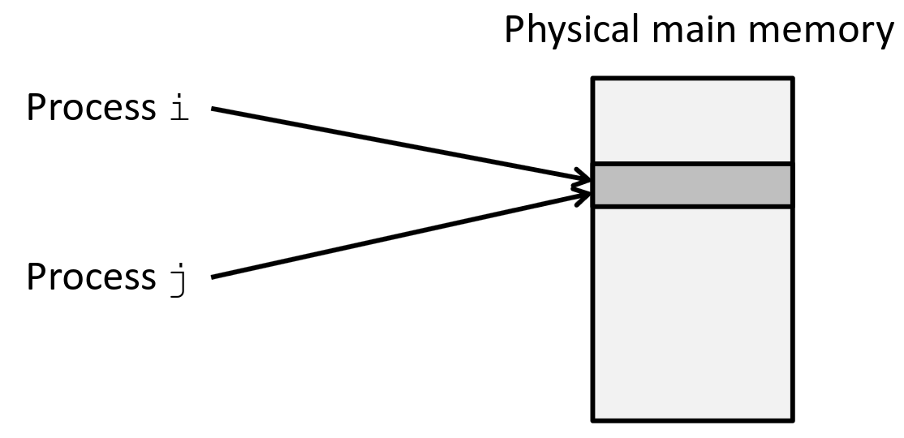
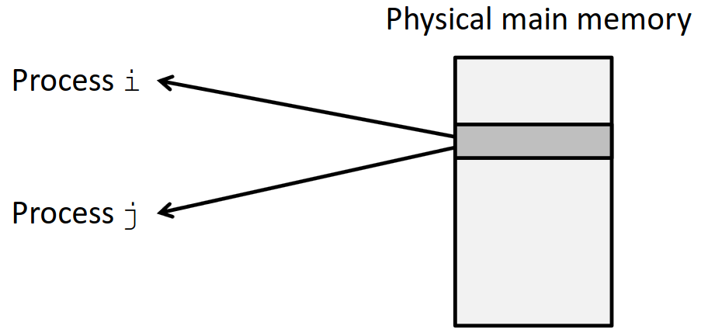
Problem 3: How to protect data?
Problem 4: How to share data?
What if two running programs both use the same address in their code?
We want to make sure processes don’t access the same physical memory locations.
… Except sometimes we do want them to share memory!
Inter-process communication
Shared code
etc.

Slide 24
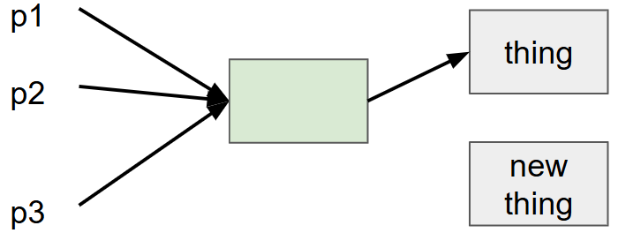
How can we solve these problems?
“Any problem in computer science can be solved by adding another level of indirection.” – David Wheeler, inventor of the subroutine
Without indirection:
With indirection:
Notes:
How do we move “thing” to “new thing”?
Without indirection: change all 3 pointers ☹
With indirection: only change 1 pointer ☺

Slide 25
Indirection
The ability to reference something using a name, reference, or container instead of the value itself.
A flexible mapping between a name and a thing allows changing the thing without notifying holders of the name.
Adds some work (now have to look up 2 things instead of 1)
But don’t have to track all uses of name/address (single source!)
Examples:
Phone system: cell phone number portability
Domain Name Service (DNS): translation from name to IP address
Call centers: route calls to available operators, etc.

Slide 26
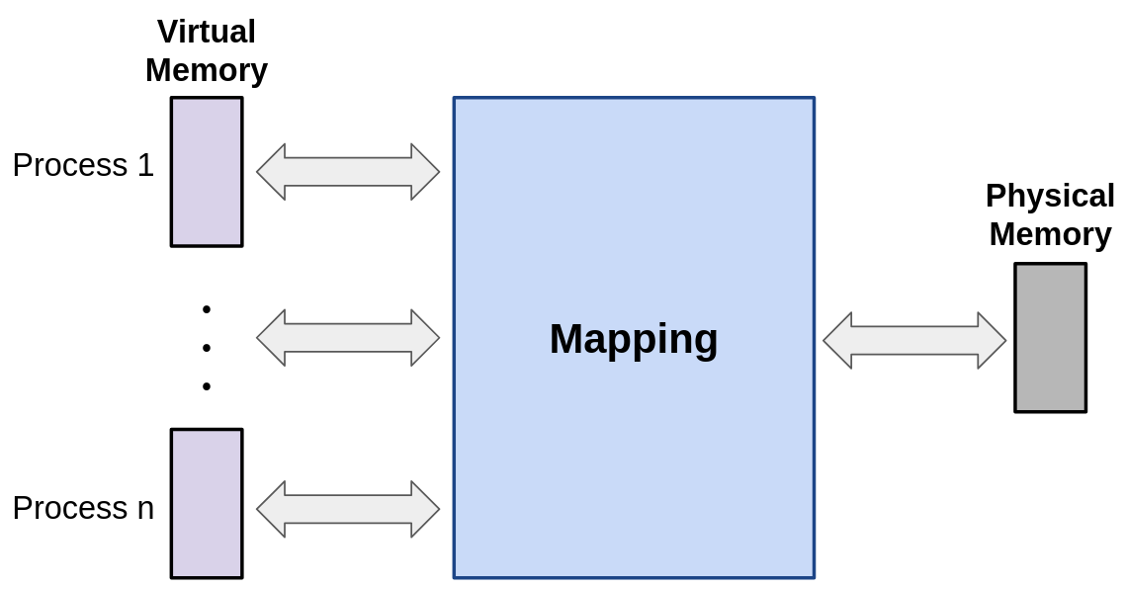
Indirection in Virtual Memory
Each process gets its own private address space
Translates to some location in physical memory
Solves previous problems!

Slide 27
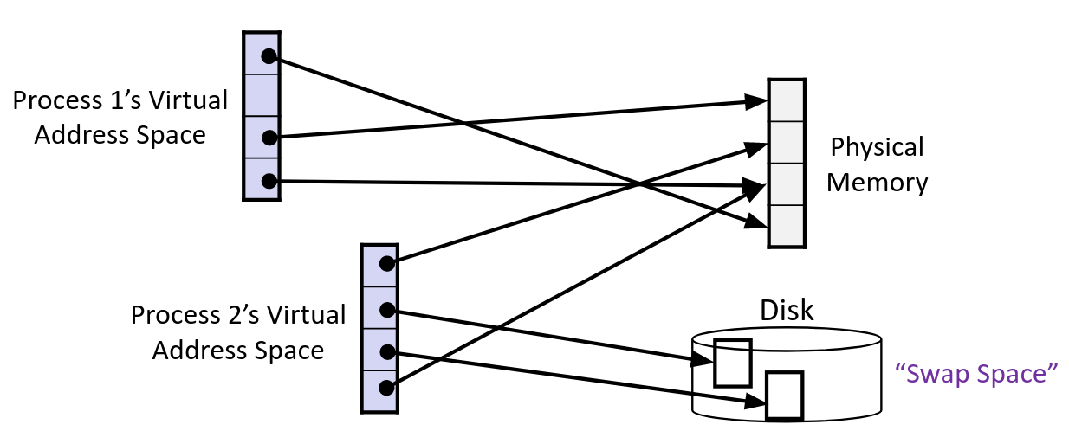
Mapping
A virtual address (VA) can be mapped to either physical memory (RAM) or on disk
Unused VAs may not have a mapping
VAs from different processes may (or may not) map to the same location in memory/disk

Slide 28
Address Spaces
Virtual Address Space: Set of N = 2^{n} virtual addresses
{0, 1, …, N-1}
Corresponds to word size (so in x86-64, n = 64)
Physical Address Space: Set of M = 2^{m} physical addresses
{0, 1, …, M-1}
Address length m depends on hardware
Every byte in main memory has:
One physical address (PA)
Zero, one, or more virtual addresses (VAs)

Slide 29
Review Questions
1.On a 64-bit machine currently running 8 processes, how much virtual memory is there?
2.True or False: A 32-bit machine with 8 GiB of RAM installed would never use all of it (in theory).
Notes:
2^64 B/process * 8 processes = 2^67 B
False. 32-bit machine = 2^32 B virtual memory per process. 2 GiB RAM = 2^33 B physical memory. Only enough for 2 processes!

Slide 30
VM and the Memory Hierarchy
Think of memory (virtual or physical) as an array of bytes, now split into pages
Pages aligned (size is P = 2𝑝 bytes), similar to cache blocks
Each virtual page can be stored in any physical page (no fragmentation!)
Pages of virtual memory are usually stored in physical memory, but spill to disk when we run out of space
Kind of like a cache!

Slide 31
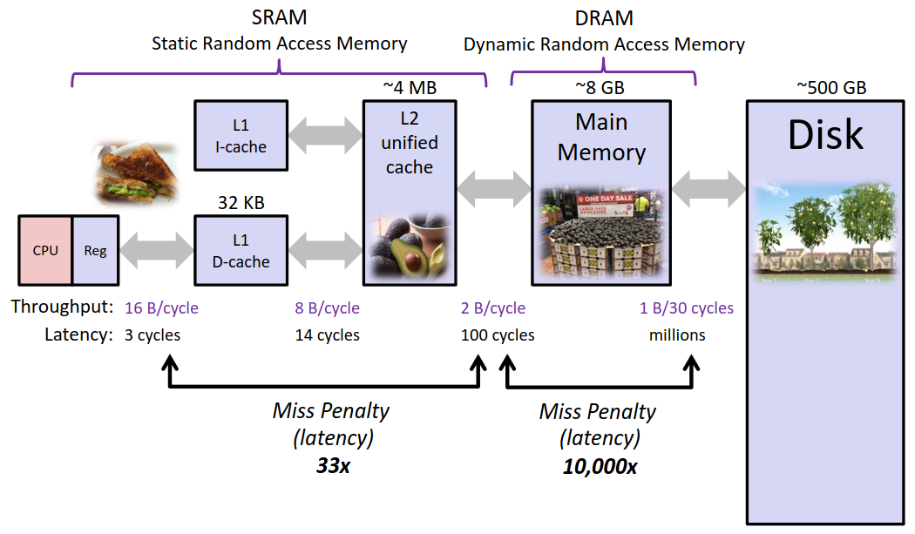
Memory Hierarchy: Core 2 Duo

Slide 32
Virtual Memory Design Consequences
Large page size: typically 4-8 KiB or 2-4 MiB
Can be up to 1 GiB (for “Big Data” apps on big computers)
Much larger than cache blocks
Fully associative
Any virtual page can be placed in any physical page
Highly sophisticated, expensive replacement algorithms in OS
Too complicated and open-ended to be implemented in hardware
Write-back rather than write-through
Really don’t want to write to disk every time we modify memory
Some things may never end up on disk (e.g., stack for short-lived process)

Slide 33
Why does VM work on RAM/disk?
Avoids disk accesses because of locality
Same reason that L1 / L2 / L3 caches work
The set of virtual pages that a program is “actively” accessing at any point in time is called its working set
If (working set of one process ≤ physical memory):
Good performance for one process (after compulsory misses)
If (working sets of all processes > physical memory):
Thrashing: Performance meltdown where pages are swapped between memory and disk continuously
This is why your computer can feel faster when you add RAM

Slide 34
Summary
fork makes two copies of the same process (parent & child)
Returns different values to the two processes
exec* replaces current process from file (new program)
exit or return from main to end a process
wait or waitpid used to synchronize parent/child execution and to reap child
Virtual memory provides:
Ability to use limited memory (RAM) across multiple processes
Illusion of contiguous virtual address space for each process
Protection and sharing amongst processes

