Slide 1
System Control Flow & Processes I
CSE 351 Summer 2024
Instructor:
Ellis Haker
Teaching Assistants:
Naama Amiel
Micah Chang
Shananda Dokka
Nikolas McNamee
Jiawei Huang

Slide 2
Administrivia
Today
HW 19 due (11:59pm)
Wednesday, 5/7
RD 22 due (1pm)
HW 20 due (11:59pm)
Lab 4 due (11:59pm)
Friday, 5/9
RD 23 due (1pm)
HW 21 due (11:59pm)
Quiz 3 released on Monday, 5/12
Due Friday, 5/16

Slide 3
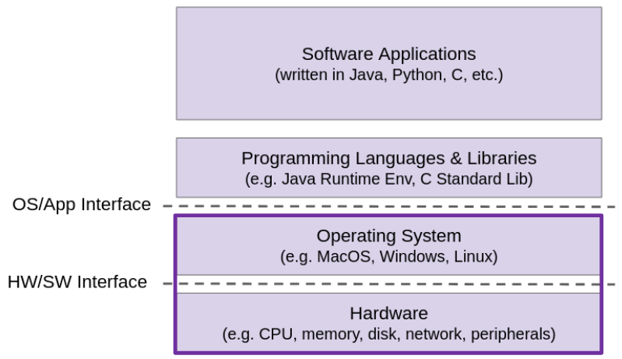
Topic Group 3: Scale & Coherence
How do we make memory accesses faster?
How do programs manage large amounts of memory?
How can we allocate memory dynamically (i.e. at runtime)
How does your computer run multiple programs at once?

Slide 4
Lecture Topics
System Control Flow
Control flow
Exceptional control flow
Asynchronous exceptions (interrupts)
Synchronous exceptions (traps & faults)
OS History
Processes and context switching
Creating new processes
fork() and exec*()
Ending a process
exit(), wait(), waitpid()
Zombies

Slide 5
Control Flow
So far: we’ve seen how the flow of control changes as a single program executes, within that program
Reality: multiple programs running concurrently
How does control flow across the many components of the system?
In particular: We usually have more programs running than CPUs…
Exceptional control flow is basic mechanism used for:
Transferring control between processes and OS
Handling I/O and virtual memory within the OS
Implementing multi-process apps like shells and web servers
Implementing concurrency

Slide 6
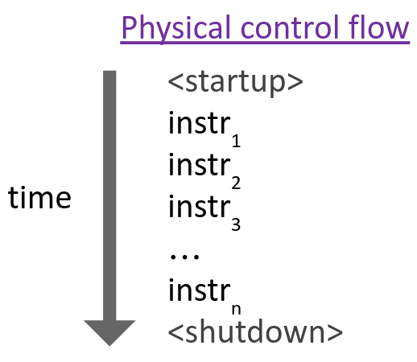
Control Flow (pt 2)
Processors only do one thing:
From startup to shutdown, CPU simply reads and executes (interprets) a sequence of instructions, one at a time
This sequence is the CPU’s control flow
Notes:
(in reality, it’s actually not one at a time, since we talked about pipelining, but we can conceptualize it as one at a time)

Slide 7
Altering Control Flow
Before, we were only thinking about what happens within a program. Now, we have to think about what happens outside a program!
Up to now, two ways to change control flow:
Jumps (conditional and unconditional)
Call and return
Both react to changes in program state
Processor also needs to react to changes in system state:
Unix/Linux user hits “Ctrl-C” on their keyboard
User clicks on a different application’s window on the screen
Data arrives from a disk or a network adapter
Instruction divides by zero
System timer expires (important later!)

Slide 8
Exceptional Control Flow
Note: these are unrelated to Java’s exceptions
Exists at all levels of a computer system
Low-level mechanisms:
Exceptions
Change in processor’s control flow in response to a system event (i.e., change in system state, user-generated interrupt)
Implemented using a combination of hardware and OS
Higher-level mechanisms:
Process context switch
Implemented by OS software and hardware timer
Signals
Implemented by OS software

Slide 9
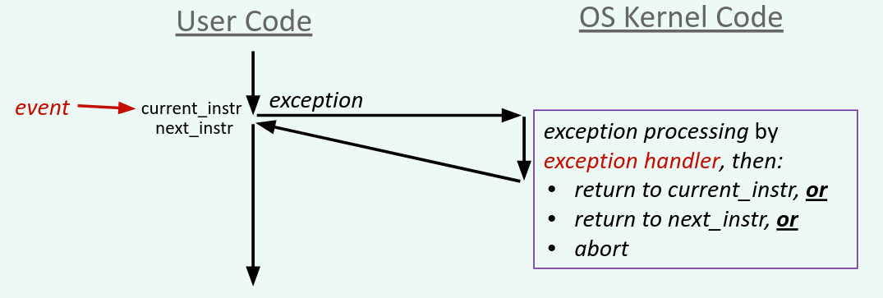
Exceptions
Note: these are unrelated to Java’s exceptions
Transfer of control to the OS kernel in response to some event
Kernel is the operating system code that lives in memory (very VIP!)
How does the system know where to jump to in the OS?

Slide 10
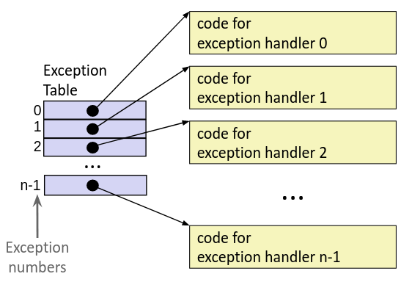
Exception Table
This is extra (non-testable) material
A jump table for exceptions (also called the Interrupt Vector Table)
Each type of event has a unique exception number k
k = index in the exception table, which points to the corresponding exception handler

Slide 11
Exception Table Excerpt
This is extra (non-testable) material
Number | Description | Exception Class
0 | Divide error | Fault
13 | General protection fault | Fault
14 | Page fault | Fault
18 | Machine check | Abort
32-255 | OS defined | Interrupt or Trap

Slide 12
Lecture Topics
System Control Flow
Control flow
Exceptional control flow
Asynchronous exceptions (interrupts)
Synchronous exceptions (traps & faults)
OS History
Processes and context switching
Creating new processes
fork() and exec*()
Ending a process
exit(), wait(), waitpid()
Zombies

Slide 13
Asynchronous Exceptions
Interrupts: caused by events external to the processor
Indicated by setting the processor’s interrupt pin(s) (wire into CPU)
After interrupt handler runs, the handler returns to “next” instruction
Examples:
I/O interrupts
Hitting Ctrl-C on the keyboard
Clicking a mouse button or tapping a touchscreen
Arrival of a packet from a network
Arrival of data from a disk
Timer interrupt
Every few milliseconds, an external timer chip triggers an interrupt
Used by the OS kernel to take back control from user programs

Slide 14
Synchronous Exceptions
Caused by events that occur as a result of executing an instruction:
Traps: Intentional (why is it called this?)
Transfer control to OS to perform some function
Ex: system calls, breakpoint traps, special instructions
After handler runs, returns control to “next” instruction
Faults: Unintentional, but possibly recoverable
Ex: page fault, segment protection faults, integer divide-by-zero exceptions
Either re-executes failing (“current”) instruction, or aborts
Aborts: Unintentional and unrecoverable
Ex: parity error, machine check (hardware failure detected)
Abort program

Slide 15
System Calls
Each system call has a unique ID number
Note: this is separate from the exception number!
Examples on Linux for x86-64:
Number | Name | Description
0 | read | Read file
1 | write | Write file
2 | open | Open file
3 | close | Close file
4 | stat | Get info about file
57 | fork | Create process
59 | execve | Execute program
60 | _exit | Terminate process
62 | kill | Send signal to process
Notes:
1-4 in this slide are for files, 57-62 are for processes

Slide 16
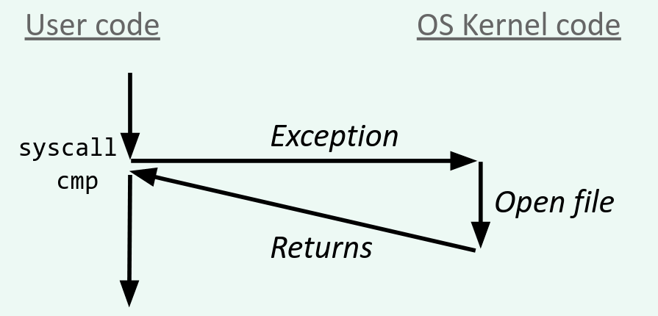
Trap Example: Opening File
User calls open(filename, options)function in C
Calls __open function, which invokes system call instruction syscall
__open:
...
mov $0x2,%eax # open is syscall 2
syscall # return value in %rax
cmp $0xfffffffffffff001,%rax # check for error
...
retq
Syscall number stored in %rax (weird)
Other arguments in regular arg registers
Check return value for negative errno
Notes:
See prev slide for syscall number

Slide 17
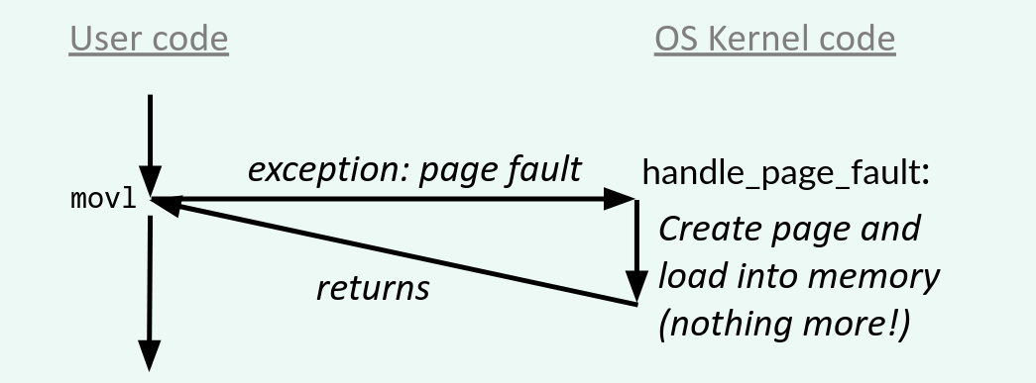
Fault Example: Page Fault (future lecture topic!)
Program writes to some location
That portion (page) of user’s memory is currently on disk and not in memory
movl $0xd, 0x8049d10
Page fault handler loads page into memory
Returns to faulting instruction: mov is executed again!
Successful on second try

Slide 18
Abort Example: Invalid Memory Reference
movl $0xd, 0x00000000
Page fault handler detects invalid address
Sends SIGSEGV signal to user process
Process exits with “segmentation fault”

Slide 19
Lecture Topics
System Control Flow
Control flow
Exceptional control flow
Asynchronous exceptions (interrupts)
Synchronous exceptions (traps & faults)
OS History
Processes and context switching
Creating new processes
fork() and exec*()
Ending a process
exit(), wait(), waitpid()
Zombies

Slide 20
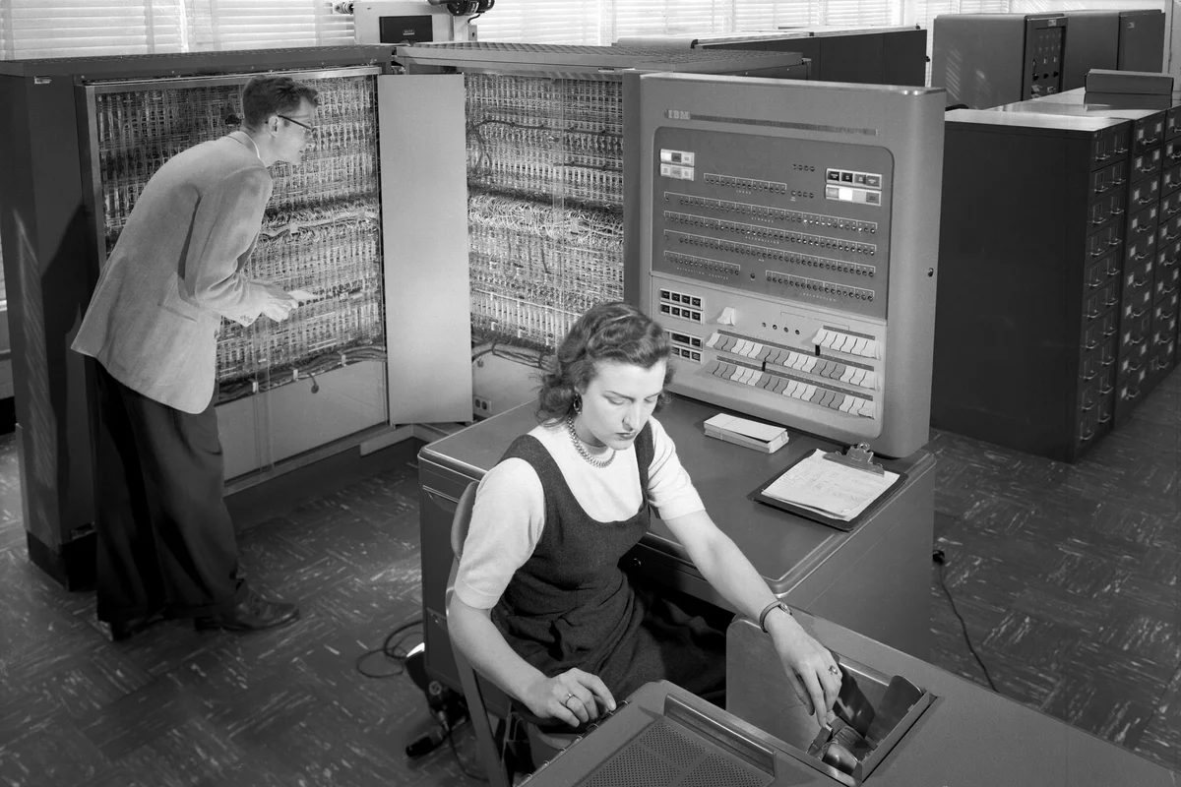
Early Operating Systems
Before there were operating systems, there was computer operator
Person who loaded in punch cards to begin running a program
Operating Systems were developed to replace the human operator
Eventually, magnetic tape replaced punch cards, allowing for multiprocessing
Programming by typing into machine
This is part of a larger trend of computers being used to automate labor.

Slide 21
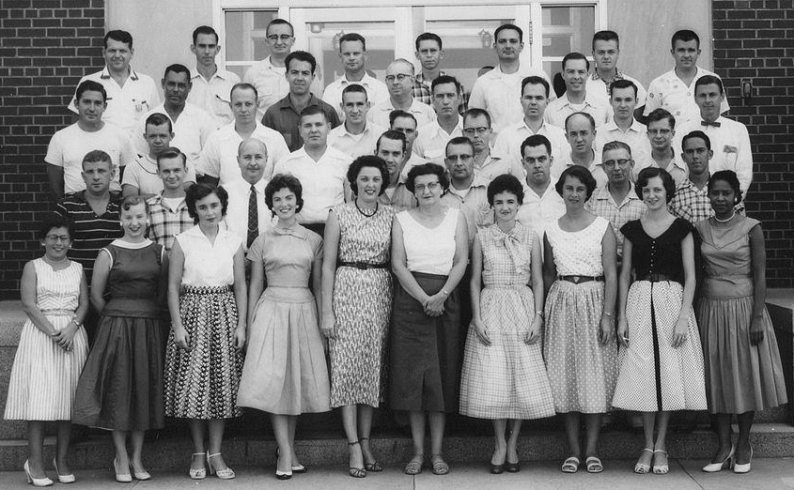
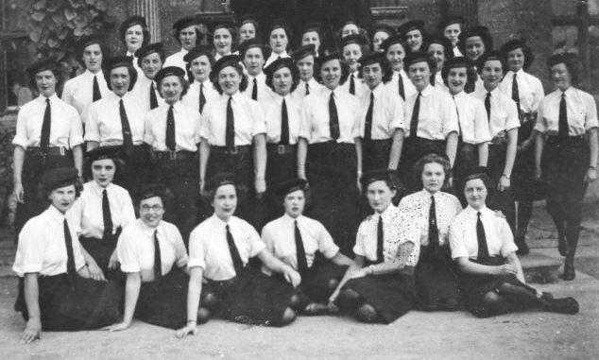
The First Computers
Computer: “a person who computes”
Doing calculations by hand quickly for aeronautics, warfare, science, etc.
Human Computers at NACA Credit: NASA
The women of Bletchley Park, Credit: BBC

Slide 22
Legacy of Computing
Computers augment the abilities of humans
Makes the labor of boring, repetitive work more widely available
Highly valued, but generally exclusively available
Computers automate the boring, repetitive work
Culturally, we are conditioned to believe that such work should be automated
Has consistently led to job elimination
e.g., ENIAC’s calculation speed could displace 2,400 human computers
Both narratives are simultaneously true, even today!
Underlying goal is efficiency of labor (usually for profit)
Take CSE480: Computer Ethics Seminar & CSE478: Autonomous Robotics for more

Slide 23
Legacy of Computing (pt 2)
Where are we now?
AI being used to automate all kinds of jobs:
Elimination of customer service jobs, especially in developing nations.
Not just affecting “blue-collar” jobs, but high-paying ones too.
Creative jobs too? Depends on whom you ask.
Notes:
Other ones from class:
Paralegals
Writers
cashiers

Slide 24
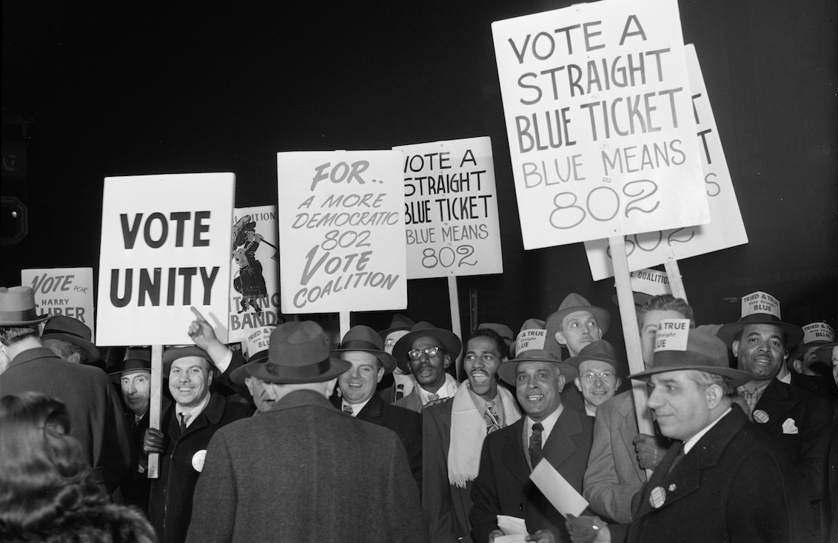
Quick Discussion
(On Ed) What jobs have you heard about that might be in imminent danger of automation? Who tends to hold these jobs?
Musicians’ Strike (1940s)
Writers’ Strike (2023)

Slide 25
Lecture Topics
System Control Flow
Control flow
Exceptional control flow
Asynchronous exceptions (interrupts)
Synchronous exceptions (traps & faults)
OS History
Processes and context switching
Creating new processes
fork() and exec*()
Ending a process
exit(), wait(), waitpid()
Zombies

Slide 26
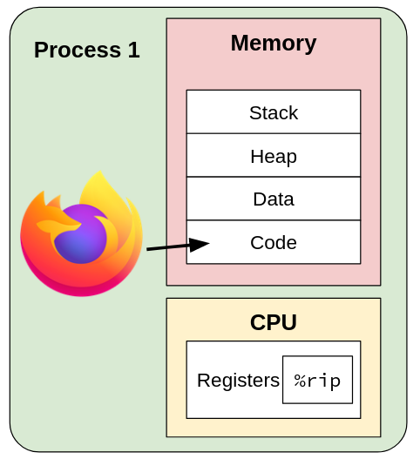
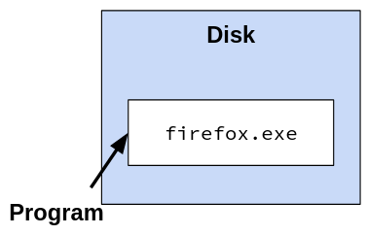
What is a Process?

Slide 27
What is a Process? (pt 2)
A process is an instance of a running program
One of the most profound ideas in computer science!
Another abstraction in our computer
Provided by the OS
Uses a data structure to keep track of each process (ID, open files, etc.)
Maintains the interface between the program and the underlying hardware
What is the difference between:
A processor? A program? A process?
Notes:
Procesor: the actual CPU, the physical hardware
Program: code
Process: context code runs in (memory, register values, etc)

Slide 28
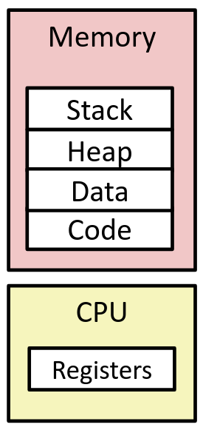
Processes
Provides each program with two key abstractions:
Logical control flow
Each program seems to have exclusive use of the CPU
Provided by a kernel mechanism called context switching
Private address space
Each program seems to have exclusive use of memory
Provided by a kernel mechanism called virtual memory
What do processes have to do with exceptional control flow?
Exceptional control flow is the mechanism the OS uses to enable multiple processes to run on the same system

Slide 29
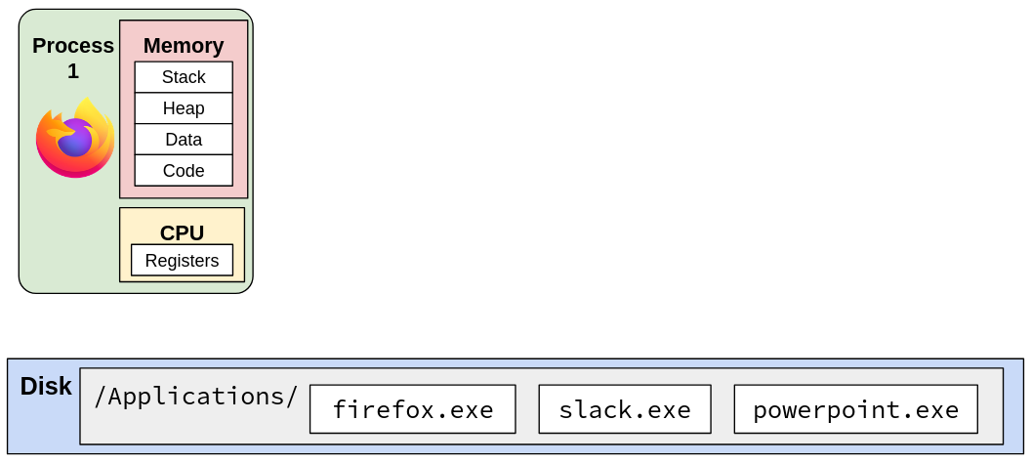
Processes (pt 2)

Slide 30
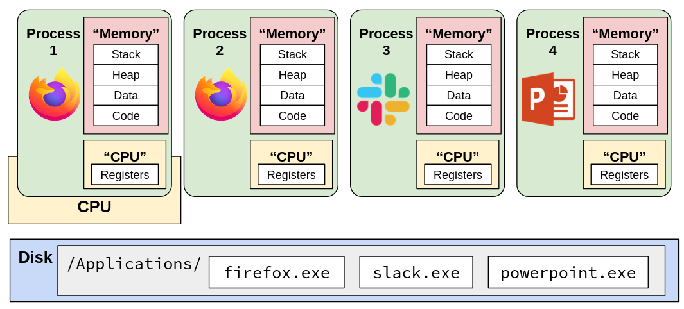
Processes (pt 3)

Slide 31
Multiprocessing: the Illusion 🧙
. . .
Computer runs many processes simultaneously
Applications for one or more users
Web browsers, email clients, editors, …
Background tasks
Monitoring network & I/O devices

Slide 32
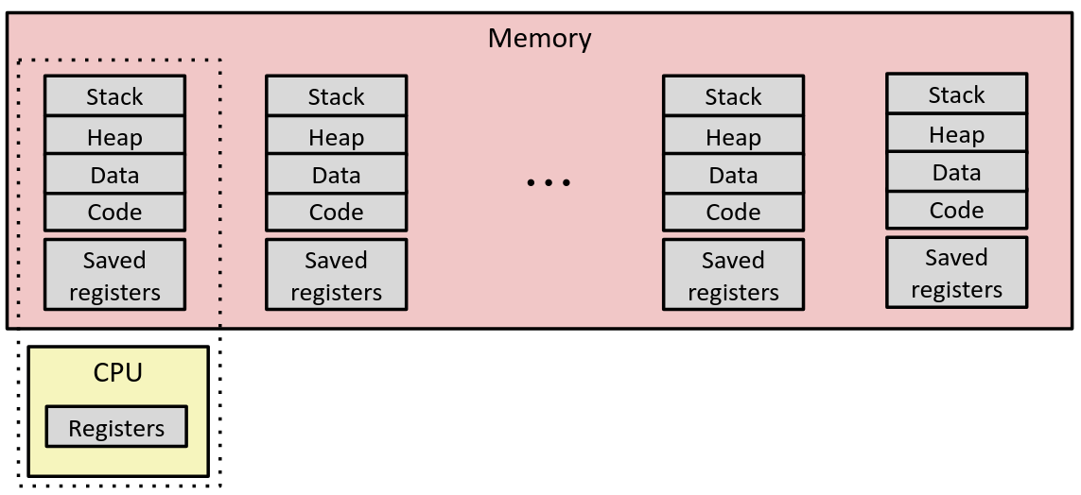
Multiprocessing: the Reality
Single CPU executes multiple processes concurrently
Interleaves process executions, runs one at a time
Address space managed by virtual memory system (we’ll get to it!)
Execution context (register values, stack, etc.) saved in memory when process isn’t running

Slide 33
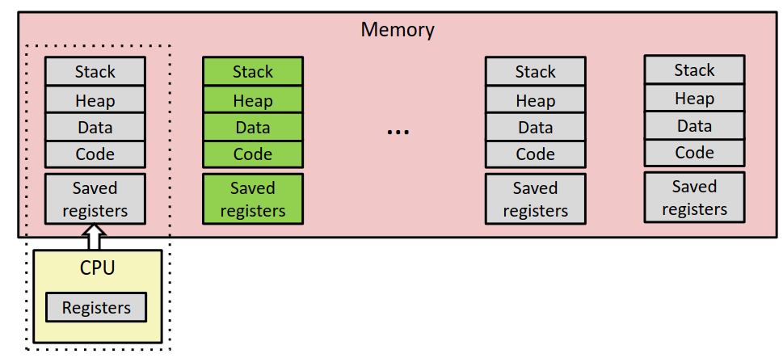
Context Switch steps
Save current registers, etc. in memory
Notes:
So when we switch back we can reload registers.

Slide 34
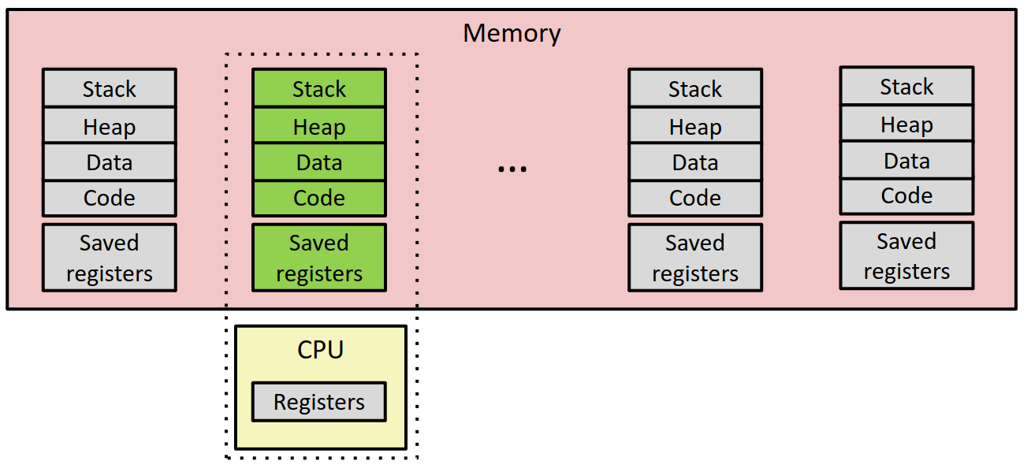
Context Switch steps (pt 2)
Save current registers in memory
Schedule next process for execution

Slide 35
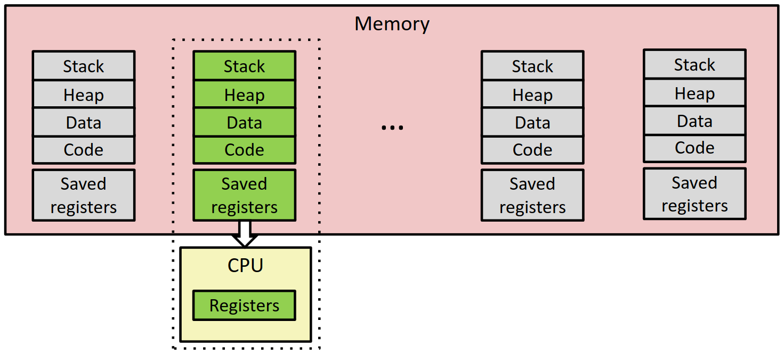
Context Switch steps (pt 3)
Save current registers, etc. in memory
Schedule next process for execution
Load saved registers and switch address space

Slide 36
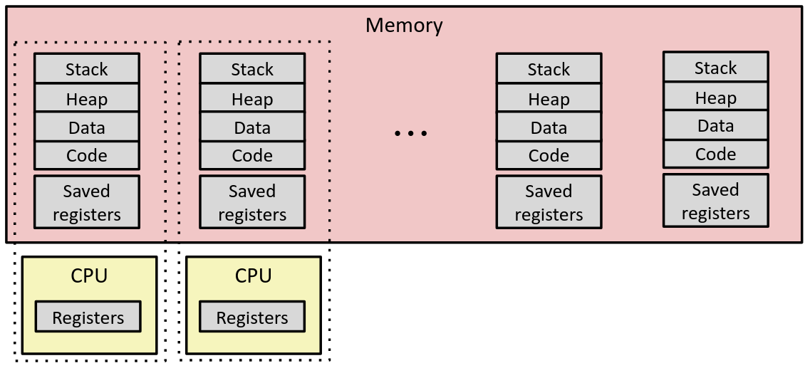
Multiprocessing: the (Modern) Reality
Multicore processors
Multiple CPUs (“cores”) on one chip
Share memory (and some caches)
Each can execute a separate process
Still constantly switching

Slide 37
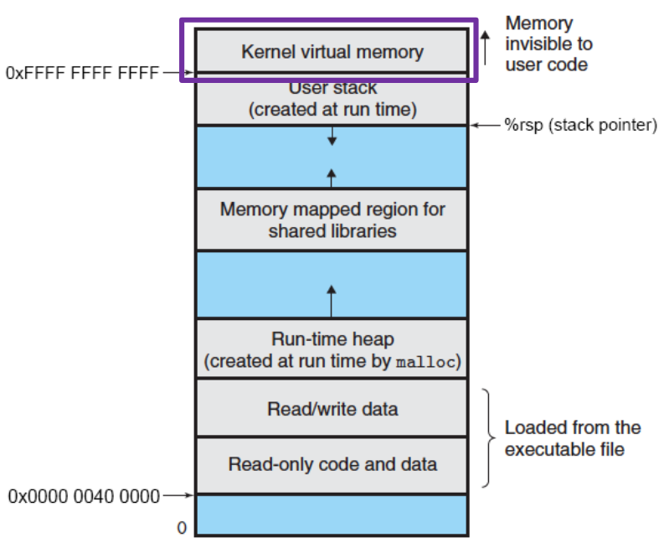
Context Switching
Assume only one CPU core
Processes are managed by a shared chunk of OS code called the kernel
The kernel is not a separate process, but rather runs as part of each user process
In x86-64 Linux:
Same address in each process’ kernel memory refers to the same shared memory location*
*sort of, the story here became more complicated after Meltdown and Spectre…
Notes:
Exception handler code goes in kernel virtual memory. User can’t run it directly, has to go through a syscall or other exception

Slide 38
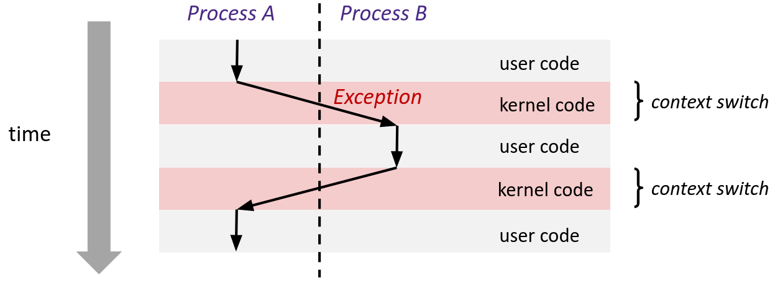
Context Switching (pt 2)
Assume only one CPU core
Context switch passes control flow from one process to another and is performed using kernel code
Can happen for a variety of reasons (process terminated, timer interrupt, etc.)
Notes:
The kernel code here is the same steps from before:
Save registers
Switch to new process
Load in registers

Slide 39
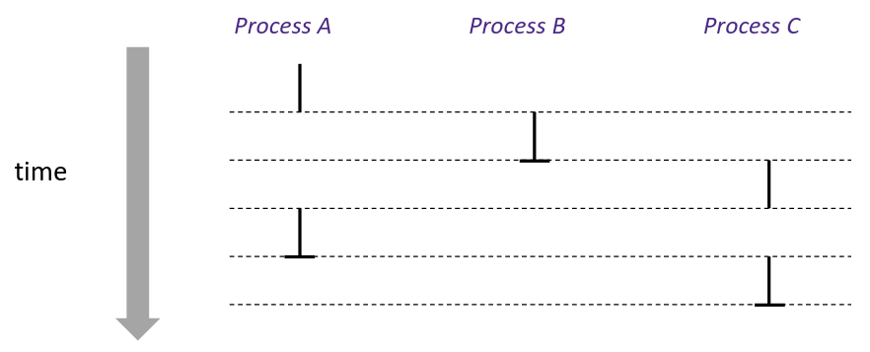
Concurrency
Assume only one CPU core
Two processes are concurrent if their instruction executions/flows overlap in time
i.e. one starts before the other has completely finished executing
Otherwise, they are sequential
Example:
Concurrent: A&B, A&C
Sequential: B&C
Notes:
Kernel code happens in between each of these processes running

Slide 40
User’s View of Concurrency
Assume only one CPU core
Control flows for concurrent processes are physically disjoint in time
CPU executes instructions for one process at a time
However, we can think of them as if they’re running at the same time, in parallel

Slide 41
Lecture Topics
System Control Flow
Control flow
Exceptional control flow
Asynchronous exceptions (interrupts)
Synchronous exceptions (traps & faults)
OS History
Processes and context switching
Creating new processes
fork() and exec*()
Ending a process
exit(), wait(), waitpid()
Zombies

Slide 42
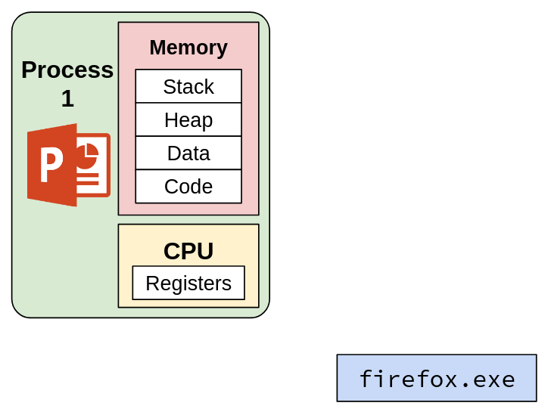
Creating New Processes and Programs

Slide 43
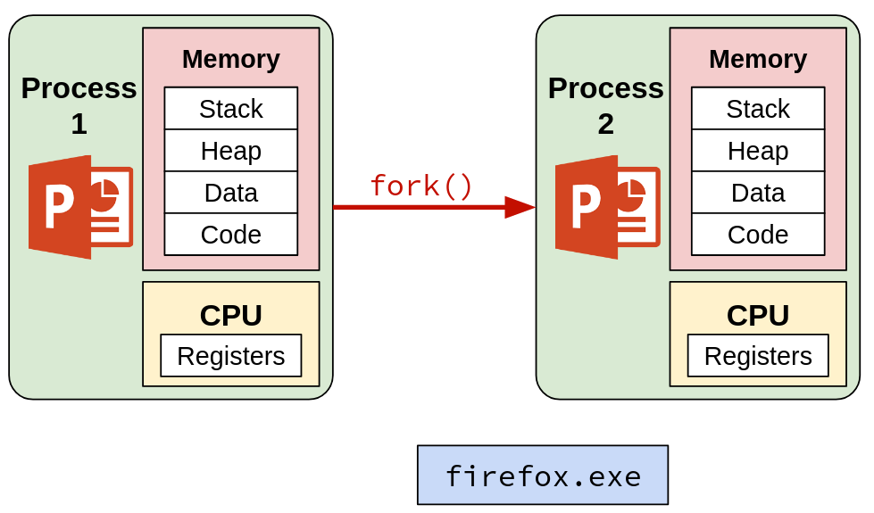
Creating New Processes and Programs (pt 2)

Slide 44
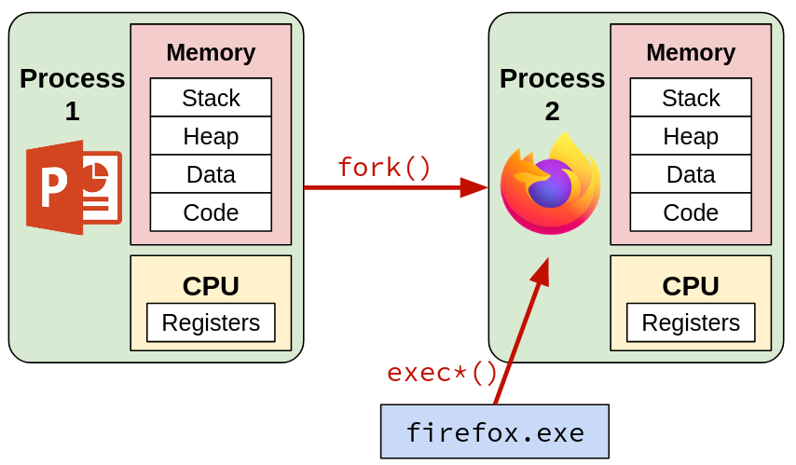
Creating New Processes and Programs (pt 3)

Slide 45
Creating New Processes and Programs
Fork-exec model (Linux)
fork() creates a copy of the current process
exec*() replaces the current process’ code and address space with the code for a different program
Family: execv, execl, execve, execle, execvp, execlp
Both fork() and exec*() are system calls
Other system calls for process management:
getpid()
exit()
wait(), waitpid()

Slide 46
fork: Creating New Processes
pid_t fork()
Creates a new “child” process that is a copy of the calling “parent” process, including all state (memory, registers, etc.)
Returns 0 to the child process
Returns child’s process ID (PID) to the parent process
fork is unique (and often confusing) because it is called once but returns “twice”
Child is almost identical to the parent
Gets an identical (but separate) copy of parent’s address space
Register %rax is 0 on return
Has a different PID than the parent

Slide 47
fork Example
pid_t pid = fork();
if (pid == 0) {
printf("hello from child\n");
} else {
printf("hello from parent\n");
}
Child has the same memory and register values as the parent (except %rax)
This includes the code in memory and %rip, so child will start executing the same code as parent, right after fork() returns
Can use the return values from fork() to distinguish between parent and child
Notes:
If case = child, else = parent

Slide 48
Why have fork and exec?
Why make a copy of the parent’s data if we’re just going to throw it away in exec()?
Easier to implement
Useful if you want the new process to execute the same code
Not all systems do it this way!
Windows uses spawn
Optional reading: “A Fork in the Road”

Slide 49
Summary: Exceptional Control Flow
Exceptional control flow allows the OS to interrupt a currently running program
Interrupts are asynchronous (i.e. they come from outside the program)
Traps are synchronous, purposefully invoked by the user application
Includes system calls: OS services that user programs can invoke
Faults are synchronous, unintentional, but possibly recoverable
Aborts are synchronous and occur in response to unrecoverable errors

Slide 50
Summary: Processes
A process is a single instance of a running program
Keeps track of the context the program is being run in (register values, memory state, etc.)
A computer can have multiple concurrent processes, but can only execute one at a time
Performs a context switch to move between processes
Processes are created using the fork system call
Creates a copy of the parent process
The exec system call throws out the old context and starts running a new program

