Slide 1
Memory Allocation I
CSE 351 Summer 2024
Instructor:
Ellis Haker
Teaching Assistants:
Naama Amiel
Micah Chang
Shananda Dokka
Nikolas McNamee
Jiawei Huang

Slide 2
Administrivia
Today:
Lab 5 released
Due Wednesday, 1/14
Monday, 1/5
RD21 due (1pm)
HW19 due (11:59pm)
Wednesday, 1/7
RD22 due (1pm)
HW20 due (11:59pm)
Lab4 due (11:59pm)

Slide 3
Dynamic Memory Allocation
Overview
Introduction and goals
Allocation and deallocation (free)
Malloc and free in C
Common memory-related bugs in C
Fragmentation
Explicit allocation implementation
Implicit free lists
Splitting and coalescing
Explicit free lists (Lab 5)
Implicit deallocation: garbage collection

Slide 4
Recap: Keeping track of free blocks
Implicit Free List
Use pointer arithmetic to traverse through entire heap until we find a free bock
Explicit Free List
Free block stores pointer to the next free block, forming a linked list
Others not covered in this class
Segregated free lists (different lists for each object type), sorting blocks by size

Slide 5
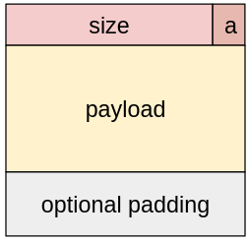
Recap: Implicit Free Lists
For each block, we need to store: size, is_allocated
Could use two works, but kinda wasteful…
Recap: if size is a multiple of 2^{n}, then lowest n bits of the size are always 0
Use the lowest bit of header word to store is_allocated flag
When reading size, mask this bit out
Block format:
a = 1 if allocated, 0 if free
If the header value is h:
h = size | a
a = h & 1
size = h & ~1
size = total block size in bytes
payload for allocated blocks only

Slide 6
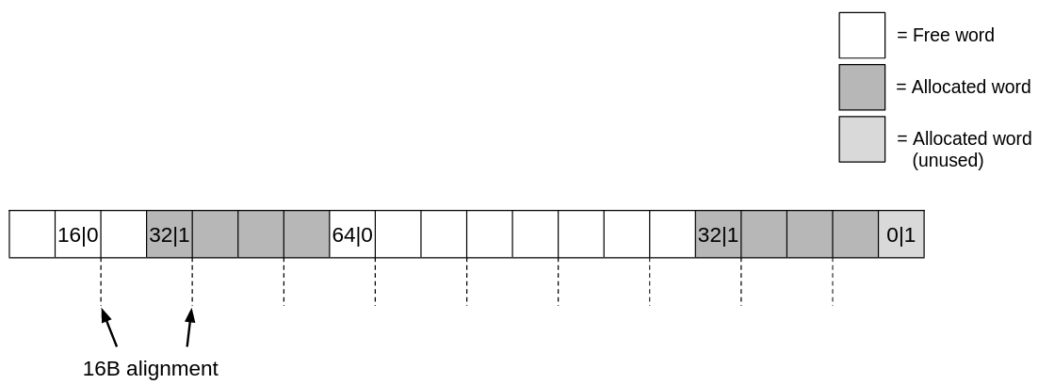
Implicit Free List Example
Each block begins with a header containing size and the allocated flag
Payload is 16B aligned
May require padding
Extra “header” to mark the end of the heap: 0|1
Adds 8B of external fragmentation
Sequence of blocks in heap (size|alloc): 16|0, 32|1, 64|0, 32|1

Slide 7
Implicit Free List: Finding a Free Block
First fit: start from beginning, choose first free block that fits
p = heap_start;
while ((p < end) && // while not past the end of heap
((*p & 1) || (*p <= len))) { // while p allocated or too small
int size = p & ~1;
p += p, size; // Go to next block, (UNSCALED +)
} // p points to selected block or end
Can take linear time in total number of blocks
Can cause “splinters” at beginning of the heap
Notes:
This is pseudocode. Ignoring the type of p and pointer arithmetic scaling

Slide 8
Implicit Free List: Finding a Free Block (pt 2)
Next fit: like first fit, but search list starting from where previous search finished
Often faster than first-fit, avoid scanning through as many allocated blocks
Some research suggests fragmentation is worse
Best fit: search through all free blocks, choose the one that’s large enough with fewest bytes left over
Usually helps fragmentation
Worse throughput, have to look through all blocks
Notes:
Best fit: tradeoff between speed and utilization

Slide 9
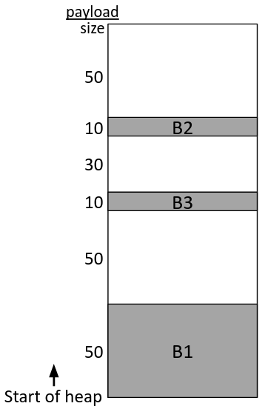
Polling Question
Which allocation strategy and requests remove external fragmentation in this Heap? Note: B3 was the last fulfilled request.
A) Best-fit:
malloc(50), malloc(50)
B) First-fit:
malloc(50), malloc(30)
C) Next-fit:
malloc(30), malloc(50)
D) Next-fit:
malloc(50), malloc(30)
Notes:
Uses both 50B blocks, 30B fragmentation
Uses lower 50B and 30B block, end of heap doesn’t count, so no fragmentation
Uses 30B and higher 50B block, 50B fragmentation
Uses higher 50B and lower 50B block (2nd one split into a 30B allocated and 20B free block). 50B fragmentation
Answer is B

Slide 10
Allocating a Free Block
Easy with implicit free list, just set the allocated bit
What if the block we choose is much larger than requested?
Split into two blocks
void split(ptr b, int bytes) { // bytes = desired block size
int newsize = ((bytes+15) >> 4) << 4; // round up to multiple of 16
int oldsize = *b; // Why not mask out low bit?
*b = newsize; // initially unallocated
if (newsize < oldsize)
*(b+newsize) = oldsize - newsize; // Set length in remaining
} // part of block (UNSCALED +)
Ex: malloc(16)

Slide 11
Freeing a Block
Simplest implementation, just set allocated bit to false
This can lead to “false fragmentation”
Ex: free(p)
What happens if we call malloc(40)? Can’t find a free block!
Solution: coalesce adjacent free blocks

Slide 12
Coalescing with Next block
void free(ptr p) { // p points to payload ptr b = p – WORD; // b points to block header (UNSCALED -)
*b &= ~1; // clear allocated bit ptr next = b + *b; // find next block (UNSCALED +) if ((*next & 1) == 0) // if next block is not allocated, *b += *next; // add its size to this block }
How do we coalesce with the preceding block, though?
Notes:
Notice that the old header is still there in memory! It’s jsut garbage data inside the block now

Slide 13
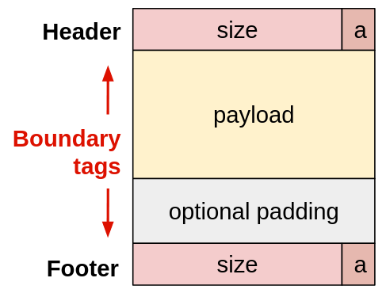
Coalescing with Previous Block
Keep a footer for each block
Copy of the header at the end of a block
Header + footer = boundary tags
When coalescing, check footer immediately before current block in memory
If free, coalesce blocks
Notes:
Green box of 16 is the one we’re freeing

Slide 14
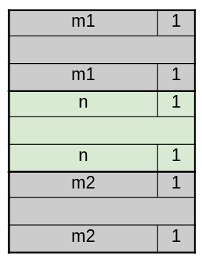
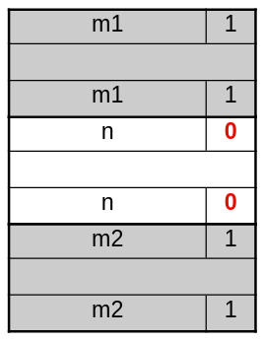
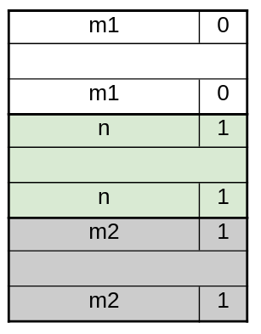
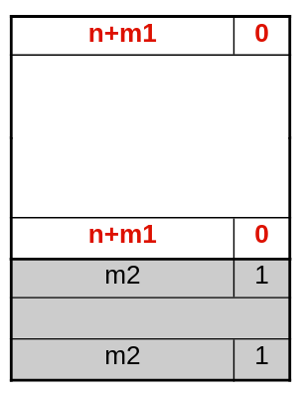
Coalescing
Case 1:
Case 2:

Slide 15
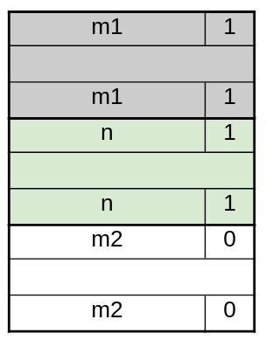
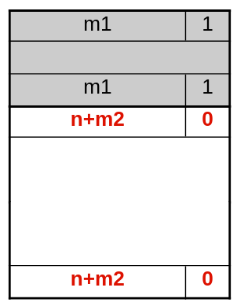
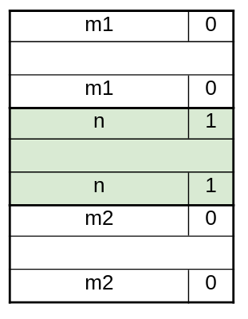
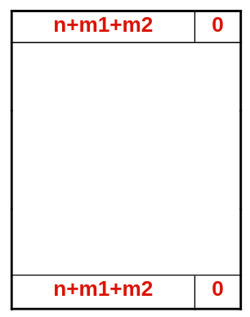
Coalescing (pt 2)
Case 3:
Case 4:

Slide 16
Implicit Free List Review Questions
When coalescing free blocks, how many neighboring blocks do we need to check on either side? Why?
If I want to check the size of the nth block forward from the current block, how many memory accesses do I need to make?
Notes:
Just one! If we always coalesce in free, there will never be 2 adjacent free blocks
N+1. Check current block’s size to get pointer to next, keep doing that until you reach n blocks ahead, then check that block’s size

Slide 17
Dynamic Memory Allocation
Overview
Introduction and goals
Allocation and deallocation (free)
Malloc and free in C
Common memory-related bugs in C
Fragmentation
Explicit allocation implementation
Implicit free lists
Splitting and coalescing
Explicit free lists (Lab 5)
Implicit deallocation: garbage collection

Slide 18
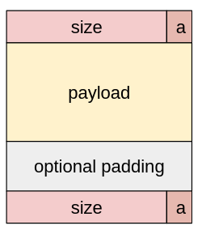
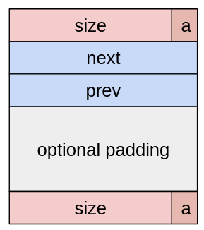
Explicit Free Lists
Allocated block:
(same as implicit free list)
Free block:
Create a linked list of free blocks only, rather than having to search through all blocks
Since only free blocks are in the list, can use the space that would be the payload for an allocated block
Still need boundary tags for coalescing

Slide 19
Doubly-Linked Lists
Linear
Root pointer points to first node
First node’s prev = NULL
Last node’s next = NULL
Better for first-fit, best-fit
Circular
Still need root pointer to tell you when to start
First and last node connected (no NULL pointers)
Better for next-fit, best-fit

Slide 20
Explicit Free Lists (pt 2)
Logically: doubly-linked list
Physically: blocks can be in any order
Free list ordering may not correlate to order in memory
Notes:
You usually don’t have to think about this fact, just follow the pointers to the next thing in the list. We also provide a lot of this code. However, keep in mind that blocks that are “””next to each other””” in the list may not actually be adjacent in memory

Slide 21
Allocating From Explicit Free Lists
Note: diagram is not realistic
Boundary tags omitted
In reality, all pointers would point to the head of the block
Notes:
Remove a block from the free list by having blocks on either side point to each other

Slide 22
Allocating From Explicit Free Lists (pt 2)
Notes:
Add split block to free list

Slide 23
Freeing With Explicit Free Lists
Insertion policy: when freeing block, where in the free list should it go?
FIFO: first-in, first-out
Insert new block at the head of the free list
Pros: simple. Insert blocks in constant time
Cons: research suggests worse fragmentation
Address-ordered policy
Insert block so that free list is in address order
Pros: research suggest less fragmentation
Cons: Insert blocks in linear time
Lab5 uses FIFO
Notes:
We will use FIFO for this lecture labs lab

Slide 24
Coalescing With Explicit Free Lists
Same cases as before
Neighboring free blocks are already part of the free list
Remove neighboring block(s) from free list
Merge into a single, larger free block
Add new block to the free list
How do we know if a neighboring block is free?
Notes:
You don’t have to explicitly handle these in Lab 5, provided for you

Slide 25
Freeing Blocks with LIFO Policy (Case 1)
No coalescing
Newly freed block becomes list head
Old head becomes its next
Notes:
New free block becomes head

Slide 26
Freeing Blocks with LIFO Policy (Case 2)
Coalesce with following block
Following block gets removed from the list
Newly made block becomes list head
Notes:
In before, following block is somewhere in the free list, as it’s own prev and next
After, those prev and next point to each other, removing old block from the list. We’d also update the header to merge the blocks together, not shown

Slide 27
Freeing Blocks with LIFO Policy (Case 3)
Coalesce with preceding block
Preceding block gets removed from the list
Newly made block becomes list head

Slide 28
Freeing Blocks with LIFO Policy (Case 4)
Coalesce with both neighbors
Both neighbors get removed from the list
Newly freed block becomes list head

Slide 29
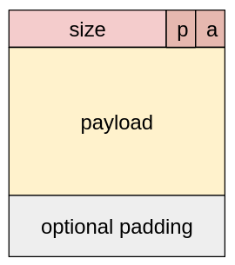
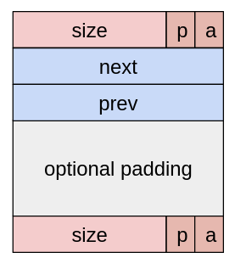
Do we always need boundary tags?
Lab 5 suggests no… why not? (Hint: when do we use boundary tags?)
We have room for more flags in our header!
Store another flag: preceding_allocated
If preceding block is allocated, don’t coalesce with it
Allocated block
Free block

Slide 30
Explicit Free List Block Size
Requirements for allocated blocks
Header (1 word)
Payload (1+ words)
Minimum size = 2 words
Requirements for free blocks
Header (1 word)
Next pointer (1 word)
Prev pointer (1 word)
Footer (1 word)
Minimum size = 4 words

Slide 31
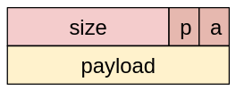
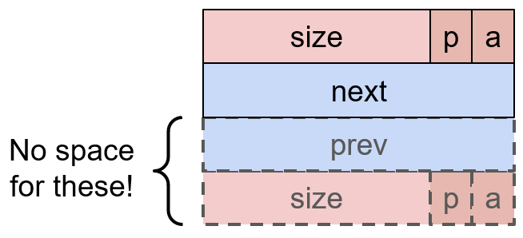
Explicit List Block Size (pt 2)
Problem: what if we allocate a very small block?
When block is freed, we won’t have room for the necessary fields
Solution: never allocate a block smaller than the minimum free block size
Add padding to the end of allocated blocks
Don’t split if resulting free block is too small

Slide 32
Dynamic Memory Allocation
Overview
Introduction and goals
Allocation and deallocation (free)
Malloc and free in C
Common memory-related bugs in C
Fragmentation
Explicit allocation implementation
Implicit free lists
Splitting and coalescing
Explicit free lists (Lab 5)
Implicit deallocation: garbage collection

Slide 33
Wouldn’t it be nice…
If we never had to free memory?
Do you free objects in Java?
Reminder: implicit allocator

Slide 34
Garbage Collection
void foo() {
int* p = (int*) malloc(128);
return; // p block is now garbage!
}
Automatic reclamation of heap-allocated storage. Application never frees memory!
Common in functional languages, scripting languages, and most modern object-oriented languages
Lisp, Racket, Erlang, ML, Haskell, Scala, Java, C#, Perl, Ruby, Python, Lua, JavaScript, Dart, Mathematica, MATLAB, many more…
Variants (“conservative” garbage collectors) exist for C and C++
However, cannot necessarily collect all garbage

Slide 35
Garbage Collection (pt 2)
How does the memory allocator know when memory can be freed?I
We cannot know what pieces of data are going to be used in the future
But, we can tell that certain blocks cannot be used if they are unreachable (via pointers in registers/stack/globals)
If a program does not have any pointers to a block in the heap, then we know it can be cleaned up
Memory allocator needs to know what is a pointer and what is not – how can it do this?
Sometimes with help from the compiler

Slide 36
Memory as a Graph
We view memory as a directed graph
Each allocated heap block is a node in the graph
Each pointer is an edge in the graph
Locations not in the heap that contain pointers into the heap are called root nodes (e.g. registers, stack locations, global variables)
A node in the heap is reachable if there is a path from a root node to that node.
Unreachable nodes are garbage.
Notes:
Simple implementation, but not the only one

Slide 37
Garbage Collection: Mark and Sweep
For every root node (i.e. every pointer in global data, the stack, or registers):
If it is a pointer to a location on the heap, mark that heap block as visited
Recursively go through pointers and mark them all as visited
Go through the entire heap:
If a block is not marked, free it

Slide 38
Why doesn’t C have Garbage Collection
People have tried! But it’s impossible to accurately predict what heap blocks C has access to. Why?
C allows you to “hide” pointers by casting them to another type
Existing C garbage collectors are “conservative” (i.e. they may not free some blocks that could be freed)
Treat every variable as if it could be a pointer
Could cause memory leaks

Slide 39
Summary
Three different policies for finding free blocks:
First-fit
Next-fit
Best-fit
When free block is bigger than you need, split into two
When freeing a block, coalesce with any adjacent free blocks in memory
Keep preceding_allocated bit in boundary tag
Store footer (copy of header) at the end of free blocks

Slide 40
Summary (pt 2)
Implicit free lists
Simpler to implement (no pointers to keep track of)
Less fragmentation
Slower, have to search through entire heap for free block
Explicit free lists
Faster, only have to search through free blocks (instead of all blocks)
Much faster when most of the heap is full
More complicated to implement
Minimum block size is larger (free blocks need pointers) -> more fragmentation
In practice, often used in conjunction with segregated free lists (see bonus slides)
Keep a separate list for different block sizes/objects

Slide 41
BONUS SLIDES
The following slides are about the SegList Allocator, for those curious. You will NOT be expected to know this material.

Slide 42
Segregated List (SegList) Allocators
Each size class of blocks has its own free list
Organized as an array of free lists
Often have separate classes for each small size
For larger sizes: One class for each two-power size
Size class (in bytes)
16
32
48-64
80-inf

Slide 43
SegList Allocator
Have an array of free lists for various size classes
To free a block:
Mark block as free
Coalesce (if needed)
Place on appropriate class list

Slide 44
SegList Advantages
Higher throughput
Search is log time for power-of-two size classes
Better memory utilization
First-fit search of seglist approximates a best-fit search of entire heap
Extreme case: Giving every block its own size class is no worse than best-fit search of an explicit list
Don’t need to use space for block size for the fixed-size classes

