Slide 1
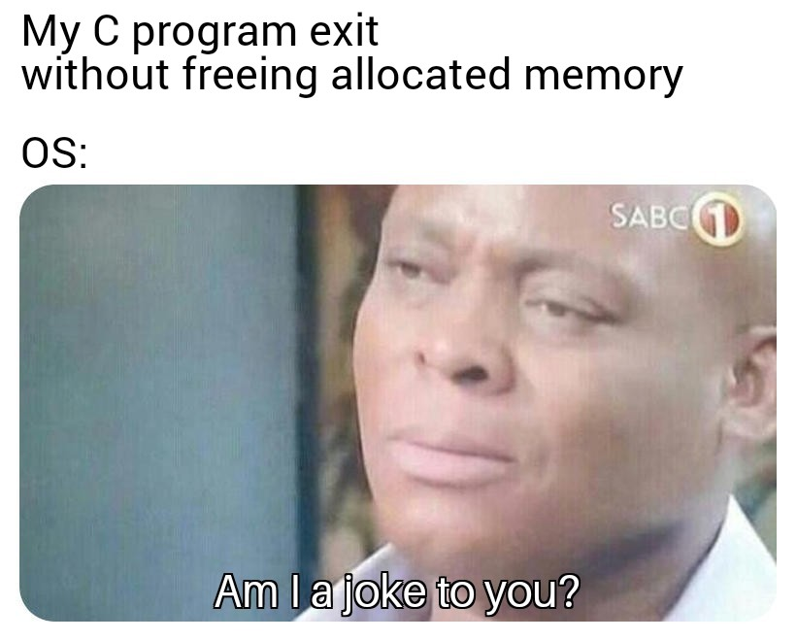
Memory Allocation I
CSE 351 Summer 2024
Instructor:
Ellis Haker
Teaching Assistants:
Naama Amiel
Micah Chang
Shananda Dokka
Nikolas McNamee
Jiawei Huang

Slide 2
Administrivia
Today
HW17 due (11:59pm)
Friday, 8/2
RD20 due (1pm)
No HW :)
Lab 5 released (due 8/14)
Monday, 8/5
RD21 due (1pm)
HW19 due (11:59pm)

Slide 3
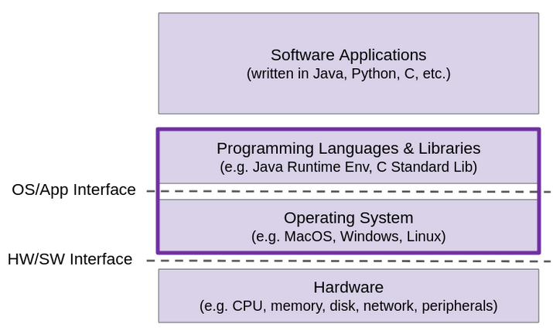
Topic Group 3: Scale & Coherence
How do we make memory accesses faster?
How do programs manage large amounts of memory?
How can we allocate memory dynamically (i.e. at runtime)
How does your computer run multiple programs at once?

Slide 4
Dynamic Memory Allocation
Overview
Introduction and goals
Allocation and deallocation (free)
Malloc and free in C
Common memory-related bugs in C
Fragmentation
Explicit allocation implementation
Implicit free lists
Explicit free lists (Lab 5)
Splitting and coalescing
Implicit deallocation: garbage collection

Slide 5
Multiple Ways to Store Program Data
Static global data
Fixed size at compile-time
Lasts entire lifetime of the program
Accessible anywhere in the program
A portion is read-only (literals)
Stack-allocated data
Local/temporary variables
Can be dynamically allocated (in some versions of C)
Known lifetime (deallocated when function returns)
Dynamic (heap) data
Size and lifetime only known at runtime
int array[1024];
void foo(int n) {
int tmp;
int local_array[n];
int* dyn =
(int*)malloc(n*sizeof(int));
}
Notes:
Array (int array[1024]) goes in static global data
Tmp, local, and dyn go in the stack
The thing dyn points to (return from malloc) goes in the heap

Slide 6
Dynamic Memory Allocation
Programmers use dynamic memory allocators to acquire memory at runtime
For data structures whose size or lifetime is known only at runtime
Stored in heap segment of memory
Types of allocators
Implicit: language handles garbage collection, programmer only needs to allocate the data
Ex: new in Java
Explicit: programmer needs to allocate and deallocate memory
Ex: malloc and free in C

Slide 7
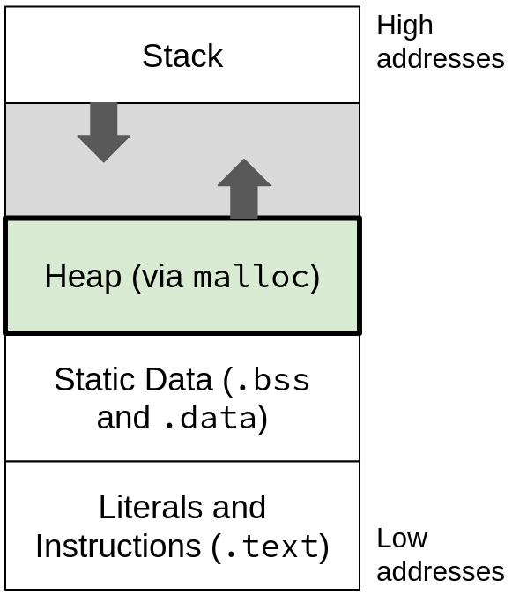
Dynamic Memory Allocation (pt 2)
Allocator organizes data into variable-sized blocks, which can be allocated or free
What happens when the heap runs out of space?
Allocator asks the OS for more!
sbrk in Unix
Notes:
You may have heard of a “heap” data structure before - this is not that!

Slide 8
Allocating Memory in C
Need to #include <stdlib.h>
void* malloc(size_t size)
Allocates a contiguous block of size bytes of uninitialized memory
size_t?! Simple typedef for an unsigned 8-byte integer
Returns a pointer to the beginning of the allocated block
Returns NULL if allocation failed, or size=0
Pointer to an invalid address (represented as address 0)
Blocks typically aligned to 8 or 16 bytes
Other versions:
calloc: initializes memory to 0
realloc: moves existing block to a larger one
Notes:
Blocks returned from multiple calls to malloc are not guaranteed to be contiguous with each other
In C, NULL always = 0. Translates to 0 in x86, not true in all ISAs

Slide 9
Freeing Memory in C
void free(void* p)
Releases block pointed to by p back to the pool of available memory
Pointer p must be the address originally returned by malloc/calloc/realloc (i.e., beginning of the block)
Don’t call free on a block that has already been released!
Undefined behavior - can even introduce buffer overflow vulnerabilities!
No action occurs if you call free(NULL)

Slide 10
Best Practices for malloc and free
malloc
Using sizeof makes code more portable (ints aren’t 4B on all machines…)
void* is implicitly cast, but explicitly casting will help you catch errors
Ex: int* ptr = (int*) malloc(n * sizeof(int));
free
After calling free, set the pointer to NULL
Avoids double-free errors
Ex:
free(ptr);
ptr = NULL;
Notes:
Go through quickly, mostly just for reference!!!

Slide 11
malloc and free Example
void foo(int n) {
int i, *p;
p = (int*) malloc(n*sizeof(int)); // allocate space for array of n ints
if (p == NULL) { // check for allocation error
perror("malloc");
exit(0);
}
for (i=0; i<n; i++) // initialize int array
p[i] = i;
free(p); // free p
p = NULL; // good practice to set to NULL after free
}
Notes:
If statement checks for malloc failure. Perror prints error messahge

Slide 12
malloc and free Interface
Applications
Must never access memory not currently allocated
Must never free memory not currently allocated
Must only use free with previously malloc’ed blocks
Allocators
Must respond immediately to malloc
Must allocate blocks from free memory
Must align blocks so they satisfy all alignment requirements
Can’t move the allocated blocks

Slide 13
Heap Management in C
Likely very different from what you’re used to
Programmer has to remember to free data when they’re done with it
Otherwise, causes a memory leak
Requires keeping track of where your data is stored
Bugs are common!

Slide 14
Find that Bug!
int* p = (int*)malloc(N * sizeof(int));
for (int i = 0; i < N; i++) {
*p = i;
p++;
}
free(p);
Notes:
Freeing a pointer not returned by malloc.
Changed p in the p++ line. Address we’re freeing isn’t the same as what malloc returned (returns a pointer to the beginning of the block, expects that same address to be passed into free

Slide 15
Find that Bug! (pt 2)
x = (int*)malloc(N * sizeof(int));
// manipulate x
free(x);
...
y = (int*)malloc(N * sizeof(int));
// manipulate y
free(x);
Notes:
Double free. Free x twice

Slide 16
Find that Bug! (pt 3)
x = (int*)malloc(N * sizeof(int));
// manipulate x
free(x);
...
y = (int*)malloc(M * sizeof(int));
for (i=0; i<M; i++) {
y[i] = x[i]++;
}
Notes:
Use after free
We already freed x before the for loop

Slide 17
Find that Bug! (pt 4)
typedef struct L {
int val;
struct L* next;
} list; // linked list node
void main() {
list* head = (list*) malloc(sizeof(list));
head->val = 0;
head->next = NULL;
// create and manipulate the rest of the list
...
free(head);
return;
}
Notes:
Memory leak
Allocated the first node with the malloc call shown. Malloc more times to make more nodes (not shown), but we only freed the head! The rest of those blocks are not freed.

Slide 18
Dynamic Memory Allocation
Overview
Introduction and goals
Allocation and deallocation (free)
Malloc and free in C
Common memory-related bugs in C
Fragmentation
Explicit allocation implementation
Implicit free lists
Explicit free lists (Lab 5)
Splitting and coalescing
Implicit deallocation: garbage collection

Slide 19
Notation
We will draw memory divided into words
Each word is 64 bit = 8 bytes
Note: textbook and old videos still use 32-bit words
Allocations will be aligned and in sizes that are a multiple of words

Slide 20
Memory Allocation Example

Slide 21
Performance Goals
Given some sequence of malloc and free requests R₀, R₁, …, R_{k}, …, R_{n-1}, maximize throughput and peak memory utilization
Often conflicting goals!
1) Throughput:
Number of completed requests per some unit of time
Example:
If 5,000 malloc calls and 5,000 free calls completed in 10 seconds, then throughput is 1,000 operations/second

Slide 22
Performance Goals (pt 2)
Aggregate Payload (P_{k})
malloc(p) returns a payload of p bytes
After request R_{k} has completed, P_{k} = the sum of currently allocated payloads
Current Heap Size (H_{k})
Allocator can increase heap size using sbrk
Assume allocator cannot decrease heap size
2) Peak Memory Utilization (U_{k}):
Memory utilization = aggregate payload ÷ heap size
i.e., how much of our heap contains payload data
U_{k} = (max_{i≤k} P_{k})÷H_{k} after k+1 requests
i.e., the maximum utilization at any point up through when R_{k} has completed
Notes:
If we graph the utilization over time (x = last request accessed, y = util). Uk is the highest point in that graph up through Rk

Slide 23
Fragmentation
Recall fragmentation in structs
Used to preserve alignment
Internal: unused space inside of a struct (between fields)
External: unused space between struct instances (after fields)
The heap is similar
Internal fragmentation: extra space inside an allocated block
External fragmentation: extra space between allocated blocks
Notes:
Fragmentation in heap can be for alignment, or other reasons

Slide 24
Internal Fragmentation
Additional space inside of an allocated block not used to store a payload
Causes
Padding for alignment
Overhead of maintaining heap data structures
Explicit policy decisions (e.g., return a big block to satisfy a small request)
Easy to measure, only depends on past requests

Slide 25
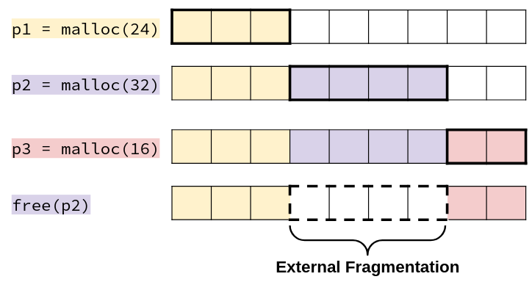
External Fragmentation
Occurs when allocation/free pattern leaves “holes” between blocks
Can cause situations where there is enough aggregate heap space to satisfy a request, but no single free block is large enough
Don’t know what future requests will be
Difficult to impossible to predict if past placements will become problematic
Notes:
Ex: if we knew p2 would be freed 1st, could put it at the end of the heap, but there’s no way to predict that!

Slide 26
Polling Question
Which of these statements is FALSE?
Temporary arrays should not be allocated on the Heap
malloc returns an address of a block that is filled with mystery data
Peak memory utilization is a measure of both internal and external fragmentation
An allocation failure will cause your program to stop
Notes:
Usually better to put on the stack. TRUE
Malloc does not initialize. TRUE
Util = (sum of all payloads) / (heap size). Fragmentation is not part of any payload. TRUE
Malloc returns NULL on failure. FALSE

Slide 27
Dynamic Memory Allocation
Overview
Introduction and goals
Allocation and deallocation (free)
Malloc and free in C
Common memory-related bugs in C
Fragmentation
Explicit allocation implementation
Implicit free lists
Explicit free lists (Lab 5)
Splitting and coalescing
Implicit deallocation: garbage collection

Slide 28
Implementation Issues
How do we know how much memory to free given just a pointer?
How do we keep track of the free blocks?
How do we pick a block to use for allocation (when many might fit)?
What do we do with the extra space when allocating a structure that is smaller than the free block it is placed in?
How do we reclaim free blocks?

Slide 29
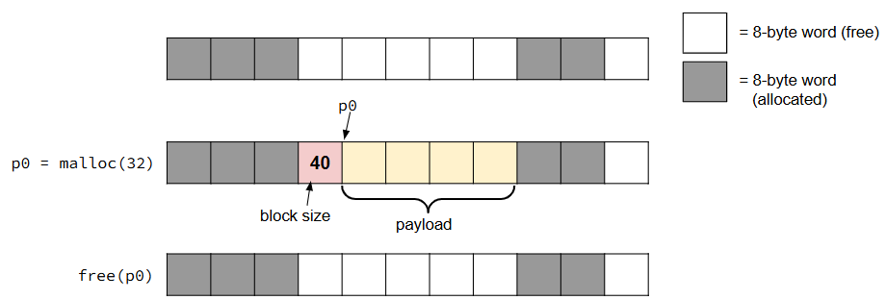
Knowing how much to free
Store the length of the block in a header
The word preceding the data
Also may contain other info, like whether the block is allocated
Requires an extra word for every block

Slide 30
Keeping track of free blocks
Implicit Free List
Use pointer arithmetic to traverse through entire heap until we find a free bock
Explicit Free List
Free block stores pointer to the next free block, forming a linked list
Others not covered in this class
Segregated free lists (different lists for each object type), sorting blocks by size
Notes:
Implicit free list
pros: saves memory
Cons: finding free block is slower
Explicit free list
pros: finding free block is fast
Cons: pointers take up memory

Slide 31
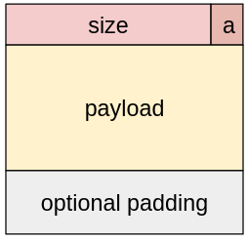
Implicit Free Lists
For each block, we need to store: size, is_allocated
Could use two works, but kinda wasteful…
Recap: if size is a multiple of 2^{n}, then lowest n bits of the size are always 0
Use the lowest bit of header word to store is_allocated flag
When reading size, mask this bit out
Block format:
a = 1 if allocated, 0 if free
If the header value is h:
h = size | a
a = h & 1
size = h & ~1
size = total block size in bytes
payload for allocated blocks only
Notes:
(i.e. not storing pointers in this example)
Ex: 8 = 0b1000, 16 = 0b10000, 24 = 0b11000, 32 = 0b100000, 40 = 0b101000. In all cases, lowest 3 bits are 0
A = h & 1 preserve lowest bit, 0s out the rest
Size = b & ~1. ~1 = 0b11…10, 0s out lowest bit

Slide 32
Header Questions
How many “flags” (boolean values) could we fit in our header if our allocator uses 16-byte alignment?
If we placed a new flag in the second least significant bit, write out a C expression that will extract this new flag from the header!
Notes:
16 = 2^4, lowest 4 bits will be 0, so we can have up to 4 flags
2 = 0b00…010, expression = header & 2

Slide 33
Summary
The heap is a segment of memory used to dynamically allocate data
Useful when we don’t know the size or when it can be freed until runtime
Fragmentation is space in the heap that is not used to store payloads
Internal: inside of a block
External: between blocks
C uses an explicit allocator, meaning the programmer decides when heap data is freed
Different heap implementations
Implicit free list: only store header and payload
Explicit free list: free blocks store pointers to the next free block (next lecture)

