Slide 1
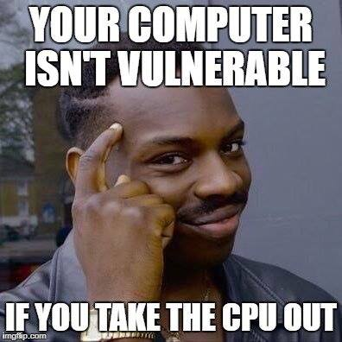
Caches Wrap-up & Side Channel Attacks
CSE 351 Summer 2024
Instructor:
Ellis Haker
Teaching Assistants:
Naama Amiel
Micah Chang
Shananda Dokka
Nikolas McNamee
Jiawei Huang

Slide 2
Administrivia
Today
Quiz 2 due (11:59pm)
Lab4 released (due 8/07)
Start early! Shorter turnaround than labs 2 and 3
Wednesday, 7/31
RD19 due (1pm)
HW17 due (11:59pm)
Friday, 8/2
RD20 due (1pm)
No HW :)

Slide 3
Lesson Topics
Cache Wrap-up
More cache images
Side Channel Attacks
Overview
Cache timing attacks
Spectre and Meltdown

Slide 4
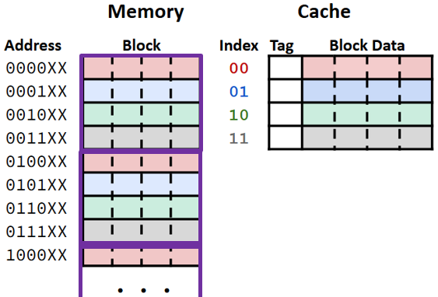
Recap: Cache Images
A contiguous, aligned chunk of memory the same size as the cache
Any two addresses with the same offset within their respective cache images will map to the same location in the cache
Notes:
For example, the first 4-byte block in each image (all colored red), will map to the first set in the cache, so the 3rd byte in each image will map to offset 3 in block 0

Slide 5
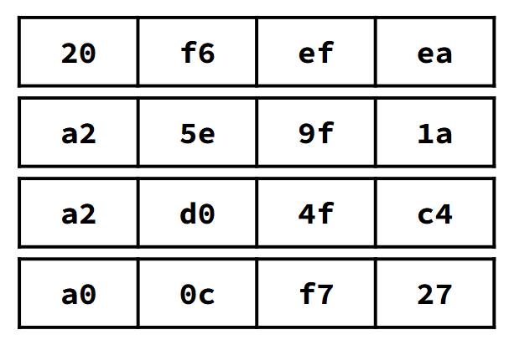
Cache Image Diagrams from HW17
Example: we have 16B of data
C = 8B, K = 2B
Show data in memory
Each row = 4B

Slide 6
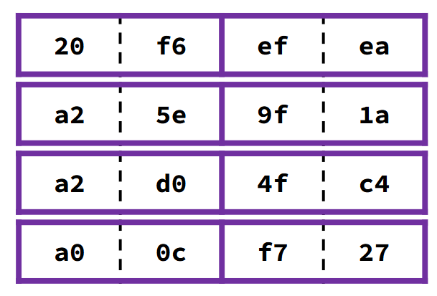
Cache Image Diagrams from HW17 (pt 2)
Example: we have 16B of data
C = 8B, K = 2B
Show data in the memory
Each row = 4B
Purple lines represent cache blocks

Slide 7
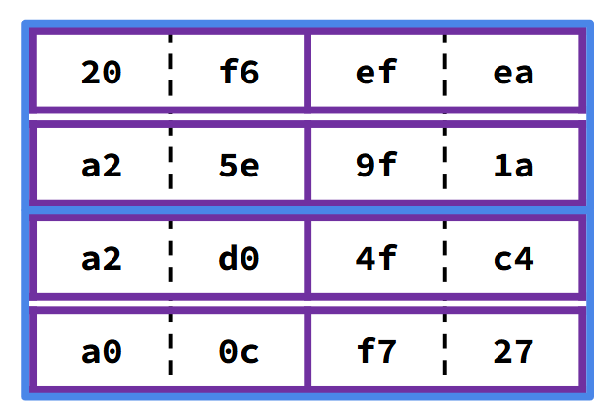
Cache Image Diagrams from HW17 (pt3)
Example: we have 16B of data
C = 8B, K = 2B
Show data in the memory
Each row = 4B
Purple lines represent cache blocks
Blue lines represent cache images

Slide 8
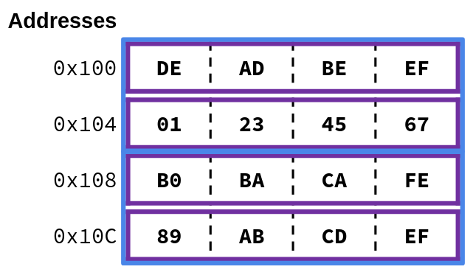
Polling Question
(Not on Ed) Based on the diagram, determine the following values:
Block size
Cache size
Assume the cache is direct-mapped, we start with a cold cache, and that i, even_sum, and odd_sum are stored in registers. How many times will a block be evicted from the cache?
short ar[8]; //&ar = 0x100
int i, even_sum = 0, odd_sum = 0;
for (i = 0; i < 8; i += 2) {
even_sum += ar[i];
}
for (i = 0; i < 8; i += 2) {
odd_sum += ar[i+1];
}
Notes:
Block size = 4B because of the purple boxes, Cache size = 8B because of the blue boxes
Each cache bock contains 2 elements. First for loop accesses elements 0, 2, 4, and 6. Second one accesses 1, 3, 5, and 7
Access 0 loads 0-1 into set 0 of the cache, no evictions.
Access 2 loads 2-3 into set 1 of the cache, no evictions.
Access 4 loads 4-5 into set 0 of the cache, evict 0-1.
Access 6 loads 6-7 into set 1 of the cache, evict 2-3.
Access 1 loads 0-1 into set 0 of the cache, evict 4-5.
Access 3 loads 2-3 into set 1 of the cache, evict 6-7.
Access 5 loads 4-5 into set 0 of the cache, evict 0-1.
Access 7 loads 6-7 into set 1 of the cache, evict 2-3.
Total = 6 evictions
Miss rate = 100%. First for loop will be all compulsory misses, second will be all conflict.

Slide 9
Lesson Topics
Cache Wrap-up
More cache images
Side Channel Attacks
Overview
Cache timing attacks
Spectre and Meltdown

Slide 10
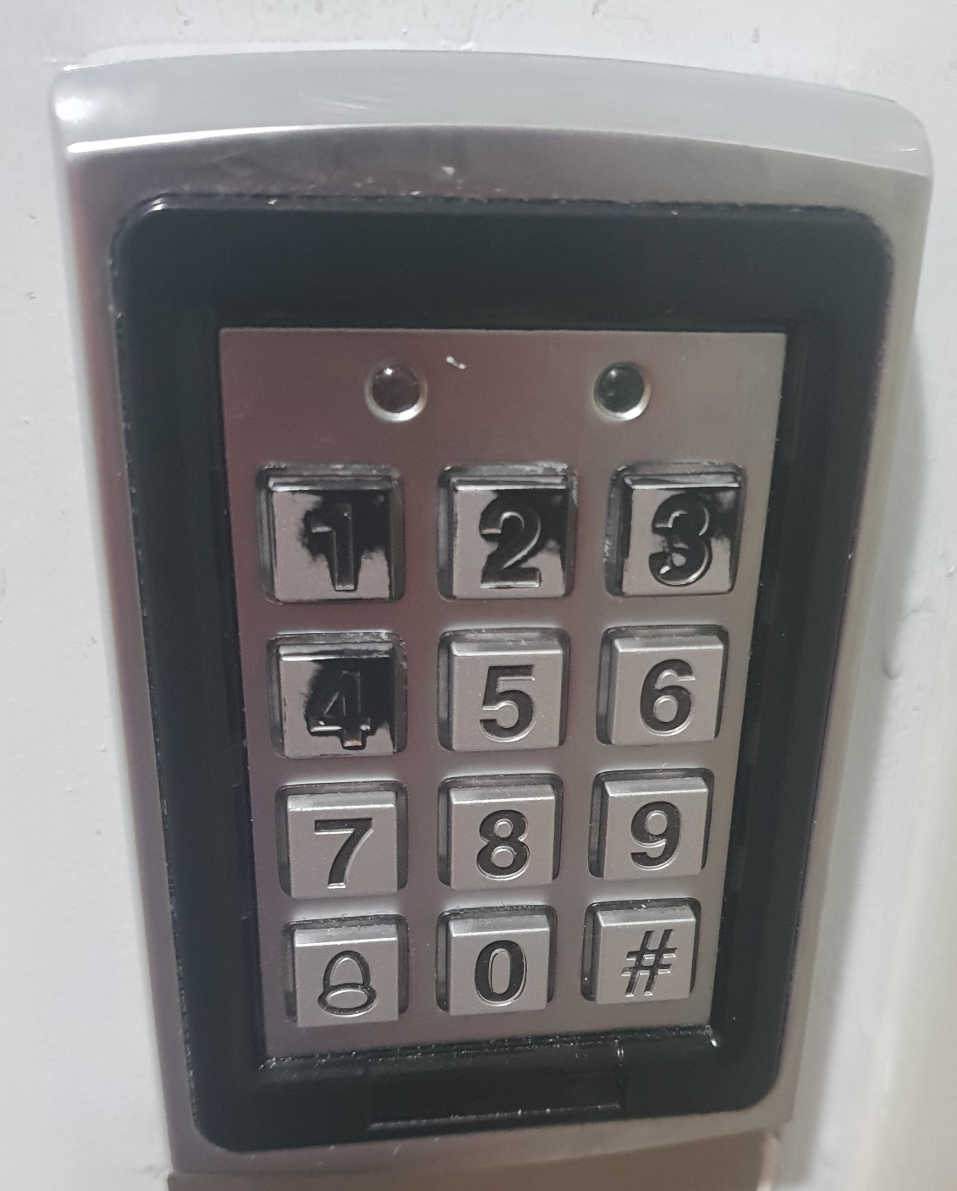
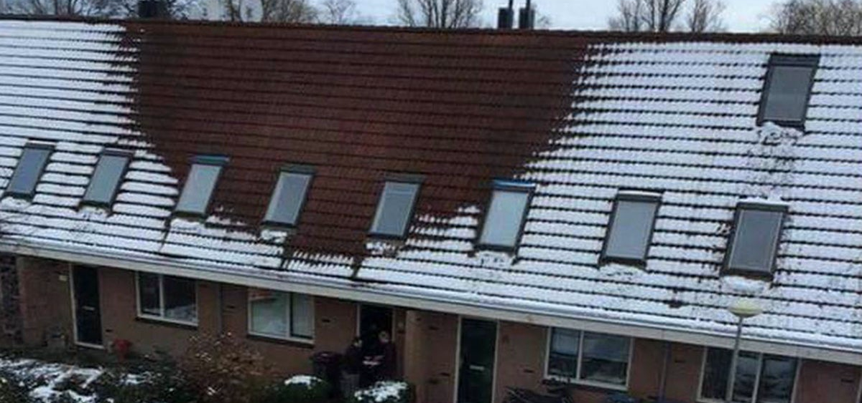
Side Channel Attacks
Attacks that use side effects of the physical implementation of a system in order to gain information
Example: can you guess the passcode for this block?
Notes:
Notice the wear on the buttons of the keypad!
Heat on roofs used to detect illegal weed farming.

Slide 11
Side Channels in Computer Security
Observable changes in hardware during program execution
Heat
Sound
Time
Example: how can this code be exploited?
// Return 1 if password is correct, 0 otherwise
int check_password(char* input, char* real) {
for (i = 0; input[i] != 0 && real[i] != 0; i++) {
if (input[i] != real[i])
return 0;
}
return 1;
}

Slide 12
Example: Password Checker
Input | Runtime
aaaaa | 1ms
baaaa | 1ms
caaaa | 2ms
cbaaa | 2ms
ccaaa | 2ms
cdaaa | 2ms
ceaaa | 3ms
… | …
// Return 1 if password is correct, 0 otherwise
int check_password(char* input, char* real) {
for (i = 0; input[i] != 0 && real[i] != 0; i++) {
if (input[i] != real[i])
return 0;
}
return 1;
}
Function returns as soon as it reaches a character that doesn’t match

Slide 13
Cache Timing Attacks
Recap:
Cache misses take significantly longer than hits
Each address will map to a single set in the cache
Conclusion:
By monitoring how long a memory access takes, we can tell whether or not it’s in the cache!
Common method: “Flush + Reload”
Allows attacker to figure out whether some address was accessed by another program

Slide 14
Attack Time

Slide 15
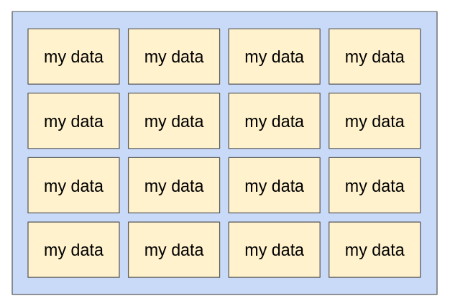
Flush + Reload
Fill the cache with data (“flush”)

Slide 16
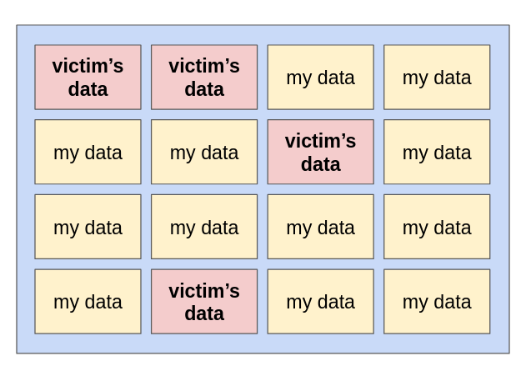
Flush + Reload (pt 2)
Fill the cache with data (“flush”)
Let victim code run
It will load its data into the cache

Slide 17
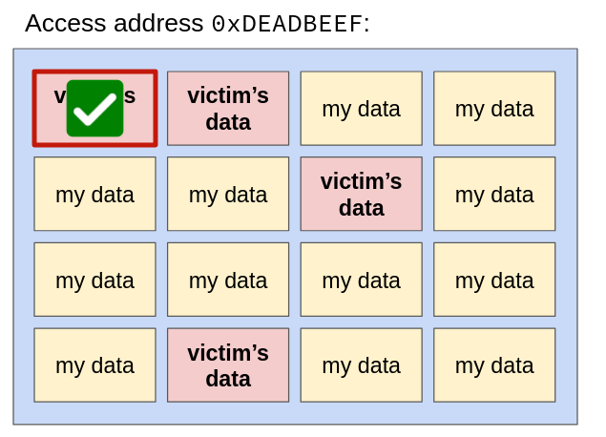
Flush + Reload (pt 3)
Fill the cache with data (“flush”)
Let victim code run
It will load its data into the cache
Access the address we want to know about (“reload”)
Slow: it’s not in the cache
Fast: it is in the cache - victim must have accessed it!

Slide 18
Lesson Topics
Cache Wrap-up
More cache images
Side Channel Attacks
Overview
Cache timing attacks
Spectre and Meltdown

Slide 19
Speculative Execution
Modern CPUs use pipelining - execute instructions ahead of time
Ex: while CPU is computing the result for one instruction, start fetching data for the next one
An analogy:
Imagine you have to bake 10 cakes
Each one takes 1 hr to make (30 min to make the batter + 30 min to bake)
Making each batch separately: 10hrs :(
What can you do to speed this up?
While one batch is baking, make the batter for the next one!
Total time: 5.5hrs :)

Slide 20
Branch Prediction
Problem: when executing a conditional branch, how does the CPU know which instruction to start working on?
Doesn’t know which instruction will come next until after the jump finishes
Solution: branch prediction
CPU learns observes program behavior during branches
Makes an educated guess as to whether a branch will be taken based on previous behavior
If the guess is correct: we saved time!
If it’s wrong: go back and execute correct branch

Slide 21
Branch Prediction Example:
movl $0, %eax # i=0
jmp .condition
.loop:
<loop body>
addl $1, %eax # i++
.condition:
cmpl %edi, %eax # i<n
jl .loop
. . .
for (int i = 0; i < n; i++) {
<loop body>
}
. . .
When executing the jl instruction, is it more likely to take the jump (restart loop), or not?
Hint: which scenario occurs more often?
Notes:
More likely to take the jump. Jump to loop body n times. Only don’t jump once

Slide 22
Spectre Attacks
Exploit both cache timing and speculative execution
Train branch predictor to take a particular branch
Make that branch access some memory location you normally wouldn’t have access to
Loads that memory location into the cache
Even after the CPU realizes it’s in the wrong branch, the data will still be in the cache!
Use cache timing to figure out what was accessed

Slide 23
Specter Attacks Example
// check value of x to prevent
// out-of-bounds array access
if (x < array_size)
y = array2[array1[x] * 4096];
Train branch predictor to go into the if statement
Pass in a value of x that is much larger than array_size
The CPU will speculatively execute the if statement body while the conditional jump is being computed
Loads array2[array1[x] * 4096] into the cache
Use flush + reload to figure out where array2[array1[x] * 4096] is
This will tell you what the value of array1[x] was
Notes:
1st access is array1[x]. 4096 is the block size. 2nd access depends on 1st

Slide 24
Spectre and Meltdown History
In 2018, two different research groups found that Intel CPUs were vulnerable to attacks using cache side channels and speculative execution
Spectre exploits branch prediction to access victim’s data
Meltdown exploits a race condition to gain access to OS memory
Affected all Intel CPUs from the previous 20 years!
Since then, other variants have been found
Vulnerabilities in ARM CPUs too

Slide 25
Spectre and Meltdown Mitigations
Prevent attacker from accessing victim’s data
Virtual Memory: future lecture topic!
Other methods not talked about in this class
Prevent speculative execution
Turn off branch prediction when running vulnerable code
Don’t let branch prediction training carry across programs
i.e., CPU “forgets” prior training when switching between programs
Prevents attacker from mistraining branch predictor
However, these strategies not used that often. Why?

Slide 26
Spectre and Meltdown Mitigations (pt 2)
Many of these mitigation strategies are not commonly used. Why?
High performance cost.
Turning off speculative execution slows down a CPU by ~30%
Attacks are unlikely
Require the attacker to already have access to the victim computer and some the victim program
There is no evidence of these attacks actually occurring in the wild (i.e. outside of a research environment)

Slide 27
Discussion
Discuss the following in groups of 2-4, then we’ll share out as a class.
Despite the initial panic, little has actually been done to remove the vulnerabilities that allow Spectre and Meltdown to occur. Why do you think this is? Some things to consider:
Would you buy a computer that had was 100% resistant to being hacked, but was 30% slower?
If you were a business executive at a tech company, how much would you be willing to pay to ensure your product was completely secure?
What if it came at the cost of other functionality (speed, features, etc.)
Do you think we should be doing more, or are things fine the way they are?

Slide 28
Conclusion
Cache side channel vulnerabilities are a result of features we’ve added to improve performance (caches, speculative execution, etc.)
Completely preventing attacks would require us to give up those performance gains, so we just live with it ¯\_ (ツ)_/¯
Tradeoff between security, functionality, and performance
Want to learn more? Take these classes:
CSE 484 (Security)
CSE 451 (Operating Systems)
CSE 469 (Computer Architecture)

