Slide 1
Caches IV
CSE 351 Summer 2024
Instructor:
Ellis Haker
Teaching Assistants:
Naama Amiel
Micah Chang
Shananda Dokka
Nikolas McNamee
Jiawei Huang

Slide 2
Administrivia
Nothing due tonight!
Sunday, 7/28
Lab3 due (11:59pm)
Monday, 7/29
HW15-16 due (11:59pm)
Quiz 2 due (11:59pm)
I made some mistakes in the last lecture (I was… very tired)
Ed slides have been fixed, and we’ll go over the last problem again today

Slide 3
Code Analysis
Assuming cache starts cold (i.e. all blocks invalid), and sum, i, and j are all stored in registers, calculate the miss rate.
m = 10 bits, C = 64B, K = 8B, E = 2
#define SIZE 8
short ar[SIZE][SIZE], sum = 0; // &ar=0x200
for (int i = 0; i < SIZE; i++) {
for (int j = 0; j < SIZE; j++)
sum += ar[j][i];
}
Notes:
Big S = Big C / Big K / E = 4 sets
8 shorts = 16 B per row
Other relevant addresses: ar[1] = 0x210, ar[2] = 0x220, ar[3] = 0x230, etc.
Code visits each element of array in columns

Slide 4
Code Analysis: relevant values
m = 10 bits, C = 64B, K = 8B, E = 2
k = 3, s = 2
8B blocks = 4 shorts per block
Starting address = 0b10000 00 000
Block stored in set 0, tag = 0b10000 = 0x10
Set | Tag | Data | Tag | Data
0
1
2
3
#define SIZE 8
short ar[SIZE][SIZE], sum = 0; // &ar=0x200
for (int i = 0; i < SIZE; i++) {
for (int j = 0; j < SIZE; j++)
sum += ar[j][i];
}
Notes:
Little k = 3, little s = 2
Slide shows elements of ar map to cache
Set 0: 00-03 (tag 10), 20-23 (tag 11), 40-43 (tag 12), 60-63 (tag 13)
Set 1: 04-47 (tag 10), 24-27 (tag 11), 44-47 (tag 12), 60-67 (tag 13)
Set 2: 10-13 (tag 10), 30-33 (tag 11), 50-53 (tag 12), 70-73 (tag 13)
Set 4: 14-17 (tag 10), 34-37 (tag 11), 54-57 (tag 12), 74-44 (tag 13)

Slide 5
Code Analysis: step 1
i = 0, j = 0
Misses: 1
Hits: 0
Access ar[0][0]
0b10000 00 000
Miss!
Load block into set 0 with tag 0x10
Set | Tag | Data | Tag | Data
0 | 10 | a[0][0] … a[0][3]
1
2
3
#define SIZE 8
short ar[SIZE][SIZE], sum = 0; // &ar=0x200
for (int i = 0; i < SIZE; i++) {
for (int j = 0; j < SIZE; j++)
sum += ar[j][i];
}
Notes:
Compulsory miss

Slide 6
Code Analysis: step 2
i = 0, j = 1
Misses: 2
Hits: 0
Access ar[1][0]
0b10000 10 000
Miss!
Load block into set 2 with tag 0x10
Set | Tag | Data | Tag | Data
0 | 10 | a[0][0] … a[0][3]
1
2 | 10 | a[1][0] … a[1][3]
3
#define SIZE 8
short ar[SIZE][SIZE], sum = 0; // &ar=0x200
for (int i = 0; i < SIZE; i++) {
for (int j = 0; j < SIZE; j++)
sum += ar[j][i];
}
Notes:
Compulsory miss

Slide 7
Code Analysis: step 3
i = 0, j = 2
Misses: 3
Hits: 0
Access ar[2][0]
0b10001 00 000
Miss!
Load block into set 0 with tag 0x11
Can store both blocks in set 0 because of associativity
Set | Tag | Data | Tag | Data
0 | 10 | a[0][0] … a[0][3] | 11 | a[2][0] … a[2][3]
1
2 | 10 | a[1][0] … a[1][3]
3
#define SIZE 8
short ar[SIZE][SIZE], sum = 0; // &ar=0x200
for (int i = 0; i < SIZE; i++) {
for (int j = 0; j < SIZE; j++)
sum += ar[j][i];
}
Notes:
Compulsory miss

Slide 8
Code Analysis: step 4
i = 0, j = 3
Misses: 4
Hits: 0
Access ar[3][0]
0b10001 10 000
Miss!
Load block into set 1 with tag 0x11
Set | Tag | Data | Tag | Data
0 | 10 | a[0][0] … a[0][3] | 11 | a[2][0] … a[2][3]
1
2 | 10 | a[1][0] … a[1][3] | 11 | a[3][0] … a[3][3]
3
#define SIZE 8
short ar[SIZE][SIZE], sum = 0; // &ar=0x200
for (int i = 0; i < SIZE; i++) {
for (int j = 0; j < SIZE; j++)
sum += ar[j][i];
}
Notes:
Compulsory miss

Slide 9
Code Analysis: step 5
i = 0, j = 4
Misses: 5
Hits: 0
Access ar[4][0]
0b10010 00 000
Miss!
Load block into set 0 with tag 0x12
Evicts least recently used block
Set | Tag | Data | Tag | Data
0 | 12 | a[4][0] … a[4][3] | 11 | a[2][0] … a[2][3]
1
2 | 10 | a[1][0] … a[1][3] | 11 | a[3][0] … a[3][3]
3
#define SIZE 8
short ar[SIZE][SIZE], sum = 0; // &ar=0x200
for (int i = 0; i < SIZE; i++) {
for (int j = 0; j < SIZE; j++)
sum += ar[j][i];
}
Notes:
Compulsory miss
least recently used = ar[0][0] = ar[0][3]

Slide 10
Code Analysis: step 6-8
i = 0, j = 5…
Misses: 8
Hits: 0
Same as step 5
Accesses to a[5][0], a[6][0], and a[7][0] will kick out the old blocks in the cache
So for i = 0:
8 accesses total (j = 0…7), 8 misses
Set | Tag | Data | Tag | Data
0 | 12 | a[4][0] … a[4][3] | 13 | a[6][0] … a[6][3]
1
2 | 12 | a[5][0] … a[5][3] | 13 | a[7][0] … a[7][3]
3
#define SIZE 8
short ar[SIZE][SIZE], sum = 0; // &ar=0x200
for (int i = 0; i < SIZE; i++) {
for (int j = 0; j < SIZE; j++)
sum += ar[j][i];
}
Notes:
3x Compulsory miss

Slide 11
Code Analysis: step 9
i = 1, j = 0
Misses: 9
Hits: 0
Access ar[0][1]
0b10000 00 010
Same block that we loaded in in step 1, but it got evicted in step 5!
Miss!
Load block back into set 0
Set | Tag | Data | Tag | Data
0 | 10 | a[0][0] … a[0][3] | 13 | a[6][0] … a[6][3]
1
2 | 12 | a[5][0] … a[5][3] | 13 | a[7][0] … a[7][3]
3
#define SIZE 8
short ar[SIZE][SIZE], sum = 0; // &ar=0x200
for (int i = 0; i < SIZE; i++) {
for (int j = 0; j < SIZE; j++)
sum += ar[j][i];
}
Notes:
Conflict miss

Slide 12
Code Analysis: step 10+
All future accesses will continue to follow this pattern
Each block is loaded in, then kicked out of the cache before it’s accessed again
Miss rate 100%!
How can we fix this?
#define SIZE 8
short ar[SIZE][SIZE], sum = 0; // &ar=0x200
for (int i = 0; i < SIZE; i++) {
for (int j = 0; j < SIZE; j++)
sum += ar[j][i];
}

Slide 13
Improving Cache Performance
Reduce stride
I.e. access data that’s closer together
#define SIZE 8
short ar[SIZE][SIZE], sum = 0; // &ar=0x200
for (int i = 0; i < SIZE; i++) {
for (int j = 0; j < SIZE; j++)
sum += ar[i][j];
}
Notes:
Access each element in rows, everything else is the same

Slide 14
Improving Cache Performance Example: step 1
Misses: 1
Hits: 3
First 4 accesses:
ar[0][0]: miss, load block into the cache
ar[0][1]: hit!
ar[0][2]: hit!
ar[0][3]: hit!
Set | Tag | Data | Tag | Data
0 | 10 | ar[0][0] … ar[0][3]
1
2
3
#define SIZE 8
short ar[SIZE][SIZE], sum = 0; // &ar=0x200
for (int i = 0; i < SIZE; i++) {
for (int j = 0; j < SIZE; j++)
sum += ar[i][j];
}
Notes:
Compulsory miss

Slide 15
Improving Cache Performance Example: step 2
Misses: 2
Hits: 6
Next 4 accesses:
ar[0][4]: miss, load block into the cache
ar[0][5]: hit!
ar[0][6]: hit!
ar[0][7]: hit!
Set | Tag | Data | Tag | Data
0 | 10 | ar[0][0] … ar[0][3]
1 | 10 | ar[0][4] … ar[0][7]
2
3
#define SIZE 8
short ar[SIZE][SIZE], sum = 0; // &ar=0x200
for (int i = 0; i < SIZE; i++) {
for (int j = 0; j < SIZE; j++)
sum += ar[i][j];
}
Notes:
Compulsory miss

Slide 16
Improving Cache Performance Example: step 3+
All accesses follow this pattern
Because we use a whole block before moving on, we will miss 1 out of every 4 accesses
Miss rate: 25%
#define SIZE 8
short ar[SIZE][SIZE], sum = 0; // &ar=0x200
for (int i = 0; i < SIZE; i++) {
for (int j = 0; j < SIZE; j++)
sum += ar[i][j];
}

Slide 17
Caches
Cache basics
Principle of locality
Memory hierarchies
Cache organization
Direct-mapped (sets; index + tag)
Associativity (ways)
Replacement policy
Handling writes
Program optimizations that consider caches

Slide 18
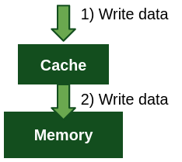
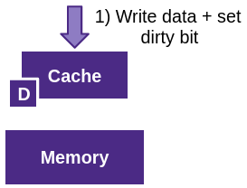
Write-Hit Policies
What to do if the data is already in the cache?
Write-through: immediately write to the next level
Write-back: don’t write to next level until we have to
Keep track of dirty bit for each block
On eviction, if dirty bit is set, write contents back to memory
Write-through
Write-back

Slide 19
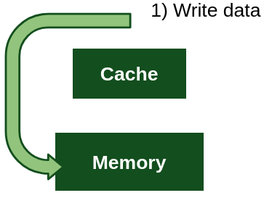
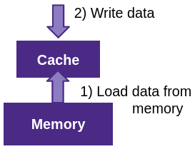
Write-Miss Policies
What to do if the block we want to write to is not in the cache?
No-write-allocate (“write around”): don’t load into the cache, just write to the next level
Write-allocate (“fetch on write”) load data into the cache before writing
No-write-allocate
Write-allocate

Slide 20
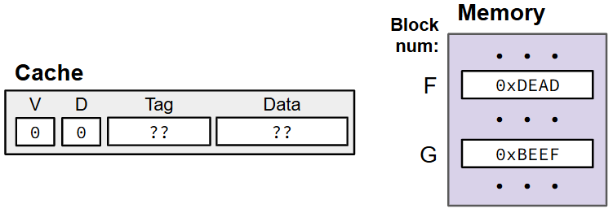
Ex: Write-Back, Write-Allocate
Write-back: defer write to next level until line is evicted
Write-allocate: on a miss, bring the data into cache
Single-block mini cache
Tag includes the entire block number
Not a realistic example
Notes:
Write-back = hit policy
Write-allocate = miss policy

Slide 21
Ex: Write-Back, Write-Allocate (pt 2)
Write-back: defer write to next level until line is evicted
Write-allocate: on a miss, bring the data into cache
1. mov $0xB0BA, (F)
Not valid x86. Assume we mean an address within block F.
Write miss
Notes:
Valid = 0 means cache line is empty

Slide 22
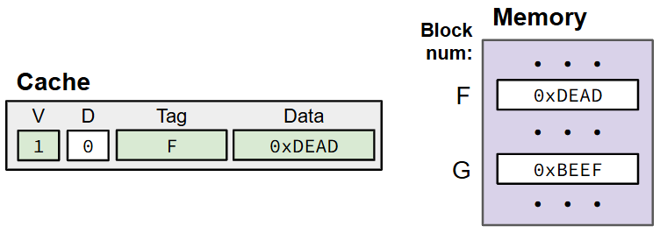
Ex: Write-Back, Write-Allocate (pt 3)
Write-back: defer write to next level until line is evicted
Write-allocate: on a miss, bring the data into cache
1. mov $0xB0BA, (F)
Write miss
Bring F into cache
Notes:
Because of write-allocate policy

Slide 23
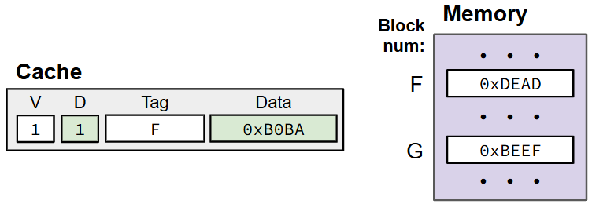
Ex: Write-Back, Write-Allocate (pt 4)
Write-back: defer write to next level until line is evicted
Write-allocate: on a miss, bring the data into cache
1. mov $0xB0BA, (F)
Write miss
Bring F into cache
Notes:
Because of write-back policy.
Memory keeps old value

Slide 24
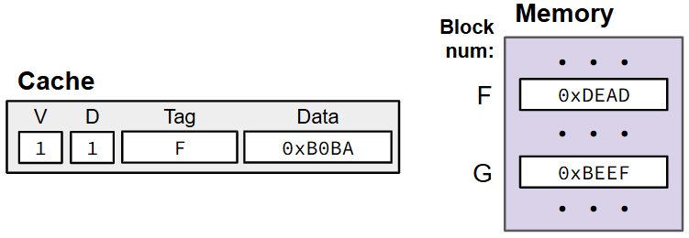
Ex: Write-Back, Write-Allocate (pt 5)
Write-back: defer write to next level until line is evicted
Write-allocate: on a miss, bring the data into cache
2. mov $0xF00D, (F)
Write hit

Slide 25
Ex: Write-Back, Write-Allocate (pt 6)
Write-back: defer write to next level until line is evicted
Write-allocate: on a miss, bring the data into cache
2. mov $0xF00D, (F)
Write hit
Write 0xF00D into cache only
Set dirty bit
Notes:
Because of write-back

Slide 26
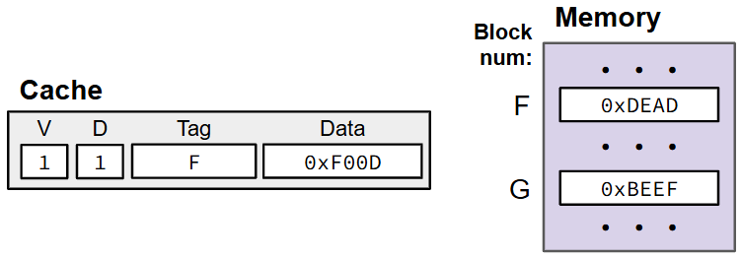
Ex: Write-Back, Write-Allocate (pt 7)
Write-back: defer write to next level until line is evicted
Write-allocate: on a miss, bring the data into cache
3. mov (G), %ax
Read miss

Slide 27
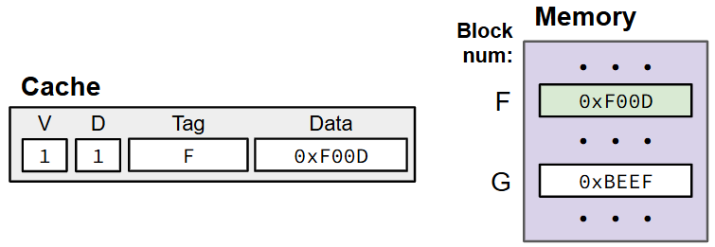
Ex: Write-Back, Write-Allocate (pt 8)
Write-back: defer write to next level until line is evicted
Write-allocate: on a miss, bring the data into cache
3. mov (G), %ax
Read miss
Write F back to memory since it is dirty
Notes:
D = 1, so copy value 0xF00D from Data into Memory

Slide 28
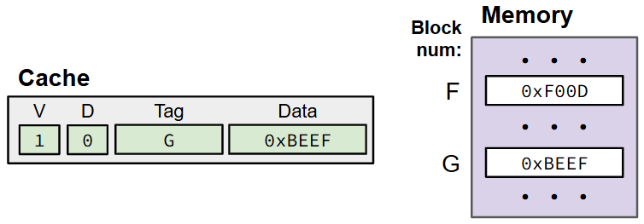
Ex: Write-Back, Write-Allocate (pt 9)
Write-back: defer write to next level until line is evicted
Write-allocate: on a miss, bring the data into cache
3. mov (G), %ax
Read miss
Write F back to memory since it is dirty
Bring G into cache

Slide 29
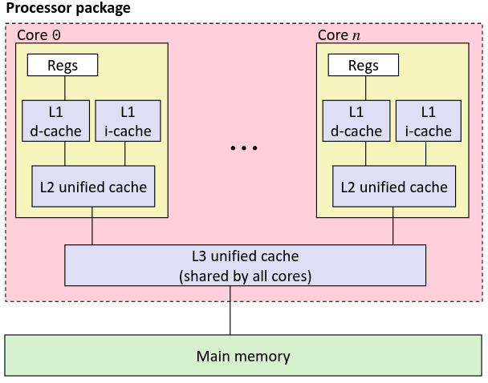
Common Policies
Write-back + Write-allocate
(most common)
Write-through + No-write-allocate
When would this be used?
Notes:
Ex: l2 cache may be write-through so that other cores can access data through shared L3

Slide 30
Polling Question
Which of the following cache statements is FALSE?
A write-through cache will always match data with the memory hierarchy level below it.
We can reduce compulsory misses by decreasing our block size.
A write-back cache will save time for code with good temporal locality on writes.
We can reduce conflict misses by increasing associativity
Notes:
True – definition of write-though
False – remember that compulsory misses mean the data hasn’t been loaded into the cache yet. The larger the block size, the more data we load in at once, so decreasing block size actually increases compulsory misses
True – good temporal locality = we write to the same location multiple times. If it were write-through, we would need to write to next hierarchy level every time, but with write-back, we only do it once (when the block is evicted)
True – higher associativity = more blocks that map to the same set can fit in the cache at once

Slide 31
Cache Simulator
Want to play around with cache parameters and policies? Check out our cache simulator!
https://courses.cs.washington.edu/courses/cse351/cachesim/
Way to use:
Take advantage of “explain mode” and navigable history to test your own hypotheses and answer your own questions
Self-guided Cache Sim Demo in section
Will be used in HW17 – Lab 4 Preparation

Slide 32
Caches
Cache basics
Principle of locality
Memory hierarchies
Cache organization
Direct-mapped (sets; index + tag)
Associativity (ways)
Replacement policy
Handling writes
Program optimizations that consider caches
Notes:
Only talking about direct-mapped caches today. This is what you read about for today. We’ll talk about the other kinds later

Slide 33
Optimizations for the Memory Hierarchy
Write code that has locality
Spatial: access data contiguously
Temporal: make sure access to the same data is not too far apart in time
How can you achieve locality?
Adjust memory accesses in code to improve miss rate (MR)
Requires knowledge of both how caches work as well as your system’s parameters
Proper choice of algorithm
Loop transformations

Slide 34
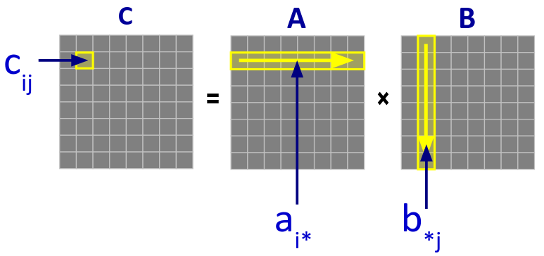
Example: Matrix Multiplication
c_{ij} = $\sum_{k=1}^{n}{\text{a}\text{ik}\text{ ∗ }\text{b}\text{kj}}$
Notes:
Go through row of A and Col of B:
Multiply values
Sum of all results = 1 element of resulting matrix
Ex: C[i][j] = A[i][1]*B[1][j] + A[i][2]*B[2][j] + A[i][3]*B[3][j]+…

Slide 35
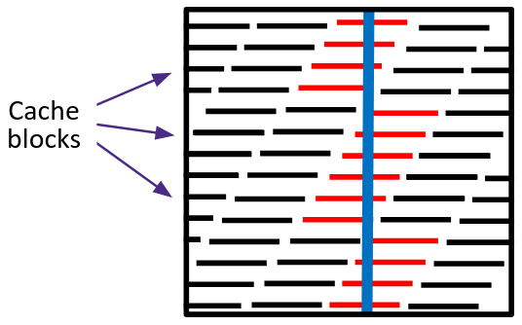
Matrices in Memory
How do cache blocks fit into this scheme?
Row-major in memory
Column of matrix is spread across multiple cache blocks
Notes:
i.e. moving by columns gets worse cache performance

Slide 36
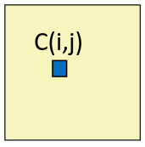
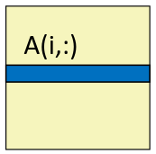
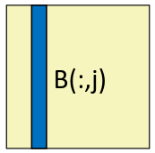
Naive Matrix Multiply
// move along rows of A
for (i = 0; i < n; i++) {
// move along columns of B
for (j = 0; j < n; j++) {
// Reads row of A, col of B
// Read & write c(i,j) n times
for (k = 0; k < n; k++)
c[i*n+j] += a[i*n+k] * b[k*n+j];
}
}
How many memory accesses are in this line?
＝
＋
✕
Notes:
C[i*n+j] = C[i][j]
A[i*n+k] = A[i][k]
B[k*n+j] = B[k][j]

Slide 37
Cache Miss Analysis (Naive)
Ignoring misses in matrix C
Example parameters:
A and B are square (n✕n) matrices of doubles
Cache block size K = 64B
8 elements per block
Cache size C << n (much smaller)
For each element of C
n/8 misses per row of A
n misses per column B
9n/8 misses per iteration
n² elements in total
9n³/8 misses
Notes:
n/8 misses for A bc going by rows gets optimal miss rate
n misses for B bc every access misses
9n/8 = n + n/8
9n^3/8 = 9n/8 * n^2

Slide 38
Linear Algebra To The Rescue
Can get the same result of a matrix multiplication by splitting the matrices into smaller submatrices (“blocks”)
Example: multiply 2 4✕4 matrices
a₁₁ | a₁₂ | a₁₃ | a₁₄
a₂₁ | a₂₂ | a₂₃ | a₂₄
a₃₁ | a₃₂ | a₃₃ | a₃₄
a₄₁ | a₄₂ | a₄₃ | a₄₄
A ＝
＝
A₁₁ | A₁₂
A₂₁ | A₂₂
, with B defined similarly
AB ＝
(A₁₁B₁₁+ A₁₂B₂₁) | (A₁₁B₁₂+ A₁₂B₂₂)
(A₂₁B₁₁+ A₂₂B₂₁) | (A₂₁B₁₂+ A₂₂B₂₂)
Notes:
Ex Top-left chunk of original matrix (little a_11, little a_12, little a_21, and little a_22) = top-left submatrix (big A_11)
Don’t need to know the details, what’s important is that we can split the matrix into smaller chunks

Slide 39
Linear Algebra To The Rescue (pt 2)
Split up each matrix into smaller blocks
Choose a block size that will fit in the cache!
This technique is called cache blocking
Perform multiplication block-by-block (rather than row-by-row)
C₂₂ = A₂₁B₁₂ + A₂₂B₂₂ + A₂₃B₃₂ + A₂₄B₄₂ = $\sum_{k=1}^{n}{\text{A}\text{2}\text{k}\text{∗}\text{Bk}\text{2}}$
Notes:
Similar alg as earlier, but now each of these (A, B, C) is a mini-matrix

Slide 40
Blocked Matrix Multiply
r = length of a block (assume r divides n evenly)
// Go through each rxr block of C
for (i = 0; i < n; i += r)
for (j = 0; j < n; j += r)
// Go through each block A(i, k) and B(k, j)
for (k = 0; k < n; k += r)
// Multiply the two blocks (same as naive algorithm)
for (ib = i; ib < i+r; ib++)
for (jb = j; jb < j+r; jb++)
for (kb = k; kb < k+r; kb++)
c[ib*n+jb] += a[ib*n+kb]*b[kb*n+jb];
Notes:
Last 3 for loops is the same as before, but because matrices are smaller, better cache performance

Slide 41
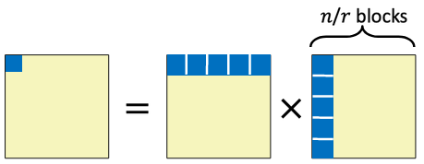
Cache Miss Analysis (Blocked)
Ignoring misses in matrix C
Example parameters:
Cache block size K = 64B
8 elements per block
Cache size C << n (much smaller)
Cache can hold 3 blocks (r✕r): 3r² < C
For each block of C
r²/8 misses per block
8 elements per cache block
2n/r blocks accessed (row and col) -> 2n/r * r²/8 = nr/4 misses
(n/r)² blocks in total
nr/4 * (n/r)² = n³/4r misses
Compare to 9n³/8 from before
Notes:
R^2/8 misses per block – opimal miss rate because it all fits in the cache at once
2n/r blocks accessed – n/r for A + n/r for B

Slide 42
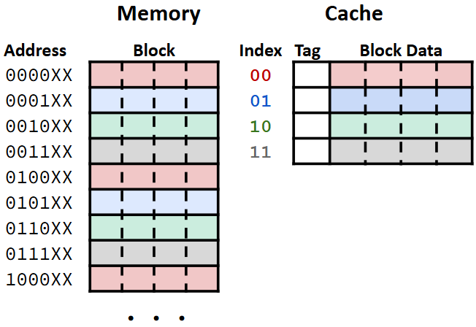
Cache Images
Recap:
Blocks are contiguous chunks of memory
Contiguous blocks in memory map to contiguous cache sets
Conclusion:
Let B = the number of blocks the cache can hold (C / K)
A contiguous, aligned chunk of B blocks (C bytes) can all fit into the cache at once!

Slide 43
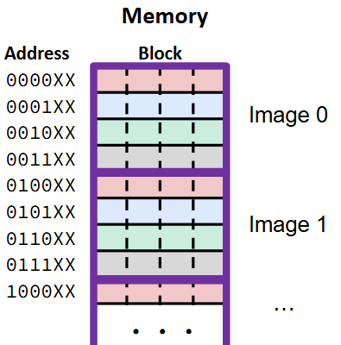
Cache Images (pt 2)
Cache image: an aligned chunk of memory the same size as the cache
Guaranteed to all fit in the cache at once
Locality!
The offset of an address within its cache image tells you where in the cache it will map to
Two addresses with the same offset in different images will map to the same location in the cache
Notes:
Ex: 1st byte of each image goes to set 0, offset 0

Slide 44
Summary
Programmer can optimize for cache performance
How data structures are organized
How data is accessed
Cache blocking for 2D arrays
Getting absolute optimum performance is very platform specific
Depends on cache size, block size, associativity, etc.
Generic guidelines:
Keep working set reasonably small (temporal locality)
Use small strides (spatial locality)
Focus on inner loop code (for nested loops)
Cache images can help you quickly figure out where data will go in the cache

