Slide 1
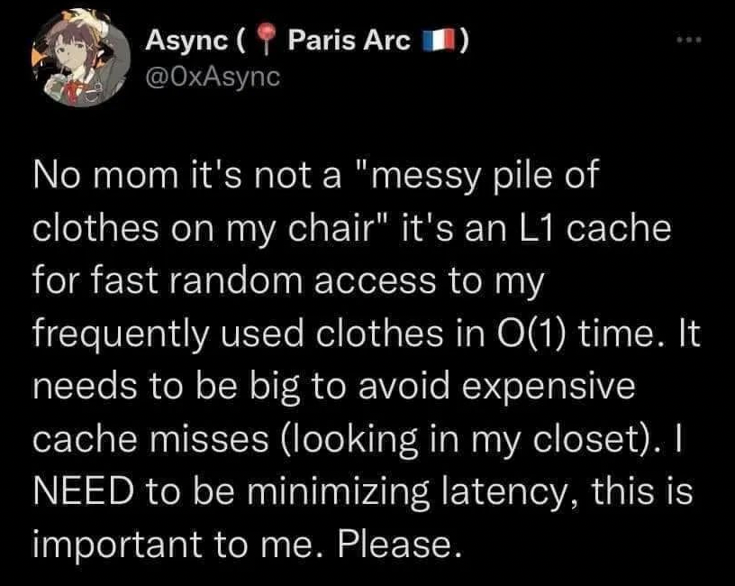
Caches III
CSE 351 Summer 2024
Instructor:
Ellis Haker
Teaching Assistants:
Naama Amiel
Micah Chang
Shananda Dokka
Nikolas McNamee
Jiawei Huang

Slide 2
Administrivia
Today
HW14 due (11:59pm)
Friday, 7/26
RD17 (1pm)
No HW due!
Sunday, 7/28
Lab3 due (11:59pm)
Monday, 7/29
No RD due!
HW15 + 16 due (11:59pm)
Quiz 2 due (11:59pm)
Notes:
Late due date for Lab3 is Tue 7/30
REMEMBER QUIZ 2

Slide 3
Caches
Cache basics
Principle of locality
Memory hierarchies
Cache organization
Direct-mapped (sets; index + tag)
Associativity (ways)
Replacement policy
Handling writes
Program optimizations that consider caches
Notes:
Only talking about direct-mapped caches today. This is what you read about for today. We’ll talk about the other kinds later

Slide 4
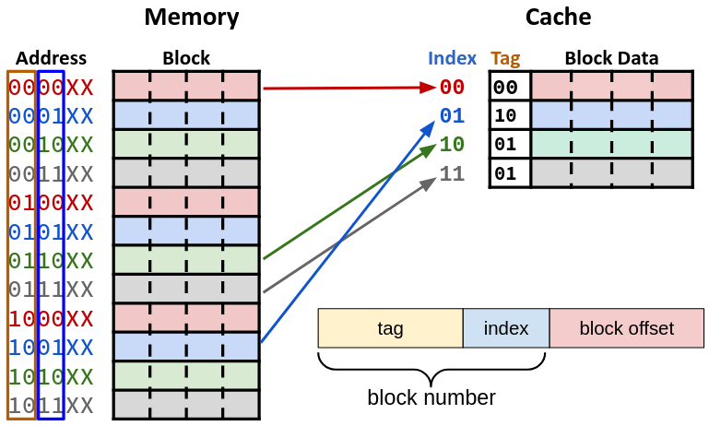
Recap: Direct-Mapped Cache
Each block in memory can only go into one set
Fast and simple
Hash function
(Block #) mod (# of sets)

Slide 5
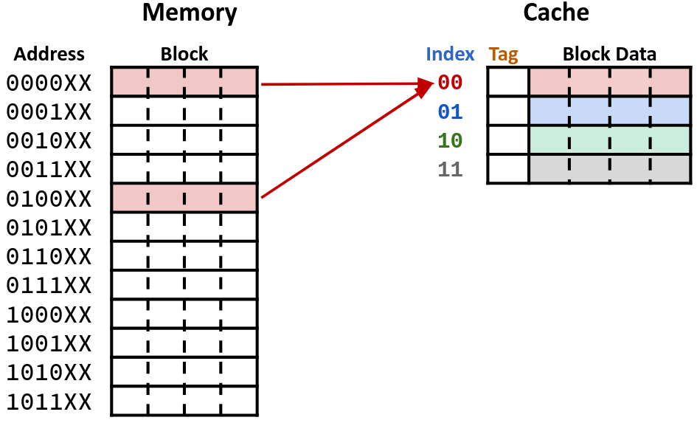
Direct-Mapped: a Problem!
What if we have the following access pattern:
0, 16, 0, 16, …
Each access will miss
Thrashing!
Rest of the cache unused

Slide 6
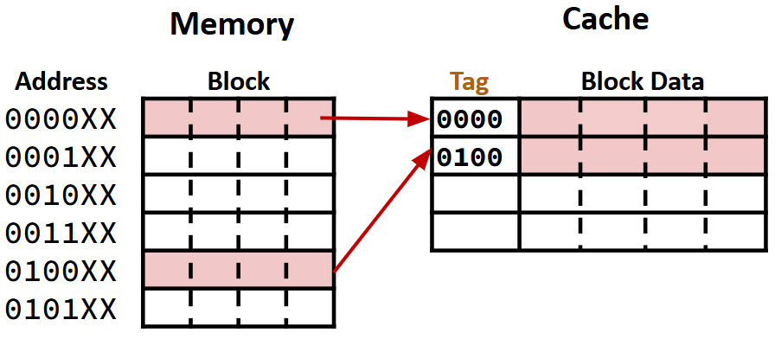
One Solution: Fully Associative
Can store any data block anywhere in the cache
When loading in a new block, store it in the first unused space
Only evict old blocks when the entire cache is full!
Problems with this?
Requires complicated hardware to check each set
More power consumed, slower
No index field needed!
Notes:
Tag = entire block#

Slide 7
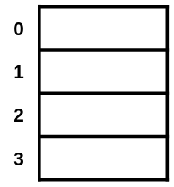
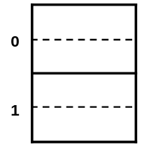
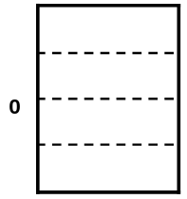
Full Solution: Associativity
Rather than just one block per set, we can have multiple
Cache line = block + relevant metadata (i.e. tag)
Associativity (E) = number of lines in a set
Cache is “E-way set associative”
If any block can go in any set, the cache is Fully Associative
1-way (1 block per set, 4 sets)
Direct-Mapped
2-way (2 blocks per set, 2 sets)
4-way (4 blocks per set, 1 set)
Fully-Associative

Slide 8
Cache Organization: Associativity
K = block size (in bytes), C = cache size (in bytes), E = associativity
S = number of sets = C÷K÷E
Use lowest s = log₂(S) bits of block number to find the set
Direct-Mapped: E = 1, so s = log₂(C÷K), same as we saw previously
Fully Associative: E = C÷K, so log₂(1) = 0
Direct-Mapped
n-way Set Associative
Fully Associative
Notes:
As E increases, S decreases, so fewer index bits

Slide 9
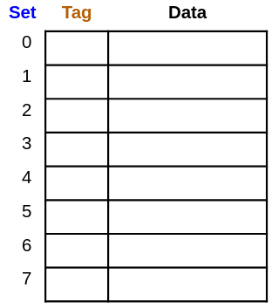
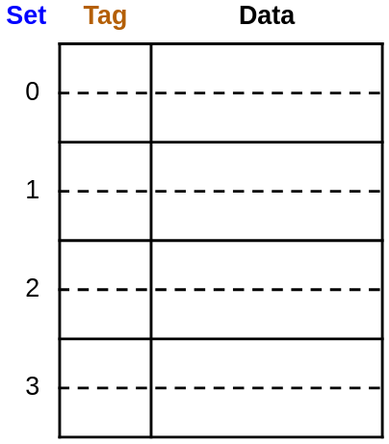
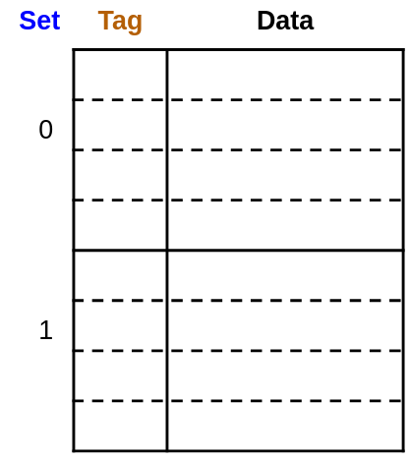
Example Placement #1
Block size 𝑲: 16 B
Capacity 𝑪/𝑲: 8 blocks
Address 𝒎: 16 bits
Where would data from address 0x1833 be placed?
0b0001 1000 0011 0011
s = ____
s = ____
s = ____
Notes:
Little k = 4 bits.
First example has 8 sets, so little s = 3, set 0b011 = 3
Second example has 4 sets, to little s = 2, set 0b11 = 3. block can go in either slot in the set
Third example has 2 sets, so little s = 1, set 0b1 = 1. block can go in any of the 4 slots in set 1

Slide 10
Block Placement and Replacement
If there is an empty line in the set, store data there
How to tell if the line is empty? Valid bit (0 = empty, 1 = used)
Stored in cache line
If there are no empty lines, which one do we replace?
No choice for direct-mapped, easy!
For other caches, need a replacement policy
Ideal is least recently used (LRU)
Most real caches approximate LRU

Slide 11
Polling Questions
We have a cache of size 2 KiB with block size of 128 B. If our cache has 2 sets, what is its associativity?
2
4
8
16
If addresses are 16 bits wide, how wide is the Tag field?
Notes:
2 KiB = 2*2^10 = 2^11 B. 128 B = 2^7 B
Associativity (E) = Cache size (C) / block size (K) / number of sets (S) = 2^11 B / 2^7 B / 2 = 2^3 = 8
Little k = log_2(big K) = 7, little s = log_2(big s) = 3. Tag bits = 16-7-3 = 6 bits

Slide 12
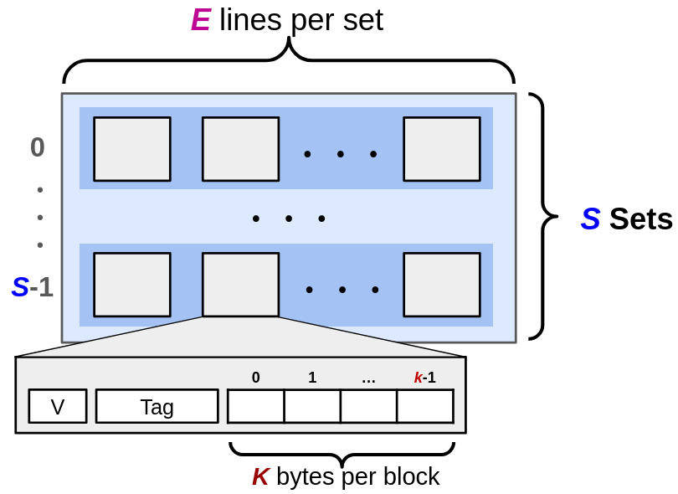
General Cache Layout Review
C = total bytes = K*E*S
(does not include tag or valid bit)

Slide 13
Notation Review
Parameter | Variable | Formulas
Block size | K (B in book) | C = K*E*S ↔ S=C/K/E k = log₂(K) ↔ K = 2^{k} s = log₂(S) ↔ S = 2^{s} m = log₂(M) ↔ M = 2^{m} m = t + s + k
Cache size | C
Associativity | E
Number of sets | S
Address space | M
Address width | m
Offset field width | k (b in book)
Index field width | s
Tag field width | t
Notes:
Address space = # of bytes/addresses in memory (see Mem & Data slides)

Slide 14
Example Cache Problem
1KiB address space, 125 cycles to go to memory. Fill in the following table:
Cache size (C) | 64B
Block size (K) | 8B
Associativity (E) | 2-way
Hit Time | 3 cycles
Miss Rate | 20%
Address width (m)
Offset bits (k)
Index bits (s)
Tag bits (t)
AMAT
Notes:
1KiB = 2^10B = 2^10 addresses = big M, 125 cycles = miss penalty
Address width (little m) = log_2(big M) = 10 bits
Offset bits (little k) = log_2(big K) = 3 bits
Index bits (little s) = log_2(big S). Big S = 2^10 / 2^3 / 2 = 2^6, so little s = 6 bits
Tag bits (t) = 10-3-6 = 1 bit
AMAT = HT + MR*MP = 3 + 0.2*125 = 28 cycles

Slide 15
Read: General Steps
Break up address into offset, index, and tag
Locate the set using index
Check if any line in the set has our data
Valid bit = 1 and tag matches
If yes - hit!
Otherwise, load in from memory
Read out data from block starting at offset
Notes:
New things added this lecture: checking any line in the set (as opposed to only having one line per set), and checking the valid bit

Slide 16
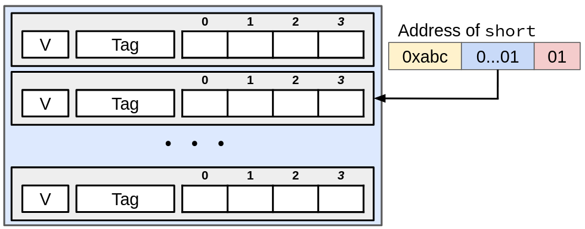
Read: Direct-Mapped Cache
One line per set (E=1), K=4B
Locate set

Slide 17
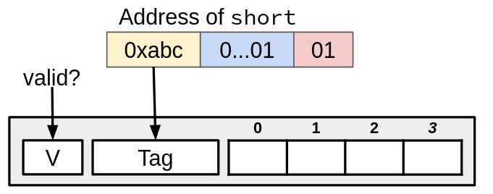
Read: Direct-Mapped Cache (pt 2)
One line per set (E=1), K=4B
Locate set
Check if valid and compare tag
No match? Old block gets evicted, replaced with new one
Notes:
Match if V==1 and Tag==0xabc

Slide 18
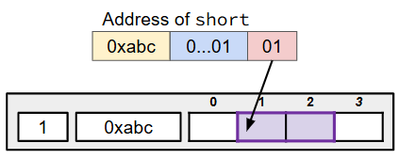
Read: Direct-Mapped Cache (pt 3)
One line per set (E=1), K=4B
Locate set
Check if valid and compare tag
Get data starting at offset
Notes:
2 B because we want a short

Slide 19
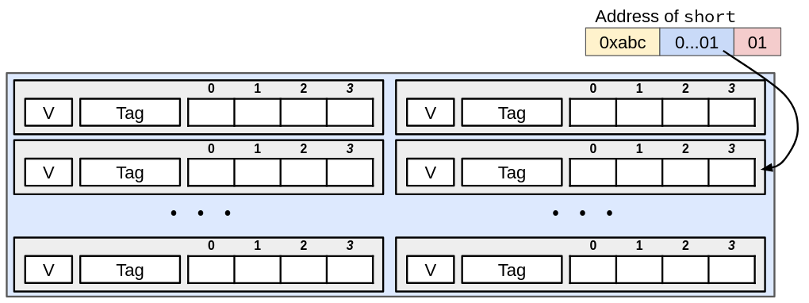
Read: Set Associative Cache
Two lines per set (E=2), K=4B
Locate set

Slide 20
Read: Set Associative Cache (pt 2)
Two lines per set (E=2), K=4B
Locate set
Check if valid and compare tag for every line in the set
No match? One line is selected to get evicted and replaced by new one
Notes:
The one on the left!

Slide 21
Read: Set Associative Cache (pt 3)
Two lines per set (E=2), K=4B
Locate set
Check if valid and compare tag for every line in the set
Get data starting at offset

Slide 22
Types of Cache Misses: 3 C’s
Compulsory (cold-start) miss
Occurs on the first access to a block
Smaller block size = more compulsory misses
Conflict miss
Occurs when cache is large enough to hold multiple data blocks, but they cannot be in the cache at the same time because they conflict
Lower associativity = more conflict misses
Does not occur in fully associative caches
Capacity miss
Occurs when the set of active blocks (the working set) is too big to fit in the cache
Smaller cache size = more capacity misses

Slide 23
Code Analysis
Assuming cache starts cold (i.e. all blocks invalid), and sum, i, and j are all stored in registers, calculate the miss rate.
m = 10 bits, C = 64B, K = 8B, E = 2
#define SIZE 8
short ar[SIZE][SIZE], sum = 0; // &ar=0x200
for (int i = 0; i < SIZE; i++) {
for (int j = 0; j < SIZE; j++)
sum += ar[j][i];
}
Notes:
More detailed explanation in next lecture
Big S = 64/8/2 = 4 sets
Little k = 3 bits, little s = 2 bits
Short is 2 B, 4 per block
Access pattern is a[0][0], a[1][0], a[2][0], a[3][0]…
a[0][0], a[2][0], a[4][0], a[6][0] = Set 0
a[1][0], a[3][0], a[5][0], a[7][0] = Set 2
a[4] kicks out a[0], a[5] kicks out a[1], a[6] kicks out a[2], a[7] kicks out a[3]
Each block is evicted before it’s used again. MR = 100%

Slide 24
Summary
Associativity: number of cache lines in a set
Direct-Mapped caches have associativity 1
Fully Associative caches have associativity equal to # of blocks (all in one set)
Most caches are somewhere in between
3 types of misses
Compulsory: first time accessing block
Conflict: block was evicted by another when the cache was not full
Capacity: block was evicted because the cache was full

