Slide 1
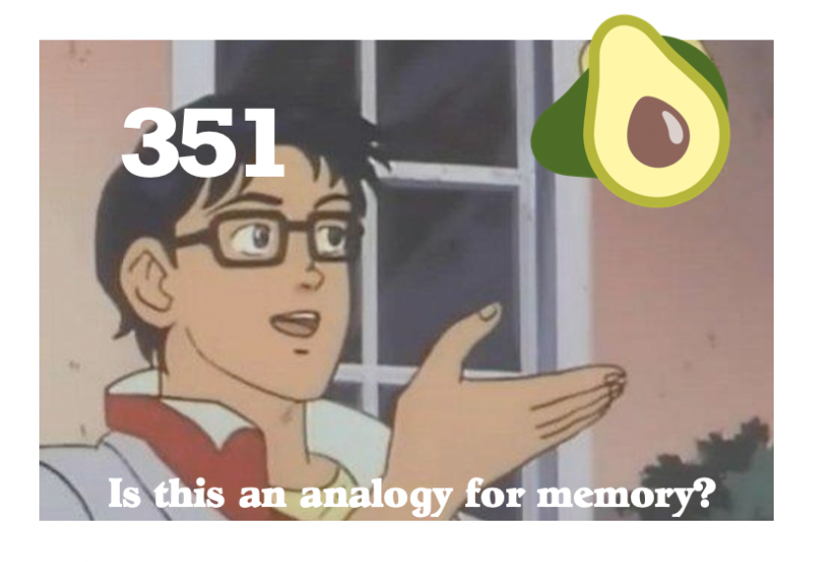
Caches II
CSE 351 Summer 2024
Instructor:
Ellis Haker
Teaching Assistants:
Naama Amiel
Micah Chang
Shananda Dokka
Nikolas McNamee
Jiawei Huang

Slide 2
Administrivia
Labs 2 and 3 extended 🥳 🥳 🥳
Regular Lab 2 date was yesterday (7/21) (late due date is tomorrow (7/23))
Lab 3 will be due Sunday 7/28 (late due date Tuesday 7/30)
Today:
HW13 Due (11:59pm)
HW15 and 16 released
Combined, due Monday 7/29
Quiz 2 Released (11:59pm)
Wednesday 7/24
RD16 Due (1pm)
HW14 Due (11:59pm)
Notes:
Probably won’t be able to do the the homework after lecture, but can get started once you do next lecture’s reading
It’s kinda long, so start early1

Slide 3
Mid-Quarter Updates
Extra office hour on Zoom (link on the course calendar)
Wednesdays 6pm-7pm
Ellis this week, Shananda after that
Additional resources
Videos on the course website Topic Videos page
Optional textbook - Computer Systems: a Programmer’s Perspective
Readings on the course website Schedule
Copies in the Allen School study center and my office
I’m trying to slow down in lecture
Please stop me if I’m going too fast :)

Slide 4
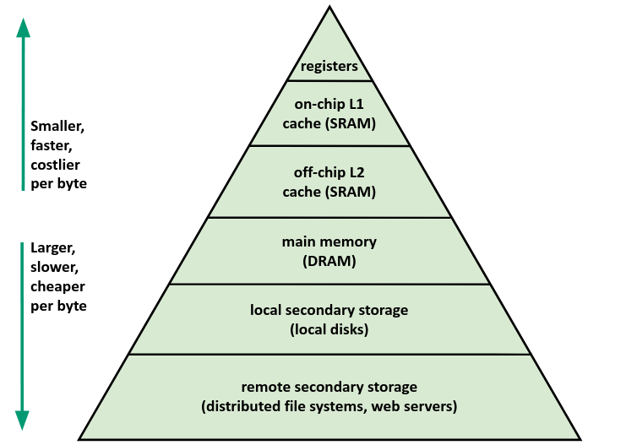
Memory Hierarchy Review
CPU registers hold words retrieved from L1 cache
L1 cache holds lines (i.e. blocks) retrieved from L2 cache
L2 cache holds lines retrieved from main memory
Main memory holds disk blocks retrieved from local disks
Local disks hold files retrieved from disks on remote network servers
Notes:
Each layer is like a “cache” for the one below it
Disk is usually for files, but also used for program data when RAM runs out

Slide 5
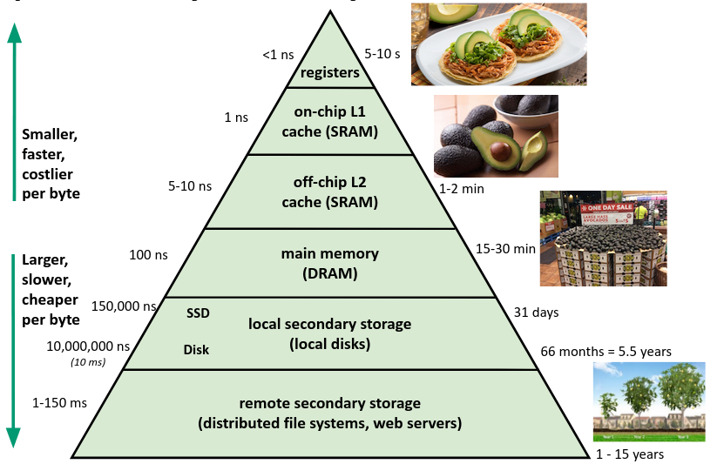
Memory Hierarchy Review (pt 2)
Notes:
Registers take 1 cycle
Can do 100+ other instructions in the time it takes to do 1 memory access!

Slide 6
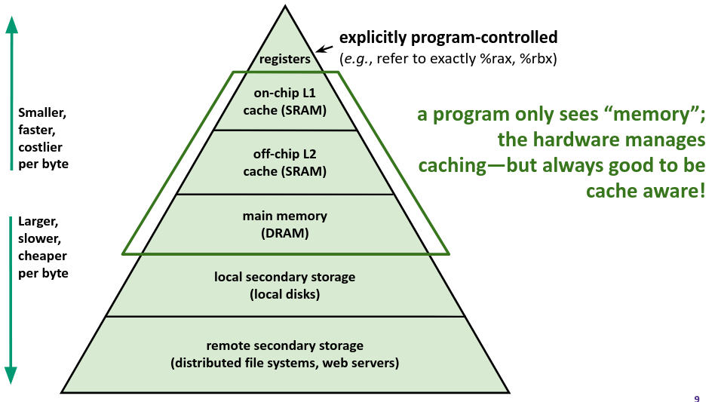
Memory Hierarchy Review (pt 3)
Notes:
Program requests data at an address, HW checks caches 1st, then memory.
Bottom 2 layers controlled by OS, take 333 and 451

Slide 7
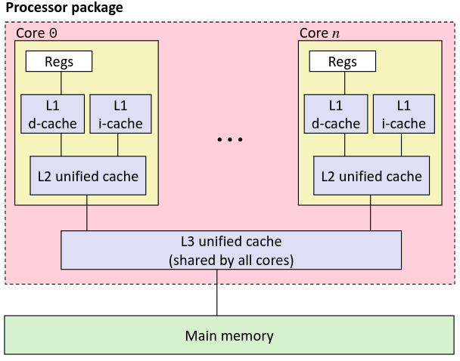
Example Microarchitecture: Intel Core i7
Block size: 64 bytes for all caches
L1 i-cache and d-cache:
32 KiB, 8-way,
Access: 4 cycles
L2 unified cache:
256 KiB, 8-way,
Access: 11 cycles
L3 unified cache:
8 MiB, 16-way,
Access: 30-40 cycles
Notes:
Multicore system
In this example, all blocks are the same, but don’t have to be
These numbers are outdated, trade secrets

Slide 8
Caches
Cache basics
Principle of locality
Memory hierarchies
Cache organization
Direct-mapped (sets; index + tag)
Associativity (ways)
Replacement policy
Handling writes
Program optimizations that consider caches
Notes:
Direct-mapped caches from reading

Slide 9
Review Question
We have a direct-mapped cache with the following parameters:
Block size of 8 bytes
Cache size of 4 KiB
How many blocks can the cache hold?
How many bits wide is the block offset field?
Which of the following addresses (could be multiple) would fall under block 3?
0x3
0x1F
0x30
0x38
Notes:
8B = 2^3 B/block, 4 KiB = 4*2^10 = 2^12 B.
2^12 B / 2^3 B per block = 2^9 = 512 blocks
Remember from reading that offset field is log_2 of the block size, so 3 bits
We’ll talk about why in lecture
Again, remember from reading that block number is address / block size. Can either convert to decimal and divide by 8, or shift by 3 (x>>3 = x / 8)
0x3 = block 0
0x1F = block 3
0x30 = block 6
0x38 = block 7

Slide 10
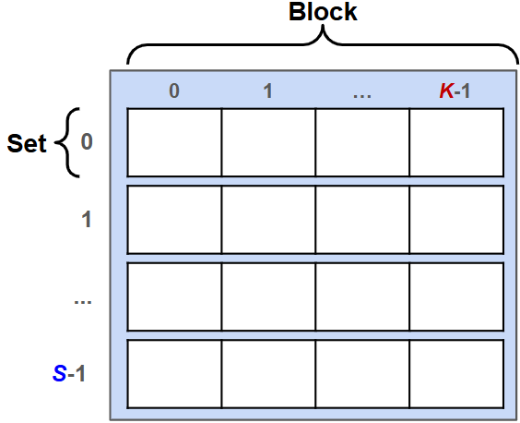
Reading Terminology Review
Cache Parameters
Block size (K)
Cache size (C bytes, or S sets)
Address fields
Block offset (k bits wide)
Block number (also called “block address”)
Index field (s bits wide)
Tag (t bits wide)
Notes:
Go through quickly - only talk about K, S, and C for now

Slide 11
Cache Organization: Block Size
Block Size (K): unit of transfer between cache and memory
Given in bytes and always a power of 2
Blocks are aligned and consist of adjacent bytes
Spatial locality!
Example: K = 4B
Notes:
Remember lab1a?

Slide 12
Cache Organization: Block Size (pt 2)
Given block size K:
Address ÷ K = block number (i.e. which block this address belongs to)
Address % K = block offset (i.e. where in the block this address is located)
Define k = log₂(K)
Lowest k bits of address tell us the block offset
Example: If we have 6-bit addresses and K = 4B, which block does address 0x15 belong to? What is its offset within that block?
Notes:
Remember within_same_block from lab1a!
Example: 0x15 = 0b00010101, remove 2 leading 0s to get 6-bit address. Lowest 2 bits = offset = 0b01 = 1. Remaining bits = block number = 0b0101 = 5

Slide 13
Cache Organization: Cache Size
Cache size (C) = how much data the cache can hold
Does not include any metadata
If size is (C) bytes, then the cache can hold C/K blocks
Ex: if C = 32KiB and K = 64B, then the cache can hold 512 blocks
Where should data go in the cache?
We need a mapping from memory addresses to specific locations in the cache to make checking the cache for an address fast
What data structure provides fast lookup?
Notes:
Hash Table!

Slide 14
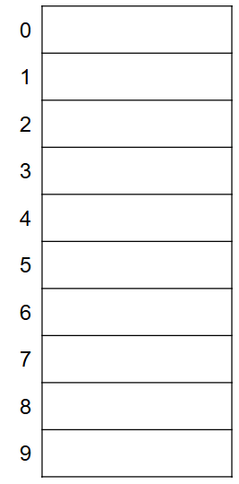
Hash Tables for Fast Lookup
Divide cache into “buckets” (sets)
Apply hash function to map each block to a set
What’s a simple hash function we can use?
Example: If we have 10 sets, what indices should each of these blocks go into?
5
27
34
102
Notes:
Modulo by number of sets. 5 goes in set 5, 27 in 7, 32 in 4, 102 in 2.
In base 10, % by ten means taking the lowest digit – easy!
In general, for a number in base b, % by b^n means taking the lowest n digits

Slide 15
Cache Organization: Sets
Number of sets (S) = cache size (C) ÷ block size (K)
Always a power of 2
Block number % S = set index (i.e. where in the cache this block goes
Define s = log₂(S)
Lowest s bits of the block number tell us the index
Notes:
Taking the lowest s bits of the block number is the same as % by 2^s

Slide 16
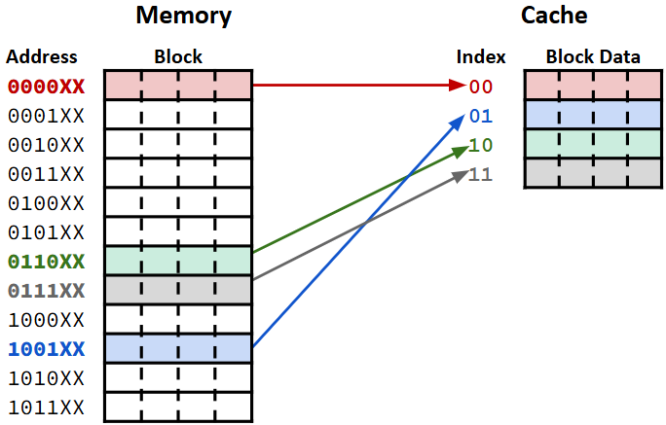
Memory and Cache Example
In this example:
K = 4B
S = 4
Map blocks to cache sets
Block# mod S = index
Notes:
XX in the addresses are offset bits (00, 01, 10, 11). Next two bits are index

Slide 17
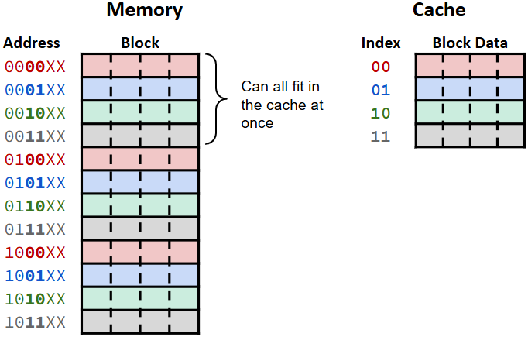
Memory and Cache Example (pt 2)
In this example:
K = 4B
S = 4
Map blocks to cache sets
Block# mod S = index
Adjacent blocks can fit into the cache at the same time!
Map to consecutive sets
Notes:
Block 0 maps to set 0, block 1 to set 1, block 2 to set 2, and block 3 to set 3.

Slide 18
Polling Question
6-bit addresses, block size K = 4 B, and our cache holds S = 4 blocks
The CPU requests data at address 0x2A.
Which index can this address be found in?
Which 3 other addresses can be found in the same block? (No Ed poll for this one)
Notes:
0x2A = 0b00101010, remove highest 2 bits to get 6-bit address = 0b101010
Lowest 2 bits = offset = 0b10 = 2
Remaining bits = block number = 0b1010
Lowest 2 bits of block number = index = 0b10 = 2
To find other addresses in the block, try all offset combinations with the same block number
0b101000 = 0x28
0b101001 = 0x29
0b101011 = 0x2B
Along with 0x2A, form a contiguous 4B block

Slide 19
Cache Organization: Sets and Tags
Problem: multiple blocks in memory will map to the same set
There will always be more blocks than sets because cache is smaller than memory
If we look in a set in the cache, how can we tell which block in memory it has?
Solution: store the remaining bits of the block number as a tag

Slide 20
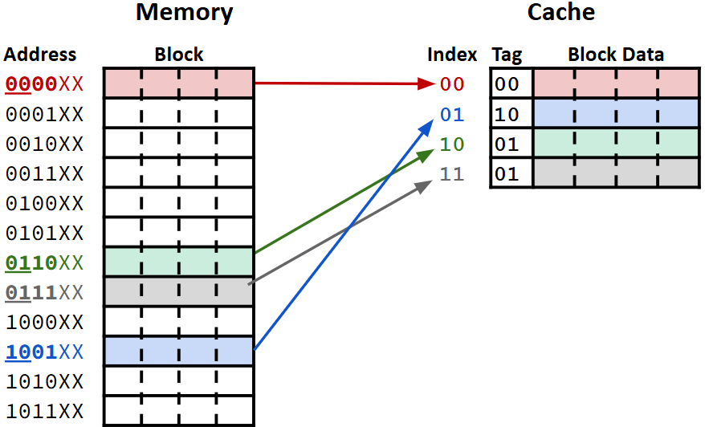
Memory and Cache Example (pt 3)
In this example:
K = 4B
S = 4
Save the tag in the cache along with the data block
All bits of the block# not used for the index

Slide 21
Memory and Cache Example (pt 4)
In this example:
K = 4B
S = 4
Save the tag in the cache along with the data block
All bits of the block# not used for the index
On lookup, check the tag to make sure we have the right block

Slide 22
Accessing Data
CPU requests a chunk of data at some address
Break address up into Tag, Index, and Offset
O = lowest k bits, I = next s bits, T = remaining bits
Check set I in the cache
If the tag matches T, return the data starting at offset O
Otherwise, load block from memory
Goes into set I, update tag to match
Then return the data at offset O

Slide 23
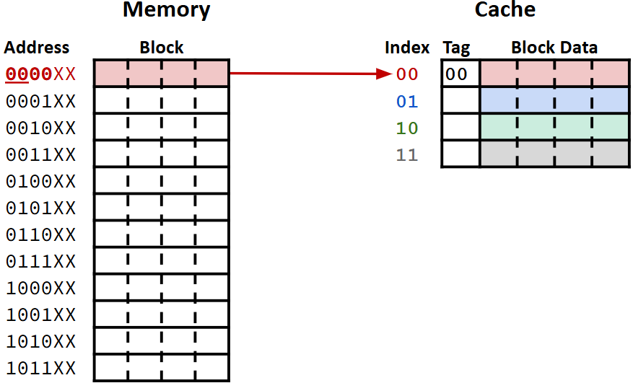
Accessing Data Example: Before
Block 0 already loaded into the cache
CPU requests 2B of data at address 0b010001
In this example:
K = 4B
S = 4
Notes:
“data 1” in block 0 and in cache set 0

Slide 24
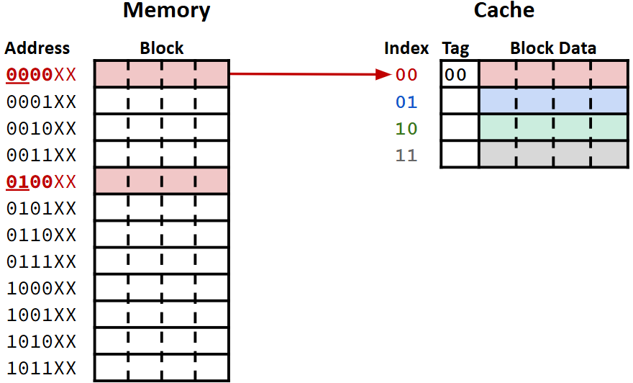
Accessing Data Example: T/I/O breakdown
k = 2, s = 2
CPU requests data at address 0b010001
T = 0b01
I = 0b00
O = 0b01
In this example:
K = 4B
S = 4
Notes:
“data1” in block 0 and cache set 0. “data2” in block 4

Slide 25
Accessing Data Example: Checking Set
T = 0b01, I = 0b00, O = 0b01
Set 0 has tag 00, doesn’t match
Cache miss!
In this example:
K = 4B
S = 4
Notes:
“data1” in block 0 and cache set 0. “data2” in block 4

Slide 26
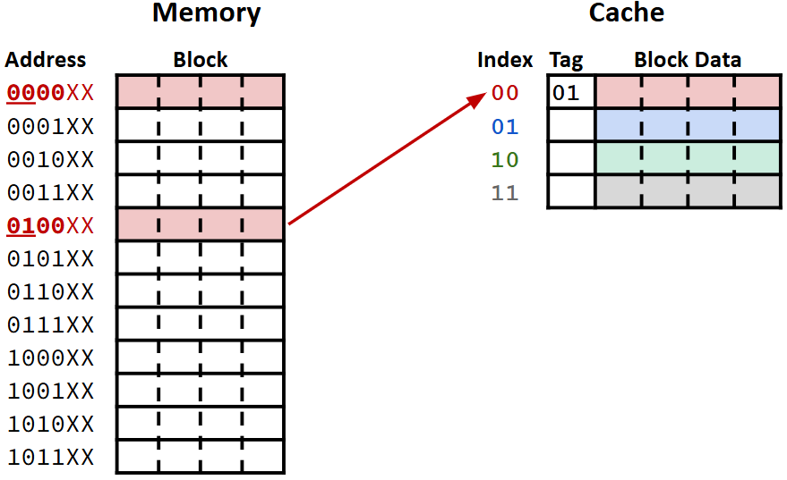
Accessing Data Example: Loading from Memory
T = 0b01, I = 0b00, O = 0b01
Store block 4 (0b0100) into the cache in set 0
Update Tag
In this example:
K = 4B
S = 4
Notes:
“data1” in block 0. “data2” in block 4 and cache set 0

Slide 27
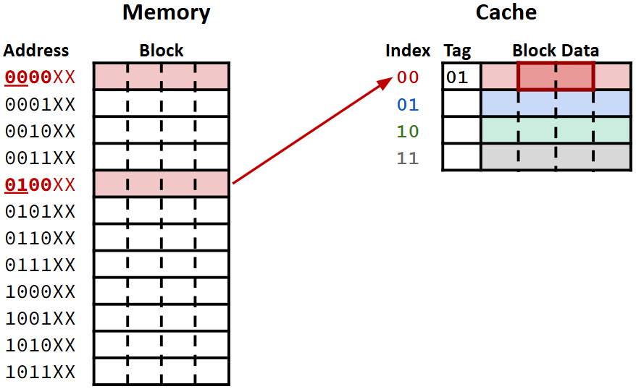
Accessing Data Example: Returning Data
T = 0b01, I = 0b00, O = 0b01
Return data starting at offset 1
In this example:
K = 4B
S = 4
Notes:
“data1” in block 0. “data2” in block 4 and cache set 0

Slide 28
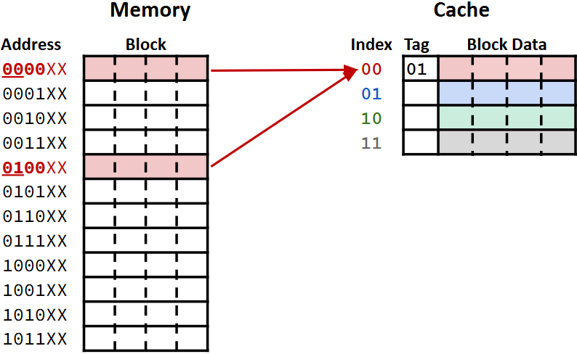
Collisions
Problem: multiple blocks map to the same set
Collision occurs when we try to load a block into a set that already has data
Evict the old block to make room
How can we fix this?
Next lecture!
Notes:
Repeated evictions between the same two blocks = thrashing

Slide 29
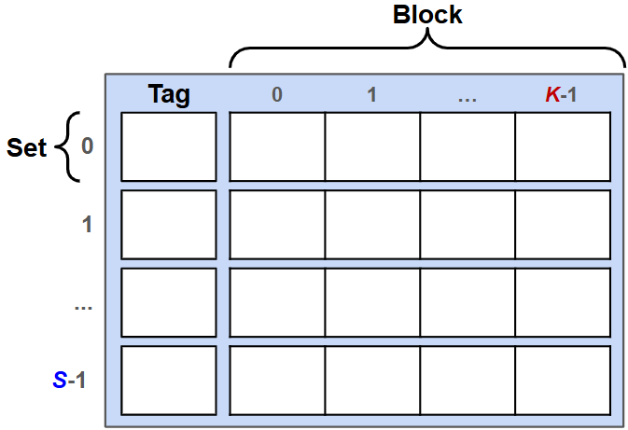
Summary: Cache Terminology
Memory is broken up into aligned blocks
Cache is broken up into sets
Each set holds one block (for now)
Store tag along with data block
Sets referenced by their index
Cache size = number of bytes of data the cache can hold
Number of sets * block size

Slide 30
Summary: Address Translation
Block size = K
k = log₂(K)
Cache size = C
Number of sets = S = C÷K
s = log₂(S)
Divide addresses (a) into fields
Offset = lowest k bits = a % K
Starting location within a block
Index = next s bits = (a÷K) % S
Which set the block is in
Tag = Remaining bits = (a÷K)÷S
Used to distinguish different blocks with the same index

