Slide 1
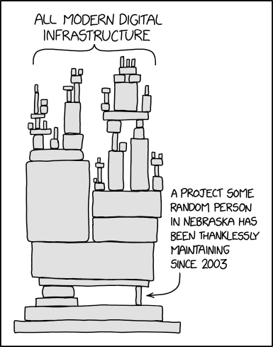
Caches I
CSE 351 Summer 2024
Instructor:
Ellis Haker
Teaching Assistants:
Naama Amiel
Micah Chang
Shananda Dokka
Nikolas McNamee
Jiawei Huang
Notes:
Image not really related to class content, but to recent tech news
Crowdstrike is a major cybersecurity company used by a lot of other businesses
Recent patch for Crowdstrike on windows introduced a bug
Windows servers had an outage, causing bug to occur during reboot
HUGE amounts of stuff shut down - including air traffic control towers, hospitals, etc.

Slide 2
Administrivia
Today
HW12 due (11:59pm)
Lab2 due (11:59pm)
Monday, 7/22
RD15 due (1pm)
HW13 due (11:59pm)
Quiz 2 released (11:59pm)
Same rules apply as Quiz 1
Wednesday, 7/24
RD16 due (1pm)
HW14 due (11:59pm)

Slide 3
Quiz 1 Grades Released!
Regrade requests will open tonight at 11:59pm
If you received a message about possible academic misconduct, please email me
And even though it’s cheesy…
Your success in life is not defined by grades
You are not defined by grades
We know it seems critically important right now, but we promise, the numbers on a transcript will fade with time.

Slide 4
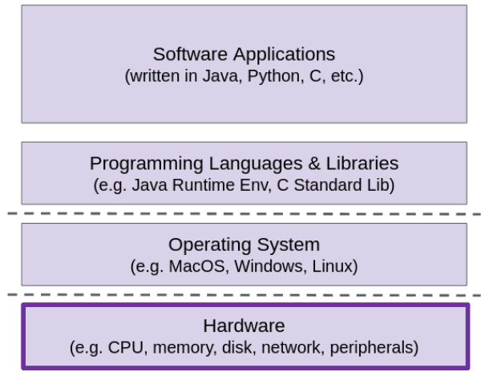
Topic Group 3: Scale & Coherence
How do we make memory accesses faster?
How do programs manage large amounts of memory?
How does your computer run multiple programs at once?
Starting with caches, which are implemented in hardware.

Slide 5
Aside: Units and Prefixes
Traditional prefixes represent powers of 10, we define new ones for base 2
Ex: 1 Kibibyte = 2¹⁰ bytes ≈ 10³ bytes = 1 Kilobyte
SI prefixes are ambiguous if base 10 or base 2 (does ‘k’ stand for kilo or kibi?)
IEC prefixes are unambiguously base 2
SI Symbol | SI Prefix | SI size | IEC symbol | IEC Prefix | IEC Size
K | Kilo- | 10³ | Ki | Kibi- | 2¹⁰
M | Mega- | 10⁶ | Mi | Mebi- | 2²⁰
G | Giga- | 10⁹ | Gi | Gibi- | 2³⁰
T | Tera- | 10¹² | Ti | Tebi- | 2⁴⁰
P | Peta- | 10¹⁵ | Pi | Pebi- | 2⁵⁰
E | Exa- | 10¹⁸ | Ei | Exbi- | 2⁶⁰
Z | Zetta- | 10²¹ | Zi | Zebi- | 2⁷⁰
Y | Yotta- | 10²⁴ | Yi | Yobi- | 2⁸⁰
Notes:
Example: kilo = 10^3 = 1000, kibi = 2^10 = 1024
People often say “kilo” when they mean”kibi”!

Slide 6
How to Remember?
You can always look it up :)
It’s on the midterm reference sheet
Mnemonics
Killer Mechanical Giraffe Teaches Pet Extinct Zebra to Yodel
Kirby Missed Ganondorf Terribly, Potentially Exterminating Zelda and Yoshi
From xkcd: Karl Marx Gave The Proletariat Eleven Zeppelins, Yo
https://xkcd.com/992/

Slide 7
Review Questions
Convert the following to or from IEC:
512 Mi-students
2³³ cats
Compute the average memory access time (AMAT) for a system with the following properties:
Hit time of 2 ns
Miss rate of 1%
Miss penalty of 300 ns
Notes:
a. Mi = 2^10, 512 = 2^9, so total is 2^9*2^20 = 2^29 students. B. 2^33 = 2^3 * 2^30 = 2^3 Gi-students = 8 Gi-students
AMAT = HT + MR*MP = 2ns + 0.01*300ns = 2ns + 3ns = 5ns

Slide 8
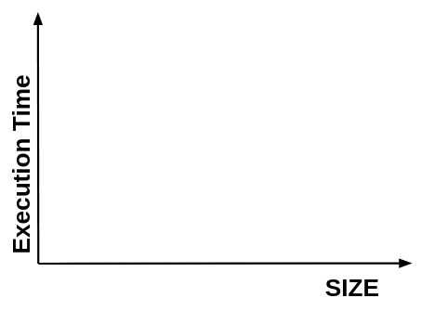
How does execution time grow with SIZE?
int array[SIZE];
int sum = 0;
for (int i = 0; i < 200000; i++) {
for (int j = 0; j < SIZE; j++) {
sum += array[j];
}
}
Notes:
Expected is a straight line, but actual data is not!

Slide 9
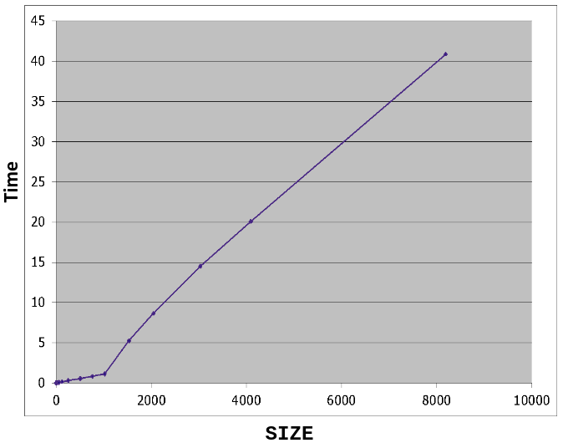
Actual Data
Notes:
Inflection point of the graph si where we exceed cache size

Slide 10
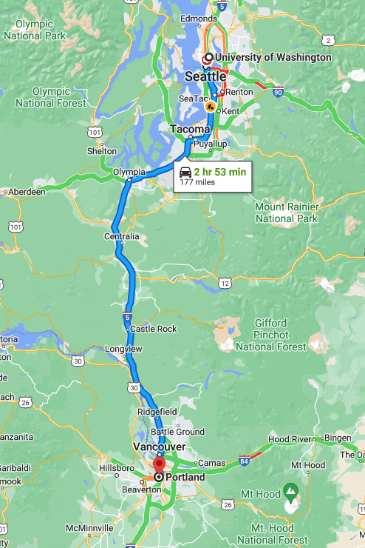
An Analogy

Slide 11
Caches
Cache basics
Principle of locality
Memory hierarchies
Cache organization
Program optimizations that consider caches

Slide 12
Problem: Processor-Memory Bottleneck
“Moore’s Law”
CPU Performance
55%/year
(2X/1.5yr)
Processor-Memory
Performance Gap (grows 50%/year)
DRAM
7%/year
(2X/10yr)
Notes:
Moore’s law died around 2002-2005, which is why we started doing multicore

Slide 13
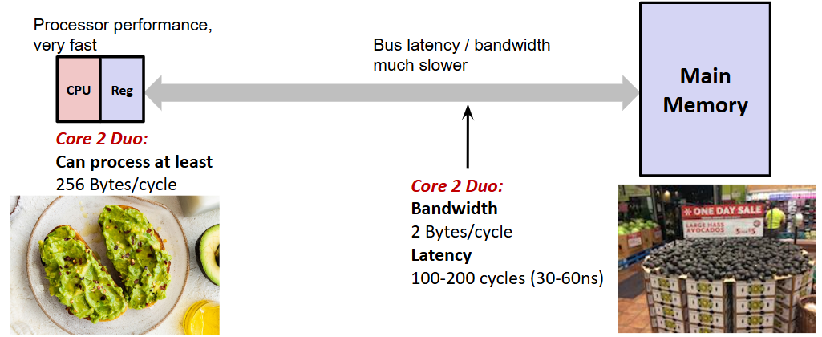
A Very Silly Analogy
Problem: memory is slow

Slide 14
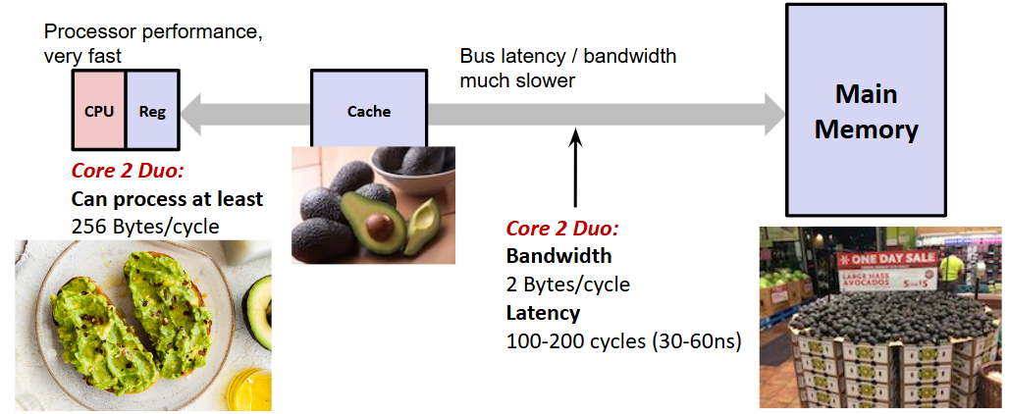
A Very Silly Analogy (pt 2)
Solution: caches!

Slide 15
Cache 💰
Pronounced “cash”
Often abbreviated to ‘$”
English: hidden storage space for provisions, weapons, or treasures
Computer: Memory with short access time used for the storage of frequently or recently used instructions or data
I-cache for instructions
d-cache for data
More generally: Used to optimize data transfers between any system elements with different characteristics (network interface cache, I/O cache, etc.)

Slide 16
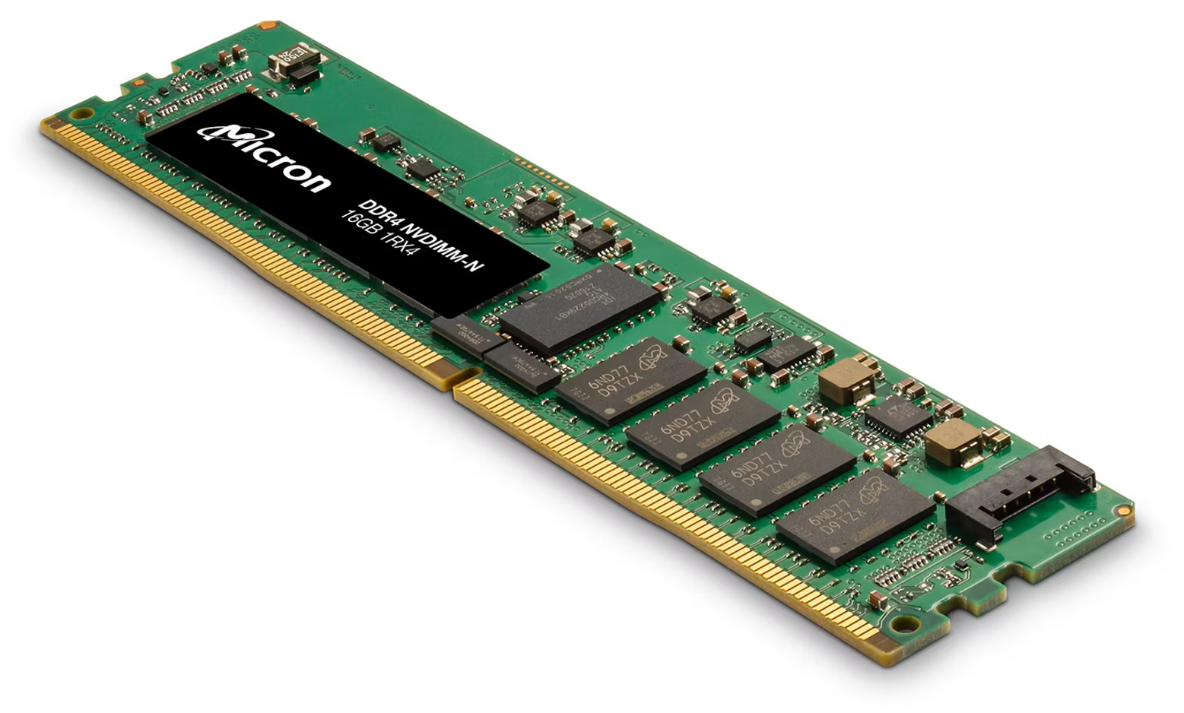
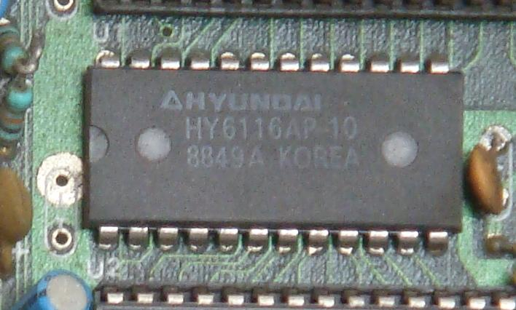
If caches are so much faster, why do we need memory?
Two common memory technologies
DRAM: high-capacity, cheap, energy efficient, but slow
SRAM: much faster, but less energy efficient and expensive
We can’t afford to have all our computer’s memory be SRAM
Use DRAM to provide large amounts of memory for cheap
Have a small SRAM cache for speed
SRAM
DRAM
Notes:
Other technologies exist too, but these are the most common right now

Slide 17
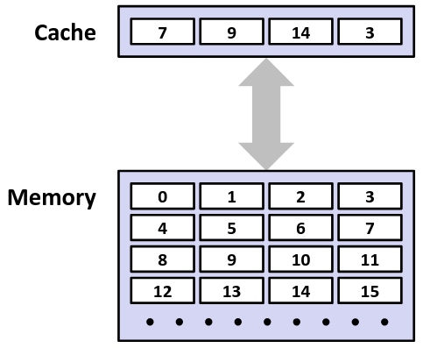
General Cache Mechanics
Memory
Slower, larger, cheaper
Partition into “blocks”
Cache
Smaller, faster, more expensive
Stores a subset of blocks from memory
Data is copied in block-sized chunks
Notes:
A box in this diagram represents a block, not a single byte

Slide 18
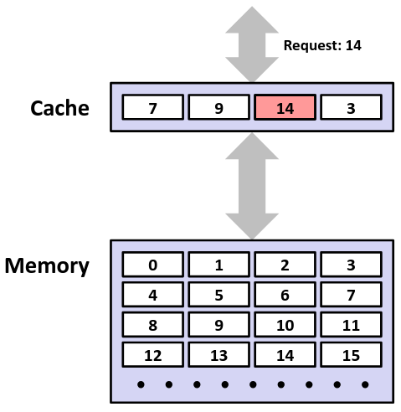
Cache Mechanics: Hit
Data we need is in block b
Block b is in the cache
Hit!
Data is returned to the CPU

Slide 19
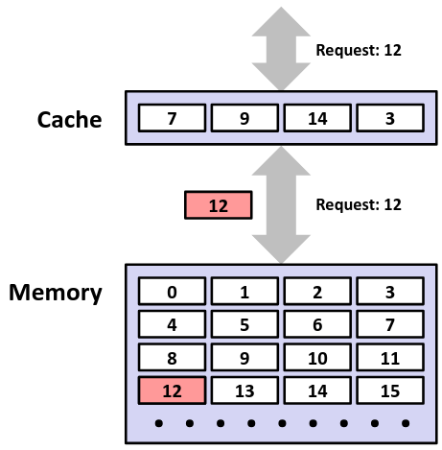
Cache Mechanics: Miss
Data we need is in block b
Block b is not in the cache already
Miss!
Block b is fetched from memory
Block b is written into the cache
Notes:
Rather than just reading from memory, we want to put it in the cache
Again, don’t just buy the one avocado, buy a bunch and store them

Slide 20
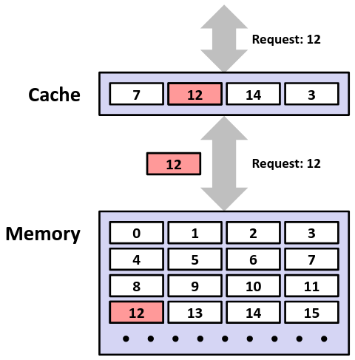
Cache Mechanics: Miss (pt 2)
Data we need is in block b
Block b is not in the cache already
Miss!
Block b is fetched from memory
Block b is written into the cache
Placement policy decides where it goes
Replacement policy decides what we kick out
Data is returned to the CPU
Notes:
Kicked out block 9

Slide 21
Why Caches Work
Takes advantage of locality
Common patterns in how programs access data
Temporal locality
If a program accesses data once, it’s likely to access it again
Spatial locality
If a program accesses some data, it’s likely to access other data that’s nearby in memory
How do caches take advantage of this?

Slide 22
Locality Example
sum = 0;
for (i = 0; i < n; i++) {
sum += a[i];
}
return sum;
Data
Temporal: sum, i, and n are accessed every loop iteration
Spacial: consecutive elements of a
Instructions
Temporal: loop body code
Instructions: instructions executed in sequence

Slide 23
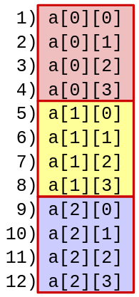
Locality Example 1
int sum_array_rows(int a[M][N])
{
int i, j, sum = 0;
for (i = 0; i < M; i++)
for (j = 0; j < N; j++)
sum += a[i][j];
return sum;
}
Access pattern:
Stride?
Notes:
Accesses adjacent elements in memory. Stride = 1
Good cache performance, Use entire block before moving on to the next

Slide 24
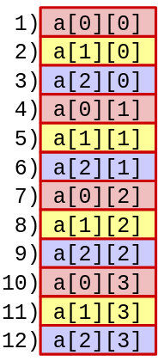
Locality Example 2
int sum_array_rows(int a[M][N])
{
int i, j, sum = 0;
for (j = 0; j < N; j++)
for (i = 0; i < M; i++)
sum += a[i][j];
return sum;
}
Access pattern:
Stride?
Notes:
Access the beginning of each row, then the next block of each row, etc. Stride = 4. Bad cache performance ☹

Slide 25
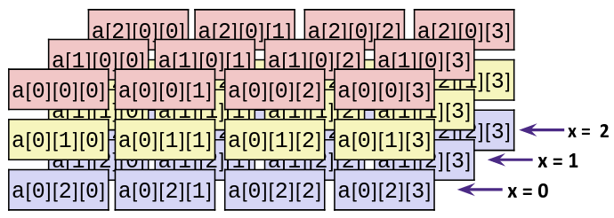
Locality Example 3
int sum_array_3D(int a[X][Y][Z])
{
int i, j, k, sum = 0;
for (i = 0; i < Y; i++)
for (j = 0; j < Z; j++)
for (k = 0; k < X; k++)
sum += a[k][i][j];
return sum;
}
Access pattern:
Notes:
Access a[0][0][0], a[1][0][0], etc. Really bad cache performance!

Slide 26
Cache Performance Metrics
Miss Rate (MR)
Fraction of memory references not found in cache
(misses / accesses) = 1 - Hit Rate
Hit Time (HT)
Time to deliver a block in the cache to the processor
Includes time to determine whether the block is in the cache
Miss Penalty (MP)
Additional time required because of a miss
Total miss time = Hit Time + Miss Penalty

Slide 27
Cache Performance
Average Memory Access Time (AMAT): average time to access data, considering both cache hits and misses
AMAT = Hit time + Miss Rate × Miss Penalty
(abbreviated AMAT = HT + MR×MP)
Notes:
Each access has 100% chance of incurring HT and MR chance of incurring MP

Slide 28
Practice Questions
Processor specs: 200 ps clock, MP of 50 clock cycles, MR of 0.02 misses/instruction, and HT of 1 clock cycle
What is the AMAT (in clock cycles)?
Which of these improvements would result in the lowest AMAT?
190 ps clock
Miss penalty of 40 clock cycles
Miss rate of 0.015 misses/instruction
Notes:
Clock cycle = amount of time for CPU to do 1 task
HT + MR*MP = 1 + 0.02*50 = 1+1 = 2 cycles. 2 cycles * 200 ps/cycle = 400 ps
A) same number of cycles -> 2 cycles * 190 ps/cycle = 380 ps
B) 1 + 0.02*40 = 1.8 cycles * 200 ps/cycle = 360 ps
C) 1 + 0.015*50 = 1.75 cycles * 200 ps/cycle = 350 ps

Slide 29
Cache Performance (pt 2)
Misses have a much larger effect on AMAT than hits!
Going to memory could be 100x slower than accessing the cache (measured in clock cycles)
High miss rate or miss penalty hurt AMAT the most
Ex: Assume HT of 1 clock cycle and MP of 100 clock cycles
If HR = 99%, AMAT = _____
If HR = 97%, AMAT = _____
Increasing hit rate by only 2% cut acces time in half!
Notes:
MR = 1-HR
If HR=99%, MR=1%=0.01, 1 + 0.01*100 = 2 cycles
If HR=97%, MR=3%=0.03, 1 + 0.03*100 = 4 cycles

Slide 30
Can we have more than one cache? Yes!
Why would we want to do that?
Avoid going to memory at all costs!
Typical performance numbers
Miss Rate
L1: 3-10%
L2: very small (likely <1%)
Hit Time
L1: 4 clock cycles
L2: 10 clock cycles
Miss Penalty
50-200 cycles for missing in L2 going to main memory)
Trend: increasing!
Notes:
These numbers are outdated! Trade secrets

Slide 31
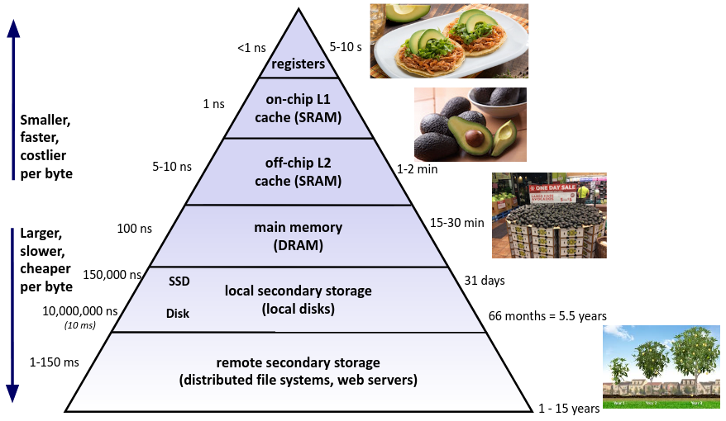
An Example Memory Hierarchy

Slide 32
Learning About Your Machine
Linux:
lscpu
ls /sys/devices/system/cpu/cpu0/cache/index0/
Example: cat /sys/devices/system/cpu/cpu0/cache/index*/size
Windows:
wmic memcache get <query> (all values in KB)
Example: wmic memcache get MaxCacheSize
Modern processor specs: http://www.7-cpu.com/

Slide 33
Summary
Memory Hierarchy
Higher levels are faster, smaller, and more expensive
Contain the most used data from lower levels
Exploits temporal and spatial locality
Caches are intermediate levels between memory and the CPU
Cache Performance
Ideal case: data found in cache (hit)
Bad case: not found in cache (miss), go to next level in hierarchy
Average Memory Access Time (AMAT) = HT + MR × MP
Hurt my high miss rate and miss penalty

