Slide 1
Buffer Overflow
CSE 351 Summer 2024
Instructor:
Ellis Haker
Teaching Assistants:
Naama Amiel
Micah Chang
Shananda Dokka
Nikolas McNamee
Jiawei Huang

Slide 2
Administrivia
Today:
HW11 due (11:59pm)
Mid-Quarter Survey due (11:59pm)
Lab3 released! (due next Friday, 7/26)
Friday, 7/19
RD14 due (1pm)
HW12 due (11:59pm)
Lab2 due (11:59pm)
Reminder: weekend counts as 1 late day
Quiz 2 released on Monday

Slide 3
TA Applications are Open!
Apply by Monday, 7/22 to TA for Fall
https://www.cs.washington.edu/students/ta
Same application for all CSE classes (besides intro)
You are eligible to TA for 351 next quarter!
If interested, please also contact Ruth Anderson to let her know you’re interested

Slide 4
Lecture Topics
Memory Layout Review
Buffer overflow
Input buffers on the stack
Overflow attacks and code injection
Exploits Based on Buffer Overflows
Defenses against buffer overflow
Societal Impact

Slide 5
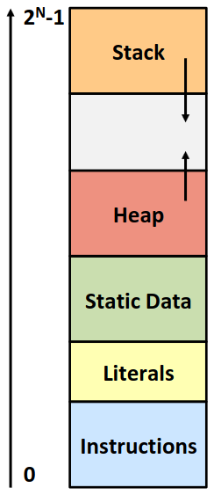
Review: Memory Layout
Stack
Local variables, procedure context
Heap
Dynamically allocated using malloc()
Future lecture topic!
Statically-allocated data
Read/write: Static Data
Read-only: Literals
Instructions
Machine code
Read-only
Notes:
Static data = global vars, etc.
Literals = string literals, etc.
Focusing on stack and instructions today

Slide 6
Memory Allocation Example
char* str = “hello!”;
int main() {
void *p1;
int local = 0;
p1 = malloc(1L << 28); /* 256 MB */
/* Some other code ... */
}
Where does everything go?
Notes:
Malloc(n) allocates n bytes on the heap, returns a pointer to it
P1 and local go on stack
Malloc makes data on heap, p1 in the stack points to it
Str goes in static data
String “hello!” goes in literals, str in static data points to it
Code for main goes in instructions

Slide 7
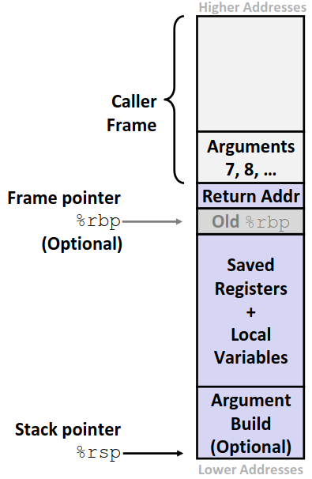
Review: x86 Stack Frame
Caller’s stack frame
Arguments 7+ for this call
Current stack frame
Return address pushed by call instruction
Old frame pointer (optional)
Local data
Callee-saved registers pushed before using
Caller-saved registers pushed before calling another function
Argument build = arguments 7+ for the next function
Notes:
Old %rbp used in labs
Local arrays go in local variables section, a[0] at lowest address (closer to the argument build), and a[n-1] at highest (closer to return addr)

Slide 8
Lecture Topics
Memory Layout Review
Buffer overflow
Input buffers on the stack
Overflow attacks and code injection
Exploits Based on Buffer Overflows
Defenses against buffer overflow
Societal Impact

Slide 9
What is a Buffer?
An array used to temporarily store data
Typically some input or output
Example: you’ve probably seen “video buffering”
Video data from the internet is written to a buffer before being played

Slide 10
Buffer Overflow in a Nutshell
C does not check array bounds
Buffer Overflow = writing past the end of an array
Characteristics of the Linux memory layout provide opportunities for malicious programs
Stack grows “backwards” in memory
Stack used for both data and control flow (return addresses)
Data and instructions both stored in memory

Slide 11
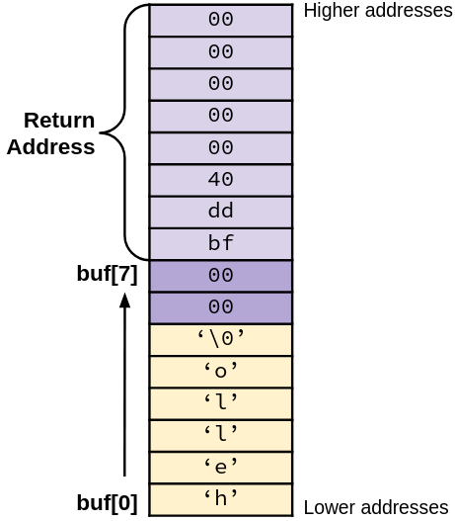
Buffer Overflow in a Nutshell (pt 2)
Stack grows down towards lower addresses
Buffer grows up towards higher addresses
Result: if we overflow a buffer on the stack, we will overwrite other data!
Example:
Enter input: hello
No overflow :)

Slide 12
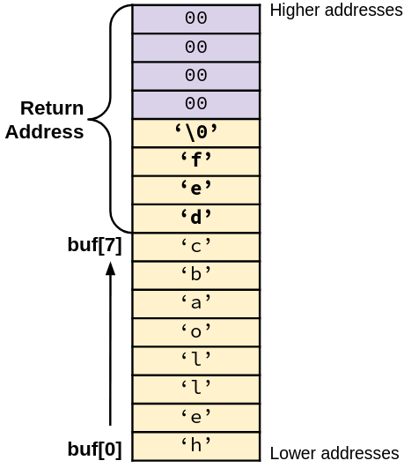
Buffer Overflow in a Nutshell (pt 3)
Stack grows down towards lower addresses
Buffer grows up towards higher addresses
Result: if we overflow a buffer on the stack, we will overwrite other data!
Example:
Enter input: helloabcdef
Buffer overflow :(

Slide 13
Buffer Overflow in a Nutshell (pt 4)
Buffer overflows on the stack can overwrite important data
e.g., the return address
A clever attacker can use this to their advantage
Simplest form is stack smashing
Overwrite return address to change how a program runs
More complex forms include code injection
Attacker can cause a program to run their own code!
Why is this a big deal?
One of the most common technical causes of security vulnerabilities
Social engineering is more common than any technical cause

Slide 14
String Library Code
Implementation of Unix function gets()
/* Get string from stdin */
char* gets(char* dest) {
int c = getchar();
char* p = dest;
while (c != EOF && c != '\n') {
*p++ = c;
c = getchar();
}
*p = '\0';
return dest;
}
What could go wrong with this code?
Notes:
Similar to Java’s System.in.next()
Gets input from user, stores at dest. Expects dest to point to an allocated array of char.

Slide 15
String Library Code (pt 2)
Implementation of Unix function gets()
What if the function reads in more data than we have space for in dest?
Similar problem in other standard library functions
strcpy()
scanf(), if given a %s specifier
/* Get string from stdin */
char* gets(char* dest) {
int c = getchar();
char* p = dest;
while (c != EOF && c != '\n') {
*p++ = c;
c = getchar();
}
*p = '\0';
return dest;
}
Notes:
Remember from arrays lecture – need to pass in size as an argument.

Slide 16
Vulnerable Buffer Code
/* Echo Line */
void echo() {
char buf[8]; // Way too small!
printf(“Enter string: ”);
gets(buf);
puts(buf);
}
gets() writes from stdin to buf
puts() writes from buf to stdout
What happens if gets() writes past the end of buf?
unix:~$ ./run_echo
Enter string: 123456789012345
123456789012345
void call_echo() {
echo();
}
unix:~$ ./run_echo
Enter string: 1234567890123456
Segmentation fault (core dumped)
Notes:
Undefined behavior!

Slide 17
Vulnerable Buffer Code Disassembly
0000000000401146 <echo>:
401146: 48 83 ec 18 sub $0x18,%rsp
... ... # calls printf
401159: 48 8d 7c 24 08 lea 0x8(%rsp),%rdi
40115e: b8 00 00 00 00 mov $0x0,%eax
401163: e8 e8 fe ff ff callq 401050 <gets@plt>
401168: 48 8d 7c 24 08 lea 0x8(%rsp),%rdi
40116d: e8 be fe ff ff callq 401030 <puts@plt>
401172: 48 83 c4 18 add $0x18,%rsp
401176: c3 retq
0000000000401177 <call_echo>:
401177: 48 83 ec 08 sub $0x8,%rsp
40117b: b8 00 00 00 00 mov $0x0,%eax
401180: e8 c1 ff ff ff callq 401146 <echo>
401185: 48 83 c4 08 add $0x8,%rsp
401189: c3 retq
Return address
Notes:
0x18 = 24. First instruction subtracts from rsp = makes 24B of space on the stack
Lea sets arg for gets (%rdi) at address %rsp+8

Slide 18
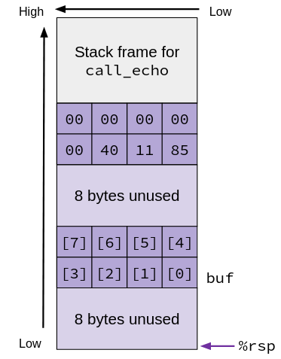
Vulnerable Code Stack (before gets())
echo:
subq $0x18,%rsp
...
leaq 0x8(%rsp),%rdi
...
call gets
...
addq $0x18,%rsp
retq
void echo() {
char buf[8];
. . .
gets(buf);
. . .
}
call_echo:
...
401180: call echo
401185: addq $0x8,%rsp
...
Notes:
8 bytes right after the stack frame for call_echo = return address
- Litte endian machine because LSB of return address is at lowest address in that block of data
24B allocated after that
Buf = %rdi, starts 8B into the stack

Slide 19
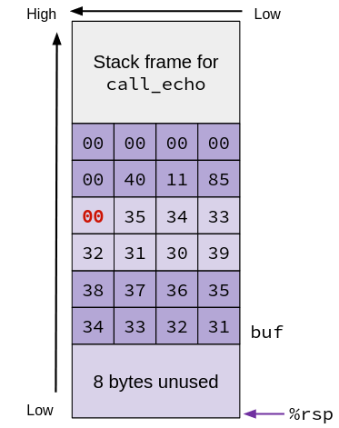
Example #1 (after gets())
echo:
subq $0x18,%rsp
...
leaq 0x8(%rsp),%rdi
...
call gets
...
addq $0x18,%rsp
retq
void echo() {
char buf[8];
. . .
gets(buf);
. . .
}
Every digit N has the ASCII 0x3N
unix:~$ ./run_echo
Enter string: 123456789012345
123456789012345
Overflowed buffer, but didn’t corrupt important data
Notes:
So 0x31 = ‘1’, 0x32 = ‘2’, etc.
0x00 is the null terminator

Slide 20
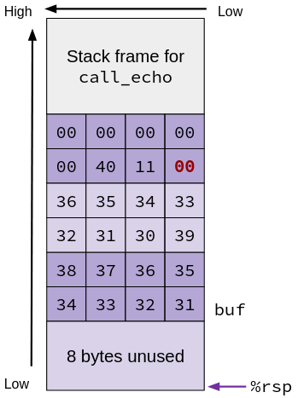
Example #2 (after gets())
echo:
subq $0x18,%rsp
...
leaq 0x8(%rsp),%rdi
...
call gets
...
addq $0x18,%rsp
retq
void echo() {
char buf[8];
. . .
gets(buf);
. . .
}
unix:~$ ./run_echo
Enter string: 1234567890123456
Segmentation fault (core dumped)
Overwrote the return address!
Notes:
After addq, %rsp points to return address.
On return, CPU tries to find next isntruction at address 0x401100!

Slide 21
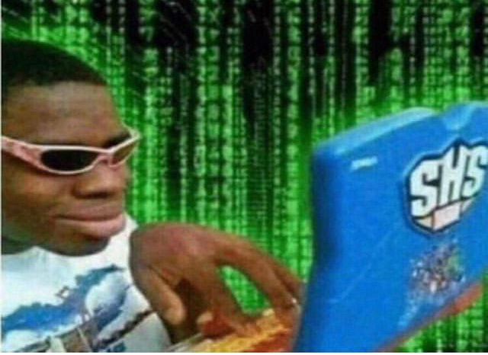
Attack Time

Slide 22
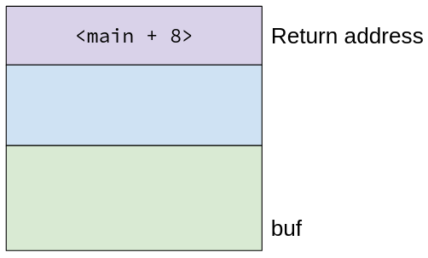
Buffer Overflow Attacks: Stack Smashing
Simpler attack
Overwrite the return address
Usually execute another function in instruction memory
Notes:
Lab2 phase 0
Ex: say there’s some other function in this program, called foo, that we want to execute

Slide 23
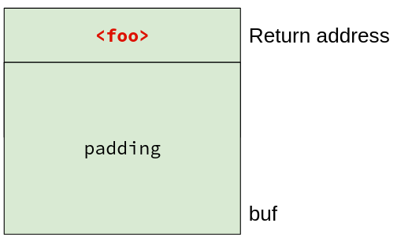
Buffer Overflow Attacks: Stack Smashing (pt 2)
Simplest common attack
Overwrite the return address
Usually execute another function in instruction memory
Enter string: <padding><foo>
Notes:
On return, executes foo

Slide 24
Buffer Overflow Attacks: Code Injection
Allows attacker to execute arbitrary code on victim machine!
Write byte code into the buffer, then overwrite the return address to point to that code
Notes:
Lab3 phase 2

Slide 25
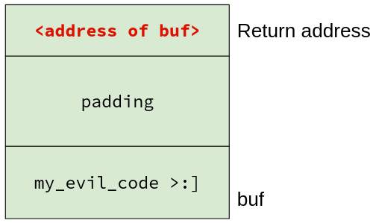
Buffer Overflow Attacks: Code Injection (pt 2)
Allows attacker to execute arbitrary code on victim machine!
Write byte code into the buffer, then overwrite the return address to point to that code
When current function returns, it will execute the code you put in the buffer!
Enter string: <evil_code><padding>
<address of buf>
Notes:
Most common thing to do is to execute a root shell. From there, you can do whatever you want

Slide 26
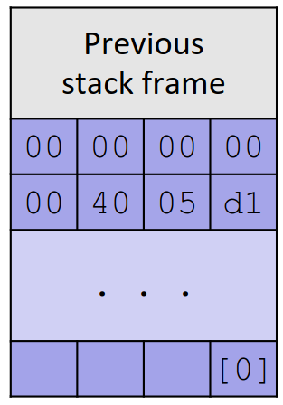
Practice Question
buggy is vulnerable to stack smashing!
What is the minimum number of characters that gets must read in order for us to change the return address to a stack address?
(for example: 0x00 00 7f ff ca fe f0 0d)
27
20
51
54
buggy:
subq $0x40, %rsp
...
leaq 16(%rsp), %rdi
call gets
...
Notes:
Overwrite d1 to 0d, 05 to f0, etc.
Subq makes 64B of stack space
Leaq means that buffer starts 16B into stack
Don’t need to write in the leading 0s of the address bc they’re already 0 in memory – write 6B of ret addr
Total = 64-16+6=54B

Slide 27
Lecture Topics
Memory Layout Review
Buffer overflow
Input buffers on the stack
Overflow attacks and code injection
Exploits Based on Buffer Overflows
Defenses against buffer overflow
Societal Impact

Slide 28
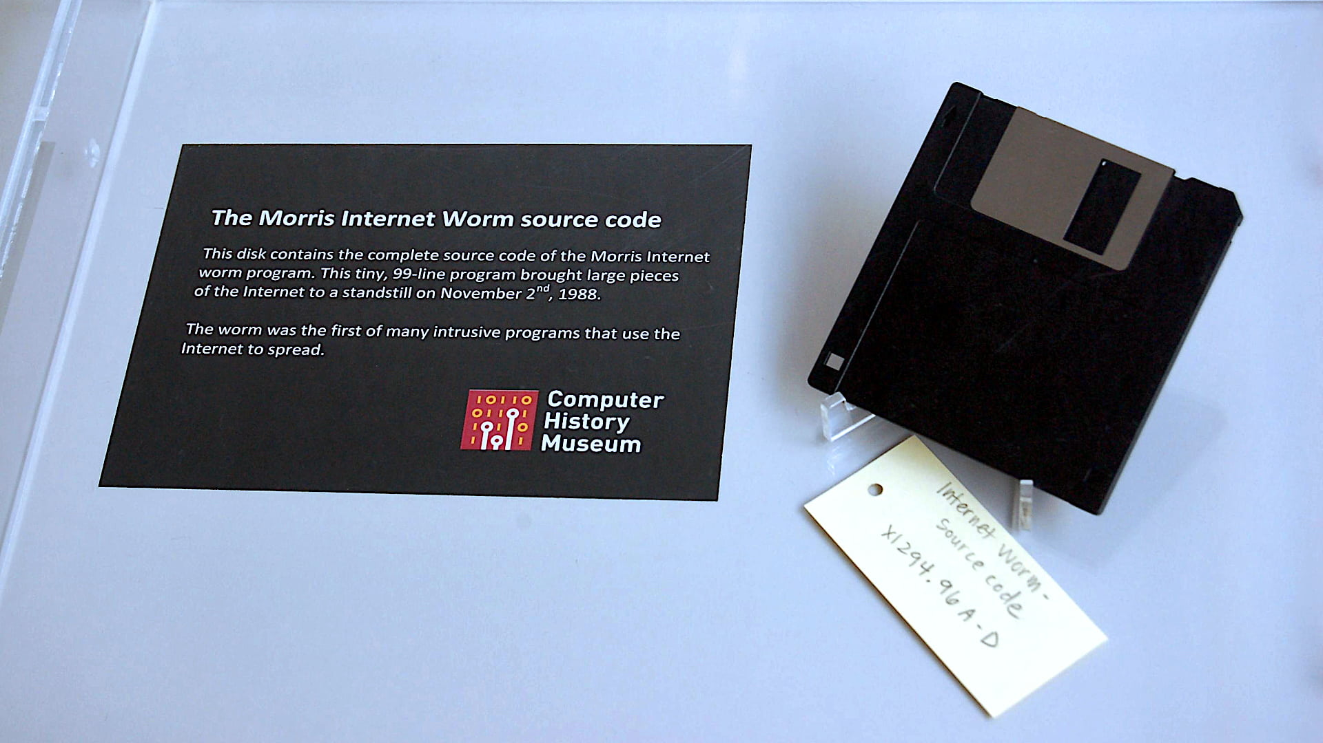
Morris Worm (1988)
First ever internet worm
Exploited finger server (fingerd), used gets to read the argument sent by the client
Attacked fingerd server with phony argument:
Ex: finger "exploit-code padding new-return-addr"
Invaded ~6000 computers in hours (10% of the internet)
The author, Robert Morris, was prosecuted
First conviction under 1986 Computer Fraud and Abuse Act
Now an MIT professor…

Slide 29
Heardbleed (2014)

Slide 30
Heardbleed (2014) (pt 2)

Slide 31
Heardbleed (2014) (pt 3)

Slide 32
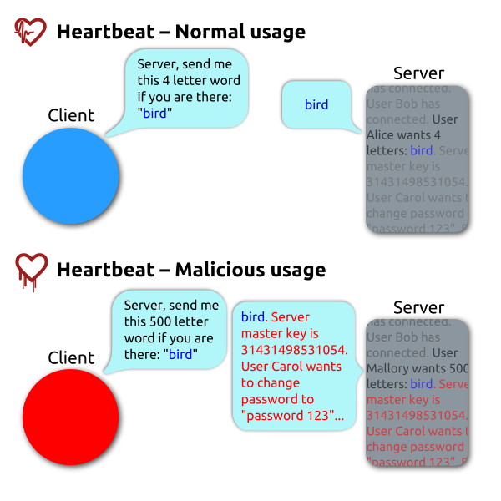
Heartbleed Explained
Exploited vulnerability in OpenSSL
Open-source security library
“Heartbeat” packet: message and length
Server echos message back
Trusted the given length!
Allowed attackers to read contents of memory
~17% of the internet affected
GitHub, Yahoo, Amazon Web Services, etc.
By FenixFeather - Own work, CC BY-SA 3.0,
https://commons.wikimedia.org/w/index.php?curid=32276981

Slide 33
Lecture Topics
Memory Layout Review
Buffer overflow
Input buffers on the stack
Overflow attacks and code injection
Exploits Based on Buffer Overflows
Defenses against buffer overflow
Societal Impact

Slide 34
System-Level Protections
Non-executable memory segments
In traditional x86, only “read” and “write” permissions, could execute anything
x86-64 added “execute” permissions
Only instruction memory marked executable
Attempting to execute non-executable memory will cause a segfault
Randomized stack offsets
At start of program, allocate a random amount of stack space
Shifts addresses for the rest of the program
Addresses will be different every time it’s run
Pros: automatic (programmer doesn’t have to do anything)
Cons: requires hardware support, doesn’t stop all attacks (e.g., return to libc)

Slide 35
Compiler-Level Protections
Stack canaries
Place special value (“canary”) in the stack just beyond the buffer
Check value for corruptio before exiting function
GCC implementation: -fstack-protector
Pros:
Easy to implement
Cons:
Only detects errors, doesn’t stop them
Slow
unix:~$ ./run_echo
Enter string: 12345678
12345678
unix:~$ ./run_echo
Enter string: 123456789
*** stack smashing detected ***
Notes:
Canary goes in between buffer and return address. Has to overwrite canary to get to ret addr

Slide 36
Programmer-Level Protections
Avoid using unsafe standard library functions
gets(), strcpy(), etc.
No way to pass in array size!
Most have been replaced with safer alternatives (fgets(), strncpy(), etc.)
Don’t use scanf()with a %s conversion specifier
Use fgets() to read the string
Use %ns (where n is the max size you can read in not including the null-terminator)
Keep track of array bounds
Define macros for array sizes
Watch out for off-by-1 errors and integer overflow

Slide 37
Programmer-Level Protections (pt 2)
Alternatively, use another language that does array index bounds check
Most modern languages check at runtime
What if I need a low-level systems language?
Rust is a systems language designed with security in mind
Does compile-time array bounds checking
Not always possible, some projects are better suited for C
Notes:
This is a big reason why C is not used as much as it used to be!
Primarily used for systems, but Rust is starting to become a real thing in that space

Slide 38
Lecture Topics
Memory Layout Review
Buffer overflow
Input buffers on the stack
Overflow attacks and code injection
Exploits Based on Buffer Overflows
Defenses against buffer overflow
Societal Impact

Slide 39
Discussion
Take a few minutes to think about the question, and then share your thoughts with the class.
Although it’s not as common as it once was, C is still the default language in certain areas of the industry (operating systems, embedded systems, etc.).
Why do we still use C if it’s so insecure?
What benefits are there to using C?
What kinds of things does C allow us to do that we can’t do in other languages?
What might dissuade developers from using another language?

Slide 40
Security vs. Functionality
Not always mutually exclusive, but often in tension
“The only system which is truly secure is one which is switched off and unplugged locked in a titanium lined safe, buried in a concrete bunker, and is surrounded by nerve gas and very highly paid armed guards. Even then, I wouldn't stake my life on it.” -Gene Stafford
Many things we do in systems programming use C features like pointer casting etc.
Even Rust has “unsafe”!
Security checks incur overhead
Notes:
Unsafe is necessary if writing os code

Slide 41
Two Narratives in C
“I think programmers should know enough to not access array elements out of bounds. It’s a relatively simple check to insert at the language level, and if you can’t remember to add it, you shouldn’t write C.”
Emphasis on the individual
“C is an absolutely awful language; why on earth doesn’t it implement bounds checking? It’s an expense, but a relatively nominal one, and the language would be so much easier to use.”
Emphasis on structures

Slide 42
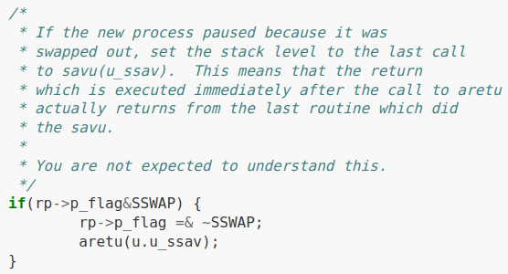
Accessibility and Computer Science
Is C accessible?
“C is good for two things: being beautiful and creating catastrophic day-0s in memory management.”
Unix 6th Edition Source Code
Is programming accessible?
A notoriously difficult task to do correctly (even for experts!)
Ideological foundations tend to over-emphasize individuals
You know how to program. What now?
Notes:
Notice “you are not expected to understand this”

Slide 43
Discussion (pt 2)
Discuss the following questions in groups of 2-4. Then we’ll share as a class.
What do you think of when you hear the word “hacker”? Where did your beliefs about hacking come from?
What are some of the possible consequences & objectives of hacking (i.e., to what ends might someone engage in hacking)?

Slide 44
What is a “hacker”?
Very different from what you see in the movies!
Real hacking is much more tedious
Stereotype is a single (usually male) person
Emphasizes “rugged individualism”
Plays into dominant narratives about who programmers are
Romanticizes crime (though “ethical hacking” does exist)
Where do these stereotypes come from?

Slide 45
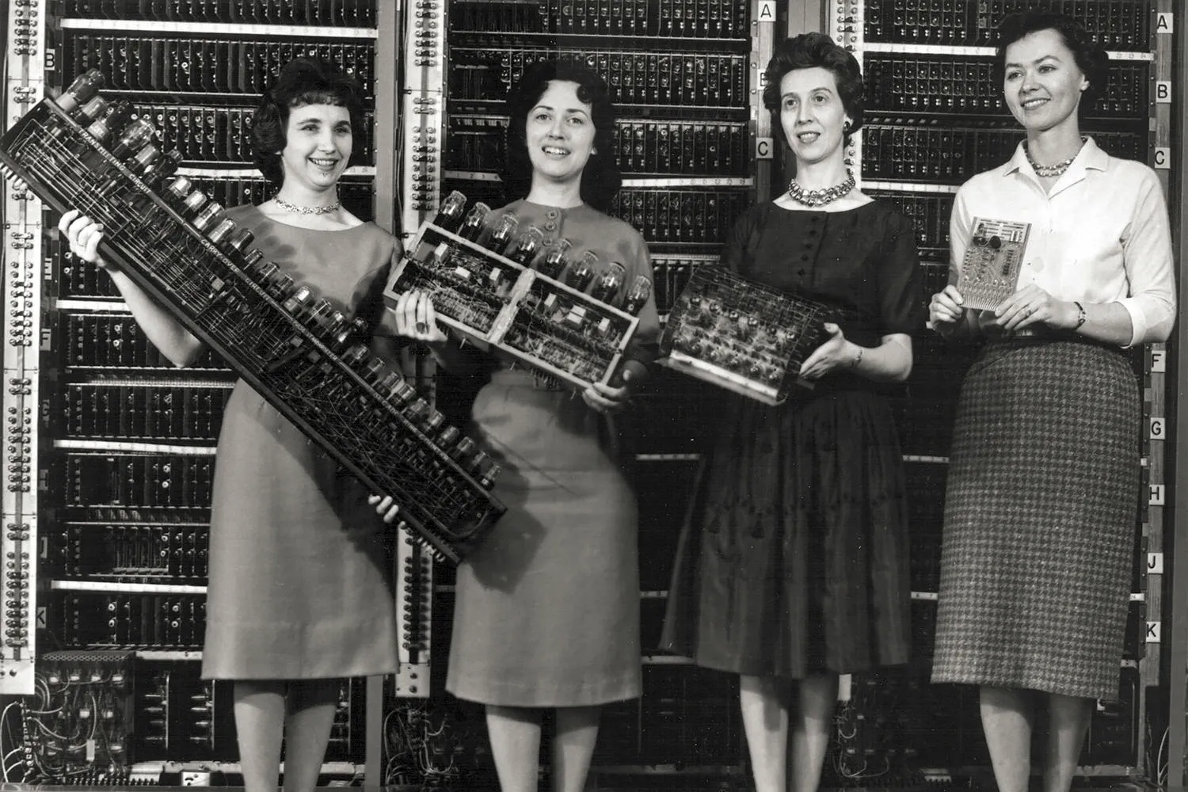
Some history
Programming used to be thought of as “women’s work”
Played into gender stereotypes: tedious, detail-
oriented work
So what changed?
Between the 1960s-80s, computing culture shifted
Focus on individualism
Competition (think hackathons, etc.)
Higher barriers to entry (specialized CS degrees)
These stereotypes were pushed to turn programing into a “legitimate” science
The “hacker” stereotype was a part of this cultural shift!

Slide 46
Think this is cool?
You’ll love Lab 3 :)
Take CSE 484 (Security)
1st lab is a more in-depth version of Lab 3
More examples in bonus slides
Talk to Tadayoshi Kohno or Franzi Roesner if you want to know more about these
Optional readings on Ed
Nintendo fun!
Flappy bird in Mario: https://www.youtube.com/watch?v=hB6eY73sLV0
Notes:
Please watch the video

Slide 47
BONUS SLIDES
You won’t be tested on this material, but it’s interesting nonetheless :)

Slide 48
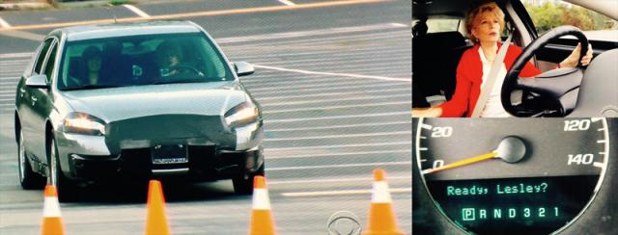
Hacking Cars (2010)
UW CSE research demonstrated wirelessly hacking a car using buffer overflow
http://www.autosec.org/pubs/cars-oakland2010.pdf
Overwrote the onboard control system’s code
Disable brakes, unlock doors, turn engine on/off

Slide 49
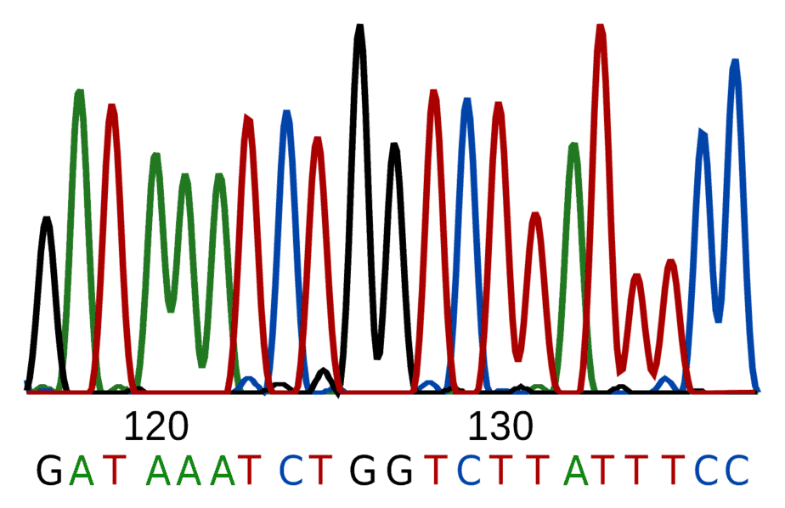
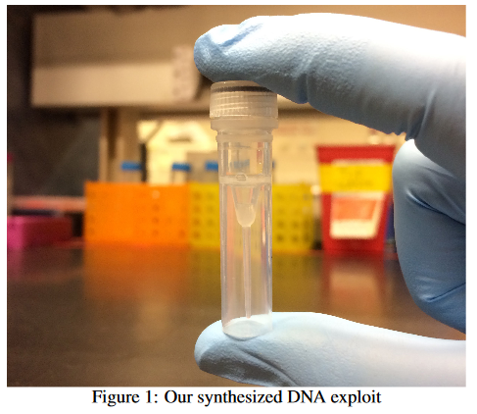
Hacking DNA Sequencing Tech (2017)
Computer Security and Privacy in DNA Sequencing
Paul G. Allen School of Computer Science & Engineering, University of Washington
DNA Sequencer reads in DNA, encodes in binary, stores in a buffer
Potential for malicious code to be encoded in DNA!
Attacker can gain control of DNA sequencing machine when malicious DNA is read
Ney et al. (2017): https://dnasec.cs.washington.edu/

