Slide 1
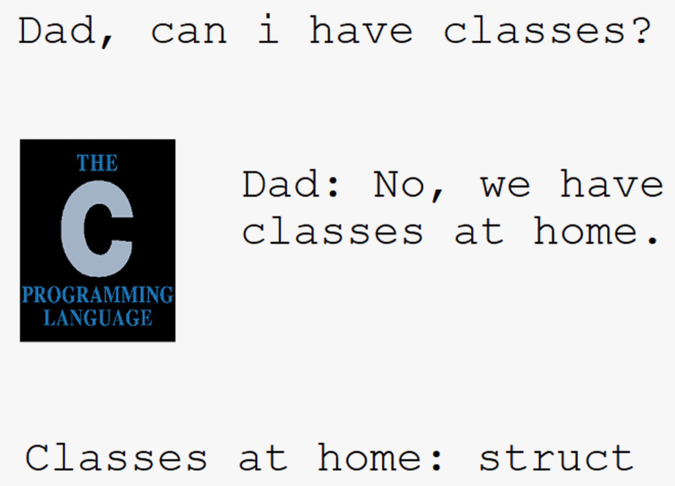
Arrays, Structs & Alignment
CSE 351 Summer 2024
Instructor:
Ellis Haker
Teaching Assistants:
Naama Amiel
Micah Chang
Shananda Dokka
Nikolas McNamee
Jiawei Huang

Slide 2
Administrivia
Today
HW10 due (11:59pm)
Mid-Quarter Survey out on Canvas
Part of your participation grade
Wednesday, 7/17
RD13 due (1pm)
HW11 due (11:59pm)
Mid-Quarter Survey due (11:59pm)
Friday, 7/19
RD14 due (1pm)
HW12 due (11:59pm)
Lab2 due (11:59pm)
Quiz 2 starts next Monday!
Due the following week

Slide 3
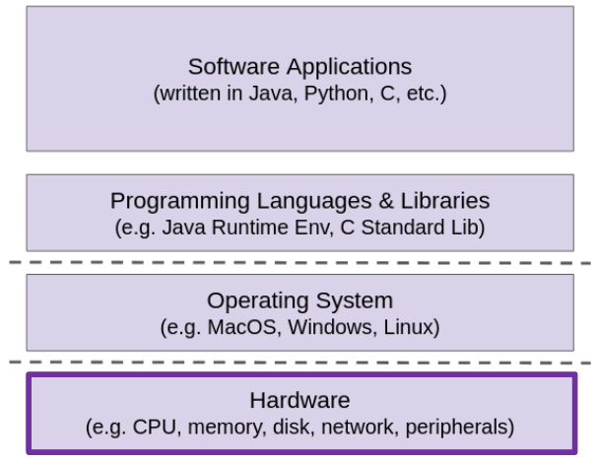
Layers of Computing Revisited
Back to Hardware for today
How are compound data types (arrays, structs) stored in memory?
How do we get individual elements/fields out of them?
Why now?
Knowing a little about assembly will help you understand this
Will be helpful for future lectures

Slide 4
Review Questions
Both questions questions use the following code:
struct ll_node {
long data;
struct ll_node* next; } n1, n2;
How much space (in bytes) does one instance of struct ll_node take?
Which of the following statements are syntactically valid?
n1.next = &n2;
n2->data = 351;
n1.next->data = 333;
(&n2)->next->next.data = 451;
Notes:
next is a pointer type, so data = 8B, next= 8B, 16B total
2. A) Yes. n1 is an instance, so “.” is correct
B) No. n2 is an instance, so “->” is incorrect
C) Yes. n1 is an instance, so “.” is correct. n1.data is a pointer, so “->” is correct
D) No. (&n2) is a pointer, so “->” is correct. (&n2)->next is also a pointer, so “->” is correct. But (&n2)->next->next is a pointer, so “.” is incorrect

Slide 5
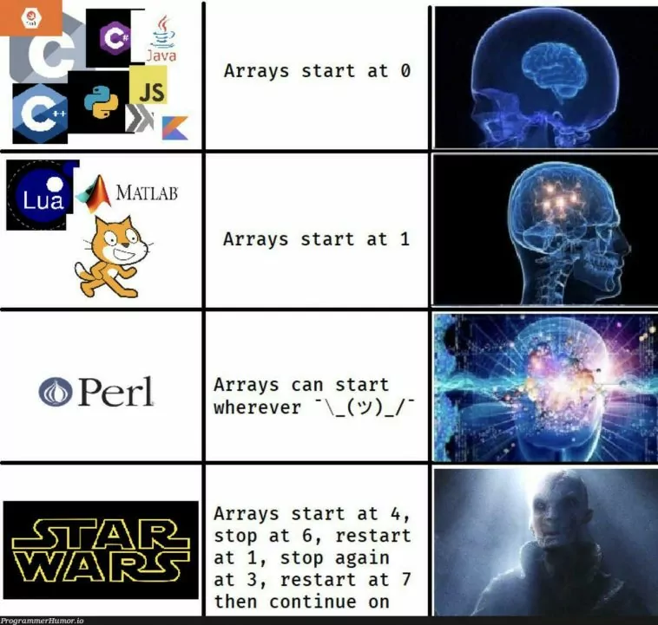
Lecture Topics
Arrays
Array review
Arrays in C
Multidimensional (nested) arrays
Multilevel arrays
Structs
Structs in C
Struct memory layout
Alignment

Slide 6
Recap: Arrays
T A[N] → array A of type T and length N
Contiguously allocated region of N*sizeof(T) bytes
Identifier A evaluates to the address of the array (type T*)
Notes:
GO THROUGH QUICKLY

Slide 7
Recap: Array Accesses
a = starting address of x
Expression | Type | Value
x | int* | a
x[4] | int | 5
x + 1 | int* | a + 4
&x[2]
*(x + 1)
x[5]
Notes:
&x[2] means “address of x[2]”. int*. a + 8
*(x+1) same as x[1]. int. 7
x[5]. int. unknown value (whatever is at address a+20)

Slide 8
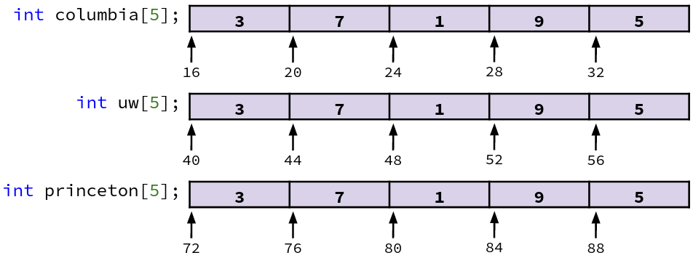
Arrays in Memory Example
// arrays of ZIP code digits
int columbia[5] = { 1, 0, 0, 2, 7 };
int uw[5] = { 9, 8, 1, 9, 5 };
int princeton[5] = { 0, 8, 5, 4, 0 };
Each array is contiguous, but multiple arrays are not guaranteed to be contiguous with each other!
Initialization list

Slide 9
C Details: Arrays and Pointers
Array variables are almost identical to pointers
char* string and char[] string are nearly identical declarations
Subtle differences: initialization, sizeof(), etc.
An array name is an expression, not a variable!
Evaluates to the address of the first (0th) element
Translates to a label in assembly
Doesn’t store the address in a variable (unlike a pointer)
Read-only, can’t re-assign array name

Slide 10
C Details: Arrays and Functions
Allocated on the stack, only allocated while scope is valid
Ex: What’s wrong with this code?
char* foo() {
char string[32];
. . .
return string;
}
An array is passed into a function as a pointer
Can no longer use sizeof()!
Ex:
int foo(int ar[], unsigned int size)
Really just an int*
Need to pass in the size!

Slide 11
Lecture Topics
Arrays
Array review
Arrays in C
Multidimensional (nested) arrays
Multilevel arrays
Structs
Structs in C
Struct memory layout
Alignment

Slide 12
Nested Array Example
int sea[4][5] =
{{ 9, 8, 1, 9, 5 },
{ 9, 8, 1, 0, 5 },
{ 9, 8, 1, 0, 3 },
{ 9, 8, 1, 1, 5 }};
Multidimensional (i.e. “nested”) array
sea evaluates to an int**
What’s the layout in memory?
Notes:
Can think of as an array of arrays

Slide 13
Nested Array Example (pt 2)
int sea[4][5] =
{{ 9, 8, 1, 9, 5 },
{ 9, 8, 1, 0, 5 },
{ 9, 8, 1, 0, 3 },
{ 9, 8, 1, 1, 5 }};
Row-major order: each row stored contiguously
Guaranteed (in C)
sea[3][2]

Slide 14
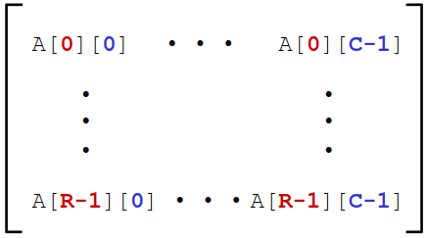
Multi-Dimensional (Nested) Arrays
Declaration: T A[R][C];
2D array of type T
R rows, C columns
Each element requires sizeof(T) bytes
How big is this array?
Conceptual view:
R*C*sizeof(T) bytes
Arrangement: row-major ordering
Notes:
Conceptually think of it as a matrix, but actually stored as a big row
Rows are contiguous

Slide 15
Nested Array Row Access
Given T A[R][C]
A[i] is the array of elements in row i
Pointer arithmetic:
A is the address of the start of the array
Starting address of row i = A + i*C*sizeof(T)
Notes:
C*sizeof(T) = size of a row
Rows are contiguous, so offset of row I = i*size of row

Slide 16
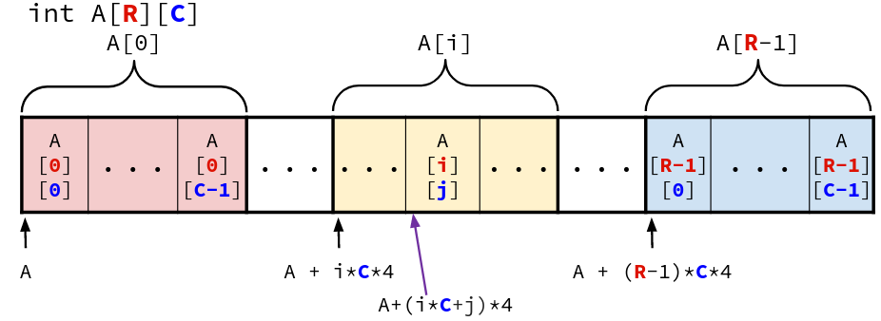
Nested Array Element Access
Given T A[R][C]
A[i][j] is element j of row i
[i][j] = Mem[A + (i*C + j)*sizeof(T)]
Address of row i + offset of element j
Notes:
i*C*sizeof(T) = row offset
J*sizeof(T) = offset of element w/in row
S offset of [i][j] = i*C*sizeof(T) + j*sizeof(T) = (i*C+j)*sizeof(T)

Slide 17
Lecture Topics
Arrays
Array review
Arrays in C
Multidimensional (nested) arrays
Multilevel arrays
Structs
Structs in C
Struct memory layout
Alignment

Slide 18
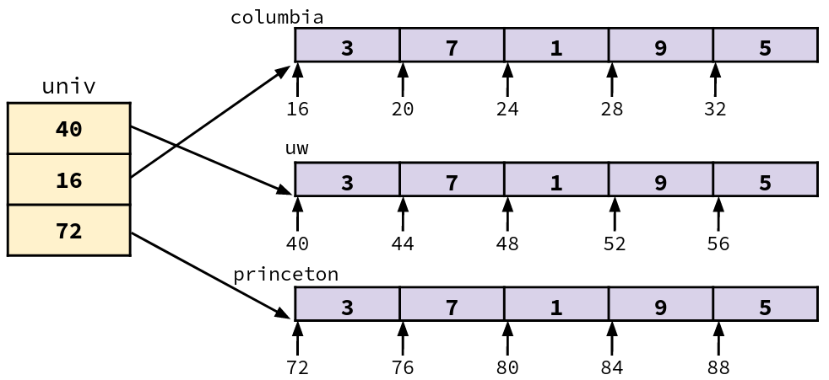
Multilevel Array
// 1-D arrays of ints
int columbia[5] = { 1, 0, 0, 2, 7 };
int uw[5] = { 9, 8, 1, 9, 5 };
int princeton[5] = { 0, 8, 5, 4, 0 };
// Multi-level array
int* univ[3] = {uw, columbia, princeton};
Variable univ is an array of pointers
Each pointer points to an array of ints
Could be different lengths!
Notes:
This is how Java does multilevel arrays
Arrays of different lengths = jagged arrays

Slide 19
Multilevel Array Element Access
Ex: univ[1][3]
Requires two memory reads. 1) to get pointer to row array. 2) to get element.
Mem[Mem[univ + 1*8] + 3*4]

Slide 20
TLDR: Array Element Accesses
Syntax looks the same, but memory layout is different
Multidimensional
Multilevel
A[i][j] = Mem[A+(i*C+j)*sizeof(T)]
A[i][j] =
Mem[Mem[A+i*ptr_size]+j*sizeof(T)]

Slide 21
Lecture Topics
Arrays
Array review
Arrays in C
Multidimensional (nested) arrays
Multilevel arrays
Structs
Structs in C
Struct memory layout
Alignment

Slide 22
Structs in C
User-defined compound data type - structured group of variables
Kinda like a Java object, but no methods or inheritance, just fields
Example:
struct album album1;
album1.title = “Heavy Rocks”;
album1.artist = “Boris”;
album1.year_released = 2002;
struct album album2;
album2.title = “Heathen”;
album2.artist = “Thou”;
album2.year_released = 2014;
struct album {
char* title;
char* artist;
int year_released;
};
Notes:
*MUCH* simpler (dumber) than an object - no methods, inheritance, or private/public fields. JUST a collection of data with a name
Use dot notation to get fields, just like a java object
No “private” fields
Left is defining the struct type, right is creating variables (instances) of that type

Slide 23
Struct Definition
struct album {
char* title;
char* artist;
int year_released;
};
Does not declare a variable, just defines the type
Variable type is “struct <name>”
have to write “struct” every time :(
Variable declarations are like any other data type:
Remember the semicolon!
struct album album1; // instance
struct album* a_ptr; // pointer
struct album playlist[5]; // array
Can also combine struct definitions and instance declarations:
struct album {
. . .
} a, *ptr = &a;
Notes:
Same as:
struct album {
…
};
struct album a;
struct album* ptr = &a;

Slide 24
Typedef in C
A way to create an alias for another data type:
typedef <data type> <alias>;
Alias can be used interchangeably with the original data type
Example: typedef unsigned long ul;
unsigned long x = 12131989;
ul x = 12131989;
Can combine definition and typedef - don’t have to type “struct” every time
struct a {
/* fields */
};
typedef struct a album;
typedef struct {
/* fields */
} album;
==
Can omit struct name

Slide 25
Scope of Struct Definition
Why is the placement of a struct definition important?
C compiler is dumb, reads through file top→bottom
Declaring a variable creates space for it somewhere
Without type definition, program doesn’t know how much space allocate!
Structs follow normal C scope rules
In practice, almost always define at the top of a file
Side note: similar rules apply to functions in C. Must define before they’re used!

Slide 26
Accessing Struct Fields
struct album {
char* title;
char* artist;
int year_released;
};
Given a struct instance, use the ‘.’ operator
struct album a1;
a1.title = “Deathconsciousness”;
Given a pointer to a struct:
struct album* p1 = &a1;
Two equivalent options:
Dereference, then use ‘.’
(*a1).artist = “Have a Nice Life”;
Use ‘->’
p1->year_released = 2008;

Slide 27
Aside: Java
An instance of a Java class is like a pointer (“reference”) to a struct containing the fields
So Java’s x.f is like C’s x->f
Ignoring methods and inheritance, that’s a future lecture!
Arrays are similar. Allocated elsewhere, variable is a pointer to the array

Slide 28
Lecture Topics
Arrays
Array review
Arrays in C
Multidimensional (nested) arrays
Multilevel arrays
Structs
Structs in C
Struct memory layout
Alignment

Slide 29
Struct Representation
struct album {
char* title;
char* artist;
int year_released;
};
Contiguously allocated in memory
Fields ordered according to declaration order
Even if another ordering would be more efficient!
Why? Easier to debug, programmer can predict what offsets fields are at
Compiler determines size + position of fields
Machine-level program has no understanding of structs

Slide 30
Accessing Struct Fields (pt 2)
struct album {
char* title;
char* artist;
int year_released;
} a, p = &a;
Compiler knows the offset of each field
get_year:
# pointer r in %rdi
movl 16(%rdi), %eax
ret
int get_year(struct album* p) {
return p->year_released;
}

Slide 31
Pointers to Struct Fields
struct album {
char* title;
char* artist;
int year_released;
} a, p = &a;
We can get the addresses of fields within a struct!
get_year_ptr:
# pointer r in %rdi
leaq 16(%rdi), %rax
ret
int* get_year_ptr(struct album* p) {
return &(p->year_released);
}

Slide 32
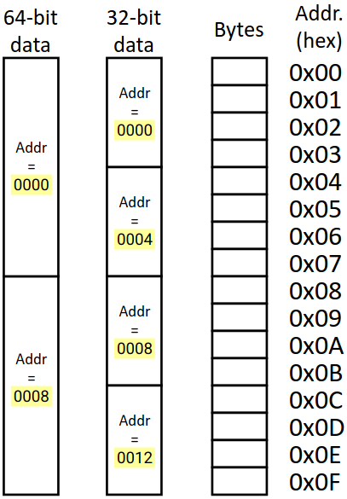
Recap: Alignment
Primitive-type data is stored at a starting address that is a multiple of its size
Required on some systems, advised in x86
Why?... Performance
Allows hardware optimizations
Some (non-x86) hardware will not work without it
Speeds up memory accesses (future lecture!)

Slide 33
Alignments in x86-64
Primitive of K bytes must have an address that is divisible by K
Useful Fact: if a number is divisible by 2^{n}, then its binary representation will end in n 0’s
Data Type | Size (bytes) | Address
char | 1 | No restrictions
short | 2 | Lowest bit is 0: 0b…0
int, float | 4 | Lowest 2 bits are 0: 0b…00
long, double | 8 | Lowest 3 bits are 0: 0b…000
long double | 16 | Lowest 4 bits are 0: 0b…0000
Notes:
Will be useful when we get to lab 5!

Slide 34
Alignment in Structs
struct S1 {
char c;
int i[2];
double v;
}
Each field must be aligned to the size of its data type
Internal fragmentation: unused space between fields to that each field is aligned
How can we minimize internal fragmentation?

Slide 35
Alignment in Structs (pt 2)
struct S1 {
double v;
int i[2];
char c;
}
Internal fragmentation: unused space between fields to that each field is aligned
Changing ordering of fields can reduce the amount of padding needed

Slide 36
Alignment in Structs (pt 3)
struct S1 {
double v;
int i[2];
char c;
}
Within struct: fields must be aligned to the size of their types
Overall struct
Must be aligned to K_{max}
K_{max} = largest alignment requirement of any field
Add external fragmentation at the end of the struct to maintain alignment

Slide 37
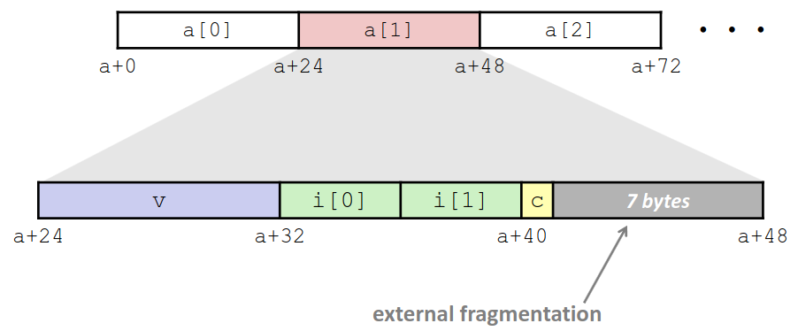
Why External Fragmentation?
struct S1 {
double v;
int i[2];
char c;
}
Arrays of structs
If overall structure is aligned to K_{max}, each field will be aligned for every element in the array

Slide 38
Alignment of Structs (pt 4)
Compiler will do the following:
Maintain the order of fields specified in the C code
Add internal fragmentation to preserve alignment of fields
Add external fragmentation to preserve alignment of the overall struct

Slide 39
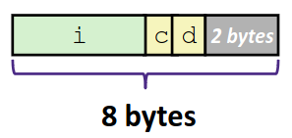
Programming With Structs Tips
Because of padding, size of a struct != the sum of the sizes of each field
Use sizeof() to get the true size
To save space, declare larger fields first
struct s {
char c;
int i;
char d;
}
struct s {
int i;
char c;
char d;
}

Slide 40
Practice Question
Minimize the size of the struct by re-ordering the fields.
sizeof(struct old) == 32 B. What sizeof(struct new)?
22 bytes
24 bytes
28 bytes
32 bytes
struct old {
int i;
short s[3];
char* c;
float f;
};
struct new{
______ ______;
______ ______;
______ ______;
______ ______;
};
Notes:
(one possible) optimal ordering = char* c (8B), int I (4B), float f (4B), struct s[3] (6B long, but aligned to 2)
C = bytes 0-7
I = bytes 8-11
F = bytes 12-15
S = bytes 16-23
2 bytes of external fragmentation
Total size = 24B

Slide 41
Summary: Arrays
Contiguously allocated
Array name evaluates to starting address
Not a variable! Becomes a label in assembly
Multidimensional arrays stored in row-major order: T A[R][C]
A[i] = array of row i = A + i*C*sizeof(T)
A[i][j] = element j of row i = Mem[A + (i*C + j)*sizeof(T)]
Multilevel arrays are arrays of pointers to other arrays: T* A[R] = {...}
A[i] = Mem[A + i*sizeof(pointer)]
A[i][j] = Mem[Mem[A+i*sizeof(pointer)] + j*sizeof(T)]

Slide 42
Summary: Structs
User defined types containing fields
Fields allocated in order declared by programmer
Accessing Fields
For an instance of the struct, use .
For a pointer, use ->
Equivalent to * (dereference) and then .
Compiler adds padding to maintain alignment
Each field must be aligned to its size: add internal fragmentation
Struct must be aligned to K_{max}: add external fragmentation
Minimize fragmentation by ordering fields from largest to smallest in C code

