Slide 1
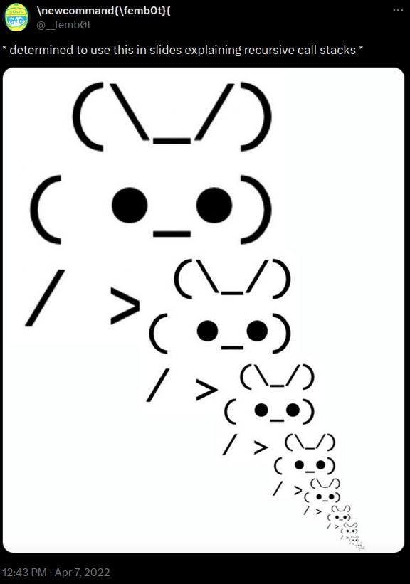
Procedures II & Executables
CSE 351 Summer 2024
Instructor:
Ellis Haker
Teaching Assistants:
Naama Amiel
Micah Chang
Shananda Dokka
Nikolas McNamee
Jiawei Huang

Slide 2
Administrivia
Today
HW9 due (11:59pm)
Quiz 1 due (11:59pm)!!!!!
Monday, 7/15
RD12 due (1pm)
HW10 due (11:59pm)
Midterm Survey out on Canvas
Wednesday, 7/17
RD13 due (1pm)
HW11 due (11:59pm)
Midterm Survey Due (11:59pm)
Notes:
Please start Lab2 early!

Slide 3
Aside: Lab2 Extra Credit
All labs from now on will have some extra credit
Separate Gradescope assignment
Not worth a significant amount of credit!
I will maybe bump your grade up if you’re on the borderline
Notes:
No points assigned to EC

Slide 4
Lecture Topics
Stack structure
Calling conventions
Passing control
Passing data
Managing local data
Stack frames
Saved registers
Stack layout
Register saving convention
Illustration of Recursion
Executables
CALL
Object Files

Slide 5
Review Questions
Answer the following questions about when main() is run (assume x and y are stored on the stack):
1. How many total stack frames are created?
A) 3 B) 5 C) 7 D) 8
2. What is the maximum depth (# of frames) of the Stack?
A) 1 B) 2 C) 3 D) 4
3. (Not on Ed) Which has a higher address address: x or y?
int main() {
int i, x = 0;
for(i=0; i<3; i++)
x = randSum(x);
printf("x = %d\n",x);
return 0;
}
int randSum(int n) {
int y = rand()%20;
return n+y;
}
Notes:
See drawing on next slide
C (7)
C (3)

Slide 6
Review Questions
Notes:
Tree:
main
3 calls to randsum each with an arrow pointing to it form main, and a 4th call for printf
For each call to randsum in level 2, there is an arrow pointing to a call to rand
Stack: 4 parts. Each starts with the same main stack frame
main, randsum1, rand1
main, randsum2, rand2
main , randsum3, rand3
main, printf
7 functions calls (including main) = 7 stack frames
Max depth = 3

Slide 7
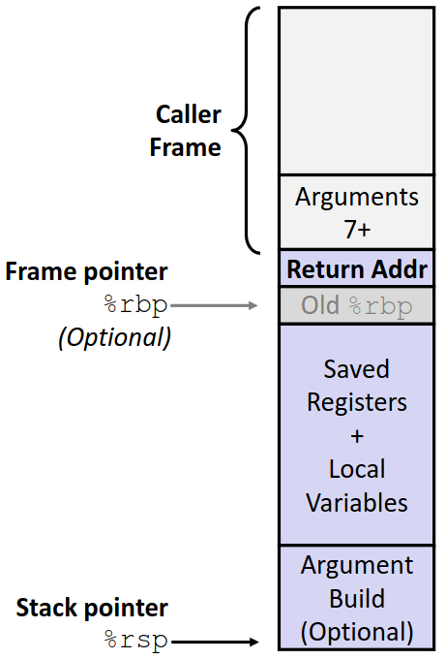
Recap: x86-64/Linux Stack Frame
Caller’s stack frame
Extra arguments (if > 6 args) for this call
Current stack frame
Return address (pushed by call)
Old frame pointer (optional)
Saved register content
Local variables (that can’t be saved in registers)
Argument build - if the current function needs to call another, extra arguments for that call go here
Notes:
Args 7+ in callers stack frame are for CURRENT call
Argument build at the bottom so for NEXT call

Slide 8
Procedure Call Example: increment
long increment(long* p, long val) {
long x = *p;
long y = x + val;
*p = y;
return x;
}
increment:
movq (%rdi), %rax
addq %rax, %rsi
movq %rsi, (%rdi)
ret
%rdi | p (arg1)
%rsi | val (arg2), y
%rax | x (return)

Slide 9
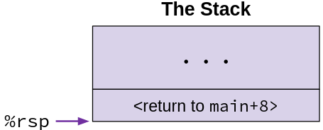
Example: initial state
long call_incr() {
long v1 = 351;
long v2 = increment(&v1, 100);
return v1 + v2;
}
call_incr:
subq $16, %rsp
movq $351, 8(%rsp)
movl $100, %esi
leaq 8(%rsp), %rdi
call increment
addq 8(%rsp), %rax
addq $16, %rsp
ret
When main calls call_incr, push the return address onto the stack
Marks the beginning of call_incr’s stack frame
Notes:
“…” = main’s stack frame

Slide 10
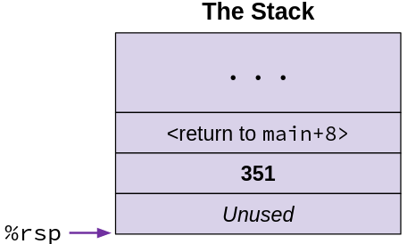
Example: step 1
long call_incr() {
long v1 = 351;
long v2 = increment(&v1, 100);
return v1 + v2;
}
call_incr:
subq $16, %rsp
movq $351, 8(%rsp)
movl $100, %esi
leaq 8(%rsp), %rdi
call increment
addq 8(%rsp), %rax
addq $16, %rsp
ret
Stack grows down, so subq adds 16B of free space to the stack
movq
$ means 351 is an immediate
Destination is memory address %rsp+8
Notes:
Subq – create 16B of stack space
Movq – wite the number 351 at address rsp+8
There are 16B between the return address and rsp, and the unused space at the bottom is 8B

Slide 11
Example: step 2
%rdi | %rsp+8
%rsi | 100
long call_incr() {
long v1 = 351;
long v2 = increment(&v1, 100);
return v1 + v2;
}
call_incr:
subq $16, %rsp
movq $351, 8(%rsp)
movl $100, %esi
leaq 8(%rsp), %rdi
call increment
addq 8(%rsp), %rax
addq $16, %rsp
ret
Set up arguments for increment
Notes:
As before, the unused space is 8B.
Rdi=1st arg, rsi=2nd arg
Lea – rdi gets the value of rsp+8, which is the address of v1, NOT the value at that address (351)

Slide 12
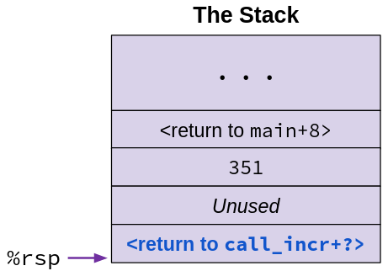
Example: step 3
%rdi
%rsi | 100
long call_incr() {
long v1 = 351;
long v2 = increment(&v1, 100);
return v1 + v2;
}
call_incr:
subq $16, %rsp
movq $351, 8(%rsp)
movl $100, %esi
leaq 8(%rsp), %rdi
call increment
addq 8(%rsp), %rax
addq $16, %rsp
ret
call pushes return address (to the addq instruction after the call) onto the stack
Sets %rip to point to the beginning of increment
return

Slide 13
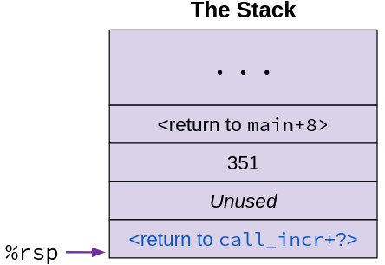
Example: step 4
%rdi | (p)
%rsi | 100 (val)
%rax | 351 (old *p)
long increment(long* p, long val) {
long x = *p;
long y = x + val;
*p = y;
return x;
}
Store return value into %rax
increment:
movq (%rdi), %rax
addq %rax, %rsi
movq %rsi, (%rdi)
ret
Notes:
Rax = x

Slide 14
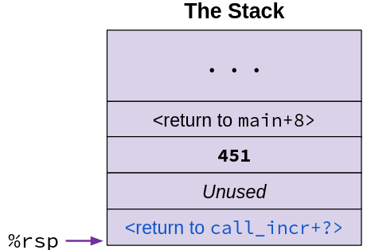
Example: step 5
%rdi | (p)
%rsi | 451 (x+val)
%rax | 351 (old *p)
long increment(long* p, long val) {
long x = *p;
long y = x + val;
*p = y;
return x;
}
Add %rax (x) to %rsi (val)
Write result to the location location %rdi (p) points to
increment:
movq (%rdi), %rax
addq %rax, %rsi
movq %rsi, (%rdi)
ret
Notes:
Addq – rsi=rsi+rax = 100+351=451
Movq – () means memory oprand. Store rsi’s value at the address in rdi

Slide 15
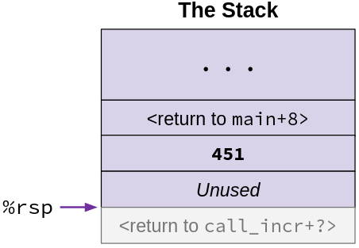
Example: step 6
%rdi | (p)
%rsi | 451 (x+val)
%rax | 351 (old *p)
long increment(long* p, long val) {
long x = *p;
long y = x + val;
*p = y;
return x;
}
Remove return address from the stack
Set %rip to removed value
increment:
movq (%rdi), %rax
addq %rax, %rsi
movq %rsi, (%rdi)
ret

Slide 16
Example: step 6.5
long call_incr() {
long v1 = 351;
long v2 = increment(&v1, 100);
return v1 + v2;
}
%rdi
%rsi | 451
%rax | 351 (v2)
call_incr:
subq $16, %rsp
movq $351, 8(%rsp)
movl $100, %esi
leaq 8(%rsp), %rdi
call increment
addq 8(%rsp), %rax
addq $16, %rsp
ret
Resume instruction at the location %rip is set to (the addq instruction)
%rax stores the value that was returned from increment
Notes:
Resume at addq instruction right after call

Slide 17
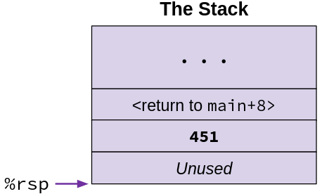
Example: step 7
long call_incr() {
long v1 = 351;
long v2 = increment(&v1, 100);
return v1 + v2;
}
%rdi
%rsi | 451
%rax | 802 (ret)
call_incr:
subq $16, %rsp
movq $351, 8(%rsp)
movl $100, %esi
leaq 8(%rsp), %rdi
call increment
addq 8(%rsp), %rax
addq $16, %rsp
ret
Update %rax to contain v1+v2
Notes:
() means memory operand. Add the value at addres rsp+8 to rax

Slide 18
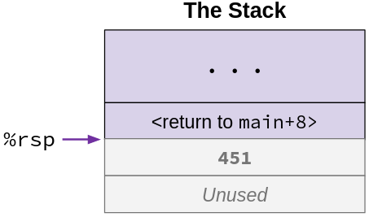
Example: step 8
%rdi
%rsi | 451
%rax | 802 (ret)
long call_incr() {
long v1 = 351;
long v2 = increment(&v1, 100);
return v1 + v2;
}
call_incr:
subq $16, %rsp
movq $351, 8(%rsp)
movl $100, %esi
leaq 8(%rsp), %rdi
call increment
addq 8(%rsp), %rax
addq $16, %rsp
ret
Clean up the stack
Return back to main (not shown)
Notes:
Addq undoes subq from earlier. Ret expects rsp to point to return address

Slide 19
Lecture Topics
Stack structure
Calling conventions
Passing control
Passing data
Managing local data
Stack frames
Saved registers
Stack layout
Register saving convention
Illustration of Recursion
Executables
CALL
Object Files

Slide 20
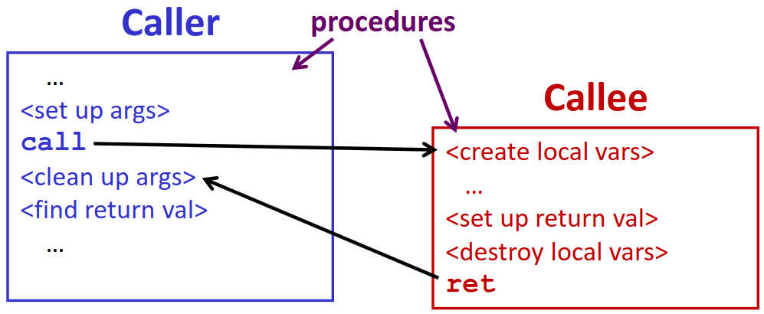
Recap: Caller and Callee
Both use the same registers for their arguments and local variables, so how do we prevent them from overwriting each other’s data?
Before writing to a register, push the old value onto the stack
Pop old value back into the register before returning
Notes:
Reminder – this is about the relationship between two procedures across one call.
A function can be both a callee for one function and caller for another!
Ex: A calls B calls C. A is a caller, B is a caller and a callee, C is a callee

Slide 21
Register Saving Conventions
Caller-saved registers
It is the caller’s responsibility to save these registers’ values before calling another procedure
Callee is free to change these registers
Caller restores registers after callee returns
Callee-saved registers
Callee guarantees that registers not be modified by this function
Caller doesn’t need to save before calling
If the callee wants to use these, it must save their old data first, and restore before it returns

Slide 22
Silly Register Convention Analogy
Parents = caller, child = callee
Parents are gone for the weekend and give their child the keys to the house
Being suspicious, they hid the valuables from the first floor (caller-saved) before leaving
They warn the child to leave the second floor untouched: “These rooms better look the same when we return!”
Child decides to throw a wild party (computation), spanning the entire house
To avoid getting in trouble, child moves all of the stuff from the second floor to the backyard shed (callee-saved) before the guests trash the house
Child cleans up house after the party and moves stuff back to second floor
Parents return home
Move valuables back into first floor and continue with their lives

Slide 23
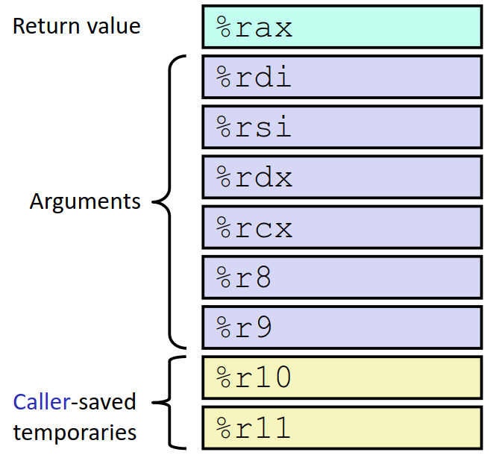
x86-64 Linux Registers: Caller-Saved
%rax
Return value from callee
%rdi...%r9
Arguments for callee
Caller saves before putting args there
%r10, %r11
General-purpose registers
Notes:
Don’t memorize – on reference sheet

Slide 24
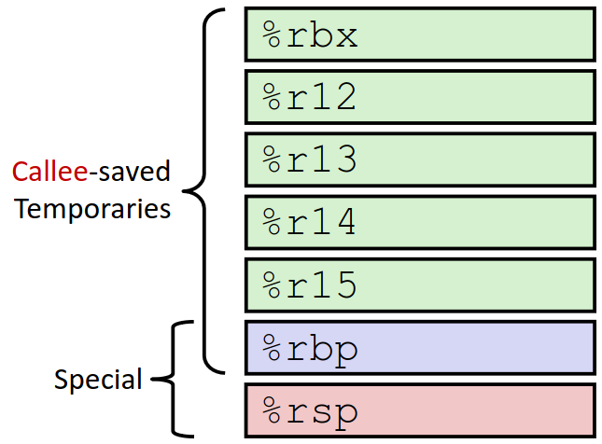
x86-64 Linux Registers: Callee-Saved
%rbx, %r12 - %r15
General-purpose registers
%rbp
Base pointer, or general-purpose
Can mix and match
%rsp
Special case
Does not explicitly push value
Stack should be in the same state on return as it was at the beginning of the call

Slide 25
Why have both Caller- and Callee-Saved?
We need one convention for all functions
Neither is “best” in all cases
If caller isn’t using a register, caller-saved is better
If callee doesn’t need a register, callee-saved is better
If “do need to save”, callee-saved generally makes faster programs
Callee can be called from multiple places
So… we went with “some of each”
Compiler tries to pick registers to minimize saving

Slide 26
Register Saving Conventions Summary
Caller-saved: register values need to be pushed onto the stack before making a procedure call only if the caller needs that value later
Callee may change those register values
Popped after call returns
Callee-saved: register values need to be pushed onto the stack only if the callee intends to use those registers
Caller expects unchanged values in those registers upon return
Popped before callee returns
Don’t forget to restore/pop the values later!

Slide 27
Lecture Topics
Stack structure
Calling conventions
Passing control
Passing data
Managing local data
Stack frames
Saved registers
Stack layout
Register saving convention
Illustration of Recursion
Executables
CALL
Object Files

Slide 28
Recursive Function
/* Recursive popcount */
long pcount_r(unsigned long x) {
if (x == 0)
return 0;
else
return (x & 1) + pcount_r(x >> 1);
}
pcount_r:
movl $0, %eax
testq %rdi, %rdi
jne .L8
ret
.L8:
pushq %rbx
movq %rdi, %rbx
shrq %rdi
call pcount_r
andl $1, %ebx
addq %rbx, %rax
popq %rbx
ret
Counts the number of 1’s in the binary representation of x
Compiler Explorer: https://godbolt.org/z/E943Gz3M5
Compiled with -O1 instead of -Og for more natural instruction ordering

Slide 29
Recursive Function: Base Case
/* Recursive popcount */
long pcount_r(unsigned long x) {
if (x == 0)
return 0;
else
return (x & 1) + pcount_r(x >> 1);
}
pcount_r:
movl $0, %eax
testq %rdi, %rdi
jne .L8
ret
.L8:
pushq %rbx
movq %rdi, %rbx
shrq %rdi
call pcount_r
andl $1, %ebx
addq %rbx, %rax
popq %rbx
ret
Notes:
Why movl (4B) when longs are 8B? Remember that 4B instructions also 0 out the rest of the 8B register!
Movl – set up ret value
Testq – set flags based on rdi&rdi = rdi = x
Jne = jump if x != 0
Ret – otherwise, return

Slide 30
Recursive Function: Saved Registers
/* Recursive popcount */
long pcount_r(unsigned long x) {
if (x == 0)
return 0;
else
return (x & 1) + pcount_r(x >> 1);
}
pcount_r:
movl $0, %eax
testq %rdi, %rdi
jne .L8
ret
.L8:
pushq %rbx
movq %rdi, %rbx
shrq %rdi
call pcount_r
andl $1, %ebx
addq %rbx, %rax
popq %rbx
ret
%rdi is a caller-saved register, needs to be saved before recursive call
Rather than saving %rdi the stack, compiler put it in %rbx, which is callee-saved
Has to save old %rbx value on the stack first
Notes:
Rbx is callee saved

Slide 31
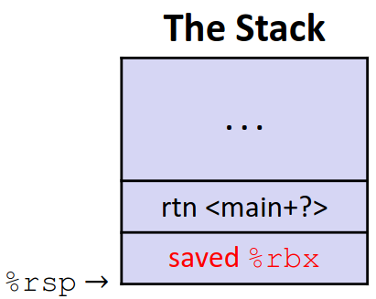
Recursive Function: Saved Registers (pt 2)
/* Recursive popcount */
long pcount_r(unsigned long x) {
if (x == 0)
return 0;
else
return (x & 1) + pcount_r(x >> 1);
}
pcount_r:
movl $0, %eax
testq %rdi, %rdi
jne .L8
ret
.L8:
pushq %rbx
movq %rdi, %rbx
shrq %rdi
call pcount_r
andl $1, %ebx
addq %rbx, %rax
popq %rbx
ret
%rdi | x
%rbx | x

Slide 32
Recursive Function: Call Setup
/* Recursive popcount */
long pcount_r(unsigned long x) {
if (x == 0)
return 0;
else
return (x & 1) + pcount_r(x >> 1);
}
pcount_r:
movl $0, %eax
testq %rdi, %rdi
jne .L8
ret
.L8:
pushq %rbx
movq %rdi, %rbx
shrq %rdi
call pcount_r
andl $1, %ebx
addq %rbx, %rax
popq %rbx
ret
Shift %rdi by 2 to set up argument for next call
%rdi | x >> 1
%rbx | x

Slide 33
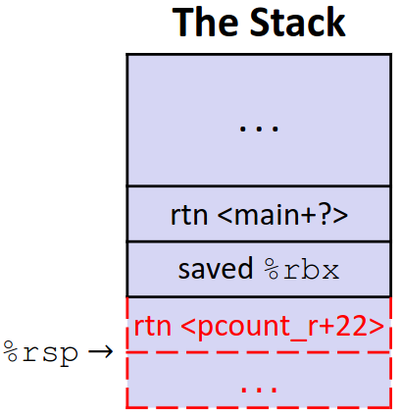
Recursive Function: Call
/* Recursive popcount */
long pcount_r(unsigned long x) {
if (x == 0)
return 0;
else
return (x & 1) + pcount_r(x >> 1);
}
pcount_r:
movl $0, %eax
testq %rdi, %rdi
jne .L8
ret
.L8:
pushq %rbx
movq %rdi, %rbx
shrq %rdi
call pcount_r
andl $1, %ebx
addq %rbx, %rax
popq %rbx
ret
%rdi | x >> 1
%rbx | x
%rax | pcount_r(x>>1)
Notes:
Rbx has our old value of x, so we use it in the next 2 instructions
Rax in the diagram shows its value when call returns

Slide 34
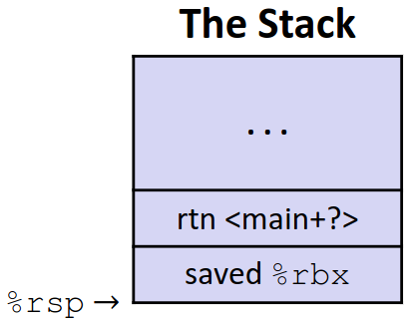
Recursive Function: Result
/* Recursive popcount */
long pcount_r(unsigned long x) {
if (x == 0)
return 0;
else
return (x & 1) + pcount_r(x >> 1);
}
pcount_r:
movl $0, %eax
testq %rdi, %rdi
jne .L8
ret
.L8:
pushq %rbx
movq %rdi, %rbx
shrq %rdi
call pcount_r
andl $1, %ebx
addq %rbx, %rax
popq %rbx
ret
%rdi | x >> 1
%rbx | x & 1
%rax | return value

Slide 35
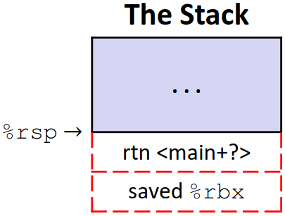
Recursive Function: Completion
/* Recursive popcount */
long pcount_r(unsigned long x) {
if (x == 0)
return 0;
else
return (x & 1) + pcount_r(x >> 1);
}
pcount_r:
movl $0, %eax
testq %rdi, %rdi
jne .L8
ret
.L8:
pushq %rbx
movq %rdi, %rbx
shrq %rdi
call pcount_r
andl $1, %ebx
addq %rbx, %rax
popq %rbx
ret
%rdi | x >> 1
%rbx | old %rbx
%rax | return value
Notes:
Rbx removed by pop, return removed by ret

Slide 36
Observations About Recursion
Works without any special considerations
Each call gets its own stack frame for local variables + return address
Register saving prevents one function call from corrupting another’s data
Stack discipline follows call/return pattern
Last-in, first-out (like a stack!)
The principals work for all functions, not just recursion

Slide 37
Lecture Topics
Stack structure
Calling conventions
Passing control
Passing data
Managing local data
Stack frames
Saved registers
Stack layout
Register saving convention
Illustration of Recursion
Executables
CALL
Object Files

Slide 38
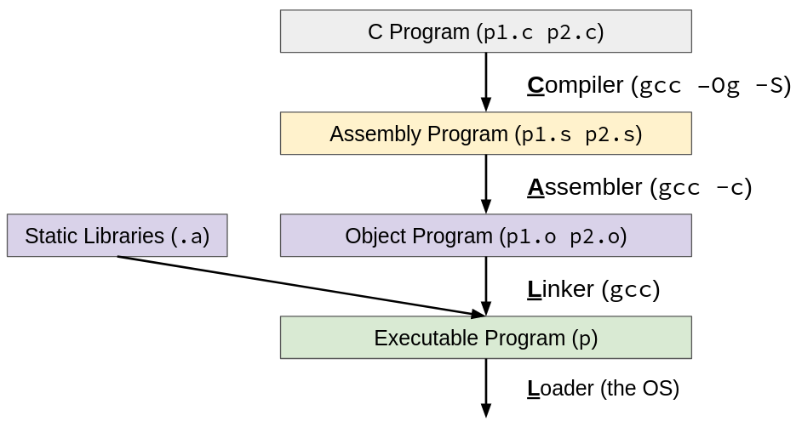
CALL: Building an Executable with C
Code in files p1.c p2.c
Compile with gcc -Og p1.c p2.c -o p
Run with ./p
Notes:
-Og = specifies level of optimization
p1.c and p2.c = input files
-o p = put resulting executable in file p

Slide 39
CALL: Compiler
Input: Higher-level language code (e.g., C, Java)
Ex: foo.c
Output: Assembly language code (e.g. x86, ARM)
Ex: foo.s
For C, starts with preprocessor to process #directives before compilation
Macro substitution, etc.
If you’re curious: http://tigcc.ticalc.org/doc/cpp.html
Performs optimizations
For gcc, specified by -O flag (e.g. -Og, -O3)
List of options: https://gcc.gnu.org/onlinedocs/gcc/Optimize-Options.html
Super complex, there’s a whole course dedicated to these (CSE 401)!
Notes:
Letter “O”, not zero

Slide 40
Compiling (into Assembly) Example
Note: this is still “source code” in a sense – human-readable
instructions, written out as text.
Example: C code (sum.c)
void sumstore(long x, long y, long *dest) {
long t = x + y;
*dest = t;
}
x86-64 assembly (gcc –Og –S sum.c -> sum.s)
sumstore:
addq %rdi, %rsi
movq %rsi, (%rdx)
ret
Warning: You may get different results with other versions of
gcc and different compiler settings

Slide 41
CALL: Assembler
Input: Assembly language code (e.g., x86, ARM)
Ex: foo.s
Output: Object files (e.g., ELF, COFF)
Ex: foo.o
Very similar to assembly but a little different; Contains object code and information tables
Reads and uses assembly directives from source files
e.g., .text, .data, .quad
x86 directives: https://docs.oracle.com/cd/E26502_01/html/E28388/eoiyg.html
Produces “machine language” (binary instructions)
Does it’s best, but object file is NOT a complete binary

Slide 42
Producing Machine Language
Simple cases: arithmetic and logical operations, shifts, etc.
i.e. Instructions that don’t reference addresses
Assembler can do this
All necessary information is contained in the instruction itself!
Complex cases: jumps, accessing static data (e.g., global variable or jump table), procedure calls
Addresses and labels are not generated in the assembly stage
May need addresses to things from other files
So what do we do in the meantime?

Slide 43
Object File Information Tables
Each object file has a symbol table and relocation table
Symbol Table holds list of “items” that may be used by other files
i.e. “this is what I have and know about”
Non-local Labels – function names usable for call
Static Data – variables & literals that might be accessed across files
Relocation Table holds list of “items” that this file needs the address of later (currently undetermined)
i.e. “these are the things I need”
Any label or piece of static data referenced in an instruction in this file
Both internal and external

Slide 44
CALL: Linker
Input: Object files (e.g., ELF, COFF)
Ex: foo.o
Output: Executable binary program
Ex: foo (default is a.out)
Combines (links) several object files
Enables separate compilation/assembling of files
Changes to one file don’t require recompiling the others
Notes:
Text segment = code + literals, data segment = static variables

Slide 45
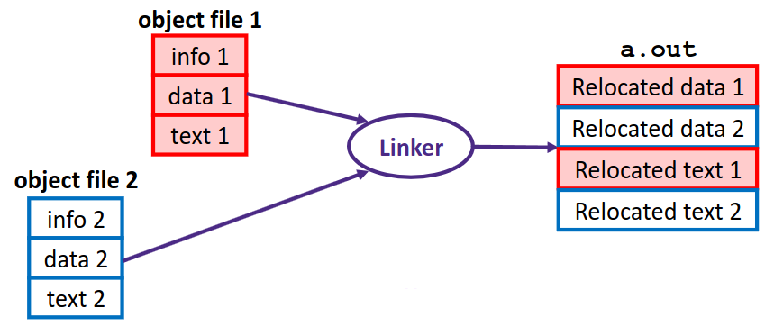
Linking Example
Concatenate text and data segments from each .o file
Go through each entry in relocation tables
Find address based on its location in the text and data segments
Replace label in the code with that address
What if we can’t resolve all the references?
Notes:
Text = instructions + literals, data = static data (global vars)

Slide 46
Linking Example (pt 2)
Concatenate text and data segments from each .o file
Go through each entry in relocation table
Find address based on its location in the text and data segments
Replace label in the code with that address
// tell the compiler that findme // is in a different file
extern void findme();
int main() {
findme();
return 0;
}
$ gcc findme.c
/usr/bin/ld: /tmp/ccAQ36Zy.o: in function ‘main’:
findme.c:(.text+0xa): undefined reference to ‘findme’
collect2: error: ld returned 1 exit status
Notes:
Text = instructions + literals, data = static data

Slide 47
CALL: Loader
Input: executable binary program, command-line arguments
Ex: ./foo arg1 arg2
Output: <program is run>
Memory sections (Instructions, Static Data, Stack) are set up
Registers are initialized
Handled by operating system
Want to implement this yourself? Take OS (CSE 451)!

Slide 48
Disassembling
Approximates of assembly from machine code (object file or executable)
Ex: objdump -d foo
Looks similar to assembly file, but we actually have more info!
Addresses, all symbols, etc.
void sumstore(long x, long y, long *dest) {
long t = x + y;
*dest = t;
}
0000000000400536 <sumstore>:
400536: 48 01 fe add %rdi,%rsi
400539: 48 89 32 mov %rsi,(%rdx)
40053c: c3 retq

Slide 49
What Can be Disassembled?
Anything that can be interpreted as executable code! However…
Not always accurate
Often illegal (for commercial software)
Falls under academic misconduct for school assignments (unless we tell you to)
% objdump -d WINWORD.EXE
WINWORD.EXE: file format pei-i386
No symbols in "WINWORD.EXE".
Disassembly of section .text:
30001000 <.text>:
30001000:
30001001:
30001003:
30001005:
3000100a:

Slide 50
Discussion
Discuss in groups of 2-4, and then we’ll talk as a class:
We’ve seen a few examples of names that are derived from history
Ex: a “word” being 2 byte in x86
Naming/etymology plays a big role in learning
Which new terms from CSE 351 been the most intuitive for you to learn vs. the most difficult?
What do you think goes into a good vs. bad name (more generally in computer science)?
Notes:
Some fun examples:
- Register names: named after intended purpose
- Core dumped: names after outdated memory technology
- Mantissa: from Latin

Slide 51
Summary
Stack is organized into frames, one for each call
Store all the data for that function, return address, and saved registers
Register saving convention prevents data from being lost between calls
Caller-saved: saved before a function is called, popped after
Callee-saved: saved before being used, popped before returning
4 steps to generate and run a program:
Compile: generate assembly for each source file
Assemble: generate object file for each source file
Includes symbol table and relocation table
Link: combine object files into one executable
Load: OS sets up memory and registers before running

