Slide 1
Stack & Procedures I
CSE 351 Summer 2024
Instructor:
Ellis Haker
Teaching Assistants:
Naama Amiel
Micah Chang
Shananda Dokka
Nikolas McNamee
Jiawei Huang

Slide 2
Administrivia
Today
HW8 due (11:59pm)
Lab1b due (11:59pm)
Friday, 7/12
RD11 due (1pm)
HW9 due (11:59pm)
Quiz 1 due (11:59pm)
No late submissions!
Notes:
Late due date for 1b is Friday
Lab2 demo in section tomorrow!

Slide 3
Lab1b Reminders
If you submit multiple times
Resubmit all necessary lab files each time
Tag your lab partner each time
Double-check style guidelines
No magic numbers
Call previous functions instead of rewriting code
Wait for the autograder to finish
You won’t see your score, but it will tell you about missing files, compilation errors, or style violations

Slide 4
Review Questions
1. How does the stack change after executing the following instructions?
pushq %rbp
subq $0x18, %rsp
2. For the following function, which registers do we know must be used?
void* memset(void* ptr, int value, size_t num);
Notes:
Q1: q = 8B, so pushq pushes 8B of data onto the stack
%rsp is the stack ptr. Stack grows down, so subtracting from rsp grows the stack. 0x18=24
8+24=32. Stack grows by 32B

Slide 5
Review Questions (pt 2)
For the following function, which registers do we know must be used?
void* memset(void* ptr, int value, size_t num);
%rax %rbx %rcx %rdx %rsi
%rdi %rsp %r8 %r9 %rip
Notes:
Answer: %rax (return), %rsi, %rdi, %rdx (args), %rsp (stack, modified when we push return address on), %rip (instructions)

Slide 6
Mechanisms Required for Procedures
P(...) {
...
y = Q(x);
printf(y);
...
}
Passing control
To beginning of procedure code
Back to return point
Passing data
Procedure arguments
Memory management
Allocate local variables during procedure execution
Deallocate on return
All implemented with machine instructions!
int Q(int i) {
int t = 3*i;
int v[10];
...
return v[t];
}
Notes:
Red dotted lines = control, green lines = data.
int y, int t, and int v[10] are all local variables

Slide 7
Lecture Topics
Stack structure
Calling conventions
Passing control
Passing data
Managing local data
Saved registers
Stack Frame Layout
Register saving convention
Illustration of Recursion

Slide 8
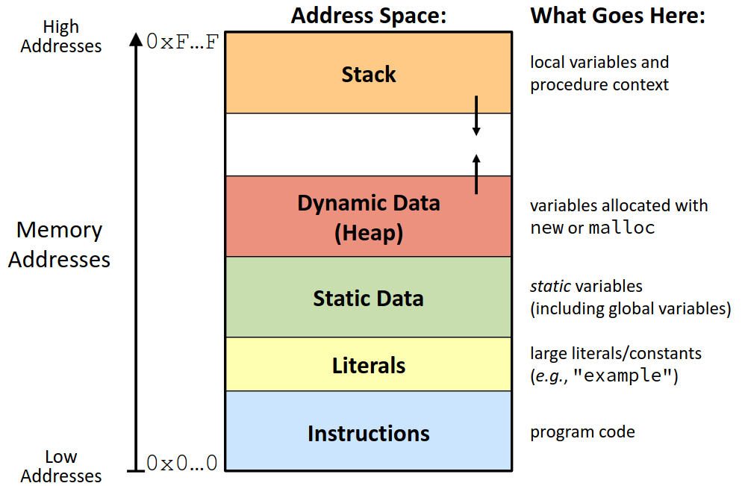
Simplified Memory Layout
Notes:
Instructions, Literals, and Static Data are statically allocated. Heap and Stack are dynamically allocated.
Instructions and Literals are read-only. Static Data, Heap, and Stack are writeable.

Slide 9
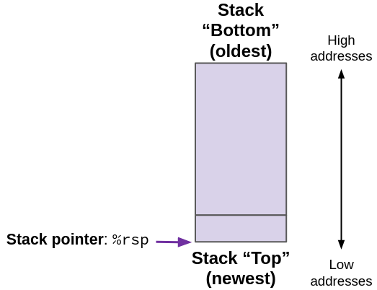
x86-64 Stack
Region of memory for managing procedures
Grows towards lower addresses
Customarily shown “upside down”
Register %rsp contains the lowest address on the stack
Lowest address = most recent thing on the stack
Notes:
Stack = last in, first out

Slide 10
Stack “Bottom” (oldest)
High addresses
%rcx
(data from old top)
Stack pointer: %rsp
+8
(old top)
Those bits are still there, we’re just not using them!
Stack “Top” (newest)
Low addresses

Slide 11
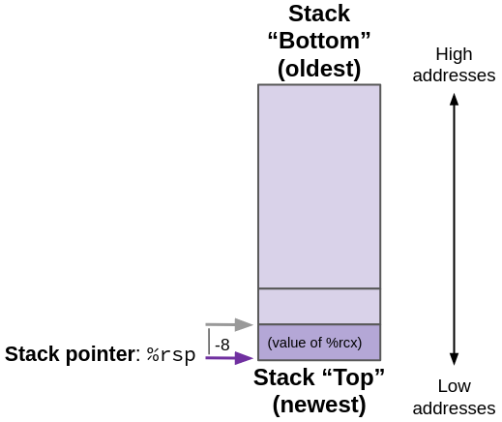
x86-64 Stack: Push
push_ src
Fetch operand at src
Can be register, memory, or immediate
Decrement %rsp by size of data (depending on width specifier)
Store value at address given by %rsp
Example: pushq %rcx
Decrement %rsp by 8
Store contents of %rcx atthat address
Notes:
Width specifier (i..e b=1, w=2, l=4, q=8)

Slide 12
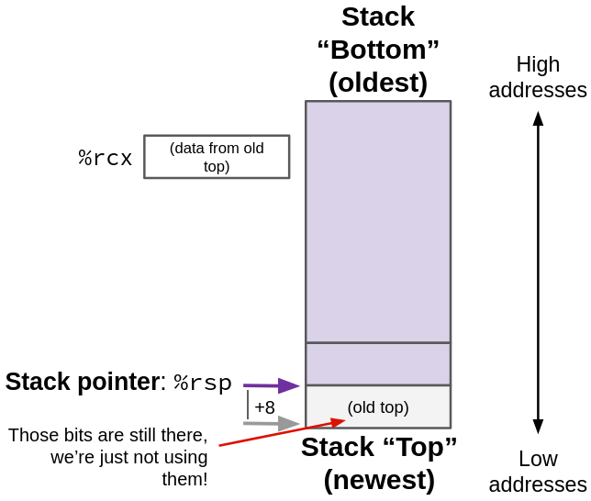
x86-64 Stack: Pop
pop_ dst
Load value at address given by %rsp
Increment %rsp by size of data
Store value at dst
Must be a register
Example: popq %rcx
Load 8 bytes starting at the location %rsp points to
Stores into %rcx
Increment %rsp by 8

Slide 13
Lecture Topics
Stack structure
Calling conventions
Passing control
Passing data
Managing local data
Saved registers
Stack Frame Layout
Register saving convention
Illustration of Recursion

Slide 14
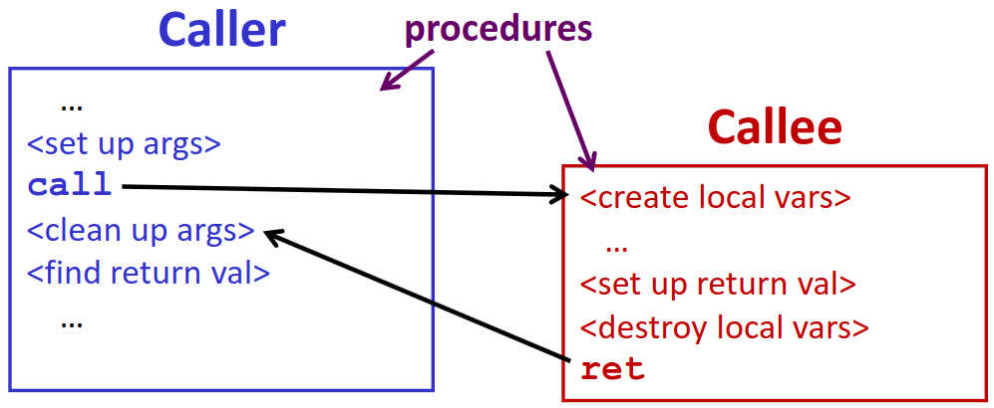
Procedure Call Overview
Caller must know where to find return value
Callee must know where to find arguments and return address
Both run on the same CPU, so they will use the same registers
How do we prevent them from overwriting each other’s data?
Notes:
Procedure: method = called on an object, function = no object.
Note: caller/callee relationship is for a single call.
Ex: A Calls B, B calls C. Between A and B, A is the caller and B is the callee. Between B and C, B is the caller and C is the callee

Slide 15
Procedure Call Overview (pt 2)
We use the calling convention (also called “procedure call linkage”) to handle these problems
Details vary between systems
We will look at the convention for Linux in x86-64

Slide 16
Procedure Control Flow
Use the stack to support procedure call and return
Procedure call: call label
Push return address onto the stack
Jump to label
Return address
Address of the instruction immediately after a procedure call
400544: call 400550 <mult2>
400549: movq %rax,(%rbx)
Memory addresses
Procedure return: ret
Pop return address off the stack and jump to that address
Notes:
Return address tells CPU where to resume when callee finishes
In the code example, return address = 0x400549

Slide 17
Code Example
0000000000400540 <multstore>:
400540: push %rbx # Save %rbx
400541: movq %rdx, %rbx # Save dest
400544: call 400550 <mult2> # mult2(x,y)
400549: movq %rax,(%rbx) # Save at dest
40054c: pop %rbx # Restore %rbx
40054d: ret # Return
void multstore
(long x, long y, long* dest)
{
long t = mult2(x, y);
*dest = t;
}
long mult2 (long a, long b)
{
long s = a * b;
return s;
}
0000000000400550 <mult2>:
400550: movq %rdi,%rax # a
400553: imulq %rsi,%rax # a * b
400557: ret # Return
Notes:
We’re going to use this code for the rest of the lecture

Slide 18
Procedure Call Example (before)
Addresses | Memory
0x130
0x128
0x120
0000000000400540 <multstore>:
...
400544: call 400550 <mult2>
400549: movq %rax,(%rbx)
...
0000000000400550 <mult2>:
400550: movq %rdi,%rax
...
400557: ret
%rsp | 0x120
%rip | 0x400544
Notes:
Each of the blocks in the memory diagram represents 8 bytes

Slide 19
Procedure Call Example (after)
Addresses | Memory
0x130
0x128
0x120
0x118 | 0x400549
0000000000400540 <multstore>:
...
400544: call 400550 <mult2>
400549: movq %rax,(%rbx)
...
0000000000400550 <mult2>:
400550: movq %rdi,%rax
...
400557: ret
%rsp | 0x118
%rip | 0x400550
Notes:
Value stored at 0x118 (0x400549) is the return address

Slide 20
Procedure Return Example (before)
Addresses | Memory
0x130
0x128
0x120
0x118 | 0x400549
0000000000400540 <multstore>:
...
400544: call 400550 <mult2>
400549: movq %rax,(%rbx)
...
0000000000400550 <mult2>:
400550: movq %rdi,%rax
...
400557: ret
%rsp | 0x118
%rip | 0x400557
Notes:
Each of the blocks in the memory diagram represents 8 bytes
Fast forward to when we reach the end of mult2. %rip currently points to the ret. The stack is the same as before

Slide 21
Procedure Return Example (after)
Addresses | Memory
0x130
0x128
0x120
0000000000400540 <multstore>:
...
400544: call 400550 <mult2>
400549: movq %rax,(%rbx)
...
0000000000400550 <mult2>:
400550: movq %rdi,%rax
...
400557: ret
%rsp | 0x120
%rip | 0x400549
Notes:
Old return address still exists ad 0x118, just no longer part of the stack

Slide 22
Lecture Topics
Stack structure
Calling conventions
Passing control
Passing data
Managing local data
Saved registers
Stack Frame Layout
Register saving convention
Illustration of Recursion

Slide 23
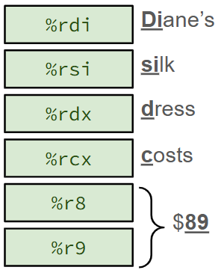
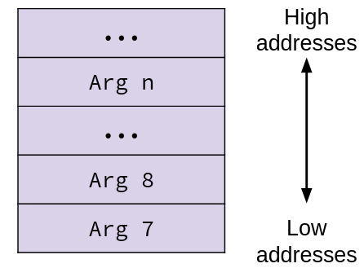
Passing Arguments
First 6 args: Registers (NOT in memory)
Extra args: Stack (Memory)
Only allocate when needed
Notes:
Extra args: caller pushes before calling!
Pushed in reverse order, arg7 last

Slide 24
High addresses
...
Arg n
...
Arg 8
Arg 7
Low addresses

Slide 25
Return Values
By convention, stored in %rax
Caller must make sure to save old contents of %rax before calling a function
Clears out space so callee can put the return value there
Part of the register saving conventions (next lecture)
Callee places return value into %rax before return
Any type <= 8B (pointer, integer, etc.)
For larger values (ex: array), returns a pointer to the data
Upon return, caller finds the value in %rax
Notes:
You may also have noticed that we always put the return value in %rax in previous examples. This is why!

Slide 26
Data Flow Example
0000000000400540 <multstore>:
# x in %rdi, y in %rsi, dest in %rdx
...
400544: call 400550 <mult2>
400549: movq %rax,(%rbx)
# t in %rax
...
void multstore
(long x, long y, long* dest)
{
long t = mult2(x, y);
*dest = t;
}
long mult2 (long a, long b)
{
long s = a * b;
return s;
}
0000000000400550 <mult2>:
# a in %rdi, b in %rsi
400550: movq %rdi,%rax # %rax=a
400553: imul %rsi,%rax # %rax=a*b=s
# s in %rax
400557: ret
Notes:
Doesn’t need to do anything to set args bc the 1st two args to multstore are the args to mult2!

Slide 27
Local Data Storage
Compiler will usually try to store local variables in registers
Faster to access than memory
Otherwise, local data goes on the stack
Common reasons why the compiler may choose to put data in the stack:
No registers available
Data is too large (ex: arrays)
Variable needs to have an address (ex: C code uses the & operator)
Other reasons (sometimes compilers do things we don’t understand!)
Programmer can’t accurately predict where their data will be stored ¯\_(ツ)_/¯
Notes:
For “variable needs to have an address” case, remember registers don’t have addresses!

Slide 28
Register Saving
A function can’t predict which other registers other functions may use
What if it overwrites a register that its caller was using?
What if it calls a function that overwrites its register values?
Example: what’s wrong with this code?
foo:
movq $351, %rbx # rbx = 351
...
call bar
...
addq %rax, %rbx # rbx = rax + 351
ret
bar:
...
movq $123, %rbx # rbx = 123
...
ret
Notes:
Foo puts the value 351 into rbx, then bar overwrites it to 123. When foo executes addq, it will still have the value 123, even though 351 is expected

Slide 29
Register Saving (pt 2)
If we want to write to a register, save its old value onto the stack to avoid losing data
Use push instruction to save register
Use pop to restore the register back to its old value
Register saving convention dictates when registers are saved
Next lecture!
Notes:
Sometimes the compiler will skip saving a register - this is because the old value is never used in the program again, so it’s not necessary

Slide 30
Register Saving Example
Now bar is free to use %rbx without messing with foo’s data :)
foo:
movq $351, %rbx # rbx = 351
...
call bar
...
addq %rax, %rbx # rbx = rax + 351
ret
bar:
...
pushq %rbx # save old rbx
movq $123, %rbx # rbx = 123
...
popq %rbx # restore rbx
ret

Slide 31
Lecture Topics
Stack structure
Calling conventions
Passing control
Passing data
Managing local data
Saved registers
Stack Frame Layout
Register saving convention
Illustration of Recursion

Slide 32
Stack-Based Languages
e.g., C, Java, most modern languages
Support recursion
Code must be re-entrant
Allow multiple simultaneous instances of the same procedure
Stack allocated in frames
State for a single instance of a procedure
Stack “discipline”
Maintained by the compiler
State for a given procedure is only needed for a limited time
Starting from when it is called to when it returns
Callee always returns before caller does
Notes:
Not all languages use a stack to organize their data, but most modern languages do
Remember recursion from intro?
We chunk stack into “frames” containing all the data for a single procedure
Stack discipline is necessary to make sure all functions maintain the stack without messing it up
This works because calling procedures is like a stack! If function A calls function B, function B is guaranteed to return before A

Slide 33
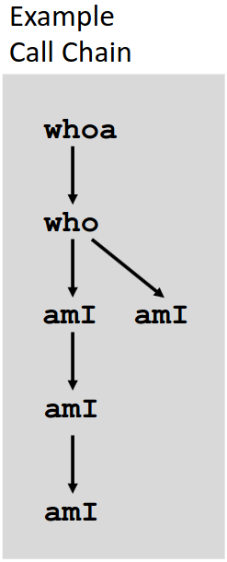
Call Chain Example
whoa(...) {
.
.
who(...);
.
.
}
who(...) {
.
amI(...);
.
amI(...);
.
}
amI(...) {
.
.
if(...)
amI(...);
.
.
}

Slide 34
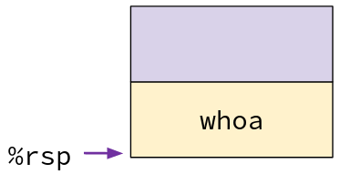
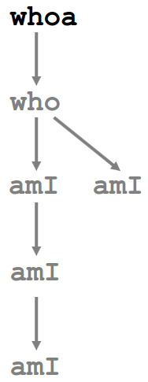
1. Call to whoa
whoa(...) {
.
.
who(...);
.
.
}

Slide 35
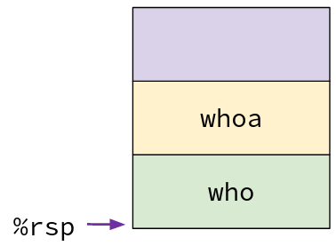
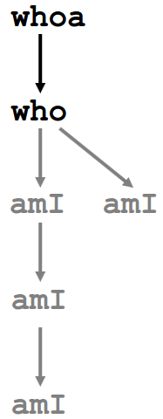
2. Call to who
whoa(...) {
.
.
who(...);
.
.
}
who(...) {
.
amI(...);
.
amI(...);
.
}

Slide 36
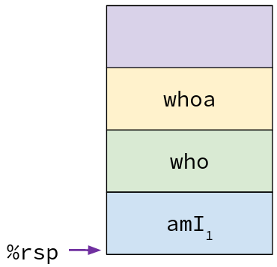
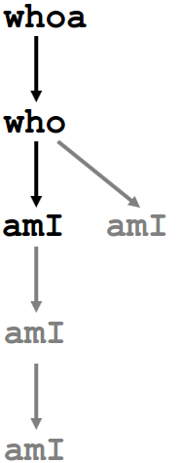
3. Call to ami
whoa(...) {
.
.
who(...);
.
.
}
who(...) {
.
amI(...);
.
amI(...);
.
}
amI(...) {
.
.
if(...)
amI(...);
.
.
}

Slide 37
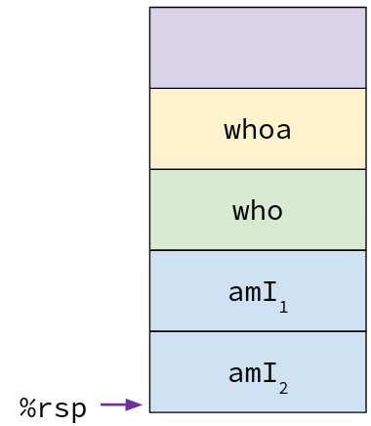
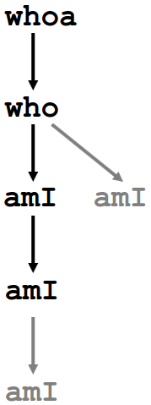
4. Recursive Call to ami
whoa(...) {
.
.
who(...);
.
.
}
who(...) {
.
amI(...);
.
amI(...);
.
}
amI(...) {
.
.
if(...)
amI(...);
.
.
}
amI(...) {
.
.
if(...)
amI(...);
.
.
}

Slide 38
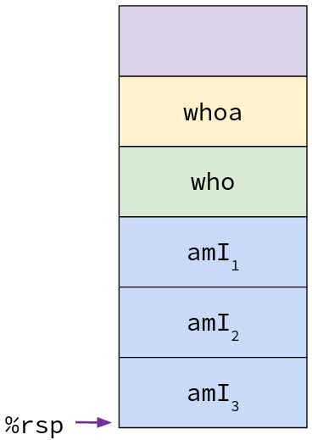
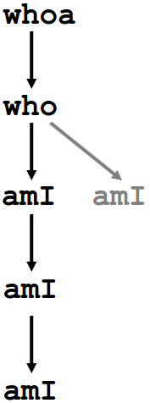
5. (another) Recursive Call to amI
whoa(...) {
.
.
who(...);
.
.
}
who(...) {
.
amI(...);
.
amI(...);
.
}
amI(...) {
.
.
if(...)
amI(...);
.
.
}
amI(...) {
.
.
if(...)
amI(...);
.
.
}
amI(...) {
.
.
if(...)
amI(...);
.
.
}

Slide 39
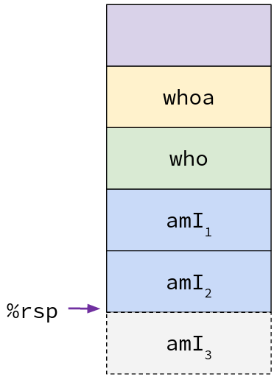
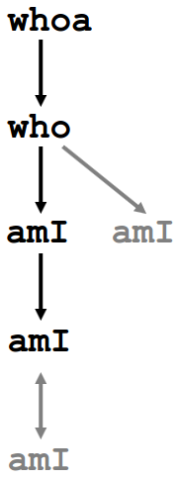
6. Return from (another) Recursive Call to amI
whoa(...) {
.
.
who(...);
.
.
}
who(...) {
.
amI(...);
.
amI(...);
.
}
amI(...) {
.
.
if(...)
amI(...);
.
.
}
amI(...) {
.
.
if(...)
amI(...);
.
.
}

Slide 40
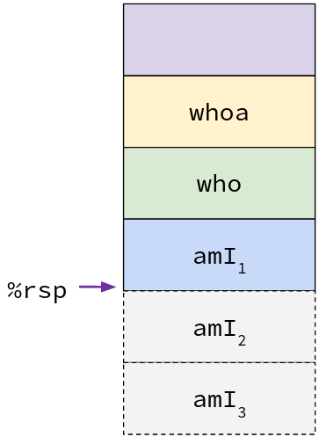
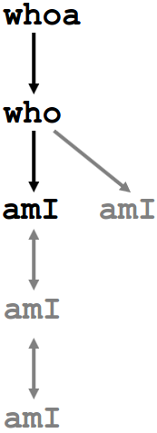
7. Return from Recursive Call to amI
whoa(...) {
.
.
who(...);
.
.
}
who(...) {
.
amI(...);
.
amI(...);
.
}
amI(...) {
.
.
if(...)
amI(...);
.
.
}

Slide 41
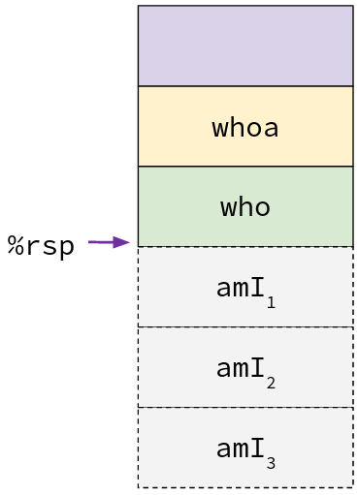
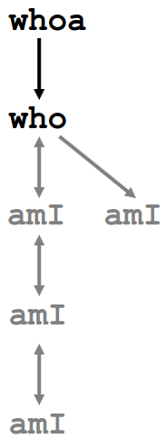
8. Return from Call to amI
whoa(...) {
.
.
who(...);
.
.
}
who(...) {
.
amI(...);
.
amI(...);
.
}

Slide 42
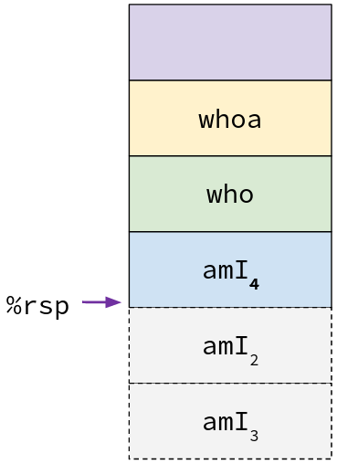
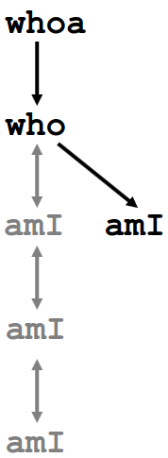
9. (yet another) Call to amI
whoa(...) {
.
.
who(...);
.
.
}
who(...) {
.
amI(...);
.
amI(...);
.
}
amI(...) {
.
.
if(...)
amI(...);
.
.
}

Slide 43
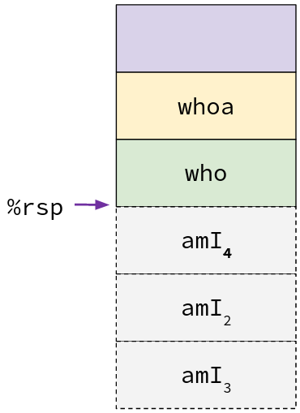
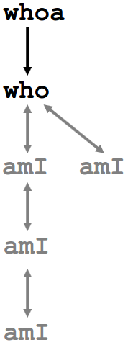
10. Return from (yet another) Call
to amI
whoa(...) {
.
.
who(...);
.
.
}
who(...) {
.
amI(...);
.
amI(...);
.
}

Slide 44
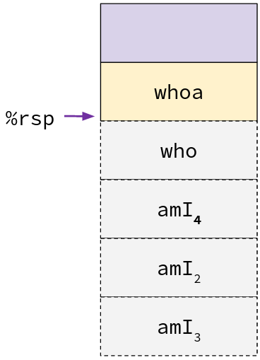
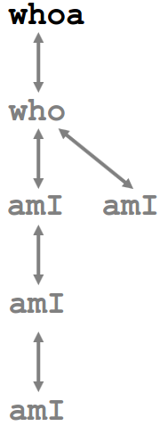
11. Return from Call to who
whoa(...) {
.
.
who(...);
.
.
}
Notes:
How many stack frames: 6 (whoa, who, amI1, amI2, amI3, amI4)
Max stack depth? 5 (whoa, who, amI1, amI2, amI3)

Slide 45
whoa
%rsp

Slide 46
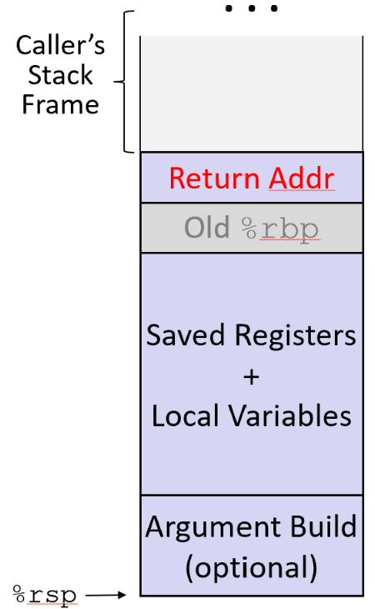
Stack Frame Layout
Return address to marks the beginning of a stack frame
This is an arbitrary choice!
“Old %rbp” no longer used in modern compilers
Argument build = args 7+ for the next procedure
Pushed onto the stack right before call
Notes:
Rbp = base pointer, points to beginning of frame
pushq % rbp saves old %rbp
movq %rsp, %rbp sets %rbp to point to old value
This use of rbp is outdated, but used in lab2+3
Argument build is for the next function. Arg build for the current function is in the caller’s stack frame, right before the beginning of the current frame

Slide 47
Stack Overflow
When the the size of the stack grows too large
%rsp points to something it’s not supposed to, segmentation fault
In theory, happens when stack collides with heap
In practice, Linux limits stack to 8 MiB
Aside: Stack Overflow website was named by popular vote from users. Some of the non-winning options:
bitoriented
dereferenced
privatevoid
shiftleft1
understandrecursion

Slide 48
Discussion: Stack Conventions
The stack is maintained between function calls by conventions, meaning you could (in theory) write code that doesn’t follow them.
Argument passing convention: 1st 6 args go in specific registers, then the stack
Return value convention: %rax
Register saving convention: next lecture
What could happen if your program didn’t follow these conventions?
Notes:
Your program would work on its own, but would break when it interacts with other code!

Slide 49
Summary
The stack is a region of memory that stores local data for procedures
Allocated in frames
Grows down. Stack Pointer (%rsp) points to the end of the stack
When a procedure is called, return address is pushed onto the stack
Popped off again on return
We use procedure call convention to pass data between procedures
1st 6 args in registers (remember with Diane’s silk dress costs $89)
Remaining args on the stack
Return value in %rax
When writing to a register, save its old value on the stack to prevent data loss

