Slide 1
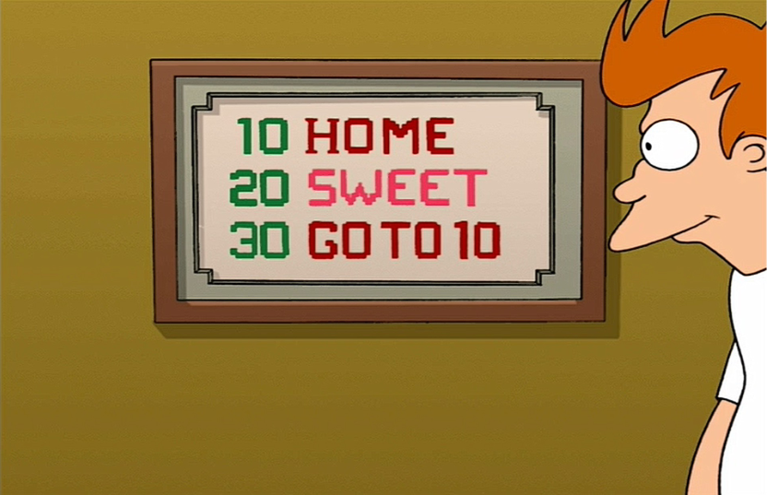
x86-64 Programming III
CSE 351 Summer 2024
Instructor:
Ellis Haker
Teaching Assistants:
Naama Amiel
Micah Chang
Shananda Dokka
Nikolas McNamee
Jiawei Huang

Slide 2
Administrivia
Today
HW7 due (11:59pm)
Lab2 out!
Due 7/19
Wednesday, 7/10
RD10 due (1pm)
HW8 due (11:59pm)
Lab1b due (11:59pm)
Friday, 7/12
RD11 due (1pm)
HW10 due (11:59pm)
Quiz 1 due (11:59pm)

Slide 3
Review Question
long absdiff(long x, long y)
{
long result;
if (x > y)
result = x-y;
else
result = y-x;
return result;
}
%rdi | x
%rsi | y
%rax | result
What should go in the two blank lines?
A) cmpq %rsi, %rdi
jle .L4
B) cmpq %rsi, %rdi
jg .L4
C) testq %rsi, %rdi
jle .L4
D) testq %rsi, %rdi
jg .L4
absdiff:
__________________
__________________
movq %rsi, %rax # x>y:
subq %rdi, %rax
ret
.L4: # x<=y:
movq %rdi, %rax
subq %rsi, %rax
ret
Notes:
Cmp = subtract, test = and (bitwise)
Cmp lets us check which is greater
Cmpq rsi, rdi = rdi-rsi = x-y
Jump to else if x!>y -> x<=y, x-y=0 -> jle, so the answer is B

Slide 4
Lecture Topics
Condition Codes
Conditional and Unconditional Branches
Loops
Switches

Slide 5
Recap: Condition Codes
4 1-byte registers that store information about the result of a previous instruction
CF: Carry (unsigned overflow)
ZF: Zero
SF: Sign (negative)
OF: Overflow (signed)
Implicitly set by any arithmetic or logical instruction
Explicitly set by two instructions:
cmp_ src1, src2 sets flags based on the result of src2-src1
test_ src1, src2 sets flags based on the result of src2&src1

Slide 6
Recap: Set Instructions
Instruction | Condition | Description
sete dst | ZF | Equal (to zero)
setne dst | ~ZF | Not Equal (to zero)
sets dst | SF | Negative
setns dst | ~SF | Nonnegative
setg dst | ~(SF^OF)&~ZF | Greater (signed)
setge dst | ~(SF^OF) | Greater or Equal (signed)
setl dst | (SF^OF) | Less than (signed)
setle dst | (SF^OF)|ZF | Less or Equal (signed)
seta dst | ~CF&~ZF | Above (unsigned “>”)
setb dst | CF | Below (unsigned “<”)
Sets lowest byte to 1 if the condition is met, 0 otherwise
Notes:
Set takes a single-byte register or memory location
Comparison is against zero! Ex: sete = set if equal to 0
Don’t need to learn the condition column

Slide 7
Recap: Reading Condition Codes
%rdi | x
%rsi | y
%rax | Return
set* Instructions
Set a byte to 0 or 1 based on condition codes
Operand is byte register (e.g., %al) or a byte in memory
Does not alter remaining bytes in register
Typically use movzb_ (zero-extended mov) to fill in the rest of the register
int gt(long x, long y)
{
return x > y;
}
cmpq %rsi, %rdi # Compare x:y
setg %al # Set when >
movzbl %al, %eax # Zero rest of %rax
ret
Notes:
Cmp sets flags based on x-y
Setg sets %al (lowest byte of %rax) to 1 if x-y>0 (i.e. x > y)
Extend to size of an int

Slide 8
Recap: Jump Instructions
Instruction | Condition | Description
jmp target | 1 | Unconditional
je target | ZF | Equal (to zero)
jne target | ~ZF | Not Equal (to zero)
js target | SF | Negative
jns target | ~SF | Nonnegative
jg target | ~(SF^OF)&~ZF | Greater (signed)
jge target | ~(SF^OF) | Greater or Equal (signed)
jl target | (SF^OF) | Less than (signed)
jle target | (SF^OF)|ZF | Less or Equal (signed)
ja target | ~CF&~ZF | Above (unsigned “>”)
jb target | CF | Below (unsigned “<”)
Sets %rip to target if the condition is met
jmp is unconditional - always jumps
Used to create if statements, loops, etc.
Notes:
Remember %rip (instruction pointer) is a special register that stores the address of the next instruction to execute

Slide 9
Choosing Instructions for Conditionals
All arithmetic instructions set condition flags based on result of operation (op)
Jump and set are comparisons against 0
Come in pairs
First instruction sets condition codes
Second instruction uses them
 |  | (op) s, d
je | “Equal” | d (op) s == 0
jne | “Not Equal” | d (op) s != 0
js | “Sign” (negative) | d (op) s < 0
jns | (nonnegative) | d (op) s >= 0
jg | “Greater” | d (op) s > 0
jge | “Greater or Equal” | d (op) s >= 0
jl | “Less” | d (op) s < 0
jle | “Less or Equal” | d (op) s <= 0
ja | “Above” (unsigned) | d (op) s > 0U
jb | “Below” (unsigned) | d (op) s < -U
addq a, b
je: b+a == 0
jne: b+a != 0
jg: b+a > 0
jl: b+a < 0
orq a, b
je: b|a == 0
jne: b|a != 0
jg: b|a > 0
jl: b|a < 0
Notes:
Most important table!! And it’s on the reference sheet (on course website and Ed)
Also includes set and how these instructions combine with cmp and test

Slide 10
Choosing Instructions for Conditionals (pt 2)
Reminder: cmp works like sub, and test works like and
Result not stored anywhere
cmpq a, b
je: b-a == 0
jne: b-a != 0
jg: b-a > 0
jl: b-a < 0
Use test, a, a to set the flags based on a single value!
 |  | (op) s, d
je | “Equal” | d (op) s == 0
jne | “Not Equal” | d (op) s != 0
js | “Sign” (negative) | d (op) s < 0
jns | (nonnegative) | d (op) s >= 0
jg | “Greater” | d (op) s > 0
jge | “Greater or Equal” | d (op) s >= 0
jl | “Less” | d (op) s < 0
jle | “Less or Equal” | d (op) s <= 0
ja | “Above” (unsigned) | d (op) s > 0U
jb | “Below” (unsigned) | d (op) s < -U
testq a, b
je: b&a == 0
jne: b&a != 0
jg: b&a > 0
jl: b&a < 0
testq a, a
je: a == 0
jne: a != 0
jg: a > 0
jl: a < 0
Notes:
Remember a&a=a

Slide 11
Labels
A jump changes the program counter (%rip)
%rip tells the CPU the address of the next instruction to execute
Labels give us a way to refer to a specific instruction in assembly code
Associated with the next instruction found in the assembly code
Eventually, each use of the label will be replaced with something that indicates the address of the instruction that it is associated with
max:
movq %rdi, %rax
cmpq %rsi, %rdi
jg done
movq %rsi, %rax
done:
ret
swap:
movq (%rdi), %rax
movq (%rsi), %rdx
movq %rdx, (%rdi)
movq %rax, (%rsi)
ret
Notes:
Note: compiler-generated labels usually in the form .L#

Slide 12
Putting it all Together (pt 1)
%rdi | x
%rsi | y
%rax | Return value
long max(long x, long y)
{
long max;
if (x > y) {
max = x;
} else {
max = y;
}
return max;
}
max:
if x<y, jump to else
movq %rdi, %rax
jump to done
else:
movq %rsi, %rax
done:
ret
Notes:
Reminder: need the opposite condition to jump to else case
Unconditional jump to done, otherwise we would execute both if and else code

Slide 13
Putting it all Together (pt 2)
%rdi | x
%rsi | y
%rax | Return value
long max(long x, long y)
{
long max;
if (x > y) {
max = x;
} else {
max = y;
}
return max;
}
max:
cmpq %rdi, %rsi # jump if
jge else # y >= x
movq %rdi, %rax
jmp done
else:
movq %rsi, %rax
done:
ret
Notes:
Cmpq = rsi-rdi = y-x
Jump to else if y-x>=0 -> y>=x

Slide 14
Expressing with Goto Code
long absdiff_j(long x, long y)
{
long result;
int ntest = (x <= y);
if (ntest) goto Else;
result = x-y;
goto Done;
Else:
result = y-x;
Done:
return result;
}
long absdiff(long x, long y)
{
long result;
if (x > y)
result = x-y;
else
result = y-x;
return result;
}
C allows goto as a means of transferring control
Closer to assembly programming style
Don’t do this!!! Bad!!!
Notes:
Exists for historical reasons, mimics assembly

Slide 15
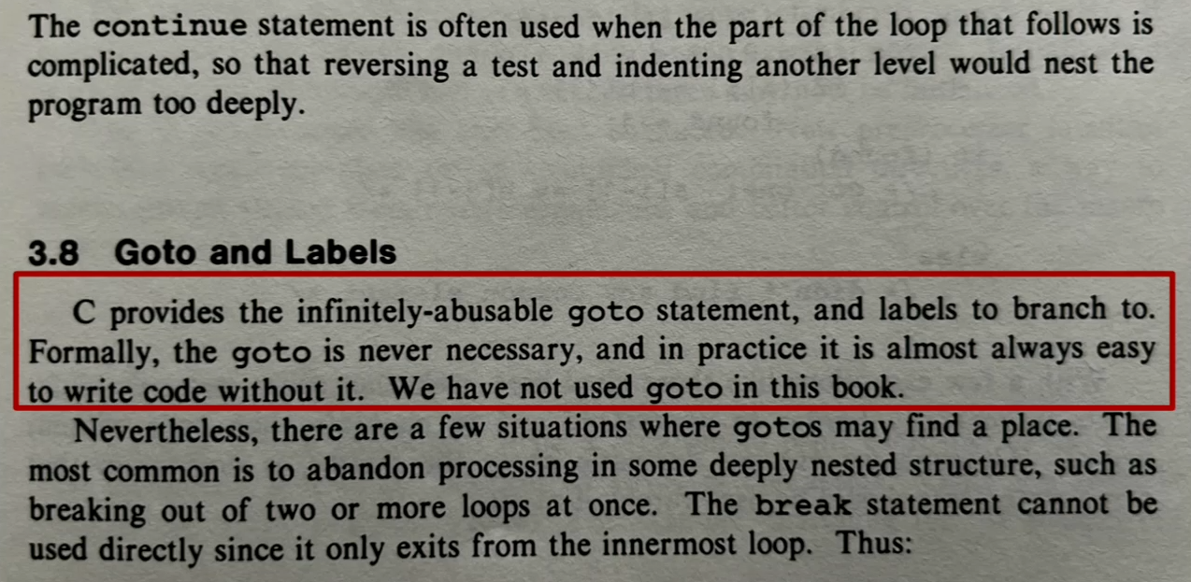
Expressing with Goto Code (pt 2)

Slide 16
Lecture Topics
Condition Codes
Conditional and Unconditional Branches
Loops
Switches

Slide 17
Compiling Loops
Example: while loop
%rax = sum
loopTop:
testq %rax, %rax # exit loop if
je loopDone # sum == 0
<loop body>
jmp loopTop # restart loop
loopDone:
while ( sum != 0 ) {
<loop body>
}
Other loops compiled similarly
Examples on the next slide
Most important to consider:
When should conditionals be evaluated (ex: while vs do-while)
How much jumping is involved?
Compiler may optimize to reduce jumping (as in the above example)

Slide 18
More While Loop Examples
While Loop (other version)
testq %rax, %rax # skip loop if
je loopDone # sum == 0
loopTop:
<loop body>
testq %rax, %rax # restart loop
jne loopTop # if sum != 0
loopDone:
while ( sum != 0 ) {
<loop body>
}
Do-While Loop
loopTop:
<loop body> # execute first
testq %rax, %rax # restart loop
jne loopTop # if sum != 0
loopDone:
do {
<loop body>
} while ( sum != 0 )
Notes:
For while loop, first testq+je skips loop if sum==0. second testq+jne is the same as the C code. Closer to C code, but less efficient
Do-while executes loop body at least once.

Slide 19
For Loops
Just turn it into a while loop!
Caveats: break and continue
break is easy, just add another jump outside of the loop
For continue, need to introduce a new label for Update, and jump to that
for (init; test; update)
{
body
}
==
<init>
loopTop:
<body>
<update>
<test>
<conditional jump to loopTop>
loopDone:
init
while (test)
{
body
update
}
Notes:
Break exits a loop early, continue skips the rest of the loop body and starts the next iteration
In a for loop, the update statement should still happen for continue, which is why we need an extra label

Slide 20
Lecture Topics
Condition Codes
Conditional and Unconditional Branches
Loops
Switches
Notes:
ASK FOR THUMBS for whether they’ve seen/used thse before

Slide 21
Switch Statement Example
long switch_ex
(long x, long y, long z)
{
long w = 1;
switch (x) {
case 1:
w = y*z; break;
case 2:
w = y/z;
/* Fall Through */
case 3:
w += z; break;
case 5:
case 6:
w -= z; break;
case 7:
w = y%z; break;
default:
w = 2;
}
return w;
}
Specify cases depending on the result of an expression
Multiple case labels
ex: 5 & 6
Fall through cases
ex: 2
Missing cases
ex: 4
Default case
Executed if the switch expression doesn’t match any other case
Notes:
Could also use an if/else ladder, but switch looks cleaner
Case 1 -> if x==1, case 2 -> if x==2, etc.
2 case will also execute case 3 code
Any x not listed will go to default

Slide 22
Jump Table Structure
Jump table = array of addresses to the start of each case
Jump Targets
Switch Form
switch (x) {
case val_0:
<lock 0>
case val_1:
<block 1>
• • •
case val_n-1:
<block n–1>
}
Jump Table
Targ0:
<block 0>
Targ0
Targ1
• • •
Targn-1
Targ1:
<block 1>
Targn-1:
<block n-1>
Approximate
goto form
target = JTab[x];
goto target;
Notes:
Targi points to the code for blocki
Case = index in jump table

Slide 23
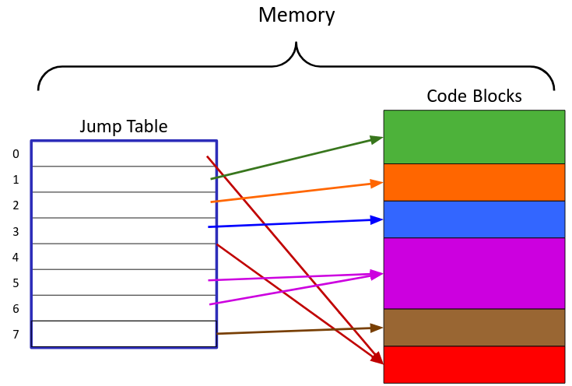
Jump Table Structure (pt 2)
switch (x) {
case 1: <code> break;
case 2: <code>
case 3: <code> break;
case 5:
case 6: <code> break;
case 7: <code> break;
default: <code>
}
if (x <= 7)
goto JTab[x];
else
goto default;
Notes:
X <=7 unsigned, so that negative numbers overflow to be >7
0 and 4 in jump table point to default

Slide 24
Switch Statement Example (pt 2)
Note: compiler chose not to initialize w
long switch_ex(long x, long y, long z)
{
long w = 1;
switch (x) {
. . .
}
return w;
}
switch_ex:
movq %rdx, %rcx
cmpq $7, %rdi # compare x:7
ja .L9 # default
jmp *.L4(,%rdi,8) # jump table
%rdi | x
%rsi | y
%rdx | z
ja = jump above. Unsigned >, catches negative cases
Notes:
Cmp+ja = if x>7 (unsigned), go to default case

Slide 25
Switch Statement Example (pt 3)
long switch_ex(long x, long y, long z)
{
long w = 1;
switch (x) {
. . .
}
return w;
}
switch_ex:
movq %rdx, %rcx
cmpq $7, %rdi # compare x:7
ja .L9 # default
jmp *.L4(,%rdi,8) # jump table
%rdi | x
%rsi | y
%rdx | z
Indirect jump
Notes:
Jmp = jump to index x in table

Slide 26
Switch Statement Assembly Explanation
.L4:
.quad .L9 # x = 0
.quad .L8 # x = 1
.quad .L7 # x = 2
.quad .L10 # x = 3
.quad .L9 # x = 4
.quad .L5 # x = 5
.quad .L5 # x = 6
.quad .L3 # x = 7
Table Structure
Each element stores an address, 8B each
Label .L4 marks start of table
Direct jump: jmp .L9
Jump target denoted by label .L9
Indirect jump: jmp *.L4(,%rdi,8)
Uses memory addressing computation
.L4 gets the address that label .L4 refers to
Scaled by 8, since each table element is 8B
Set %rsp to the label stored at address L4+%rdi*8
* means “get the data at that address” (kind of like a C dereference)
Notes:
.L4 = label for table
.LX (x!=4) = label for case code
Remember “quad” = 8B in x86_64
x/out *, would set %rsp to &table[x]. w/ *, sets it to table[x]

Slide 27
Summary
Control flow in x86 is determined by condition codes (CF, ZF, SF, OF)
Set flags implicitly with arithmetic/logical instructions, or explicitly with cmp and test
Set (set*) instructions set a given 1-byte memory location to 1 or 0 depending on condition
Conditional jump (j*) instructions set %rsp point to a given instruction if condition is true
Unconditional jump (jmp) always sets %rsp
Most control flow constructs (e.g., if-else, for-loop, while-loop) can be implemented in assembly using combinations of conditional and unconditional jumps
Indirect jumps and jump tables are used to implement switches

