Slide 1
x86-64 Programming II
CSE 351 Summer 2024
Instructor:
Ellis Haker
Teaching Assistants:
Naama Amiel
Micah Chang
Shananda Dokka
Nikolas McNamee
Jiawei Huang

Slide 2
Administrivia
Today:
HW6 due (11:59pm)
Late deadline for Lab 1a (11:59pm)
Quiz 1 out (11:59pm)
Reminder: Abbot Elementary policy (see course website for details)
Monday 7/8:
RD9 due (1pm)
HW7 due (11:59pm)
Wednesday 7/10:
RD 10 due (1pm)
HW8 due (11:59pm)
Lab1b due (11:59pm)
Notes:
Also reminder to make Ed questions about quiz private

Slide 3
Aside: C Macros
Basic syntax is of the form: #define NAME expression
NOT the same as a Java constant, though they’re used similarly
Performs a naive copy before compilation
Any time the characters in NAME appear, will be replaced with the characters in expression
Expression doesn’t have to be a constant
Order of operations may get mixed up if you’re not careful!
Remember that integer constants are signed ints by default, need to cast if you plan on using them as anything else
Useful in Lab 1b
Please don’t use magic numbers in your code!
Notes:
Preprocessor – done before compilation, just does search + replace!
Ex: #define MACRO 1+2
If we then have the line “int x=3*MACRO;”, this becomes “int x = 3*1+2;”, which is 5 ☹

Slide 4
Lecture Topics
Address Computation Part 2: Electric Boogaloo
Memory addressing mode examples
lea instruction
Move extension
Control flow
Processor state
Condition codes
jmp and set instructions

Slide 5
Recap: Memory Addressing Modes
General format: D(Rb,Ri,S) = Mem[Reg(Rb) + Reg(Ri)*S + D]
Rb = base register (any register)
Ri = index register (any register except %rsp)
S = scale factor (1, 2, 4, 8) - Why these numbers?
D = displacement value (immediate)
Can leave any of these out:
D(Rb,Ri) - S=1
(Rb,Ri,S) - D=0
(Rb,Ri) - D=0, S=1
(,Ri,S) - D=0, Rb=0
etc…
Notes:
Why these numbers? Same our data widths! Used for ptr arithmetic/array indexing

Slide 6
Address Computation Examples
%rdx | 0xF000
%rcx | 0x0100
8-bit addresses
Reminder: D(Rb,Ri,S) →Mem[Reg[Rb]+Reg[Ri]*S+D]
(ignoring memory addressing portion for this exercise, just calculating address)
Expression | Address Computation | Address
0x8(%rdx)
(%rdx, %rcx)
(%rdx, %rcx, 4)
0x80(, %rcx, 2)
Notes:
0x8(%rdx): 0x8=D, %rdx=Rb. %rdx+0x8 = 0xF008
(%rdx, %rcx): %rdx=Rb, %rcx=Ri. %rdx+%rcx = 0xF100
(%rdx, %rcx, 4): %rdx=Rb, %rcx=Ri, 4=S. %rdx+%rcx*4 = 0xF400
0x80(, %rcx, 2): 0x80=D, %rcx=Ri (notice the comma!), 2=S. 0x80+%rcx*2 = 0x0280

Slide 7
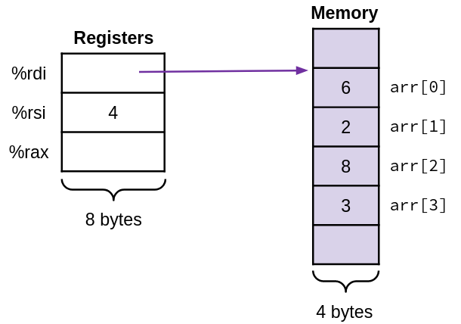
Address Computation Code Example
%rdi | arr
%rsi | len
%eax | Return value
int last_elem(int* arr, long len)
{
return arr[len-1];
}
last_elem:
movl -4(%rdi,%rsi,4), %eax
ret
Notes:
movl -4(%rdi, %si, 4), eax gets 4B of data at rdi+rsi*4-4 = arr+len*4-4 = arr+(len-1)*r=arr[len-1]. In this diagram, stores the value 3 into %rax

Slide 8
Review Question
Which of the following x86-64 instructions correctly calculates %rax=9*%rdi?
leaq (,%rdi,9), %rax
movq (,%rdi,9), %rax
leaq (%rdi,%rdi,8), %rax
movq (%rdi,%rdi,8), %rax
Notes:
Can’t be A or B bc 9 is not valid – S must be 1, 2, 4, or 8.
For D and C, both instructions will compute rdi+rdi*8=rdi*8. lea stores this result into %rax, but mov treats the result as an address and gets data from that location in memory, so the answer is C.

Slide 9
Address Computation Instruction
leaq src, dst
“lea” stands for load effective address
src is address expression (using memory addressing format), dst is a register
Sets dst to the address computed by the src expression
Does not go to memory! – it just does math
Example: leaq (%rdx,%rcx,4), %rax
Uses:
Computing addresses without a going to memory
Ex: assembly equivalent of p = &x[i]
Computing arithmetic expressions of the form x+k*i+d (k must be 1, 2, 4, or 8)
Can use to compute anything! Doesn’t have to be an address

Slide 10
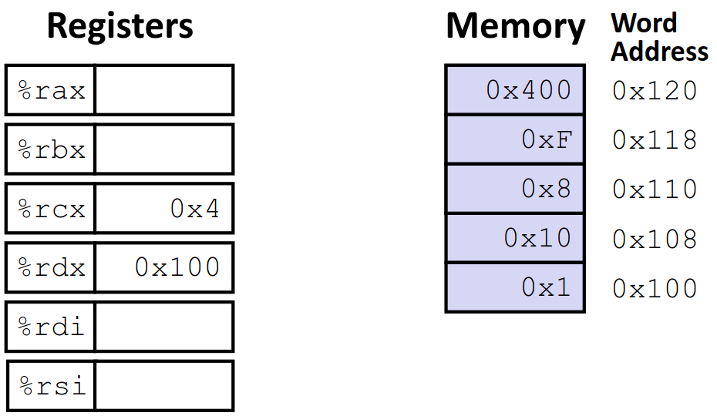
Example: lea vs mov
leaq (%rdx,%rcx,4), %rax
movq (%rdx,%rcx,4), %rbx
leaq (%rdx), %rdi
movq (%rdx), %rsi
Notes:
1st instruction: rdx+rcx*4=0x100+4*4=0x110. Stores 0x110 into %rax
2nd instruction: same calculation as before, but gets data at memory address 0x110, stores value 0x8 into %rbx
3rd instruction: stores value in %rdx into %rdi. Stores 0x100 into %rdi
4th instruction: stores the value %rdx points to into %rsi. Stores 0x1 into %rsi
Note: leaq (%rdx), %rdi == movq (%rdx), %rdi)

Slide 11
lea Arithmetic Example
long arith(long x, long y, long z)
{
long t1 = x + y;
long t2 = z + t1;
long t3 = x + 4;
long t4 = y * 48;
long t5 = t3 + t4;
long rval = t2 * t5;
return rval;
}
arith:
leaq (%rdi,%rsi), %rax
addq %rdx, %rax
leaq (%rsi,%rsi,2), %rdx
salq $4, %rdx
leaq 4(%rdi,%rdx), %rcx
imulq %rcx, %rax
ret
%rdi | x
%rsi | y
%rax | t1, t2, rval
%rcx | t5
%rdx | z, t4
Notice imulq is only used once!
Uses leaq and salq instead

Slide 12
lea Arithmetic Example (pt 2)
long arith(long x, long y, long z)
{
long t1 = x + y;
long t2 = z + t1;
long t3 = x + 4;
long t4 = y * 48;
long t5 = t3 + t4;
long rval = t2 * t5;
return rval;
}
arith:
leaq (%rdi,%rsi), %rax
addq %rdx, %rax
leaq (%rsi,%rsi,2), %rdx
salq $4, %rdx
leaq 4(%rdi,%rdx), %rcx
imulq %rcx, %rax
ret
%rdi | x
%rsi | y
%rax | t1
%rcx
%rdx | z
Notes:
Rax = rdi+rsi = x+y = t1

Slide 13
lea Arithmetic Example (pt 3)
long arith(long x, long y, long z)
{
long t1 = x + y;
long t2 = z + t1;
long t3 = x + 4;
long t4 = y * 48;
long t5 = t3 + t4;
long rval = t2 * t5;
return rval;
}
arith:
leaq (%rdi,%rsi), %rax
addq %rdx, %rax
leaq (%rsi,%rsi,2), %rdx
salq $4, %rdx
leaq 4(%rdi,%rdx), %rcx
imulq %rcx, %rax
ret
%rdi | x
%rsi | y
%rax | t1, t2
%rcx
%rdx | z
Notes:
Rax = rdx+rax = z+t1 = t2

Slide 14
lea Arithmetic Example (pt 4)
long arith(long x, long y, long z)
{
long t1 = x + y;
long t2 = z + t1;
long t3 = x + 4;
long t4 = y * 48;
long t5 = t3 + t4;
long rval = t2 * t5;
return rval;
}
arith:
leaq (%rdi,%rsi), %rax
addq %rdx, %rax
leaq (%rsi,%rsi,2), %rdx
salq $4, %rdx
leaq 4(%rdi,%rdx), %rcx
imulq %rcx, %rax
ret
%rdi | x
%rsi | y
%rax | t1, t2
%rcx
%rdx | z, t4
Notes:
Skips line 3 for now
Remember x << 4 = x*2^4 = x*16
1st instruction: rdx = rsi+rsi*2 = y+y*2 = y*3
2nd instruction: rdx = rdx*16 = y*3*16 = y*48
Compiler does this because an lea + shift is faster than a single imul instruction

Slide 15
lea Arithmetic Example (pt 5)
long arith(long x, long y, long z)
{
long t1 = x + y;
long t2 = z + t1;
long t3 = x + 4;
long t4 = y * 48;
long t5 = t3 + t4;
long rval = t2 * t5;
return rval;
}
arith:
leaq (%rdi,%rsi), %rax
addq %rdx, %rax
leaq (%rsi,%rsi,2), %rdx
salq $4, %rdx
leaq 4(%rdi,%rdx), %rcx
imulq %rcx, %rax
ret
%rdi | x
%rsi | y
%rax | t1, t2
%rcx | t5
%rdx | z, t4
Notes:
Back to line 3, 2 C lines in 1 x86 instruction
Rcx = 4+rdi+rdx = 4+x+t4 = t3+t4 = t5

Slide 16
lea Arithmetic Example (pt 6)
long arith(long x, long y, long z)
{
long t1 = x + y;
long t2 = z + t1;
long t3 = x + 4;
long t4 = y * 48;
long t5 = t3 + t4;
long rval = t2 * t5;
return rval;
}
arith:
leaq (%rdi,%rsi), %rax
addq %rdx, %rax
leaq (%rsi,%rsi,2), %rdx
salq $4, %rdx
leaq 4(%rdi,%rdx), %rcx
imulq %rcx, %rax
ret
%rdi | x
%rsi | y
%rax | t1, t2, rval
%rcx | t5
%rdx | z, t4
Notes:
Rax = rax*rcx = t2*t5 = rval

Slide 17
Lecture Topics
Address Computation Part 2: Electric Boogaloo
Memory addressing mode examples
lea instruction
Move extension
Control flow
Processor state
Condition codes
jmp and set instructions

Slide 18
Move extension: movz and movs
movz__ src, dst = Move with zero extension
movs__ src, dst = Move with sign extension
src can me memory or register. dst must be a register
Copy from a smaller source value to a larger destination
Takes two width specifiers: 1st is source, 2nd is destination
Fill remaining bits of dest with zero (movz) or sign bit (movs)
Example:
movzbw %al, %bx
Notes:
Z = zero-extend, b = 1B src, w = 2B dst, %al = lowest B of %rax, %bx = lowest 2B of %rbx.
In diagram, copy 0xFF from %rax to %rbx, extend with 0s in the 2nd byte, rest left untouched

Slide 19
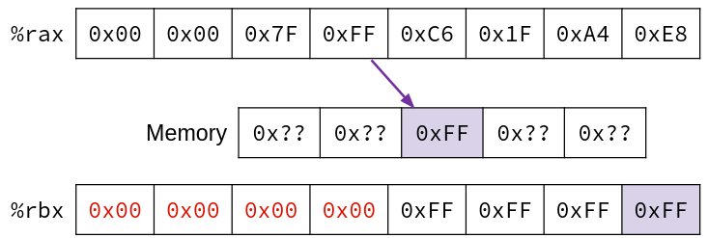
Move extension: movz and movs (pt 2)
movz__ src, dst = Move with zero extension
movs__ src, dst = Move with sign extension
Example:
movsbl (%rax), %ebx
In x86_64, any instruction that writes a 4-byte value to a register automatically sets the highest 4 bytes of that register to 0!
Notes:
S = sign-extend, b = 1B src, l = 4B dst, (%rax) = Mem[%rax], %ebx = lowest 4B of %rbx.
In diagram: %rax gives the location in memory, copy 0xFF from memory to lowest byte of %rbx, extend with 0xFF in the next 4B

Slide 20
Lecture Topics
Address Computation Part 2: Electric Boogaloo
Memory addressing mode examples
lea instruction
Move extension
Control flow
Processor state
Condition codes
jmp and set instructions

Slide 21
Control Flow
%rdi | x
%rsi | y
%rax | Return value
How do we alter the flow of execution?
ex: if/else ladders, loops, etc.
Example:
long max(long x, long y)
{
long max;
if (x > y) {
max = x;
} else {
max = y;
}
return max;
}
max:
???
movq %rdi, %rax
???
???
movq %rsi, %rax
???
ret

Slide 22
Control Flow (pt 2)
%rdi | x
%rsi | y
%rax | Return value
How do we alter the flow of execution?
ex: if/else ladders, loops, etc.
Example:
Conditional jump
long max(long x, long y)
{
long max;
if (x > y) {
max = x;
} else {
max = y;
}
return max;
}
max:
if x<y, jump to else
movq %rdi, %rax
jump to done
else:
movq %rsi, %rax
done:
ret
Unconditional jump

Slide 23
Conditionals and Control Flow
Conditional jump
Jump to somewhere else if some condition is true, otherwise execute next instruction in order
Unconditional jump
Always jump when you get to this instruction
Together, they can implement most control flow constructs in high-level languages:
if (condition) {...} else {...}
while (condition) {...}
for (initialization; condition; iterative) {...}
switch {...}

Slide 24
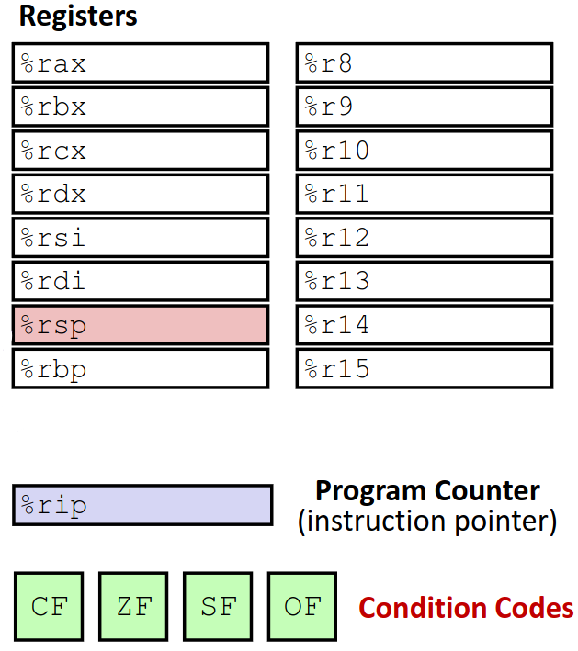
x86 Processor State (partial)
Program data
General-purpose registers (ex: %rax)
Next instruction
Instruction pointer (%rip)
Status of recent operations
Condition codes: single-bit registers (CF, ZF, SF, OF)
We’ll talk about more in the future!

Slide 25
Condition Codes
Keep track of information about the recent instructions
Carry Flag: CF
1 if carry-out from MSB (unsigned overflow)
Zero Flag:
1 if result is 0
Sign Flag: SF
1 if result < 0 when interpreted as signed (i.e. MSB is 1)
Overflow Flag: OF
1 if signed overflow

Slide 26
Condition Codes: Implicit Setting
Any arithmetic or logical instruction implicitly sets condition codes
(Think of it as a side effect)
lea doesn’t count!
Ex: addb $1, %ax (%ax = 0xFF)
Result = 0x00
CF=1 ZF=1 SF=0 OF=0
Reminder: the hardware doesn’t keep track of data types!
i.e. it will still set the sign and zero flags, even if you’re interpreting the data as unsigned!
Notes:
0b11111111 + 1 = 0b00000000 (plus a carry bit)
CF = 1, extra bit “dropped off”
ZF = 1, result is 0
SF = 0, result is not negative
OF = 0, -1+1=0, expected result

Slide 27
Condition Codes: Explicit Setting
Compare instruction: cmp_ src1, src2
Sets flags based on src2-src1, but doesn’t store
CF = 1 if unsigned overflow (good for unsigned comparison)
ZF = 1 if src1==src2
SF = 1 if (src2-src1)<0 (good for signed comparison)
OF = 1 if signed overflow
Notes:
CF: if src2-src1 overflows (unsigned), then src2<src1 (unsigned)
ZF: 1 if src1==src2 because src2-src1==0
SF: if src2-src1 < 0 (signed), then src2<src2 (signed)

Slide 28
Condition Codes: Explicit Setting (pt 2)
Test instruction: test_ src1, src2
Sets flags based on src1&src2, but doesn’t store
Can’t have carry out (CF) or overflow(OF)
ZF = 1 if src1&src2==0
SF = 1 if src2&src1<0 (signed, i.e. MSB=1)
Notes:
SF: in 2’s comp, MSB=1 means negative

Slide 29
Polling Question: Condition Code Setting
Assuming that %al = 0x80 and %bl = 0x81, which flags (CF, ZF, SF, OF) are set when we execute cmpb %al, %bl?
(Hint: instead of computing %bl - %al, compute %bl + (-%al))
Notes:
Al = 0b10000000, -al = ~al+1 = 0b01111111+1 = 0b10000000 (oops!)
Bl+(-al) = 0b10000001+0b10000000 = 0b00000001 (plus a carry bit)
CF = 1 (because of carry bit)
ZF = 0 (result != 0)
SF = 0 (result is not negative)
OF = 0 (tricky! Looks like overflow based on signs of operands and result, but 0x81-0x80=1, which is our answer!)

Slide 30
Using Condition Codes: Setting
General format: set* dst
Sets lowest byte of dst to 1 if the condition is met, 0 otherwise
Does not alter the remaining 7 bytes
Don’t bother memorizing, just use the chart.
Instruction | Condition | Description
sete dst | ZF | Equal (to zero)
setne dst | ~ZF | Not Equal (to zero)
sets dst | SF | Negative
setns dst | ~SF | Nonnegative
setg dst | ~(SF^OF)&~ZF | Greater (signed)
setge dst | ~(SF^OF) | Greater or Equal (signed)
setl dst | (SF^OF) | Less than (signed)
setle dst | (SF^OF)|ZF | Less or Equal (signed)
seta dst | ~CF&~ZF | Above (unsigned “>”)
setb dst | CF | Below (unsigned “<”)
Notes:
Dst should be a 1-byte register or memory location
Don’t need to know the condition column!

Slide 31
Reading Condition Codes
%edi | x
%esi | y
%eax | Return value
Use set* instructions
Remember: only alters the lowest byte of a register
Commonly seen with movz instructions to fill out remaining bytes
Example:
(comments)
int gt(int x, int y)
{
return x > y;
}
gt:
cmpl %esi, %edi # Compare x and y
setg %al # Set when >
movzbl %al, %eax # Zero rest of %rax
ret
Notes:
Cmpl: set flags based on edi-esi = x-y
Setg: set %al to 1 if x-y>0 -> x>y
Movzbl: extend to 4B int

Slide 32
Using Condition Codes: Jumping
General format: j* target
Sets %rip to target if the condition is met
jmp is unconditional - always jumps
Used to create if/else statements, loops, etc.
More info next lecture
Don’t bother memorizing, just use the chart.
Instruction | Condition | Description
jmp target | 1 | Unconditional
je target | ZF | Equal (to zero)
jne target | ~ZF | Not Equal (to zero)
js target | SF | Negative
jns target | ~SF | Nonnegative
jg target | ~(SF^OF)&~ZF | Greater (signed)
jge target | ~(SF^OF) | Greater or Equal (signed)
jl target | (SF^OF) | Less than (signed)
jle target | (SF^OF)|ZF | Less or Equal (signed)
ja target | ~CF&~ZF | Above (unsigned “>”)
jb target | CF | Below (unsigned “<”)
Notes:
%rip points to next instruction to execute

Slide 33
Summary:
Memory addressing modes allow us to compute an address in a single instruction
D(Rb, Ri, S) -> Rb + Ri*S + D
lea just performs the computation and stores the result
All instructions treat the result as an address, then get data at that address in memory
Condition codes store information about previous operation
Implicitly set by any arithmetic or logical instruction
Explicitly set by cmp and test instructions
Used with jump and set instructions

