Slide 1
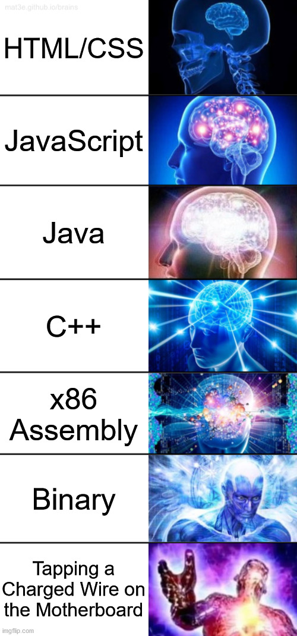
x86-64 Programming I
CSE 351 Summer 2024
Instructor:
Ellis Haker
Teaching Assistants:
Naama Amiel
Micah Chang
Shananda Dokka
Nikolas McNamee
Jiawei Huang

Slide 2
Administrivia
Due today
HW5 (11:59pm)
Lab 1a (11:59pm)
Due Friday, 7/5
RD8 (1pm)
HW6 (11:59pm)
Quiz 1 released Friday at 11:59pm
Optional reading posted on Ed
Recent article about designing assembly language design
Beyond the scope of this course, but very cool!

Slide 3
Review Questions
Assume that the register %rdx holds the value 0x 01 02 03 04 05 06 07 08
Answer the following questions about the instruction subq $1, %rdx
Operation type:
Operand types:
Operating width:
(extra) Result stored in %rdx:
Notes:
1. Subq is subtraction, so arithmetic
2. 1st type is an immediate bc of dollar sign, 2nd is a register bc of %
3. 8 bytes bc of q
Result = %rdx – 1 = 0x0102030405060707

Slide 4
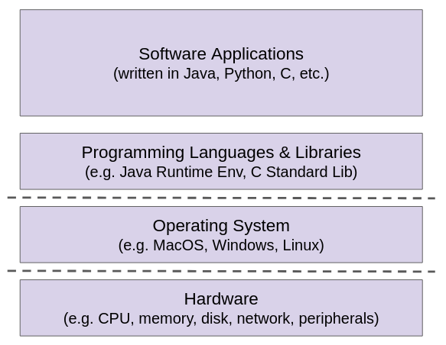
Layers of Computing Revisited
So far, we’ve focused on hardware
How does the CPU store and read data from memory?
Shifting focus to languages & libraries
How are programs created and executed on the CPU?
Take CSE 401 to learn more
Still needs hardware support!
Take CSE 469 to learn more

Slide 5
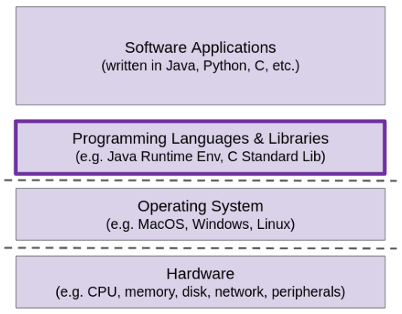
Programming Languages & Libraries: 351 View
Topics:
x86-64 assembly
Procedures
Stacks
Executables
How does your source code become something that your computer understands?
How does the CPU organize and manipulate local data?
Notes:
We’ll focus on the first question for the next 3 lectures

Slide 6
Lecture Topics
Assembly intro
Instruction set philosophies
X86-64 programming
Data types
Instructions
Registers
Memory addressing

Slide 7
Definitions
Instruction Set Architecture (ISA): the parts of a processor design that one needs to understand to write assembly code
What is directly visible to software
The “contract” between hardware and software
351 focus
Microarchitecture: hardware implementation of the ISA
CSE/EE 469

Slide 8
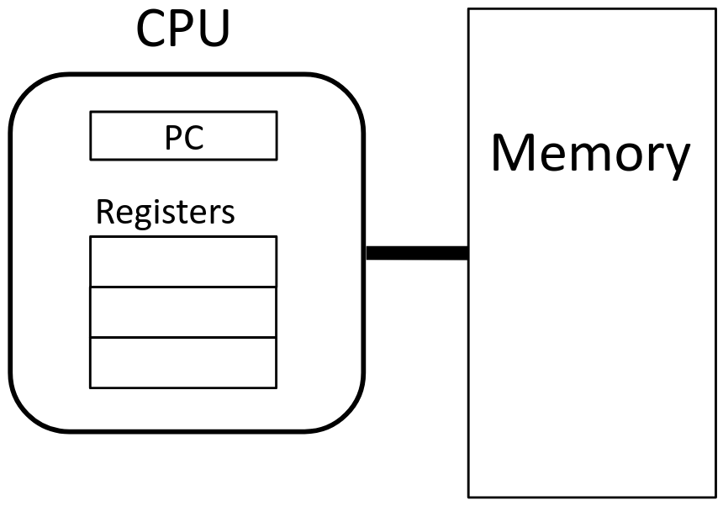
Instruction Set Architectures (Review)
ISA defines:
The system’s state (e.g., registers, memory, program counter)
The instructions the CPU can execute
The effect that each of these instructions will have on the system state
Notes:
PC stands for program counter

Slide 9
What is a Register? (Review)
Special locations on the CPU that store a small amount of data
Accessed very quickly (once per clock cycle)
Have names, not addresses
In x86, start with % (e.g., %rsi)
Registers are at the heart of assembly programming
Very useful, but scarce, especially in x86

Slide 10
Memory vs. Registers (Review)
Memory
Addresses
Ex: 0x7FFFD024C3DC
Big
~16GB
Slow
~50-100ns
Dynamic
Can expand as needed
Registers
Names
Ex: %rdi
Small
16 8-byte registers = 128B
Fast
<1ns
Static
Fixed number in hardware

Slide 11
General ISA Design Decisions
Instructions
What instructions are available? What do they do?
How are they encoded?
Registers
How many are there?
How wide are they?
Memory
How do you specify a memory location?

Slide 12
Instruction Set Philosophies (Review)
Complex Instruction Set Computing (CISC): lots of elaborate instructions
Lots of tools for programmers to use, but hardware must be able to handle all instructions
x86-64 is CISC, but only a small subset of instructions encountered with Linux programs
Reduced Instruction Set Computing (RISC): keep instruction set small and regular
Easier to build fast, less power-hungry hardware
Let software do the complicated operations by composing simpler ones
ARM, RISC-V

Slide 13
Instruction Set Philosophies (Review) (pt 2)
Complex Instruction Set Computing (CISC): lots of elaborate instructions
Lots of tools for programmers to use, but hardware must be able to handle all instructions
x86-64 is CISC, but only a small subset of instructions encountered with Linux programs
Example: ADDSUBPS
“Adds odd-numbered single-precision floating-point values of the first source operand (second operand) with the corresponding single-precision floating-point values from the second source operand (third operand); stores the result in the odd-numbered values of the destination operand (first operand). Subtracts the even-numbered single-precision floating-point values from the second source operand from the corresponding single-precision floating values in the first source operand; stores the result into the even-numbered values of the destination operand.”

Slide 14
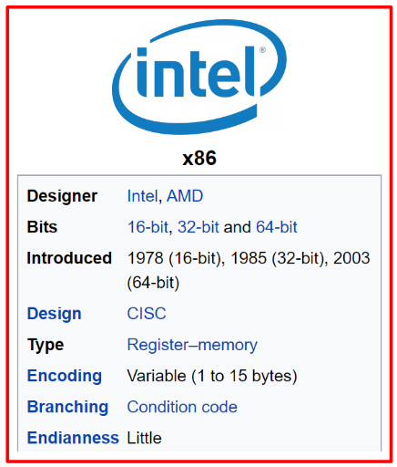
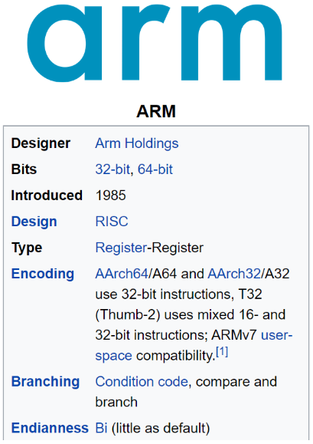
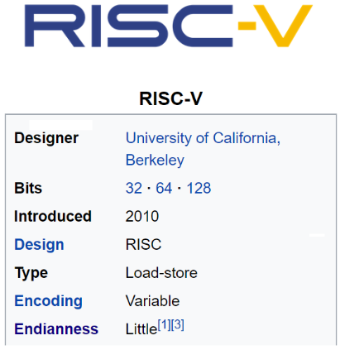
Mainstream ISAs
PCs, older Macs
x86-64 instruction set
Mobile devices, M1/M2 Macs
ARM instruction set
Mostly research
RISC-V instruction set

Slide 15
Current Industry Trends - A RISC-y Shift
Historically, there was a lot of debate about RISC vs CISC
Intel went the CISC route in the 1980s
Would make programming in assembly easier
Implementing more things in hardware
Traditional wisdom says the RISC is better for simple systems, not PCs
But things are shifting!
Apple switched to ARM in 2020
Why?
Efficiency: RISC uses less power
Performance: each instruction is faster, easier to parallelize
Scalability: suitable for devices of all sizes (desktops, laptops, and phones)

Slide 16
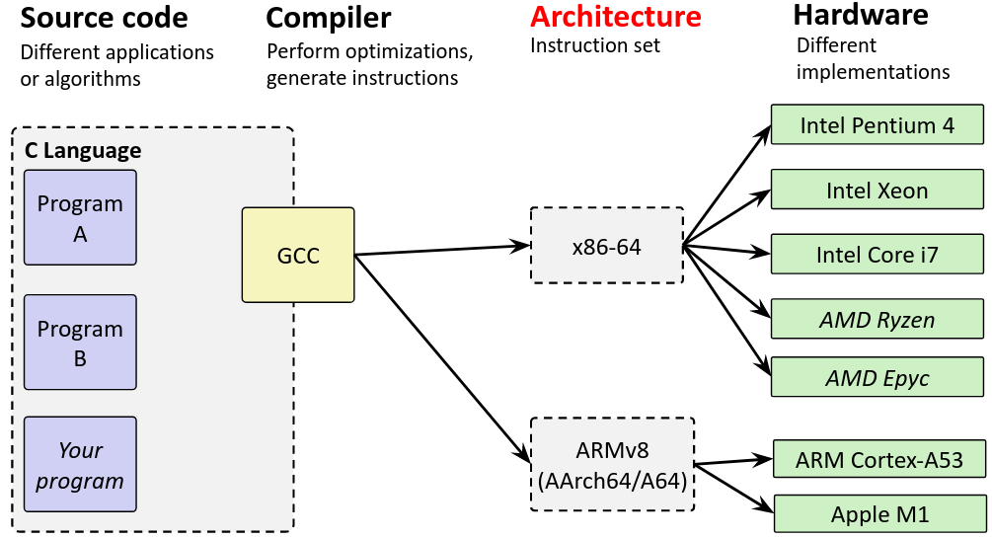
Architecture Sits at the Hardware Interface
Notes:
There’s an extra step between architecture and hardware: converting assembly to binary

Slide 17
Writing Assembly Code? In $CURRENT_YEAR???
Chances are, you’ll never write a program in assembly, but understanding it is the key to the machine-level execution model
Behavior of programs in the presence of bugs
When high-level language model breaks down
Tuning program performance
Understand optimizations done/not done by the compiler
Implementing systems software
What are the “states” of processes that the OS must manage
Using special units (timers, I/O co-processors, etc.) inside processor!
Fighting malicious software
Distributed software is in binary form
Notes:
In some industries, it’s relevant (architecture, compilers, systems, security)
Developing an accurate mental model of computation is important! Especially for debugging and improving performance
VERY rare for compilers to have bugs (modern compilers are really good), but *occasionally* it happens
Maybe you’re building a new programming language, and you’re the one making the compiler for it!
Detecting hacking attempts - you can read an executable and see if it’s dangerous
Can “reverse-engineer” a program back into assembly
NOTE: when you check off the “terms and conditions” that nobody reads, you agree not to do this
ALSO: doing this in this class (when we don’t tell you to) is academic misconduct

Slide 18
Lecture Topics
Assembly intro
Instruction set philosophies
X86-64 programming
Data types
Instructions
Registers
Memory addressing

Slide 19
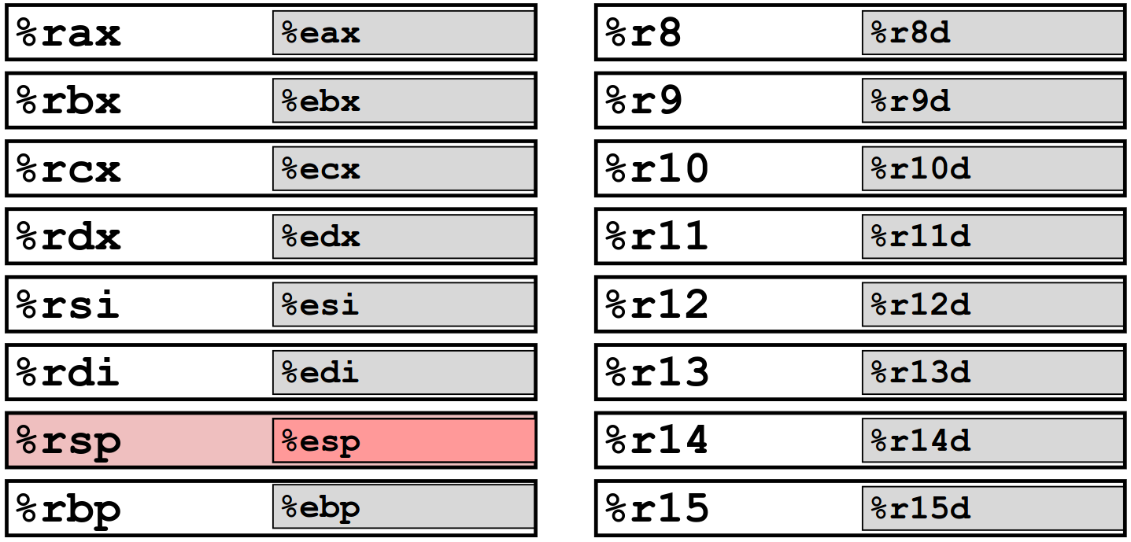
x86-64 Integer Registers – 64 bits wide
Notes:
64 bits = 8 bytes
The big registers shown here (ex: %rax) are 8B, the smaller ones within them (ex: %eax) are 4B
%rsp is a special register. We’ll talk about it later!

Slide 20
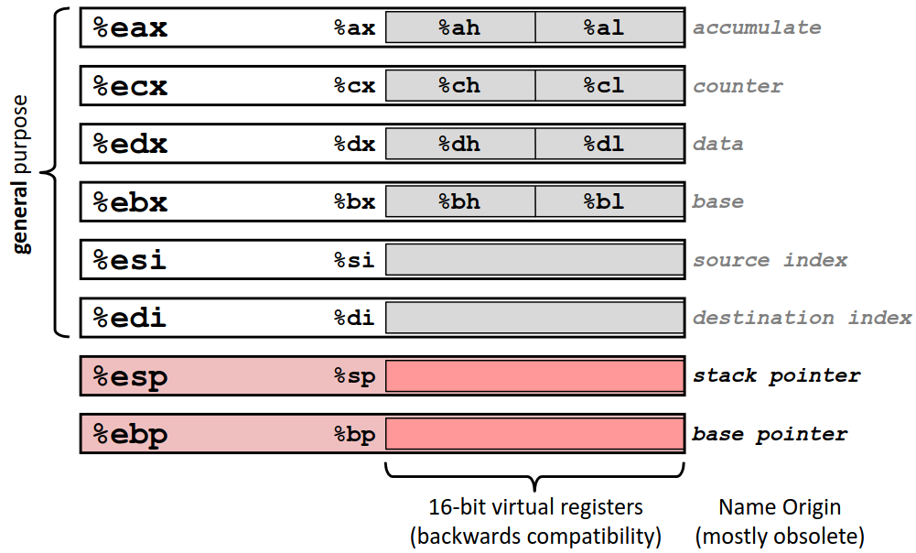
Some History: IA32 Registers – 32 bits wide
Notes:
We still have access to these old register names! Now refer to the lower bytes of the 8B register
All of these are on the midterm reference sheet

Slide 21
x86-64 Assembly “Data Types”
Integral data of 1, 2, 4, or 8 bytes (b, w, l, q)
Floating point data, not covered in 351
Different registers for those (e.g., %xmm1, %ymm2)
Come from extensions to x86 (SSE, AVX, …)
No aggregate types such as arrays or structs
Just contiguously allocate bytes in memory
Two common syntaxes—Must know which you’re reading!
AT&T: used in our course, gnu tools (including gcc), …
Intel: used in Intel documentation, Intel tools, …
Notes:
Signed and unsigned integers are treated the same. HW doesn’t distinguish!
For arrays and structs, only get single elements at a time.
Why AT&T? It used to be Bell Labs!

Slide 22
Instruction Sizes and Operands (Review)
Size specifiers
b = 1-byte (“byte”)
w = 2-byte (“word”)
l = 4-byte (“long word”)
q = 8-byte (“quad word”)
If using registers, much match width
Operand types
Immediate: constant value ($)
Register: 1 of 16 general-purpose registers (%)
Memory: consecutive bytes of memory at a computed address ( () )
Why is “word” 2 bytes? Because that was the word size when x86 was new, and it has to be maintained for backwards compatibility.
Notes:
Register size must match instruction. Ex: if using q, use 8B register. If using l, use 4B. Etc..
See memory addressing slides for more info on memory operands

Slide 23
Instruction Types (Review)
Remember: Memory
is indexed just like an
array of bytes!
Transfer data between memory and a register
Load from memory -> register
%reg = Memory[address]
Store from register -> memory
Memory[address] = %reg
Note: cannot transfer between two memory locations in one instruction!
Perform arithmetic operation on register or memory data
Ex: c = a + b; z = x << y; i = h & g;
Control flow: what instruction to execute next
Unconditional jumps to/from procedures
Conditional branches
Notes:
Control flow is the subject of a future lecture

Slide 24
Moving Data
General form: mov_ <source>, <destination>
More of a “copy” than a “move”
Missing letter (_) is for the width specifier
Ex: movq %rax, %rbx
Copies the 8-byte value from register %rax into register %rbx
Operand Combinations:
Immediate -> Register or Memory (copies Immediate value to location)
Register -> Register or Memory (copies data in register to location)
Memory -> Register (copies data in memory to register)
Can’t go from memory -> memory in a single instruction!
Notes:
_ can be replaced with either b, w, l, or q.
Source can be imm, reg, or mem. Destination can be reg or mem. Can’t have an immediate as the destination.
To move data from mem->mem requires 2 instructions: mem->reg + reg->mem

Slide 25
Some Arithmetic Operations
Format | Computation | Notes
addq src, dst | dst = dst + src
subq src, dst | dst = dst - src
imulq src, dst | dst = dst * src
sarq src, dst | dst = dst >> src | Arithmetic
shrq src, dst | dst = dst >> src | Logical
shlq src, dst | dst = dst << src | Same as shlq
xorq src, dst | dst = dst ^ src
andq src, dst | dst = dst & src
orq src, dst | dst = dst | src
Binary (two-argument) operations
Beware argument order!
src can be immediate, register, or memory
dst only register or memory
Results always stored in dst
Maximum of one memory operand!
No distinction between signed and unsigned
Only arithmetic vs logical shifts
Notes:
Max of one memory operand, same as mov

Slide 26
Practice Question
Which of the following are valid implementations of rcx = rax + rbx?
addq %rax, %rcx
addq %rbx, %rcx
movq $0, %rcx
addq %rbx, %rcx
addq %rax, %rcx
movq %rax, %rcx
addq %rbx, %rcx
xorq %rax, %rax
addq %rax, %rcx
addq %rbx, %rcx
Notes:
1. No: addq %rax, %rcx (rcx = rcx + rax)
addq %rbx, %rcx (rcx = rcx + rax + rbx)
2. Yes: movq $0, %rcx (rcx = 0)
addq %rbx, %rcx (rcx = 0 + rbx = rbx)
addq %rax, %rcx (rcx = rax + rbx)
3. Yes: movq %rax, %rcx (rcx = rax)
addq %rbx, %rcx (rcx = rax + rbx)
4. No: xorq %rax, %rax (rax = 0, remember anything xor itself = 0!)
addq %rax, %rcx (rcx = rcx + 0 = rcx)
addq %rbx, %rcx (rcx = rbx + rcx)

Slide 27
Arithmetic Example
Register | Uses
%rdi | 1st arg (x)
%rsi | 2nd arg (y)
%rax | return value
long simple_arith(long x, long y)
{
long t1 = x + y;
long t2 = t1 * 3;
return t2;
}
simple_arith:
addq %rdi, %rsi
imulq $3, %rsi
movq %rsi, %rax
ret
y += x;
y *= 3;
long r = y;
return r;

Slide 28
Example of Basic Addressing Modes
long add_ptr(long* xp, long* yp)
{
long t0 = *xp;
long t1 = *yp;
return t0 + t1;
}
Parentheses = memory addressing
Treat the value in the register as an address
add_ptr:
movq (%rdi), %rdx
movq (%rsi), %rax
addq %rdx, %rax
ret
Compiler Explorer:
https://godbolt.org/z/zc4Pcq

Slide 29
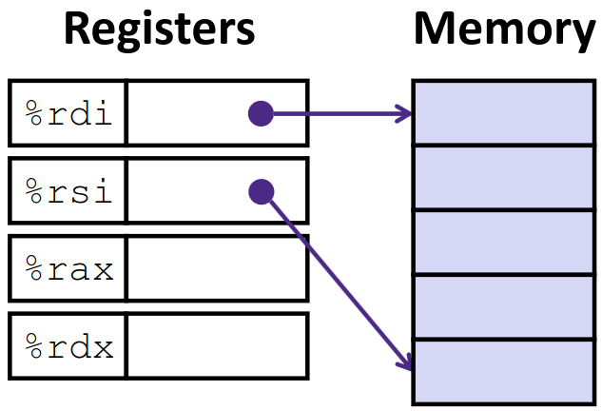
Understanding add_ptr()
Register | Variable
%rdi | xp
%rsi | yp
%rdx | t0
%rax | return
long add_ptr(long* xp, long* yp)
{
long t0 = *xp;
long t1 = *yp;
return t0 + t1;
}
add_ptr:
movq (%rdi), %rdx
movq (%rsi), %rax
addq %rdx, %rax
ret
Notes:
%rdi = xp, so the data location %rdi points to is *xp
%rsi = yp, so the data location %rsi points to is *yp
%rdx gets the value *xp
%rax gets the value *yp + *xp

Slide 30
Memory Addressing Modes
General format: D(Rb,Ri,S) = Mem[Reg(Rb) + Reg(Ri)*S + D]
Rb = base register (any register)
Ri = index register (any register except %rsp)
S = scale factor (1, 2, 4, 8) - Why these numbers?
D = displacement value (immediate)
Can leave any of these out:
D(Rb,Ri) - S=1
(Rb,Ri,S) - D=0
(Rb,Ri) - D=0, S=1
(,Ri,S) - D=0, Rb=0
etc…
Notes:
Why these numbers? Same as data widths. Used for pointer arithmetic / array indexing!
If leaving any out, S defaults to 1, all others default to 0
D(Rb, Ri) = Rb + Ri + D
(Rb, Ri, S) = Rb + Ri*S
(Rb, Ri) = Rb + Ri
(, Ri, S) = Ri*s (note the comma)
In the example (%rdi) on previous slide, %rdi was Rb

Slide 31
Address Computation Examples
%rdx | 0xF000
%rcx | 0x0100
8-bit addresses
Reminder: D(Rb,Ri,S) →Mem[Reg[Rb]+Reg[Ri]*S+D]
(ignoring memory addressing portion for this exercise)
Expression | Address Computation | Address
0x8(%rdx)
(%rdx, %rcx)
(%rdx, %rcx, 4)
0x80(, %rcx, 2)
Notes:
Stopped here, we’ll continue on Friday ☺

Slide 32
Summary
x86-64 is a complex (CISC) architecture
There are 3 types instructions
Data transfer
Arithmetic
Control flow
There are 3 types of operands
Registers (%)
Immediates ($)
Memory ( () )
Registers are small, fast places to store memory
Limited number, each with their own name

