Slide 1
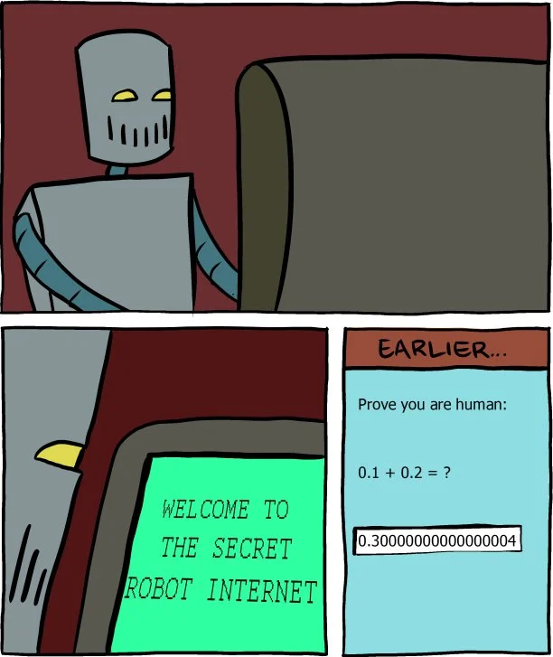
Floating Point
CSE 351 Summer 2024
Instructor:
Ellis Haker
Teaching Assistants:
Naama Amiel
Micah Chang
Shananda Dokka
Nikolas McNamee
Jiawei Huang
https://0.30000000000000004.com

Slide 2
Administrivia
HW4 due today (11:59pm)
Due Wednesday, 7/3
RD7 (1pm)
HW5 (11:59pm)
Lab1a (11:59pm)
Late due date Friday, 7/5
No class on Thursday
Video section on Panopto
Quiz 1 released this Friday!

Slide 3
Lab1a Reminders
Should compile without warnings, pass all tests and dlc.py
Submit pointer.c and lab1Asynthesis.txt to Gradescope
1 submission per group
If you’re submitting with a partner, please add them to your submission
Please wait for the autograder to finish so you can confirm it worked!
Don’t wait until the last minute to submit!
Please remove debug print statements before submitting!
Remember: 1-on-1 request form

Slide 4
Quiz 1
Out on Friday, 7/5, due Friday, 7/12 on Gradescope
Covers everything up through floating point
Open-note, open-book
See the Exams page on the course website for practice materials
You can discuss with classmates, but all work must be your own!
“Abbot Elementary Rule”: talk with other students, then do something else for a while before writing your submission
i.e. brainstorming with others is fine, but you should not be writing your answers together
Staff can answer clarifying questions, but not content questions
Please make all quiz-related Ed questions private!

Slide 5
Review Questions
2⁻¹ = 0.5
2⁻² = 0.25
2⁻³ = 0.125
Convert 11.375₁₀ to normalized binary scientific notation
What is the value (in decimal) encoded by the following floating-point number?
0b 0 1000 0000 110 0000 0000 0000 0000 0000
Notes:
0b1011.011 (in decimal, equal to 1*8 + 0*4 + 1*2 + 1*1 + 0*0.5 + 1*0.25 + 1*0.125) . Then we shift right by 3 to get 0b1.011011, so we have to multiply by 2^3 to make up for it. Result = 0b1.011011*2^3
Most-significant bit is S, next 8 bits are E, rest ar M. Bias = 2^7-1 = 127. Positive bc sign bit is 0. Exponent = 128 - 127 = 1. Mantissa = (1).11, so total = 0b1.11*2 = 0b11.1 (multiply by 2 = left shift by 1) = 3.5

Slide 6
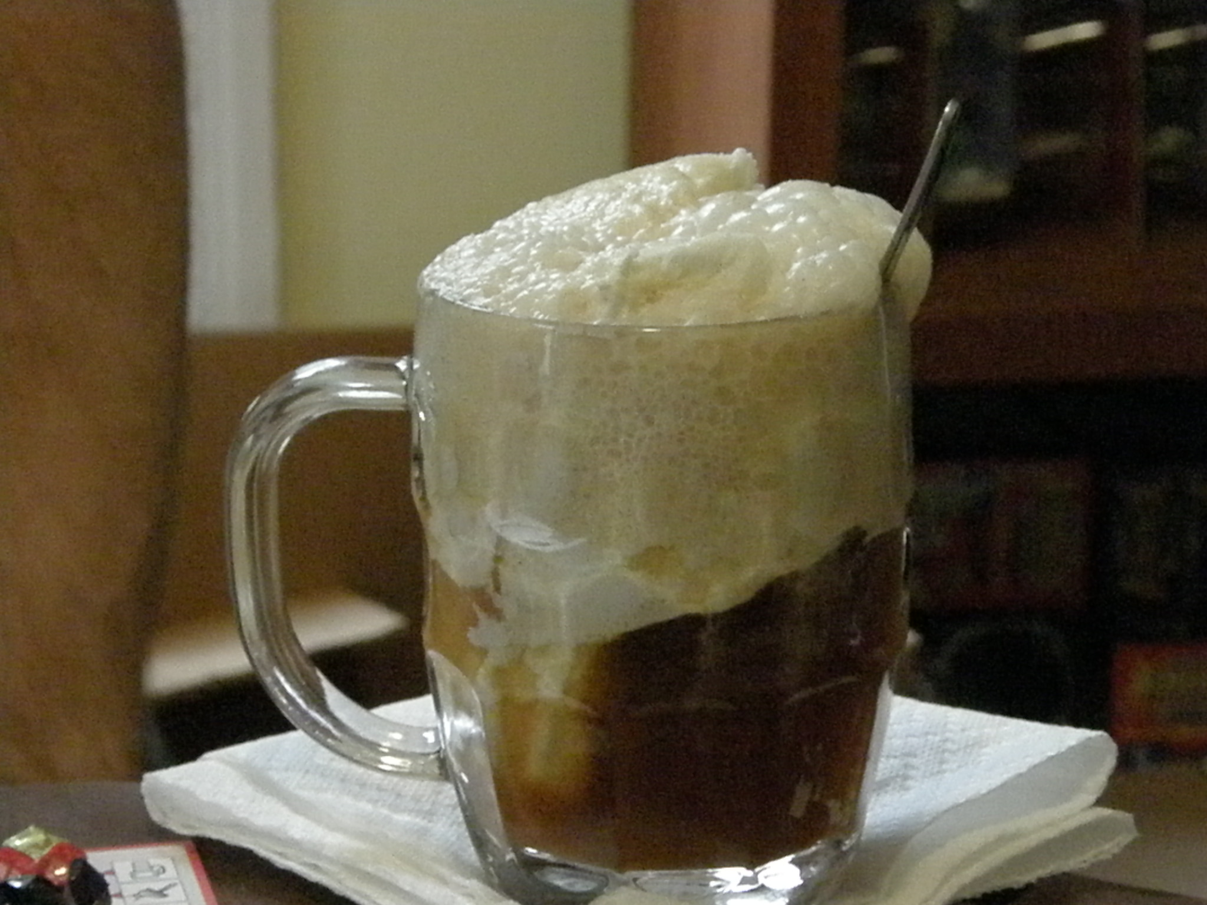
Number Representation Revisited
What can we represent in C so far?
Signed and unsigned integers
Characters
Addresses
How do we encode the following?
Real numbers (ex: 3.14159)
Very large numbers (ex: 6.02*10²³)
Very small numbers (ex: 6.26*10⁻³⁴)
Special cases (ex: ∞, NaN)

Slide 7
Floating Point Topics
Fractional binary numbers (fixed point)
Floating point
IEEE standard
Floating point operations and rounding
Floating point in C
There are many more details we won’t cover (it’s a 58-page standard…)
Bonus slides at the end :)

Slide 8
Binary Representation of Fractions
Let’s start by looking at base 10:
Each place represents a power of 10. Power decreases as you read left->right
Decimal point marks when the negative powers start
Ex:
10² | 10¹ | 10⁰ |  | 10⁻¹ | 10⁻² | 10⁻³
1 | 2 | 3 | . | 4 | 5 | 6
Base 2 is similar:
Every place to the right of the binary point represents a negative power of 2
Ex:
2³ | 2² | 2⁰ |  | 2⁻¹ | 2⁻² | 2⁻³
1 | 0 | 1 | . | 0 | 1 | 1
= 1*2² + 0*2¹ + 1*2⁰ + 0*2⁻¹ + 1*2⁻² + 1*2⁻³ = 5.375₁₀

Slide 9
Limits of Representation
Even with an arbitrary number of bits, can only represent numbers of the form x*2^{y}
Other rational numbers have infinite bit representations
Value | Binary Representation
1/3 = 0.333333…₁₀ | 0.01010101[01]…₂
1/5 = 0.2₁₀ | 0.001100110011[0011]…₂
1/10 = 0.1₁₀ | 0.0001100110011[0011]…₂

Slide 10
Fixed Point Encoding
Implied binary point between two bits in a number
Two examples
Binary point is between bits 2 and 3
b₇b₆b₅b₄b₃ (.) b₂b₁b₀
Binary point is between bits 4 and 5
b₇b₆b₅ (.) b₄b₃b₂b₁b₀
Which scheme is better?
Notes:
Real-world example: money! Ex $10.95, we only count 2 places after the decimal point
Which scheme is better? Depends! 1 can encode higher values, but w/ less precision. 2 has more precision, but can only encode whole #s up to 7. No good solution for all cases, so we don’t use it.

Slide 11
Floating Point Representation (Review)
Based on scientific notation
In decimal:
12000000 -> 1.2 x 10⁷
0.0000012 -> 1.2 x 10⁻⁶
In binary:
11000.000 -> 1.1 x 2⁴
0.00011 -> 1.1 x 2⁻⁴
Divvy up the bits in our encoding
Sign (+/-)
Exponent
Mantissa (everything after the binary point)
Notes:
Reminder: shift right by n places in base b = divide by b^n
First decimal example: shift right by 7, so multiple by 10^7 to get back to the same value
First binary example: shift right by 4, so multiply by 2^4
Second binary example: shift left by 4, so multiply by 2^(-4)

Slide 12
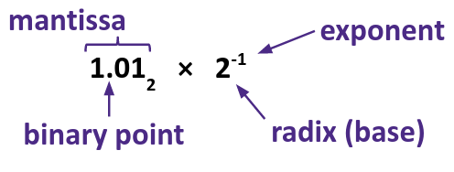
Binary Scientific Notation (Review)
Normalized form: exactly one (non-zero) bit to the left of the binary point
Called “floating point” because the binary point “floats” to different parts of the number (as opposed to fixed)

Slide 13
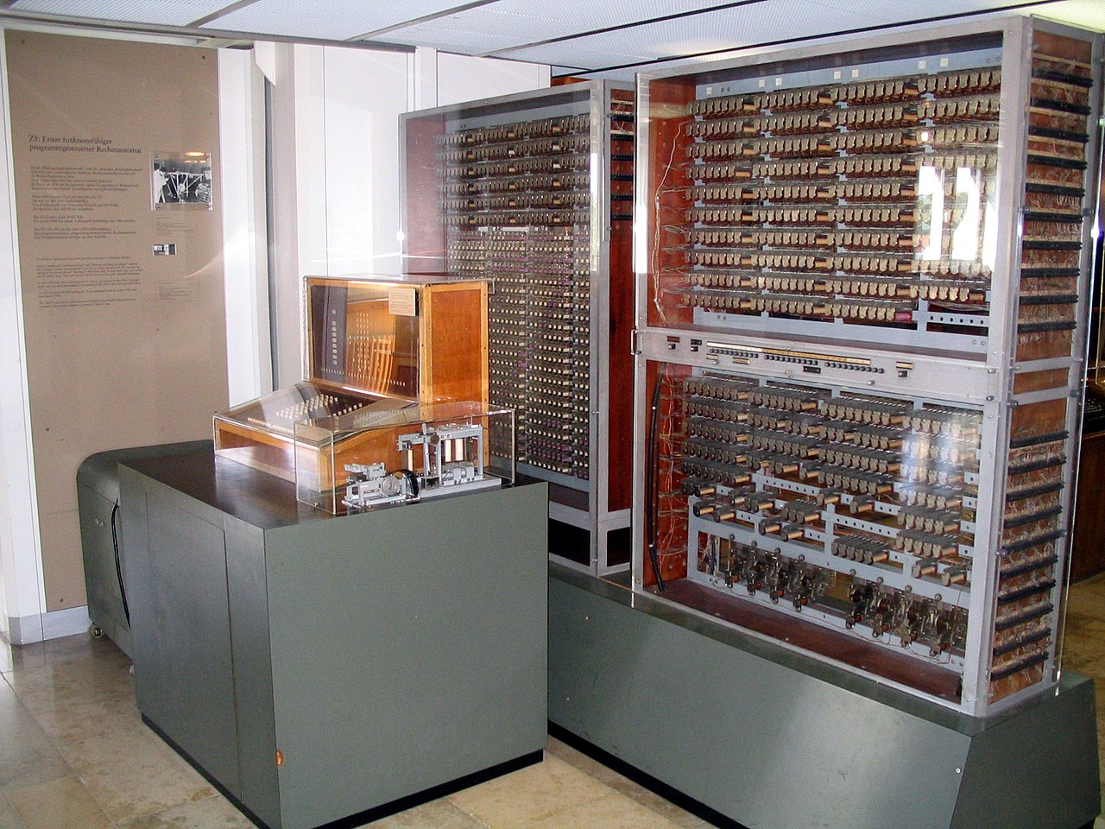
Floating Point History
1914: first design by Leonardo Torres y Quevedo
1940: implementations by Konrad Zuse, but not exactly the same as the modern standard
1985: IEEE 754 standard
Primary architect was William Kahan, who won a Turing Award for this work
Standardized bit encoding, well-defined behavior for all operations
Still what we use today!
Kahan

Slide 14
IEEE Floating Point
IEEE 754 (established 1985)
Developed to make numerically-sensitive programs portable
Specifies two things: a representation scheme and the result of operations
Supported by all major CPUs
Two opposing concerns:
Scientists numerical analysts want them to be as real as possible
Engineers want them to be easy to implement and fast
Who won? Mostly scientists
Nice standards for rounding, overflow, underflow, but complex for hardware
Float operations can be an order of magnitude slower than integer ops!
CPU speed commonly measured in FLOPS (float ops per second)

Slide 15
Floating Point Encoding (Review)
Value = ±1.Mantissa * 2^{Exponent}
Bit fields: (-1)^{S} * 1.M * 2E
Representation scheme:
Sign bit (S): 0 is positive, 1 is negative
Mantissa (a.k.a. significand): the fractional part of the number in normalized form, encoded in the bit vector M
Exponent: weighs the number by a (possible negative) power of 2, encoded in the bit vector E

Slide 16
The Exponent Field (Review)
Use biased notation
Read as unsigned, but with a bias of 2^{w-1}-1 (127, for an 8-bit E field)
Exponent = E - bias ↔ E = Exponent + bias
Why?
Makes floating point arithmetic easier
Somewhat compatible with two’s complement hardware
Notes:
Why not use 2’s comp? makes float comparison easier

Slide 17
The Mantissa Field (Review)
Implicit leading 1 before the binary point
There’s always a 1 there in normalized form, so we don’t need to encode it!
Example: 0b 0011 1111 1100 0000 0000 0000 0000 0000
Read as 1.1₂ = 1.5₁₀, not 0.1₂ = 0.5₁₀
Mantissa “limits”
Low values (near M = 0b00…00) are close to 2^{Exp}
High values (near M = 0b11…11) are close to 2^{Exp+1}

Slide 18
Normalized Floating Point Conversions
FP -> Decimal
Append bits of M to leading 1
Multiply by 2^{E-bias}
“Multiply out” exponent by shifting
If exp < 0, shift right (logical) by
-exp
If exp > 0, shift left by exp
Multiply by sign (-1^{S})
Convert from binary to decimal
Decimal -> FP
Convert from decimal to binary
Convert to normalized form
Shift left or right (logical) until there’s a single 1 before the binary point
Multiply by 2^{exp}, where exp = number of places shifted (negative for left shift, positive for right)
S = 0 if positive, 1 if negative
E = exp + bias
M = bits after the binary point

Slide 19
Practice Question
Convert the decimal number -7.375 into floating point representation.
Challenge Question:
Find the value of the following sum in normalized binary scientific notation:
1.01₂*2⁰ + 1.11₂*2²
Notes:
Bias = 2^7-1 = 127
7.375 = 0b111.011 (1*4 + 1*2 + 1*1 + 0*0.5 + 1*0.25 + 1*0.125) = 0b1.011011*2^2
S = 1 (negative
E = 2+127 = 129 = 0b10000001
M = 0b1101100…00 (23b total)
Answer = 0b1100000011101100…00
Challenge question: 0b1.01*2^0 = 0b1.01
0b1.11*2^2 = 0b111
0b1.01+0b111 = 0b1000.01 = 0b1.00001*2^3

Slide 20
Special Cases
But wait, what happened to zero?
Special case: E and M are all 0s
Two zeroes… but at least 0x00..00 is 0, like integers
Other special cases: E = 0xFF
M = 0: +/- ∞
Ex: division by 0
Still works for comparisons!
M ≠ 0: NaN
Ex: 0/0, ∞-∞, imaginary numbers
Value of M tells you what the error was
Propagates through computations
Notes:
Sign magnitude ☹

Slide 21
Floating Point Topics
Fractional binary numbers (fixed point)
Floating point
IEEE standard
Floating point operations and rounding
Floating point in C

Slide 22
Precision and Accuracy
Accuracy is a measure of the difference between the actual value of a number and its computer representation
Precision is a count of the number of bits in a computer word used to represent a value
Capacity for accuracy
High precision permits high accuracy but doesn’t guarantee it. It is possible to have high precision but low accuracy.
Example: float pi = 3.14;
pi will be represented with all 24 bits of mantissa (highly precise), but still an approximation
Notes:
These words have broader definitions in science, but these definitions work for our purposes
Precision: how well you set yourself up to be accurate.
24 bits of mantissa = 23 bits + implicit 1
It’s possible to have high precision but low accuracy (see example). But *also* possible to have high accuracy but low precision. Ex: char c = 3. Entirely accurate (if that’s the number you’re trying to represent, but few bits of precision

Slide 23
Need Greater Precision?
64 bits = double precision
Exponent bias is now 2¹⁰–1 = 1023
Advantages
Greater precision (larger mantissa), greater range (larger exponent field)
Disadvantages
More space used, slower to manipulate
Notes:
Even though exponent is only a few bits larger, we still get a much larger range because it increases exponentially - from 2^8 to 2^11 possible values = 1792 more exponents. Then when you add the greater mantissa precision, significantly wider range

Slide 24
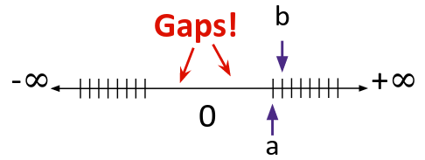
Representation Limits
Largest value (besides ∞)?
E = 0xFF has been taken!
E = 0xFE, M = 0b11…11 -> 1.1…1₂*2¹²⁷ = 2¹²⁸ – 2¹⁰⁴
Much bigger than the max int!
Smallest (non-zero) value?
E = 0x00 has been taken!
E = 0x01, M = 0b00…00 -> 2⁻¹²⁶
Normalization and implicit 1 are to blame
Another special case: denormalized numbers
E = 0, M ≠ 0 are
Replace implicit leading 1 with a 0
Notes:
For denormalized, E still treated as 0, so value is +/- 0b0.M * 2^(-127)
Denormalized fills in the gaps around 0

Slide 25
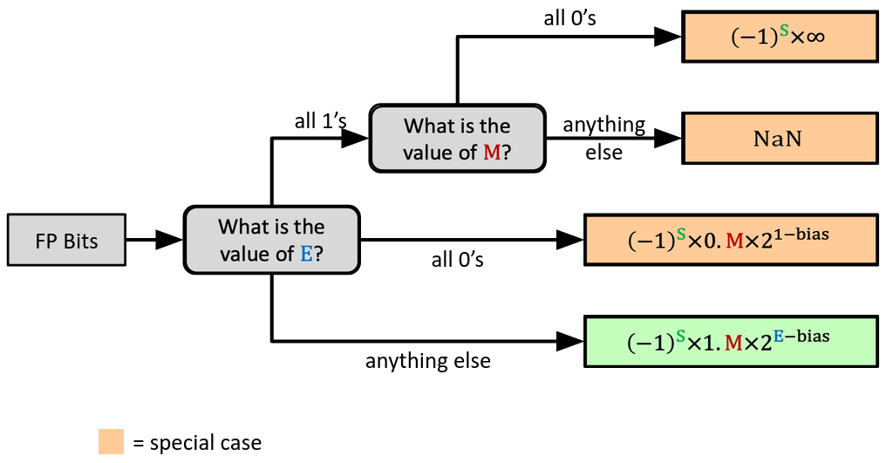
Floating Point Decoding Flow Chart
Notes:
Don’t go over this! Just for reference!!

Slide 26
Distribution of Values (Review)
Like integers, floats cannot represent every possible value
Overflow: the number we want to store is too large to be represented
Floats have other problems too, due to finite precision:
Underflow: value is too small to represent
Between 0 and the smallest denormalized number
Rounding: we don’t have enough bits
Between two representable values
Floats can represent very large or very precise numbers, but not both!
Notes:
Another way to think of this: overflow/underflow occur because exponent is out of range, rounding is because we don’t have enough mantissa bits

Slide 27
Representational Errors
Overflow yields ±∞, underflow yields 0
±∞ and NaN can be used in operations
Result is usually still the same, but not always intuitive
Floating point operations do not work like real math, due to rounding
Not associative
Ex: (3.14 + 10¹⁰⁰)–10¹⁰⁰ != 3.14+(10¹⁰⁰–10¹⁰⁰)
Not distributive
Ex: 100*(0.1 + 0.2) != 100*0.1 + 100*0.2
Not cumulative
Repeatedly adding a very small number to a very large one may do nothing

Slide 28
Why does this matter?
1982: Vancouver Stock Exchange 10% error in less than 2 years
1991: Patriot missile targeting error
Clock skew due to conversion from int to float
1994: Intel Pentium FDIV (float division) hardware bug ($475 million)
1996: Ariane 5 rocket exploded ($1 billion)
Overflow converting 64-bit float to 16-bit int
1997: USS Yorktown “smart” warship stranded
Divide by zero

Slide 29
Floating Point Topics
Fractional binary numbers (fixed point)
Floating point
IEEE standard
Floating point operations and rounding
Floating point in C

Slide 30
Floating Point in C
Two common levels of precision
float 1.0f - single precision (32-bit)
double 1.0 - double precision (64-bit)
#include <math.h> to get INFINITY and NAN constants
#include <float.h> for additional constants
Equality (==) comparisons between floating point numbers are tricky, and often return unexpected results, so just avoid them!

Slide 31
Floating Point Conversions in C
Casting between int, float, and double changes the bit representation!
int -> float
May be rounded (not enough mantissa bits)
Overflow impossible
int or float -> double
No rounding or overflow possible
long -> double
Depends on word size (32-bit is exact, 64-bit may cause rounding)
double or float -> int
Truncates fractional part (rounded towards zero)
Undefined when out of range or NaN, typically sets to TMin

Slide 32
Summary
Floating point approximates real numbers using binary scientific notation
Exponent in biased notation
Standard encoding is IEEE 754
Defines standard bit width for fields, behavior in operations, and special cases
Floats also suffer from having a fixed bit width
Can get overflow, but also underflow and rounding
Floating point arithmetic can have unexpected results!
Never test floats for equality
Conversion between float and other data types can cause errors
Be especially careful when converting between int and float!

Slide 33
BONUS SLIDES
Some additional information about floating point numbers. We won’t test you on this, but you may find it interesting :)

Slide 34
Floating Point Rounding
This is extra (non-testable) material
The IEEE 754 standard actually specifies different rounding modes:
Round to nearest, ties to nearest even number (standard)
Round toward +∞ (round up)
Round toward -∞ (round down)
Round toward 0 (truncate)
In our tiny example (E = 4 bits, M = 3 bits) with standard rounding
Mantissa = 1.001 01 rounds to M = 0b001
Mantissa = 1.001 11 rounds to M = 0b010
Mantissa = 1.001 10 rounds to M = 0b010
Mantissa = 1.000 10 rounds to M = 0b000

Slide 35
Limits of Interest
This is extra (non-testable) material
The following thresholds can help you get a sense of when certain outcomes come into play, but don’t worry about the specifics
FOver = 2^{bias+1}
Largest representable normalized number
FDenorm = 21^{1-bias}
Smallest representable normalized number
FUnder = 2^{1-bias-m}
m is the width of the mantissa field
Smallest representable denormalized number

Slide 36
Denormalized Numbers
This is extra (non-testable) material
No leading 1
Uses implicit exponent of –126 even though E = 0x00
Denormalized numbers close the gap between zero and the smallest normalized number
Smallest norm: ± 1.0…0₂×2⁻¹²⁶ = ± 2⁻¹²⁶
Smallest denorm: ± 0.0…01₂×2⁻¹²⁶ = ± 2⁻¹⁴⁹
There is still a gap between zero and the smallest denormalized number
Much closer to zero!

Slide 37
Floating Point in the “Wild”
This is extra (non-testable) material
3 formats from IEEE 754 standard widely used in computer hardware and languages
In C, called float, double, long double
Common applications:
3D graphics: textures, rendering, rotation, translation
“Big Data”: scientific computing at scale, machine learning
Non-standard formats in domain-specific areas:
Bfloat16: training ML models; range more valuable than precision
TensorFloat-32: Nvidia-specific hardware for Tensor Core GPUs
Type | S bits | E bits | M bits | Total bits
Half-precision | 1 | 5 | 10 | 16
Bfloat16 | 1 | 8 | 7 | 16
TensorFloat-32 | 1 | 8 | 10 | 19
Single-precision | 1 | 8 | 23 | 32

