Slide 1
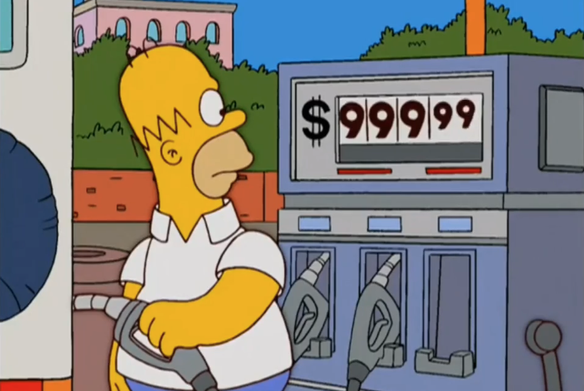

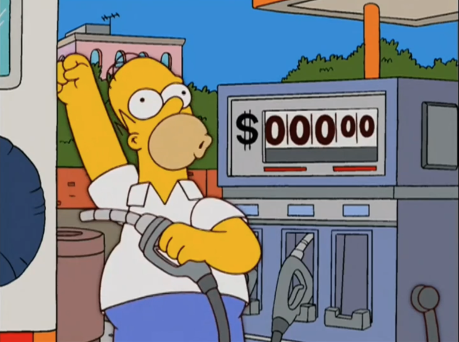
Integers II
CSE 351 Summer 2024
Instructor:
Ellis Haker
Teaching Assistants:
Naama Amiel
Micah Chang
Shananda Dokka
Nikolas McNamee
Jiawei Huang

Slide 2
Announcements, Reminders
Due Today:
  HW 3 (11:59pm)
Due Monday, 7/1
  RD 6 (1pm)
  HW 4 (11:59pm)
Lab 1b releases today, due 7/10
  Bit manipulation on a custom encoding scheme
  Bonus slides at the end might be helpful :)

Slide 3
Review Questions
What is the value and encoding of Tmin (minimum signed value) for a fictional 7-bit wide integer data type?
For unsigned char uc = 0xB3;, what the result (in hex) of the cast (unsigned short)uc?
What is the result of the following expressions?
  (signed char)uc >> 2
  (unsigned char)uc >> 3
Notes:
Encoding = 1000000 = -2^6 = -64
Char = 1B, short = 2B. In unsigned, pad extra space with 0s. Answer = 0x00B3
0xB3 = 0b10110011
For signed, we pad with most-significant bit, so answer = 0b11101100 = 0xEC
Unsigned, we pad with 0, so answer = 0b00010110 = 0x16

Slide 4
Integers
Binary representation of integers
  Unsigned and signed
  Casting in C
  Arithmetic operations
Consequences of finite width representations
  Overflow
Shifting operations
Notes:
4

Slide 5
Values to Remember
Unsigned
UMin = 0
  0b00…00
UMax = 2^{w}-1
  0b11…11
Signed (2’s Complement)
TMin = -2^{w-1}
  0b10…00
TMax = 2^{w-1} - 1
  0b01…11
Example: if w = 64
 | Hex | Decimal
UMax | FF FF FF FF FF FF FF FF | 18,446,744,073,709,551,615
TMax | 7F FF FF FF FF FF FF FF | 9,223,372,036,854,775,807
UMin | 00 00 00 00 00 00 00 00 | 0
TMin | 80 00 00 00 00 00 00 00 | -9,223,372,036,854,775,808

Slide 6
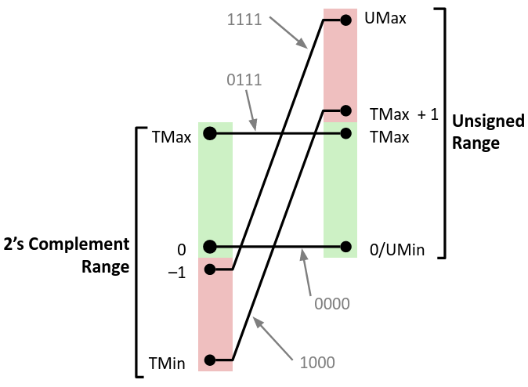
Signed/Unsigned Conversion Visualized
4-bit example
Notes:
Green region (0-Tmax) is the region where both encodings are the same.
1000=Tmin in 2’s comp, Tmax+1 in unsigned
0000=0 in both
0111=Tmax in both
1111=-1 in 2’s comp, Umax in unsigned

Slide 7
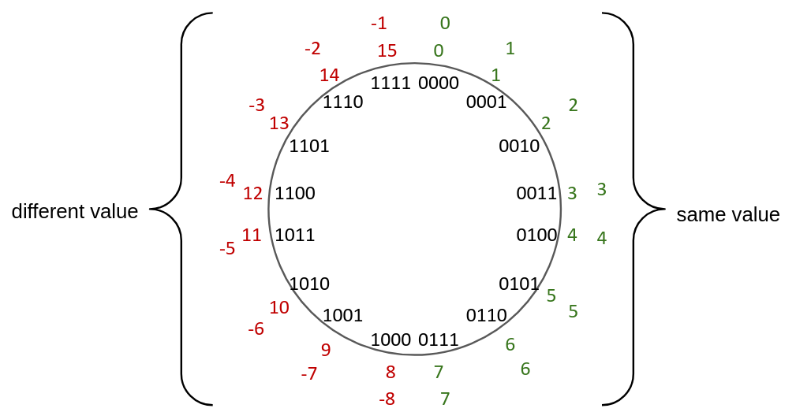
Signed/Unsigned Conversion Visualized (pt 2)
4-bit example
Notes:
7 = Tmax
-8 = Tmin
15 = Umax
0 = Umin

Slide 8
C Integer Casting (Review)
Bits are unchanged, just interpreted differently
  Ex:
int tx, ty;
unsigned int ux, uy;
Explicit casting:
  Ex:
tx = (int)ux;
uy = (unsigned int)ty;
Implicit casting can occur during assignments or function calls:
  Ex:
tx = ux;
uy = ty;
Common source of bugs!

Slide 9
Casting Surprises (Review)
⚠️
Integer literals (constants)
  By default, treated as signed ints
  Hex constants already have an explicit binary representation
  Use “U” (or “u”) suffix to explicitly force unsigned
  Ex: 4294967259u
Expression Evaluation
  When you mixed unsigned and signed in a single expression, then signed values are implicitly cast to unsigned
  Including comparison operators <, >, ==, <=, >=
  Yeah, no idea why. Thanks, C…

Slide 10
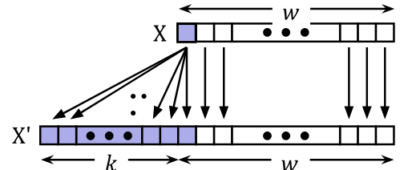
Sign Extension (Review)
Given a w-bit integer, how can we extend it to a (w+k)-bit integer while keeping the value the same?
  Unsigned - pad with 0s
    Ex: 0b1000 = 0b00001000 = 8
  Signed - pad with the most significant bit
    Ex: 0b1000 = 0b11111000 = -8
Notes:
Fun fact: can duplicate MSb any # of times in 2’s comp!
Ex: 1000 = -8
11000 = -16+8 = -8
111000 = -32+16+8 = -8

Slide 11
Two’s Complement Arithmetic
Same as unsigned!
  Simplifies hardware, no special algorithm needed
  Just add as normal, then discard the highest carry bit
    Modular addition: result = sum modulo 2^{w}
Example:
carry
1111
1101 = -3
+1111 = -1
11100 = -4
0011 = 3
+0001 = 1
0100 = 4

Slide 12
Why Does Two’s Complement Work?
For all representable numbers x, we theoretically want additive inverse:
  i.e. (bit representation of x) + (bit representation of -x) = 0
What are the 8-bit negative encodings for the following?
00000001
+ ????????
00000000
00000010
+ ????????
00000000
11000011
+ ????????
00000000

Slide 13
Why Does Two’s Complement Work? (pt 2)
For all representable numbers x, we theoretically want additive inverse:
  i.e. (bit representation of x) + (bit representation of -x) = 0
What are the 8-bit negative encodings for the following?
00000001
+ 11111111
00000000
00000010
+ 11111110
00000000
11000011
+00111101
00000000
These are the bitwise complement plus 1!
-x == ~x + 1
Notes:
When adding 00000001+11111111, we add a carry bit every bit, which means every place adds up to 0. There’s an extra carry bit, but it gets dropped off, so the final result is 0

Slide 14
Integers
Binary representation of integers
  Unsigned and signed
  Casting in C
  Arithmetic operations
Consequences of finite width representations
  Overflow
Shifting operations
Notes:
14

Slide 15

Arithmetic Overflow (Review)
What happens if a calculation produces a result that can’t be represented in the current encoding scheme? Overflow!
  Remember: fixed width integers can’t represent every possible number
  Occurs in both signed and unsigned
  Can occur in both positive and negative directions
Both C and Java ignore overflow exceptions
  You end up with a bad value in your program and no indication/warning
Notes:
We still call it overflow, even if it’s in the negative direction
C and Java will both just keep running! But because the value is not what you wanted, may get unexpected behavior

Slide 16
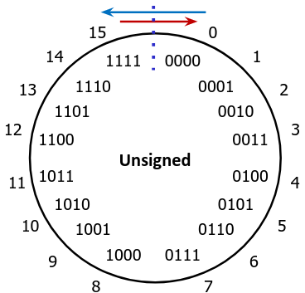
Overflow: Unsigned
Occurs when result is less than both operands for addition, or greater than for subtraction
Addition: drop carry bit (result is 2^{w} too small)
1111 = 15
+ 0001 = 1
10000 = 16
0
Subtraction: “borrow” extra bit (result is 2^{w} too large)
1
0001 = 1
- 0010 = 2
= -1
1111
15
Notes:
Note, no actual bit to borrow from in HW, just theoretical

Slide 17
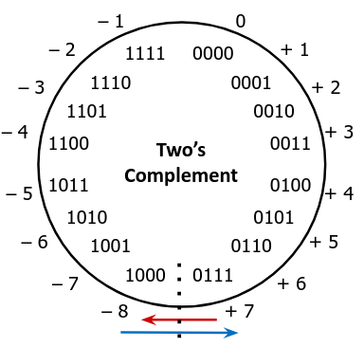
Overflow: Signed
Occurs when both operands for an addition have the same sign, and result doesn’t match
Positive addition: (+) + (+) = (-)
0110 = 6
+ 0011 = 3
1001 = -7???
Negative addition (i.e. subtraction): (-) + (-) = (+)
1001 = -7
- 0011 = 3
0110 = 6???
Notes:
-7-3 is the same as -7 + -3 = 0b1001+0b1101 = 0b0110 (carry bit dropped off)

Slide 18

Why does this matter?
1985: Therac-25 radiation therapy machine
  Overdoses of radiation due to arithmetic overflow on 1-byte safety flag
2000: Y2K problem
  Limited representation (2-digit decimal year)
  Similar issue will occur with Unix time in 2038!
2013: Deep impact spacecraft lost
  Suspected integer overflow from storing time as tenth-seconds in unsigned int
    Lost on 8/11/13, 00:38:49.6
Notes:
Therac-25 errors together. If there are 256 errors, overflows back to 0!
Unix time stored as # of seconds since 1/1/1970 in a signed int. Will overflow in 2038.
Time the spacecraft was lost is one after the last representable time.

Slide 19
Integers
Binary representation of integers
  Unsigned and signed
  Casting in C
  Arithmetic operations
Consequences of finite width representations
  Overflow
Shifting operations
Notes:
19

Slide 20
Shift Operations (Review)
Move all bits left or right, extra bits “fall off” the end
Left shift by n positions (x << n)
  Lose the most-significant n bits, fill in the least-significant n bits with 0s
Right shift by n positions (x >> n)
  Lose the least-significant n bits
  Unsigned, use logical: fill with most-significant n bits with 0s
  Signed, use arithmetic: replicate the previous most-significant bit
x | 0010 0010
x << 3 | 0001 0000
(logical) x >> 2 | 0000 1000
(arithmetic) x>> 2 | 0000 1000
x | 1010 0010
x << 3 | 0001 0000
(logical) x >> 2 | 0010 1000
(arithmetic) x>> 2 | 1110 1000
Ex: 0x22
Ex: 0xA2

Slide 21
Shift Operations (Review) (pt 2)
Arithmetic
  Left shift (x << n) == multiply by 2^{n}
  Right shift (x >> n) == divide by 2^{n}
    For signed values, logical right shift preserves the sign
  Fun fact: Shifting is often faster than the general multiply and divide operations!
Notes:
  Shifts by less than 0 or more than w (width of the variable) are undefined
    i.e. we don’t know what will happen!
  In Java, arithmetic shift is >>, logical is >>>
Notes:
In base 10, shifting multiply/divide by 10^n. ex: 3<<1=30, 3<<2=300, etc.

Slide 22
Left Shifting, 8-bit Example
Shifting can cause overflow!
In theory x << n should be x*2^{n}
Signed overflow
Code | Binary | Signed | Unsigned | Theoretical Value
x = 25 | 00011001 | 25 | 25 | 25
L1 = x << 2 | 00 01100100 | 100 | 100 | 100
L2 = x << 3 | 000 11001000 | -56 | 200 | 200
L3 = x << 4 | 0001 10010000 | -112 | 114 | 400
Unsigned overflow

Slide 23
Right Shifting, 8-bit Example
Unsigned = logical shift
In theory, x >> n should be x÷2^{n}
Code | Binary | Unsigned | Theoretical Value
x = 240u | 11110000 | 240 | 240
R1 = x >> 3 | 00011110 000 | 30 | 30
R2 = x >> 5 | 00000111 10000 | 7 | 7.5?

Slide 24
Right Shifting, 8-bit Example (pt 2)
Signed = arithmetic shift
In theory, x >> n should be x÷2^{n}
Code | Binary | Unsigned | Theoretical Value
x = -16 | 11110000 | -16 | -16
R1 = x >> 3 | 11111110 000 | -2 | -2
R2 = x >> 5 | 11111111 10000 | -1 | -0.5?

Slide 25
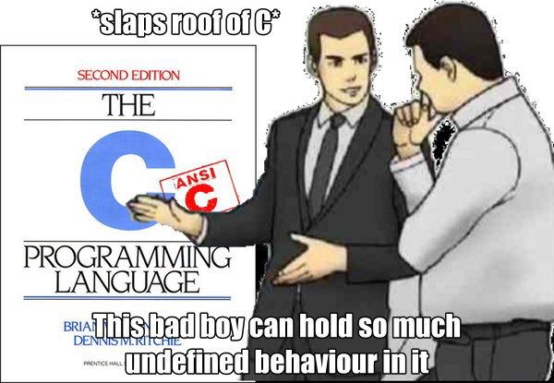
Undefined Behavior in C
Not defined in C standard, may get different behavior depending on your OS, architecture, compiler, etc.
How much undefined behavior have we talked about in just the last few lectures?
  Shifting by more than size of type
  Indexing arrays out of bounds
  Using a variable before initializing (mystery data)
  … and there will be more!

Slide 26
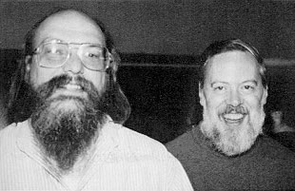
C Language
Development began in 1971, standardized in 1978
  Developed to write Unix (precursor to Linux and MacOS)
Computers were much more limited in the 70s!
Computer users were also very different!
  Not as accessible
  Computers were “for experts”
Goals:
  Portability
  Performance
Non-Goals:
  Safety
  Ease

Slide 27
Summary
Casting between signed and unsigned in C
  Bit pattern remains the same, just interpreted differently
  Cast can be explicit or implicit
We can represent a limited number of values in w bits
  When we exceed the limit (in either direction), we get overflow
Shifting is a useful bitwise behavior
  Can be used to remove certain bits (similar to masking), or in place of multiplication
  Right shift can be logical or arithmetic
    Logical pads with 0s, used for unsigned
    Arithmetic pads with MSB, used for signed

Slide 28
BONUS SLIDES
Some examples of using shift operators in combination with bitmasks, which you may find helpful for Lab 1b.
Extract the 2nd most significant byte of an int
Extract the sign bit of a signed int
Conditionals as Boolean expressions

Slide 29
Practice Question 1
Assuming 8-bit data (i.e., bit position 7 is the MSB), what will the following expression evaluate to?
  UMin = 0, UMax = 255, TMin = -128, TMax = 127
127 < (signed char) 128u
Notes:
128u = 0b10000000 = -128 in 2’s comp. 127 < -128 is False!

Slide 30
Practice Questions 2
For the following additions, did signed and/or unsigned overflow occur?
  0x27 + 0x81
  0x7F + 0xD9
Helpful values (assuming 8-bit integers):
  0x27 = 39 (signed) = 39 (unsigned)
  0xD9 = -39 (signed) = 217 (unsigned)
  0x7F = 127 (signed) = 127 (unsigned)
  0x81 = -127 (signed) = 129 (unsigned)
Notes:
0x27+0x81 = 39-127=-88, or 39u+129u=168u
= 0b00110111+0b10000001=0b10111000. No unsigned bc no dropped bit, no signed bc we’re adding values with different signs
0x7F+0xD9 = 127-39=88, or 127u+217u=344u
= 0b01111111+0b11011001=0b01011000. Yes unsigned because extra carry bit is dropped. No signed bc we’re adding values with different signs.

Slide 31
Exploration Questions
For the following expressions, find a value of signed char x, if there exists one, that makes the expression True.
Assume we are using 8-bit integers:
  x == (unsigned char) x
  x >= 128U
  x != (x>>2)<<2
  x == -x
    Hint: there are two solutions
  (x < 128U) && (x > 0x3F)
Notes:
x==(unsigned char) x: x=-1. (unsigned char)x = 255. other solutions are possible.
x >= 128u: x=-1. when mixing types, defaults to unsigned. Other solutions are possible.
x != (x>>2)<<2: x=1. x>>2=0, (x>>2)<<2=0. other solutions are possible.
x == -x: x=-128. x=0b10000000, -x=~x+1=0b01111111+1=0b10000000. 0 also works!
(x<128U) && (x>0x3F): when mixing signs, defaults to unsigned. 0x3F=3*16+15=63, so anything between 64 and 127 will work

Slide 32
Using Shifts and Masks
Extract the 2nd most significant byte of an int:
  First shift, then mask: (x>>16) & 0xFF
x | 00000001 00000010 00000011 00000100
x>>16 | 00000000 00000000 00000001 00000010
0xFF | 00000000 00000000 00000000 11111111
(x>>16) & 0xFF | 00000000 00000000 00000000 00000010
  Or first mask, then shift: (x & 0xFF0000)>>16
x | 00000001 00000010 00000011 00000100
0xFF0000 | 00000000 11111111 00000000 00000000
X & 0xFF0000 | 00000000 00000010 00000000 00000000
(x & 0xFF)>>16 | 00000000 00000000 00000000 00000010

Slide 33
Using Shifts and Masks (pt 2)
Extract the sign bit of a signed int:
  First shift, then mask: (x>>31) & 0x1
    Assuming arithmetic shift here, but this works in either case
    Need mask to clear 1s possibly shifted in
x | 00000001 | 00000010 | 00000011 | 00000100
x>>31 | 00000000 | 00000000 | 00000000 | 00000000
0x1 | 00000000 | 00000000 | 00000000 | 00000001
(x>>31) & 0x1 | 00000000 | 00000000 | 00000000 | 00000000
x | 10000001 | 00000010 | 00000011 | 00000100
x>>31 | 11111111 | 11111111 | 11111111 | 11111111
0x1 | 00000000 | 00000000 | 00000000 | 00000001
(x>>31) & 0x1 | 00000000 | 00000000 | 00000000 | 00000001

Slide 34
Using Shifts and Masks (pt 3)
Conditionals as Boolean expressions
  For int x, what does (x<<31)>>31 do?
  Can use in place of conditional:
    In C: if(x) {a=y;} else {a=z;} is the same as…
    a=(((!!x<<31)>>31)&y) | (((!x<<31)>>31)&z);
x=!!123 | 00000000 | 00000000 | 00000000 | 00000001
x<<31 | 10000000 | 00000000 | 00000000 | 00000000
(x<<31)>>31 | 11111111 | 11111111 | 11111111 | 11111111
!x | 00000000 | 00000000 | 00000000 | 00000000
!x<<31 | 00000000 | 00000000 | 00000000 | 00000000
(!x<<31)>>31 | 00000000 | 00000000 | 00000000 | 00000000
Notes:
Use !! to force to 0/1

