Slide 1
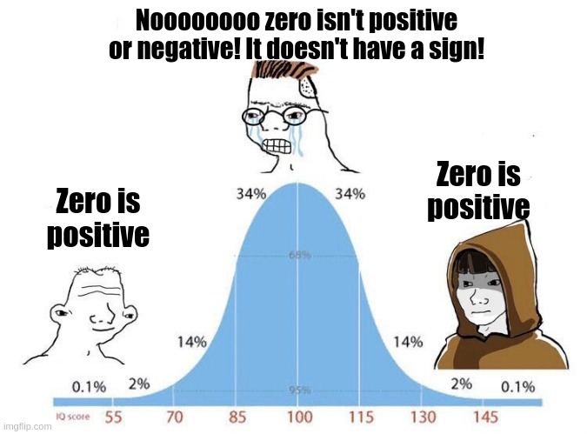
Data III, Integers I
CSE 351 Summer 2024
Instructor:
Ellis Haker
Teaching Assistants:
Naama Amiel
Micah Chang
Shananda Dokka
Nikolas McNamee
Jiawei Huang

Slide 2
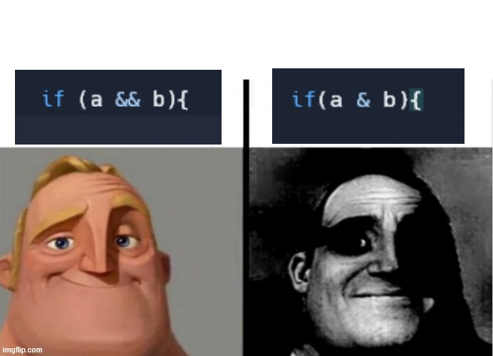
Administrivia
HW 2 due today (11:59pm)
Due Friday:
RD 5 (1pm)
HW 3 (11:59pm)
Due Monday:
RD 6 (1pm)
HW 4 (11:59pm)

Slide 3
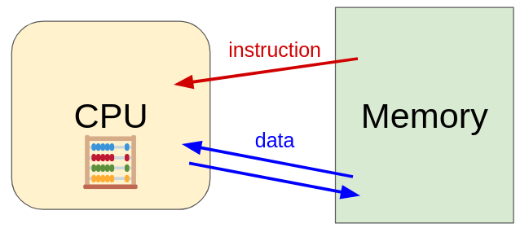
Recap: CPU and Memory
How does the CPU find its data in memory?
How are common C types encoded?
How can we use C to manipulate data in memory?

Slide 4
Review Questions
Compute the result of the following expressions for char c = 0x81;
c ^ c
~c & 0xA9
c || 0x80
!!c
Compute the decimal value of signed char sc = 0xF0; (using 2’s complement)
Notes:
0x81 is 0b10000001
c ^ c: ^ = bitwise XOR, anything XOR itself is 0
~c & 0xA9: ~ = bitwise NOT, & = bitwise AND. ~c = 0b01111100, & that w/ 0b10101001 = 0b00101000 = 0x28
c || 0x80: || = logical OR. c and 0x80 are both True, True OR True = True = 1
!!c: ! = logical NOT. c = True, so NOT c = False, NOT(NOT c) = True = 1
2. 2 ways:
0xF0 = 0b11110000 = -2^7 + 2^6 + 2^5 + 2^4 = -16 (the 2^7 is negative in 2’s comp)
~0xF0 + 1 = 0b00001111 + 1 = 0b00010000 = 16. –sc = 16, so sc = -16

Slide 5
Logical Operators (Review)
No boolean type in C by default
All non-zero values are treated as “true,” zero is “false”
Result is always a 1 or 0
AND (&&), OR (||), NOT (!)
&& (AND) | F | T
F | F | F
T | F | T
|| (OR) | F | T
F | F | T
T | T | T
! (NOT)
F | T
T | F

Slide 6
Bitwise Operators (Review)
Apply the given operation (AND, OR, NOT, XOR) to each bit of a value separately
Ex: 0xA | 0x3 = 0b1010 | 0b0011 = 0b1011 = 0xB
& (AND) | 0 | 1
0 | 0 | 0
1 | 0 | 1
| (OR) | 0 | 1
0 | 0 | 1
1 | 1 | 1
^ (XOR) | 0 | 1
0 | 0 | 1
1 | 1 | 0
~ (NOT)
0 | 1
1 | 0
Notes:
XOR is the same as !=

Slide 7
Bitmasks
We can use binary bitwise operators (&, |, ^) along with a specially chosen bitmask in order to read or write to particular bits in a piece of data
Useful operations - for any bit b (answer with 0, 1, b, or ~b):
b & 0 = ___ b ^ 0 = ___ b | 0 = ___
b & 1 = ___ b ^ 1 = ___ b | 1 = ___
Notes:
b & 0 = 0, b & 1 = b, so & is “set some bits to 0, keep the rest the same”
b ^ 0 = b, b ^ 1 = ~b, so ^ is “negate some bits, keep the rest the same”
b | 0 = b, b | 1 = 1, so | is “set some bits to 1, keep the rest the same”

Slide 8
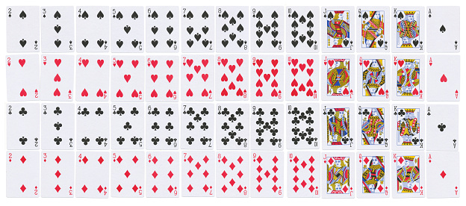
Numerical Encoding Design Example
Encode a standard deck of playing cards
4 suits, 13 cards each = 52 total
Operations to implement:
Which card is of higher value?
Are they the same suit?
First: how to represent?

Slide 9
Naive Approach
Binary encoding of 52 cards - only 6 bits needed
2⁶ = 64 >= 52
Fits in one byte
Just count cards in binary
Problem: hard to compare value & suit
Binary | Suit & Value
000000 | Ace of Clubs
000001 | Ace of Diamonds
000010 | Ace of Hearts
000011 | Ace of Spades
… | …
110010 | King of Hearts
110011 | King of Spades

Slide 10
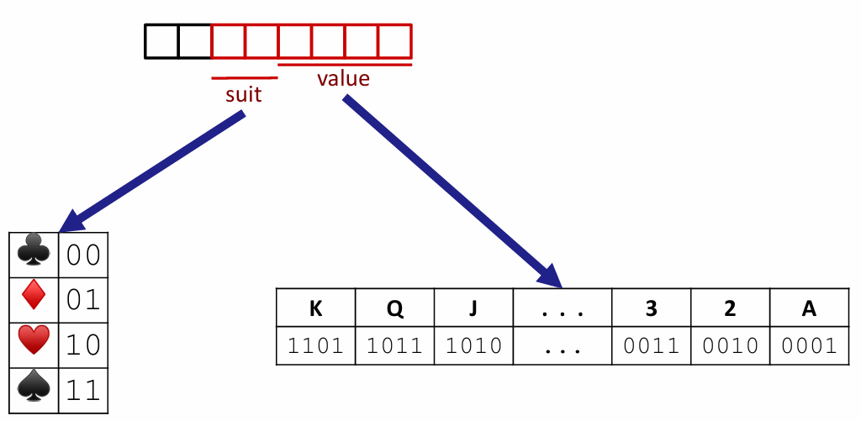
Better Approach: Fields
Separate binary encodings of suit (2 bits) and value (4 btis)
Still fits in one byte, easier to do comparisons 😎
Notes:
Value encoding = numerical value (if we treat A as a low card)

Slide 11
Compare Card Suits
#define SUIT_MASK = 0x30 // 0b00110000
int same_suit(char card1, char card2) {
return (!((card1 & SUIT_MASK) ^ (card2 & SUIT_MASK)));
}
Notes:
Reminder: b&1 = b, b&0 = 0
card1 ^ SUIT_MASK preserves the suit, 0 out the rest.
^ is the same as !=
! Negates to ^ to get ==

Slide 12
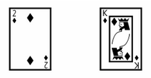
Compare Card Suits (pt 2)
return (!((card1 & SUIT_MASK) ^ (card2 & SUIT_MASK)));
0 | 0 | 0 | 1 | 0 | 0 | 1 | 0
0 | 0 | 0 | 1 | 1 | 1 | 0 | 1
&
&
0 | 0 | 1 | 1 | 0 | 0 | 0 | 0
0 | 0 | 1 | 1 | 0 | 0 | 0 | 0
=
=
0 | 0 | 0 | 1 | 0 | 0 | 0 | 0
0 | 0 | 0 | 1 | 0 | 0 | 0 | 0
^
0 | 0 | 0 | 0 | 0 | 0 | 0 | 0
!
0 | 0 | 0 | 0 | 0 | 0 | 0 | 1

Slide 13
Compare Card Suits: Equivalent Technique
return (card1 & SUIT_MASK) == (card2 & SUIT_MASK);
0 | 0 | 0 | 1 | 0 | 0 | 1 | 0
0 | 0 | 0 | 1 | 1 | 1 | 0 | 1
&
&
0 | 0 | 1 | 1 | 0 | 0 | 0 | 0
0 | 0 | 1 | 1 | 0 | 0 | 0 | 0
=
=
0 | 0 | 0 | 1 | 0 | 0 | 0 | 0
0 | 0 | 0 | 1 | 0 | 0 | 0 | 0
==
0 | 0 | 0 | 0 | 0 | 0 | 0 | 1

Slide 14
Compare Card Values
#define VALUE_MASK = 0x0F // 0b00001111
int greater_value(char card1, char card2) {
return ((unsigned int)(card1 & VALUE_MASK) >
(unsigned int)(card2 & VALUE_MASK));
}
Notes:
card1 & VALUE_MASK preserves value, 0 out the rest

Slide 15
Compare Card Values
return ((unsigned int)(card1 & VALUE_MASK) >
(unsigned int)(card2 & VALUE_MASK));
0 | 0 | 0 | 1 | 0 | 0 | 1 | 0
0 | 0 | 0 | 1 | 1 | 1 | 0 | 1
&
&
0 | 0 | 0 | 0 | 1 | 1 | 1 | 1
0 | 0 | 0 | 0 | 1 | 1 | 1 | 1
=
=
0 | 0 | 0 | 0 | 0 | 0 | 1 | 0
0 | 0 | 0 | 0 | 1 | 1 | 0 | 1
>
0 | 0 | 0 | 0 | 0 | 0 | 0 | 0

Slide 16
Integers
Notes:
Note: your CPU doesn’t keep track of what data type your variables are! Interprets bits based on what the instruction says, not what the variable was declared as
Ex:
printf(“%d”, -1) prints -1
printf(“%u”, -1) reads the binary for -1, but interprets as unsigned, prints out a large positive number

Slide 17
Encoding Integers (Review)
The hardware (and C) supports two flavors of integers
Unsigned - only non-negative numbers
Signed - positive and negative numbers
By default, C ints are signed
Java only supports signed
Reminder: we cannot represent all integers in a finite number of bits!
If our data type is w bits wide, we have 2^{w} different encodings
Unsigned values: 0 … 2^{w} - 1
Signed values: -2^{w-1} … 2^{w-1} - 1
Notes:
Can specify sign in C (ex: unsigned int, signed long, etc)

Slide 18
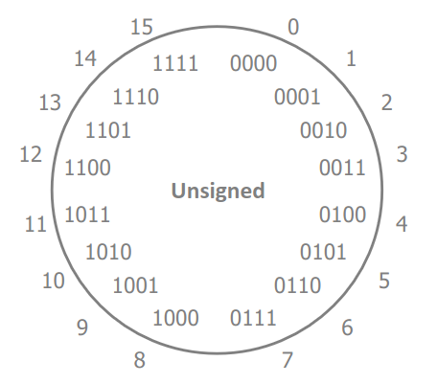
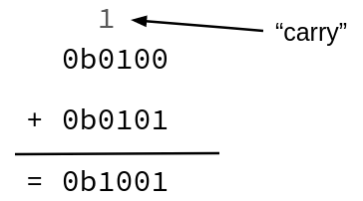
Unsigned Integers (Review)
Just like the binary->base 10 conversion from day 1
b₇b₆b₅b₄b₃b₂b₁b₀ = b₇*2⁷ + b₆*2⁶ + … + b₁*2¹ + b₀*2⁰
Arithmetic: just add like “normal”
If sum exceeds 1 bit, carry over to the next
Ex: 4+5 = 9
Notes:
Diagram shows binary increasing clockwise. For unsigned, decimal value also increase clockwise

Slide 19
How do we represent signed integers?
Historically, different machines did this different ways
Sign and magnitude
1’s complement
2’s complement
Notes:
2’s complement is what’s currently used

Slide 20
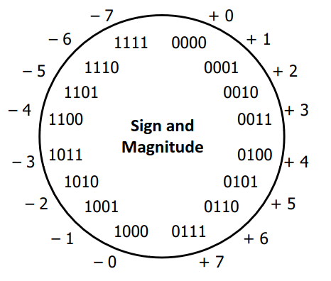
Sign and Magnitude (Review)
Not used in practice for integers!
Designate highest-order (most-significant) bit to represent sign
Sign = 0: positive number
0x7F = 0b01111111 = positive 0b1111111 = 127
Sign = 1: negative number
0xFF = 0b11111111 = negative 0b1111111 = -127
Benefits:
Positive numbers have the same encoding as their unsigned equivalents
0x00 = 0
Easy to tell the sign of a number

Slide 21
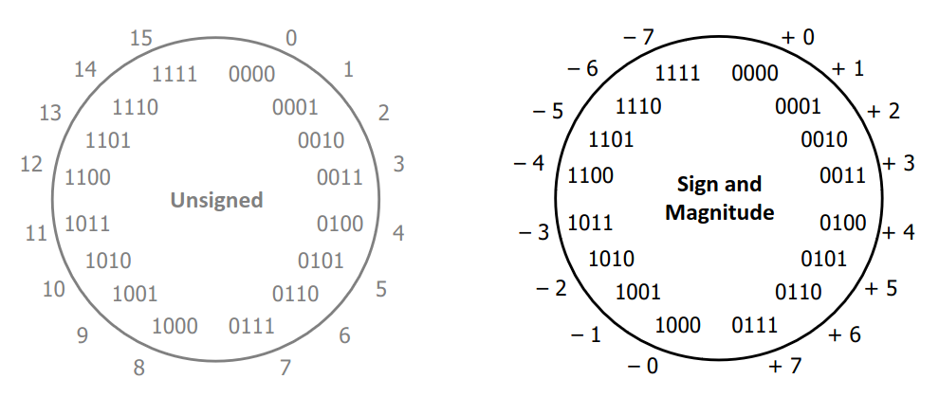
Sign and Magnitude (pt 2)
Drawbacks?

Slide 22
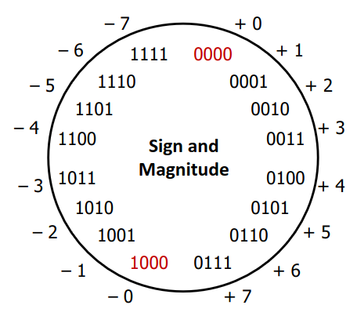
Sign and Magnitude (pt 2)
Not used in practice for integers!
Drawbacks:
Two representations of 0 (bad for checking equality)
0x00 = 0b0000000 = positive 0b0000000 = “positive” 0
0x80 = 0b1000000 = positive 0b0000000 = “negative” 0

Slide 23
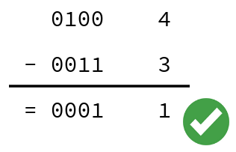
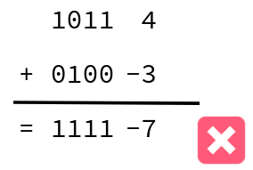
Sign and Magnitude (pt 3)
Not used in practice for integers!
Drawbacks:
Two representations of 0 (bad for checking equality)
Arithmetic is cumbersome
Negative numbers increment in the wrong direction
Ex: 4-3 != 4+(-3)
Notes:
As binary increases, negative #s decrease

Slide 24
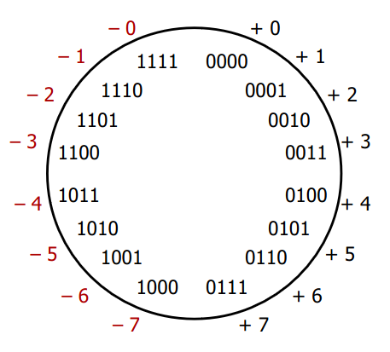
Two’s Complement
Let’s fix these problems:
Flip negative encodings so incrementing works
This is called “one’s complement”
Notes:
You don’t need to know one’s complement, just a fun fact ☺

Slide 25
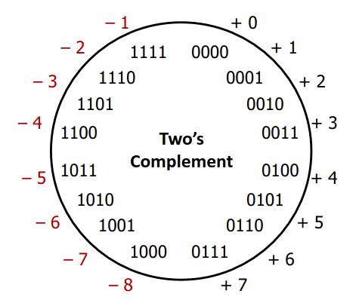
Two’s Complement (pt 2)
Let’s fix these problems:
Flip negative encodings so incrementing works
Shift negative encodings over by 1 to eliminate double-0
Still has a lot of the same benefits as sign-magnitude
Positive values still the same as unsigned
MSB still indicates sign!
0 is treated as “positive”, so we can represent one more negative number than positive

Slide 26
Two’s Complement Negatives (Review)
Accomplished with one neat mathematical trick!
Most-significant bit has negative weight
4-bit example:
1010₂ unsigned:
1*2³ + 0*2² + 1*2¹ + 0*2⁰ = 10
1010₂ two’s complement:
-1*2³ + 0*2² + 1*2¹ + 0*2⁰ = -6
-1 is represented as 11..11₂
MSB makes it “super negative,” need to add as much positive value as possible to get to -1
Easy trick to negate: just flip the bits and add 1!
Notes:
Ex: 1 = 0b0001, ~1 = 0b1110, ~1 + 1 = 0b1111 = -1 ☺

Slide 27
Polling Question
Take the 4-bit number encoding x = 0b1011
Which of the following numbers is NOT a valid interpretation of x using any of the number representation schemes discussed today? (Unsigned, Sign and Magnitude, or 2’s Complement)
-4
-5
11
-3
We’re lost…
Notes:
Unsigned: 2^3 + 2^1 + 2^0 = 11
Sign-mag: -(2^1 + 2^0) = -3
2’s comp: -2^3 + 2^1 + 2^0 = -5

Slide 28
Discussion
Discuss these questions in groups of 2-4
We’ll discuss as a class afterwards, so be prepared to share out
Please be respectful of others’ opinions and experiences
Java was designed to only support signed ints
Why might the designers of Java chosen this?
What are some benefits and drawbacks of this decision?
What does this tell you about the implicit values embedded in C vs Java?

Slide 29
Summary
Bitwise operators allow for fine-grained manipulations of data
Bitwise AND (&), OR (|), and NOT (~) are different than logical AND (&&), OR (||), and NOT (!)
Useful for bitmasks
Choice of encoding scheme is important
Tradeoffs based on size requirements and desired operations
Integers are represented using unsigned and two’s complement representations
Sign and Magnitude no longer used for integers
Limited by fixed bit width

