Slide 1
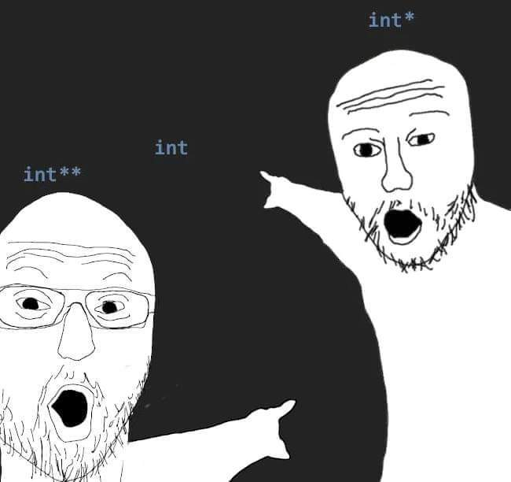
Memory, Data, & Addressing II
CSE 351 Summer 2024
Instructor:
Ellis Haker
Teaching Assistants:
Naama Amiel
Micah Chang
Shananda Dokka
Nikolas McNamee
Jiawei Huang

Slide 2
Administrivia
HW 1 and Lab 0 due tonight (11:59pm)
Due Wednesday, 6/26:
RD 4 (1pm)
HW 2 (11:59pm)
Lab 1a out now!
Due 7/3 (late due date 7/5), turn in on Gradescope
Can be completed with a partner
Turn in one submission for the both of you

Slide 3
Reminder: Lab Late Days
You get 5 free late days for the quarter
Late days only apply to labs
No benefit to having leftover late days
If working with a partner, every counts towards both of your late days
Count lateness in days (even if just by a second)
Weekends count as 1 day
No submissions accepted more than 2 days late
Once free late days are used up, deduct 10% per day
Use at your own risk - don’t want to fall to far behind
Intended to allow for unexpected circumstances

Slide 4
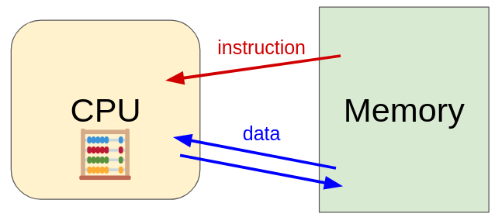
Recap: CPU and Memory
How does the CPU find its data in memory?
How are common C types encoded?
How can we use C to manipulate data in memory?
Notes:
This lecture’s focus is a and c

Slide 5
Lecture Outline
Assignment in C
Memory example
More pointers
Pointer arithmetic
Arrays
Memory example
Arrays and pointers
Strings
Box-and-arrow diagrams

Slide 6
Review Question
In the code on the right, which of the following expressions evaluate to an address?
x + 10
p + 10
&x + 10
*(&p)
ar[1]
&ar[2]
int x = 351;
char* p = &x;
int ar[3];
Notes:
Remember that & = dereference and * = address-of
Int + int = int
Char* + int = char*
Int* + int = int*
* and & cancel each other out, so we end up back at p, which is a char*
Int
Int*
So b, c, d, and f are the correct answers

Slide 7
Assignment in C
32-bit example
(pointers are 4-bytes wide)
little-endian
A variable is represented by a location
Declaration ≠ initialization!
Initially “garbage” or “mystery data”
Example:
int x, y;
(x is at address 0x00, y is at address 0x08)
 | 0x0 | 0x1 | 0x2 | 0x3
0x00 | 00 | 01 | 29 | F3
0x04 | A7 | 00 | 32 | 00
0x08 | 01 | 00 | 00 | 00
0x0C | DE | AD | BE | EF
0x10 | 26 | 00 | 00 | 00
0x14 | EE | EE | EE | EE
x
y
Notes:
Declaring a variable = allocating memory

Slide 8
Assignment in C (pt 2)
32-bit example
(pointers are 4-bytes wide)
little-endian
A variable is represented by a location
Declaration ≠ initialization!
Initially “garbage” or “mystery data”
Example:
int x, y;
(x is at address 0x00, y is at address 0x08)
 | 0x0 | 0x1 | 0x2 | 0x3
0x00 | 00 | 01 | 29 | F3
0x04 | A7 | 00 | 32 | 00
0x08 | 01 | 00 | 00 | 00
0x0C | DE | AD | BE | EF
0x10 | 26 | 00 | 00 | 00
0x14 | EE | EE | EE | EE
x
y

Slide 9
Assignment in C (pt 3)
32-bit example
(pointers are 4-bytes wide)
little-endian
Left hand side = Right hand side
LHS must evaluate to a location
RHS must evaluate to a value
Could be an address, or any other data
Store RHS value at LHS location
Example:
int x, y;
x = 0;
 | 0x0 | 0x1 | 0x2 | 0x3
0x00 | 00 | 00 | 00 | 00
0x04 | A7 | 00 | 32 | 00
0x08 | 01 | 00 | 00 | 00
0x0C | DE | AD | BE | EF
0x10 | 26 | 00 | 00 | 00
0x14 | EE | EE | EE | EE
x
y

Slide 10
Assignment in C (pt 4)
32-bit example
(pointers are 4-bytes wide)
little-endian
Left hand side = Right hand side
LHS must evaluate to a location
RHS must evaluate to a value
Could be an address, or any other data
Store RHS value at LHS location
Example:
int x, y;
x = 0;
y = 0x3CD02700;
 | 0x0 | 0x1 | 0x2 | 0x3
0x00 | 00 | 00 | 00 | 00
0x04 | A7 | 00 | 32 | 00
0x08 | 00 | 27 | D0 | 3C
0x0C | DE | AD | BE | EF
0x10 | 26 | 00 | 00 | 00
0x14 | EE | EE | EE | EE
x
y
little-endian!
Notes:
LSB of y is 00, and is at the lowest address within y

Slide 11
Assignment in C (pt 6)
32-bit example
(pointers are 4-bytes wide)
little-endian
Left hand side = Right hand side
LHS must evaluate to a location
RHS must evaluate to a value
Could be an address, or any other data
Store RHS value at LHS location
Example:
int x, y;
x = 0;
y = 0x3CD02700;
x = y + 3; (compute y+3, then store into x)
 | 0x0 | 0x1 | 0x2 | 0x3
0x00 | 03 | 27 | D0 | 3C
0x04 | A7 | 00 | 32 | 00
0x08 | 00 | 27 | D0 | 3C
0x0C | DE | AD | BE | EF
0x10 | 26 | 00 | 00 | 00
0x14 | EE | EE | EE | EE
x
y

Slide 12
Assignment in C (pt 7)
32-bit example
(pointers are 4-bytes wide)
little-endian
Example:
int x, y;
x = 0;
y = 0x3CD02700;
x = y + 3;
int* z = &y + 3; (z stored at 0x0C)
(compute &y+3, and store into z?)
 | 0x0 | 0x1 | 0x2 | 0x3
0x00 | 03 | 27 | D0 | 3C
0x04 | A7 | 00 | 32 | 00
0x08 | 00 | 27 | D0 | 3C
0x0C | DE | AD | BE | EF
0x10 | 26 | 00 | 00 | 00
0x14 | EE | EE | EE | EE
x
y
z
Notes:
Incorrect!

Slide 13
Assignment in C (pt 8)
32-bit example
(pointers are 4-bytes wide)
little-endian
Example:
int x, y;
x = 0;
y = 0x3CD02700;
x = y + 3;
int* z = &y + 3; (z stored at 0x0C)
(compute &y+12, and store into z)
 | 0x0 | 0x1 | 0x2 | 0x3
0x00 | 03 | 27 | D0 | 3C
0x04 | A7 | 00 | 32 | 00
0x08 | 00 | 27 | D0 | 3C
0x0C | 14 | 00 | 00 | 00
0x10 | 26 | 00 | 00 | 00
0x14 | EE | EE | EE | EE
x
y
z
Pointer arithmetic!

Slide 14
Pointer Arithmetic (Review)
Pointer arithmetic is scaled by the size of the target type
In this example sizeof(int) = 4
int* z = &y + 3;
Get address of y, add 3*sizeof(int), then store result in z
&y = 0x08 = 8₁₀
3*4=12
8+12 =20 = 0x14 (1*16 + 4)
Pointer arithmetic can be dangerous!
Can easily lead to bad memory accesses
Be especially careful with casting
Notes:
Can think of the line “int* z = &y + 3” as “set z to point 3 ints after the address of y”

Slide 15
Assignment in C (pt 8)
32-bit example
(pointers are 4-bytes wide)
little-endian
Example:
int x, y;
x = 0;
y = 0x3CD02700;
x = y + 3;
int* z = &y + 3;
*z = y; (get value at y, put in address stored in z)
 | 0x0 | 0x1 | 0x2 | 0x3
0x00 | 03 | 27 | D0 | 3C
0x04 | A7 | 00 | 32 | 00
0x08 | 00 | 27 | D0 | 3C
0x0C | 14 | 00 | 00 | 00
0x10 | 26 | 00 | 00 | 00
0x14 | 00 | 27 | D0 | 3C
x
y
z
The dereference of a pointer is also a location

Slide 16
Arrays in C (Review)
Declaration: type name[size];
Example: int a[6];
Can also use initialization list: int a[] = {2, 4, 6, 8, 10};
Indexing using brackets
i.e. a[n] gets the n^{th} element of the array, counting from 0
Stored as a single contiguous chunk of memory
Total size = size of data * number of elements
Variable name (a) evaluates to the starting address
Endianness only applies within a single element. Elements always stored in increasing order
Notes:
Array syntax is very similar to Java
Additional note with regard to a being an address: not exactly the same as a pointer! More like a constant
Endianness example: bytes w/in a[0] would be stored according to endiannes, but a[0] always comes before a[1], regardless of endianness!

Slide 17
Arrays in C Example
64-bit example
(pointers are 8-bytes wide)
little-endian
Declaration: int a[6];
 | 0x0 0x8 | 0x1 0x9 | 0x2 0xA | 0x3 0xB | 0x4 0xC | 0x5 0xD | 0x6 0xE | 0x7 0xF
0x00
0x08
0x10
0x18
0x20
0x28
0x30
0x38
0x40
0x48
a[0]
a[2]
a[4]
a[1]
a[3]
a[5]

Slide 18
Arrays in C Example (pt 2)
64-bit example
(pointers are 8-bytes wide)
little-endian
Declaration: int a[6];
Indexing: a[0] = 0x15F;
a[5] = a[0];
 | 0x0 0x8 | 0x1 0x9 | 0x2 0xA | 0x3 0xB | 0x4 0xC | 0x5 0xD | 0x6 0xE | 0x7 0xF
0x00
0x08
0x10 | 5F | 01 | 00 | 00
0x18
0x20 |  |  |  |  | 5F | 01 | 00 | 00
0x28
0x30
0x38
0x40
0x48
a[0]
a[2]
a[4]
Notes:
Because we’re in little endian, 0x5F is stored at the lowest address

Slide 19
Arrays in C Example (pt 3)
64-bit example
(pointers are 8-bytes wide)
little-endian
Declaration: int a[6];
Indexing: a[0] = 0x15F;
a[5] = a[0];
a[6] = 0xBAD;
a[-1] = 0xBAD;
 | 0x0 0x8 | 0x1 0x9 | 0x2 0xA | 0x3 0xB | 0x4 0xC | 0x5 0xD | 0x6 0xE | 0x7 0xF
0x00
0x08 |  |  |  |  | AD | 0B | 00 | 00
0x10 | 5F | 01 | 00 | 00
0x18
0x20 |  |  |  |  | 5F | 01 | 00 | 00
0x28 | AD | 0B | 00 | 00
0x30
0x38
0x40
0x48
a[0]
a[2]
a[4]
No bounds checking!!
Notes:
Calculates where these indices would be if they existed, so a[-1] = bytes 0xC-0xF, and a[6] = bytes 0x28-0x2B

Slide 20
Arrays in C Example (pt 4)
64-bit example
(pointers are 8-bytes wide)
little-endian
Declaration: int a[6];
Indexing: a[0] = 0x15F;
a[5] = a[0];
a[6] = 0xBAD;
a[-1] = 0xBAD;
Pointers: int* p;
p = a;
p = &a[0];
p = 0x10;
 | 0x0 0x8 | 0x1 0x9 | 0x2 0xA | 0x3 0xB | 0x4 0xC | 0x5 0xD | 0x6 0xE | 0x7 0xF
0x00
0x08 |  |  |  |  | AD | 0B | 00 | 00
0x10 | 5F | 01 | 00 | 00
0x18
0x20 |  |  |  |  | 5F | 01 | 00 | 00
0x28 | AD | 0B | 00 | 00
0x30
0x38
0x40 | 10 | 00 | 00 | 00 | 00 | 00 | 00 | 00
0x48
a[0]
a[2]
a[4]
equivalent
p
Notes:
Reminder that a evaluates to starting address

Slide 21
Arrays and Pointer Arithmetic
Both are scaled by the size of the type, so they can be used interchangeably!
Array indexing = pointer arithmetic + dereference
Example: all of the following are equivalent
a[1] = 0xB
*(p+1) = 0xB
p[1] = 0xB
*(a+1) = 0xB
Notes:
If p points to the start of the array, the p+1 points to element 1, so *(p+1) = a[1]
“p” and “a” have the same value, can be used interchangeably.

Slide 22
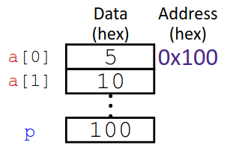
Polling Question
Consider the following code:
1 void main() {
2 int a[] = {0x5, 0x10};
3 int* p = a;
4 p = p + 1;
5 *p = *p + 1;
6 }
The variable values just after line 3 executes are shown in the diagram on the right. What are they after line 5?
p a[0] a[1]
0x101 0x05 0x11
0x104 0x05 0x11
0x101 0x06 0x10
0x104 0x06 0x10
Notes:
Line 4 does pointer arithmetic, so p=104, which now points to a[1]. In line 5, the *p on the RHS evaluates to 10, so adding 1 gets 11, and we store that back into *p (a[1]), so the correct answer is B

Slide 23
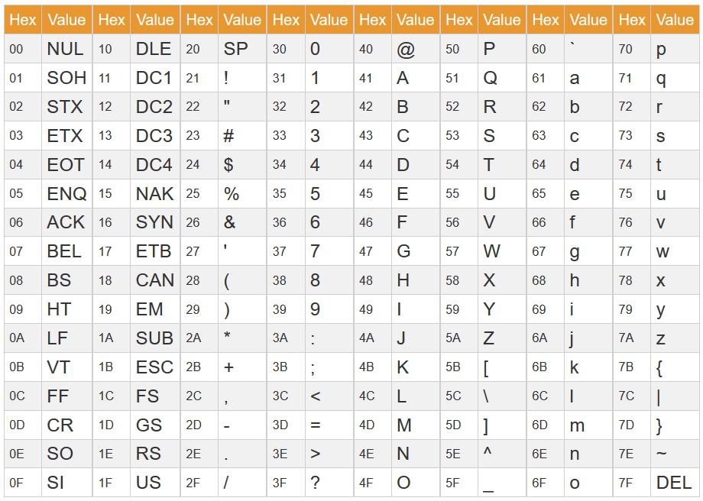
Representing Strings (Review)
In C, stored as an array of bytes (char*)
No String keyword, unlike in Java
One-byte ASCII codes for each character (English-only)

Slide 24
Representing Strings (Review) (pt 2)
Last character followed by a null character to mark the end of the string
0 byte, often written as ‘\0’
Example: “Sam is cool!”;
Decimal | 83 | 97 | 109 | 32 | 105 | 115 | 32 | 99 | 111 | 111 | 108 | 33 | 0
Hex | 0x53 | 0x61 | 0x6D | 0x20 | 0x69 | 0x73 | 0x20 | 0x63 | 0x6F | 0x6F | 0x6C | 0x21 | 0x00
Text | ‘S’ | ‘a’ | ‘m’ | ‘ ‘ | ‘i’ | ‘s’ | ‘ ‘ | ‘c’ | ‘o’ | ‘o’ | ‘l’ | ‘!’ | ‘\0’
Notes:
Also called a “null terminator”
Declaring a string in quotes, implicitly allocates 1 extra byte for the null char

Slide 25
Endianness and Strings
Endianness doesn’t apply to single-byte values (like chars)
As with all arrays, element 0 is stored at the lowest address regardless of endianness
Example: “12345”;
0x00 | 0x01 | 0x02 | 0x03 | 0x04 | 0x05
0x31 | 0x32 | 0x33 | 0x34 | 0x35 | 0x00
‘1’ | ‘2’ | ‘3’ | ‘4’ | ‘5’ | ‘\0’
Notes:
Aka: we don’t have to care about endianness
1st char = lowest address, null terminator = highest address

Slide 26
Examining Data Representations
show_bytes prints out the byte representation of the data at start
Tread any data as a byte array by casting it to char*
C has unchecked casts. !! Danger !!
void show_bytes(char* start, int len) {
int i;
for (i = 0; i < len; i++){
printf("%p\t0x%.2hhX\n", start+i, *(start+i));
printf("\n");
}
printf directives: %p = print pointer \t = tab
%.2hh = print value as char in hex, padding to 2 digits \n = new line
Notes:
%p gets the value start+I, %.2hhX gets the value *(start+i)
*(start+i) = start[i]
Prints in format: “<addr> 0x<data>”

Slide 27
Examining Data Representations (pt 2)
void show_bytes(char* start, int len) {
int i;
for (i = 0; i < len; i++){
printf("%p\t0x%.2hhX\n", start+i, *(start+i));
printf("\n");
}
void show_int(int x) {
show_bytes((char*) &x, sizeof(int));
}
Notes:
Note: show_bytes trusts that len is correct! DANGER
Since x is an int, start will be it’s starting address, cast to a char*, and len = 4

Slide 28
show_bytes Execution Example
int main() {
int x = 123456; // 0x00 01 E2 40
printf("int x = %d;\n", x);
show_int(x);
}
Result (Linux x86-64)
Note: addresses will change with each run (try it!), but fall in the same general range
Notes:
%d gets the value x, so this prints out “int x = 123456”
We know this machine is little endian because LSB (0x40) is at lowest address

Slide 29
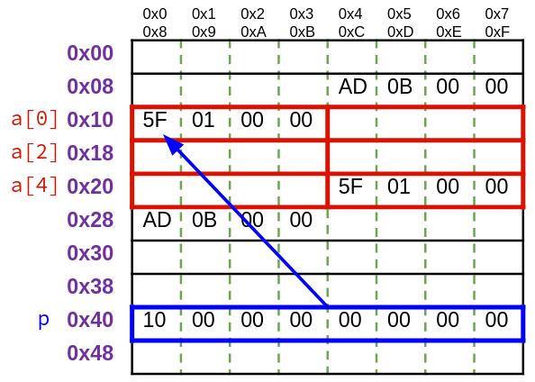
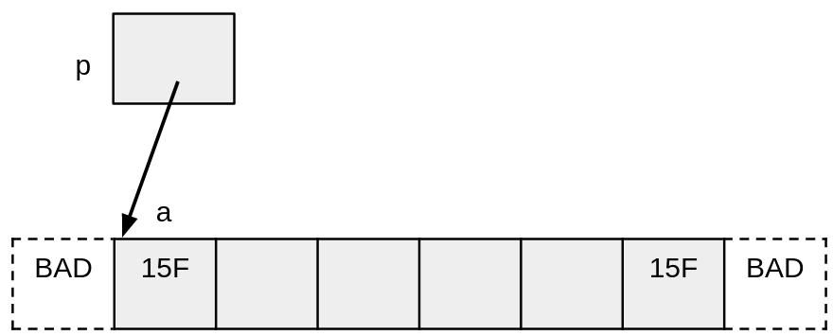
Box-and-Arrow Diagrams (Review)
Simplified way of drawing out memory
Each variable is a box
If relevant, the address may be written above the box
If a pointer points to another variable, draw an arrow between them
If relevant, may also write the address inside the pointer’s box

Slide 30
Polling Question
Consider the following code:
char* str = “hello”;
char* p = str;
*str = ‘j’;
p += 4;
*p = *p + 10;
After it’s finished, what will the value of str be? (Hint: draw a memory diagram!) You may want to look up an ASCII encoding chart.
Notes:
Note: this code actually doesn’t work! Strings declared in quotes are static. My bad…
‘o’ = 0x6F, 10 = 0xA, 0x6F + 0xA = 0x79 = ‘y’
Diagram is an array containing the values ‘h’, ‘e’, ‘l’, ‘l’, ‘o’, ‘\0’. Two boxes labeled “str” and “p” both point to the beginning of this array (‘h’). ‘h’ is then replaced with ‘j’, The “p” box is changed to point to the letter ‘o’, and ‘o’ is changed to ‘y’

Slide 31
Summary
Variables are represented by locations in memory
Assignment in C stores a value in that location
Pointer arithmetic scales by the size of the target type
Convenient when scanning array-like structures in memory
Be careful when using! Particularly when casting to another pointer type
Arrays are stored as contiguous blocks of memory
Unlike Java, C does not do bounds checking on arrays!!
Array indexing is equivalent to doing pointer arithmetic, then dereferencing the result
Strings are null-terminated arrays of ASCII characters
Unlike Java, no dedicated String type

