Slide 1
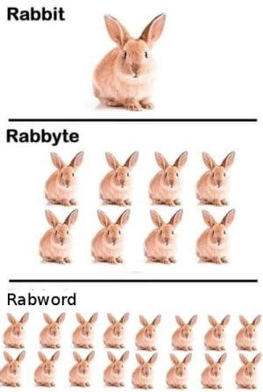
Memory, Data, & Addressing I
CSE 351 Summer 2024
Instructor:
Ellis Haker
Teaching Assistants:
Naama Amiel
Micah Chang
Shananda Dokka
Nikolas McNamee
Jiawei Huang

Slide 2
Administrivia
HW Deadlines changed
Now due 11:59pm instead of before lecture
Pre-lecture readings are still due at 1!
Office hours are now available!
See calendar on the course website
RD3 due 6/24 (Monday), before 1pm
HW1 and Lab0 due 6/24 (Monday), before 11:59pm
Not like a normal lab - on Ed, individual only, no late days
You likely won’t understand much of what happens in this lab, and that’s ok!
We’ll revisit it throughout the quarter

Slide 3
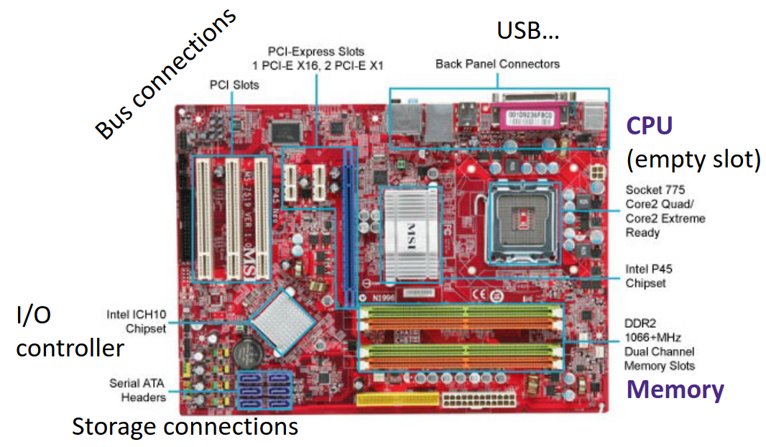
Hardware: Physical View

Slide 4
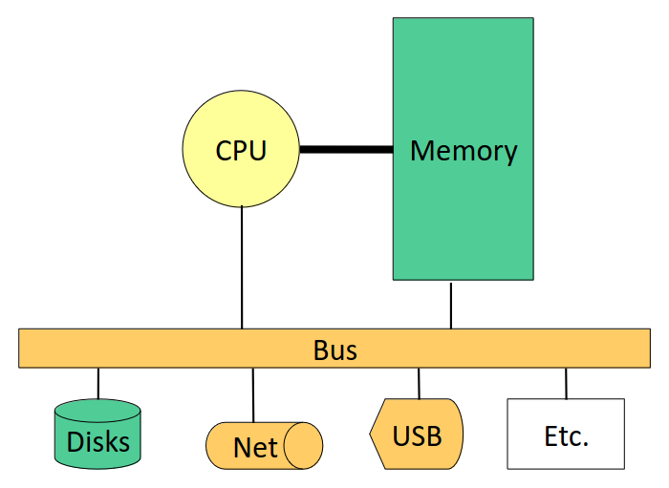
Hardware: Logical View
Hooray, abstraction!
Notes:
CPU and memory are the focus for 351. The components at the bottom (disk, net, USB, etc.) are all external devices. Disk is the only one of these we’ll cover in 351. The bus allows the CPU and memory to connect to these devices

Slide 5
Hardware: 351 View
Memory
CPU
The CPU executes instructions
Memory is where data (including instructions) is stored
How is data encoded? Binary encoding!
Notes:
CPU = central processing unit

Slide 6
Hardware: 351 View (pt 2)
CPU
Memory
If you want to know how this works in hardware, take CSE/EE 469
instruction
data
To execute an instruction, the CPU must:
1. Fetch instruction
2. (if applicable) Fetch data needed for the instruction
3. Perform the computation
4. (if applicable) Write the result back to memory

Slide 7
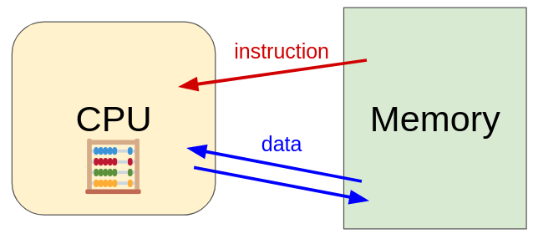
Hardware: 351 View (pt 2)
We’ll start by focusing on memory
How does the CPU know where to find its data?
How are common data types encoded?
How can we use C to manipulate data?

Slide 8
Review Questions (pt 1)
1. By looking at the bits stored in memory, I can tell what a particular 4 bytes is used to represent.
A) True B) False
2. We can fetch a piece of data from memory as long as we have its address.
A) True B) False
Notes:
False: you nee to know its encoding scheme to know what the data represents
2. False: you also need to know the data’s size

Slide 9
Review Questions (pt 2)
3. Which of the following bytes have a most-significant bit (MSB) of 1?
A) 0x63 B) 0x90 C) 0xCA D) 0xD
4. Consider the following declared variables:
int x = 351;
char* p = &x;
How much space in memory does variable p take up (on a 64-bit machine)?
A) 1 byte B) 2 bytes C) 4 bytes D) 8 bytes
Notes:
3. 1 byte = 8 bits, 1 hex digit = 4 bits, so it takes 2 hex digits to write a byte
0x63 = 0b01100011, MSB=0
0x90 = 0b10010000, MSB=1
0xCA = 0b11001010, MSB=1
0xD=1101, but we need to pad with leading 0s to get up to a byte, so the full value is 0b00001101, MSB=0
4. 8 bytes: 64-bit machine means that addresses are 64 bits (8 bytes long). P is a pointer, so it’s the size of an address

Slide 10
Fixed-length Binary (Review)
Because storage is finite, everything is stored as “fixed” length
Data is moved and manipulated in fixed-length chunks
Multiple fixed lengths (e.g., 1 byte, 4 bytes, 8 bytes)
Leading zeros now must be included up to “fill out” the fixed length
Example: the “eight-bit” (1-byte) representation of the number 4 is 0b00000100
Most significant bit (MSB)
Least significant bit (LSB)

Slide 11
Bits and Bytes and Things (Review)
Useful Fact: n bits can represent up to 2^{n} things
If we want to represent x things, we need n bits, where 2^{n} >= x
Example: how many bits would we need to represent the letters a-z?
26 letters, so we need 5 bits (2⁵ = 32 > 26)
Sometimes (oftentimes?) the “things” we are representing are bytes!

Slide 12
Addresses in Memory (Review)
You can think of memory as a single, large array of bytes, each with a unique address (index)
Addresses are fixed-width
Amount of addressable memory = address space
If addresses are a bits long, how many addresses are there?
So how big is the address space?
Notes:
2^a addresses, each corresponds to 1 byte, so 2^a byte address space

Slide 13
Machine “Words” (Review)
Instructions are encoded in machine code (in binary)
Historically (and still true in some assembly languages), all instructions were exactly the same size, we call this a word
We have chosen to tie word size with address width
Still true for languages that don’t have fixed-width instructions: word size = address size
Most modern systems use 64-bit (8-byte) words
Address space = 2⁶⁴ addresses, each represents a byte of data
2⁶⁴ bytes = 1.8*10¹⁹ bytes = 18 EB (exabytes)
(Side note: your computer does not actually have this much memory! We’ll talk about this more later)

Slide 14
Discussion Question
Over time, computers have grown in word size:
Word Size | Instruction Set Architecture | First Intel CPU | Year Introduced
8-bit | ?? (Poor & Pyle) | Intel 8008 | Early 70s
16-bit | x86 | Intel 8086 | 1978
32-bit | IA-32 | Intel 386 | 1985
64-bit | IA-64 (2001), x86-64(2004) | Itanium | 2001
What do you think are the causes, advantages, and disadvantages of this trend?
Notes:
3-5 min?

Slide 15
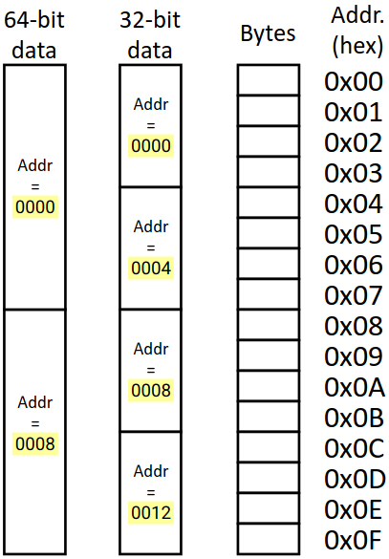
Address of Multibyte Data
Addresses still specify locations of bytes, but we can choose to view memory as a series of fixed-size chunks instead
Addresses of successive chunks differ by data size
The address of any chunk of memory is the lowest address of the chunk
To specify a chunk, need both its address and size
Typically aligned, meaning their starting addresses are multiples of the data size

Slide 16
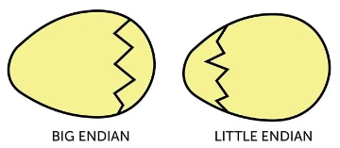
Byte Ordering (Review)
How should bytes within a piece of data be ordered in memory?
Similar to writing in human languages
Ex: English reads left-right, but Arabic reads right-left
By convention, ordering of bytes is called endianness
Two options: big-endian and little-endian
Reference to Gulliver’s Travels: tribes cut their eggs on different sides

Slide 17
Endianness
Big-endian (SPARC, z/Architecture)
Least-significant byte at the highest address
Little-endian (x86, x86-64)
Least-significant byte at the lowest address
Bi-endian (ARM, PowerPC)
Endianness can be specified as either big or little
Example: 4-byte data 0xA1B2C3D4 at address 0x100
Notes:
In the example, the LSB is 0xD4, so this will go at the highest address (0x103) in Big-Endian, and the lowest address (0x100) in little endian.
We use x86-64 in this class, so we’ll mostly be working with little endian

Slide 18
Polling Question
We store the value 0x 01 02 03 04 as a word at address 0x100 in a big-endian, 64-bit machine
What is the byte of data stored at address 0x104?
A) 0x04
B) 0x40
C) 0x01
D) 0x10
E) We’re lost…
0x100 | 0x101 | 0x102 | 0x103 | 0x104 | 0x105 | 0x106 | 0x107
Notes:
64-bit means word size is 8 bytes. 0x100 is the starting address, so data spans 0x100-0x107. LSB is 0x04, so this goes at 0x107, fill in the rest backwards (including leading 0s). The value at 0x104 is 0x01

Slide 19
Endianness (pt 2)
Endianness only applies to data storage
Often, a programmer can ignored endianness because it is handled for them
Bytes wired into correct place when reading and storing from memory (hardware)
Compiler and assembler generate correct behavior (software)
Endianness still shows up:
Logical issues: accessing different amount of data than how you stored it (e.g., store int, access byte as a char)
Need to know exact values to debug memory errors
Manual translation of machine code

Slide 20
Data Representations in C
to use bool in C, must
#include <stdbool.h>
Java Data Type | C Data Type | 32-bit (old) | 64-bit
boolean | bool | 1 | 1
byte | char | 1 | 1
char |  | 2 | 2
short | short/short int | 2 | 2
int | int | 4 | 4
float | float | 4 | 4
 | long/long int | 4 | 8
double | double | 8 | 8
long | long long/long long int | 8 | 16
 | long double | 8 | 16
(reference) | pointer (*) | 4 | 8
address size = word size
Notes:
In practice, it’s common to use char instead of bool

Slide 21
Pointers in C (Review)
Data type that stores an address
We say it points to the data at that address
Declaration: <type>* <name>;
The star is part of the data type - indicates that it is a pointer
Example: int* ptr;
Type of pointer tells you how to interpret the data at that address
Ex: a char* points to a char, an int* points to an int, etc.
Probably unfamiliar to most of you, but not entirely new!
Java uses pointers to reference objects, it just hides this from the programmer
Notes:
In the example, if we left out the *, it would just be an int variable

Slide 22
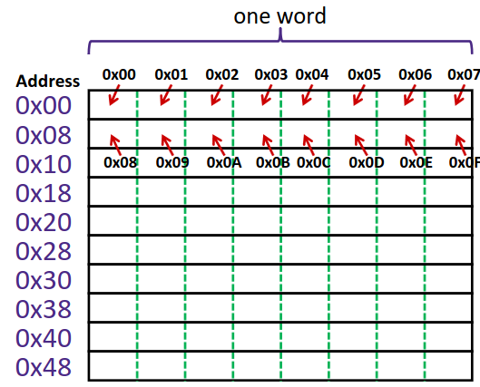
A Picture of Memory (64-bit view)
A 64-bit (8-byte) aligned view of memory, big endian
Each cell is one byte
Each row is composed of 8 bytes
The labels on the left are the starting addresses of each row

Slide 23
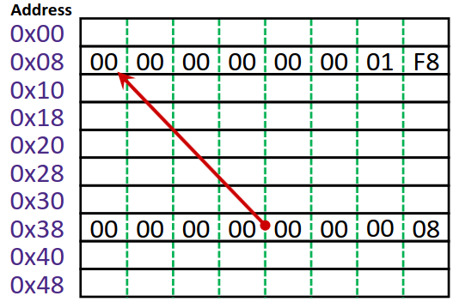
Addresses and Pointers
64-bit (8-byte) word
One row = 8 bytes
Big endian
A pointer is a data object that holds an address
Address can point to any data
Example:
8-byte value 504 (0x1F8) stored at address 0x08
Pointer stored at 0x38 points to the data at 0x08
Notes:
Big endian, so byte 0xF8 goes at the end of the row (address 0xF).
The value 0x08 (padded out 8 bytes) is stored at 0x38.

Slide 24
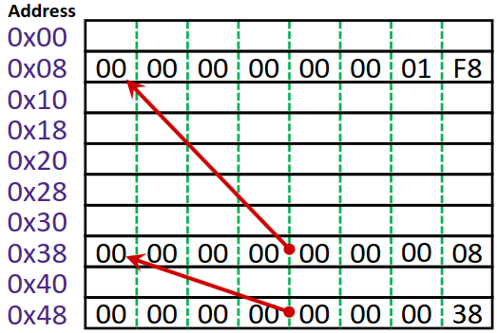
Addresses and Pointers (pt 2)
64-bit (8-byte) word
One row = 8 bytes
Big endian
Example cont.:
Pointer stored at 0x48 points to the data at 0x38
Pointer to a pointer!
What data type is address 0x08?
We don’t know! It depends on how you use it
Could be a pointer, long, etc.
Notes:
The value 0x38 (padded out to 8 bytes) is stored at address 0x48

Slide 25
Pointer Operators
& = “address of” operator
* = “value at address” or “dereference” operator
Note: * is also used when declaring a pointer variable, this is NOT an operator in this context
Operator confusion
These are unary operators (i.e., they take 1 operand)
Both & and * are used as binary operators as well
x & y is bitwise AND (we’ll talk about this in the next couple lectures)
x * y is multiplication
Notes:
&-attach to any variable – “give me a pointer to this thing”
* - pointers only – “give me the thing this points to”

Slide 26
Addresses and Pointers (pt 3)
64-bit (8-byte) word
One row = 8 bytes
Big endian
Here’s some example C code that may create the memory layout from before:
long x = 504;
long* p1 = &x;
long** p2 = &p1;
What is the value of *p2? What is its data type?

Slide 27
Summary
Memory is a long, byte-addressed array
Word size bounds the size of the address and memory (address space)
Different data types use different number of bytes
Address of multi-byte piece of memory given by the lowest address
Endianness determines memory storage order for multi-byte data
Least significant byte in lowest (little-endian) or highest (big-endian) address of memory chunk
Pointers are data objects that hold addresses
All pointers are the same length as the system’s word size
Type of pointer determines size of thing being pointed at
We use * (dereference) and & (address-of) operators to interact with pointers

