Slide 1
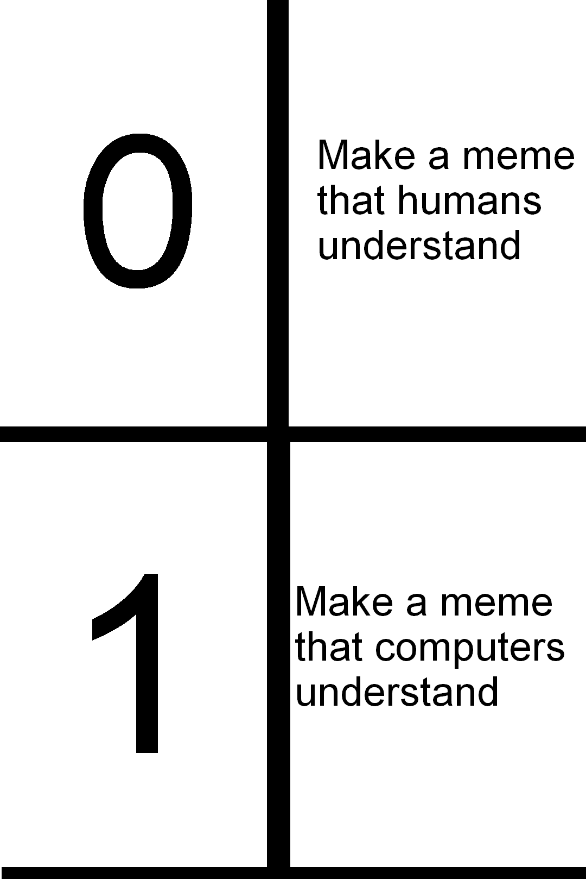
The Hardware Software Interface
CSE 351 Summer 2024
Instructor:
Ellis Haker
Teaching Assistants:
Naama Amiel
Micah Chang
Shananda Dokka
Nikolas McNamee
Jiawei Huang

Slide 2
Lecture Outline
Introduction
Syllabus/Logistics
Binary and Numerical Representation

Slide 3
Introductions: Course Staff
Instructor: Ellis
BS/MS student
Research focus in Operating Systems
Long-time TA, first-time instructor!
TAs:
Naama, Micah, Shananda, Nikolas, and Jiawei
Available in section, office hours, and on Ed
More than anything, we want you to feel
Welcome in this space
Able to learn and succeed in this course
Comfortable reaching out if you need help or want change

Slide 4
Introductions: You!
~70 students
CSE majors, ECE majors, and more
Majority of the class are non-majors
Most of you will find almost everything in the course new
Get to know each other! Help each other out!
Research suggests that group work supports learning
Working well with others is a valuable life skill
Diversity of perspectives expands your horizons
Take advantage of group work, where permissible, to learn, not just get a grade

Slide 5
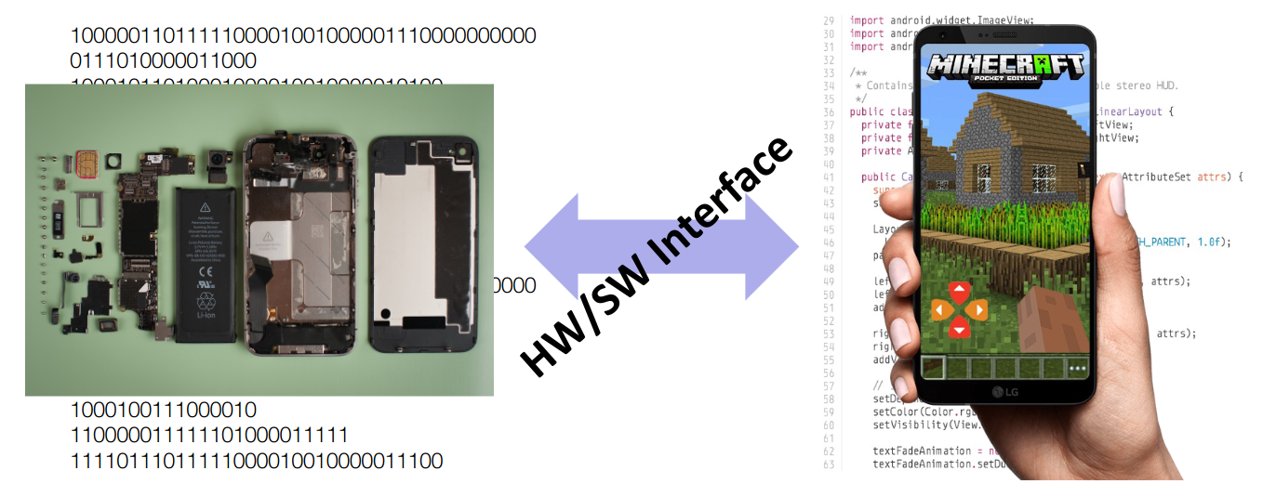
Introductions: CSE 351
You’ll learn the key abstractions “under the hood”
How does your source code become something the computer understands?
What happens as your computer is executing one or more programs?

Slide 6
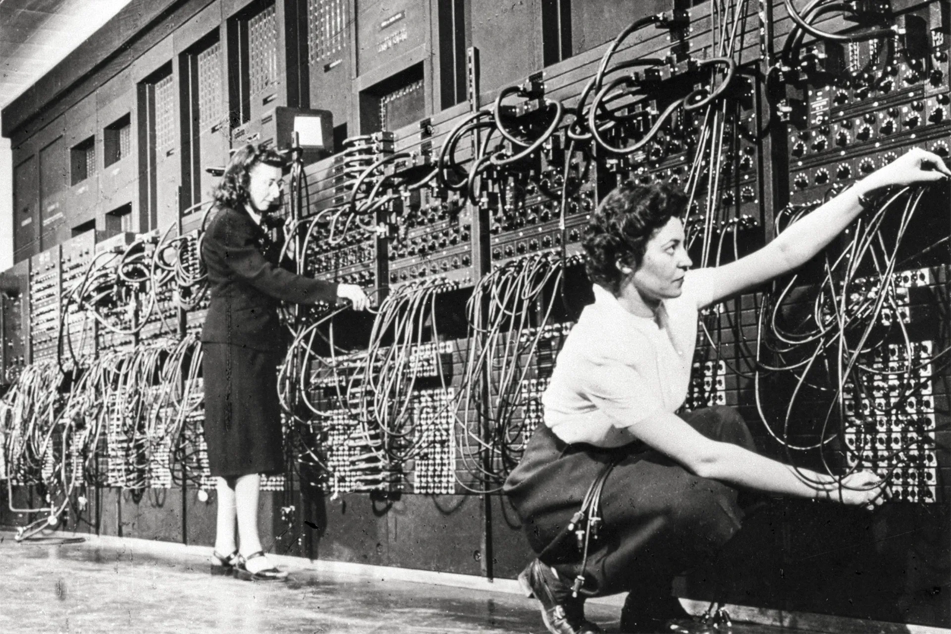
Some History
Hardware started out quite primitive
Programmed with very basic instructions
Very tedious!
Software was also very basic
Programs reflected the actual hardware they ran on
Programmer had to specify each step manually
Programmers working on the ENIAC, circa 1946.

Slide 7
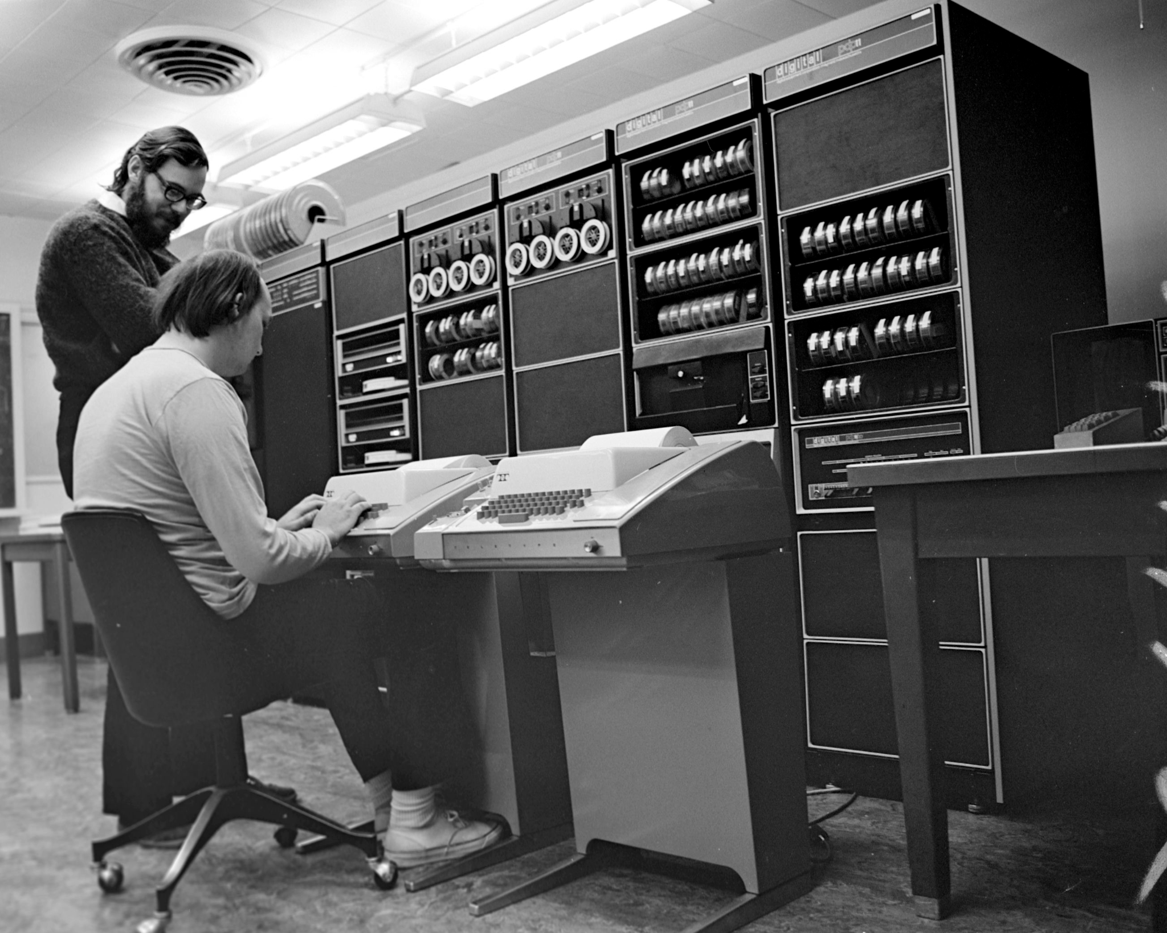
Some History pt 2
As time went on, programming became more abstract
Assembly language: basic set of instructions
Early high-level languages: C, FORTRAN, etc.
Data types, arrays, loops, etc.
Still closer to the hardware than modern languages
Now: Java, Python, etc.
Lots of convenient features!
Don’t have to know much about the hardware to program
Brian Kernighan and Dennis Ritchie, creators of the original C standard.

Slide 8
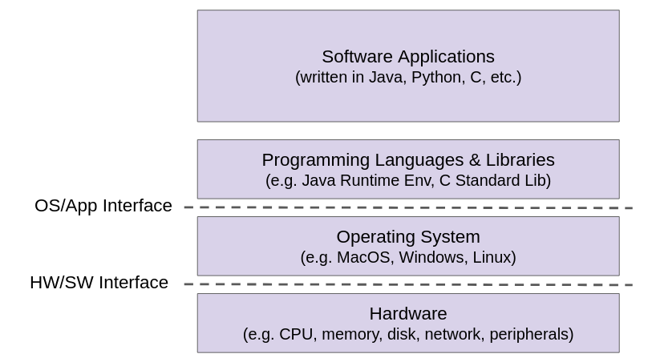
Layers of Computing
Notes:
Software Applications = most of CSE
Operating Systems = CSE451 (and some other courses)
Hardware = most of ECE, CSE369, 371, and 469
CSE351 lives between OS and Hardware

Slide 9
Course Perspective
CSE 351 will make you a better programmer
Learn how software really works
Understand some of the abstractions that exist between hardware and software, why they exist, and how they build upon each other
Why is this important?
Better debugging
Better basis for evaluation performance
You might miss Java, but keep an open mind!
Take note of anything that piques your interest. There’s lots of classes you can take to explore this space further

Slide 10
Syllabus/Logistics
Notes:
~1:25-1:30

Slide 11
Important Tools
Course Website: https://courses.cs.Washington.edu/courses/cse351/24su
Syllabus, schedule, lab specs, etc.
Ed course
Discussion: announcements, ask and answer questions
Lessons: readings, lecture polls, homework
Gradescope: lab submissions, take-home quizzes
Canvas: surveys, grade book
Panopto: lecture recordings
Find Ed Lessons in the top-right corner of Ed.

Slide 12
Quizzes
Three throughout the quarter
Take-home on Gradescope
Will have ~1 week to complete
More information to come when we get to the first quiz

Slide 13
Assignments
Pre-lecture readings: Ed
Graded on completion, due 1pm before lecture
Lecture polls: Ed
Conducted during class, graded on completion, due 1pm before the next lecture
Homework: Ed
Unlimited attempts, due 1pm two lectures after it’s assigned
Labs: Course website/Gradescope (except for Lab0)
~1-2 weeks per lab, due at 11:59pm
Assignments need to be turned in before the time listed. If the clock reads 11:59pm when you turn in your lab, it’s late!

Slide 14
Late Policies
Labs can be turned in up to 2 days after the deadline
You get 5 free late days to use throughout the quarter
After your free late days are used up, we will deduct 10% per day
We cannot accept Ed assignments after the due date!
You only need to complete 80% of the readings and lecture polls for full credit
Your lowest homework score will be dropped
If you have DRS accommodations that contradict these policies, I will contact you
Please email me if I don’t reach out by the end of today

Slide 15
Extensions, Accommodations, Help
We’re here to help! We want you to have the best experience possible
Extenuating circumstances
Students (and staff) face an extremely varied set of circumstances
We will try to be accommodating, but the earlier you reach out, the better
For formal accommodations go through Disability Resources for Students (DRS)
They can help you even for temporary disabilities (injury, etc.)
Don’t suffer in silence – talk to a staff member!
Go to office hours
Ask on the Ed board
Request a 1-on-1 meeting

Slide 16
Grade Breakdown
Pre-lecture readings: 7%
Homework: 20%
Labs: 40%
Can be done individually or in pairs
Quizzes: 30% (10% each)
Participation: 3%
Includes answering lecure polls, participation in section, office hours, and Ed

Slide 17
Administrivia/TODOs
Explore the course website, and read the syllabus
Make sure you can connect to the CSE Linux environment (attu/calgary)
(Optionally) sign up for CSE 391: System and Software Tools
Due Friday (6/21)
Pre-course Survey (on Canvas), due 1pm
HW0 (Ed) due 1pm
RD1 & RD2 (Ed) due 1pm
Due Monday (6/24)
RD3 (Ed) due 1pm
HW1 (Ed) due 1pm
Lab0 (Ed) due 11:59pm
Reminder: no class on Wednesday due to holiday!

Slide 18
Binary
Notes:
~1:45-1:50

Slide 19
Base Definitions (Review)
If we’re in base b, that means we have b possible symbols to use
In decimal (base 10), we have the digits 0-9
Each digit represents a power of b
The rightmost digit always represents 1 (b⁰), and it increases as we read left
Ex: compare the number written “351” in base 10 vs base 6
10² = 100 | 10¹ = 10 | 10⁰ = 1
3 | 5 | 1
6² = 36 | 6¹ = 6 | 6⁰ = 1
3 | 5 | 1
In base 10, this numeral means we have 3 100s, 5 10s, and a 1.
In base 6, this numeral means we have 3 36s, 5 6s, and a 1.
Notes:
Ex: if we’re in base 4, then we have the symbols 0-3. After that, we have to go to double-digits, so we’d write the number four as 10, five as 11, etc.

Slide 20
Base Conversions pt 1 (Review)
To convert from base b to decimal, multiply each digit by its corresponding place value, then add them
Ex: find the decimal value of 246₈ (note, the subscript “8” denotes the base):
8² = 64 | 8¹ = 8 | 8⁰ = 1
2 | 4 | 6
So the total value is 2*64 + 4*8 +6*1 = 166

Slide 21
Base Conversions pt 2 (Review)
To convert a number N from decimal to base b:
Find the highest power i such that b^{i} < N
Divide N by b^{i} and round down to the nearest integer. The result is the ith digit of our final number
Take the remainder, and repeat step 2 with i-1 until you reach i=0
Ex: convert the number 123 to base 4:
4³ = 64, 123/64 = 1, remainder = 59
4² = 16, 59/16 = 3, remainder = 11
4¹ = 4, 11/4 = 2, remainder = 3
4⁰ = 1, 3/1 = 3
So the final answer is 1323₄
Notes:
We start by listing all the powers of 4 that are <= the target number. This tells us what the values of each place will be. Starting from highest to lowest, we have: 64, 16, 4, 1
Then, starting from the highest one, we figure out how many times we can fit that into the target number (i.e. what should the value of that place be), subtract that amount, and then continue to the next base.

Slide 22
Review Question: Base Conversion
What is the decimal value of 107₈?
71
87
107
568
Notes:
In base 8, the lowest place represents 1s, the next is 8s, and the next is 64s, so the final value of this number is 1*64+0*8+7*1 = 71

Slide 23
Binary
Humans think about numbers in base 10, but computers “think” about numbers in base 2 (binary)
A binary digit is called a bit
A group of 4 bits is called a nibble
A group of 8 bits is called a byte

Slide 24
Why Binary?
Easy to store and read
For larger bases, noise would lead to inaccuracies
Other bases are possible, but not yet viable
The Setun was a ternary (base 3) computer built in the USSR in 1958
UW research into DNA storage (base 4: A, C, G, T)
Quantum

Slide 25
Binary and Hex (Review)
Binary is inconvenient for humans, so computer scientists often write numbers in base 16 (hexadecimal)
16 digits: 0-9, A-F
Why hex?
Easy conversion, each hex digit = 4 bits!
2 hex digits = 1 byte
We use prefixes to denote common bases
0b = binary
0x = hex
No prefix = decimal

Slide 26
Common Base Conversion (Review)
Base 10 | Base 2 | Base 16
0 | 0000 | 0
1 | 0001 | 1
2 | 0010 | 2
3 | 0011 | 3
4 | 0100 | 4
5 | 0101 | 5
6 | 0110 | 6
7 | 0111 | 7
8 | 1000 | 8
9 | 1001 | 9
10 | 1010 | A
11 | 1011 | B
12 | 1100 | C
13 | 1101 | D
14 | 1110 | E
15 | 1111 | F
hex -> binary: translate each digit according to chart, then drop leading 0s
Ex: 0x2D = 0b0010 1101 = 0b101101
binary -> hex: break into groups of 4 bits from right to left, add leading 0s if necessary, then translate
Ex: 0b101101 = 0b0010 1101 = 0x2D
Note: does not work for decimal conversions!
You will probably have this table memorized by the end of the quarter :)

Slide 27
Review Questions: Binary, Hex, and Decimal
What is the hex value of 108?
0x6C
0xA8
0x108
0x612
Convert 0b100110110101101 to hex.
Convert 0x3C9 to binary.
Notes:
We list the powers of 16 that are <= 108:
16, 1
Then we figure out how many times 16 can go into 108, which is 6, so that’s the value of our 16s place. 16*6=96, subtracting that from 108, we get 12, so that is how many we have in our 1s place. 12 in hex is C, so the final value is 0x6C.
2. Split the number into groups of 4, starting from the right. The leftmost group will have 3 bits, so we add a leading 0. Then, we plug these values into the chart and get the result 0x4DAD
3. Plug the hex values into the chart, and we get 0b0011 1100 1001. Removing the two leading 0s gets us 0b1111001001

Slide 28
Numerical Encoding
You can represent anything countable using numbers!
But you need to agree on an encoding
Computers store all data as a binary number
Examples:
Decimal Integers: 0→0b0, 1→0b1, 2→0b10, etc.
English Letters: CSE→0x435345, yay→0x796179
Emojis: 😃 0x0, 😞 0x1, 😎 0x2, 😇 0x3, 😈 0x4, 🙋 0x5

Slide 29
So What’s it Mean?
A sequence of bits can have many meanings!
Consider the hex sequence 0x4E6F21
Possible interpretations include:
The decimal number 5120257
The real number 7.203034*10⁻³⁹
The characters “No!”
The background color of this slide (sort of an olive green?)
It’s up to the program/programmer to decide how to interpret the sequence of bits

Slide 30
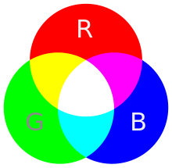
Binary Encoding Example - Colors
RGB - Red, Green Blue
Additive model, represent amount of each color of light
1 byte (8 bits) for each color
Ex: Blue = 0x0000FF, White = 0xFFFFFF
Dark Purple = 0x7030a0

Slide 31
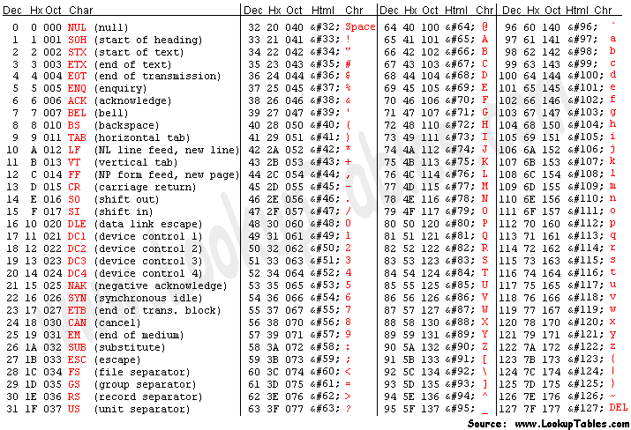
Binary Encoding Example - Text
American Standard Information Exchange (ASCII)
Unicode (international)

Slide 32
Binary Encoding Example - Files and Programs
At the lowest level, all digital data is stored as bits!
Layers of abstraction keep everything comprehensible to humans
Data/files are groups of bits interpreted by a program
Program is also a sequence of bits interpreted by the CPU
You can see the hex representation of your files in a text editor - try it!
Vim: %!xxd
Emacs: M-x hexl-mode

Slide 33
Summary
All computer data is stored in binary
Humans think in decimal, have to convert between bases
Hex as a more human-readable base that’s easy to convert
Binary can represent anything!
Program needs to know how to interpret the bits

Slide 34
Some fun topics we will touch on (vote on Ed!)
What is a GFLOP and why is it used in computer benchmarks?
How and why does running many programs for a long time eat into your memory (RAM)?
What is stack overflow and how does it happen?
Why does your computer slow down when you run out of disk space?
What was the flaw behind the original Internet worm, the Heartbleed bug, and the Cloudbleed bug?
What is the meaning behind the different CPU specifications? (e.g., # of cores, # and size of cache)

