Slide 1
Memory, Data, & Addressing I CSE 351 Summer 2021
Instructor:
Mara Kirdani-Ryan
Teaching Assistants:
Kashish Aggarwal
Nick Durand
Colton Jobes
Tim Mandzyuk
Notes:
Be courageous! From the I-90 bike tunnel
Matisse helped revolutionize modern art in early 20th century, heavily critized for challenging norms in painting
Lost ones, Lauryn Hill
Went over – took a while to go through unit summaries (~10min), finished on time, but didn’t have time for breakouts

Slide 2
Questions in Lecture
Ohyay is new for us too!
Help us make this course phenomenal
Questions in “Questions” pane, staff will respond in chat, then remove the question
”Questions” got a bit cluttered on Monday
Keep an eye on chat! See if someone’s asked your question!

Slide 3
Gentle reminders!
Pre-Course Survey and hw0 due tonight @ 8pm
hw1 due Friday (6/25) @ 8pm
Lab 0 due Monday (6/28) @ 8pm
This lab is exploratory and looks like a hw; the other labs will look a lot different (involve writing code etc.)
Don’t worry if everything in Lab 0 doesn’t make perfect sense right now! We’ll continue to cover everything in more detail
Lab 0: get used to modifying and running C code to see the output
A powerful tool for understanding the technical concepts in this course!
Readings should be completed by 10am on day of lecture
Lecture activities should be completed by 10am of NEXT lecture
Notes:
Y’all, things aren’t due at midnight, that feels inhumane and mean. Science says that the vast, vast majority of folks benefit from consistent bedtimes and not working for a few hours before bed.
If you’re up until 2am on the reg and you’d prefer a different deadline time, reach out, but goodness, sleep is so so important for learning.

Slide 4
How’d the reading go?

Slide 5
Learning Objectives
Proficiency with this lecture means you can:
Get started on your floorplan, and understand why we’re doing these
Fxplain the prevailing notions of modern (~1870 on) computing
Given a piece of data and an endianness, show how that data will be represented in memory
Say if a piece of data is aligned in memory
Explain what “Byte-Adressable memory” means

Slide 6
Unit Summaries
No exams this quarter! Yay!
We’re doing something else instead…

Slide 7
Unit Summaries*
No exams this quarter! Yay!
We’re doing something else instead…
3 Tasks per Summary (we’ll have 3 total):
Create a floorplan (4-5 hours)
Reflect on your learning (30min)
Answer a few “exam-style” questions (30min)
*this is reiterating http://cs.uw.edu/351/unit_summaries, look there for complete details

Slide 8
Task 1: Create a Floorplan
We’re treating units as ”floors” in the HoC
What would the floorplan for this “floor” look like?
Schematics, drawings, sketches, whatever format works for you!
Good CS Folks™ work to understand socio-technical context!
Demonstrate technical & socio-technical understanding!
You’ll also submit:
A design doc that justifies your decisions
How long this all took you
See the website for details

Slide 9
Task 1: Design
This is a design task!
There isn’t a clear, correct answer!
Design Requires Iteration and Feedback!
Well-scoring Task 1s probably tried a few things out
Key Idea: Prototyping
Roughly sketch a few ideas, then pick one to work on
Get feedback on prototypes and early iterations!
We’ll have some in-class time, ask for feedback in OH
Small-group work ok, but your final design should represent your synthesis, words, and design
We can’t grade in advance, but we can critique

Slide 10
Task 1: Evaluation Criteria
Completeness: Did you cover everything?
Are omissions justified?
Cohesion: Do things fit together sensibly?
We’ll be gentle, we understand it isn’t a perfect fit
Clarity: Can we understand you?
Have you worked through meaningful iterations? Does this seem polished for 4-5 hours of work?
Creativity: Does your floorplan feel uniquely yours?
We’re not grading on conventional artistic skill!
Be unconventional! We’re cool with that!

Slide 11
Task 1: Qualification
This is different than anything from my undergrad
Probably different from most CSE courses as well
I want to try this at least once!
No examples, but we’re here to help!
Notes:
I have an idea of how I’d like to do this, and I’d like to try it at least once. We can do floor-plans/essays, or something else that I haven’t thought of! My requirements are that it doesn’t have a single correct answer and that there’s lots of space for self-expressions, but beyond that I’m open to ideas.

Slide 12
Task 1: Qualification
This is different than anything from my undergrad
Probably different from most CSE courses as well
I want to try this at least once!
No examples, but we’re here to help!
If you’re not sure where to start, that’s ok!
Design tasks usually feel this way
Most of the work you do after college will be a design task!
No examples, no clear answers, requiring creativity and justification
Hopefully, this is good preparation 😊
Notes:
Ask for questions here!

Slide 13
Unit Summary: Call to Action
Start thinking about how these pieces fit together!
Start now! It’ll save you time! 😁
Reach out if you have concerns/questions!
This is an experiment*, I’d like it to be a good one
Demonstrate your socio-technical understanding!
*an experiment that’s based in best-practices in education
Notes:
“If you’re having trouble getting started, come to office hours! For me, anxiety about task completion sometimes manifests as procrastination and de-prioritization, and that’s something that’s really helpful for me to talk through”

Slide 14
"It is creative apperception more than anything else that makes the individual feel that life is worth living. Contrasted with this is a relationship to external reality which is one of compliance, the world and its details being recognized but only as something to be fitted in with or demanding adaption. Compliance carries with it a sense of futility for the individual and is associated with the idea that nothing matters and life is not worth living. In a tantalizing way, many individuals have experienced just enough of creative living to recognize that for most of their time they are living uncreatively, as if caught up in the creativity of someone else, or of a machine" (p87). D.W. Winnicott
Notes:
Individuals feel that life is worth living when they can shape their reality, rather than be shaped by it

Slide 15
"It is creative apperception more than anything else that makes the individual feel that life is worth living. Contrasted with this is a relationship to external reality which is one of compliance, the world and its details being recognized but only as something to be fitted in with or demanding adaption. Compliance carries with it a sense of futility for the individual and is associated with the idea that nothing matters and life is not worth living. In a tantalizing way, many individuals have experienced just enough of creative living to recognize that for most of their time they are living uncreatively, as if caught up in the creativity of someone else, or of a machine" (p87). D.W. Winnicott

Slide 16
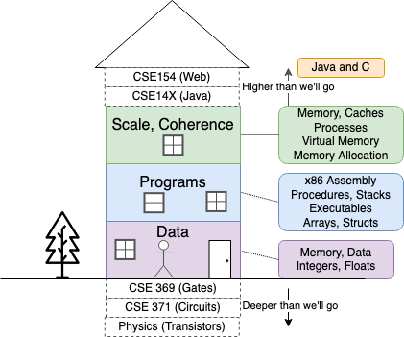
First Floor: Data
How do we represent data (strings, numbers) computationally?
What limits exist? Why?
What values were encoded into data representations?
What was prioritized? Why?
Today: Memory!

Slide 17
Memory, Data, and Addressing
Hardware - High Level Overview
Representing information as bits and bytes
Memory is a byte-addressable array
“Word” size = address size = register size
Organizing and addressing data in memory
Endianness – ordering bytes in memory
Manipulating data in memory using C
Boolean algebra and bit-level manipulations
How do we store information for other floors and systems to access?

Slide 18
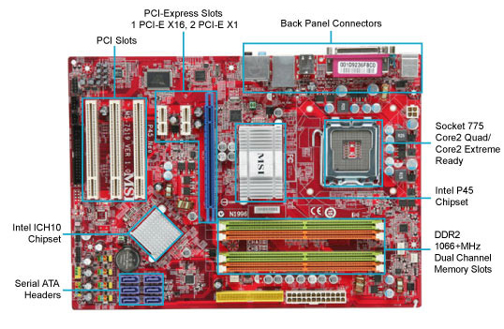
(Modern) Hardware: Physical View
USB…
Bus connections
CPU
(empty slot)
I/O
controller
Memory
Storage connections
Notes:
CPU
Looks funny because of heat sink

Slide 19
(Modern) Hardware: Logical View
Memory
CPU
Bus
Disks
USB
Etc.
Net
Notes:
CPU: all computations done here
Memory: big array of bytes
Big pipe between CPU and memory, since we compute on data, we’ll need lots of data
Bus: connect everything else to each other
Bus just means you broadcast on it (to everyone)
Same root as the other kind of “bus”
Disks bigger storage, slower, farther away, persistent
Network, etc.

Slide 20
Hardware: 351 View (version 0)
Memory
?
CPU
The CPU executes instructions
Memory stores data
Binary encoding!
Instructions are just data
How are data and instructions represented?
Notes:
The CPU and Memory are what this course focuses on.

Slide 21
Aside: Why Base 2?
Electronic implementation
Easy to store with bi-stable elements
Reliably transmitted on noisy and inaccurate wires
Other bases possible, but not yet viable:
DNA data storage (base 4: A, C, G, T) is hot@UW
Quantum computing
0
1
0
3.3V
2.8V
0.5V
0.0V
Notes:
adenine (A), cytosine (C), guanine (G), or thymine (T)

Slide 22
Hardware: 351 View (version 0)
Memory
instructions
?
data
CPU
To execute an instruction, the CPU must:
Fetch the instruction
(if applicable) Fetch data needed by the instruction
Perform the specified computation
(if applicable) Write the result back to memory
Notes:
The CPU and Memory are what this course focuses on.

Slide 23
Hardware: 351 View (version 1)
Memory
instructions
i-cache
take 469
data
CPU
registers
More CPU details:
Instructions are held temporarily in the instruction cache
Other data are held temporarily in registers
Instruction fetching is hardware-controlled
Data movement is programmer-controlled (assembly)
Notes:
Take EE/CSE469 to learn about the internal workings and design of the CPU, but we will reveal a few more details here.

Slide 24
Hardware: 351 View (version 1)
Memory
instructions
i-cache
take 469
data
CPU
registers
Let’s start with memory!
How does a program find its data in memory?

Slide 25
Review Questions
By looking at the bits stored in memory, I can tell what a particular 4 bytes is being used to represent.
🤖 True 🏠 False 🥶 Help!

Slide 26
Review Questions
By looking at the bits stored in memory, I can tell what a particular 4 bytes is being used to represent.
🤖 True 🏠 False 🥶 Help!
We can fetch a piece of data from memory if we have its address.
🤖 True 🏠 False 🥶 Help!

Slide 27
Review Questions
By looking at the bits stored in memory, I can tell what a particular 4 bytes is being used to represent.
🤖 True 🏠 False 🥶 Help!
We can fetch a piece of data from memory if we have its address.
🤖 True 🏠 False 🥶 Help!
Which of the following bytes have a most-significant bit (MSB) of 1?
🤖 0x63 🏠 0x90 💡 0xCA ✨ 0xF
🥶 Help!

Slide 28
Binary Encoding Additional Details
Because storage is finite in reality, everything is stored as “fixed” length
Data is moved and manipulated in fixed-length chunks
Multiple fixed lengths (e.g. 1 byte, 4 bytes, 8 bytes)
Leading zeros now must be included up to “fill out” the fixed length
Example: the “eight-bit” representation of the number 4 is 0b00000100
Least Significant Bit (LSB)
Most Significant Bit (MSB)

Slide 29
Addresses refer to Bytes of Memory!
0xF…FF
0x0…01
0xF…FE
0x0…00
 |  |  |  |  |  | • • •
Conceptually, memory is a single, large array of bytes, each with a unique address (index)
Each address is just a number represented in fixed-length binary
Programs refer to bytes in memory by their addresses
Domain of possible addresses = address space
We can store addresses as data to “remember” where other data is in memory
But not all values fit in a single byte… (e.g. 351)
Many operations use multi-byte values
Notes:
House analogy: each byte is a house, which has a unique address/number. Address space is the block, size of address space is how many houses are on this block.
Each byte can be read and written
Address space determined by how many bits in the address
So what if things don’t fit in a single byte?
How many things does 1 byte allow us to address?

Slide 30
Machine “Words”
Instructions encoded into machine code (binary)
Historically (still true in some assembly languages), all instructions were exactly the size of a word
We chose to match word size to address size
word size = address size = register size
word size = $w$ bits $→$ $2w$ addresses
Current x86 systems use 64-bit (8-byte) words
Potential address space: $264$ addresses 2⁶⁴ bytes ≈ 1.8 x 10¹⁹ bytes = 18 billion billion bytes = 18 EB (exabytes)
Actual physical address space: 48 bits
Notes:
Instead, we typically talk about addresses in terms of “words”
Use same word size anywhere that you typically store addresses
You could count the world population with 33 fingers (using population number of 7.454 billion)

Slide 31
Data Representations
Sizes of data types (in bytes)
Java Data Type | C Data Type | 32-bit (old) | x86-64
boolean | bool | 1 | 1
byte | char | 1 | 1
char | none, why? | 2 | 2
short | short int | 2 | 2
int | int | 4 | 4
float | float | 4 | 4
 | long int | 4 | 8
double | double | 8 | 8
long | long long | 8 | 8
 | long double | 8 | 16
(reference) | pointer * | 4 | 8
(reference) | pointer * | 4 | 8
address size = word size
To use “bool” in C, you must #include <stdbool.h>
Notes:
This mapping is mostly an arbitrary historical artifact except for address sizes.
Java Chars are unicode!

Slide 32
Word-Oriented View of Memory
64-bit
Words
32-bit
Words
Addr.
(hex)
Addresses still specify locations of bytes in memory, but we can choose to view memory as a series of word-sized chunks of data instead
Addresses of successive words differ by word size
Which byte’s address should we use for each word?
Bytes
0x00
Addr
=
??
0x01
0x02
Addr
=
??
0x03
0x04
Addr
=
??
0x05
0x06
0x07
0x08
Addr
=
??
0x09
0x0A
Addr
=
??
0x0B
0x0C
Addr
=
??
0x0D
0x0E
0x0F
Notes:
What do we use to address bigger chunks of bytes?

Slide 33
Addresses of multi-byte data
64-bit
Words
32-bit
Words
Addr.
(hex)
Addresses still specify locations of bytes in memory, but we can choose to view memory as a series of word-sized chunks of data instead
Addresses of successive words differ by word size
Which byte’s address should we use for each word?
The address of any chunk of memory is given by the address of the first byte
To specify a chunk of memory, need both its address and its size
Bytes
0x00
Addr
=
??
0x01
0x02
0000
Addr
=
??
0x03
0x04
0000
Addr
=
??
0x05
0x06
0004
0x07
0x08
Addr
=
??
0x09
0x0A
Addr
=
??
0008
0x0B
0008
0x0C
Addr
=
??
0x0D
0x0E
0012
0x0F
Notes:
Use the first byte of the word
Still count by bytes
Aside: isn’t this wasteful?
Yes, but remember how much we can address with 64 bits? Probably don’t need to worry too much.

Slide 34
Alignment
64-bit
Words
32-bit
Words
Addr.
(hex)
The address of a chunk of memory is considered aligned if its address is a multiple of its size
View memory as a series of consecutive chunks of this particular size and see if your chunk doesn’t cross a boundary
Bytes
0x00
Addr
=
??
0x01
0x02
0000
Addr
=
??
0x03
0x04
0000
Addr
=
??
0x05
0x06
0004
0x07
0x08
Addr
=
??
0x09
0x0A
Addr
=
??
0008
0x0B
0008
0x0C
Addr
=
??
0x0D
0x0E
0012
0x0F
Notes:
Use the first byte of the word
Still count by bytes
Aside: isn’t this wasteful?
Yes, but remember how much we can address with 64 bits? Probably don’t need to worry too much.

Slide 35
A Picture of Memory (64-bit view)
A “64-bit (8-byte) word-aligned” view of memory:
In this type of picture, each row is composed of 8 bytes
Each cell is a byte
An aligned, 64-bit chunk of data will fit on one row
one word
Address
0x00
0x01
0x02
0x03
0x04
0x05
0x06
0x07
0x00
0x08
0x10
0x18
0x20
0x28
0x30
0x38
0x40
0x48
Notes:
In this course, we’ll be doing everything in 64-bits
What’s the second row’s address going to be?
0x08
Third?
0x10

Slide 36
A Picture of Memory (64-bit view)
A “64-bit (8-byte) word-aligned” view of memory:
In this type of picture, each row is composed of 8 bytes
Each cell is a byte
An aligned, 64-bit chunk of data will fit on one row
one word
Address
0x00
0x01
0x02
0x03
0x04
0x05
0x06
0x07
0x00
0x08
0x10
0x08
0x09
0x0A
0x0B
0x0C
0x0D
0x0E
0x0F
0x18
0x20
0x28
0x30
0x38
0x40
0x48

Slide 37
Addresses and Pointers
64-bit example
(pointers are 64-bits wide)
big-endian
An address refers to a location in memory
A pointer is a data object that holds an address
Address can point to any data
Value 504 stored at address 0x08
504₁₀ = 0x1F8 = 0x 00 ... 00 01 F8
Pointer stored at 0x38 points to address 0x08
Address
0x00
0x08
00
00
00
00
00
00
01
F8
0x10
0x18
0x20
0x28
0x30
0x38
00
00
00
00
00
00
00
08
0x40
0x48
Notes:
Note that everything is just padded with extra 0s

Slide 38
Addresses and Pointers
64-bit example
(pointers are 64-bits wide)
big-endian
An address refers to a location in memory
A pointer is a data object that holds an address
Address can point to any data
Pointer stored at 0x48 points to address 0x38
Pointer to a pointer!
Is the data stored at 0x08 a pointer?
Could be, depending on how you use it
Address
0x00
😵
0x08
00
00
00
00
00
00
01
F8
0x10
0x18
0x20
0x28
0x30
0x38
00
00
00
00
00
00
00
08
0x40
0x48
00
00
00
00
00
00
00
38
Notes:
Note that everything is just padded with extra 0s

Slide 39
Data Representations
Sizes of data types (in bytes)
Java Data Type | C Data Type | 32-bit (old) | x86-64
boolean | bool | 1 | 1
byte | char | 1 | 1
char | none, why? | 2 | 2
short | short int | 2 | 2
int | int | 4 | 4
float | float | 4 | 4
 | long int | 4 | 8
double | double | 8 | 8
long | long long | 8 | 8
 | long double | 8 | 16
(reference) | pointer * | 4 | 8
(reference) | pointer * | 4 | 8
address size = word size
To use “bool” in C, you must #include <stdbool.h>
Notes:
This mapping is mostly an arbitrary historical artifact except for address sizes.
Single letters (characters) are single byte, because C uses ASCII by default, and excludes most other language

Slide 40
Memory Alignment Revisited
A primitive object of $K$ bytes must have an address that is a multiple of $K$ to be considered aligned
For good memory system performance, Intel (x86) recommends data be aligned
x86-64 hardware will work correctly otherwise
Design choice: x86-64 instructions are variable length
$K$ | Type
1 | char
2 | short
4 | int, float
8 | long, double, pointers

Slide 41
Byte Ordering
How should bytes within a word be ordered?
Goal: consecutive bytes in consecutive addresses
Ex: store the 4-byte (32-bit) int: 0x a1 b2 c3 d4
Byte ordering convention: Endianness
The two options are big-endian and little-endian
In which address does the least significant byte go?
Based on Gulliver’s Travels: tribes cut eggs on different sides (big, little)

Slide 42
Byte Ordering
Big-endian (SPARC, z/Architecture)
Least significant byte has highest address
Little-endian (x86, x86-64)
Least significant byte has lowest address
Bi-endian (ARM, PowerPC)
Endianness can be specified as big or little
Ex: 4-byte data 0xa1b2c3d4 at address 0x100
0x100
0x101
0x102
0x103
Big-Endian
01
23
45
67
0x100
0x101
0x102
0x103
Little-Endian
67
45
23
01
Notes:
Big Endian
Most significant is first
Little Endian
Looks backwards
Let’s look at some more examples…

Slide 43
Byte Ordering
Big-endian (SPARC, z/Architecture)
Least significant byte has highest address
Little-endian (x86, x86-64)
Least significant byte has lowest address
Bi-endian (ARM, PowerPC)
Endianness can be specified as big or little
Ex: 4-byte data 0xa1b2c3d4 at address 0x100
0x100
0x101
0x102
0x103
Big-Endian
01
a1
23
b2
45
c3
67
d4
0x100
0x101
0x102
0x103
Little-Endian
67
d4
45
c3
23
b2
01
a1
Notes:
Big Endian
Most significant is first
Little Endian
Looks backwards
Let’s look at some more examples…

Slide 44
Byte Ordering
Decimal: 12345
Binary: 0011 0000 0011 1001
Hex: 3 0 3 9
IA32, x86-64 (little-endian)
SPARC (big-endian)
int x = 12345;
// or x = 0x3039;
0x00
39
00
0x00
0x01
30
00
0x01
0x02
00
30
0x02
0x03
00
39
0x03
long int y = 12345;
// or y = 0x3039;
(A long int is the size of a word)
32-bit
IA32
64-bit
x86-64
32-bit
SPARC
64-bit
SPARC
0x00
39
39
0x00
0x00
00
00
0x00
0x01
30
30
0x01
0x01
00
00
0x01
0x02
00
00
0x02
0x02
30
00
0x02
0x03
00
00
0x03
0x03
39
00
0x03
00
0x04
00
0x04
00
0x05
00
0x05
00
0x06
30
0x06
00
0x07
39
0x07

Slide 45
Polling Question
We store the value 0x 01 02 03 04 as a word at address 0x100 in a big-endian, 64-bit machine
What is the byte of data stored at address 0x104?
🤖 0x04
🏠 0x40
💡 0x01
✨ 0x10
🥶 We’re lost…

Slide 46
Endianness
Endianness only applies to memory storage
Often programmer can ignore endianness because it is handled for you
Bytes wired into correct place when reading or storing from memory (hardware)
Compiler and assembler generate correct behavior (software)
Endianness still shows up:
Logical issues: accessing different amount of data than how you stored it (e.g. store int, access LSB as char)
Need to know exact values to debug memory errors
Manual translation to and from machine code (in 351)

Slide 47
Challenge Question
Assume the state of memory is as shown below for a little-endian machine.
If we (1) read the value of an int at address 0x102, (2) add 8 to it, and then (3) store the new value as an int at address 0x104, which of the following addresses retain their original value?
A. 0x102 B. 0x104 C. 0x105 D. 0x107
 |  | 0x100 |  |  |  |  |  |  | 0x107
$⋯$ | 9F | 23 | B7 | C8 | 55 | D0 | 00 | 04 | 08 | $⋯$

Slide 48
But, how’d we get here?
We’ll be answering this question again and again
Modern hardware, modern house, historic relics
No decisions were an accident!
Priorities might’ve been misaligned, dated, inconsistent
Priorities might’ve been racist, sexist, ableist
Let’s go back to modern* foundations…
*We’ll go further back in a week
Notes:
Some historic relics are antiques, other are dangerous and should be replaced
Endiannees might be cute, other pieces are more dated

Slide 49
What were the prevailing notions of computing during its modern incarnation?

Slide 50
Hardware: 351 View (version 1)
Memory
instructions
i-cache
take 469
data
CPU
registers
More CPU details:
Instructions are held temporarily in the instruction cache
Other data are held temporarily in registers
Instruction fetching is hardware-controlled
Data movement is programmer-controlled (assembly)
Notes:
We started with our 351 view of hardware, let’s look at a historic view

Slide 51
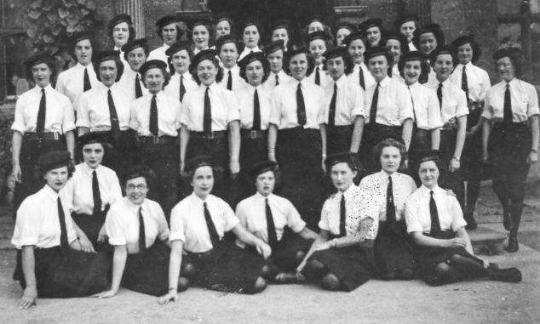
(Modern) Hardware: Historic View
Computer: one who computes
The women of Bletchley Park, Credit: BBC
Notes:
Historic view of computers is just people,
Adds “computers wanted” referred to people who could do arithmetic quickly and accurately

Slide 52
(Modern) Hardware: Historic View
Computer: one who computes
Mostly white cis-women
“Boring, repetitive work”, doing math quickly
The women of Bletchley Park, Credit: BBC
Notes:
Computing was one of the few careers available to women interested in mathematics,

Slide 53
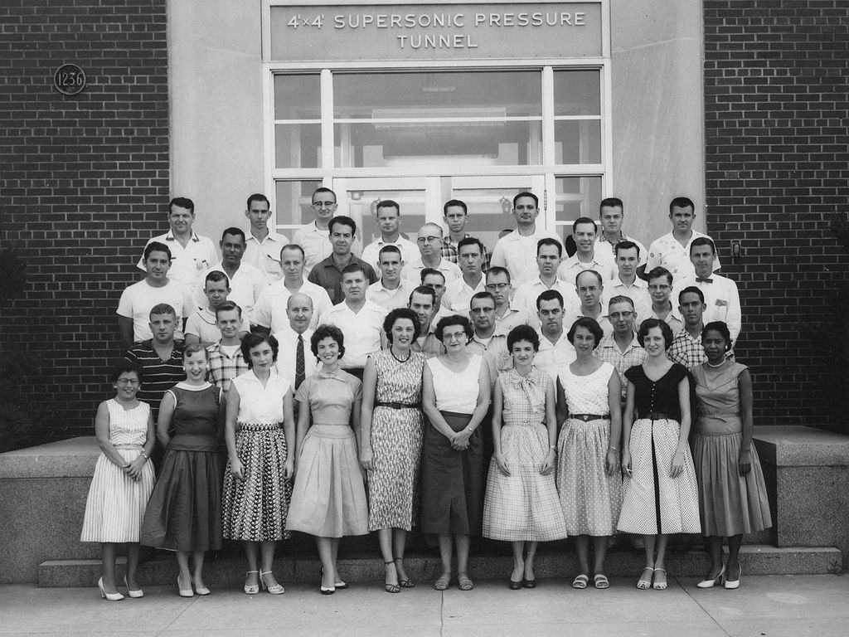
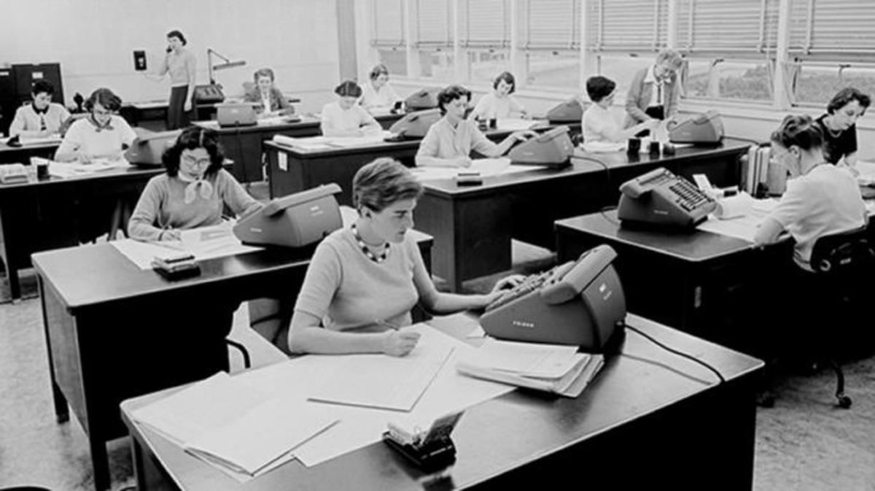
Computing in the US
Computer: one who computes
Observatory calculations @ Harvard (1870s)
Human Computers at JPL, Credit: JPL
Human Computers at NACA, Credit: NASA
Notes:
NACA: National Advisory committee for Aeronautics
Computing, one of few routes to a high paying job for women, especially women of color
Foundation of modern computers are people, computing for aeronautics, cryptography (science, engineering, warfare)

Slide 54
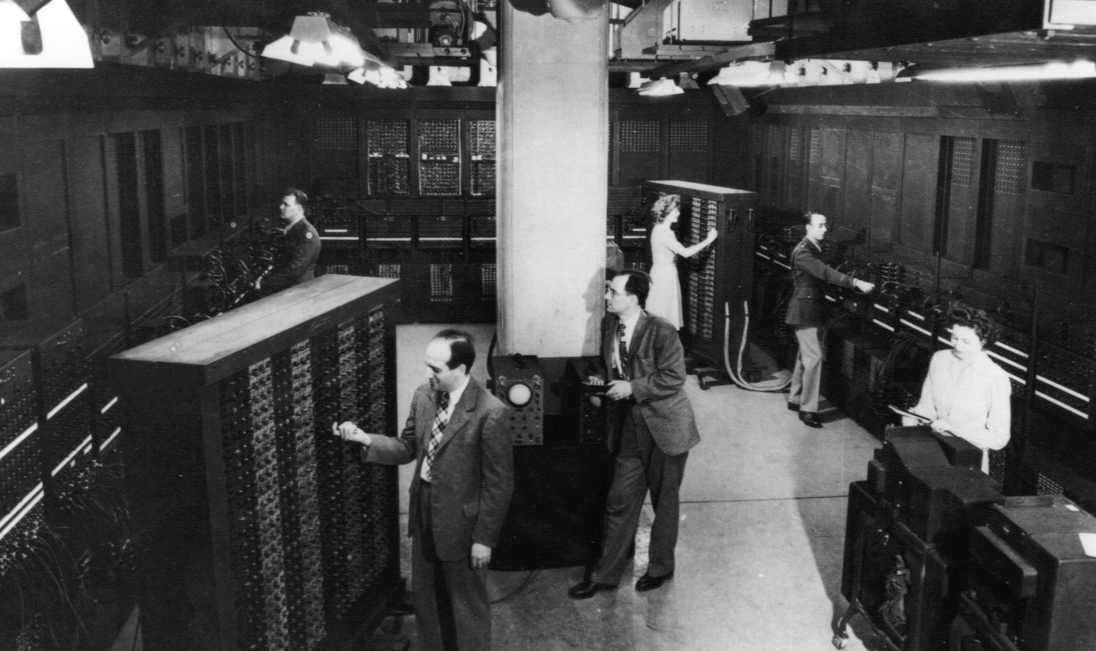
The ENIAC: Augmenting/Automating
Notes:
ENIAC enters, Augmenting human ability, automating out the labor of these human computers
ENIAC: ballistics calculations for the US military

Slide 55
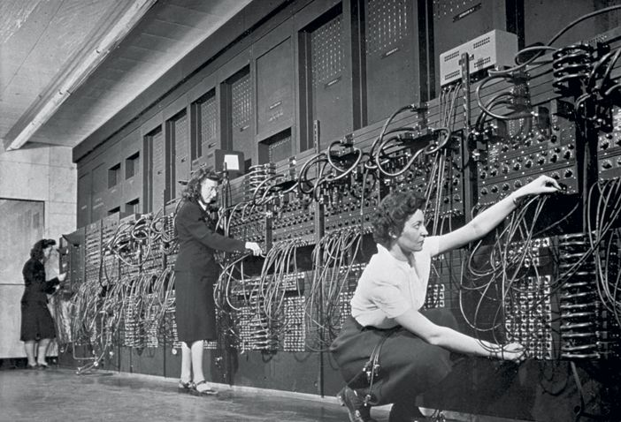
Programming, historically
1940s
Jean Jennings (left), Marlyn Wescoff (center), and Ruth Lichterman program ENIAC at the University of Pennsylvania, circa 1946. Photo: Corbis
http://fortune.com/2014/09/18/walter-isaacson-the-women-of-eniac/
Notes:
Design of computers was exclusive to men, while “boring, repetitive work” of programming was a job for women
Quote in reading, ”if not programming, what will I do?”

Slide 56
Notes:
Lucrative jobs available to women interested in mathematics
8k in 1967 -> $63,337, 20k -> $158,343
One story: boring repet
http://thecomputerboys.com/wp-content/uploads/2011/06/cosmopolitan-april-1967-1-large.jpg

Slide 57
“People like Grace Hopper were very consciously mobilizing gender stereotypes to get women in.” Janet Abbate, Recoding Gender

Slide 58
Modern Hardware: Historic Relics
“Boring, repetitive work” should be automated for efficiency/profit
Two narratives, both true: Automation/Augmentation
Consistently eliminating jobs of marginalized folks
Notes:
Narrative in computers and in programming
Automation: replace work viewed as ”unskilled” with robots for profit, efficiency
Augmentation: “unskilled” work performed by “skilled” workers is a waste of time
This relic remains, look anywhere in computing

Slide 59
Historic Robots
Robot: (Czech) compulsory service
Slav robota: servitude, hardship
Robots: tool to replace “unskilled” work, servants
Notes:
This unskilled replacement wasn’t neutral…

Slide 60
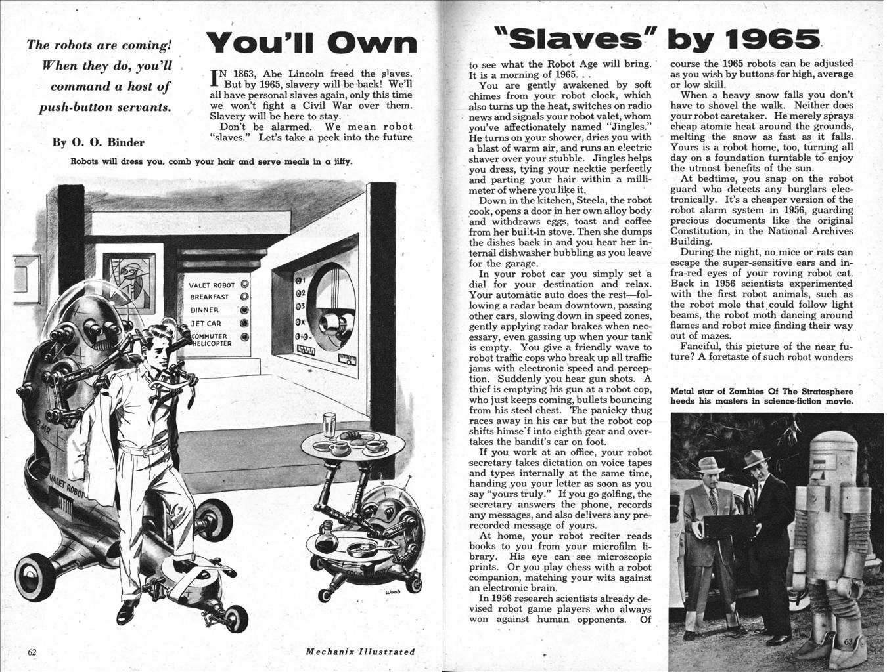
Notes:
It was racist! Replacing (frequently) marginalized workers with robot slaves; racism maintained throughout transitions in the integrated circuit
Note that the “we” advertises to weathly white men, through imagry/narratives
Cred to Ruha Benjamin, mechanix illustraed, 1957

Slide 61
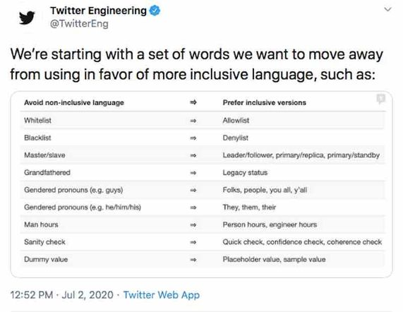
It was racist, and continues to be
*This isn’t to praise Twitter, this was the first list I found
Notes:
Other evidence of racist histories
It’s better, but goodness, this was a long, long time coming in 2020

Slide 62
Modern Hardware: Historic Relics
“Boring, repetitive work” should be automated
Two narratives, both true: Automation/Augmentation
Consistently eliminating jobs of marginalized folks
This relic remains!
Boring, repetitive work = ”robot work”
Performed by those deemed less than human
Robot work should be done by robots (non-human)
“Robot work” anything unvalued by the powerful
If the task can’t be automated, use people (less-human)
Frequently, this ends up being marginalized people, who later have their jobs automated
Notes:
Boring repetitive work should be automated
”Robot work” – cooking, caring for children, personal maintenance, inter-personal relating
”Robots”, either machines, or unstable work for marginalized people
See “Neoliberalism and the feminization of labor” for a much broader picture

Slide 63
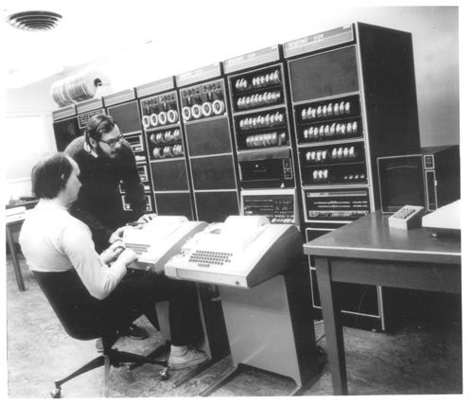
Programming, historically
1940s
1970s
Jean Jennings (left), Marlyn Wescoff (center), and Ruth Lichterman program ENIAC at the University of Pennsylvania, circa 1946. Photo: Corbis
http://fortune.com/2014/09/18/walter-isaacson-the-women-of-eniac/
https://s-media-cache-ak0.pinimg.com/564x/91/37/23/91372375e2e6517f8af128aab655e3b4.jpg
Notes:
Design of computers was exclusive to men, while “boring, repetitive work” of programming was a job for women
By 1970, these guys (one of whom is Ritchie, who wrote the C book), are typing instructions into a PDP-11

Slide 64
Modern Robots: Personal Computers
Notes:
Personal computing, automated the role of programmers.
New robots/tools to augment humans to do more “interesting, innovative work”, for whom?
Wealthy, white boys, mostly, those already with social power and privilege

Slide 65
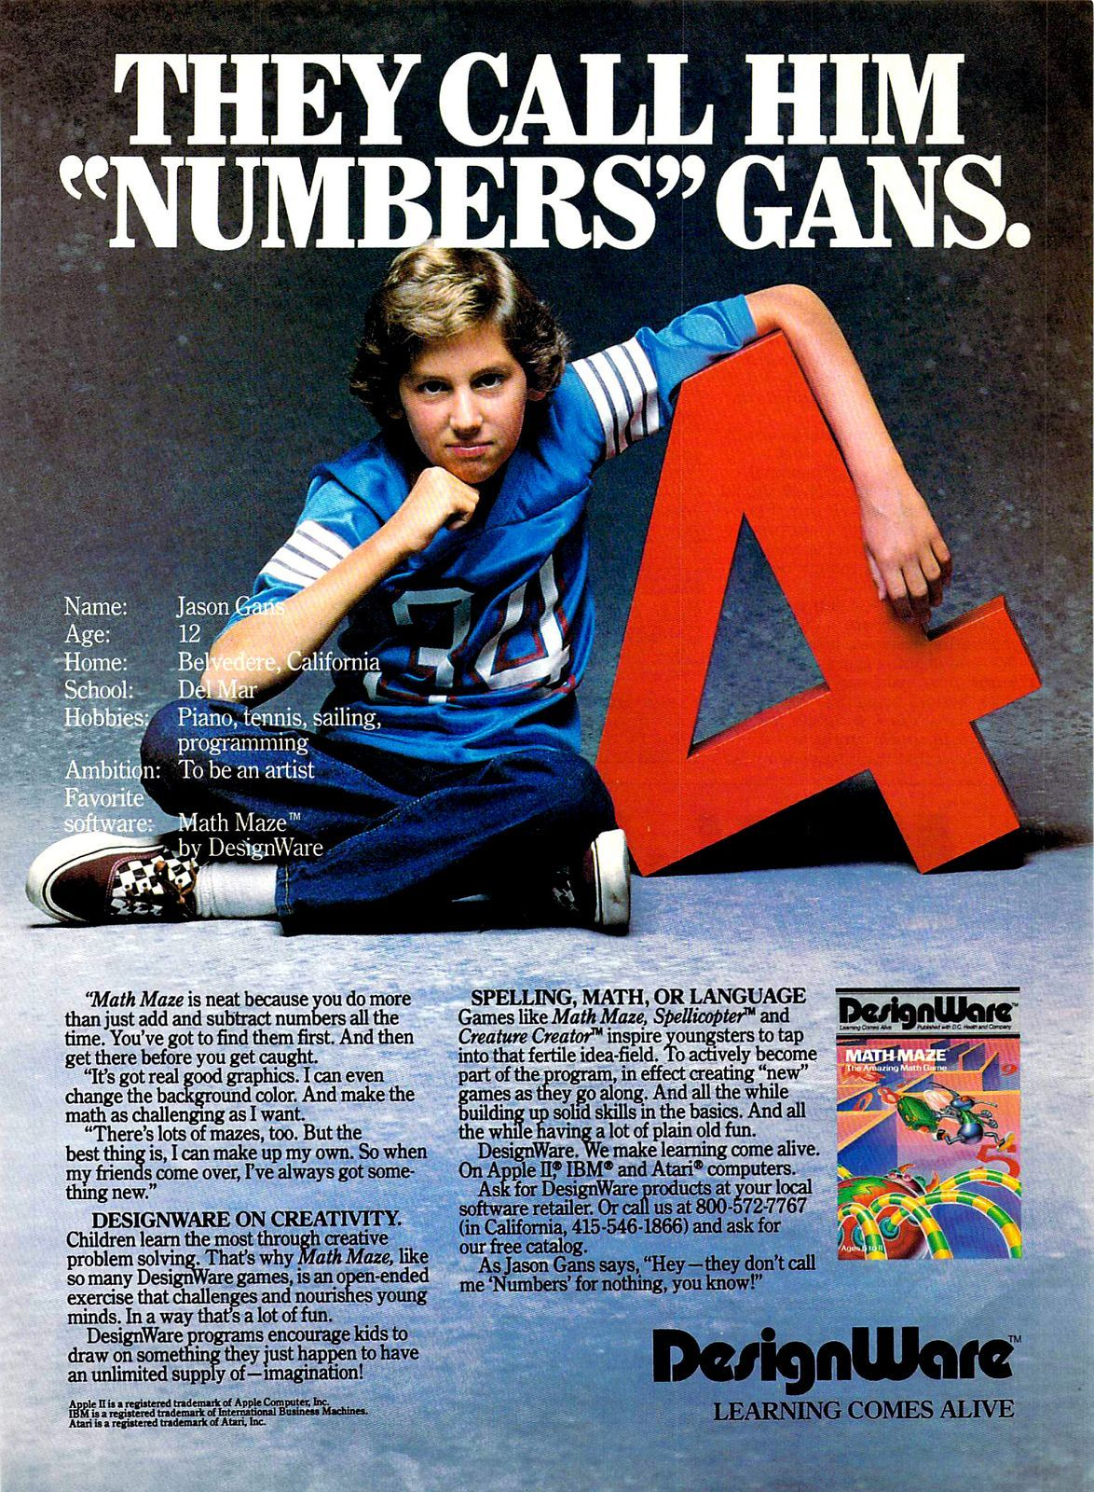
The advent of personal computing
Notes:
Boys, and men, wealthy, and white
White, upper-middle class suburban boys encouraged to learn mathematics
Literally colonial relics on the right
http://flashbak.com/wp-content/uploads/2014/10/1980S-COMPUTER-14.jpg
http://blog.modernmechanix.com/apple-ad-what-kind-of-man-owns-his-own-computer/

Slide 66
Notes:
Who could attend universities that could afford computers, who were encouraged to take mathematics courses
Computing tied to mathematics, men encouraged to take math courses, women encouraged to be wives and homemakers
https://timeline.com/apple-kids-cant-wait-2792d326aa31

Slide 67
Notes:
Norms mirrored by K-12 schools that could afford expensive computers
https://www.google.com/url?sa=i&url=https%3A%2F%2Ftimeline.com%2Fapple-kids-cant-wait-2792d326aa31&psig=AOvVaw1SDBMXAQgiXaiuwCfnD1ta&ust=1623971922131000&source=images&cd=vfe&ved=0CAoQjRxqFwoTCKCR2f6knfECFQAAAAAdAAAAABAv

Slide 68
Modern Hardware: Historic Relics
“Boring, repetitive work” should be automated
Two narratives, both true: Automation/Augmentation
Consistently eliminating jobs of marginalized folks
Boring, repetitive work is ”robot work”
Robot work should be performed by robots
“Robot work” anything unvalued by the powerful, once including computing, programming
If the task can’t be automated, use people
Frequently, this ends up being marginalized people
Augmentation is highly valued, and exclusive
“Boring, repetitive work” is more available
We’ll get to earlier computational machines later!

Slide 69
Breakout rooms!
Join any breakout corresponding to your section
Section AA – Any room from A1 to A6
I’ll bring y’all back in 5 minutes
Do you see these norms today? Where?
We’ll share out with Ohyay reactions!

