Slide 1
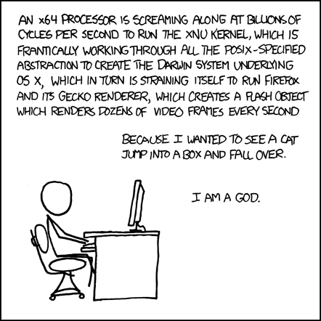
The Hardware/Software Interface
Instructor:
Mara Kirdani-Ryan
Teaching Assistants:
Kashish Aggarwal Nick Durand
Colton Jobes. Tim Mandzyuk
Mort Garson’s Plantasia
“Warm Earth Music for plants,
and the people that love them”
http://xkcd.com/66/
Notes:
This comic illustrates how complex computer systems are, and all the things that have to happen for a program to execute
By the end of this course, you’ll understand, mm, almost half of that, but it’s the good bits
Lesson plan
Introductions, Course admin
House of computing introduction (10m)
Binary numbering (15m)
Limits of representation (10m)
TODO
Make clear that ohyay emojis can be used at any time, not just when I ask for them
Have an opportunity for breakouts

Slide 2
Introductions: Me
Call me Mara! I use they/them
(no Dr., Prof., just Mara please!)
Trans/non-binary/queer/neurodiverse, I don’t like boxes
PhD student, Amy Ko
Former/recovering computer architect
Currently working in computing education
Bikes, yoga, guitar, bird sounds, cat
Notes:
Comp Arch: Many-core compilers, intermittent FPGAs, other cool stuff
Ced: Why CS undergrads go to 4 companies, what to do instead

Slide 3
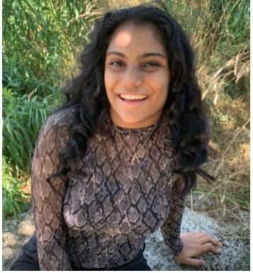
…and a wonderful course staff!
TAs:
More than anything, we want you to feel…
Comfortable and welcome in this space
Able to learn and succeed in this course
Comfortable reaching out if you’d like change
We’re available in OH/Section/on Ed
We want to help!

Slide 4
Introductions: You!
~40 students registered
CSE majors, ECE majors, and more
Lots of new pieces, regardless of background
Get to know each other! Help each other!
Science says that learning happen best in groups!
Plus, it’s less lonely!
Most of your life will likely involve working with others
You’re limited by your own perspective, try to understand others!

Slide 5
ohyay!
This is ohyay!
It’s quirky, but much less industrial than Zoom
Multiple forms of participation!
More than 6 reactions!
So far, 3 make sound!

Slide 6
Pick an Emoji! How do you feel about ohyay?

Slide 7
Welcome to Summer 2021!
Hopefully Ohyay Uni > Zoom Uni
We’re trying a few new things this quarter:
New Content!
New Tooling!
New Assessments!
We’re open to feedback!
Come to office hours, send us an email!
We’d love to work with you to make this course better!
Notes:
Also, anon feedback at the landing page in ohyay

Slide 8
Some Definitions
Computing:
Any activity involving computation (like CS, but including non-programming computation tasks)
Socio-technical:
Interactions between society and technology
Computing exists beyond algorithms!
How is technology used? For what purposes?
We shape our tools, our tools shape us
Emoji! How do you feel about socio-technical content?

Slide 9
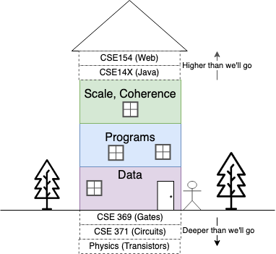
The House of Computing (HoC)
Notes:
Houses are built based around needs, and shape needs
Metaphor throughout the course – computing is a house, built in the 40s
Like many houses built in the 40s, some antique charm, some trends that have faded, parts are downright unsafe
We’re going to go exploring in the house of computing

Slide 10
An introduction…
We don’t have time to explore everything…
…but you can take more courses to explore more!
You might want to linger in some space…
…notice and nurture those wants!
You might miss Java…
We just ask you to keep your heart open
Something unexpected might pique your interest!

Slide 11
Remodeling
This house doesn’t work for everyone!
Accessibility issues
Obsolete priorities
Little regard for welfare
Much, much more
Notes:
The way that we’ve structured computing as a tool doesn’t work for everyone

Slide 12
“More and more, the oppressors are using science and technology as unquestionably powerful instruments for their purpose, the maintenance of the oppressive order thorough manipulation and repression” Paulo Freire, 1970

Slide 13
Remodeling, and you
Things need to be fixed!
Understand the foundation before you start hammering!
Technical know-how and socio-technical understanding together!

Slide 14
A loving disclaimer
It’s summer!
I’m a grad student!
I wanted to try something new!
This is going to be different!
Come to my OH/send email if this isn’t working.
More than anything, we want you to feel…
Comfortable and welcome in this space
Able to learn and succeed in this course
Comfortable reaching out if you’d like change
Notes:
HoC disclaimer,
"It's summer, I'm a grad student, no one's watching, so we're going to try some things that are pretty different than prior offerings of 351 and pretty different than my understanding of how this department runs their courses. If you have concerns about the way this is going, before you go to Dan or anyone, I'd like to hear you out myself! Come to office hours with feedback, I'm happy to listen, and we can try to find an understanding together."

Slide 15
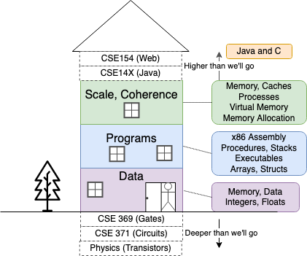
Course Overview

Slide 16
Goals for this course
Learn how computers work!
(With some necessary cuts, we only have 8 weeks)
Learn why they were designed to work that way
Computers didn’t come out of nothing, they were built!
Learn about CS from an ideological perspective
The values encoded in systems stuck around!
We’ll connect to some modern incarnations
Notes:
You know what you’d need to do if you wanted to rebuild anything
TODO

Slide 17
Lecture Outline
Course Introduction
Course Policies
https://cs.uw.edu/351/syllabus
Binary

Slide 18
Bookmarks
Website: https://cs.uw.edu/351
Schedule, policies, materials, videos, assignments, etc.
Discussion on EdStem (link on course page)
Announcements here!
Ask and answer questions!
Lessons on EdStem (link on course page)
Pre-lecture Readings, lecture questions, HW
Gradescope: (link on course page)
Lab/Unit Summary submissions and grades
Canvas: (link on course page)
Calendar, grade book

Slide 19
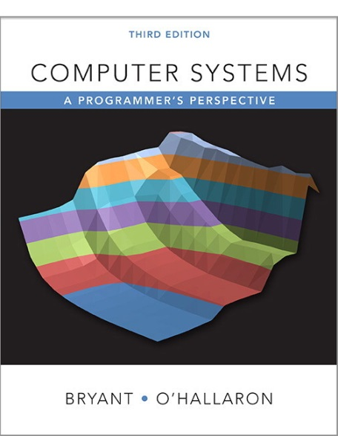
Recommended Textbooks
Computer Systems: A Programmer’s Perspective
Website: http://csapp.cs.cmu.edu
Latest edition: (North American) 3rd edition
http://csapp.cs.cmu.edu/3e/changes3e.html
http://csapp.cs.cmu.edu/3e/errata.html
It’s a good, popular, systems book
Recommended lecture readings on website
Starkly lacking critical content
A good C book – any will do
The C Programming Language (Kernighan, Ritchie)
Notes:
Both books are extremely popular, both exclusively technical, unfortunately

Slide 20
Course Components:
Lectures (26)
Via Ohyay, review concepts, discuss content
Ideally slides posted before, recordings after
Sections (9)
Via Ohyay, short review then mainly group work
Not recorded, but materials/helpful videos posted after
Office Hours
Via Ohyay, schedule on the course site. Not recorded.
Come ask questions! (course material or others)
We may add a queue, stay tuned

Slide 21
Course Components:
Pre-quarter and Mid-quarter surveys (on Canvas)
Meant to check in and get to know you better
Online Readings
Before lecture
Labs (6)
In depth applications/investigations of course material
Specs on website, submitted via Gradescope
Unit Summaries (3)
We’ll talk more on Wednesday
Can use up to 7 late days on labs and unit summaries (see syllabus for more details)

Slide 22
Grading
Readings/Section Worksheets: ~10%
One attempt per question (completion)
Homework: ~20%
Unlimited submission attempts (autograded correctness)
Labs: ~40%
Last submission graded (correctness)
Unit Summaries: ~30%
Meant to replace the review, summarizing, and reflecting that studying for exams provides. More info on these later.
Notes:
Icons made by Freepik (https://www.flaticon.com/authors/freepik)

Slide 23
Lab Collaboration and Academic Integrity
Ideally, I would’ve remade the course assignments so that cheating wasn’t possible
I didn’t have time!
This collaboration policy doesn’t match the “real world”, but we want assignments to gauge your understanding, so we can step in and help if needed
Read the syllabus! There’s a quiz!
Collaboration allowed on some assignments, some must be independent.
Your own words, your own ideas, your own work

Slide 24
Course Environment and Culture
Your physical and emotional well-being are much more important than course material!
Let us know what we can do to help!
Notes:
Still a pandemic, still an unprecedented quarter, most folks that I know have had a life-changing personal crisis in the last year
We’re here to help, but we can’t help unless you reach out!

Slide 25
To-Do List
Admin
Explore/read website thoroughly
Check that you can access Ed Discussion & Lessons
Get your machine set up to access the CSE Linux environment (CSE VM or attu) as soon as possible
Optional: CSE 391: System & Software Tools
Assignments
Pre-Course Survey and hw0 due Wednesday (6/23) – 8:00pm
Hw1 due Friday (6/25) – 8:00pm
Lab 0 due Monday (6/28) – 8:00pm
Readings due before each lecture – 10am
Lecture activities from today are due before NEXT lecture -- 10am

Slide 26
Course Overview

Slide 27
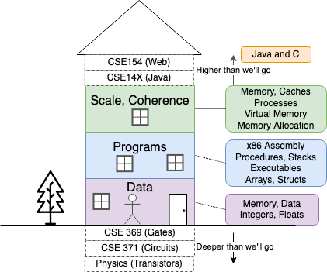
First Floor: Data
How do we represent data (strings, numbers) computationally? What limits exist? Why?
What values were encoded into data representations?
Notes:
Why some data representations over others

Slide 28
Lecture Outline
Course Introduction
Course Policies
Binary
Decimal, Binary, and Hexadecimal
Base Conversion
Binary Encoding

Slide 29
Decimal Numbering System
Ten symbols: 0, 1, 2, 3, 4, 5, 6, 7, 8, 9
Represent larger numbers as sequence of digits
Each digit is one of the available symbols
Example: 7061 in decimal (base 10)
7061₁₀ = (7 $×$ 10³) + (0 $×$ 10²) + (6 $×$ 10¹) + (1 $×$ 10⁰)
Notes:
Ones digit, Tens digit, Hundreds digit, etc.

Slide 30
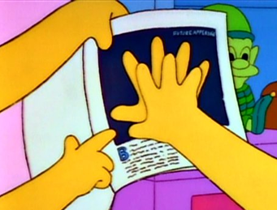
Octal Numbering System
Eight symbols: 0, 1, 2, 3, 4, 5, 6, 7
Notice that we no longer use 8 or 9
Base comparison:
Base 10: 0, 1, 2, 3, 4, 5, 6, 7, 8, 9, 10, 11, 12…
Base 8: 0, 1, 2, 3, 4, 5, 6, 7, 10, 11, 12, 13, 14…
Example: What is 7061₈ in base 10?
7061₈ = (7 $×$ 8³) + (0 $×$ 8²) + (6 $×$ 8¹) + (1 $×$ 8⁰) = 3633₁₀

Slide 31
Warmup Question
What is 34₈ in base 10?
✨ 32₁₀
🦗 34₁₀
🥶 7₁₀
🐈 28₁₀
🧄 35₁₀
Notes:
Pause for a few seconds, then react

Slide 32
Binary and Hexadecimal
Binary is base 2
Symbols: 0, 1
Convention: 2₁₀ = 10₂ = 0b10
Example: What is 0b110 in base 10?
0b110 = 110₂ = (1 $×$ 2²) + (1 $×$ 2¹) + (0 $×$ 2⁰) = 6₁₀
Hexadecimal (hex, for short) is base 16
Symbols? 0, 1, 2, 3, 4, 5, 6, 7, 8, 9, …?
Convention: 16₁₀ = 10₁₆ = 0x10
Example: What is 0xA5 in base 10?
0xA5 = A5₁₆ = (10 $×$ 16¹) + (5 $×$ 16⁰) = 165₁₀
9, A, B, C, D, E, F 🤯

Slide 33
Polling Question
Which of the following orderings is correct?
✨ 0xC < 0b1010 < 11
🦗 0xC < 11 < 0b1010
🥶 11 < 0b1010 < 0xC
🐈 0b1010 < 11 < 0xC
🧄 0b1010 < 0xC < 11
Notes:
1010 < 11 < 0xC
Pause for a few seconds, then spam reaction

Slide 34
Converting to Base 10
Can convert from any base to base 10
0b110 = 110₂ = (1 $×$ 2²) + (1 $×$ 2¹) + (0 $×$ 2⁰) = 6₁₀
0xA5 = A5₁₆ = (10 $×$ 16¹) + (5 $×$ 16⁰) = 165₁₀
We learned to think in base 10, so this is fairly natural for us
Challenge: Convert into other bases (e.g. 2, 16)

Slide 35
Challenge Question
Convert 13₁₀ into binary
Hints:
2³ = 8
2² = 4
2¹ = 2
2⁰ = 1
Notes:
Think! No voting!

Slide 36
Converting from Decimal to Binary
Given a decimal number N:
List increasing powers of 2 from right to left until $≥$ N
Then from left to right, ask is that (power of 2) $≤$ N?
If YES, put a 1 below and subtract that power from N
If NO, put a 0 below and keep going
Example: 13 to binary
2⁴=16 | 2³=8 | 2²=4 | 2¹=2 | 2⁰=1

Slide 37
Converting from Decimal to Base B
Given a decimal number N:
List increasing powers of B from right to left until $≥$ N
Then from left to right, ask is that (power of B) $≤$ N?
If YES, put how many of that power go into N and subtract from N
If NO, put a 0 below and keep going
Example: 165 to hex
16²=256 | 16¹=16 | 16⁰=1

Slide 38
Converting Binary $↔$ Hexadecimal
Hex $→$ Binary
Sub hex, then drop leading zeros
Example: 0x2D to binary
0x2 is 0b0010, 0xD is 0b1101
Drop two zeros; 0b101101
Binary $→$ Hex
Pad leading zeros until multiple of 4, then sub each group of 4
Example: 0b101101
Pad to 0b 0010 1101
Substitute to get 0x2D
Base 10 | Base 2 | Base 16
0 | 0000 | 0
1 | 0001 | 1
2 | 0010 | 2
3 | 0011 | 3
4 | 0100 | 4
5 | 0101 | 5
6 | 0110 | 6
7 | 0111 | 7
8 | 1000 | 8
9 | 1001 | 9
10 | 1010 | A
11 | 1011 | B
12 | 1100 | C
13 | 1101 | D
14 | 1110 | E
15 | 1111 | F

Slide 39
Binary $→$ Hex Practice
Convert 0b100 1101 1010 1101
How many digits?
Pad?
Substitute?
Base 10 | Base 2 | Base 16
0 | 0000 | 0
1 | 0001 | 1
2 | 0010 | 2
3 | 0011 | 3
4 | 0100 | 4
5 | 0101 | 5
6 | 0110 | 6
7 | 0111 | 7
8 | 1000 | 8
9 | 1001 | 9
10 | 1010 | A
11 | 1011 | B
12 | 1100 | C
13 | 1101 | D
14 | 1110 | E
15 | 1111 | F

Slide 40
Base Comparison
Why does all of this matter?
Humans think about numbers in base 10, but computers “think” about numbers in base 2
Binary encoding is what allows computers to do all of the amazing things that they do!
Base 10 | Base 2 | Base 16
0 | 0000 | 0
1 | 0001 | 1
2 | 0010 | 2
3 | 0011 | 3
4 | 0100 | 4
5 | 0101 | 5
6 | 0110 | 6
7 | 0111 | 7
8 | 1000 | 8
9 | 1001 | 9
10 | 1010 | A
11 | 1011 | B
12 | 1100 | C
13 | 1101 | D
14 | 1110 | E
15 | 1111 | F

Slide 41
Numerical Encoding
You can represent anything countable using numbers!
Though, not everything is countable
Need to agree on an encoding
Kind of like learning a new language
Examples:
Decimal Integers: 0$→$0b0, 1$→$0b1, 2$→$0b10, etc.
English Letters: CSE$→$0x435345, yay$→$0x796179
Emoticons: 😃 0x0, 😞 0x1, 😎 0x2, 😇 0x3, 😈 0x4, 🙋 0x5
Notes:
Base 2 is too hard for humans to read, so we use base 16 as a convenient way to hold what is effectively binary data in our brains.

Slide 42
Binary Encoding
With N binary digits, how many “things” can you represent?
N binary digits to represent $n$ things, where 2^{N} $≥n$
Ex: 5 binary digits for alphabet because 2⁵ = 32 > 26
A binary digit is known as a bit
A group of 4 bits (1 hex digit) is called a nibble
A group of 8 bits (2 hex digits) is called a byte
1 bit $→$ 2 things, 1 nibble $→$ 16 things, 1 byte $→$ 256 things

Slide 43
So What’s It Mean?
A sequence of bits can have many meanings!
Consider the hex sequence 0x4E6F21
Common interpretations include:
The decimal number 5140257
The characters “No!”
The background color of this slide
The real number 7.203034 $×$ 10⁻³⁹
It is up to the program/programmer to decide how to interpret the sequence of bits

Slide 44
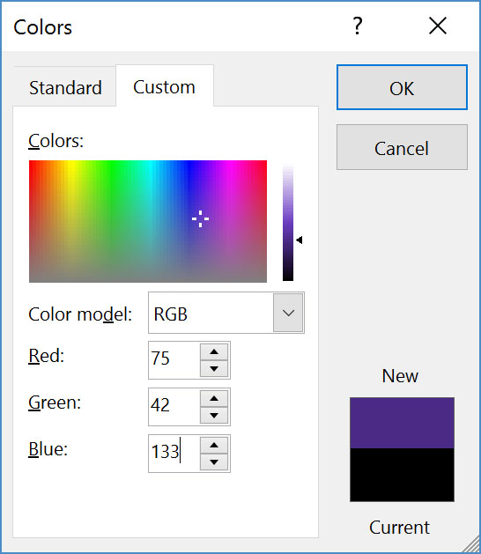
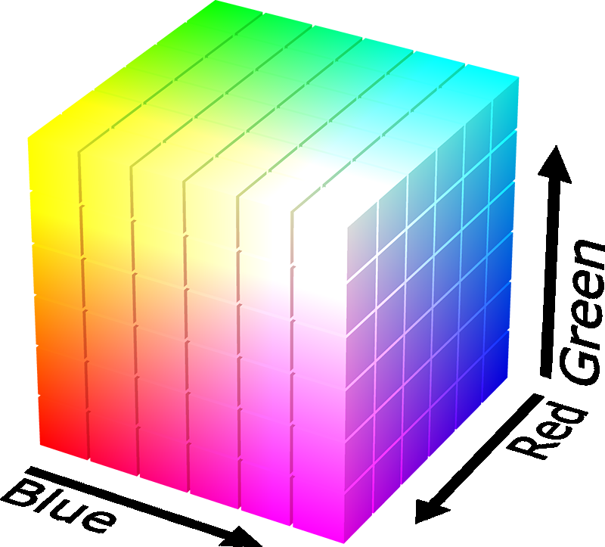
Binary Encoding – Colors
RGB – Red, Green, Blue
Additive color model (light): byte (8 bits) for each color
Commonly seen in hex (in HTML, photo editing, etc.)
Examples: Blue$→$0x0000FF, Gold$→$0xFFD700, White$→$0xFFFFFF, Deep Pink$→$0xFF1493

Slide 45
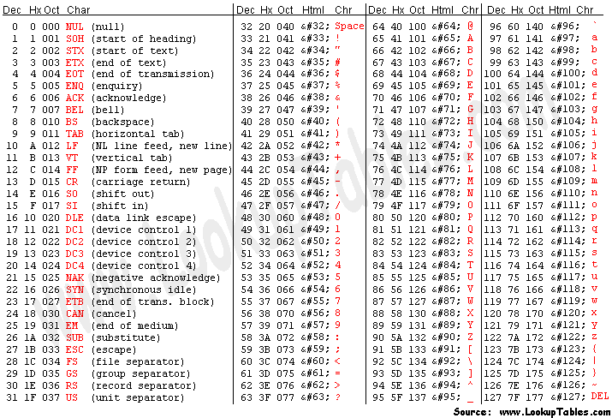
Binary Encoding – Digital Text
ASCII Encoding (www.asciitable.com)
American Standard Code for Information Interchange
What’s Missing?
Notes:
Made to represent all digital text
Give a basic outline of the table (symbols, numbers, lowercase, capital letters)

Slide 46
How do encodings get created?
Usually, a committee gets together
Collectively decides on design priorities
Collectively creates standard
This committee is usually made up of senior, well-established members of large, powerful companies*
Members bring existing ideas, company priorities
*Also, similarly powerful academics, industry researchers (e.g. Bell Labs)
Notes:
Currently Apple, Amazon, Microsoft, etc.

Slide 47
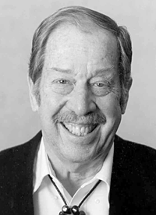
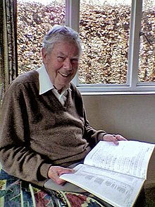
Computing Standards: Qualification
ASCII: should encode all american digital text
Created in 1963, who was well-established?
Robert W. Bemer
Hugh McGregor Ross

Slide 48
Computing Standards: Qualification
ASCII: should encode all american digital text
Created in 1963, who was well-established?
White/Cis/straight men, English-primary
Only their interests were represented when deciding on priorities!
ASCII: Represent everything on an american typewriter, as efficiently as possible
Unicode: “Universal” language, still with problems

Slide 49
ASCII Design Goals
Represent everything on an american typewriter, as efficiently as possible
Fewer bits for encoding is better!
Memory was expensive, 32KB in brand new machines
Economic incentive to be efficient
Organize similar characters together
Numbers, uppercase, lowercase, then other stuff

Slide 50
Standards always “encode” the priorities of their creators into data!
Notes:
Standards are often problematic -- they represent the collective interests of a single (often privileged) group of people

Slide 51
Breakout rooms!
Join any breakout corresponding to your section
Section AA – Any room from A1 to A6
I’ll bring y’all back in 5 minutes
If you designed ASCII, what would you have done?
We’ll share out with Ohyay reactions!

Slide 52
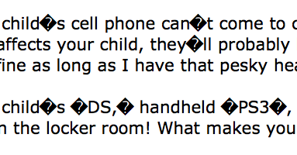
But…they fixed it, right?
Unicode: “Universal language” uses 8-32 bits
ASCII uses 7, for reference
Unicode still has issues!
OS/Applications need to support new characters
ASCII’s still around, sometimes apps “guess” wrong

Slide 53
Standards stick around, consider priorities carefully!
Notes:
Standards are generally a good thing -- we can talk to each other, it’s important to consider who the “we” being described is

Slide 54
Summary
Humans think about numbers in decimal; computers think about numbers in binary
Base conversion to go between them
Hexadecimal is more human-readable than binary
All information on a computer is bits (binary)
Binary encoding can represent countable things!
Program needs to know how to interpret the bits
Encodings aren’t “neutral”, priorities are baked in

Slide 55
Learning Objectives (added late)
By the end of this lecture, you should be able to:
Explain the house of computing, what exists, and what you might need to know before remodeling
Understand the course policies, and where to look if you forget something (the syllabus!)
Convert between decimal, binary, and hexadecimal numbers
Explain how encodings and standards get created, and how that process can be problematic

