Slide 1
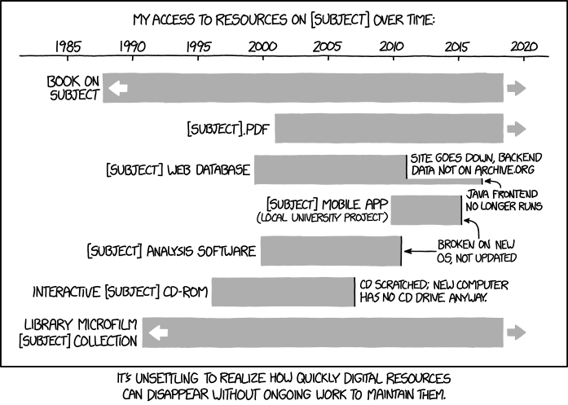
Memory Allocation II
CSE 351 Winter 2020
Instructor:
Ruth Anderson
Teaching Assistants:
Jonathan Chen
Justin Johnson
Porter Jones
Josie Lee
Jeffery Tian
Callum Walker
Eddy (Tianyi) Zhou
http://xkcd.com/1909/

Slide 2
Administrivia
hw21 due Monday (3/09)
hw22 due Wednesday (3/11) – Do EARLY, will help with Lab 5
Lab 5 (on Mem Alloc) due the last day of class (3/13)
  Can only use 1 late day (hard deadline Sun 3/15)
  Light style grading
Final Exam:
Wed, March 18, 2:30-4:20pm in CSE2 G20

Slide 3
Implicit Free List Example
Each block begins with header (size in bytes and allocated bit)
Sequence of blocks in heap (size|allocated):
16|0, 32|1, 64|0, 32|1
Start of heap
Free word
16|0
32|1
64|0
32|1
0|1
Allocated word
Allocated word
unused
16 bytes = 2 word alignment
16-byte alignment for payload
  May require initial padding (internal fragmentation)
  Note size: padding is considered part of previous block
Special one-word marker (0|1) marks end of list
  Zero size is distinguishable from all other blocks

Slide 4
Implicit List: Finding a Free Block
(*p) gets the block header
(*p & 1) extracts the allocated bit
(*p & -2) extracts the size
First fit
  Search list from beginning, choose first free block that fits:
  Can take time linear in total number of blocks
  In practice can cause “splinters” at beginning of list
p = heap_start;
while ((p < end) && // not past end
((*p & 1) || // already allocated
(*p <= len))) { // too small
p = p + (*p & -2); // go to next block (UNSCALED +)
} // p points to selected block or end
p = heap_start
Free word
16|0
32|1
64|0
32|1
0|1
Allocated word
Allocated word
unused
Notes:
Why doesn’t “*p <= len” mask off the allocated bit too? Because this is the second condition in the || test, which means that the first condition (*p & 1) must have already been false, so we know that the allocated bit can’t be set and we don’t have to bother masking it off.
Tends to concentrate small blocks at front of heap.

Slide 5
Implicit List: Finding a Free Block
Next fit
  Like first-fit, but search list starting where previous search finished
  Should often be faster than first-fit: avoids re-scanning unhelpful blocks
  Some research suggests that fragmentation is worse
Best fit
  Search the list, choose the best free block: large enough AND with fewest bytes left over
  Keeps fragments small—usually helps fragmentation
  Usually worse throughput

Slide 6

Polling Question
payload
size
Which allocation strategy and requests
remove external fragmentation in this
Heap? B3 was the last fulfilled request.
  http://pollev.com/rea
50
10
B2
(A)
Best-fit:
malloc(50), malloc(50)
30
10
B3
(B)
First-fit:
malloc(50), malloc(30)
50
(C)
Next-fit:
malloc(30), malloc(50)
B1
50
(D)
Next-fit:
malloc(50), malloc(30)
Start of heap

Slide 7
Implicit List: Allocating in a Free Block
Allocating in a free block: splitting
  Since allocated space might be smaller than free space, we might want to split the block
Assume ptr points to a free block and has unscaled pointer arithmetic
void split(ptr b, int bytes) { // bytes = desired block size
int newsize = ((bytes+15) >> 4) << 4; // round up to multiple of 16
int oldsize = *b; // why not mask out low bit?
*b = newsize; // initially unallocated
if (newsize < oldsize)
*(b+newsize) = oldsize - newsize; // set length in remaining
} // part of block (UNSCALED +)
malloc(24):
ptr b = find(24+8)
split(b, 24+8)
allocate(b)
16|1
48|0
16|1
Free word
b
Allocated word
16|0
Newly-allocated
word
16|1
32|1
16|1
Notes:
Note that we add 4 to the malloc request size to account for the header
Why not mask out? Bit must be 0, otherwise it's not a free block!

Slide 8
Implicit List: Freeing a Block
Simplest implementation just clears “allocated” flag
  void free(ptr p) {*(p-WORD) &= -2;}
  But can lead to “false fragmentation”
16|1
32|1
16|0
16|1
Free word
p
Allocated word
Block of interest
free(p)
16|1
32|0
16|0
16|1
malloc(40)
Oops! There is enough free space, but the allocator won’t be able to find it

Slide 9
Implicit List: Coalescing with Next
Join (coalesce) with next block if also free
How do we coalesce with the previous block?
16|1
32|1
16|0
16|1
Free word
p
Allocated word
Block of interest
free(p)
16|1
48|0
16|0
16|1
logically gone
void free(ptr p) { // p points to payload
ptr b = p – WORD; // b points to block header
*b &= -2; // clear allocated bit
ptr next = b + *b; // find next block (UNSCALED +)
if ((*next & 1) == 0) // if next block is not allocated,
*b += *next; // add its size to this block
}

Slide 10
Implicit List: Bidirectional Coalescing
Boundary tags [Knuth73]
  Replicate header at “bottom” (end) of free blocks
  Allows us to traverse backwards, but requires extra space
  Important and general technique!
32/0
32/0
32/1
32/1
48/0
48/0
32/1
32/1
Format of
allocated and
free blocks:
Header
size
a
a = 1: allocated block
a = 0: free block
size: block size (in bytes)
payload: application data
(allocated blocks only)
payload and
padding
Boundary tags
Footer
size
a

Slide 11
Constant Time Coalescing
Case 1
Case 2
Case 3
Case 4
Allocated
Allocated
Free
Free
Block being freed
Allocated
Free
Allocated
Free

Slide 12
Constant Time Coalescing
Case 1
m1 | 1
m1 | 1
n | 1
n | 1
m2 | 1
m2 | 1
m1 | 1
m1 | 1
n | 0
n | 0
m2 | 1
m2 | 1
Case 2
m1 | 1
m1 | 1
n | 1
n | 1
m2 | 0
m2 | 0
m1 | 1
m1 | 1
n+m2 | 0
n+m2 | 0
Case 3
m1 | 0
m1 | 0
n | 1
n | 1
m2 | 1
m2 | 1
n+m1 | 0
n+m1 | 0
m2 | 1
m2 | 1
Case 4
m1 | 0
m1 | 0
n | 1
n | 1
m2 | 0
m2 | 0
n+m1+m2 | 0
n+m1+m2 | 0

Slide 13
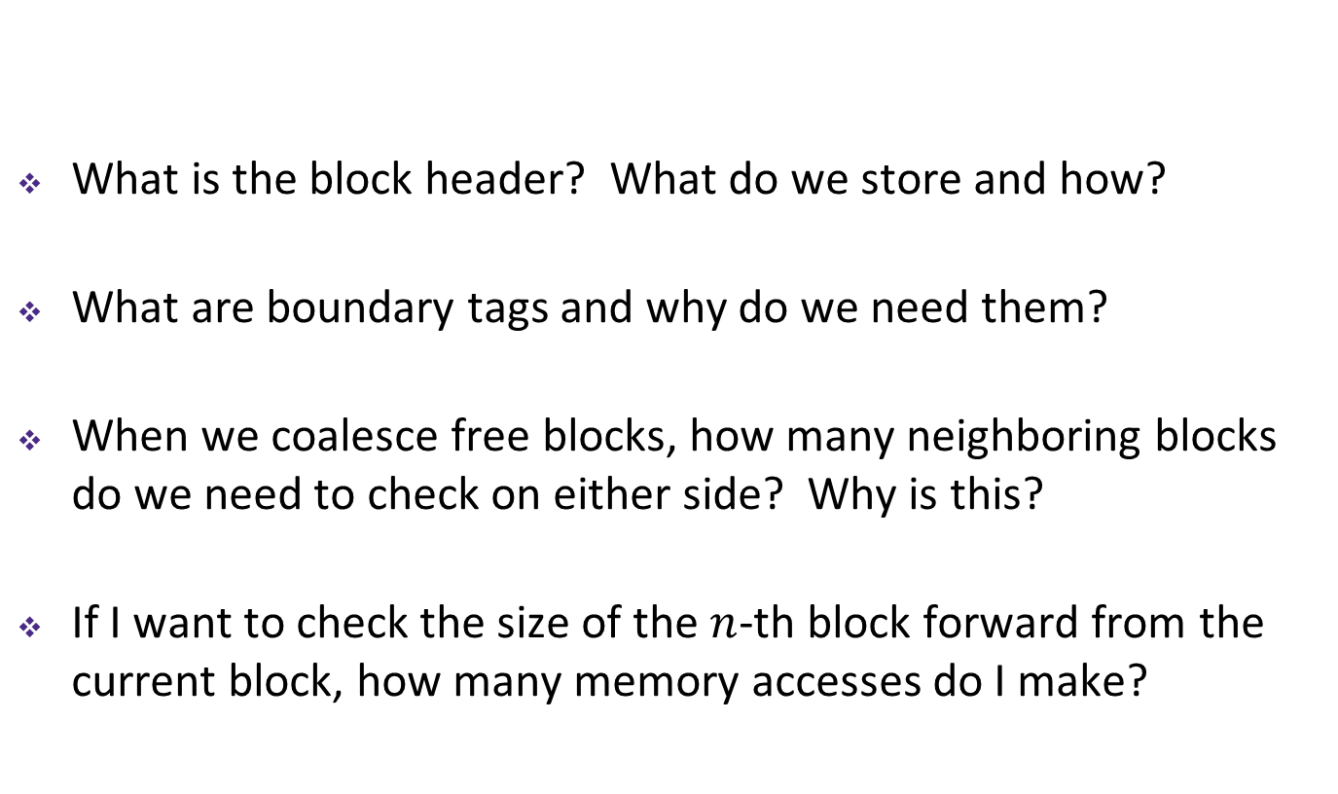
Implicit Free List Review Questions
What is the block header? What do we store and how?
What are boundary tags and why do we need them?
When we coalesce free blocks, how many neighboring blocks do we need to check on either side? Why is this?
If I want to check the size of the $n$-th block forward from the current block, how many memory accesses do I make?
32/0
32/0
32/1
32/1
48/0
48/0
32/1
32/1

Slide 14
Keeping Track of Free Blocks
= 8-byte word (free)
= 8-byte word (allocated)
Implicit free list using length – links all blocks using math
  No actual pointers, and must check each block if allocated or free
Explicit free list among only the free blocks, using pointers
Segregated free list
  Different free lists for different size “classes”
Blocks sorted by size
  Can use a balanced binary tree (e.g. red-black tree) with pointers within each free block, and the length used as a key
40
32
48
16
40
32
48
16

Slide 15
Explicit Free Lists
Allocated block:
Free block:
size
a
size
a
payload and
padding
next
prev
size
a
size
a
(same as implicit free list)
Use list(s) of free blocks, rather than implicit list of all blocks
  The “next” free block could be anywhere in the heap
    So we need to store next/previous pointers, not just sizes
  Since we only track free blocks, so we can use “payload” for pointers
  Still need boundary tags (header/footer) for coalescing
Notes:
Storing pointers in the “payload” section of a free block could require a larger minimum block size, possibly increasing internal fragmentation.

Slide 16
Doubly-Linked Lists
⋅⋅⋅
Linear
  Needs head/root pointer
  First node prev pointer is NULL
  Last node next pointer is NULL
  Good for first-fit, best-fit
Circular
  Still have pointer to tell you which node to start with
  No NULL pointers (term condition is back at starting point)
  Good for next-fit, best-fit
Root
Start
⋅⋅⋅

Slide 17
Explicit Free Lists
Logically: doubly-linked list
Physically: blocks can be in any order
A
B
C
Forward (next) links
A
B
32
32
32
32
48
48
32
32
32
32
C
Back (prev) links

Slide 18
Allocating From Explicit Free Lists
Note: These diagrams are not very specific about where inside a block a pointer points. In reality we would always point to one place (e.g. start/header of a block).
Before
After
(with splitting)
= malloc(…)
Notes:
4 pointers updated, same number of list nodes.
Don’t forget to update boundary tags for both the allocated and new free blocks!

Slide 19
Allocating From Explicit Free Lists
Note: These diagrams are not very specific about where inside a block a pointer points. In reality we would always point to one place (e.g. start/header of a block).
Before
After
(fully allocated)
= malloc(…)
Notes:
2 pointers updated, one fewer list node.
Don’t forget to create the boundary tags for the allocated block!

Slide 20
Freeing With Explicit Free Lists
Insertion policy: Where in the free list do you put the newly freed block?
  LIFO (last-in-first-out) policy
    Insert freed block at the beginning (head) of the free list
    Pro: simple and constant time
    Con: studies suggest fragmentation is worse than the alternative
  Address-ordered policy
    Insert freed blocks so that free list blocks are always in address order:
    address(previous) < address(current) < address(next)
    Con: requires linear-time search
    Pro: studies suggest fragmentation is better than the alternative

Slide 21
Coalescing in Explicit Free Lists
Case 1
Case 2
Case 3
Case 4
Allocated
Allocated
Free
Free
Block being freed
Allocated
Free
Allocated
Free
Neighboring free blocks are already part of the free list
  Remove old block from free list
  Create new, larger coalesced block
  Add new block to free list (insertion policy)
How do we tell if a neighboring block if free?

Slide 22
Freeing with LIFO Policy (Case 1)
Boundary tags not shown, but don’t forget about them!
Before
free( )
Root
Insert the freed block at the root of the list
After
Root
Notes:
Note: all blue “next” pointers and red “previous” pointers should probably point to either the header or footer of the next/previous block – it shouldn’t matter which (I think), as long as it’s done consistently. The diagrams on this slide and on the next few do not always show pointers to the exact word for the block header/footer.

Slide 23
Freeing with LIFO Policy (Case 2)
Boundary tags not shown, but don’t forget about them!
Before
free( )
Root
Splice successor block out of list, coalesce both memory blocks, and insert the new block at the root of the list
After
Root
Notes:
Note: all blue “next” pointers and red “previous” pointers should probably point to either the header or footer of the next/previous block – it shouldn’t matter which (I think), as long as it’s done consistently. The diagrams on this slide and on the next few do not always show pointers to the exact word for the block header/footer.

Slide 24
Freeing with LIFO Policy (Case 3)
Boundary tags not shown, but don’t forget about them!
Before
free( )
Root
Splice predecessor block out of list, coalesce both memory blocks, and insert the new block at the root of the list
After
Root
Notes:
Note: all blue “next” pointers and red “previous” pointers should probably point to either the header or footer of the next/previous block – it shouldn’t matter which (I think), as long as it’s done consistently. The diagrams on this slide and on the next few do not always show pointers to the exact word for the block header/footer.

Slide 25
Freeing with LIFO Policy (Case 4)
Boundary tags not shown, but don’t forget about them!
Before
free( )
Root
Splice predecessor and successor blocks out of list, coalesce all 3 memory blocks, and insert the new block at the root of the list
After
Root

Slide 26
Do we always need the boundary tags?
Allocated block:
Free block:
size
a
size
a
payload and
padding
next
prev
size
a
size
a
(same as implicit free list)
Lab 5 suggests no…

Slide 27
Explicit List Summary
Comparison with implicit list:
  Block allocation is linear time in number of free blocks instead of all blocks
    Much faster when most of the memory is full
  Slightly more complicated allocate and free since we need to splice blocks in and out of the list
  Some extra space for the links (2 extra pointers needed for each free block)
    Increases minimum block size, leading to more internal fragmentation
Most common use of explicit lists is in conjunction with segregated free lists
  Keep multiple linked lists of different size classes, or possibly for different types of objects

Slide 28
BONUS SLIDES
The following slides are about the SegList Allocator, for those curious. You will NOT be expected to know this material.

Slide 29
Keeping Track of Free Blocks
= 8-byte box (free)
= 8-byte box (allocated)
Implicit free list using length – links all blocks using math
  No actual pointers, and must check each block if allocated or free
Explicit free list among only the free blocks, using pointers
Segregated free list
  Different free lists for different size “classes”
Blocks sorted by size
  Can use a balanced binary tree (e.g. red-black tree) with pointers within each free block, and the length used as a key
40
32
48
16
40
32
48
16

Slide 30
Segregated List (SegList) Allocators
Each size class of blocks has its own free list
Organized as an array of free lists
Often have separate classes for each small size
For larger sizes: One class for each two-power size
Size class
(in bytes)
16
32
48-64
80-inf

Slide 31
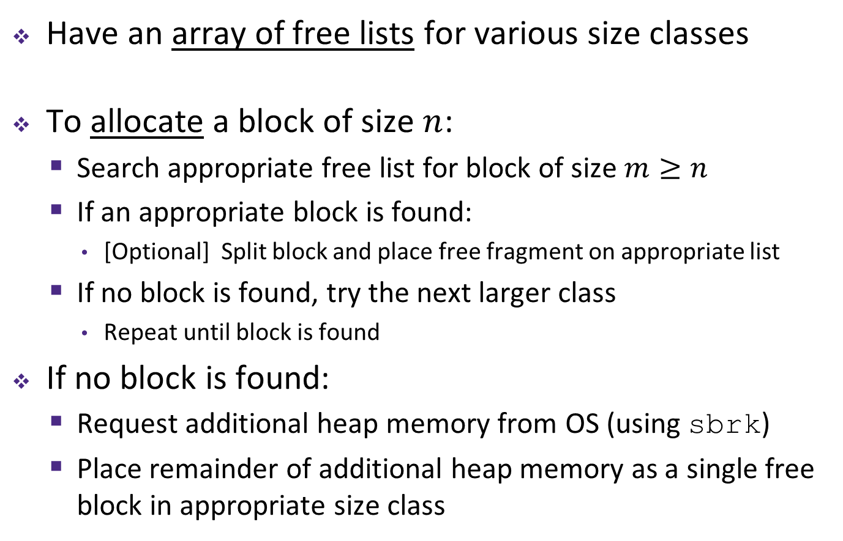
SegList Allocator
Have an array of free lists for various size classes
To allocate a block of size $n$:
  Search appropriate free list for block of size $m≥n$
  If an appropriate block is found:
    [Optional] Split block and place free fragment on appropriate list
  If no block is found, try the next larger class
    Repeat until block is found
If no block is found:
  Request additional heap memory from OS (using sbrk)
  Place remainder of additional heap memory as a single free block in appropriate size class

Slide 32
SegList Allocator
Have an array of free lists for various size classes
To free a block:
  Mark block as free
  Coalesce (if needed)
  Place on appropriate class list

Slide 33
SegList Advantages
Higher throughput
  Search is log time for power-of-two size classes
Better memory utilization
  First-fit search of seglist approximates a best-fit search of entire heap
  Extreme case: Giving every block its own size class is no worse than best-fit search of an explicit list
  Don’t need to use space for block size for the fixed-size classes

Slide 34
Freeing with LIFO Policy (Explicit Free List)
 | Predecessor Block | Successor Block | Change in Nodes in Free List | Number of Pointers Updated
Case 1 | Allocated | Allocated
Case 2 | Allocated | Free
Case 3 | Free | Allocated
Case 4 | Free | Free

