Slide 1
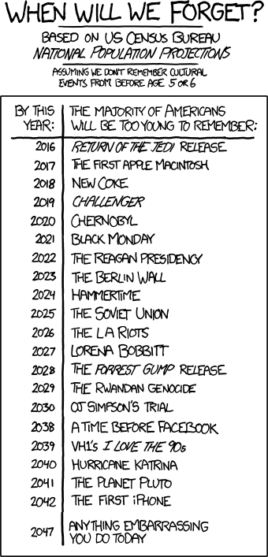
Memory Allocation I CSE 351 Winter 2020
Instructor:
Ruth Anderson
Teaching Assistants:
Jonathan Chen
Justin Johnson
Porter Jones
Josie Lee
Jeffery Tian
Callum Walker
Eddy (Tianyi) Zhou
Adapted from
https://xkcd.com/1093/

Slide 2
Administrivia
Section on 3/05 – Lab 5! Bringing laptop may be useful
hw20 due Friday (3/06)
hw21 due Monday (3/09)
hw22 due Wednesday (3/11) – Do EARLY, will help with Lab 5
Lab 5 (on Mem Alloc) due the last day of class (3/13)
The most significant amount of C programming you will do in this class – combines lots of topics from this class: pointers, bit manipulation, structs, examining memory
Understanding the concepts first and efficient debugging will save you lots of time
Can be submitted at most ONE day late. (Sun 3/15)

Slide 3
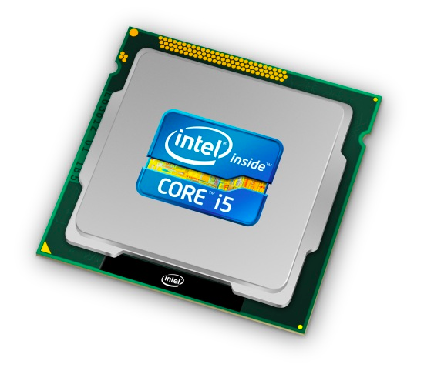
Roadmap
C:
Java:
Memory & data
Integers & floats
x86 assembly
Procedures & stacks
Executables
Arrays & structs
Memory & caches
Processes
Virtual memory
Memory allocation
Java vs. C
car *c = malloc(sizeof(car));
c->miles = 100;
c->gals = 17;
float mpg = get_mpg(c);
free(c);
Car c = new Car();
c.setMiles(100);
c.setGals(17);
float mpg = c.getMPG();
Assembly language:
get_mpg:
pushq %rbp
movq %rsp, %rbp
...
popq %rbp
ret
OS:
Machine code:
0111010000011000
100011010000010000000010
1000100111000010
110000011111101000011111
Computer system:

Slide 4
Multiple Ways to Store Program Data
Static global data
Fixed size at compile-time
Entire lifetime of the program (loaded from executable)
Portion is read-only (e.g. string literals)
Stack-allocated data
Local/temporary variables
Can be dynamically sized (in some versions of C)
Known lifetime (deallocated on return)
Dynamic (heap) data
Size known only at runtime (i.e. based on user-input)
Lifetime known only at runtime (long-lived data structures)
int array[1024];
void foo(int n) {
int tmp;
int local_array[n];
int* dyn =
(int*)malloc(n*sizeof(int));
}

Slide 5
Memory Allocation
Dynamic memory allocation
Introduction and goals
Allocation and deallocation (free)
Fragmentation
Explicit allocation implementation
Implicit free lists
Explicit free lists (Lab 5)
Segregated free lists
Implicit deallocation: garbage collection
Common memory-related bugs in C

Slide 6
Dynamic Memory Allocation
Programmers use dynamic memory allocators to acquire virtual memory at run time
For data structures whose size (or lifetime) is known only at runtime
Manage the heap of a process’ virtual memory:
Types of allocators
Explicit allocator: programmer allocates and frees space
Example: malloc and free in C
Implicit allocator: programmer only allocates space (no free)
Example: garbage collection in Java, Caml, and Lisp
User stack
Heap (via malloc)
Uninitialized data (.bss)
Initialized data (.data)
Program text (.text)
0
Notes:
http://en.wikipedia.org/wiki/Data_segment#Program_memory
.data is for data that is initialized at compile-time: string literals, and static/global variables initialized to some value.
.bss is for static/global variables with no explicit initialization in the code.
http://en.wikipedia.org/wiki/.bss
.data is fixed-size, have to know ahead of time how much you need

Slide 7
Dynamic Memory Allocation
Allocator organizes heap as a collection of variable-sized blocks, which are either allocated or free
Allocator requests pages in the heap region; virtual memory hardware and OS kernel allocate these pages to the process
Application objects are typically smaller than pages, so the allocator manages blocks within pages
(Larger objects handled too; ignored here)
User stack
Top of heap
(brk ptr)
Heap (via malloc)
Uninitialized data (.bss)
Initialized data (.data)
Program text (.text)
0

Slide 8
Allocating Memory in C
Need to #include <stdlib.h>
void* malloc(size_t size)
Allocates a continuous block of size bytes of uninitialized memory
Returns a pointer to the beginning of the allocated block; NULL indicates failed request
Typically aligned to an 8-byte (x86) or 16-byte (x86-64) boundary
Returns NULL if allocation failed (also sets errno) or size==0
Different blocks not necessarily adjacent
Good practices:
ptr = (int*) malloc(n*sizeof(int));
sizeof makes code more portable
void* is implicitly cast into any pointer type; explicit typecast will help you catch coding errors when pointer types don’t match
Notes:
man 3 malloc

Slide 9
Allocating Memory in C
Need to #include <stdlib.h>
void* malloc(size_t size)
Allocates a continuous block of size bytes of uninitialized memory
Returns a pointer to the beginning of the allocated block; NULL indicates failed request
Typically aligned to an 8-byte (x86) or 16-byte (x86-64) boundary
Returns NULL if allocation failed (also sets errno) or size==0
Different blocks not necessarily adjacent
Related functions:
void* calloc(size_t nitems, size_t size)
“Zeros out” allocated block
void* realloc(void* ptr, size_t size)
Changes the size of a previously allocated block (if possible)
void* sbrk(intptr_t increment)
Used internally by allocators to grow or shrink the heap
Notes:
man 3 malloc

Slide 10
Freeing Memory in C
Need to #include <stdlib.h>
void free(void* p)
Releases whole block pointed to by p to the pool of available memory
Pointer p must be the address originally returned by m/c/realloc (i.e. beginning of the block), otherwise system exception raised
Don’t call free on a block that has already been released or on NULL
Notes:
man 3 free

Slide 11
Memory Allocation Example in C
void foo(int n, int m) {
int i, *p;
p = (int*) malloc(n*sizeof(int)); /* allocate block of n ints */
if (p == NULL) { /* check for allocation error */
perror("malloc");
exit(0);
}
for (i=0; i<n; i++) /* initialize int array */
p[i] = i;
/* add space for m ints to end of p block */
p = (int*) realloc(p,(n+m)*sizeof(int));
if (p == NULL) { /* check for allocation error */
perror("realloc");
exit(0);
}
for (i=n; i < n+m; i++) /* initialize new spaces */
p[i] = i;
for (i=0; i<n+m; i++) /* print new array */
printf("%d\n", p[i]);
free(p); /* free p */
}

Slide 12
Notation
= 1 word = 8 bytes
We will draw memory divided into words
Each word is 64 bits = 8 bytes
Allocations will be in sizes that are a multiple of boxes (i.e. multiples of 8 bytes)
Book and old videos still use 4-byte word
Holdover from 32-bit version of textbook 🙁
Allocated block
(4 words)
Free block
(3 words)
Free word
Allocated word

Slide 13
Allocation Example
= 8-byte word
p1 = malloc(32)
p2 = malloc(40)
p3 = malloc(48)
free(p2)
p4 = malloc(16)
Notes:
How do we know how much to free?
Allocator has to remember!

Slide 14
Implementation Interface
Applications
Can issue arbitrary sequence of malloc and free requests
Must never access memory not currently allocated
Must never free memory not currently allocated
Also must only use free with previously malloc’ed blocks
Allocators
Can’t control number or size of allocated blocks
Must respond immediately to malloc
Must allocate blocks from free memory
Must align blocks so they satisfy all alignment requirements
Can’t move the allocated blocks
Notes:
No overlap: application thinks they're separate pieces of data
No move: application holds pointers, can't go track them down

Slide 15
Performance Goals
Goals: Given some sequence of malloc and free requests $R_{0},R_{1},…,R_{k},…,R_{n−1}$, maximize throughput and peak memory utilization
These goals are often conflicting
Throughput
Number of completed requests per unit time
Example:
If 5,000 malloc calls and 5,000 free calls completed in 10 seconds, then throughput is 1,000 operations/second

Slide 16
Performance Goals
Definition: Aggregate payload $P_{k}$
malloc(p) results in a block with a payload of p bytes
After request $R_{k}$ has completed, the aggregate payload $P_{k}$ is the sum of currently allocated payloads
Definition: Current heap size $H_{k}$
Assume $H_{k}$ is monotonically non-decreasing
Allocator can increase size of heap using sbrk
Peak Memory Utilization
Defined as $U_{k}=(\max_{i≤k}{P_{i}})/H_{k}$ after $k$+1 requests
Goal: maximize utilization for a sequence of requests
Why is this hard? And what happens to throughput?
Notes:
Note: heap size can be decreased by using the brk(2) system call.
Packing analogy.

Slide 17
Fragmentation
Poor memory utilization is caused by fragmentation
Sections of memory are not used to store anything useful, but cannot satisfy allocation requests
Two types: internal and external
Recall: Fragmentation in structs
Internal fragmentation was wasted space inside of the struct (between fields) due to alignment
External fragmentation was wasted space between struct instances (e.g. in an array) due to alignment
Now referring to wasted space in the heap inside or between allocated blocks

Slide 18
Internal Fragmentation
For a given block, internal fragmentation occurs if payload is smaller than the block
Causes:
Padding for alignment purposes
Overhead of maintaining heap data structures (inside block, outside payload)
Explicit policy decisions (e.g. return a big block to satisfy a small request)
Easy to measure because only depends on past requests
block
Internal
fragmentation
payload
Internal
fragmentation
Notes:
Policy examples for performance: library book checkout duration, creating a new Google calendar event

Slide 19
External Fragmentation
= 8-byte word
For the heap, external fragmentation occurs when allocation/free pattern leaves “holes” between blocks
That is, the aggregate payload is non-continuous
Can cause situations where there is enough aggregate heap memory to satisfy request, but no single free block is large enough
Don’t know what future requests will be
Difficult to impossible to know if past placements will become problematic
p1 = malloc(32)
p2 = malloc(40)
p3 = malloc(48)
free(p2)
p4 = malloc(48)
Oh no! (What would happen now?)

Slide 20
Polling Question
Which of the following statements is FALSE?
Vote at http://pollev.com/rea
Temporary arrays should not be allocated on the Heap
malloc returns an address of a block that is filled with garbage
Peak memory utilization is a measure of both internal and external fragmentation
An allocation failure will cause your program to stop
We’re lost…

Slide 21
Implementation Issues
How do we know how much memory to free given just a pointer?
How do we keep track of the free blocks?
How do we pick a block to use for allocation (when many might fit)?
What do we do with the extra space when allocating a structure that is smaller than the free block it is placed in?
How do we reinsert a freed block into the heap?

Slide 22
Knowing How Much to Free
= 8-byte word (free)
= 8-byte word (allocated)
Standard method
Keep the length of a block in the word preceding the data
This word is often called the header field or header
Requires an extra word for every allocated block
p0
p0 = malloc(32)
40
block size
data
free(p0)

Slide 23
Keeping Track of Free Blocks
= 8-byte word (free)
= 8-byte word (allocated)
Implicit free list using length – links all blocks using math
No actual pointers, and must check each block if allocated or free
Explicit free list among only the free blocks, using pointers
Segregated free list
Different free lists for different size “classes”
Blocks sorted by size
Can use a balanced binary tree (e.g. red-black tree) with pointers within each free block, and the length used as a key
40
32
48
16
40
32
48
16

Slide 24
Implicit Free Lists
e.g. with 8-byte alignment, possible values for size: 00001000 = 8 bytes
00010000 = 16 bytes
00011000 = 24 bytes
. . .
For each block we need: size, is-allocated?
Could store using two words, but wasteful
Standard trick
If blocks are aligned, some low-order bits of size are always 0
Use lowest bit as an allocated/free flag (fine as long as aligning to $K$>1)
When reading size, must remember to mask out this bit!
8 bytes
Format of allocated and free blocks:
size
a
a = 1: allocated block
a = 0: free block
size: block size (in bytes)
payload: application data
(allocated blocks only)
size | a;
x & 1;
x & ~1;
If x is first word (header):
x = size | a;
a = x & 1;
size = x & ~1;
payload
optional
padding
Notes:
Where is p pointing?

