Slide 1
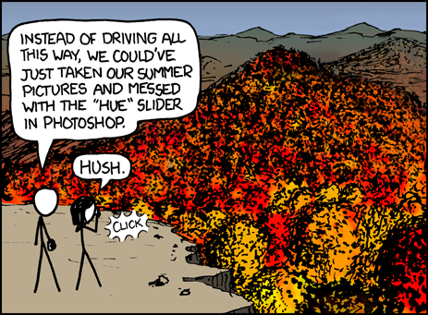
Virtual Memory III CSE 351 Winter 2020
Instructor:
Ruth Anderson
Teaching Assistants:
Jonathan Chen
Justin Johnson
Porter Jones
Josie Lee
Jeffery Tian
Callum Walker
Eddy (Tianyi) Zhou
https://xkcd.com/648/

Slide 2
Administrivia
Lab 4 – Due Tonight! (3/02)
Cache parameter puzzles and code optimizations
hw19 due Wednesday (3/04)
hw20 due Friday (3/06)

Slide 3
Address Translation: Page Hit
2
Cache/
Memory
CPU Chip
MMU
PTEA
1
PTE
CPU
VA
3
PA
4
Data
5
1) Processor sends virtual address to MMU (memory management unit)
2-3) MMU fetches PTE from page table in cache/memory (Uses PTBR to find beginning of page table for current process)
4) MMU sends physical address to cache/memory requesting data
5) Cache/memory sends data to processor
VA = Virtual Address PTEA = Page Table Entry Address PTE= Page Table Entry PA = Physical Address Data = Contents of memory stored at VA originally requested by CPU

Slide 4
Address Translation: Page Fault
Exception
Page fault handler
4
CPU Chip
2
Cache/
Memory
Disk
MMU
PTEA
Victim page
1
5
CPU
VA
PTE
7
3
New page
6
1) Processor sends virtual address to MMU
2-3) MMU fetches PTE from page table in cache/memory
4) Valid bit is zero, so MMU triggers page fault exception
5) Handler identifies victim (and, if dirty, pages it out to disk)
6) Handler pages in new page and updates PTE in memory
7) Handler returns to original process, restarting faulting instruction

Slide 5
Hmm… Translation Sounds Slow
The MMU accesses memory twice: once to get the PTE for translation, and then again for the actual memory request
The PTEs may be cached in L1 like any other memory word
But they may be evicted by other data references
And a hit in the L1 cache still requires 1-3 cycles
What can we do to make this faster?
Solution: add another cache! 🎉

Slide 6
Speeding up Translation with a TLB
Translation Lookaside Buffer (TLB):
Small hardware cache in MMU
Split VPN into TLB Tag and TLB Index based on # of sets in TLB
Maps virtual page numbers to physical page numbers
Stores page table entries for a small number of pages
Modern Intel processors have 128 or 256 entries in TLB
Much faster than a page table lookup in cache/memory
Set
0
1
TLB
Virtual Page Number
Page offset
V
TLBT
PTE
V
TLBT
PTE
TLBT
TLBI
V
TLBT
PTE
V
TLBT
PTE
Notes:
“The architecture of the IBM System/370” R.P. Case and A. Padegs Communications of the ACM. 21:1, 73-96, January 1978.
Perhaps the first paper to use the term translation lookaside buffer. The name arises from the historical name for a cache, which was a lookaside buffer as called by those developing the Atlas system at the University of Manchester; a cache of address translations thus became a translation lookaside buffer. Even though the term lookaside buffer fell out of favor, TLB seems to have stuck, for whatever reason.
“x86info -c” on Intel Core2 Duo CPU:
L1 Data TLB: 4KB pages, 4-way set associative, 16 entries
Data TLB: 4K pages, 4-way associative, 256 entries.
L1 Data TLB: 4MB pages, 4-way set associative, 16 entries
Data TLB: 4MB pages, 4-way associative, 32 entries

Slide 7
TLB Hit
TLB
VPN
→
PTE
VPN
→
PTE
VPN
→
PTE
CPU Chip
TLB
2
PTE
VPN
3
Cache/
Memory
1
MMU
CPU
VA
PA
4
Data
5
A TLB hit eliminates a memory access!

Slide 8
TLB Miss
TLB
VPN
→
PTE
VPN
→
PTE
VPN
→
PTE
CPU Chip
TLB
4
2
PTE
VPN
Cache/
Memory
1
MMU
3
CPU
VA
PTEA
PA
5
Data
6
A TLB miss incurs an additional memory access (the PTE)
Fortunately, TLB misses are rare
Notes:
Does a TLB miss require disk access?

Slide 9
Fetching Data on a Memory Read
Check TLB
Input: VPN, Output: PPN
TLB Hit: Fetch translation, return PPN
TLB Miss: Check page table (in memory)
Page Table Hit: Load page table entry into TLB
Page Fault: Fetch page from disk to memory, update corresponding page table entry, then load entry into TLB
Check cache
Input: physical address, Output: data
Cache Hit: Return data value to processor
Cache Miss: Fetch data value from memory, store it in cache, return it to processor

Slide 10
Address Translation
Virtual Address
TLB Lookup
TLB Miss
TLB Hit
Check the
Page Table
Protection
Check
Page not
in Mem
Page
in Mem
Access
Denied
Access
Permitted
Page Fault
(OS loads page)
Update
TLB
Protection
Fault
Physical
Address
Find in Disk
Find in Mem
SIGSEGV
Check cache
Miss
Hit
Notes:
Need to restart instruction.
Soft and hard page faults.

Slide 11
Address Manipulation
request from CPU:
$n$-bit virtual address
split to access TLB:
TLB Tag
TLB Index
Page Offset
(on TLB miss) access PT:
Virtual Page Number
Page offset
TRANSLATION
$m$-bit physical address:
Physical Page Number
Page offset
split to access cache:
Cache Tag
Cache Index
Offset
Notes:
Need to restart instruction.
Soft and hard page faults.

Slide 12
Context Switching Revisited
What needs to happen when the CPU switches processes?
Registers:
Save state of old process, load state of new process
Including the Page Table Base Register (PTBR)
Memory:
Nothing to do! Pages for processes already exist in memory/disk and protected from each other
TLB:
Invalidate all entries in TLB – mapping is for old process’ VAs
Cache:
Can leave alone because storing based on PAs – good for shared data

Slide 13
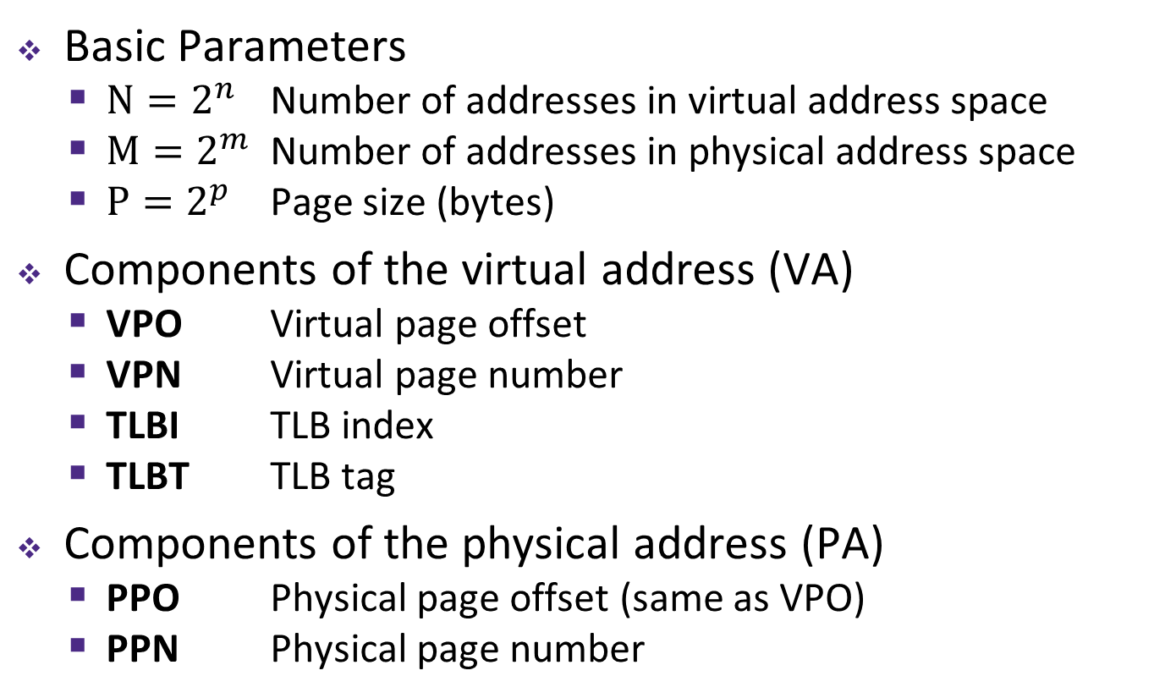
Summary of Address Translation Symbols
Basic Parameters
$N=2^{n}$ Number of addresses in virtual address space
$M=2^{m}$ Number of addresses in physical address space
$P=2^{p}$ Page size (bytes)
Components of the virtual address (VA)
VPO Virtual page offset
VPN Virtual page number
TLBI TLB index
TLBT TLB tag
Components of the physical address (PA)
PPO Physical page offset (same as VPO)
PPN Physical page number

Slide 14
Address Translation
VM is complicated, but also elegant and effective
Level of indirection to provide isolated memory & caching
TLB as a cache of page tables avoids two trips to memory for every memory access
Virtual Address
TLB
Lookup
TLB Miss
TLB Hit
Check the
Page Table
Protection
Check
Page not
in Mem
Page
in Mem
Access
Denied
Access
Permitted
Page Fault
(OS loads page)
Update
TLB
Protection
Fault
Physical
Address
Find in Disk
Find in Mem
SIGSEGV
Check cache
Notes:
Need to restart instruction.
Soft and hard page faults.

Slide 15
Simple Memory System Example (small)
Addressing
14-bit virtual addresses
12-bit physical address
Page size = 64 bytes
13
12
11
10
9
8
7
6
5
4
3
2
1
0
VPN
VPO
Virtual Page Number
Virtual Page Offset
11
10
9
8
7
6
5
4
3
2
1
0
PPN
PPO
Physical Page Number
Physical Page Offset

Slide 16
Simple Memory System: Page Table
Only showing first 16 entries (out of _____)
Note: showing 2 hex digits for PPN even though only 6 bits
Note: other management bits not shown, but part of PTE
VPN | PPN | Valid
0 | 28 | 1
1 | – | 0
2 | 33 | 1
3 | 02 | 1
4 | – | 0
5 | 16 | 1
6 | – | 0
7 | – | 0
VPN | PPN | Valid
8 | 13 | 1
9 | 17 | 1
A | 09 | 1
B | – | 0
C | – | 0
D | 2D | 1
E | – | 0
F | 0D | 1
Notes:
Size of page table = 2^(n-p) entries

Slide 17
Simple Memory System: TLB
16 entries total
4-way set associative
Why does the TLB ignore the page offset?
TLB tag
TLB index
13
12
11
10
9
8
7
6
5
4
3
2
1
0
virtual page number
virtual page offset
Set
Tag
PPN
Valid
Tag
PPN
Valid
Tag
PPN
Valid
Tag
PPN
Valid
0
03
–
0
09
0D
1
00
–
0
07
02
1
1
03
2D
1
02
–
0
04
–
0
0A
–
0
2
02
–
0
08
–
0
06
–
0
03
–
0
3
07
–
0
03
0D
1
0A
34
1
02
–
0
Notes:
Calculate VPN for valid TLB entry using Tag & Set

Slide 18
Simple Memory System: Cache
Note: It is just coincidence that the PPN is the same width as the cache Tag
Direct-mapped with $K$ = 4 B, $C/K$ = 16
Physically addressed
cache tag
cache index
cache offset
11
10
9
8
7
6
5
4
3
2
1
0
physical page number
physical page offset
Index | Tag | Valid | B0 | B1 | B2 | B3
0 | 19 | 1 | 99 | 11 | 23 | 11
1 | 15 | 0 | – | – | – | –
2 | 1B | 1 | 00 | 02 | 04 | 08
3 | 36 | 0 | – | – | – | –
4 | 32 | 1 | 43 | 6D | 8F | 09
5 | 0D | 1 | 36 | 72 | F0 | 1D
6 | 31 | 0 | – | – | – | –
7 | 16 | 1 | 11 | C2 | DF | 03
Index | Tag | Valid | B0 | B1 | B2 | B3
8 | 24 | 1 | 3A | 00 | 51 | 89
9 | 2D | 0 | – | – | – | –
A | 2D | 1 | 93 | 15 | DA | 3B
B | 0B | 0 | – | – | – | –
C | 12 | 0 | – | – | – | –
D | 16 | 1 | 04 | 96 | 34 | 15
E | 13 | 1 | 83 | 77 | 1B | D3
F | 14 | 0 | – | – | – | –

Slide 19
Current State of Memory System
Page table (partial):
TLB:
VPN | PPN | V
0 | 28 | 1
1 | – | 0
2 | 33 | 1
3 | 02 | 1
4 | – | 0
5 | 16 | 1
6 | – | 0
7 | – | 0
VPN | PPN | V
8 | 13 | 1
9 | 17 | 1
A | 09 | 1
B | – | 0
C | – | 0
D | 2D | 1
E | – | 0
F | 0D | 1
Set | Tag | PPN | V | Tag | PPN | V | Tag | PPN | V | Tag | PPN | V
0 | 03 | – | 0 | 09 | 0D | 1 | 00 | – | 0 | 07 | 02 | 1
1 | 03 | 2D | 1 | 02 | – | 0 | 04 | – | 0 | 0A | – | 0
2 | 02 | – | 0 | 08 | – | 0 | 06 | – | 0 | 03 | – | 0
3 | 07 | – | 0 | 03 | 0D | 1 | 0A | 34 | 1 | 02 | – | 0
Cache:
Index | Tag | V | B0 | B1 | B2 | B3
0 | 19 | 1 | 99 | 11 | 23 | 11
1 | 15 | 0 | – | – | – | –
2 | 1B | 1 | 00 | 02 | 04 | 08
3 | 36 | 0 | – | – | – | –
4 | 32 | 1 | 43 | 6D | 8F | 09
5 | 0D | 1 | 36 | 72 | F0 | 1D
6 | 31 | 0 | – | – | – | –
7 | 16 | 1 | 11 | C2 | DF | 03
Index | Tag | V | B0 | B1 | B2 | B3
8 | 24 | 1 | 3A | 00 | 51 | 89
9 | 2D | 0 | – | – | – | –
A | 2D | 1 | 93 | 15 | DA | 3B
B | 0B | 0 | – | – | – | –
C | 12 | 0 | – | – | – | –
D | 16 | 1 | 04 | 96 | 34 | 15
E | 13 | 1 | 83 | 77 | 1B | D3
F | 14 | 0 | – | – | – | –
Notes:
TLB and Cache are separate pieces of hardware; page table stored in memory
Show correlation between TLB & page table (VPN 0x0D and 0x0F in particular)

Slide 20
Memory Request Example #1
Note: It is just coincidence that the PPN is the same width as the cache Tag
Virtual Address: 0x03D4
Physical Address:
TLBT
TLBI
13
12
11
10
9
8
7
6
5
4
3
2
1
0
0
0
0
0
1
1
1
1
0
1
0
1
0
0
VPN
VPO
VPN ______ | TLBT _____ | TLBI _____ | TLB Hit? ___ | Page Fault? ___ | PPN _____
CT
CI
CO
11
10
9
8
7
6
5
4
3
2
1
0
PPN
PPO
CT ______ | CI _____ | CO _____ | Cache Hit? ___ | Data (byte) _______
Notes:
TLB Hit, Cache Hit

Slide 21
Memory Request Example #2
Note: It is just coincidence that the PPN is the same width as the cache Tag
Virtual Address: 0x038F
Physical Address:
TLBT
TLBI
13
12
11
10
9
8
7
6
5
4
3
2
1
0
0
0
0
0
1
1
1
0
0
0
1
1
1
1
VPN
VPO
VPN ______ | TLBT _____ | TLBI _____ | TLB Hit? ___ | Page Fault? ___ | PPN _____
CT
CI
CO
11
10
9
8
7
6
5
4
3
2
1
0
PPN
PPO
CT ______ | CI _____ | CO _____ | Cache Hit? ___ | Data (byte) _______
Notes:
TLB Miss, page fault

Slide 22
Memory Request Example #3
Note: It is just coincidence that the PPN is the same width as the cache Tag
Virtual Address: 0x0020
Physical Address:
TLBT
TLBI
13
12
11
10
9
8
7
6
5
4
3
2
1
0
0
0
0
0
0
0
0
0
1
0
0
0
0
0
VPN
VPO
VPN ______ | TLBT _____ | TLBI _____ | TLB Hit? ___ | Page Fault? ___ | PPN _____
CT
CI
CO
11
10
9
8
7
6
5
4
3
2
1
0
PPN
PPO
CT ______ | CI _____ | CO _____ | Cache Hit? ___ | Data (byte) _______
Notes:
TLB Miss, Page Table Hit, Cache Miss

Slide 23
Memory Request Example #4
Note: It is just coincidence that the PPN is the same width as the cache Tag
Virtual Address: 0x036B
Physical Address:
TLBT
TLBI
13
12
11
10
9
8
7
6
5
4
3
2
1
0
0
0
0
0
1
1
0
1
1
0
1
0
1
1
VPN
VPO
VPN ______ | TLBT _____ | TLBI _____ | TLB Hit? ___ | Page Fault? ___ | PPN _____
CT
CI
CO
11
10
9
8
7
6
5
4
3
2
1
0
PPN
PPO
CT ______ | CI _____ | CO _____ | Cache Hit? ___ | Data (byte) _______
Notes:
TLB Hit, Cache Hit

Slide 24
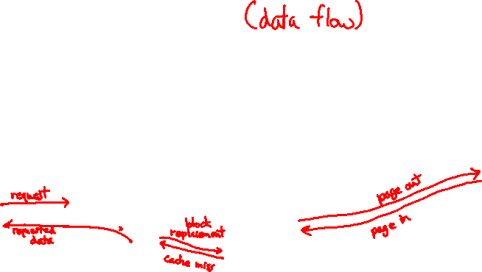
Memory Overview
movl 0x8043ab, %rdi
Disk
requested 32-bits
Page
Main memory
(DRAM)
CPU
Cache
Page
Line
MMU
Block
TLB

Slide 25
Page Table Reality
This is extra (non-testable) material
Just one issue… the numbers don’t work out for the story so far!
The problem is the page table for each process:
Suppose 64-bit VAs, 8 KiB pages, 8 GiB physical memory
How many page table entries is that?
About how long is each PTE?
Moral: Cannot use this naïve implementation of the virtual→physical page mapping – it’s way too big
Notes:
2^64/2^13 = 2^51
PPN = 20 bits; plus Valid, R/W/X; so ~ 3 B per PTE
So each page table takes up 2^52 + 2^51 B!

Slide 26
A Solution: Multi-level Page Tables
This is extra (non-testable) material
This is called a page walk
Page table base register
(PTBR)
n-1
Virtual Address
p-1
0
VPN 1
VPN 2
...
VPN k
VPO
Level 1
page table
Level 2
page table
Level k
page table
...
...
PPN
TLB
m-1
p-1
0
PPN
PPO
VPN
→
PTE
Physical Address
VPN
→
PTE
VPN
→
PTE

Slide 27
Multi-level Page Tables
This is extra (non-testable) material
A tree of depth $k$ where each node at depth $i$ has up to $2^{j}$ children if part $i$ of the VPN has $j$ bits
Hardware for multi-level page tables inherently more complicated
But it’s a necessary complexity – 1-level does not fit
Why it works: Most subtrees are not used at all, so they are never created and definitely aren’t in physical memory
Parts created can be evicted from cache/memory when not being used
Each node can have a size of ~1-100KB
But now for a $k$-level page table, a TLB miss requires $k+1$ cache/memory accesses
Fine so long as TLB misses are rare – motivates larger TLBs

Slide 28
Practice VM Question
Our system has the following properties
1 MiB of physical address space
4 GiB of virtual address space
32 KiB page size
4-entry fully associative TLB with LRU replacement
Fill in the following blanks:
________ | Entries in a page table | ________ | Minimum bit-width of PTBR
________ | TLBT bits | ________ | Max # of valid entries in a page table

Slide 29
Practice VM Question
One process uses a page-aligned square matrix mat[] of 32-bit integers in the code shown below:
#define MAT_SIZE = 2048
for(int i = 0; i < MAT_SIZE; i++)
mat[i*(MAT_SIZE+1)] = i;
What is the largest stride (in bytes) between successive memory accesses (in the VA space)?

Slide 30
Practice VM Question
One process uses a page-aligned square matrix mat[] of 32-bit integers in the code shown below:
#define MAT_SIZE = 2048
for(int i = 0; i < MAT_SIZE; i++)
mat[i*(MAT_SIZE+1)] = i;
Assuming all of mat[] starts on disk, what are the following hit rates for the execution of the for-loop?
________ | TLB Hit Rate | ________ | Page Table Hit Rate

Slide 31
Virtual Memory Summary
Programmer’s view of virtual memory
Each process has its own private linear address space
Cannot be corrupted by other processes
System view of virtual memory
Uses memory efficiently by caching virtual memory pages
Efficient only because of locality
Simplifies memory management and sharing
Simplifies protection by providing permissions checking

Slide 32
Memory System Summary
Memory Caches (L1/L2/L3)
Purely a speed-up technique
Behavior invisible to application programmer and (mostly) OS
Implemented totally in hardware
Virtual Memory
Supports many OS-related functions
Process creation, task switching, protection
Operating System (software)
Allocates/shares physical memory among processes
Maintains high-level tables tracking memory type, source, sharing
Handles exceptions, fills in hardware-defined mapping tables
Hardware
Translates virtual addresses via mapping tables, enforcing permissions
Accelerates mapping via translation cache (TLB)

