Slide 1
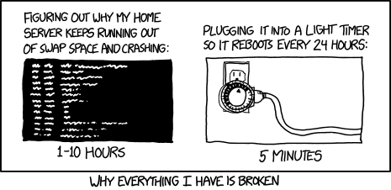
Virtual Memory II CSE 351 Winter 2020
Instructor:
Ruth Anderson
Teaching Assistants:
Jonathan Chen
Justin Johnson
Porter Jones
Josie Lee
Jeffery Tian
Callum Walker
Eddy (Tianyi) Zhou
https://xkcd.com/1495/

Slide 2
Administrivia
Lab 4 – Due Monday (3/02)
Cache parameter puzzles and code optimizations
hw19 due Wednesday (3/04)
hw20 due Friday (3/06)

Slide 3
Mapping
A virtual address (VA) can be mapped to either physical memory or disk
Unused VAs may not have a mapping
VAs from different processes may map to same location in memory/disk
Process 1’s Virtual
Address Space
Physical Memory
Process 2’s Virtual
Address Space
Disk
“Swap Space”

Slide 4
A System Using Physical Addressing
Main memory
0:
1:
2:
CPU
Physical address (PA)
3:
4:
0x4
5:
6:
7:
8:
...
M-1:
Data (int/float)
Used in “simple” systems with (usually) just one process:
Embedded microcontrollers in devices like cars, elevators, and digital picture frames

Slide 5
A System Using Virtual Addressing
Main memory
0:
CPU Chip
1:
Virtual address
(VA)
Physical address
(PA)
2:
CPU
MMU
3:
4:
0x4100
0x4
5:
6:
7:
8:
Memory Management Unit
...
M-1:
Data (int/float)
Physical addresses are completely invisible to programs
Used in all modern desktops, laptops, servers, smartphones…
One of the great ideas in computer science

Slide 6
Why Virtual Memory (VM)?
Efficient use of limited main memory (RAM)
Use RAM as a cache for the parts of a virtual address space
Some non-cached parts stored on disk
Some (unallocated) non-cached parts stored nowhere
Keep only active areas of virtual address space in memory
Transfer data back and forth as needed
Simplifies memory management for programmers
Each process “gets” the same full, private linear address space
Isolates address spaces (protection)
One process can’t interfere with another’s memory
They operate in different address spaces
User process cannot access privileged information
Different sections of address spaces have different permissions
Notes:
Adds disks to memory hierarchy
Simplifies memory for processes & programmers
Security/protection

Slide 7
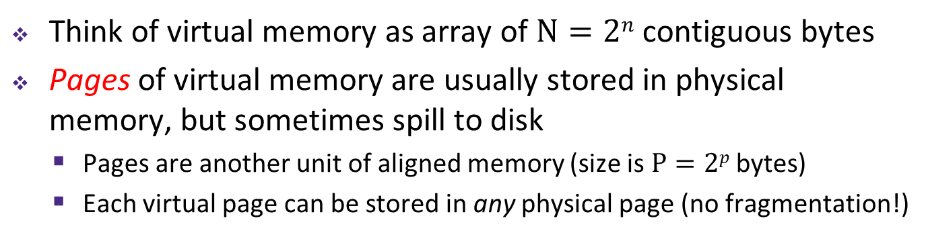
VM and the Memory Hierarchy
Think of virtual memory as array of $N=2n$ contiguous bytes
Pages of virtual memory are usually stored in physical memory, but sometimes spill to disk
Pages are another unit of aligned memory (size is $P=2p$ bytes)
Each virtual page can be stored in any physical page (no fragmentation!)
Virtual memory
Physical memory
0
Empty
PP 0
VP 0
Unallocated
0
PP 1
VP 1
Empty
Physical pages (PP's)
Virtual pages (VP's)
Unallocated
Empty
2^{m}-1
PP 2^{m-p}-1
Disk
VP 2^{n-p}-1
2^{n}-1
“Swap Space”
Notes:
Swap space: https://www.linux.com/news/all-about-linux-swap-space

Slide 8
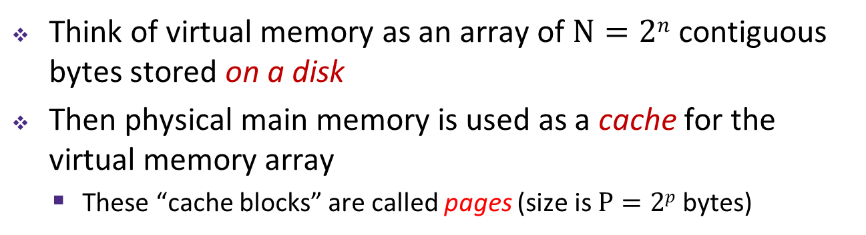
or: Virtual Memory as DRAM Cache for Disk
Think of virtual memory as an array of $N=2n$ contiguous bytes stored on a disk
Then physical main memory is used as a cache for the virtual memory array
These “cache blocks” are called pages (size is $P=2p$ bytes)
Virtual memory
Physical memory
VP 0
Unallocated
0
VP 1
Cached
0
Empty
PP 0
Uncached
PP 1
Unallocated
Empty
Cached
Uncached
Empty
Cached
M-1
PP 2^{m-p}-1
VP 2^{n-p}-1
Uncached
N-1
Virtual pages (VPs)
“stored on disk”
Physical pages (PPs)
cached in DRAM

Slide 9
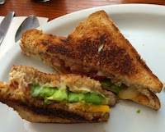
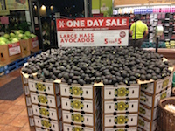
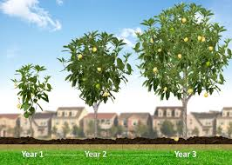

Memory Hierarchy: Core 2 Duo
Not drawn to scale
SRAM
Static Random Access Memory
DRAM
Dynamic Random Access Memory
~4 MB
~8 GB
~500 GB
L1
I-cache
L2 unified cache
Main Memory
Disk
32 KB
CPU
Reg
L1
D-cache
Throughput:
16 B/cycle
8 B/cycle
2 B/cycle
1 B/30 cycles
Latency:
3 cycles
14 cycles
100 cycles
millions
Miss Penalty
(latency)
33x
Miss Penalty
(latency)
10,000x

Slide 10
Virtual Memory Design Consequences
Large page size: typically 4-8 KiB or 2-4 MiB
Can be up to 1 GiB (for “Big Data” apps on big computers)
Compared with 64-byte cache blocks
Fully associative
Any virtual page can be placed in any physical page
Requires a “large” mapping function – different from CPU caches
Highly sophisticated, expensive replacement algorithms in OS
Too complicated and open-ended to be implemented in hardware
Write-back rather than write-through
Really don’t want to write to disk every time we modify something in memory
Some things may never end up on disk (e.g. stack for short-lived process)

Slide 11
Why does VM work on RAM/disk?
Avoids disk accesses because of locality
Same reason that L1 / L2 / L3 caches work
The set of virtual pages that a program is “actively” accessing at any point in time is called its working set
If (working set of one process ≤ physical memory):
Good performance for one process (after compulsory misses)
If (working sets of all processes > physical memory):
Thrashing: Performance meltdown where pages are swapped between memory and disk continuously (CPU always waiting or paging)
This is why your computer can feel faster when you add RAM
Notes:
Improving a program’s temporal locality can lead to a smaller working set (using data in one place in the program rather than many places).
Full quote: “Every problem in computer science can be solved by adding another level of indirection, but that usually will create another problem.”

Slide 12
Virtual Memory (VM)
Overview and motivation
VM as a tool for caching
Address translation
VM as a tool for memory management
VM as a tool for memory protection

Slide 13

Address Translation
How do we perform the virtual $→$ physical address translation?
Main memory
0:
CPU Chip
1:
Virtual address
(VA)
Physical address
(PA)
2:
CPU
MMU
3:
4:
0x4100
0x4
5:
6:
7:
8:
Memory Management Unit
...
M-1:
Data (int/float)

Slide 14

Address Translation: Page Tables
CPU-generated address can be split into:
Request is Virtual Address (VA), want Physical Address (PA)
Note that Physical Offset = Virtual Offset (page-aligned)
Use lookup table that we call the page table (PT)
Replace Virtual Page Number (VPN) for Physical Page Number (PPN) to generate Physical Address
Index PT using VPN: page table entry (PTE) stores the PPN plus management bits (e.g. Valid, Dirty, access rights)
Has an entry for every virtual page
$n$-bit address:
Virtual Page Number
Page Offset

Slide 15
Page Table Diagram
Physical memory
(DRAM)
Physical page #
Page tables stored in physical memory
Too big to fit elsewhere – managed by MMU & OS
How many page tables in the system?
One per process
Page Table
(DRAM)
VP 1
PP 0
Virtual page #
Valid
PPN/Disk Addr
VP 2
PP 1
PTE 0: 0
0
null
VP 7
PP 2
PTE 1: 1
1
PTE 2: 2
1
VP 4
PP 3
PTE 3: 3
0
PTE 4: 4
1
Virtual memory (DRAM/disk)
PTE 5: 5
0
null
PTE 6: 6
0
VP 1
PTE 7: 7
1
...
...
VP 2
VP 3
VP 4
VP 6
VP 7
Notes:
Space allocated for pages in disk called Swap Space

Slide 16
Page Table Address Translation
CPU
Virtual address (VA)
Page table base register
(PTBR)
Virtual page number (VPN)
Virtual page offset (VPO)
Page table address
for process
Page table
Valid
PPN
Valid bit = 0:
page not in memory
(page fault)
Physical page number (PPN)
Physical page offset (PPO)
In most cases, the MMU can perform this translation without software assistance
Physical address (PA)
Notes:
PTBR is another name for control register 3 (CR3) in x86: http://en.wikipedia.org/wiki/Control_register#CR3

Slide 17
Polling Question
How many bits wide are the following fields?
16 KiB pages
48-bit virtual addresses
16 GiB physical memory
Vote at: http://pollev.com/rea
VPN PPN
(A)
34 24
(B)
32 18
(C)
30 20
(D)
34 20

Slide 18
Page Hit
Page hit: VM reference is in physical memory
Page Table (DRAM)
Physical memory
(DRAM)
Virtual address
Valid
PPN/Disk Addr
PTE 0
0
null
VP 1
PP 0
1
VP 2
1
VP 7
0
VP 4
PP 3
1
0
null
0
Virtual memory (DRAM/disk)
PTE 7
1
...
...
VP 1
VP 2
Example: Page size = 4 KiB
VP 3
VP 4
Virtual Addr:
0x00740b
Physical Addr:
VP 6
VP 7
VPN:
PPN:
Notes:
4kB page = 2^12
3 hex digits

Slide 19
Page Fault
Page fault: VM reference is NOT in physical memory
Page Table (DRAM)
Physical memory
(DRAM)
Virtual address
Valid
PPN/Disk Addr
PTE 0
0
null
VP 1
PP 0
1
VP 2
1
VP 7
0
VP 4
PP 3
1
0
null
0
Virtual memory (DRAM/disk)
PTE 7
1
...
...
VP 1
VP 2
Example: Page size = 4 KiB
Provide a virtual address request (in hex) that results in this particular page fault:
VP 3
VP 4
VP 6
VP 7
Virtual Addr:

Slide 20
Reminder: Page Fault Exception
int a[1000];
int main () {
a[500] = 13;
}
User writes to memory location
That portion (page) of user’s memory is currently on disk
Page fault handler must load page into physical memory
Returns to faulting instruction: mov is executed again!
Successful on second try
80483b7: c7 05 10 9d 04 08 0d movl $0xd,0x8049d10
User code
OS Kernel code
exception: page fault
handle_page_fault:
movl
Create page and
load into memory
returns

Slide 21
Handling a Page Fault
Page miss causes page fault (an exception)
Page Table (DRAM)
Physical memory
(DRAM)
Virtual address
Valid
PPN/Disk Addr
PTE 0
0
null
VP 1
PP 0
1
VP 2
1
VP 7
0
VP 4
PP 3
1
0
null
Virtual memory (DRAM/disk)
0
PTE 7
1
VP 1
...
...
VP 2
VP 3
VP 4
VP 6
VP 7

Slide 22
Handling a Page Fault
Page miss causes page fault (an exception)
Page fault handler selects a victim to be evicted (here VP 4)
Page Table (DRAM)
Physical memory
(DRAM)
Virtual address
Valid
PPN/Disk Addr
PTE 0
0
null
VP 1
PP 0
1
VP 2
1
VP 7
0
VP 4
PP 3
1
0
null
Virtual memory (DRAM/disk)
0
PTE 7
1
VP 1
...
...
VP 2
VP 3
VP 4
VP 6
VP 7
Notes:
Check dirty bit on eviction!

Slide 23
Handling a Page Fault
Page miss causes page fault (an exception)
Page fault handler selects a victim to be evicted (here VP 4)
Page Table (DRAM)
Physical memory
(DRAM)
Virtual address
Valid
PPN/Disk Addr
PTE 0
0
null
VP 1
PP 0
1
VP 2
1
VP 7
1
VP 3
PP 3
0
0
null
Virtual memory (DRAM/disk)
0
PTE 7
1
VP 1
...
...
VP 2
VP 3
VP 4
VP 6
VP 7

Slide 24
Handling a Page Fault
Page miss causes page fault (an exception)
Page fault handler selects a victim to be evicted (here VP 4)
Offending instruction is restarted: page hit!
Page Table (DRAM)
Physical memory
(DRAM)
Virtual address
Valid
PPN/Disk Addr
PTE 0
0
null
VP 1
PP 0
1
VP 2
1
VP 7
1
VP 3
PP 3
0
0
null
Virtual memory (DRAM/disk)
0
PTE 7
1
VP 1
...
...
VP 2
VP 3
VP 4
VP 6
VP 7

Slide 25
Virtual Memory (VM)
Overview and motivation
VM as a tool for caching
Address translation
VM as a tool for memory management
VM as a tool for memory protection

Slide 26
VM for Managing Multiple Processes
Key abstraction: each process has its own virtual address space
It can view memory as a simple linear array
With virtual memory, this simple linear virtual address space need not be contiguous in physical memory
Process needs to store data in another VP? Just map it to any PP!
Virtual Address Space for Process 1:
0
0
Physical
Address
Space (DRAM)
VP 1
VP 2
PP 2
...
N-1
Address
translation
PP 6
(e.g., read-only
library code)
Virtual Address Space for Process 2:
0
PP 8
VP 1
VP 2
...
...
N-1
M-1

Slide 27
Simplifying Linking and Loading
Memory
invisible to
user code
Linking
Each program has similar virtual address space
Code, Data, and Heap always start at the same addresses
Loading
execve allocates virtual pages for .text and .data sections & creates PTEs marked as invalid
The .text and .data sections are copied, page by page, on demand by the virtual memory system
Kernel virtual memory
User stack
(created at runtime)
%rsp
(stack
pointer)
Memory-mapped region for
shared libraries
brk
Run-time heap
(created by malloc)
Read/write segment
(.data, .bss)
Loaded
from the
executable
file
Read-only segment
(.init, .text, .rodata)
0x400000
Unused
0

Slide 28
VM for Protection and Sharing
The mapping of VPs to PPs provides a simple mechanism to protect memory and to share memory between processes
Sharing: map virtual pages in separate address spaces to the same physical page (here: PP 6)
Protection: process can’t access physical pages to which none of its virtual pages are mapped (here: Process 2 can’t access PP 2)
Virtual Address Space for Process 1:
0
0
Physical
Address
Space (DRAM)
VP 1
VP 2
PP 2
...
N-1
Address
translation
PP 6
(e.g., read-only
library code)
Virtual Address Space for Process 2:
0
PP 8
VP 1
VP 2
...
...
N-1
M-1

Slide 29
Memory Protection Within Process
VM implements read/write/execute permissions
Extend page table entries with permission bits
MMU checks these permission bits on every memory access
If violated, raises exception and OS sends SIGSEGV signal to process (segmentation fault)
Physical
Address Space
Process i:
Valid
READ
WRITE
EXEC
PPN
VP 0:
Yes
Yes
No
No
PP 6
VP 1:
Yes
Yes
No
Yes
PP 4
VP 2:
Yes
Yes
Yes
No
PP 2
PP 2
•
•
•
PP 4
PP 6
Process j:
Valid
READ
WRITE
EXEC
PPN
VP 0:
Yes
Yes
Yes
No
PP 9
PP 8
VP 1:
Yes
Yes
No
No
PP 6
PP 9
VP 2:
Yes
Yes
Yes
No
PP 11
PP 11
Notes:
Why no Dirty bit? Typically handled by OS.

Slide 30
Review Question
What should the permission bits be for pages from the following sections of virtual memory?
Section | Read | Write | Execute
Stack
Heap
Static Data
Literals
Instructions

