Slide 1
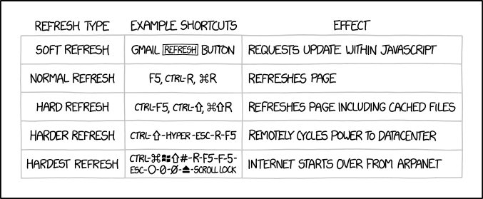
Processes CSE 351 Winter 2020
Instructor: Teaching Assistants:
Ruth Anderson Jonathan Chen Justin Johnson Porter Jones
Josie Lee Jeffery Tian Callum Walker
Eddy (Tianyi) Zhou
http://xkcd.com/1854/

Slide 2
Administrivia
Lab 3 due TONIGHT (2/24)
hw17 due Wednesday (2/26)
Lab 4 preparation!
Lab 4 coming soon!
Cache parameter puzzles and code optimizations

Slide 3
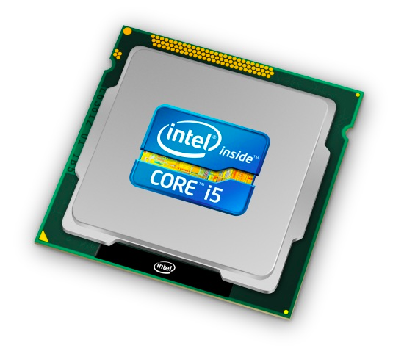
Roadmap
C:
Java:
Memory & data
Integers & floats
x86 assembly
Procedures & stacks
Executables
Arrays & structs
Memory & caches
Processes
Virtual memory
Memory allocation
Java vs. C
car *c = malloc(sizeof(car));
c->miles = 100;
c->gals = 17;
float mpg = get_mpg(c);
free(c);
Car c = new Car();
c.setMiles(100);
c.setGals(17);
float mpg = c.getMPG();
Assembly language:
get_mpg:
pushq %rbp
movq %rsp, %rbp
...
popq %rbp
ret
OS:
Machine code:
0111010000011000
100011010000010000000010
1000100111000010
110000011111101000011111
Computer system:

Slide 4
Leading Up to Processes
System Control Flow
Control flow
Exceptional control flow
Asynchronous exceptions (interrupts)
Synchronous exceptions (traps & faults)

Slide 5
Control Flow
So far: we’ve seen how the flow of control changes as a single program executes
Reality: multiple programs running concurrently
How does control flow across the many components of the system?
In particular: More programs running than CPUs
Exceptional control flow is basic mechanism used for:
Transferring control between processes and OS
Handling I/O and virtual memory within the OS
Implementing multi-process apps like shells and web servers
Implementing concurrency

Slide 6
Control Flow
Processors do only one thing:
From startup to shutdown, a CPU simply reads and executes (interprets) a sequence of instructions, one at a time
This sequence is the CPU’s control flow (or flow of control)
Physical control flow
<startup>
instr₁
instr₂
instr₃
…
instr_{n}
<shutdown>
time

Slide 7
Altering the Control Flow
Up to now, two ways to change control flow:
Jumps (conditional and unconditional)
Call and return
Both react to changes in program state
Processor also needs to react to changes in system state
Unix/Linux user hits “Ctrl-C” at the keyboard
User clicks on a different application’s window on the screen
Data arrives from a disk or a network adapter
Instruction divides by zero
System timer expires
Can jumps and procedure calls achieve this?
No – the system needs mechanisms for “exceptional” control flow!

Slide 8
Java Digression
This is extra (non-testable) material
Java has exceptions, but they’re something different
Examples: NullPointerException, MyBadThingHappenedException, …
throw statements
try/catch statements (“throw to youngest matching catch on the call-stack, or exit-with-stack-trace if none”)
Java exceptions are for reacting to (unexpected) program state
Can be implemented with stack operations and conditional jumps
A mechanism for “many call-stack returns at once”
Requires additions to the calling convention, but we already have the CPU features we need
System-state changes on previous slide are mostly of a different sort (asynchronous/external except for divide-by-zero) and implemented very differently

Slide 9
Exceptional Control Flow
Exists at all levels of a computer system
Low level mechanisms
Exceptions
Change in processor’s control flow in response to a system event (i.e. change in system state, user-generated interrupt)
Implemented using a combination of hardware and OS software
Higher level mechanisms
Process context switch
Implemented by OS software and hardware timer
Signals
Implemented by OS software
We won’t cover these – see CSE451 and CSE/EE474

Slide 10
Exceptions
An exception is transfer of control to the operating system (OS) kernel in response to some event (i.e. change in processor state)
Kernel is the memory-resident part of the OS
Examples: division by 0, page fault, I/O request completes, Ctrl-C
How does the system know where to jump to in the OS?
User Code
OS Kernel Code
event
current_instr
exception
next_instr
exception processing by exception handler, then:
return to current_instr,
return to next_instr, OR
abort

Slide 11
Exception Table
This is extra (non-testable) material
A jump table for exceptions (also called Interrupt Vector Table)
Each type of event has a unique exception number $k$
$k$ = index into exception table (a.k.a interrupt vector)
Handler $k$ is called each time exception $k$ occurs
code for
exception handler 0
Exception
Table
code for
exception handler 1
0
1
code for
exception handler 2
2
...
n-1
...
Exception
numbers
code for
exception handler n-1
Notes:
(Jump tables for switch statements: x86 Programming III slides)
The book calls this an Exception table. I am using that at the top of the slide to be consistent with the book and with the previous slide.

Slide 12
Exception Table (Excerpt)
This is extra (non-testable) material
Exception Number | Description | Exception Class
0 | Divide error | Fault
13 | General protection fault | Fault
14 | Page fault | Fault
18 | Machine check | Abort
32-255 | OS-defined | Interrupt or trap
Notes:
According to the book: Ones in gray are Intel-defined, Others are OS-defined
Intel® 64 and IA-32 Architectures Software Developer's Manual, Volume 1: Basic Architecture - Describes the architecture and programming environment of processors supporting IA-32 and Intel 64 Architectures.
“Systems often use an interrupt controller to group the device interrupts together before passing on the signal to a single interrupt pin on the CPU. This saves interrupt pins on the CPU…” http://www.tldp.org/LDP/tlk/dd/interrupts.html
This is why cat /proc/interrupts doesn’t match this slide - /proc/interrupts shows APIC’s “IRQ numbers”, not the OS’s exception numbers

Slide 13
Leading Up to Processes
System Control Flow
Control flow
Exceptional control flow
Asynchronous exceptions (interrupts)
Synchronous exceptions (traps & faults)

Slide 14
Asynchronous Exceptions (Interrupts)
Caused by events external to the processor
Indicated by setting the processor’s interrupt pin(s) (wire into CPU)
After interrupt handler runs, the handler returns to “next” instruction
Examples:
I/O interrupts
Hitting Ctrl-C on the keyboard
Clicking a mouse button or tapping a touchscreen
Arrival of a packet from a network
Arrival of data from a disk
Timer interrupt
Every few milliseconds, an external timer chip triggers an interrupt
Used by the OS kernel to take back control from user programs
Notes:
Also:
Hard reset interrupt
hitting the reset button on front panel
Soft reset interrupt
hitting Ctrl-Alt-Delete on a PC

Slide 15
Synchronous Exceptions
Caused by events that occur as a result of executing an instruction:
Traps
Intentional: transfer control to OS to perform some function
Examples: system calls, breakpoint traps, special instructions
Returns control to “next” instruction
Faults
Unintentional but possibly recoverable
Examples: page faults, segment protection faults, integer divide-by-zero exceptions
Either re-executes faulting (“current”) instruction or aborts
Aborts
Unintentional and unrecoverable
Examples: parity error, machine check (hardware failure detected)
Aborts current program

Slide 16
System Calls
Each system call has a unique ID number
Examples for Linux on x86-64:
Number | Name | Description
0 | read | Read file
1 | write | Write file
2 | open | Open file
3 | close | Close file
4 | stat | Get info about file
57 | fork | Create process
59 | execve | Execute a program
60 | _exit | Terminate process
62 | kill | Send signal to process

Slide 17
Traps Example: Opening File
User calls open(filename, options)
Calls __open function, which invokes system call instruction syscall
00000000000e5d70 <__open>:
...
e5d79: b8 02 00 00 00 mov $0x2,%eax # open is syscall 2
e5d7e: 0f 05 syscall # return value in %rax
e5d80: 48 3d 01 f0 ff ff cmp $0xfffffffffffff001,%rax
...
e5dfa: c3 retq
User code
OS Kernel code
%rax contains syscall number
Other arguments in %rdi, %rsi, %rdx, %r10, %r8, %r9
Return value in %rax
Negative value is an error corresponding to negative errno
syscall
Exception
cmp
Open file
Returns
Notes:
Note: on x86-64, syscall and sysret are used instead of int 0x80.
Interrupt number 0x80 tells OS that this is a system call; to specify which system call, the system call’s number is stored in a register (%eax on IA32 Linux) before executing the int instruction.
http://stackoverflow.com/questions/2705702/x86-assembly-before-making-a-system-call-on-linux-should-you-save-all-registers

Slide 18
Fault Example: Page Fault
User writes to memory location
That portion (page) of user’s memory is currently on disk
Page fault handler must load page into physical memory
Returns to faulting instruction: mov is executed again!
Successful on second try
int a[1000];
int main () {
a[500] = 13;
}
80483b7: c7 05 10 9d 04 08 0d movl $0xd,0x8049d10
User code
OS Kernel code
exception: page fault
handle_page_fault:
movl
Create page and
load into memory
returns
Notes:
Can SIGSEGV ever be handled without aborting? Yes, but program can’t really run afterwards: http://www.linuxprogrammingblog.com/all-about-linux-signals?page=4

Slide 19
Fault Example: Invalid Memory Reference
int a[1000];
int main() {
a[5000] = 13;
}
80483b7: c7 05 60 e3 04 08 0d movl $0xd,0x804e360
User Process
OS
exception: page fault
handle_page_fault:
movl
detect invalid address
signal process
Page fault handler detects invalid address
Sends SIGSEGV signal to user process
User process exits with “segmentation fault”
Notes:
Can SIGSEGV ever be handled without aborting? Yes, but program can’t really run afterwards: http://www.linuxprogrammingblog.com/all-about-linux-signals?page=4

Slide 20
Summary
Exceptions
Events that require non-standard control flow
Generated externally (interrupts) or internally (traps and faults)
After an exception is handled, one of three things may happen:
Re-execute the current instruction
Resume execution with the next instruction
Abort the process that caused the exception

Slide 21
Processes
Processes and context switching
Creating new processes
fork(), exec*(), and wait()
Zombies

Slide 22
What is a process?
It’s an illusion!
Process 1
Memory
Stack
Heap
Data
Code
CPU
Registers
%rip
Disk
Chrome.exe

Slide 23
What is a process?
Another abstraction in our computer system
Provided by the OS
OS uses a data structure to represent each process
Maintains the interface between the program and the underlying hardware (CPU + memory)
What do processes have to do with exceptional control flow?
Exceptional control flow is the mechanism the OS uses to enable multiple processes to run on the same system
What is the difference between:
A processor? A program? A process?
Notes:
The data structure is the process control block (PCB).

Slide 24
Processes
A process is an instance of a running program
One of the most profound ideas in computer science
Not the same as “program” or “processor”
Process provides each program with two key abstractions:
Logical control flow
Each program seems to have exclusive use of the CPU
Provided by kernel mechanism called context switching
Private address space
Each program seems to have exclusive use of main memory
Provided by kernel mechanism called virtual memory
Memory
Stack
Heap
Data
Code
CPU
Registers

Slide 25
What is a process?
It’s an illusion!
Computer
Process 3
Process 2
“Memory”
Stack
“Memory”
Heap
Process 1
Data
Process 4
Stack
Code
Heap
“CPU”
“Memory”
Data
“Memory”
Code
Registers
Stack
“CPU”
Stack
Heap
Heap
Data
Registers
Data
Code
Code
CPU
“CPU”
“CPU”
Registers
Registers
Disk
/Applications/
Chrome.exe
Slack.exe
PowerPoint.exe

Slide 26
What is a process?
It’s an illusion!
Computer
Process 3
Process 2
“Memory”
Stack
“Memory”
Heap
Process 1
Data
Process 4
Stack
Code
Heap
“CPU”
“Memory”
Data
“Memory”
Code
Registers
Stack
“CPU”
Stack
Heap
Heap
Data
Registers
Data
Code
Code
CPU
“CPU”
“CPU”
Operating
System
Registers
Registers
Disk
/Applications/
Chrome.exe
Slack.exe
PowerPoint.exe

Slide 27
Multiprocessing: The Illusion
Memory
Memory
Memory
Stack
Stack
Stack
Heap
Heap
…
Heap
Data
Data
Data
Code
Code
Code
CPU
CPU
CPU
Registers
Registers
Registers
Computer runs many processes simultaneously
Applications for one or more users
Web browsers, email clients, editors, …
Background tasks
Monitoring network & I/O devices

Slide 28
Multiprocessing: The Reality
Memory
Stack
Stack
Stack
Heap
Heap
…
Heap
Data
Data
Data
Code
Code
Code
Saved registers
Saved registers
Saved registers
CPU
Registers
Single processor executes multiple processes concurrently
Process executions interleaved, CPU runs one at a time
Address spaces managed by virtual memory system (later in course)
Execution context (register values, stack, …) for other processes saved in memory

Slide 29
Multiprocessing
Memory
Stack
Stack
Stack
Heap
Heap
…
Heap
Data
Data
Data
Code
Code
Code
Saved registers
Saved registers
Saved registers
CPU
Registers
Context switch
Save current registers in memory

Slide 30
Multiprocessing
Memory
Stack
Stack
Stack
Heap
Heap
…
Heap
Data
Data
Data
Code
Code
Code
Saved registers
Saved registers
Saved registers
CPU
Registers
Context switch
Save current registers in memory
Schedule next process for execution

Slide 31
Multiprocessing
Memory
Stack
Stack
Stack
Heap
Heap
…
Heap
Data
Data
Data
Code
Code
Code
Saved registers
Saved registers
Saved registers
CPU
Registers
Context switch
Save current registers in memory
Schedule next process for execution
Load saved registers and switch address space

Slide 32
Multiprocessing: The (Modern) Reality
Memory
Stack
Stack
Stack
Heap
Heap
…
Heap
Data
Data
Data
Code
Code
Code
Saved registers
Saved registers
Saved registers
CPU
CPU
Multicore processors
Multiple CPUs (“cores”) on single chip
Share main memory (and some of the caches)
Each can execute a separate process
Kernel schedules processes to cores
Still constantly swapping processes
Registers
Registers

Slide 33
Concurrent Processes
Assume only one CPU
Each process is a logical control flow
Two processes run concurrently (are concurrent) if their instruction executions (flows) overlap in time
Otherwise, they are sequential
Example: (running on single core)
Concurrent: A & B, A & C
Sequential: B & C
Process A
Process B
Process C
time

Slide 34
User’s View of Concurrency
Assume only one CPU
Control flows for concurrent processes are physically disjoint in time
CPU only executes instructions for one process at a time
However, the user can think of concurrent processes as executing at the same time, in parallel
Process A
Process B
Process C
Process A
Process B
Process C
User View
time

Slide 35
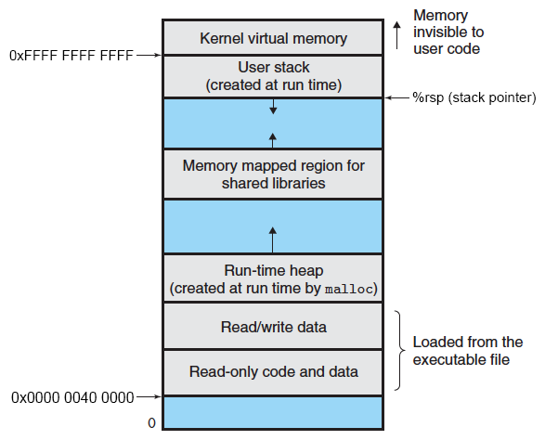
Context Switching
Assume only one CPU
Processes are managed by a shared chunk of OS code called the kernel
The kernel is not a separate process, but rather runs as part of a user process
In x86-64 Linux:
Same address in each process refers to same shared memory location

Slide 36
Context Switching
Assume only one CPU
Processes are managed by a shared chunk of OS code called the kernel
The kernel is not a separate process, but rather runs as part of a user process
Context switch passes control flow from one process to another and is performed using kernel code
Process A
Process B
user code
Exception
kernel code
context switch
time
user code
kernel code
context switch
user code

Slide 37
Processes
Processes and context switching
Creating new processes
fork() , exec*(), and wait()
Zombies

Slide 38
Creating New Processes & Programs
Process 1
Process 2
“Memory”
“Memory”
Stack
Stack
Heap
fork()
Heap
Data
Data
Code
Code
“CPU”
“CPU”
Registers
Registers
exec*()
Chrome.exe

Slide 39
Creating New Processes & Programs
fork-exec model (Linux):
fork() creates a copy of the current process
exec*() replaces the current process’ code and address space with the code for a different program
Family: execv, execl, execve, execle, execvp, execlp
fork() and execve() are system calls
Other system calls for process management:
getpid()
exit()
wait(), waitpid()
Notes:
Review: system calls are traps (intentional exception).
http://en.wikipedia.org/wiki/Fork-exec: “Microsoft Windows does not support the fork-exec model, as it does not have a system call analogous to fork(). The spawn() family of functions declared in process.h can replace it in cases where the call to fork() is followed directly by exec().”

Slide 40
fork: Creating New Processes
pid_t fork(void)
Creates a new “child” process that is identical to the calling “parent” process, including all state (memory, registers, etc.)
Returns 0 to the child process
Returns child’s process ID (PID) to the parent process
Child is almost identical to parent:
Child gets an identical (but separate) copy of the parent’s virtual address space
Child has a different PID than the parent
fork is unique (and often confusing) because it is called once but returns “twice”
pid_t pid = fork();
if (pid == 0) {
printf("hello from child\n");
} else {
printf("hello from parent\n");
}

Slide 41
Understanding fork()
Process X (parent; PID X)
Process Y (child; PID Y)
pid_t fork_ret = fork();
if (fork_ret == 0) {
printf("hello from child\n");
} else {
printf("hello from parent\n");
}
pid_t fork_ret = fork();
if (fork_ret == 0) {
printf("hello from child\n");
} else {
printf("hello from parent\n");
}

Slide 42
Understanding fork()
Process X (parent; PID X)
Process Y (child; PID Y)
pid_t fork_ret = fork();
if (fork_ret == 0) {
printf("hello from child\n");
} else {
printf("hello from parent\n");
}
pid_t fork_ret = fork();
if (fork_ret == 0) {
printf("hello from child\n");
} else {
printf("hello from parent\n");
}
fork_ret = Y
fork_ret = 0
pid_t fork_ret = fork();
if (fork_ret == 0) {
printf("hello from child\n");
} else {
printf("hello from parent\n");
}
pid_t fork_ret = fork();
if (fork_ret == 0) {
printf("hello from child\n");
} else {
printf("hello from parent\n");
}

Slide 43
Understanding fork()
Process X (parent; PID X)
Process Y (child; PID Y)
pid_t fork_ret = fork();
if (fork_ret == 0) {
printf("hello from child\n");
} else {
printf("hello from parent\n");
}
pid_t fork_ret = fork();
if (fork_ret == 0) {
printf("hello from child\n");
} else {
printf("hello from parent\n");
}
fork_ret = Y
fork_ret = 0
pid_t fork_ret = fork();
if (fork_ret == 0) {
printf("hello from child\n");
} else {
printf("hello from parent\n");
}
pid_t fork_ret = fork();
if (fork_ret == 0) {
printf("hello from child\n");
} else {
printf("hello from parent\n");
}
hello from parent
hello from child
Which one appears first?

Slide 44
Summary
Processes
At any given time, system has multiple active processes
On a one-CPU system, only one can execute at a time, but each process appears to have total control of the processor
OS periodically “context switches” between active processes
Implemented using exceptional control flow
Process management
fork: one call, two returns
execve: one call, usually no return
wait or waitpid: synchronization
exit: one call, no return

