Slide 1

Caches II
CSE 351 Winter 2020
Instructor:
Ruth Anderson
Teaching Assistants:
Jonathan Chen
Justin Johnson
Porter Jones
Josie Lee
Jeffery Tian
Callum Walker
Eddy (Tianyi) Zhou

Slide 2
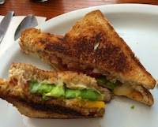

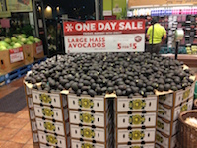
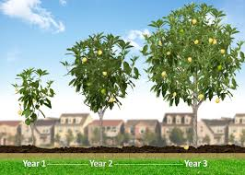
An Example Memory Hierarchy
<1 ns
5-10 s
registers
1 ns
on-chip L1
cache (SRAM)
Smaller,
faster,
costlier
per byte
5-10 ns
off-chip L2
cache (SRAM)
1-2 min
Larger,
slower,
cheaper
per byte
100 ns
main memory
(DRAM)
15-30 min
150,000 ns
SSD
31 days
local secondary storage
(local disks)
10,000,000 ns
(10 ms)
Disk
66 months = 5.5 years
1-150 ms
remote secondary storage
(distributed file systems, web servers)
1 - 15 years
Notes:
Going to SSD is like walking down to California to get an avocado
Disk is like waiting a year for a new crop of avocados
Going across the world is like waiting for an avocado tree to grow up from a seed…

Slide 3
Memory Hierarchies
Some fundamental and enduring properties of hardware and software systems:
  Faster storage technologies almost always cost more per byte and have lower capacity
  The gaps between memory technology speeds are widening
    True for: registers ↔ cache, cache ↔ DRAM, DRAM ↔ disk, etc.
  Well-written programs tend to exhibit good locality
These properties complement each other beautifully
  They suggest an approach for organizing memory and storage systems known as a memory hierarchy
    For each level k, the faster, smaller device at level k serves as a cache for the larger, slower device at level k+1

Slide 4
An Example Memory Hierarchy
registers
CPU registers hold words retrieved from L1 cache
on-chip L1
cache (SRAM)
Smaller,
faster,
costlier
per byte
L1 cache holds cache lines retrieved from L2 cache
off-chip L2
cache (SRAM)
L2 cache holds cache lines retrieved from main memory
Larger,
slower,
cheaper
per byte
main memory
(DRAM)
Main memory holds disk blocks retrieved from local disks
local secondary storage
(local disks)
Local disks hold files retrieved from disks on remote network servers
remote secondary storage
(distributed file systems, web servers)
Notes:
Implemented with different technologies!
disks, solid-state
DRAM: little wells that drain slowly, refreshed periodically
SRAM: flip-flops, little logic gates that feedback with each other, faster but uses more power!
That’s why they’re different sizes and costs

Slide 5
An Example Memory Hierarchy
explicitly program-controlled (e.g. refer to exactly %rax, %rbx)
registers
on-chip L1
cache (SRAM)
Smaller,
faster,
costlier
per byte
program sees “memory”;
hardware manages caching
transparently
off-chip L2
cache (SRAM)
Larger,
slower,
cheaper
per byte
main memory
(DRAM)
local secondary storage
(local disks)
remote secondary storage
(distributed file systems, web servers)
Notes:
So, why haven’t we seen caches before now in this class?
Because they’re designed to be architecturally transparent!

Slide 6
Intel Core i7 Cache Hierarchy
Processor package
Core 0
Core 3
Block size:
64 bytes for all caches
L1 i-cache and d-cache:
  32 KiB, 8-way,
  Access: 4 cycles
L2 unified cache:
  256 KiB, 8-way,
  Access: 11 cycles
L3 unified cache:
  8 MiB, 16-way,
  Access: 30-40 cycles
Regs
Regs
L1
d-cache
L1
i-cache
L1
d-cache
L1
i-cache
…
L2 unified cache
L2 unified cache
L3 unified cache
(shared by all cores)
Main memory
Notes:
cat /sys/devices/system/cpu/cpu0/cache/index0/ways_of_associativity

Slide 7
Making memory accesses fast!
Cache basics
Principle of locality
Memory hierarchies
Cache organization
  Direct-mapped (sets; index + tag)
  Associativity (ways)
  Replacement policy
  Handling writes
Program optimizations that consider caches
Notes:
Divide addresses into “index” and “tag”

Slide 8

Cache Organization (1)
Note: The textbook uses “B” for block size
Block Size ($K$): unit of transfer between $\$$ and Mem
  Given in bytes and always a power of 2 (e.g. 64 B)
  Blocks consist of adjacent bytes (differ in address by 1)
    Spatial locality!
Notes:
Just like withinBlock() from Lab 1!

Slide 9

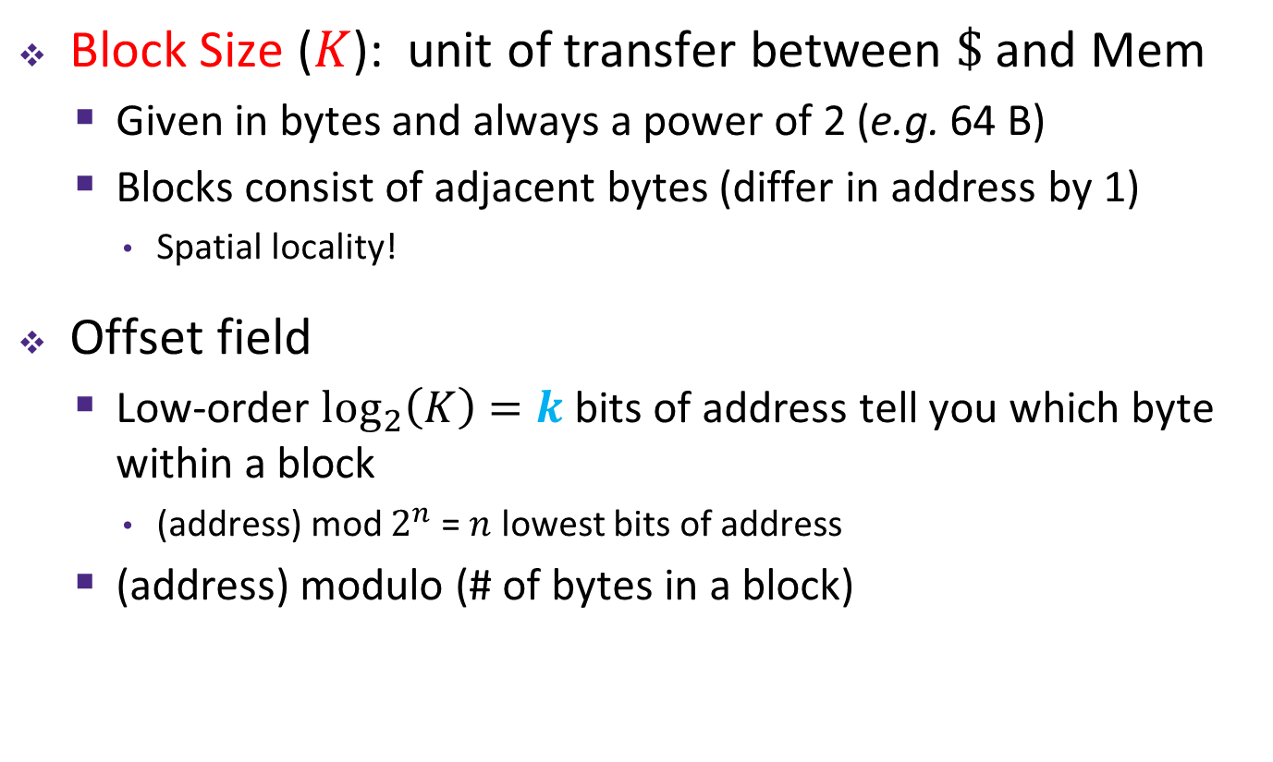

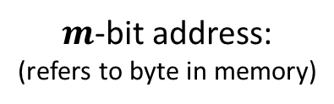
Cache Organization (1)
Note: The textbook uses “b” for offset bits
Block Size ($K$): unit of transfer between $\$$ and Mem
  Given in bytes and always a power of 2 (e.g. 64 B)
  Blocks consist of adjacent bytes (differ in address by 1)
    Spatial locality!
Offset field
  Low-order $\log_{2}\left(K\right)=k$ bits of address tell you which byte within a block
    (address) mod $2^{n}$ = $n$ lowest bits of address
  (address) modulo (# of bytes in a block)
$m−k$ bits
$k$ bits
$m$-bit address:
(refers to byte in memory)
Block Number
Block Offset
Notes:
Just like withinBlock() from Lab 1!

Slide 10
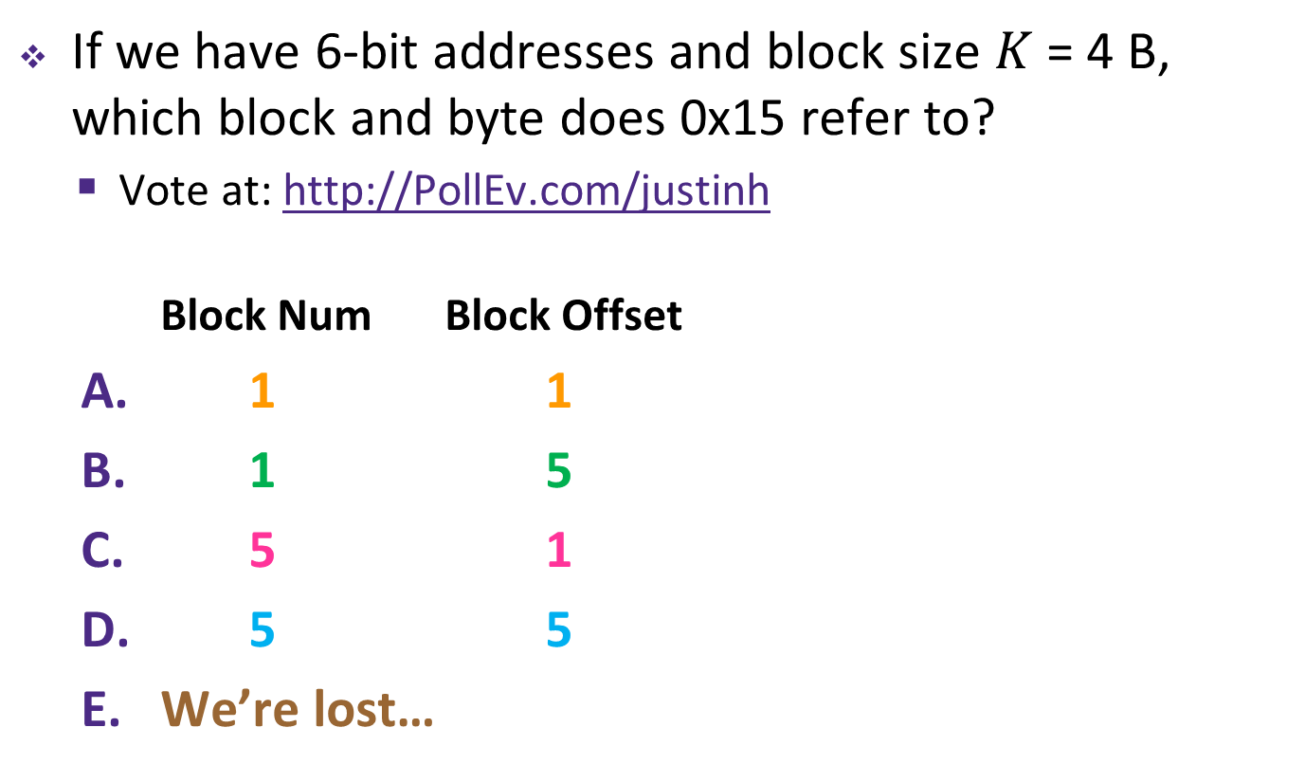
Polling Question
If we have 6-bit addresses and block size $K$ = 4 B, which block and byte does 0x15 refer to?
  Vote at: http://pollev.com/rea
  Block Num Block Offset
1 1
1 5
5 1
5 5
We’re lost…

Slide 11
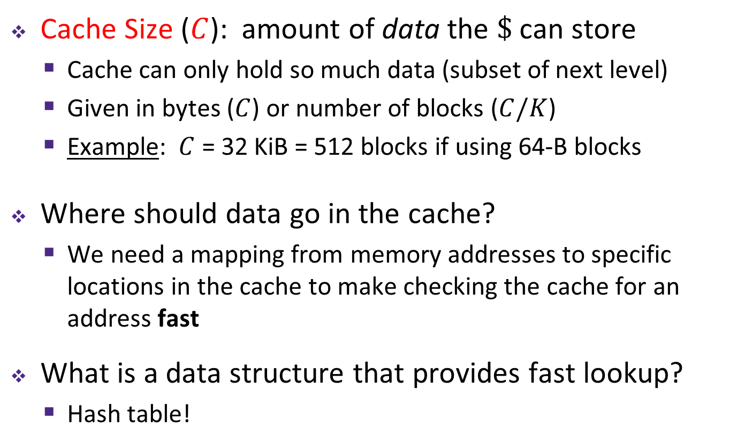
Cache Organization (2)
Cache Size ($C$): amount of data the $\$$ can store
  Cache can only hold so much data (subset of next level)
  Given in bytes ($C$) or number of blocks ($C/K$)
  Example: $C$ = 32 KiB = 512 blocks if using 64-B blocks
Where should data go in the cache?
  We need a mapping from memory addresses to specific locations in the cache to make checking the cache for an address fast
What is a data structure that provides fast lookup?
  Hash table!

Slide 12
Review: Hash Tables for Fast Lookup
Insert:
5
27
34
102
119
0
1
2
3
4
5
6
7
8
9
Apply hash function to map data to “buckets”
Notes:
hash(27) % N (10) = 7…

Slide 13
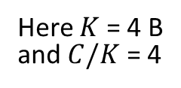
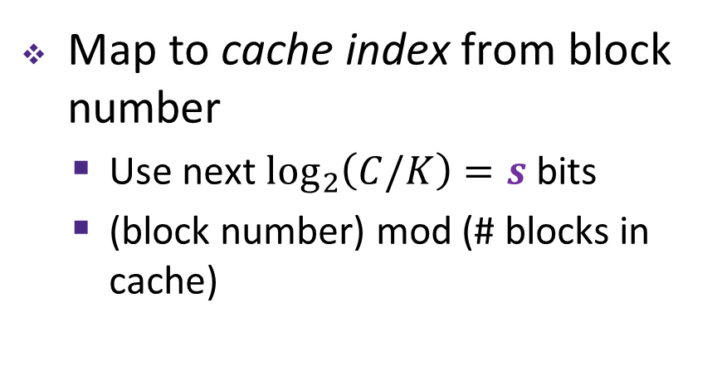
Place Data in Cache by Hashing Address
Memory
Cache
Block Num | Block Data
0000
0001
0010
0011
0100
0101
0110
0111
1000
1001
1010
1011
1100
1101
1110
1111
Index | Block Data
00
01
10
11
Here $K$ = 4 B
and $C/K$ = 4
Map to cache index from block number
  Use next $\log_{2}\left(C/K\right)=s$ bits
  (block number) mod (# blocks in cache)
Notes:
Assume 6-bit addresses. Show how to split into Index and Offset fields.

Slide 14
Place Data in Cache by Hashing Address
Memory
Cache
Block Num | Block Data
0000
0001
0010
0011
0100
0101
0110
0111
1000
1001
1010
1011
1100
1101
1110
1111
Index | Block Data
00
01
10
11
Here $K$ = 4 B
and $C/K$ = 4
Map to cache index from block number
  Lets adjacent blocks fit in cache simultaneously!
    Consecutive blocks go in consecutive cache indices

Slide 15
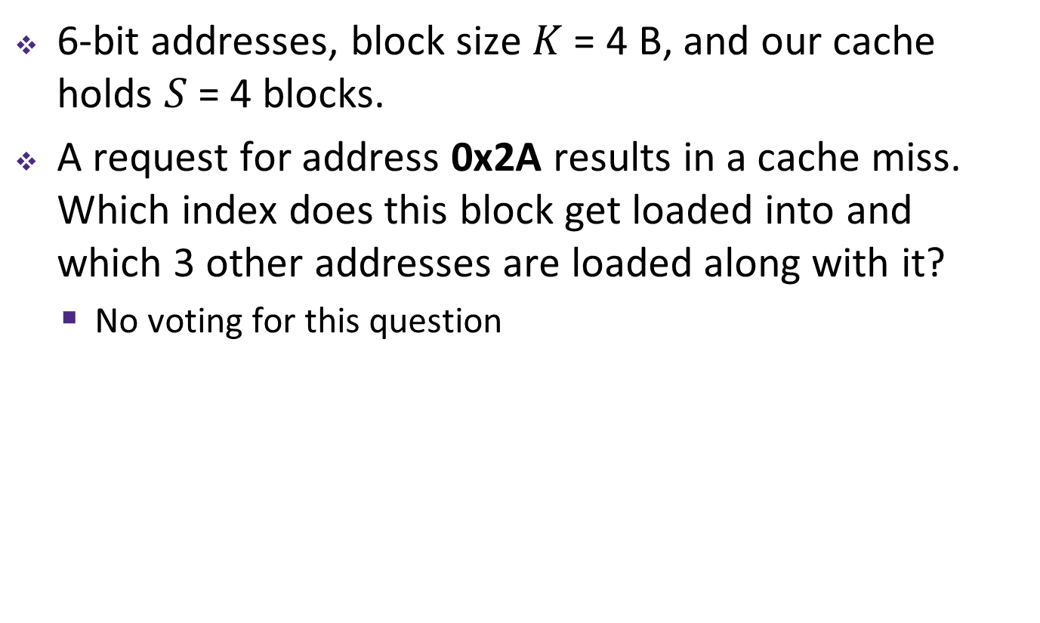
Practice Question
6-bit addresses, block size $K$ = 4 B, and our cache holds $S$ = 4 blocks.
A request for address 0x2A results in a cache miss. Which index does this block get loaded into and which 3 other addresses are loaded along with it?
  No voting for this question

Slide 16
Place Data in Cache by Hashing Address
Memory
Cache
Block Num | Block Data
0000
0001
0010
0011
0100
0101
0110
0111
1000
1001
1010
1011
1100
1101
1110
1111
Index | Block Data
00
01
10
11
Here $K$ = 4 B
and $C/K$ = 4
Collision!
  This might confuse the cache later when we access the data
  Solution?

Slide 17
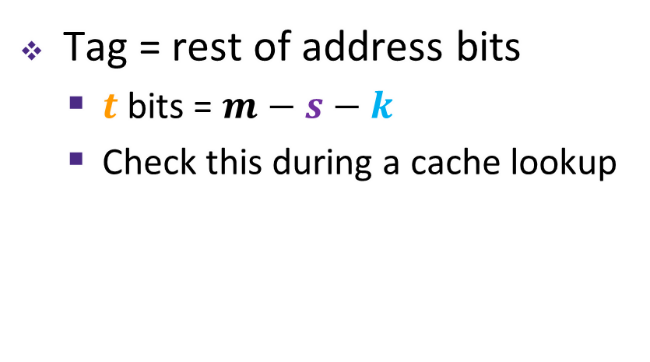
Tags Differentiate Blocks in Same Index
Memory
Cache
Block Num | Block Data
0000
0001
0010
0011
0100
0101
0110
0111
1000
1001
1010
1011
1100
1101
1110
1111
Index | Tag |  | Block Data
00 | 00
01
10 | 01
11 | 01
Here $K$ = 4 B
and $C/K$ = 4
Tag = rest of address bits
  $t$ bits = $m−s−k$
  Check this during a cache lookup
Notes:
Possible analogies for Tag:
Hash by first name, tag by last name
Hash by 7-digit phone number, tag by area code

Slide 18
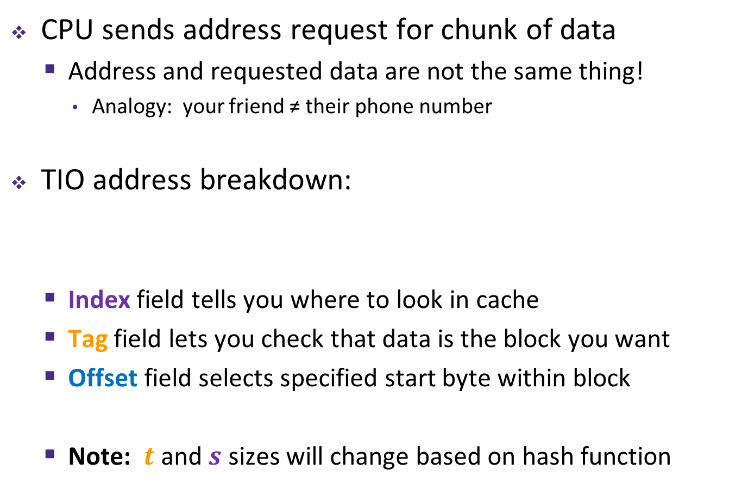




Checking for a Requested Address
CPU sends address request for chunk of data
  Address and requested data are not the same thing!
    Analogy: your friend ≠ their phone number
TIO address breakdown:
  Index field tells you where to look in cache
  Tag field lets you check that data is the block you want
  Offset field selects specified start byte within block
  Note: $t$ and $s$ sizes will change based on hash function
$m$-bit address:
Tag ($t$)
Index ($s$)
Offset ($k$)
Block Number

Slide 19
Cache Puzzle
Vote at http://pollev.com/rea
Based on the following behavior, which of the following block sizes is NOT possible for our cache?
  Cache starts empty, also known as a cold cache
  Access (addr: hit/miss) stream:
    (14: miss), (15: hit), (16: miss)
4 bytes
8 bytes
16 bytes
32 bytes
We’re lost…
Notes:
Lab 4!

Slide 20
Direct-Mapped Cache
Memory
Cache
Block Num | Block Data
00 00
00 01
00 10
00 11
01 00
01 01
01 10
01 11
10 00
10 01
10 10
10 11
11 00
11 01
11 10
11 11
Index | Tag |  | Block Data
00 | 00
01 | 11
10 | 01
11 | 01
Here $K$ = 4 B
and $C/K$ = 4
Hash function: (block number) mod (# of blocks in cache)
  Each memory address maps to exactly one index in the cache
  Fast (and simpler) to find a block

Slide 21
Direct-Mapped Cache Problem
Memory
Cache
Block Num | Block Data
00 00
00 01
00 10
00 11
01 00
01 01
01 10
01 11
10 00
10 01
10 10
10 11
11 00
11 01
11 10
11 11
Index | Tag |  | Block Data
00 | ??
01 | ??
10
11 | ??
Here $K$ = 4 B
and $C/K$ = 4
What happens if we access the following addresses?
  8, 24, 8, 24, 8, …?
  Conflict in cache (misses!)
  Rest of cache goes unused
Solution?
Notes:
Conflict! Rest of cache unused!

Slide 22






Notes Diagrams
Smaller,
faster,
costlier
per byte
registers
on-chip L1
cache (SRAM)
off-chip L2
cache (SRAM)
Larger,
slower,
cheaper
per byte
main memory
(DRAM)
local secondary storage
(local disks)
remote secondary storage
(distributed file systems, web servers)
$m$-bit address:
(refers to a byte in memory)
$t$ bits
$s$ bits
$k$ bits
Tag
Index
Offset
Used for
tag comparison
Selects
the index
Selects the
byte from block
$m−k$ bits
$k$ bits
$m$-bit address:
Block Number
Block Offset
Notes:
Implemented with different technologies!
disks, solid-state
DRAM: little wells that drain slowly, refreshed periodically
SRAM: flip-flops, little logic gates that feedback with each other, faster but uses more power!
That’s why they’re different sizes and costs

