Slide 1
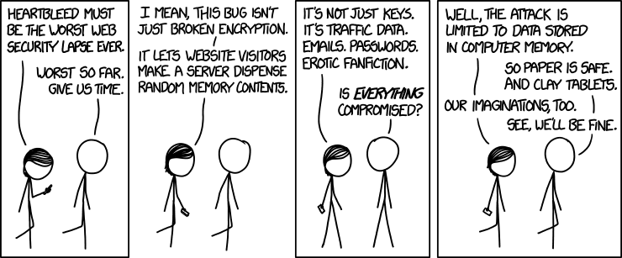
Memory & Caches I
CSE 351 Winter 2020
Instructor:
Ruth Anderson
Teaching Assistants:
Jonathan Chen
Justin Johnson
Porter Jones
Josie Lee
Jeffery Tian
Callum Walker
Eddy (Tianyi) Zhou
Alt text: I looked at some of the data dumps from vulnerable sites, and it was ... bad. I saw emails, passwords, password hints. SSL keys and session cookies. Important servers brimming with visitor IPs. Attack ships on fire off the shoulder of Orion, c-beams glittering in the dark near the Tannhäuser Gate. I should probably patch OpenSSL.
http://xkcd.com/1353/

Slide 2
Administrivia
hw14 due Wednesday (2/19)
Video to watch! Due Wed 2/19
  Goal: shift lecture schedule slightly to give you more time for Lab5 (an extra weekend!)
  1-2 videos will be posted to stand in for lecture we are missing on Monday – watch before lecture on Wed 2/19
Lab 3 due next Monday (2/24)
Midterm grades coming soon
  Solutions posted on website soon
  Graded exam will be found on Gradescope
  Regrade requests will be open for a short time after grade release

Slide 3



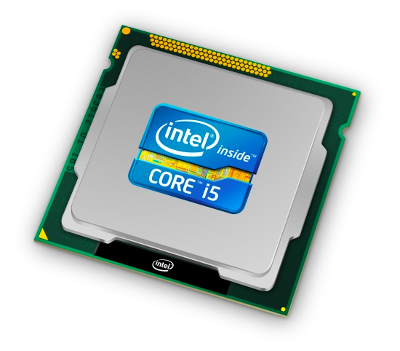
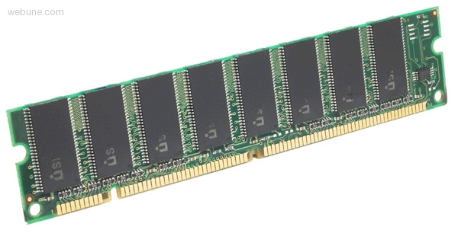
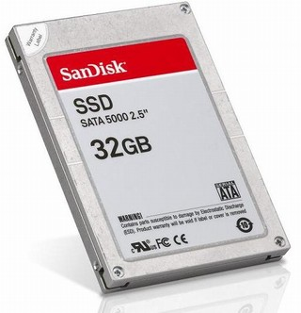
Roadmap
C:
Java:
Memory & data
Integers & floats
x86 assembly
Procedures & stacks
Executables
Arrays & structs
Memory & caches
Processes
Virtual memory
Memory allocation
Java vs. C
car *c = malloc(sizeof(car));
c->miles = 100;
c->gals = 17;
float mpg = get_mpg(c);
free(c);
Car c = new Car();
c.setMiles(100);
c.setGals(17);
float mpg =
c.getMPG();
Assembly language:
get_mpg:
pushq %rbp
movq %rsp, %rbp
...
popq %rbp
ret
OS:
Machine code:
0111010000011000
100011010000010000000010
1000100111000010
110000011111101000011111
Computer system:

Slide 4
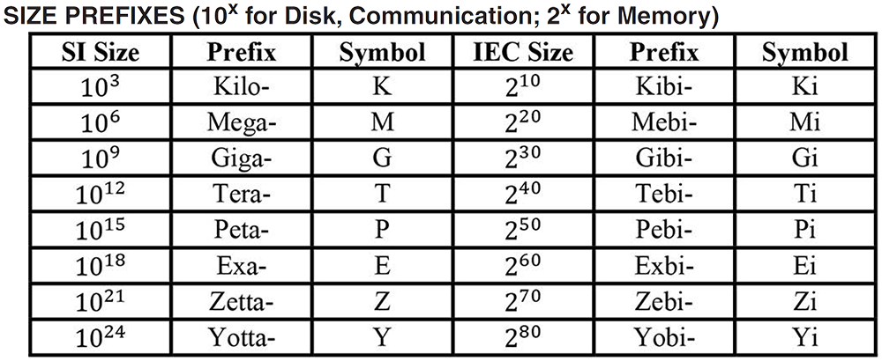
Aside: Units and Prefixes
Here focusing on large numbers (exponents > 0)
Note that 10³ ≈ 2¹⁰
SI prefixes are ambiguous if base 10 or 2
IEC prefixes are unambiguously base 2
Notes:
Disk capacity SI to IEC conversion

Slide 5
How to Remember?
Will be given to you on Final reference sheet
Mnemonics
  There unfortunately isn’t one well-accepted mnemonic
    But that shouldn’t stop you from trying to come with one!
  Killer Mechanical Giraffe Teaches Pet, Extinct Zebra to Yodel
  Kirby Missed Ganondorf Terribly, Potentially Exterminating Zelda and Yoshi
  xkcd: Karl Marx Gave The Proletariat Eleven Zeppelins, Yo
    https://xkcd.com/992/
  Post your best on Piazza!

Slide 6
How does execution time grow with SIZE?
int array[SIZE];
int sum = 0;
for (int i = 0; i < 200000; i++) {
for (int j = 0; j < SIZE; j++) {
sum += array[j];
}
}
Plot:
Execution Time
SIZE

Slide 7
Actual Data
Time
SIZE
Notes:
Knee in the curve
After some size threshold
Memory “wall”
Steeper slope = execution time grows faster
Fits in cache, doesn’t fit in cache

Slide 8
Making memory accesses fast!
Cache basics
Principle of locality
Memory hierarchies
Cache organization
Program optimizations that consider caches

Slide 9
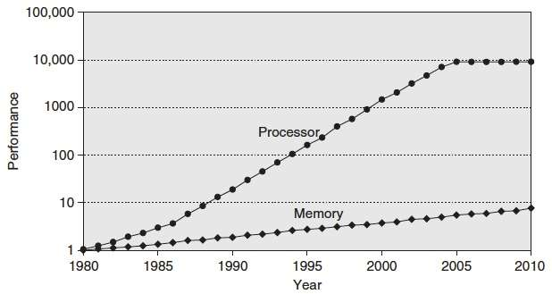
Processor-Memory Gap
“Moore’s Law”
µProc
55%/year
(2X/1.5yr)
Processor-Memory
Performance Gap
(grows 50%/year)
DRAM
7%/year
(2X/10yrs)
1989 first Intel CPU with cache on chip
1998 Pentium III has two cache levels on chip

Slide 10
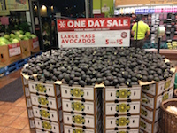
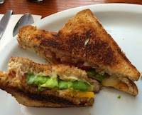
Problem: Processor-Memory Bottleneck
Processor performance
doubled about
every 18 months
Bus latency / bandwidth
evolved much slower
Main Memory
CPU
Reg
Core 2 Duo:
Can process at least
256 Bytes/cycle
Core 2 Duo:
Bandwidth
2 Bytes/cycle
Latency
100-200 cycles (30-60ns)
Problem: lots of waiting on memory
cycle: single machine step (fixed-time)
Notes:
What is a cycle
Only 2 hard problems in computer science: cache invalidation, naming things, and off-by-one errors.
Okay, so if one bite takes ~5-10 seconds
Going to memory: 15-30 minutes: going to grocery store

Slide 11

Problem: Processor-Memory Bottleneck
Processor performance
doubled about
every 18 months
Bus latency / bandwidth
evolved much slower
Main Memory
CPU
Reg
Cache
Core 2 Duo:
Can process at least
256 Bytes/cycle
Core 2 Duo:
Bandwidth
2 Bytes/cycle
Latency
100-200 cycles (30-60ns)
Solution: caches
cycle: single machine step (fixed-time)
Notes:
Have your avocados and eat them too

Slide 12
Cache 💰
Pronunciation: “cash”
  We abbreviate this as “$”
English: A hidden storage space
for provisions, weapons, and/or treasures
Computer: Memory with short access time used for the storage of frequently or recently used instructions (i-cache/I$) or data (d-cache/D$)
  More generally: Used to optimize data transfers between any system elements with different characteristics (network interface cache, I/O cache, etc.)

Slide 13
General Cache Mechanics
Smaller, faster, more expensive memory
Caches a subset of the blocks
Cache
7
9
14
3
Data is copied in block-sized transfer units
Memory
0
1
2
3
Larger, slower, cheaper memory.
Viewed as partitioned into “blocks”
4
5
6
7
8
9
10
11
12
13
14
15
Notes:
Note: these are not bytes: blocks

Slide 14
General Cache Concepts: Hit
Request: 14
Data in block b is needed
Block b is in cache:
Hit!
Cache
7
9
14
3
14
Data is returned to CPU
Memory
0
1
2
3
4
5
6
7
8
9
10
11
12
13
14
15

Slide 15
General Cache Concepts: Miss
Request: 12
Data in block b is needed
Block b is not in cache:
Miss!
Cache
7
9
14
3
12
Block b is fetched from
memory
12
Request: 12
Block b is stored in cache
Placement policy:
determines where b goes
Replacement policy:
determines which block
gets evicted (victim)
Memory
0
1
2
3
4
5
6
7
8
9
10
11
12
12
13
14
15
Data is returned to CPU

Slide 16
Why Caches Work
Locality: Programs tend to use data and instructions with addresses near or equal to those they have used recently

Slide 17
Why Caches Work
Locality: Programs tend to use data and instructions with addresses near or equal to those they have used recently
Temporal locality:
  Recently referenced items are likely
  to be referenced again in the near future
block
Notes:
Analogy: took a bite of sandwich, probably going to take another soon

Slide 18
Why Caches Work
Locality: Programs tend to use data and instructions with addresses near or equal to those they have used recently
Temporal locality:
  Recently referenced items are likely
  to be referenced again in the near future
Spatial locality:
  Items with nearby addresses tend
  to be referenced close together in time
How do caches take advantage of this?
block
block
Notes:
Analogy: took a bite of sandwich, probably going to take a bite out of other half of sandwich (as opposed to a new sandwich)

Slide 19
Example: Any Locality?
sum = 0;
for (i = 0; i < n; i++) {
sum += a[i];
}
return sum;
Data:
  Temporal: sum referenced in each iteration
  Spatial: consecutive elements of array a[] accessed
Instructions:
  Temporal: cycle through loop repeatedly
  Spatial: reference instructions in sequence

Slide 20
Locality Example #1
int sum_array_rows(int a[M][N])
{
int i, j, sum = 0;
for (i = 0; i < M; i++)
for (j = 0; j < N; j++)
sum += a[i][j];
return sum;
}

Slide 21
Locality Example #1
int sum_array_rows(int a[M][N])
{
int i, j, sum = 0;
for (i = 0; i < M; i++)
for (j = 0; j < N; j++)
sum += a[i][j];
return sum;
}
M = 3, N=4
a[0][0] |  | a[0][1] |  | a[0][2] |  | a[0][3]
a[1][0] |  | a[1][1] |  | a[1][2] |  | a[1][3]
a[2][0] |  | a[2][1] |  | a[2][2] |  | a[2][3]
Access Pattern:
stride = ?
1) | a[0][0]
2) | a[0][1]
3) | a[0][2]
4) | a[0][3]
5) | a[1][0]
6) | a[1][1]
7) | a[1][2]
8) | a[1][3]
9) | a[2][0]
10) | a[2][1]
11) | a[2][2]
12) | a[2][3]
Layout in Memory
a [0] [0] | a [0] [1] | a [0] [2] | a [0] [3] | a [1] [0] | a [1] [1] | a [1] [2] | a [1] [3] | a [2] [0] | a [2] [1] | a [2] [2] | a [2] [3]
76
92
108
Note: 76 is just one possible starting address of array a

Slide 22
Locality Example #2
int sum_array_cols(int a[M][N])
{
int i, j, sum = 0;
for (j = 0; j < N; j++)
for (i = 0; i < M; i++)
sum += a[i][j];
return sum;
}

Slide 23
Locality Example #2
int sum_array_cols(int a[M][N])
{
int i, j, sum = 0;
for (j = 0; j < N; j++)
for (i = 0; i < M; i++)
sum += a[i][j];
return sum;
}
M = 3, N=4
a[0][0] |  | a[0][1] |  | a[0][2] |  | a[0][3]
a[1][0] |  | a[1][1] |  | a[1][2] |  | a[1][3]
a[2][0] |  | a[2][1] |  | a[2][2] |  | a[2][3]
Access Pattern:
stride = ?
1) | a[0][0]
2) | a[1][0]
3) | a[2][0]
4) | a[0][1]
5) | a[1][1]
6) | a[2][1]
7) | a[0][2]
8) | a[1][2]
9) | a[2][2]
10) | a[0][3]
11) | a[1][3]
12) | a[2][3]
Layout in Memory
a [0] [0] | a [0] [1] | a [0] [2] | a [0] [3] | a [1] [0] | a [1] [1] | a [1] [2] | a [1] [3] | a [2] [0] | a [2] [1] | a [2] [2] | a [2] [3]
76
92
108

Slide 24
Locality Example #3
int sum_array_3D(int a[M][N][L])
{
int i, j, k, sum = 0;
for (i = 0; i < N; i++)
for (j = 0; j < L; j++)
for (k = 0; k < M; k++)
sum += a[k][i][j];
return sum;
}
What is wrong with this code?
How can it be fixed?
a[2][0][0] |  | a[2][0][1] |  | a[2][0][2] |  | a[2][0][3]
a[2][1][0] |  | a[2][1][1] |  | a[2][1][2] |  | a[2][1][3]
a[2][2][0] |  | a[2][2][1] |  | a[2][2][2] |  | a[2][2][3]
a[1][0][0] |  | a[1][0][1] |  | a[1][0][2] |  | a[1][0][3]
a[1][1][0] |  | a[1][1][1] |  | a[1][1][2] |  | a[1][1][3]
a[1][2][0] |  | a[1][2][1] |  | a[1][2][2] |  | a[1][2][3]
a[0][0][0] |  | a[0][0][1] |  | a[0][0][2] |  | a[0][0][3]
a[0][1][0] |  | a[0][1][1] |  | a[0][1][2] |  | a[0][1][3]
a[0][2][0] |  | a[0][2][1] |  | a[0][2][2] |  | a[0][2][3]
m = 2
m = 1
m = 0

Slide 25

Locality Example #3
int sum_array_3D(int a[M][N][L])
{
int i, j, k, sum = 0;
for (i = 0; i < N; i++)
for (j = 0; j < L; j++)
for (k = 0; k < M; k++)
sum += a[k][i][j];
return sum;
}
What is wrong with this code?
How can it be fixed?
Layout in Memory (M = ?, N = 3, L = 4)
a [0] [0] [0] | a [0] [0] [1] | a [0] [0] [2] | a [0] [0] [3] | a [0] [1] [0] | a [0] [1] [1] | a [0] [1] [2] | a [0] [1] [3] | a [0] [2] [0] | a [0] [2] [1] | a [0] [2] [2] | a [0] [2] [3]
a [1] [0] [0] | a [1] [0] [1] | a [1] [0] [2] | a [1] [0] [3] | a [1] [1] [0] | a [1] [1] [1] | a [1] [1] [2] | a [1] [1] [3] | a [1] [2] [0] | a [1] [2] [1] | a [1] [2] [2] | a [1] [2] [3]
$$⋅ ⋅ ⋅$$
76
92
108
124
140
156
172
Notes:
HIDE until I fix this slide.

Slide 26
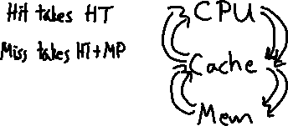
Cache Performance Metrics
Huge difference between a cache hit and a cache miss
  Could be 100x speed difference between accessing cache and main memory (measured in clock cycles)
Miss Rate (MR)
  Fraction of memory references not found in cache (misses / accesses) = 1 - Hit Rate
Hit Time (HT)
  Time to deliver a block in the cache to the processor
    Includes time to determine whether the block is in the cache
Miss Penalty (MP)
  Additional time required because of a miss

Slide 27
Cache Performance
Two things hurt the performance of a cache:
  Miss rate and miss penalty
  Average Memory Access Time (AMAT): average time to access memory considering both hits and misses
  AMAT = Hit time + Miss rate × Miss penalty
  (abbreviated AMAT = HT + MR × MP)
99% hit rate twice as good as 97% hit rate!
  Assume HT of 1 clock cycle and MP of 100 clock cycles
  97%: AMAT =
  99%: AMAT =

Slide 28
Polling Question
Processor specs: 200 ps clock, MP of 50 clock cycles, MR of 0.02 misses/instruction, and HT of 1 clock cycle
  AMAT =
Which improvement would be best?
  Vote at http://PollEv.com/rea
  190 ps clock
  Miss penalty of 40 clock cycles
  MR of 0.015 misses/instruction

Slide 29
Can we have more than one cache?
Why would we want to do that?
  Avoid going to memory!
Typical performance numbers:
  Miss Rate
    L1 MR = 3-10%
    L2 MR = Quite small (e.g. < 1%), depending on parameters, etc.
  Hit Time
    L1 HT = 4 clock cycles
    L2 HT = 10 clock cycles
  Miss Penalty
    P = 50-200 cycles for missing in L2 & going to main memory
    Trend: increasing!

Slide 30
Summary
Memory Hierarchy
  Successively higher levels contain “most used” data from lower levels
  Exploits temporal and spatial locality
  Caches are intermediate storage levels used to optimize data transfers between any system elements with different characteristics
Cache Performance
  Ideal case: found in cache (hit)
  Bad case: not found in cache (miss), search in next level
  Average Memory Access Time (AMAT) = HT + MR × MP
    Hurt by Miss Rate and Miss Penalty

Slide 31
Notes Diagrams
Temporal Locality:
data accessed
Spatial Locality:
blocks in cache

Slide 32
Handout: Any Locality?
sum = 0;
for (i = 0; i < n; i++) {
sum += a[i];
}
return sum;
Data:
  Temporal:
  Spatial:
Instructions:
  Temporal:
  Spatial:

