Slide 1
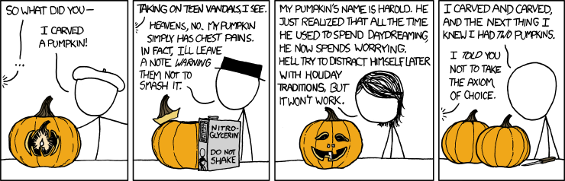
Buffer Overflows CSE 351 Winter 2020
Instructor: Teaching Assistants:
Ruth Anderson Jonathan Chen Justin Johnson Porter Jones
Josie Lee Jeffery Tian Callum Walker
Eddy (Tianyi) Zhou
http://xkcd.com/804/

Slide 2
Administrivia
Mid-quarter survey due Thursday (2/13)
hw13 due Friday (2/14)
Lab 3 released after class, due next Monday (2/24)
You will have everything you need by the end of this lecture
Section Tomorrow:
Bring laptop and lab3 downloaded and untar-ed already
Midterm grades coming soon
Solutions posted on website soon
Graded exam will be found on Gradescope
Regrade requests will be open for a short time after grade release

Slide 3
Buffer Overflows
Address space layout (more details!)
Input buffers on the stack
Overflowing buffers and injecting code
Defenses against buffer overflows

Slide 4
Review: General Memory Layout
not drawn to scale
2^{N}-1
Stack
Stack
Local variables (procedure context)
Heap
Dynamically allocated as needed
malloc(), calloc(), new, …
Statically allocated Data
Read/write: global variables (Static Data)
Read-only: string literals (Literals)
Code/Instructions
Executable machine instructions
Read-only
Heap
Static Data
Literals
Instructions
0

Slide 5
x86-64 Linux Memory Layout
This is extra (non-testable) material
0x00007FFFFFFFFFFF
Stack
Stack
Runtime stack has 8 MiB limit
Heap
Dynamically allocated as needed
malloc(), calloc(), new, …
Statically allocated data (Data)
Read-only: string literals
Read/write: global arrays and variables
Code / Shared Libraries
Executable machine instructions
Read-only
Heap
Shared
Libraries
Heap
Data
Hex Address
0x400000
Instructions
0x000000

Slide 6
Memory Allocation Example
not drawn to scale
char big_array[1L<<24]; /* 16 MB */
char huge_array[1L<<31]; /* 2 GB */
int global = 0;
int useless() { return 0; }
int main()
{
void *p1, *p2, *p3, *p4;
int local = 0;
p1 = malloc(1L << 28); /* 256 MB */
p2 = malloc(1L << 8); /* 256 B */
p3 = malloc(1L << 32); /* 4 GB */
p4 = malloc(1L << 8); /* 256 B */
/* Some print statements ... */
}
Stack
Heap
Shared
Libraries
Heap
Data
Instructions
Where does everything go?
Notes:
big_array, huge_array, global: data
int local,

Slide 7
Memory Allocation Example
not drawn to scale
char big_array[1L<<24]; /* 16 MB */
char huge_array[1L<<31]; /* 2 GB */
int global = 0;
int useless() { return 0; }
int main()
{
void *p1, *p2, *p3, *p4;
int local = 0;
p1 = malloc(1L << 28); /* 256 MB */
p2 = malloc(1L << 8); /* 256 B */
p3 = malloc(1L << 32); /* 4 GB */
p4 = malloc(1L << 8); /* 256 B */
/* Some print statements ... */
}
Stack
Heap
Shared
Libraries
Heap
Data
Instructions
Where does everything go?
Notes:
big_array, huge_array, global: data
int local,

Slide 8

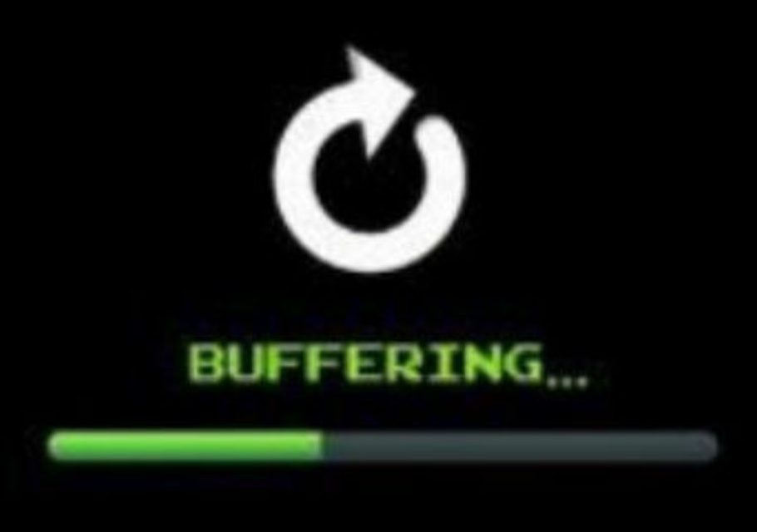
What Is a Buffer?
A buffer is an array used to temporarily store data
You’ve probably seen “video buffering…”
The video is being written into a buffer before being played
Buffers can also store user input

Slide 9
Reminder: x86-64/Linux Stack Frame
Higher Addresses
Caller’s Stack Frame
Arguments (if > 6 args) for this call
Current/ Callee Stack Frame
Return address
Pushed by call instruction
Old frame pointer (optional)
Caller-saved pushed before setting up arguments for a function call
Callee-saved pushed before using long-term registers
Local variables (if can’t be kept in registers)
“Argument build” area (Need to call a function with >6 arguments? Put them here)
Caller
Frame
Arguments
7, 8, …
Frame pointer %rbp
Return Addr
Old %rbp
(Optional)
Saved
Registers
+
Local
Variables
Argument
Build
(Optional)
Stack pointer
%rsp
Lower Addresses

Slide 10
Buffer Overflow in a Nutshell
C does not check array bounds
Many Unix/Linux/C functions don’t check argument sizes
Allows overflowing (writing past the end) of buffers (arrays)
“Buffer Overflow” = Writing past the end of an array
Characteristics of the traditional Linux memory layout provide opportunities for malicious programs
Stack grows “backwards” in memory
Data and instructions both stored in the same memory
Notes:
http://en.wikipedia.org/wiki/Morris_worm

Slide 11
Buffer Overflow in a Nutshell
Higher Addresses
00
00
Stack grows down towards lower addresses
Buffer grows up towards higher addresses
If we write past the end of the array, we overwrite data on the stack!
00
Return
Address
00
00
40
dd
bf
buf[7]
'\0'
'o'
'l'
'l'
Enter input: hello
'e'
buf[0]
'h'
No overflow ☺
Lower Addresses

Slide 12
Buffer Overflow in a Nutshell
Higher Addresses
00
00
Stack grows down towards lower addresses
Buffer grows up towards higher addresses
If we write past the end of the array, we overwrite data on the stack!
00
Return
Address
00
00
40
dd
bf
buf[7]
Enter input: helloabcdef
buf[0]
Lower Addresses

Slide 13
Buffer Overflow in a Nutshell
Higher Addresses
00
00
Stack grows down towards lower addresses
Buffer grows up towards higher addresses
If we write past the end of the array, we overwrite data on the stack!
00
Return
Address
00
'\0'
'f'
'e'
'd'
buf[7]
'c'
'b'
'a'
'o'
'l'
'l'
Enter input: helloabcdef
'e'
buf[0]
'h'
Buffer overflow! ☹
Lower Addresses

Slide 14
Buffer Overflow in a Nutshell
Buffer overflows on the stack can overwrite “interesting” data
Attackers just choose the right inputs
Simplest form (sometimes called “stack smashing”)
Unchecked length on string input into bounded array causes overwriting of stack data
Try to change the return address of the current procedure
Why is this a big deal?
It was the #1 technical cause of security vulnerabilities
#1 overall cause is social engineering / user ignorance

Slide 15
String Library Code
Implementation of Unix function gets()
What could go wrong in this code?
/* Get string from stdin */
char* gets(char* dest) { int c = getchar();
char* p = dest;
while (c != EOF && c != '\n') {
*p++ = c;
c = getchar();
}
*p = '\0';
return dest;
}
pointer to start
of an array
same as:
*p = c;
p++;

Slide 16
String Library Code
Implementation of Unix function gets()
No way to specify limit on number of characters to read
Similar problems with other Unix functions:
strcpy: Copies string of arbitrary length to a dst
scanf, fscanf, sscanf, when given %s specifier
/* Get string from stdin */
char* gets(char* dest) { int c = getchar();
char* p = dest;
while (c != EOF && c != '\n') {
*p++ = c;
c = getchar();
}
*p = '\0';
return dest;
}
Notes:
The man page for gets(3) now says “BUGS: Never use gets().”

Slide 17
Vulnerable Buffer Code
/* Echo Line */ void echo() { char buf[8]; /* Way too small! */ gets(buf); puts(buf); }
void call_echo() {
echo();
}
unix> ./buf-nsp
Enter string: 123456789012345
123456789012345
unix> ./buf-nsp
Enter string: 1234567890123456
Illegal instruction
unix> ./buf-nsp
Enter string: 12345678901234567
Segmentation Fault
Notes:
If we overrun the buffer, it’s fine for a while...
But then we add one more character, and it seg-faults!
Why? (let’s see...)

Slide 18
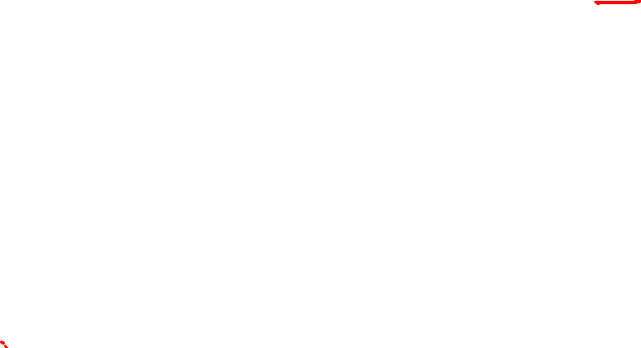
Buffer Overflow Disassembly (buf-nsp)
echo:
0000000000400597 <echo>:
400597: 48 83 ec 18 sub $0x18,%rsp
... ... calls printf ...
4005aa: 48 8d 7c 24 08 lea 0x8(%rsp),%rdi
4005af: e8 d6 fe ff ff callq 400480 <gets@plt>
4005b4: 48 89 7c 24 08 lea 0x8(%rsp),%rdi
4005b9: e8 b2 fe ff ff callq 4004a0 <puts@plt>
4005be: 48 83 c4 18 add $0x18,%rsp
4005c2: c3 retq
call_echo:
00000000004005c3 <call_echo>:
4005c3: 48 83 ec 08 sub $0x8,%rsp
4005c7: b8 00 00 00 00 mov $0x0,%eax
4005cc: e8 c6 ff ff ff callq 400597 <echo>
4005d1: 48 83 c4 08 add $0x8,%rsp
4005d5: c3 retq
return address
Notes:
@plt means grab from “procedure linkage table” (specific to dynamic linking and loading)

Slide 19
Buffer Overflow Stack
Before call to gets
Stack frame for call_echo
Return address (8 bytes)
8 bytes unused
[7] | [6] | [5] | [4]
[3] | [2] | [1] | [0]
8 bytes unused
/* Echo Line */ void echo() { char buf[8]; /* Way too small! */ gets(buf); puts(buf); }
echo:
subq $24, %rsp
...
leaq 8(%rsp), %rdi
call gets
...
buf
⟵%rsp
Note: addresses increasing right-to-left, bottom-to-top
Notes:
(sorry) addresses go right-to-left, bottom-to-top

Slide 20
Buffer Overflow Example
Before call to gets
Stack frame for call_echo
00 | 00 | 00 | 00
00 | 40 | 05 | d1
8 bytes unused
[7] | [6] | [5] | [4]
[3] | [2] | [1] | [0]
8 bytes unused
void echo() { char buf[8];
gets(buf); . . . }
echo:
subq $24, %rsp
...
leaq 8(%rsp), %rdi
call gets
...
call_echo:
. . .
4005cc: callq 400597 <echo>
4005d1: add $0x8,%rsp
. . .
buf
⟵%rsp
Notes:
Little-endian

Slide 21
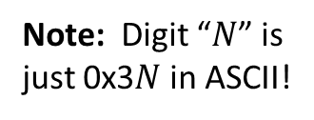
Buffer Overflow Example #1
After call to gets
Stack frame for call_echo
00 | 00 | 00 | 00
00 | 40 | 05 | d1
00 | 35 | 34 | 33
32 | 31 | 30 | 39
38 | 37 | 36 | 35
34 | 33 | 32 | 31
8 bytes unused
void echo() { char buf[8];
gets(buf); . . . }
echo:
subq $24, %rsp
...
leaq 8(%rsp), %rdi
call gets
...
call_echo:
. . .
4005cc: callq 400597 <echo>
4005d1: add $0x8,%rsp
. . .
buf
⟵%rsp
unix> ./buf-nsp
Enter string: 123456789012345
123456789012345
Note: Digit “$N$” is
just 0x3$N$ in ASCII!
Overflowed buffer, but did not corrupt state
Notes:
Null-terminated string

Slide 22
Buffer Overflow Example #2
After call to gets
Stack frame for call_echo
00 | 00 | 00 | 00
00 | 40 | 05 | 00
36 | 35 | 34 | 33
32 | 31 | 30 | 39
38 | 37 | 36 | 35
34 | 33 | 32 | 31
8 bytes unused
void echo() { char buf[8];
gets(buf); . . . }
echo:
subq $24, %rsp
...
leaq 8(%rsp), %rdi
call gets
...
call_echo:
. . .
4005cc: callq 400597 <echo>
4005d1: add $0x8,%rsp
. . .
buf
⟵%rsp
unix> ./buf-nsp
Enter string: 1234567890123456
Illegal instruction
Overflowed buffer and corrupted return pointer

Slide 23
Buffer Overflow Example #2 Explained
After return from echo
Stack frame for call_echo
00 | 00 | 00 | 00
00 | 40 | 05 | 00
36 | 35 | 34 | 33
32 | 31 | 30 | 39
38 | 37 | 36 | 35
34 | 33 | 32 | 31
8 bytes unused
00000000004004f0 <deregister_tm_clones>:
4004f0: push %rbp
4004f1: mov $0x601040,%eax
4004f6: cmp $0x601040,%rax
4004fc: mov %rsp,%rbp
4004ff: je 400518
400501: mov $0x0,%eax
400506: test %rax,%rax
400509: je 400518
40050b: pop %rbp
40050c: mov $0x601040,%edi
400511: jmpq *%rax
400513: nopl 0x0(%rax,%rax,1)
400518: pop %rbp
400519: retq
⟵%rsp
buf
“Returns” to a byte that is not the beginning of an instruction,
so program signals SIGILL, Illegal instruction
Notes:
deregister_tm_clones deals with transactional memory, which is intended to make programming with threads simpler (parallelism and synchronization – waaaaaay beyond the scope of this course).

Slide 24
Malicious Use of Buffer Overflow: Code Injection Attacks
Stack after call to gets()
High Addresses
void foo(){
bar();
A:...
}
foo stack frame
return address A
A B
A (return addr)
pad
int bar() {
char buf[64];
gets(buf);
...
return ...;
}
data written
by gets()
bar stack frame
exploit code
buf starts here
B
Low Addresses
Input string contains byte representation of executable code
Overwrite return address A with address of buffer B
When bar() executes ret, will jump to exploit code

Slide 25
Peer Instruction Question
smash_me is vulnerable to stack smashing!
What is the minimum number of characters that gets must read in order for us to change the return address to a stack address?
For example: (0x00 00 7f ff CA FE F0 0D)
Previous stack frame
00 | 00 | 00 | 00
00 | 40 | 05 | d1
. . .
 |  |  | [0]
27
30
51
54
We’re lost…
smash_me:
subq $0x40, %rsp
...
leaq 16(%rsp), %rdi
call gets
...

Slide 26
Exploits Based on Buffer Overflows
Buffer overflow bugs can allow attackers to
execute arbitrary code on victim machines
Distressingly common in real programs
Programmers keep making the same mistakes ☹
Recent measures make these attacks much more difficult
Examples across the decades
Original “Internet worm” (1988)
Heartbleed (2014, affected 17% of servers)
Similar issue in Cloudbleed (2017)
Hacking embedded devices
Cars, Smart homes, Planes
Notes:
https://www.gao.gov/assets/700/694913.pdf

Slide 27
Example: the original Internet worm (1988)
Exploited a few vulnerabilities to spread
Early versions of the finger server (fingerd) used gets() to read the argument sent by the client:
finger droh@cs.cmu.edu
Worm attacked fingerd server with phony argument:
finger "exploit-code padding new-return-addr"
Exploit code: executed a root shell on the victim machine with a direct connection to the attacker
Scanned for other machines to attack
Invaded ~6000 computers in hours (10% of the Internet)
see June 1989 article in Comm. of the ACM
The author of the worm (Robert Morris*) was prosecuted…
Notes:
Robert Morris is now a professor at MIT
He was the first person convicted under the ‘86 Computer Fraud and Abuse Act
He was fined $10k plus 400 hours of community service
TCP: transmission control protocol

Slide 28
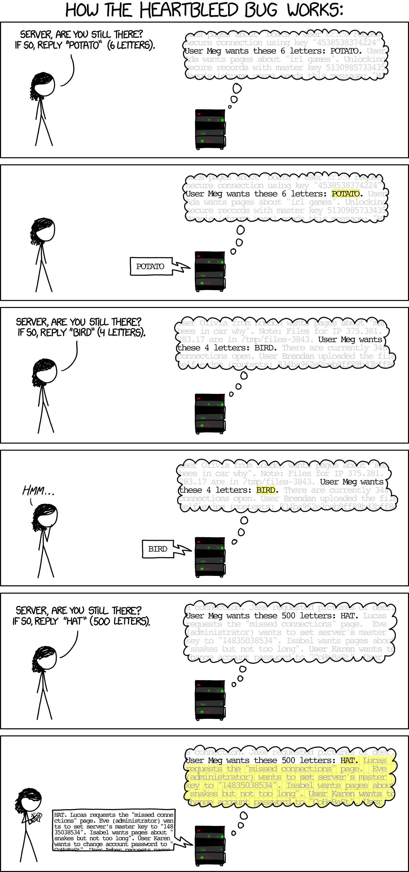
Example: Heartbleed

Slide 29
Example: Heartbleed

Slide 30
Example: Heartbleed

Slide 31
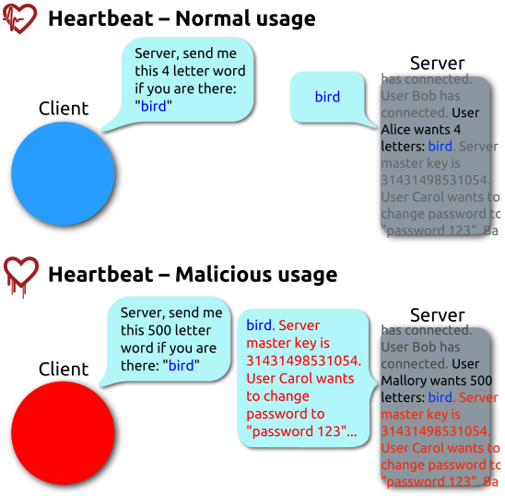
Heartbleed (2014)
Buffer over-read in OpenSSL
Open source security library
Bug in a small range of versions
“Heartbeat” packet
Specifies length of message
Server echoes it back
Library just “trusted” this length
Allowed attackers to read contents of memory anywhere they wanted
Est. 17% of Internet affected
“Catastrophic”
Github, Yahoo, Stack Overflow, Amazon AWS, ...
By FenixFeather - Own work, CC BY-SA 3.0, https://commons.wikimedia.org/w/index.php?curid=32276981

Slide 32
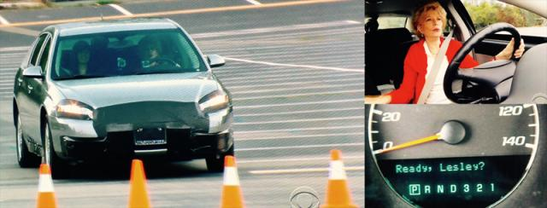
Hacking Cars
UW CSE research from 2010 demonstrated wirelessly hacking a car using buffer overflow
Overwrote the onboard control system’s code
Disable brakes
Unlock doors
Turn engine on/off

Slide 33
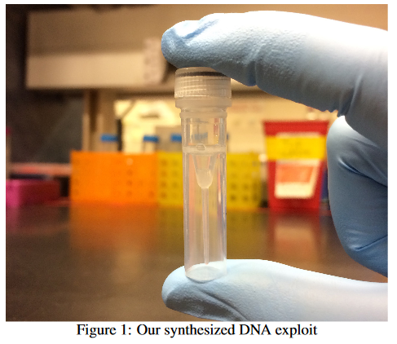


Hacking DNA Sequencing Tech
Potential for malicious code to be encoded in DNA!
Attacker can gain control of DNA sequencing machine when malicious DNA is read
Ney et al. (2017)
https://dnasec.cs.washington.edu/

Slide 34
Dealing with buffer overflow attacks
Employ system-level protections
Avoid overflow vulnerabilities
Have compiler use “stack canaries”

Slide 35
1) System-Level Protections
Non-executable code segments
In traditional x86, can mark region of memory as either “read-only” or “writeable”
Can execute anything readable
x86-64 added explicit “execute” permission
Stack marked as non-executable
Do NOT execute code in Stack, Static Data, or Heap regions
Hardware support needed
Stack after call
to gets()
foo
stack
frame
B
pad
data written
by gets()
bar
stack
frame
exploit
code
B
Any attempt to execute this code will fail
Notes:
ARM also added this in 2009

Slide 36
1) System-Level Protections
Non-executable code segments
Wait, doesn’t this fix everything?
Works well, but can’t always use it
Many embedded devices do not have this protection
Cars
Smart homes
Pacemakers
Some exploits still work!
Return-oriented programming
Return to libc attack
JIT-spray attack
Stack after call
to gets()
foo
stack
frame
B
pad
data written
by gets()
bar
stack
frame
exploit
code
B
Any attempt to execute this code will fail

Slide 37
1) System-Level Protections
High Addresses
Randomized stack offsets
At start of program, allocate random amount of space on stack
Shifts stack addresses for entire program
Addresses will vary from one run to another
Makes it difficult for hacker to predict beginning of inserted code
Example: Code from Slide 6 executed 5 times; address of variable local =
0x7ffd19d3f8ac
0x7ffe8a462c2c
0x7ffe927c905c
0x7ffefd5c27dc
0x7fffa0175afc
Stack repositioned each time program executes
Random
allocation
main’s stack frame
Other functions’ stack frames
B?
pad
exploit
code
B?
Low Addresses

Slide 38
2) Avoid Overflow Vulnerabilities in Code
/* Echo Line */ void echo() { char buf[8]; /* Way too small! */ fgets(buf, 8, stdin); puts(buf); }
Use library routines that limit string lengths
fgets instead of gets (2nd argument to fgets sets limit)
strncpy instead of strcpy
Don’t use scanf with %s conversion specification
Use fgets to read the string
Or use %ns where n is a suitable integer

Slide 39
2) Avoid Overflow Vulnerabilities in Code
Alternatively, don’t use C - use a language that does array index bounds check
Buffer overflow is impossible in Java
ArrayIndexOutOfBoundsException
Rust language was designed with security in mind
Panics on index out of bounds, plus more protections

Slide 40

3) Stack Canaries
Basic Idea: place special value (“canary”) on stack just beyond buffer
Secret value that is randomized before main()
Placed between buffer and return address
Check for corruption before exiting function
GCC implementation
-fstack-protector
unix>./buf
Enter string: 12345678
12345678
unix> ./buf
Enter string: 123456789
*** stack smashing detected ***
Notes:
Name is derived from “canary in the coal mine”

Slide 41
Protected Buffer Disassembly (buf)
This is extra (non-testable) material
echo:
400607: sub $0x18,%rsp
40060b: mov %fs:0x28,%rax
400614: mov %rax,0x8(%rsp)
400619: xor %eax,%eax
... ... call printf ...
400625: mov %rsp,%rdi
400628: callq 400510 <gets@plt>
40062d: mov %rsp,%rdi
400630: callq 4004d0 <puts@plt>
400635: mov 0x8(%rsp),%rax
40063a: xor %fs:0x28,%rax
400643: jne 40064a <echo+0x43>
400645: add $0x18,%rsp
400649: retq
40064a: callq 4004f0 <__stack_chk_fail@plt>

Slide 42
Setting Up Canary
This is extra (non-testable) material
Before call to gets
Stack frame for call_echo
Return address (8 bytes)
Canary (8 bytes)
[7] | [6] | [5] | [4]
[3] | [2] | [1] | [0]
/* Echo Line */ void echo() { char buf[8]; /* Way too small! */ gets(buf); puts(buf); }
Segment register (don’t worry about it)
echo:
. . .
movq %fs:40, %rax # Get canary
movq %rax, 8(%rsp) # Place on stack
xorl %eax, %eax # Erase canary
. . .
buf
⟵%rsp

Slide 43
Checking Canary
This is extra (non-testable) material
After call to gets
Stack frame for call_echo
Return address (8 bytes)
Canary (8 bytes)
00 | 37 | 36 | 35
34 | 33 | 32 | 31
/* Echo Line */ void echo() { char buf[8]; /* Way too small! */ gets(buf); puts(buf); }
echo:
. . .
movq 8(%rsp), %rax # retrieve from Stack
xorq %fs:40, %rax # compare to canary
jne .L4 # if not same, FAIL
. . .
.L4: call __stack_chk_fail
buf
⟵%rsp
Input: 1234567

Slide 44
Summary of Prevention Measures
Employ system-level protections
Code on the Stack is not executable
Randomized Stack offsets
Avoid overflow vulnerabilities
Use library routines that limit string lengths
Use a language that makes them impossible
Have compiler use “stack canaries”

Slide 45
Think this is cool?
You’ll love Lab 3 😉
Check out the buffer overflow simulator!
Take CSE 484 (Security)
Several different kinds of buffer overflow exploits
Many ways to counter them
Nintendo fun!
Using glitches to rewrite code: https://www.youtube.com/watch?v=TqK‐2jUQBUY
Flappy Bird in Mario: https://www.youtube.com/watch?v=hB6eY73sLV

Slide 46
Extra Notes about %rbp
This is extra (non-testable) material
%rbp is used to store the frame pointer
Name comes from “base pointer”
You can refer to a variable on the stack as %rbp+offset
The base of the frame will never change, so each variable can be uniquely referred to with its offset
The top of the stack (%rsp) may change, so referring to a variable as %rsp-offset is less reliable
For example, if you need save a variable for a function call, pushing it onto the stack changes %rsp

Slide 47
Where Is It?
Variable/Label | Section of Memory
big_array
global
huge_array
local
main
p1
*p1
useless

Slide 48
Notes Diagrams
Higher Addresses
Higher Addresses
∙ ∙ ∙
∙ ∙ ∙
Caller’s
Stack
Frame
Caller’s
Stack
Frame
Return Addr
3) array addr
Return Addr
Old %rbp
Old %rbp
2) padding
Saved Registers
+
Local Variables
Saved Registers
+
Local Variables
1) exploit
code
start of local array
stack
smashing
start of local array
%rsp
%rsp
Lower Addresses
Lower Addresses

