Slide 1

Structs & Alignment CSE 351 Winter 2020
Instructor:
Ruth Anderson
Teaching Assistants:
Jonathan Chen
Justin Johnson
Porter Jones
Josie Lee
Jeffery Tian
Callum Walker
Eddy (Tianyi) Zhou
http://xkcd.com/163/

Slide 2
Administrivia
Lab 2 due tonight (2/07)
Lab 3 coming soon!
Midterm Monday (2/10), during lecture
Mid-quarter survey due Thursday (2/13)
hw13 due next Friday (2/14)

Slide 3

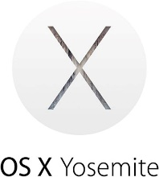

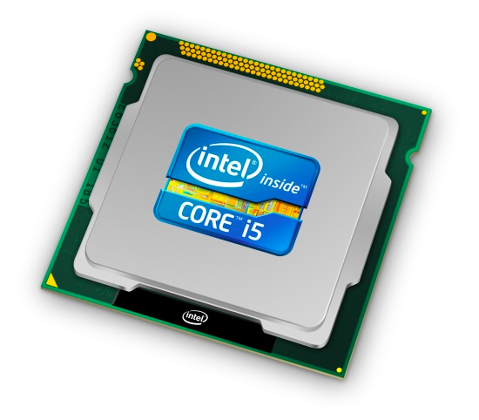
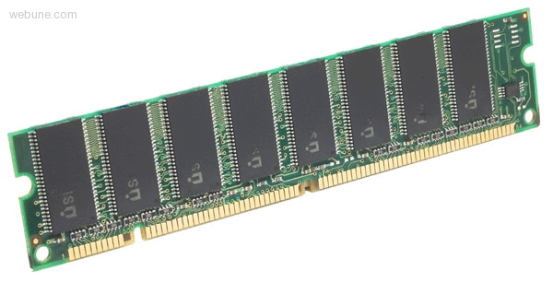

Roadmap
C:
Java:
Memory & data
Integers & floats
x86 assembly
Procedures & stacks
Executables
Arrays & structs
Memory & caches
Processes
Virtual memory
Memory allocation
Java vs. C
car *c = malloc(sizeof(car));
c->miles = 100;
c->gals = 17;
float mpg = get_mpg(c);
free(c);
Car c = new Car();
c.setMiles(100);
c.setGals(17);
float mpg = c.getMPG();
Assembly language:
get_mpg:
pushq %rbp
movq %rsp, %rbp
...
popq %rbp
ret
OS:
Machine code:
0111010000011000
100011010000010000000010
1000100111000010
110000011111101000011111
Computer system:

Slide 4
Polling Question
Which of the following statements is FALSE?
Vote at http://pollev.com/rea
sea[4][-2] is a valid array reference
sea[1][1] makes two memory accesses
sea[2][1] will always be a higher address than sea[1][2]
sea[2] is calculated using only lea
We’re lost…
9
8
1
9
5
9
8
1
0
5
9
8
1
0
3
9
8
1
1
5
int sea[4][5];
76
96
116
136
156

Slide 5
Data Structures in Assembly
Arrays
One-dimensional
Multi-dimensional (nested)
Multi-level
Structs
Alignment
Unions

Slide 6
Structs in C
A structured group of variables, possibly including other structs
Way of defining compound data types
struct song {
char *title;
int lengthInSeconds;
int yearReleased;
};
struct song song1;
song1.title = "Señorita";
song1.lengthInSeconds = 191;
song1.yearReleased = 2019;
struct song song2;
song2.title = "Call Me Maybe";
song2.lengthInSeconds = 193;
song2.yearReleased = 2011;
struct song {
char *title;
int lengthInSeconds;
int yearReleased;
};
song1
title: "Señorita"
lengthInSeconds: 191
yearReleased: 2019
song2
title: "Call Me Maybe"
lengthInSeconds: 193
yearReleased: 2011

Slide 7
Struct Definitions
Structure definition:
Does NOT declare a variable
Variable type is “struct name”
Variable declarations like any other data type:
Can also combine struct and instance definitions:
This syntax can be difficult to read, though
struct name {
/* fields */
};
Easy to forget semicolon!
struct name name1, *pn, name_ar[3];
instance
pointer
array
struct name {
/* fields */
} st, *p = &st;

Slide 8
Typedef in C
A way to create an alias for another data type: typedef <data type> <alias>;
After typedef, the alias can be used interchangeably with the original data type
e.g. typedef unsigned long int uli;
Joint struct definition and typedef
Don’t need to give struct a name in this case
struct nm {
/* fields */
};
typedef struct nm name;
name n1;
typedef struct {
/* fields */
} name;
name n1;

Slide 9
Scope of Struct Definition
Why is the placement of struct definition important?
What actually happens when you declare a variable?
Creating space for it somewhere!
Without definition, program doesn’t know how much space
Almost always define structs in global scope near the top of your C file
Struct definitions follow normal rules of scope
struct data {
int ar[4];
long d;
};
Size = _____ bytes
struct rec {
int a[4];
long i;
struct rec* next;
};
Size = _____ bytes

Slide 10
Accessing Structure Members
Given a struct instance, access member using the . operator:
struct rec r1; r1.i = val;
Given a pointer to a struct:
struct rec *r;
r = &r1; // or malloc space for r to point to
We have two options:
Use * and . operators: (*r).i = val;
Use -> operator for short: r->i = val;
In assembly: register holds address of the first byte
Access members with offsets
struct rec {
int a[4];
long i;
struct rec *next;
};
Notes:
How does a “.” access get translated into assembly? It looks exactly like a pointer access: an offset is added to the beginning of the struct to reach the appropriate member, then the access is performed. When a “.” access is performed, no “pointer” (i.e. no address kept in some register) is needed: the struct’s location on the current function’s stack frame (or in the args section of the caller’s stack frame) is always known, so the offsets can always be calculated relative to %rsp.

Slide 11
Java side-note
class Record { ... }
Record x = new Record();
An instance of a class is like a pointer to a struct containing the fields
(Ignoring methods and subclassing for now)
So Java’s x.f is like C’s x->f or (*x).f
In Java, almost everything is a pointer (“reference”) to an object
Cannot declare variables or fields that are structs or arrays
Always a pointer to a struct or array
So every Java variable or field is ≤ 8 bytes (but can point to lots of data)

Slide 12
Structure Representation
struct rec {
int a[4];
long i;
struct rec *next;
} st, *r = &st;
r
a
i
next
0
16
24
32
Characteristics
Contiguously-allocated region of memory
Refer to members within structure by names
Fields may be of different types

Slide 13
Structure Representation
struct rec {
int a[4];
long i;
struct rec *next;
} st, *r = &st;
r
a
i
next
0
16
24
32
Structure represented as block of memory
Big enough to hold all of the fields
Fields ordered according to declaration order
Even if another ordering would be more compact
Compiler determines overall size + positions of fields
Machine-level program has no understanding of the structures in the source code

Slide 14
Accessing a Structure Member
struct rec {
int a[4];
long i;
struct rec *next;
} st, *r = &st;
r
r->i
a
i
next
0
16
24
32
Compiler knows the offset of each member within a struct
Compute as *(r+offset)
Referring to absolute offset, so no pointer arithmetic
long get_i(struct rec *r)
{
return r->i;
}
# r in %rdi, index in %rsi
movq 16(%rdi), %rax
ret

Slide 15
Exercise: Pointer to Structure Member
struct rec {
int a[4];
long i;
struct rec *next;
} st, *r = &st;
r
a
i
next
0
16
24
32
long* addr_of_i(struct rec *r)
{
return &(r->i);
}
# r in %rdi
__ ,%rax
ret
struct rec** addr_of_next(struct rec *r)
{
return &(r->next);
}
# r in %rdi
__ ,%rax
ret

Slide 16
Generating Pointer to Array Element
struct rec {
int a[4];
long i;
struct rec *next;
} st, *r = &st;
r
r+4*index
a
i
next
0
16
24
32
Generating Pointer to Array Element
Offset of each structure member determined at compile time
Compute as: r+4*index
int* find_addr_of_array_elem
(struct rec *r, long index)
{
return &r->a[index];
}
&(r->a[index])
# r in %rdi, index in %rsi
leaq (%rdi,%rsi,4), %rax
ret
Notes:
Note the order of operation: & applies to the entire expression
Also: 2 instances of “syntactic sugar”

Slide 17

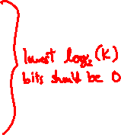
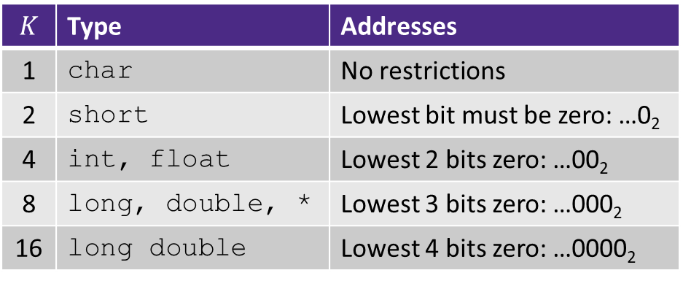

Review: Memory Alignment in x86-64
Aligned means that any primitive object of $K$ bytes must have an address that is a multiple of $K$
Aligned addresses for data types:
$$K$$ | Type | Addresses
1 | char | No restrictions
2 | short | Lowest bit must be zero: …0₂
4 | int, float | Lowest 2 bits zero: …00₂
8 | long, double, * | Lowest 3 bits zero: …000₂
16 | long double | Lowest 4 bits zero: …0000₂
Notes:
Can relate to withinBlock() function from Lab 1

Slide 18
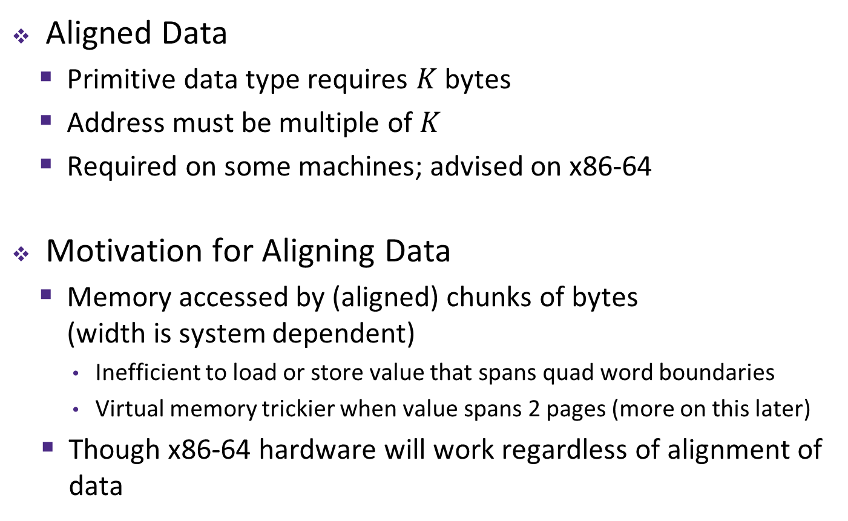
Alignment Principles
Aligned Data
Primitive data type requires $K$ bytes
Address must be multiple of $K$
Required on some machines; advised on x86-64
Motivation for Aligning Data
Memory accessed by (aligned) chunks of bytes (width is system dependent)
Inefficient to load or store value that spans quad word boundaries
Virtual memory trickier when value spans 2 pages (more on this later)
Though x86-64 hardware will work regardless of alignment of data
Notes:
Analogy?

Slide 19
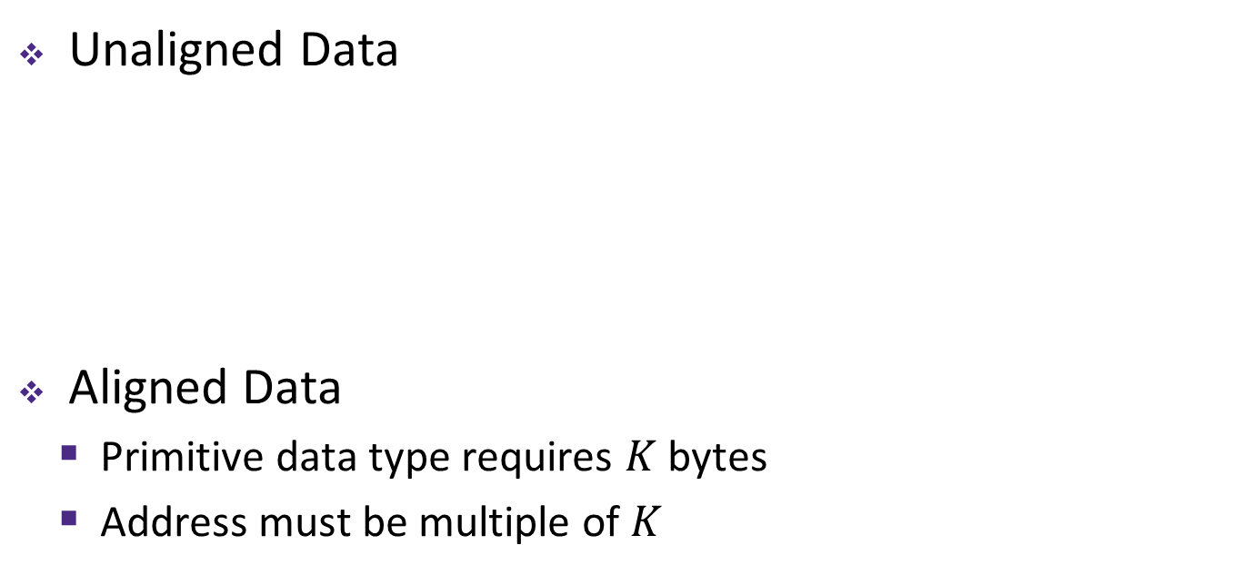
Structures & Alignment
Unaligned Data
Aligned Data
Primitive data type requires $K$ bytes
Address must be multiple of $K$
struct S1 {
char c;
int i[2];
double v;
} st, *p = &st;
c
i[0]
i[1]
v
p
p+1
p+5
p+9
p+17
c
3 bytes
i[0]
i[1]
4 bytes
v
p+0
p+4
p+8
p+16
p+24
Multiple of 4
Multiple of 8
Multiple of 8
internal fragmentation
Multiple of 8
Notes:
struct S1 { … } *p; - this defines a new type “struct S1”, and creates a variable p with type “struct S1 *”
#include <stddef.h>// for offsetof
printf("sizeof p = %d\n", (int) sizeof(p));
printf("offset of v in p = %d\n", (int) offsetof(struct S1, v));

Slide 20
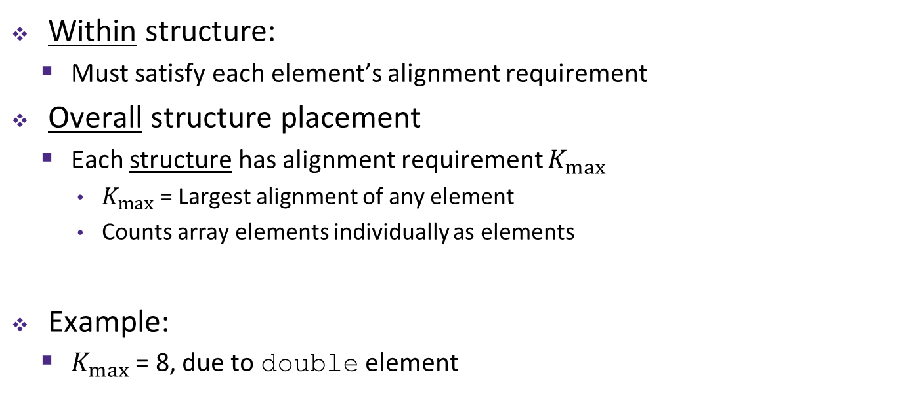
Satisfying Alignment with Structures (1)
Within structure:
Must satisfy each element’s alignment requirement
Overall structure placement
Each structure has alignment requirement $K_{max}$
$K_{max}$ = Largest alignment of any element
Counts array elements individually as elements
Example:
$K_{max}$ = 8, due to double element
struct S1 {
char c;
int i[2];
double v;
} st, *p = &st;
c
3 bytes
i[0]
i[1]
4 bytes
v
p+0
p+4
p+8
p+16
p+24
Multiple of 4
Multiple of 8
Multiple of 8
internal fragmentation

Slide 21
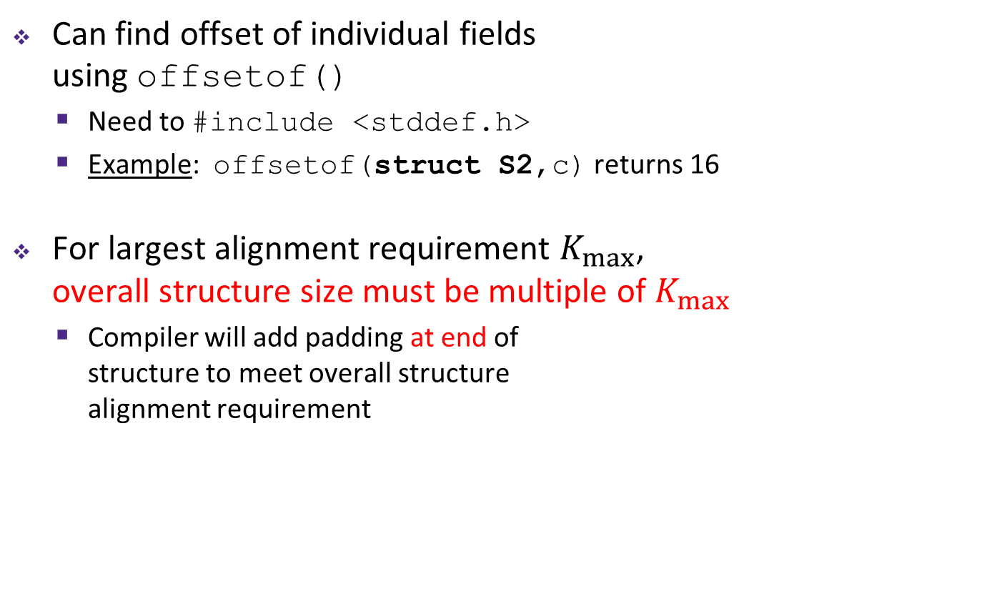
Satisfying Alignment with Structures (2)
Can find offset of individual fields using offsetof()
Need to #include <stddef.h>
Example: offsetof(struct S2,c) returns 16
For largest alignment requirement $K_{max}$, overall structure size must be multiple of $K_{max}$
Compiler will add padding at end of structure to meet overall structure alignment requirement
struct S2 {
double v;
int i[2];
char c;
} st, *p = &st;
 | v |  |  |  |  |  |  | i[0] |  |  |  | i[1] |  |  |  | c | 7 bytes
p+0 |  |  |  |  |  |  | p+8 |  |  |  |  |  |  |  | p+16 |  |  |  |  |  |  |  | p+24
Multiple of 8
external fragmentation
Multiple of 8

Slide 22

Arrays of Structures
Overall structure length multiple of $K_{max}$
Satisfy alignment requirement for every element in array
struct S2 {
double v;
int i[2];
char c;
} a[10];
 | a[0] |  |  |  |  | a[1] |  |  |  |  | a[2] |  |  |  |  | • • •
a+0 |  |  |  |  | a+24 |  |  |  |  | a+48 |  |  |  |  | a+72
 | v |  |  |  |  |  |  | i[0] |  |  |  | i[1] |  |  |  | c | 7 bytes
a+24 |  |  |  |  |  |  | a+32 |  |  |  |  |  |  |  | a+40 |  |  |  |  |  |  |  | a+48
external fragmentation
Notes:
struct S2 { … } a[10]; - declares a new type “struct S2”, then declares an array a that contains 10 “struct S2” elements

Slide 23
Alignment of Structs
Compiler will do the following:
Maintains declared ordering of fields in struct
Each field must be aligned within the struct (may insert padding)
offsetof can be used to get actual field offset
Overall struct must be aligned according to largest field
Total struct size must be multiple of its alignment (may insert padding)
sizeof should be used to get true size of structs

Slide 24
How the Programmer Can Save Space
Compiler must respect order elements are declared in
Sometimes the programmer can save space by declaring large data types first
struct S4 {
char c;
int i;
char d;
} st;
struct S5 {
int i;
char c;
char d;
} st;
c
3 bytes
i
d
3 bytes
i
c
d
2 bytes
12 bytes
8 bytes

Slide 25
Polling Question
Vote on sizeof(struct old):
http://pollev.com/rea
Minimize the size of the struct by re-ordering the vars
What are the old and new sizes of the struct?
sizeof(struct old) = _____ sizeof(struct new) = _____
16 bytes
22 bytes
28 bytes
32 bytes
We’re lost…
struct old {
int i;
short s[3];
char *c;
float f;
};
struct new {
int i;
______ ______;
______ ______;
______ ______;
};

Slide 26
Summary
Arrays in C
Aligned to satisfy every element’s alignment requirement
Structures
Allocate bytes for fields in order declared by programmer
Pad in middle to satisfy individual element alignment requirements
Pad at end to satisfy overall struct alignment requirement

Slide 27
Data Structures in Assembly
This is extra (non-testable) material
Arrays
One-dimensional
Multi-dimensional (nested)
Multi-level
Structs
Alignment
Unions

Slide 28
Unions
This is extra (non-testable) material
Only allocates enough space for the largest element in union
Can only use one member at a time
struct S {
char c;
int i[2];
double v;
} s, *sp = &s;
union U {
char c;
int i[2];
double v;
} u, *up = &u;
 | c
 | i[0] |  |  |  | i[1]
 | v
up+0 |  |  | up+4 |  |  |  |  | up+8
 | c | 3 bytes |  |  | i[0] |  |  |  | i[1] |  |  |  | 4 bytes |  |  | v
sp+0 |  |  |  | sp+4 |  |  |  | sp+8 |  |  |  |  |  |  | sp+16 |  |  |  |  |  | sp+24

Slide 29
Accessing Array Elements
Compute start of array element as: 12*index
sizeof(S3) = 12, including alignment padding
Element j is at offset 8 within structure
Assembler gives offset a+8
struct S3 {
short i;
float v;
short j;
} a[10];
 | a[0] |  |  |  |  | • • • |  |  |  | a[index] |  |  |  | • • |  |  | •
a+0 |  |  |  |  | a+12 |  |  |  | a+12*index
 |  |  |  |  | i | 2 bytes |  | v |  |  | j | 2 bytes
 |  |  |  | a+12*index
a+12*index+8
short get_j(int index)
{
return a[index].j;
}
# %rdi = index
leaq (%rdi,%rdi,2),%rax # 3*index
movzwl a+8(,%rax,4),%eax

Slide 30
Roadmap
C:
Java:
Memory & data
Integers & floats
x86 assembly
Procedures & stacks
Executables
Arrays & structs
Memory & caches
Processes
Virtual memory
Memory allocation
Java vs. C
car *c = malloc(sizeof(car));
c->miles = 100;
c->gals = 17;
float mpg = get_mpg(c);
free(c);
Car c = new Car();
c.setMiles(100);
c.setGals(17);
float mpg = c.getMPG();
Assembly language:
get_mpg:
pushq %rbp
movq %rsp, %rbp
...
popq %rbp
ret
OS:
Machine code:
0111010000011000
100011010000010000000010
1000100111000010
110000011111101000011111
Computer system:

Slide 31
Assembly Programmer’s View
CPU
Memory
Addresses
%rip
%rax
%r8
Stack
%rbx
%r9
Data
%rcx
%r10
CF
ZF
%rdx
%r11
%rsi
%r12
Instructions
%rdi
%r13
Dynamic Data (Heap)
SF
OF
%rsp
%r14
%rbp
%r15
Programmer-visible state
PC: the Program Counter (%rip in x86-64)
Address of next instruction
Named registers
Together in “register file”
Heavily used program data
Condition codes
Store status information about most recent arithmetic operation
Used for conditional branching
Static Data
Literals
Instructions
Memory
Byte-addressable array
Code and user data
Includes the Stack (for supporting procedures)

Slide 32
x86-64 Instructions
Data movement
mov, movs, movz, ...
Arithmetic
add, sub, shl, sar, lea, ...
Control flow
cmp, test, j*, set*, ...
Stack/procedures
push, pop, call, ret, ...

Slide 33
Turning C into Object Code
Code in files p1.c p2.c
Compile with command: gcc -Og p1.c p2.c -o p
Use basic optimizations (-Og)
Put resulting machine code in file p
text
C program (p1.c p2.c)
Compiler (gcc –Og -S)
text
Asm program (p1.s p2.s)
Assembler (gcc -c or as)
binary
Object program (p1.o p2.o)
Static libraries (.a)
Linker (gcc or ld)
binary
Executable program (p)
Notes:
gcc –S flag: “Compile only; do not assemble or link”
au is the portable GNU assembler
ld is the GNU linker

Slide 34
Assembling
Executable has addresses
gcc -g pcount.c –o pcount
objdump –d pcount
00000000004004f6 <pcount_r>:
4004f6: b8 00 00 00 00 mov $0x0,%eax
4004fb: 48 85 ff test %rdi,%rdi
4004fe: 74 13 je 400513 <pcount_r+0x1d>
400500: 53 push %rbx
400501: 48 89 fb mov %rdi,%rbx
400504: 48 d1 ef shr %rdi
400507: e8 ea ff ff ff callq 4004f6 <pcount_r>
40050c: 83 e3 01 and $0x1,%ebx
40050f: 48 01 d8 add %rbx,%rax
400512: 5b pop %rbx
400513: f3 c3 rep ret
assembler

Slide 35
A Picture of Memory (64-bit view)
00000000004004f6 <pcount_r>:
4004f6: b8 00 00 00 00 mov $0x0,%eax
4004fb: 48 85 ff test %rdi,%rdi
4004fe: 74 13 je 400513 <pcount_r+0x1d>
400500: 53 push %rbx
400501: 48 89 fb mov %rdi,%rbx
400504: 48 d1 ef shr %rdi
400507: e8 ea ff ff ff callq 4004f6 <pcount_r>
40050c: 83 e3 01 and $0x1,%ebx
40050f: 48 01 d8 add %rbx,%rax
400512: 5b pop %rbx
400513: f3 c3 rep ret
0|8 | 1|9 | 2|a | 3|b | 4|c | 5|d | 6|e | 7|f
 |  |  |  |  |  |  |  | 0x00
 |  |  |  |  |  |  |  | 0x08
 |  |  |  |  |  |  |  | 0x10
... |  |  |  |  |  |  |  | ...
 |  |  |  |  |  | b8 | 00 | 0x4004f0
00 | 00 | 00 | 48 | 85 | ff | 74 | 13 | 0x4004f8
53 | 48 | 89 | fb | 48 | d1 | ef | e8 | 0x400500
ea | ff | ff | ff | 83 | e3 | 01 | 48 | 0x400508
01 | d8 | 5b | f3 | c3 |  |  |  | 0x400510
Notes:
Note that it’s not word-aligned!
But look how compact it is

Slide 36
c
3 bytes
i[0]
i[1]
i[2]
v
s
6 bytes
fp+0
fp+4
fp+16
fp+24
fp+32
multiple of 4
multiple of 8
multiple of 2
fp+26
internal fragmentation
external fragmentation
multiple of 8
multiple of 8

