Slide 1
Executables & Arrays
CSE 351 Winter 2020
Instructor:
Ruth Anderson
Teaching Assistants:
Jonathan Chen
Justin Johnson
Porter Jones
Josie Lee
Jeffery Tian
Callum Walker
Eddy (Tianyi) Zhou
http://xkcd.com/1270/

Slide 2
Administrivia
Lab 2 & hw12 due Friday (2/07)
Midterm Monday (2/10), during lecture
Mid-quarter survey due Thursday (2/13)
hw13 due next Friday (2/14)
  Based on the next two lectures, longer than normal

Slide 3

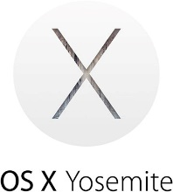

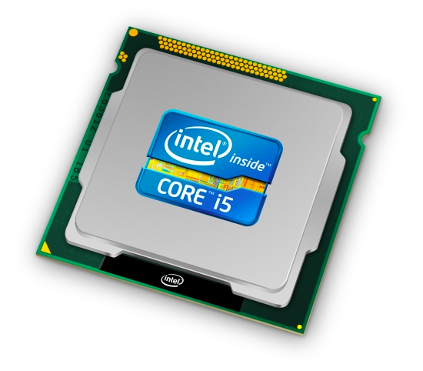
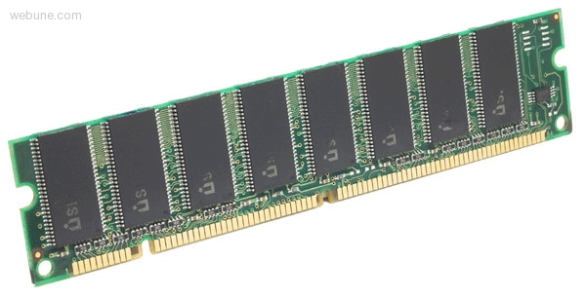
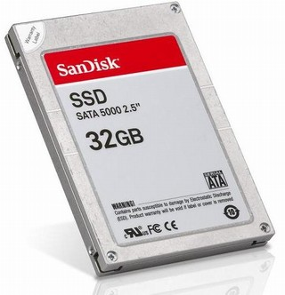
Roadmap
C:
Java:
Memory & data
Integers & floats
x86 assembly
Procedures & stacks
Executables
Arrays & structs
Memory & caches
Processes
Virtual memory
Memory allocation
Java vs. C
car *c = malloc(sizeof(car));
c->miles = 100;
c->gals = 17;
float mpg = get_mpg(c);
free(c);
Car c = new Car();
c.setMiles(100);
c.setGals(17);
float mpg =
c.getMPG();
Assembly language:
get_mpg:
pushq %rbp
movq %rsp, %rbp
...
popq %rbp
ret
OS:
Machine code:
0111010000011000
100011010000010000000010
1000100111000010
110000011111101000011111
Computer system:

Slide 4
Building an Executable from a C File
Code in files p1.c p2.c
Compile with command: gcc -Og p1.c p2.c -o p
  Put resulting machine code in file p
Run with command: ./p
text
C program (p1.c p2.c)
Compiler (gcc –Og -S)
text
Asm program (p1.s p2.s)
Assembler (gcc -c or as)
binary
Object program (p1.o p2.o)
Static libraries (.a)
Linker (gcc or ld)
binary
Executable program (p)
Loader (the OS)

Slide 5
Compiler
Input: Higher-level language code (e.g. C, Java)
  foo.c
Output: Assembly language code (e.g. x86, ARM, MIPS)
  foo.s
First there’s a preprocessor step to handle #directives
  Macro substitution, plus other specialty directives
  If curious/interested: http://tigcc.ticalc.org/doc/cpp.html
Super complex, whole courses devoted to these!
Compiler optimizations
  “Level” of optimization specified by capital ‘O’ flag (e.g. -Og, -O3)
  Options: https://gcc.gnu.org/onlinedocs/gcc/Optimize-Options.html

Slide 6
Compiling Into Assembly
C Code (sum.c)
x86-64 assembly (gcc –Og –S sum.c)
Warning: You may get different results with other versions of gcc and different compiler settings
void sumstore(long x, long y, long *dest) {
long t = x + y;
*dest = t;
}
sumstore(long, long, long*):
addq %rdi, %rsi
movq %rsi, (%rdx)
ret
Notes:
https://godbolt.org/g/5hQk8a

Slide 7
Assembler
Input: Assembly language code (e.g. x86, ARM, MIPS)
  foo.s
Output: Object files (e.g. ELF, COFF)
  foo.o
  Contains object code and information tables
Reads and uses assembly directives
  e.g. .text, .data, .quad
  x86: https://docs.oracle.com/cd/E26502_01/html/E28388/eoiyg.html
Produces “machine language”
  Does its best, but object file is not a completed binary
Example: gcc -c foo.s
Notes:
ELF = executable and linkable format
COFF = common object file format

Slide 8
Producing Machine Language
Simple cases: arithmetic and logical operations, shifts, etc.
  All necessary information is contained in the instruction itself
What about the following?
  Conditional jump
  Accessing static data (e.g. global var or jump table)
  call
Addresses and labels are problematic because the final executable hasn’t been constructed yet!
  So how do we deal with these in the meantime?

Slide 9
Object File Information Tables
Symbol Table holds list of “items” that may be used by other files
  Non-local labels – function names for call
  Static Data – variables & literals that might be accessed across files
Relocation Table holds list of “items” that this file needs the address of later (currently undetermined)
  Any label or piece of static data referenced in an instruction in this file
    Both internal and external
Each file has its own symbol and relocation tables

Slide 10
Object File Format
object file header: size and position of the other pieces of the object file
text segment: the machine code
data segment: data in the source file (binary)
relocation table: identifies lines of code that need to be “handled”
symbol table: list of this file’s labels and data that can be referenced
debugging information
More info: ELF format
  http://www.skyfree.org/linux/references/ELF_Format.pdf

Slide 11
Linker
Input: Object files (e.g. ELF, COFF)
  foo.o
Output: executable binary program
  a.out
Combines several object files into a single executable (linking)
Enables separate compilation/assembling of files
  Changes to one file do not require recompiling of whole program

Slide 12
Linking
Take text segment from each .o file and put them together
Take data segment from each .o file, put them together, and concatenate this onto end of text segments
Resolve References
  Go through Relocation Table; handle each entry
object file 1
info 1
a.out
data 1
Relocated data 1
text 1
Linker
Relocated data 2
object file 2
Relocated text 1
info 2
Relocated text 2
data 2
text 2

Slide 13
Disassembling Object Code
Disassembled:
Disassembler (objdump -d sum)
  Useful tool for examining object code (man 1 objdump)
  Analyzes bit pattern of series of instructions
  Produces approximate rendition of assembly code
  Can run on either a.out (complete executable) or .o file
0000000000400536 <sumstore>:
400536: 48 01 fe add %rdi,%rsi
400539: 48 89 32 mov %rsi,(%rdx)
40053c: c3 retq

Slide 14
What Can be Disassembled?
% objdump -d WINWORD.EXE
WINWORD.EXE: file format pei-i386
No symbols in "WINWORD.EXE".
Disassembly of section .text:
30001000 <.text>:
30001000: 55 push %ebp
30001001: 8b ec mov %esp,%ebp
30001003: 6a ff push $0xffffffff
30001005: 68 90 10 00 30 push $0x30001090
3000100a: 68 91 dc 4c 30 push $0x304cdc91
Reverse engineering forbidden by
Microsoft End User License Agreement
Anything that can be interpreted as executable code
Disassembler examines bytes and attempts to reconstruct assembly source

Slide 15
Loader
Input: executable binary program, command-line arguments
  ./a.out arg1 arg2
Output: <program is run>
Loader duties primarily handled by OS/kernel
  More about this when we learn about processes
Memory sections (Instructions, Static Data, Stack) are set up
Registers are initialized

Slide 16
Roadmap
C:
Java:
Memory & data
Integers & floats
x86 assembly
Procedures & stacks
Executables
Arrays & structs
Memory & caches
Processes
Virtual memory
Memory allocation
Java vs. C
car *c = malloc(sizeof(car));
c->miles = 100;
c->gals = 17;
float mpg = get_mpg(c);
free(c);
Car c = new Car();
c.setMiles(100);
c.setGals(17);
float mpg =
c.getMPG();
Assembly language:
get_mpg:
pushq %rbp
movq %rsp, %rbp
...
popq %rbp
ret
OS:
Machine code:
0111010000011000
100011010000010000000010
1000100111000010
110000011111101000011111
Computer system:

Slide 17
Data Structures in Assembly
Arrays
  One-dimensional
  Multidimensional (nested)
  Multilevel
Structs
  Alignment
Unions

Slide 18

Review: Array Allocation
Basic Principle
  T A[N]; $→$ array of data type T and length N
  Contiguously allocated region of N*sizeof(T) bytes
  Identifier A returns address of array (type T*)
char msg[12];
x
x + 12
int val[5];
x
x + 4
x + 8
x + 12
x + 16
x + 20
double a[3];
x
x + 8
x + 16
x + 24
char* p[3];
(or char *p[3];)
x
x + 8
x + 16
x + 24

Slide 19

Review: Array Access
Basic Principle
  T A[N]; $→$ array of data type T and length N
  Identifier A returns address of array (type T*)
Reference Type Value
int x[5];
3
7
1
9
5
a
a+4
a+8
a+12
a+16
a+20
x[4] | int | 5
x | int* | a
x+1 | int* | a + 4
&x[2] | int* | a + 8
x[5] | int | ?? (whatever’s in memory at addr x+20)
*(x+1) | int | 7
x+i | int* | a + 4*i

Slide 20
Array Example
// arrays of ZIP code digits
int cmu[5] = { 1, 5, 2, 1, 3 };
int uw[5] = { 9, 8, 1, 9, 5 };
int ucb[5] = { 9, 4, 7, 2, 0 };
brace-enclosed
list initialization

Slide 21
Array Example
// arrays of ZIP code digits
int cmu[5] = { 1, 5, 2, 1, 3 };
int uw[5] = { 9, 8, 1, 9, 5 };
int ucb[5] = { 9, 4, 7, 2, 0 };
int cmu[5];
1
5
2
1
3
16
20
24
28
32
36
int uw[5];
9
8
1
9
5
36
40
44
48
52
56
int ucb[5];
9
4
7
2
0
56
60
64
68
72
76
Example arrays happened to be allocated in successive 20 byte blocks
  Not guaranteed to happen in general

Slide 22
Array Accessing Example
int uw[5];
9
8
1
9
5
36
40
44
48
52
56
// return specified digit of ZIP code
int get_digit(int z[5], int digit) {
return z[digit];
}
get_digit:
movl (%rdi,%rsi,4), %eax # z[digit]
Register %rdi contains starting address of array
Register %rsi contains array index
Desired digit at %rdi+4*%rsi, so use memory reference (%rdi,%rsi,4)

Slide 23
Referencing Examples
int cmu[5];
1
5
2
1
3
16
20
24
28
32
36
int uw[5];
9
8
1
9
5
36
40
44
48
52
56
int ucb[5];
9
4
7
2
0
56
60
64
68
72
76
Reference Address Value Guaranteed?
  uw[3]
  uw[6]
  uw[-1]
  cmu[15]
No bounds checking
Example arrays happened to be allocated in successive 20 byte blocks
  Not guaranteed to happen in general

Slide 24
C Details: Arrays and Pointers
Arrays are (almost) identical to pointers
  char *string and char string[] are nearly identical declarations
  Differ in subtle ways: initialization, sizeof(), etc.
An array name is an expression (not a variable) that returns the address of the array
  It looks like a pointer to the first (0th) element
    *ar same as ar[0], *(ar+2) same as ar[2]
  An array name is read-only (no assignment) because it is a label
    Cannot use "ar = <anything>"

Slide 25
C Details: Arrays and Functions
Declared arrays only allocated while the scope is valid:
  char* foo() {
  char string[32]; ...;
  return string;
  }
An array is passed to a function as a pointer:
  Array size gets lost!
int foo(int ar[], unsigned int size) {
... ar[size-1] ...
}
BAD!
Really int *ar
Must explicitly
pass the size!

Slide 26
Data Structures in Assembly
Arrays
  One-dimensional
  Multidimensional (nested)
  Multilevel
Structs
  Alignment
Unions

Slide 27
Nested Array Example
int sea[4][5] =
{{ 9, 8, 1, 9, 5 },
{ 9, 8, 1, 0, 5 },
{ 9, 8, 1, 0, 3 },
{ 9, 8, 1, 1, 5 }};
Remember, T A[N] is an array with elements of type T, with length N
What is the layout in memory?

Slide 28
Nested Array Example
int sea[4][5] =
{{ 9, 8, 1, 9, 5 },
{ 9, 8, 1, 0, 5 },
{ 9, 8, 1, 0, 3 },
{ 9, 8, 1, 1, 5 }};
Remember, T A[N] is an array with elements of type T, with length N
sea[3][2];
Row 0
Row 1
Row 2
Row 3
9
8
1
9
5
9
8
1
0
5
9
8
1
0
3
9
8
1
1
5
76
96
116
136
156
“Row-major” ordering of all elements
Elements in the same row are contiguous
Guaranteed (in C)

Slide 29
Two-Dimensional (Nested) Arrays
Declaration: T A[R][C];
  2D array of data type T
  R rows, C columns
  Each element requires
  sizeof(T) bytes
Array size?
A[0][0]
• • •
A[0][C-1]
•
•
•
•
•
•
A[R-1][0]
• • •
A[R-1][C-1]

Slide 30
Two-Dimensional (Nested) Arrays
Declaration: T A[R][C];
  2D array of data type T
  R rows, C columns
  Each element requires
  sizeof(T) bytes
Array size:
  R*C*sizeof(T) bytes
Arrangement: row-major ordering
A[0][0]
• • •
A[0][C-1]
•
•
•
•
•
•
A[R-1][0]
• • •
A[R-1][C-1]
int A[R][C];
• • •
A
[0]
[0]
A
[0]
[C-1]
• • •
A
[1]
[0]
A
[1]
[C-1]
• • •
• • •
A
[R-1]
[0]
A
[R-1]
[C-1]
4*R*C bytes

Slide 31
Nested Array Row Access
Row vectors
  Given T A[R][C],
    A[i] is an array of C elements (“row i”)
    A is address of array
    Starting address of row i =
A + i*(C * sizeof(T))
int A[R][C];
A[0]
A[i]
A[R-1]
• • •
A
[0]
[0]
A
[0]
[C-1]
• • •
• • •
A
[i]
[0]
A
[i]
[C-1]
• • •
• • •
A
[R-1]
[0]
A
[R-1]
[C-1]
A
A+i*C*4
A+(R-1)*C*4

Slide 32
Nested Array Row Access Code
int* get_sea_zip(int index)
{
return sea[index];
}
int sea[4][5] =
{{ 9, 8, 1, 9, 5 },
{ 9, 8, 1, 0, 5 },
{ 9, 8, 1, 0, 3 },
{ 9, 8, 1, 1, 5 }};
get_sea_zip(int):
movslq %edi, %rdi
leaq (%rdi,%rdi,4), %rax
leaq sea(,%rax,4), %rax
ret
sea:
.long 9
.long 8
.long 1
.long 9
.long 5
.long 9
.long 8
...
Notes:
https://godbolt.org/z/5gYaer (using –O1 compiler flag)
Remember that static (global) variables are in memory, too...

Slide 33
Nested Array Row Access Code
int* get_sea_zip(int index)
{
return sea[index];
}
int sea[4][5] =
{{ 9, 8, 1, 9, 5 },
{ 9, 8, 1, 0, 5 },
{ 9, 8, 1, 0, 3 },
{ 9, 8, 1, 1, 5 }};
What data type is sea[index]?
What is its value?
# %rdi = index
leaq (%rdi,%rdi,4),%rax # 5 * index
leaq sea(,%rax,4),%rax # sea + (20 * index)
Translation?

Slide 34
Nested Array Row Access Code
int* get_sea_zip(int index)
{
return sea[index];
}
int sea[4][5] =
{{ 9, 8, 1, 9, 5 },
{ 9, 8, 1, 0, 5 },
{ 9, 8, 1, 0, 3 },
{ 9, 8, 1, 1, 5 }};
# %rdi = index
leaq (%rdi,%rdi,4),%rax # 5 * index
leaq sea(,%rax,4),%rax # sea + (20 * index)
Row Vector
  sea[index] is array of 5 ints
  Starting address = sea+20*index
Assembly Code
  Computes and returns address
  Compute as: sea+4*(index+4*index)= sea+20*index
Notes:
Returns an address!

Slide 35
Nested Array Element Access
Array Elements
  A[i][j] is element of type T, which requires K bytes
  Address of A[i][j] is
int A[R][C];
A[0]
A[i]
A[R-1]
• • •
A
[0]
[0]
A
[0]
[C-1]
• • •
• • • • • •
A
[i]
[j]
• • •
• • •
A
[R-1]
[0]
A
[R-1]
[C-1]
A
A + i*C*4
A + (R-1)*C*4
?

Slide 36
Nested Array Element Access
Array Elements
  A[i][j] is element of type T, which requires K bytes
  Address of A[i][j] is
  A + i*(C*K) + j*K == A + (i*C + j)*K
int A[R][C];
A[0]
A[i]
A[R-1]
• • •
A
[0]
[0]
A
[0]
[C-1]
• • •
• • • • • •
A
[i]
[j]
• • •
• • •
A
[R-1]
[0]
A
[R-1]
[C-1]
A
A + i*C*4
A + (R-1)*C*4
A + i*C*4 + j*4

Slide 37
Nested Array Element Access Code
int get_sea_digit
(int index, int digit)
{
return sea[index][digit];
}
int sea[4][5] =
{{ 9, 8, 1, 9, 5 },
{ 9, 8, 1, 0, 5 },
{ 9, 8, 1, 0, 3 },
{ 9, 8, 1, 1, 5 }};
leaq (%rdi,%rdi,4), %rax # 5*index
addl %rax, %rsi # 5*index+digit
movl sea(,%rsi,4), %eax # *(sea + 4*(5*index+digit))
Array Elements
  sea[index][digit] is an int (sizeof(int)=4)
  Address = sea + 5*4*index + 4*digit
Assembly Code
  Computes address as: sea + ((index+4*index) + digit)*4
  movl performs memory reference

Slide 38
Multidimensional Referencing Examples
9
8
1
9
5
9
8
1
0
5
9
8
1
0
3
9
8
1
1
5
int sea[4][5];
76
96
116
136
156
Reference Address Value Guaranteed?
  sea[3][3]
  sea[2][5]
  sea[2][-1]
  sea[4][-1]
  sea[0][19]
  sea[0][-1]
  Code does not do any bounds checking
  Ordering of elements within array guaranteed

Slide 39
Data Structures in Assembly
Arrays
  One-dimensional
  Multidimensional (nested)
  Multilevel
Structs
  Alignment
Unions

Slide 40
Multilevel Array Example
Multilevel Array Declaration(s):
int cmu[5] = { 1, 5, 2, 1, 3 };
int uw[5] = { 9, 8, 1, 9, 5 };
int ucb[5] = { 9, 4, 7, 2, 0 };
int* univ[3] = {uw, cmu, ucb};
Is a multilevel array the
same thing as a 2D array?
NO
2D Array Declaration:
int univ2D[3][5] = {
{ 9, 8, 1, 9, 5 },
{ 1, 5, 2, 1, 3 },
{ 9, 4, 7, 2, 0 }
};
One array declaration = one contiguous block of memory

Slide 41
Multilevel Array Example
int cmu[5] = { 1, 5, 2, 1, 3 };
int uw[5] = { 9, 8, 1, 9, 5 };
int ucb[5] = { 9, 4, 7, 2, 0 };
Variable univ denotes array of 3 elements
Each element is a pointer
  8 bytes each
Each pointer points to array of ints
int* univ[3] = {uw, cmu, ucb};
cmu
1
5
2
1
3
univ
16
20
24
28
32
36
160
36
uw
9
8
1
9
5
168
16
ucb
36
40
44
48
52
56
176
60
9
4
7
2
0
60
64
68
72
76
80
Note: this is how Java represents multidimensional arrays

Slide 42
Element Access in Multilevel Array
int get_univ_digit
(int index, int digit)
{
return univ[index][digit];
}
cmu
univ
1
5
2
1
3
160
36
uw
16
20
24
28
32
36
168
16
9
8
1
9
5
176
60
ucb
36
40
44
48
52
56
9
4
7
2
0
60
64
68
72
76
80
salq $2, %rsi # rsi = 4*digit
addq univ(,%rdi,8), %rsi # p = univ[index] + 4*digit
movl (%rsi), %eax # return *p
ret
Computation
  Element access Mem[Mem[univ+8*index]+4*digit]
  Must do two memory reads
    First get pointer to row array
    Then access element within array
  But allows inner arrays to be different lengths (not in this example)

Slide 43
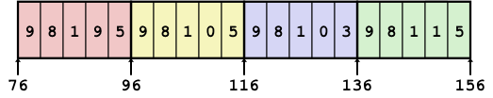
Array Element Accesses
Multidimensional array
Multilevel array
int get_sea_digit
(int index, int digit)
{
return sea[index][digit];
}
int get_univ_digit
(int index, int digit)
{
return univ[index][digit];
}
cmu
univ
1
5
2
1
3
160
36
uw
16
20
24
28
32
36
168
16
9
8
1
9
5
176
60
ucb
36
40
44
48
52
56
9
4
7
2
0
60
64
68
72
76
80
Access looks the same, but it isn’t:
Mem[sea+20*index+4*digit]
Mem[Mem[univ+8*index]+4*digit]

Slide 44
Multilevel Referencing Examples
cmu
1
5
2
1
3
univ
16
20
24
28
32
36
160
36
uw
9
8
1
9
5
168
16
ucb
36
40
44
48
52
56
176
60
9
4
7
2
0
60
64
68
72
76
80
Reference Address Value Guaranteed?
  univ[2][3]
  univ[1][5]
  univ[2][-2]
  univ[3][-1]
  univ[1][12]
  C code does not do any bounds checking
  Location of each lower-level array in memory is not guaranteed

Slide 45
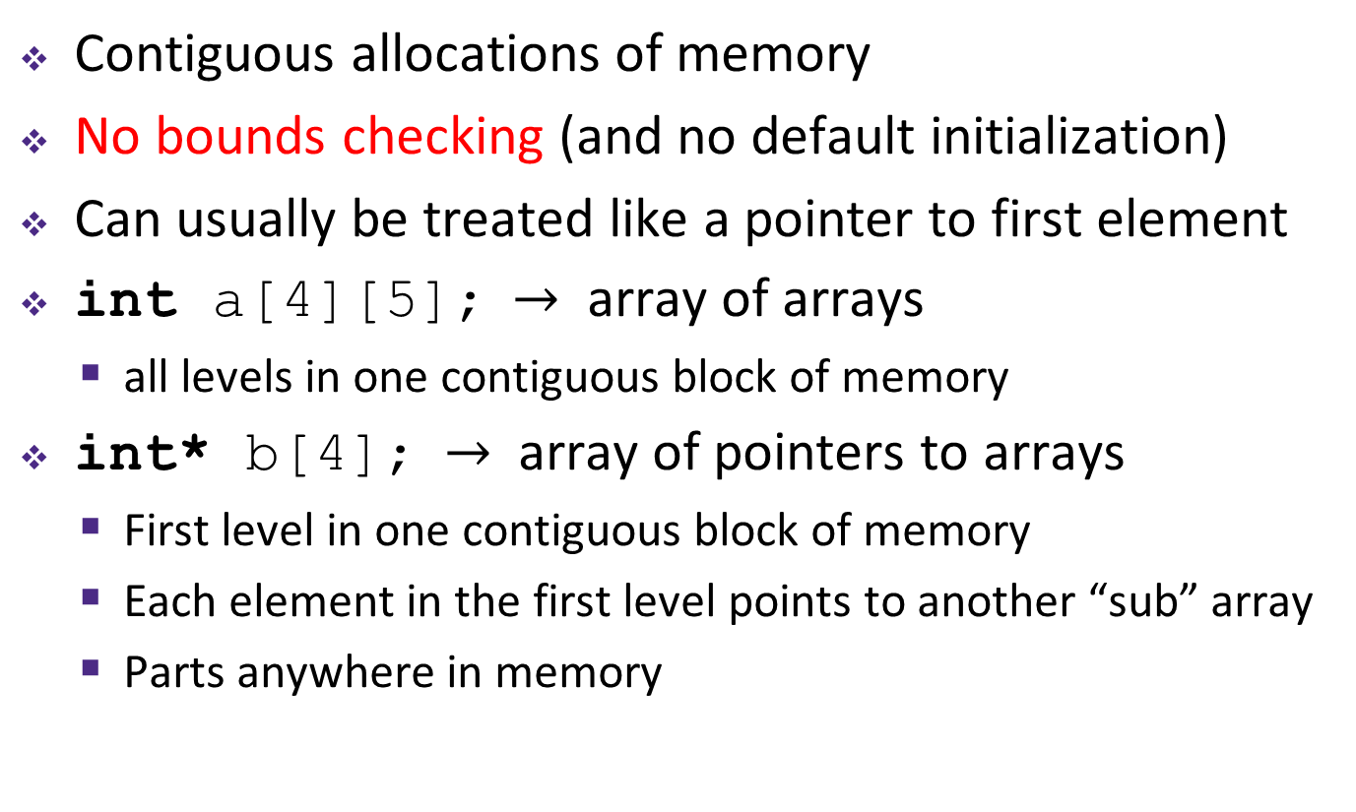
Summary
Contiguous allocations of memory
No bounds checking (and no default initialization)
Can usually be treated like a pointer to first element
int a[4][5]; $→$ array of arrays
  all levels in one contiguous block of memory
int* b[4]; $→$ array of pointers to arrays
  First level in one contiguous block of memory
  Each element in the first level points to another “sub” array
  Parts anywhere in memory

Slide 46
Referencing Examples
int cmu[5];
1
5
2
1
3
16
20
24
28
32
36
int uw[5];
9
8
1
9
5
36
40
44
48
52
56
int ucb[5];
9
4
7
2
0
56
60
64
68
72
76
Reference Address Value Guaranteed?
  uw[3]
  uw[6]
  uw[-1]
  cmu[15]
36 + 4* 3 = 48 9 Yes
36 + 4* 6 = 60 4 No
36 + 4*-1 = 32 3 No
16 + 4*15 = 76 ?? No
No bounds checking
Example arrays happened to be allocated in successive 20 byte blocks
  Not guaranteed to happen in general

Slide 47
Array Loop Example
int zd2int(int z[5])
{
int i;
int zi = 0;
for (i = 0; i < 5; i++) {
zi = 10 * zi + z[i];
}
return zi;
}
zi = 10*0 + 9 = 9
zi = 10*9 + 8 = 98
zi = 10*98 + 1 = 981
zi = 10*981 + 9 = 9819
zi = 10*9819 + 5 = 98195
9
8
1
9
5

Slide 48
Array Loop Example
int uw[5];
9
8
1
9
5
36
40
44
48
52
56
int zd2int(int z[5])
{
int i;
int zi = 0;
for (i = 0; i < 5; i++) {
zi = 10 * zi + z[i];
}
return zi;
}
Original:
Transformed:
  Eliminate loop variable i,
  use pointer zend instead
  Convert array code to
  pointer code
    Pointer arithmetic on z
  Express in do-while form
  (no test at entrance)
int zd2int(int z[5])
{
int zi = 0;
int *zend = z + 5;
do {
zi = 10 * zi + *z;
z++;
} while (z < zend);
return zi;
}
address just past
5th digit
Increments by 4 (size of int)
Notes:
15au: With –Og, gcc will generate different code for each of these. With –O1, the same code.

Slide 49
Array Loop Implementation
gcc with –O1
Registers:
  %rdi z
  %rax zi
  %rcx zend
Computations
int zd2int(int z[5])
{
int zi = 0;
int *zend = z + 5;
do {
zi = 10 * zi + *z;
z++;
} while (z < zend);
return zi;
}
# %rdi = z
leaq 20(%rdi),%rcx #
movl $0,%eax #
.L17:
leal (%rax,%rax,4),%edx #
movl (%rdi),%eax #
leal (%rax,%rdx,2),%eax #
addq $4,%rdi #
cmpq %rdi,%rcx #
jne .L17 #

Slide 50
Array Loop Implementation
gcc with –O1
Registers:
  %rdi z
  %rax zi
  %rcx zend
Computations
  10*zi + *z implemented as: *z + 2*(5*zi)
  z++ increments by 4 (size of int)
int zd2int(int z[5])
{
int zi = 0;
int *zend = z + 5;
do {
zi = 10 * zi + *z;
z++;
} while (z < zend);
return zi;
}
# %rdi = z
leaq 20(%rdi),%rcx # rcx = zend = z+5
movl $0,%eax # rax = zi = 0
.L17:
leal (%rax,%rax,4),%edx # zi + 4*zi = 5*zi
movl (%rdi),%eax # eax = *z
leal (%rax,%rdx,2),%eax # zi = *z + 2*(5*zi)
addq $4,%rdi # z++
cmpq %rdi,%rcx # zend - z
jne .L17 # if != goto loop

Slide 51
Strange Referencing Examples
9
8
1
9
5
9
8
1
0
5
9
8
1
0
3
9
8
1
1
5
int sea[4][5];
76
96
116
136
156
Reference Address Value Guaranteed?
  sea[3][3]
  sea[2][5]
  sea[2][-1]
  sea[4][-1]
  sea[0][19]
  sea[0][-1]
  Code does not do any bounds checking
  Ordering of elements within array guaranteed
  76+20*3+4*3 = 148 1 Yes
  76+20*2+4*5 = 136 9 Yes
  76+20*2+4*-1 = 112 5 Yes
  76+20*4+4*-1 = 152 5 Yes
  76+20*0+4*19 = 152 5 Yes
  76+20*0+4*-1 = 72 ?? No

Slide 52
Strange Referencing Examples
cmu
1
5
2
1
3
univ
16
20
24
28
32
36
160
36
uw
9
8
1
9
5
168
16
ucb
36
40
44
48
52
56
176
60
9
4
7
2
0
60
64
68
72
76
80
Reference Address Value Guaranteed?
  univ[2][3]
  univ[1][5]
  univ[2][-2]
  univ[3][-1]
  univ[1][12]
  C code does not do any bounds checking
  Location of each lower-level array in memory is not guaranteed
  60+4*3 = 72 2 Yes
  16+4*5 = 36 9 No
  60+4*-2 = 52 5 No
  #@%!^?? ?? No
  16+4*12 = 64 4 No

Slide 53
object file 1
info 1
data 1
a.out
text 1
Relocated data 1
executable
data segment
Linker
Relocated data 2
object file 2
Relocated text 1
executable
code segment
info 2
Relocated text 2
data 2
text 2

