Slide 1
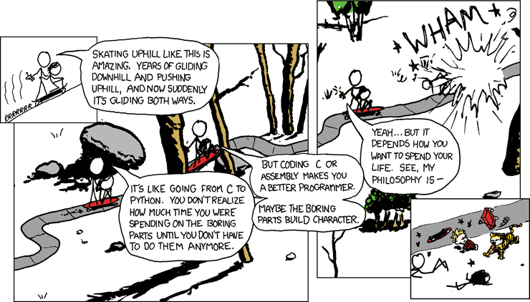
x86-64 Programming II
CSE 351 Winter 2020
Instructor:
Ruth Anderson
Teaching Assistants:
Jonathan Chen
Justin Johnson
Porter Jones
Josie Lee
Jeffery Tian
Callum Walker
Eddy (Tianyi) Zhou
http://xkcd.com/409/

Slide 2
Administrivia
Lab 1a due tonight!
  Pay attention to Gradescope’s feedback!
Lab 2 (x86-64) coming soon
  Learn to read x86-64 assembly and use GDB
Submissions that fail the autograder get a ZERO
  No excuses – make full use of tools & Gradescope’s interface
Midterm is in two weeks (2/10 during lecture)
  You will be provided a fresh reference sheet
    Study and use this NOW so you are comfortable with it when the exam comes around
  Form study groups and look at past exams!

Slide 3
Address Computation Instruction
leaq src, dst
  "lea" stands for load effective address
  src is address expression (any of the formats we’ve seen)
  dst is a register
  Sets dst to the address computed by the src expression (does not go to memory! – it just does math)
  Example: leaq (%rdx,%rcx,4), %rax
Uses:
  Computing addresses without a memory reference
    e.g. translation of p = &x[i];
  Computing arithmetic expressions of the form x+k*i+d
    Though k can only be 1, 2, 4, or 8
Notes:
Those address calculations always go to memory except in one special case

Slide 4
Example: lea vs. mov
Registers
Memory
Word
Address
%rax
0x400
123
0x120
%rbx
0xF
0x118
0x8
0x110
%rcx
0x4
0x10
0x108
%rdx
0x100
0x1
0x100
%rdi
%rsi
leaq (%rdx,%rcx,4), %rax
movq (%rdx,%rcx,4), %rbx
leaq (%rdx), %rdi
movq (%rdx), %rsi

Slide 5
lea – “It just does math”

Slide 6
Arithmetic Example
Register | Use(s)
%rdi | 1st argument (x)
%rsi | 2nd argument (y)
%rdx | 3rd argument (z)
long arith(long x, long y, long z)
{
long t1 = x + y;
long t2 = z + t1;
long t3 = x + 4;
long t4 = y * 48;
long t5 = t3 + t4;
long rval = t2 * t5;
return rval;
}
arith:
leaq (%rdi,%rsi), %rax
addq %rdx, %rax
leaq (%rsi,%rsi,2), %rdx
salq $4, %rdx
leaq 4(%rdi,%rdx), %rcx
imulq %rcx, %rax
ret
Interesting Instructions
  leaq: “address” computation
  salq: shift
  imulq: multiplication
    Only used once!
Notes:
Just jumping back to an arithmetic example now that we’ve covered lea to show how the compiler often generates lea instead of add, and sal (shift) instead of multiplication
y*48 becomes:
leaq (%rsi,%rsi,2), %rdx == y*2+y == y*3
salq $4, %rdx == (y*3) << 4 == (y*3)*2^4 == (y*3)*16
Use imulq when operand is dynamic (we don’t know at compile time what we’re multiplying by)

Slide 7
Arithmetic Example
Register | Use(s)
%rdi | x
%rsi | y
%rdx | z, t4
%rax | t1, t2, rval
%rcx | t5
long arith(long x, long y, long z)
{
long t1 = x + y;
long t2 = z + t1;
long t3 = x + 4;
long t4 = y * 48;
long t5 = t3 + t4;
long rval = t2 * t5;
return rval;
}
arith:
leaq (%rdi,%rsi), %rax # rax/t1 = x + y
addq %rdx, %rax # rax/t2 = t1 + z
leaq (%rsi,%rsi,2), %rdx # rdx = 3 * y
salq $4, %rdx # rdx/t4 = (3*y) * 16
leaq 4(%rdi,%rdx), %rcx # rcx/t5 = x + t4 + 4
imulq %rcx, %rax # rax/rval = t5 * t2
ret
Notes:
Just jumping back to an arithmetic example now that we’ve covered lea to show how the compiler often generates lea instead of add, and sal (shift) instead of multiplication
y*48 becomes:
leaq (%rsi,%rsi,2), %rdx == y*2+y == y*3
salq $4, %rdx == (y*3) << 4 == (y*3)*2^4 == (y*3)*16
Use imulq when operand is dynamic (we don’t know at compile time what we’re multiplying by)

Slide 8
Polling Question
Which of the following x86-64 instructions correctly calculates %rax = 9 * %rdi?
  Vote at http://pollev.com/rea
leaq (,%rdi,9), %rax
movq (,%rdi,9), %rax
leaq (%rdi,%rdi,8), %rax
movq (%rdi,%rdi,8), %rax
We’re lost…

Slide 9
Control Flow
Register | Use(s)
%rdi | 1st argument (x)
%rsi | 2nd argument (y)
%rax | return value
long max(long x, long y)
{
long max;
if (x > y) {
max = x;
} else {
max = y;
}
return max;
}
max:
???
movq %rdi, %rax
???
???
movq %rsi, %rax
???
ret
Notes:
Execution starts at the entry to the function…
By default just goes from one instruction to the next
So, how do we tell assembly code to only execute some of the instructions?
With a branch instruction (also called a jump)

Slide 10
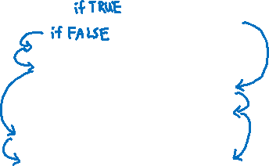
Control Flow
Register | Use(s)
%rdi | 1st argument (x)
%rsi | 2nd argument (y)
%rax | return value
long max(long x, long y)
{
long max;
if (x > y) {
max = x;
} else {
max = y;
}
return max;
}
max:
if x <= y then jump to else
movq %rdi, %rax
jump to done
else:
movq %rsi, %rax
done:
ret
Conditional jump
Unconditional jump
Notes:
Execution starts at the entry to the function…
By default just goes from one instruction to the next
So, how do we tell assembly code to only execute some of the instructions?
With a branch instruction (also called a jump)

Slide 11
Conditionals and Control Flow
Conditional branch/jump
  Jump to somewhere else if some condition is true,
  otherwise execute next instruction
Unconditional branch/jump
  Always jump when you get to this instruction
Together, they can implement most control flow constructs in high-level languages:
  if (condition) then {…} else {…}
  while (condition) {…}
  do {…} while (condition)
  for (initialization; condition; iterative) {…}
  switch {…}

Slide 12
x86 Control Flow
Condition codes
Conditional and unconditional branches
Loops
Switches

Slide 13

Processor State (x86-64, partial)
Information about currently executing program
  Temporary data
  ( %rax, … )
  Location of runtime stack ( %rsp )
  Location of current code control point
  ( %rip, … )
  Status of recent tests
  ( CF, ZF, SF, OF )
    Single bit registers:
Registers
%rax
%r8
%rbx
%r9
%rcx
%r10
%rdx
%r11
%rsi
%r12
%rdi
%r13
%rsp
%r14
%rbp
%r15
current top of the Stack
%rip
Program Counter
(instruction pointer)
CF
ZF
SF
OF
Condition Codes

Slide 14
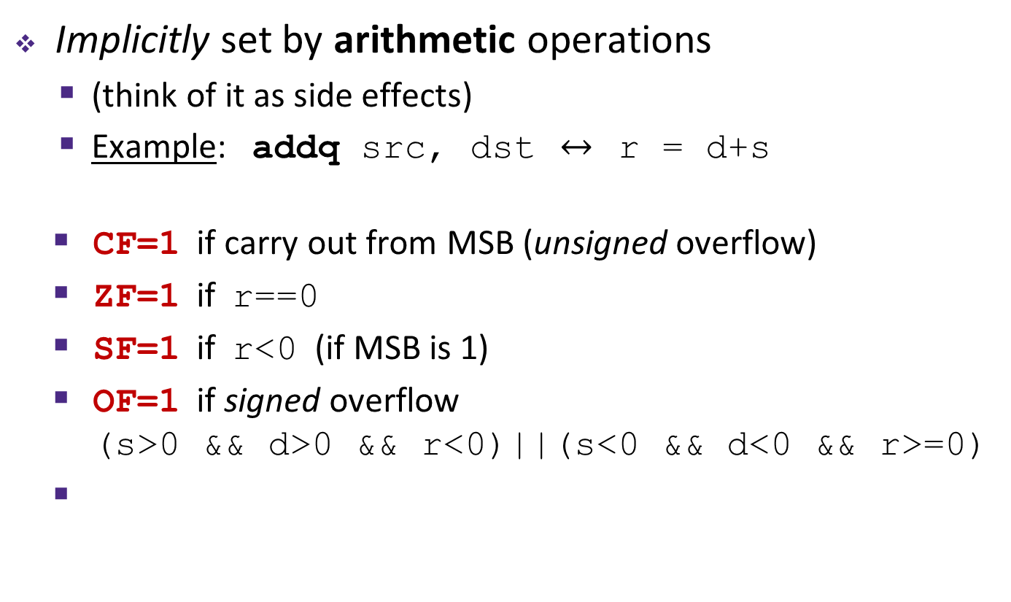
Condition Codes (Implicit Setting)
Implicitly set by arithmetic operations
  (think of it as side effects)
  Example: addq src, dst $↔$ r = d+s
  CF=1 if carry out from MSB (unsigned overflow)
  ZF=1 if r==0
  SF=1 if r<0 (if MSB is 1)
  OF=1 if signed overflow
  (s>0 && d>0 && r<0)||(s<0 && d<0 && r>=0)
Not set by lea instruction (beware!)
CF
Carry Flag
ZF
Zero Flag
SF
Sign Flag
OF
Overflow Flag

Slide 15
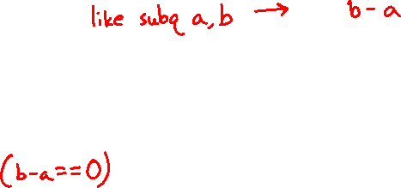
Condition Codes (Explicit Setting: Compare)
Explicitly set by Compare instruction
  cmpq src1, src2
  cmpq a, b sets flags based on b-a, but doesn’t store
  CF=1 if carry out from MSB (good for unsigned comparison)
  ZF=1 if a==b
  SF=1 if (b-a)<0 (if MSB is 1)
  OF=1 if signed overflow
  (a>0 && b<0 && (b-a)>0) ||
  (a<0 && b>0 && (b-a)<0)
CF
Carry Flag
ZF
Zero Flag
SF
Sign Flag
OF
Overflow Flag

Slide 16
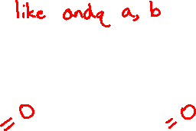
Condition Codes (Explicit Setting: Test)
Explicitly set by Test instruction
  testq src2, src1
  testq a, b sets flags based on a&b, but doesn’t store
    Useful to have one of the operands be a mask
  Can’t have carry out (CF) or overflow (OF)
  ZF=1 if a&b==0
  SF=1 if a&b<0 (signed)
CF
Carry Flag
ZF
Zero Flag
SF
Sign Flag
OF
Overflow Flag

Slide 17
Using Condition Codes: Jumping
j* Instructions
  Jumps to target (an address) based on condition codes
Instruction | Condition | Description
jmp target | 1 | Unconditional
je target | ZF | Equal / Zero
jne target | ~ZF | Not Equal / Not Zero
js target | SF | Negative
jns target | ~SF | Nonnegative
jg target | ~(SF^OF)&~ZF | Greater (Signed)
jge target | ~(SF^OF) | Greater or Equal (Signed)
jl target | (SF^OF) | Less (Signed)
jle target | (SF^OF)|ZF | Less or Equal (Signed)
ja target | ~CF&~ZF | Above (unsigned “>”)
jb target | CF | Below (unsigned “<“)
Notes:
Bunch of different jump instructions
First, unconditional

Slide 18
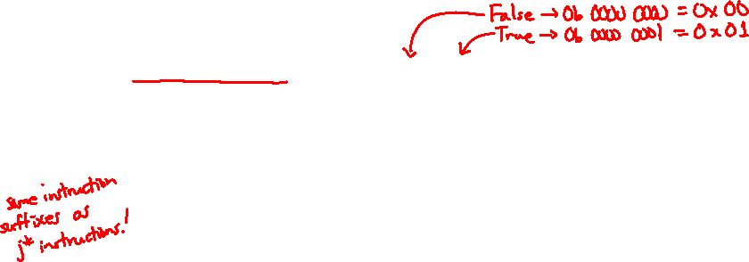
Using Condition Codes: Setting
set* Instructions
  Set low-order byte of dst to 0 or 1 based on condition codes
  Does not alter remaining 7 bytes
Instruction | Condition | Description
sete dst | ZF | Equal / Zero
setne dst | ~ZF | Not Equal / Not Zero
sets dst | SF | Negative
setns dst | ~SF | Nonnegative
setg dst | ~(SF^OF)&~ZF | Greater (Signed)
setge dst | ~(SF^OF) | Greater or Equal (Signed)
setl dst | (SF^OF) | Less (Signed)
setle dst | (SF^OF)|ZF | Less or Equal (Signed)
seta dst | ~CF&~ZF | Above (unsigned “>”)
setb dst | CF | Below (unsigned “<”)

Slide 19
Reminder: x86-64 Integer Registers
Accessing the low-order byte:
%rax
%r8
%al
%r8b
%rbx
%r9
%bl
%r9b
%rcx
%r10
%cl
%r10b
%rdx
%r11
%dl
%r11b
%rsi
%r12
%sil
%r12b
%rdi
%r13
%dil
%r13b
%rsp
%r14
%spl
%r14b
%rbp
%r15
%bpl
%r15b

Slide 20
Reading Condition Codes
Register | Use(s)
%rdi | 1st argument (x)
%rsi | 2nd argument (y)
%rax | return value
set* Instructions
  Set a low-order byte to 0 or 1 based on condition codes
  Operand is byte register (e.g. al, dl) or a byte in memory
  Do not alter remaining bytes in register
    Typically use movzbl (zero-extended mov) to finish job
int gt(long x, long y)
{
return x > y;
}
cmpq %rsi, %rdi #
setg %al #
movzbl %al, %eax #
ret
Notes:
Zero-extend: sets the upper bytes to 0
The order of the cmpq operands is backwards, unfortunately; first we do cmpq y, x, but then the setg is “true” if x > y. So, think of the cmpq as performing x – y, like a sub instruction, and then it makes more sense.

Slide 21
Reading Condition Codes
Register | Use(s)
%rdi | 1st argument (x)
%rsi | 2nd argument (y)
%rax | return value
set* Instructions
  Set a low-order byte to 0 or 1 based on condition codes
  Operand is byte register (e.g. al, dl) or a byte in memory
  Do not alter remaining bytes in register
    Typically use movzbl (zero-extended mov) to finish job
int gt(long x, long y)
{
return x > y;
}
cmpq %rsi, %rdi # Compare x:y
setg %al # Set when >
movzbl %al, %eax # Zero rest of %rax
ret
Notes:
Zero-extend: sets the upper bytes to 0
The order of the cmpq operands is backwards, unfortunately; first we do cmpq y, x, but then the setg is “true” if x > y. So, think of the cmpq as performing x – y, like a sub instruction, and then it makes more sense.

Slide 22
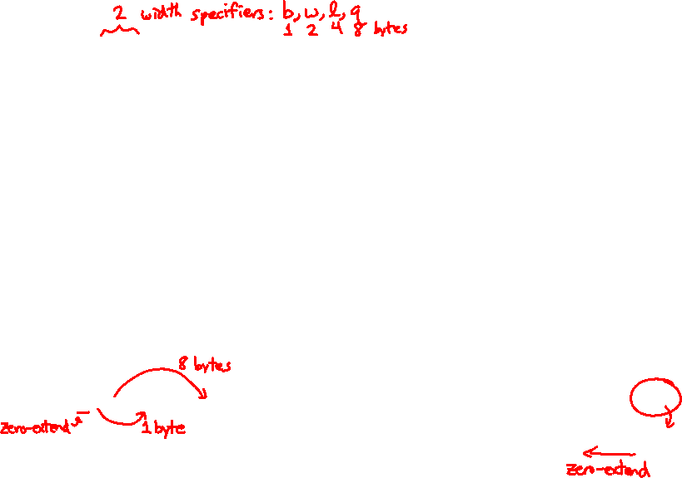
Aside: movz and movs
    movz_ _ src, regDest # Move with zero extension
    movs_ _ src, regDest # Move with sign extension
  Copy from a smaller source value to a larger destination
  Source can be memory or register; Destination must be a register
  Fill remaining bits of dest with zero (movz) or sign bit (movs)
    movzSD / movsSD:
    S – size of source (b = 1 byte, w = 2)
    D – size of dest (w = 2 bytes, l = 4, q = 8)
    Example:
    movzbq %al, %rbx
0x?? | 0x?? | 0x?? | 0x?? | 0x?? | 0x?? | 0x?? | 0xFF | $←$%rax
0x00 | 0x00 | 0x00 | 0x00 | 0x00 | 0x00 | 0x00 | 0xFF | $←$%rbx

Slide 23
Aside: movz and movs
    movz_ _ src, regDest # Move with zero extension
    movs_ _ src, regDest # Move with sign extension
  Copy from a smaller source value to a larger destination
  Source can be memory or register; Destination must be a register
  Fill remaining bits of dest with zero (movz) or sign bit (movs)
    movzSD / movsSD:
    S – size of source (b = 1 byte, w = 2)
    D – size of dest (w = 2 bytes, l = 4, q = 8)
    Example:
    movsbl (%rax), %ebx
    Note: In x86-64, any instruction that generates a 32-bit (long word) value for a register also sets the high-order portion of the register to 0. Good example on p. 184 in the textbook.
0x00 | 0x00 | 0x7F | 0xFF | 0xC6 | 0x1F | 0xA4 | 0xE8 | $←$%rax
... | 0x?? | 0x?? | 0x80 | 0x?? | 0x?? | 0x?? | ... | $←$ MEM
Copy 1 byte from memory into 8-byte register & sign extend it
0x00 | 0x00 | 0x00 | 0x00 | 0xFF | 0xFF | 0xFF | 0x80 | $←$%rbx

Slide 24
Summary
Control flow in x86 determined by status of Condition Codes
  Showed Carry, Zero, Sign, and Overflow, though others exist
  Set flags with arithmetic instructions (implicit) or Compare and Test (explicit)
  Set instructions read out flag values
  Jump instructions use flag values to determine next instruction to execute

