Slide 1
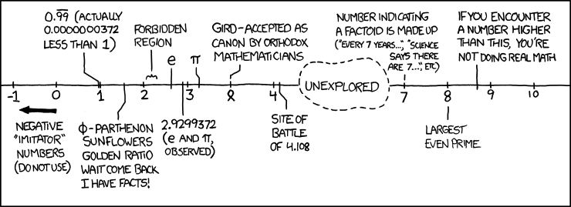
Floating Point II CSE 351 Winter 2020
Instructor: Teaching Assistants:
Ruth Anderson Jonathan Chen Justin Johnson Porter Jones
Josie Lee Jeffery Tian Callum Walker
Eddy (Tianyi) Zhou
http://xkcd.com/899/

Slide 2
Administrivia
hw6 due Friday, hw7 due Monday
Lab 1a due last night. Lates accepted until Thurs.
Lab 1b due Monday (1/27)
Submit bits.c and lab1Breflect.txt
Section tomorrow on Integers and Floating Point

Slide 3
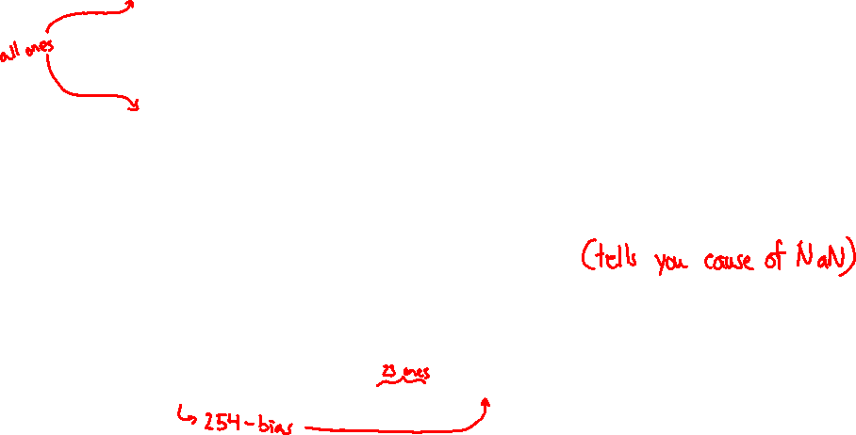
Other Special Cases
E = 0xFF, M = 0: ± ∞
e.g. division by 0
Still work in comparisons!
E = 0xFF, M ≠ 0: Not a Number (NaN)
e.g. square root of negative number, 0/0, ∞–∞
NaN propagates through computations
Value of M can be useful in debugging
New largest value (besides ∞)?
E = 0xFF has now been taken!
E = 0xFE has largest: 1.1…1₂×2¹²⁷ = 2¹²⁸ – 2¹⁰⁴

Slide 4
Floating Point Encoding Summary
E | M | Meaning
0x00 | 0 | ± 0
0x00 | non-zero | ± denorm num
0x01 – 0xFE | anything | ± norm num
0xFF | 0 | ± ∞
0xFF | non-zero | NaN

Slide 5
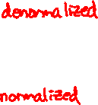
Floating Point Interpretation Flow Chart
all 0’s
$${\left(−1\right)}^{S}×∞$$
all 1’s
What is the value of M?
anything
else
$$NaN$$
FP Bits
What is the value of E?
$${\left(−1\right)}^{S}×0.M×2^{1−bias}$$
all 0’s
$${\left(−1\right)}^{S}×1.M×2^{E−bias}$$
anything else
= special case

Slide 6
Floating point topics
Fractional binary numbers
IEEE floating-point standard
Floating-point operations and rounding
Floating-point in C
There are many more details that we won’t cover
It’s a 58-page standard…
Notes:
Start by talking about representing fractional numbers in binary in general
Then about the IEEE Standard for floating point representation, operations,
Will not cover:
All the details of the 58-page spec
Or expect you to perform operations
Want to show you how floating point values are represented
To give you a sense of the kinds of things that can go wrong with them

Slide 7
Tiny Floating Point Representation
We will use the following 8-bit floating point representation to illustrate some key points:
Assume that it has the same properties as IEEE floating point:
bias =
encoding of $−0$ =
encoding of $+∞$ =
encoding of the largest (+) normalized # =
encoding of the smallest (+) normalized # =
S
E
M
1
4
3

Slide 8
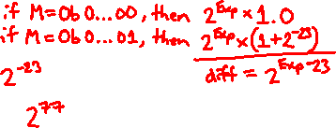
Distribution of Values
What ranges are NOT representable?
Between largest norm and infinity
Between zero and smallest denorm
Between norm numbers?
Given a FP number, what’s the bit pattern of the next largest representable number?
What is this “step” when Exp = 0?
What is this “step” when Exp = 100?
Distribution of values is denser toward zero
Overflow (Exp too large)
Underflow (Exp too small)
Rounding

Slide 9
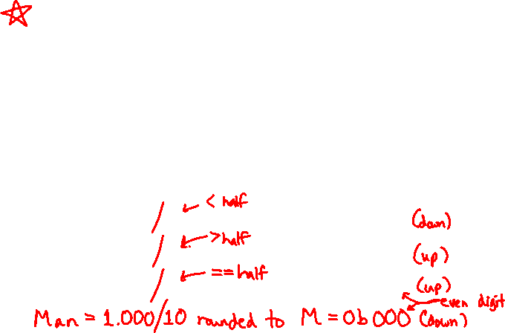
Floating Point Rounding
This is extra (non-testable) material
The IEEE 754 standard actually specifies different rounding modes:
Round to nearest, ties to nearest even digit
Round toward $+∞$ (round up)
Round toward $−∞$ (round down)
Round toward 0 (truncation)
In our tiny example:
Man = 1.001 01 rounded to M = 0b001
Man = 1.001 11 rounded to M = 0b010
Man = 1.001 10 rounded to M = 0b010
S
E
M
1
4
3

Slide 10
Floating Point Operations: Basic Idea
x +_{f} y = Round(x + y)
x *_{f} y = Round(x * y)
Basic idea for floating point operations:
First, compute the exact result
Then round the result to make it fit into the specified precision (width of M)
Possibly over/underflow if exponent outside of range
Value = (-1)^{S}×Mantissa×2^{Exponent}
S
E
M
Notes:
We won’t be asking you to do these yourself, but seeing a bit about how it works will help you understand the ways in which it can go wrong, which we may ask you about

Slide 11
Mathematical Properties of FP Operations
Overflow yields $±∞$ and underflow yields $0$
Floats with value $±∞$ and NaN can be used in operations
Result usually still $±∞$ or NaN, but not always intuitive
Floating point operations do not work like real math, due to rounding
Not associative: (3.14+1e100)–1e100 != 3.14+(1e100–1e100)
0 3.14
Not distributive: 100*(0.1+0.2) != 100*0.1+100*0.2
30.000000000000003553 30
Not cumulative
Repeatedly adding a very small number to a large one may do nothing
Notes:
NaNs or infinity can taint results, spread through a numerical computations
Floating point operations are not like real mathematical operations
The same algebraic properties, associative, commutative, distributive, no longer work right

Slide 12
Limits of Interest
This is extra (non-testable) material
The following thresholds will help give you a sense of when certain outcomes come into play, but don’t worry about the specifics:
FOver = $2^{bias+1}$ = $2^{8}$
This is just larger than the largest representable normalized number
FDenorm = $2^{1−bias}$ = $2^{−6}$
This is the smallest representable normalized number
FUnder = $2^{1−bias−m}$ = $2^{−9}$
$m$ is the width of the mantissa field
This is the smallest representable denormalized number

Slide 13
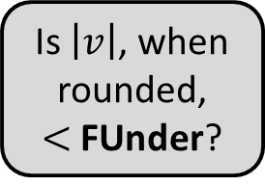
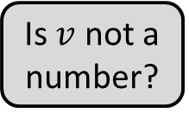
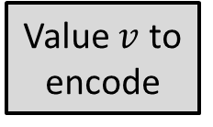
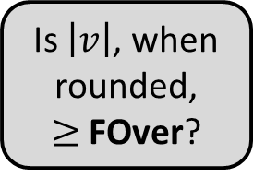
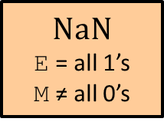
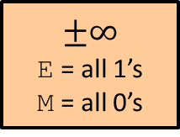
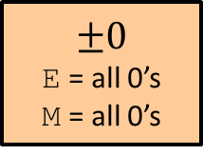
Floating Point Encoding Flow Chart
Is $\left|v\right|$, when rounded, $≥$ FOver?
No
Value $v$ to encode
Is $v$ not a number?
No
Yes
Yes
$NaN$
E = all 1’s M ≠ all 0’s
$$±∞$$
E = all 1’s M = all 0’s
$$±0$$
E = all 0’s M = all 0’s
Is $\left|v\right|$, when rounded, $<$ FUnder?
Is $\left|v\right|$, when rounded, $<$ FDenorm?
Yes
Yes
No
No
Denormed
E = all 0’s
0.M = Man
Normed
E = Exp + bias 1.M = Man
= special case

Slide 14
Example Question
Using our 8-bit representation, what value gets stored when we try to encode 384 = 2⁸ + 2⁷?
No voting
+ 256
+ 384
+ $∞$
NaN
We’re lost…
S
E
M
1
4
3

Slide 15
Polling Question
Using our 8-bit representation, what value gets stored when we try to encode 2.625 = 2¹ + 2⁻¹ + 2⁻³?
Vote at http://pollev.com/rea
+ 2.5
+ 2.625
+ 2.75
+ 3.25
We’re lost…
S
E
M
1
4
3

Slide 16
Floating point topics
Fractional binary numbers
IEEE floating-point standard
Floating-point operations and rounding
Floating-point in C
There are many more details that we won’t cover
It’s a 58-page standard…
Notes:
Start by talking about representing fractional numbers in binary in general
Then about the IEEE Standard for floating point representation, operations,
Will not cover:
All the details of the 58-page spec
Or expect you to perform operations
Want to show you how floating point values are represented
To give you a sense of the kinds of things that can go wrong with them

Slide 17
Floating Point in C
!!!
Two common levels of precision:
float 1.0f single precision (32-bit)
double 1.0 double precision (64-bit)
#include <math.h> to get INFINITY and NAN constants
Equality (==) comparisons between floating point numbers are tricky, and often return unexpected results, so just avoid them!

Slide 18
Floating Point Conversions in C
!!!
Casting between int, float, and double changes the bit representation
int $→$ float
May be rounded (not enough bits in mantissa: 23)
Overflow impossible
int or float $→$ double
Exact conversion (all 32-bit ints representable)
long $→$ double
Depends on word size (32-bit is exact, 64-bit may be rounded)
double or float $→$ int
Truncates fractional part (rounded toward zero)
“Not defined” when out of range or NaN: generally sets to Tmin (even if the value is a very big positive)

Slide 19
Polling Question
We execute the following code in C. How many bytes are the same (value and position) between i and f?
Vote at http://pollev.com/rea
0 bytes
1 byte
2 bytes
3 bytes
We’re lost…
int i = 384; // 2^8 + 2^7
float f = (float) i;
Notes:
Purposely choose to skip this one. But do include solution in posted materials.

Slide 20
Floating Point and the Programmer
#include <stdio.h> int main(int argc, char* argv[]) { float f1 = 1.0; float f2 = 0.0; int i; for (i = 0; i < 10; i++) f2 += 1.0/10.0; printf("0x%08x 0x%08x\n", *(int*)&f1, *(int*)&f2); printf("f1 = %10.9f\n", f1); printf("f2 = %10.9f\n\n", f2); f1 = 1E30; f2 = 1E-30; float f3 = f1 + f2; printf("f1 == f3? %s\n", f1 == f3 ? "yes" : "no" );
return 0; }
$ ./a.out
0x3f800000 0x3f800001
f1 = 1.000000000
f2 = 1.000000119
f1 == f3? yes

Slide 21
Floating Point Summary
Floats also suffer from the fixed number of bits available to represent them
Can get overflow/underflow
“Gaps” produced in representable numbers means we can lose precision, unlike ints
Some “simple fractions” have no exact representation (e.g. 0.2)
“Every operation gets a slightly wrong result”
Floating point arithmetic not associative or distributive
Mathematically equivalent ways of writing an expression may compute different results
Never test floating point values for equality!
Careful when converting between ints and floats!

Slide 22
Number Representation Really Matters
1991: Patriot missile targeting error
clock skew due to conversion from integer to floating point
1996: Ariane 5 rocket exploded ($1 billion)
overflow converting 64-bit floating point to 16-bit integer
2000: Y2K problem
limited (decimal) representation: overflow, wrap-around
2038: Unix epoch rollover
Unix epoch = seconds since 12am, January 1, 1970
signed 32-bit integer representation rolls over to TMin in 2038
Other related bugs:
1982: Vancouver Stock Exchange 10% error in less than 2 years
1994: Intel Pentium FDIV (floating point division) HW bug ($475 million)
1997: USS Yorktown “smart” warship stranded: divide by zero
1998: Mars Climate Orbiter crashed: unit mismatch ($193 million)
Notes:
This is the part where I try to scare you…

Slide 23
Summary
Floating point encoding has many limitations
Overflow, underflow, rounding
Rounding is a HUGE issue due to limited mantissa bits and gaps that are scaled by the value of the exponent
Floating point arithmetic is NOT associative or distributive
Converting between integral and floating point data types does change the bits
E | M | Meaning
0x00 | 0 | ± 0
0x00 | non-zero | ± denorm num
0x01 – 0xFE | anything | ± norm num
0xFF | 0 | ± ∞
0xFF | non-zero | NaN

