Slide 1
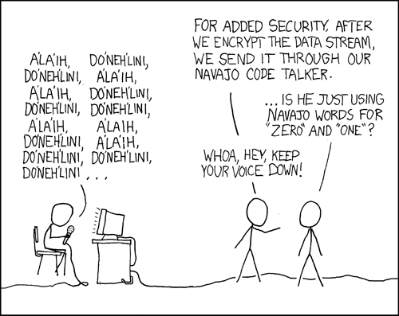
Data III & Integers I
CSE 351 Winter 2020
Instructor:
Ruth Anderson
Teaching Assistants:
Jonathan Chen
Justin Johnson
Porter Jones
Josie Lee
Jeffery Tian
Callum Walker
Eddy (Tianyi) Zhou
http://xkcd.com/257/

Slide 2
Administrivia
hw3 due Wednesday, hw4 due Friday
Lab 1a released
  Workflow:
    Edit pointer.c
    Run the Makefile (make) and check for compiler errors & warnings
    Run ptest (./ptest) and check for correct behavior
    Run rule/syntax checker (python dlc.py) and check output
  Due Friday 1/17, will overlap a bit with Lab 1b
    We grade just your last submission

Slide 3
Lab Reflections
All subsequent labs (after Lab 0) have a “reflection” portion
  The Reflection questions can be found on the lab specs and are intended to be done after you finish the lab
  You will type up your responses in a .txt file for submission on Canvas
  These will be graded “by hand” (read by TAs)
Intended to check your understand of what you should have learned from the lab
  Also great practice for short answer questions on the exams

Slide 4
Memory, Data, and Addressing
Representing information as bits and bytes
  Binary, hexadecimal, fixed-widths
Organizing and addressing data in memory
  Memory is a byte-addressable array
  Machine “word” size = address size = register size
  Endianness – ordering bytes in memory
Manipulating data in memory using C
  Assignment
  Pointers, pointer arithmetic, and arrays
Boolean algebra and bit-level manipulations
Notes:
More fine-grained data manipulations.

Slide 5
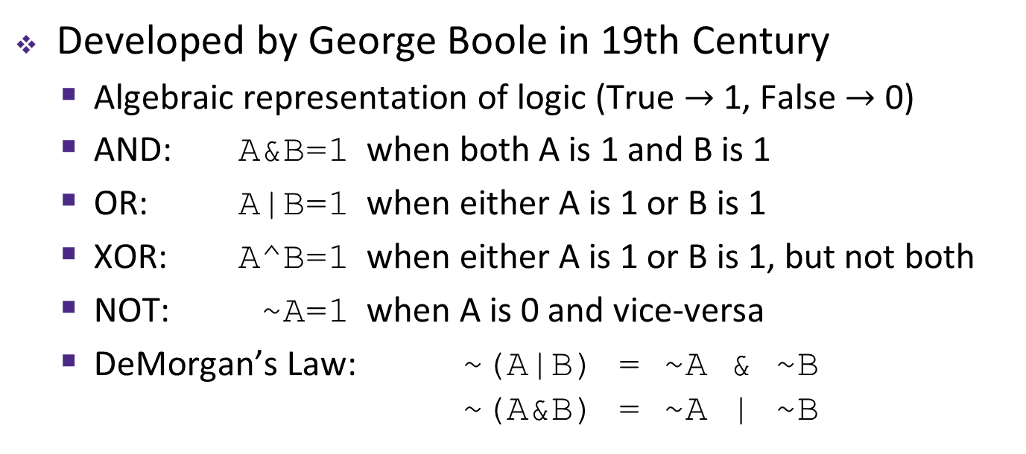
Boolean Algebra
Developed by George Boole in 19th Century
  Algebraic representation of logic (True $→$ 1, False $→$ 0)
  AND: A&B=1 when both A is 1 and B is 1
  OR: A|B=1 when either A is 1 or B is 1
  XOR: A^B=1 when either A is 1 or B is 1, but not both
  NOT: ~A=1 when A is 0 and vice-versa
  DeMorgan’s Law: ~(A|B) = ~A & ~B
  ~(A&B) = ~A | ~B
AND
OR
XOR
NOT
& | 0 | 1
0 | 0 | 0
1 | 0 | 1
| | 0 | 1
0 | 0 | 1
1 | 1 | 1
^ | 0 | 1
0 | 0 | 1
1 | 1 | 0
~
0 | 1
1 | 0

Slide 6
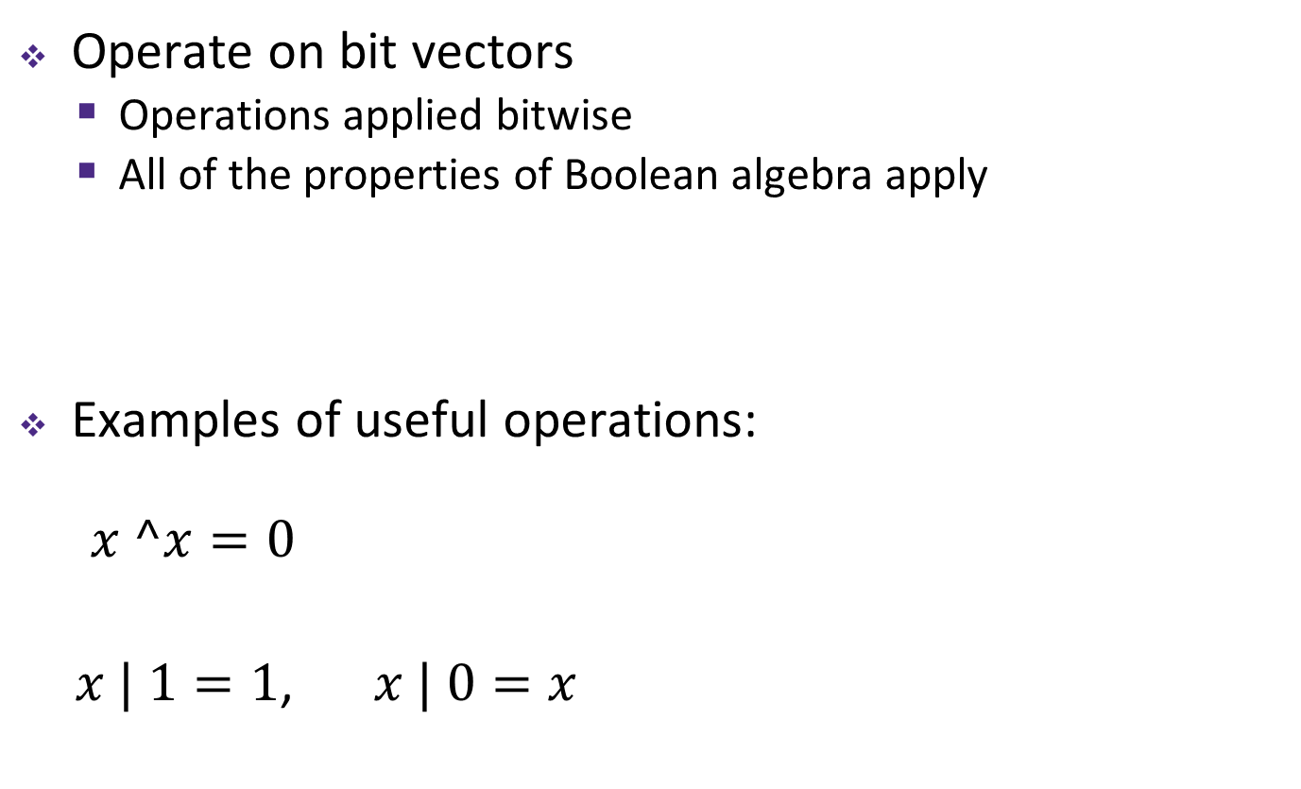
General Boolean Algebras
Operate on bit vectors
  Operations applied bitwise
  All of the properties of Boolean algebra apply
Examples of useful operations:
$x ^x=0$
  $x | 1=1$, $x | 0=x$
01101001
& 01010101
01101001
| 01010101
01101001
^ 01010101
~ 01010101
01010101
^ 01010101
00000000
01010101
| 11110000
11110101
Notes:
Now, how do we use the boolean operators?
Typically on ”bit vectors” (treat a byte, or multiple bytes) as a bit vector

Slide 7
Bit-Level Operations in C
& (AND), | (OR), ^ (XOR), ~ (NOT)
  View arguments as bit vectors, apply operations bitwise
  Apply to any “integral” data type
    long, int, short, char, unsigned
Examples with char a, b, c;
  a = (char) 0x41; // 0x41->0b 0100 0001
  b = ~a; // 0b ->0x
  a = (char) 0x69; // 0x69->0b 0110 1001
  b = (char) 0x55; // 0x55->0b 0101 0101
  c = a & b; // 0b ->0x
  a = (char) 0x41; // 0x41->0b 0100 0001
  b = a; // 0b 0100 0001
  c = a ^ b; // 0b ->0x
Notes:
Some bit-twiddling puzzles in Lab 1

Slide 8
Contrast: Logic Operations
Logical operators in C: && (AND), || (OR), ! (NOT)
  0 is False, anything nonzero is True
  Always return 0 or 1
  Early termination (a.k.a. short-circuit evaluation) of &&, ||
Examples (char data type)
  !0x41 -> 0x00
  !0x00 -> 0x01
  !!0x41 -> 0x01
  p && *p
    If p is the null pointer (0x0), then p is never dereferenced!
  0xCC && 0x33 -> 0x01
  0x00 || 0x33 -> 0x01

Slide 9
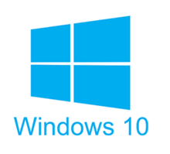
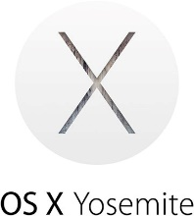

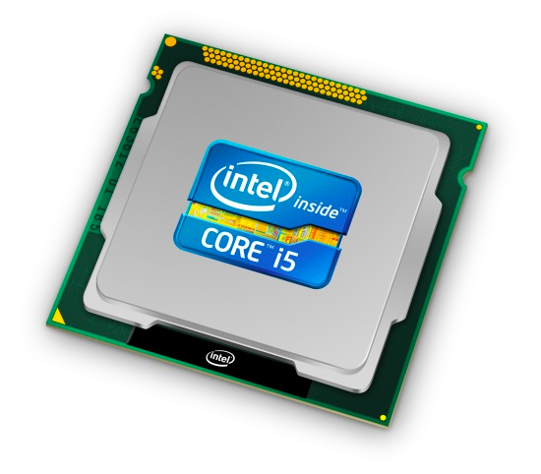
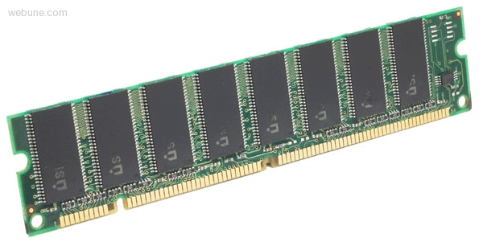
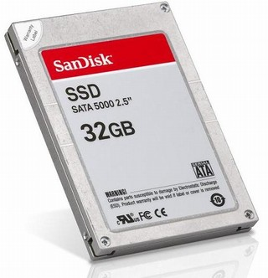
Roadmap
C:
Java:
Memory & data
Integers & floats
x86 assembly
Procedures & stacks
Executables
Arrays & structs
Memory & caches
Processes
Virtual memory
Memory allocation
Java vs. C
car *c = malloc(sizeof(car));
c->miles = 100;
c->gals = 17;
float mpg = get_mpg(c);
free(c);
Car c = new Car();
c.setMiles(100);
c.setGals(17);
float mpg =
c.getMPG();
Assembly language:
get_mpg:
pushq %rbp
movq %rsp, %rbp
...
popq %rbp
ret
OS:
Machine code:
0111010000011000
100011010000010000000010
1000100111000010
110000011111101000011111
Computer system:

Slide 10
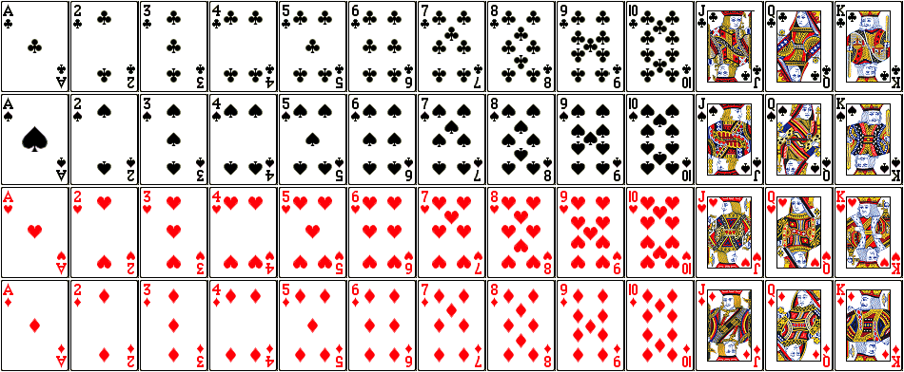
But before we get to integers….
Encode a standard deck of playing cards
52 cards in 4 suits
  How do we encode suits, face cards?
What operations do we want to make easy to implement?
  Which is the higher value card?
  Are they the same suit?
Notes:
Value comparison: War
Same suit: Crazy Eights

Slide 11
Two possible representations
1 bit per card (52): bit corresponding to card set to 1
  “One-hot” encoding (similar to set notation)
  Drawbacks:
    Hard to compare values and suits
    Large number of bits required
1 bit per suit (4), 1 bit per number (13): 2 bits set
  Pair of one-hot encoded values
  Easier to compare suits and values, but still lots of bits used
low-order 52 bits of 64-bit word
4 suits
13 numbers
Notes:
Can you think of a possible advantage to this approach?
What if we wanted to represent multiple cards (i.e. a poker hand)

Slide 12
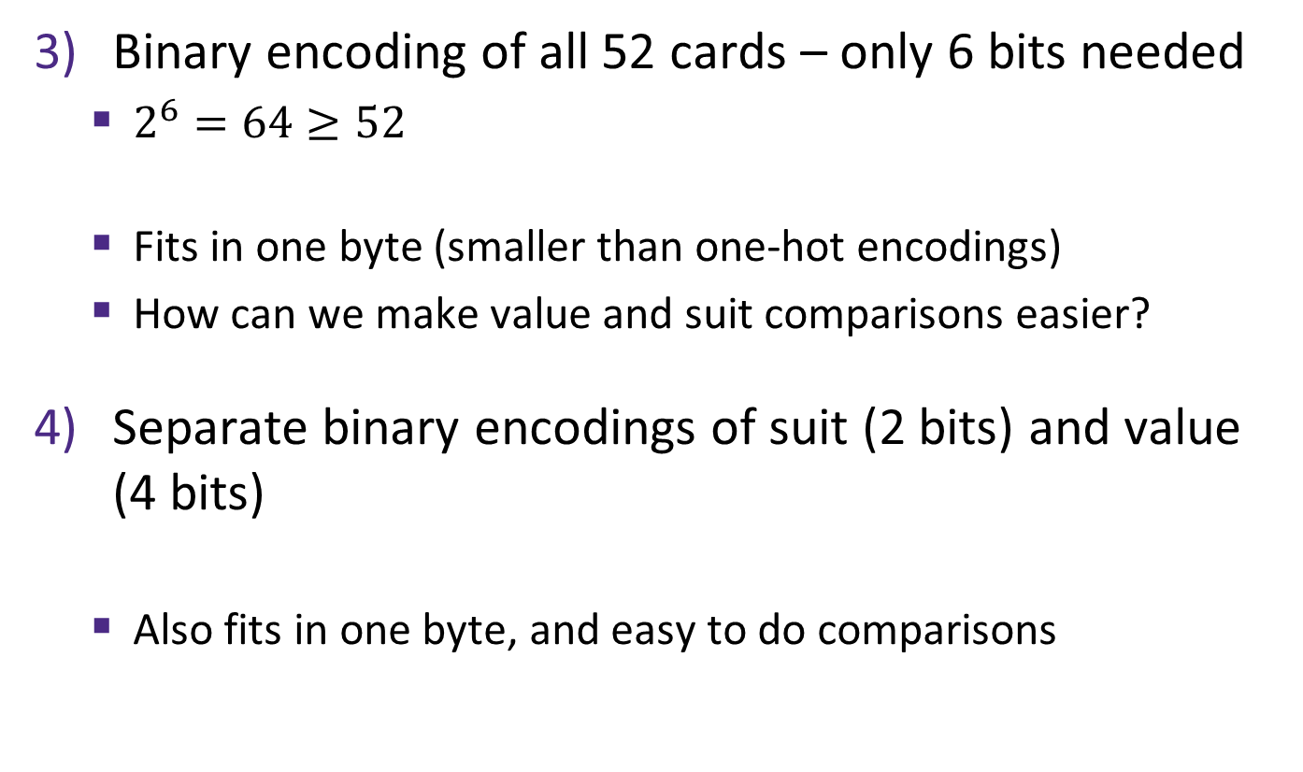
Two better representations
Binary encoding of all 52 cards – only 6 bits needed
  $2^{6}=64≥52$
  Fits in one byte (smaller than one-hot encodings)
  How can we make value and suit comparisons easier?
Separate binary encodings of suit (2 bits) and value (4 bits)
  Also fits in one byte, and easy to do comparisons
low-order 6 bits of a byte
suit
value
♣ | 00
♦ | 01
♥ | 10
♠ | 11
K | Q | J | . . . | 3 | 2 | A
1101 | 1100 | 1011 | ... | 0011 | 0010 | 0001
Notes:
Notice the arbitrariness of binary encoding choices: A is 1 instead of 0, ordering of suits (CDHS or DCHS?)

Slide 13
Compare Card Suits
mask: a bit vector designed to achieve a desired behavior when used with a bitwise operator on another bit vector v.
Here we turn all but the bits of interest in v to 0.
  char hand[5]; // represents a 5-card hand
  char card1, card2; // two cards to compare
  card1 = hand[0];
  card2 = hand[1];
  ...
  if ( sameSuitP(card1, card2) ) { ... }
  #define SUIT_MASK 0x30
  int sameSuitP(char card1, char card2) {
  return (!((card1 & SUIT_MASK) ^ (card2 & SUIT_MASK)));
  //return (card1 & SUIT_MASK) == (card2 & SUIT_MASK);
  }
returns int
equivalent
SUIT_MASK = 0x30 =
0
0
1
1
0
0
0
0
suit
value

Slide 14
Compare Card Suits
mask: a bit vector designed to achieve a desired behavior when used with a bitwise operator on another bit vector v.
Here we turn all but the bits of interest in v to 0.
  #define SUIT_MASK 0x30
  int sameSuitP(char card1, char card2) {
  return (!((card1 & SUIT_MASK) ^ (card2 & SUIT_MASK)));
  //return (card1 & SUIT_MASK) == (card2 & SUIT_MASK);
  }
🃂
🃎
0 | 0 | 0 | 1 | 0 | 0 | 1 | 0
0 | 0 | 0 | 1 | 1 | 1 | 0 | 1
&
&
0 | 0 | 1 | 1 | 0 | 0 | 0 | 0
SUIT_MASK
0 | 0 | 1 | 1 | 0 | 0 | 0 | 0
=
=
0 | 0 | 0 | 1 | 0 | 0 | 0 | 0
0 | 0 | 0 | 1 | 0 | 0 | 0 | 0
^
0 | 0 | 0 | 0 | 0 | 0 | 0 | 0
!(x^y) equivalent to x==y
!
0 | 0 | 0 | 0 | 0 | 0 | 0 | 1

Slide 15
Compare Card Values
mask: a bit vector designed to achieve a desired behavior when used with a bitwise operator on another bit vector v.
  char hand[5]; // represents a 5-card hand
  char card1, card2; // two cards to compare
  card1 = hand[0];
  card2 = hand[1];
  ...
  if ( greaterValue(card1, card2) ) { ... }
  #define VALUE_MASK 0x0F
  int greaterValue(char card1, char card2) {
  return ((unsigned int)(card1 & VALUE_MASK) >
  (unsigned int)(card2 & VALUE_MASK));
  }
VALUE_MASK = 0x0F =
0
0
0
0
1
1
1
1
suit
value

Slide 16
Compare Card Values
mask: a bit vector designed to achieve a desired behavior when used with a bitwise operator on another bit vector v.
  #define VALUE_MASK 0x0F
  int greaterValue(char card1, char card2) {
  return ((unsigned int)(card1 & VALUE_MASK) >
  (unsigned int)(card2 & VALUE_MASK));
  }
🃂
🃎
0 | 0 | 1 | 0 | 0 | 0 | 1 | 0
0 | 0 | 1 | 0 | 1 | 1 | 0 | 1
&
&
0 | 0 | 0 | 0 | 1 | 1 | 1 | 1
VALUE_MASK
0 | 0 | 0 | 0 | 1 | 1 | 1 | 1
=
=
0 | 0 | 0 | 0 | 0 | 0 | 1 | 0
0 | 0 | 0 | 0 | 1 | 1 | 0 | 1
2₁₀ > 13₁₀
0 (false)

Slide 17
Integers
Binary representation of integers
  Unsigned and signed
  Casting in C
Consequences of finite width representation
  Overflow, sign extension
Shifting and arithmetic operations
Notes:
17

Slide 18


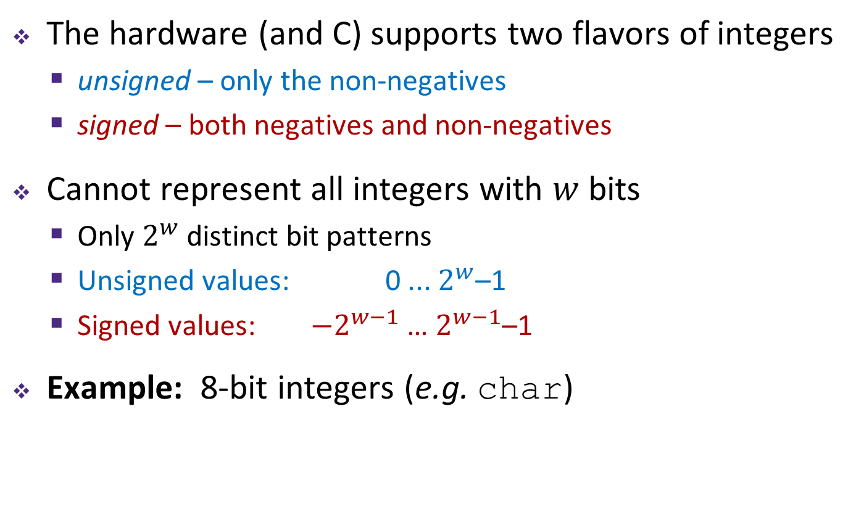





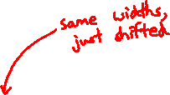



Encoding Integers
The hardware (and C) supports two flavors of integers
  unsigned – only the non-negatives
  signed – both negatives and non-negatives
Cannot represent all integers with $w$ bits
  Only $2^{w}$ distinct bit patterns
  Unsigned values: 0 ... $2^{w}$–1
  Signed values: $−2^{w−1}$ … $2^{w−1}$–1
Example: 8-bit integers (e.g. char)
-$∞$
+$∞$
$$−128$$
$$0$$
$$+128$$
$$+256$$
$${−2}^{8−1}$$
$$0$$
$${+2}^{8−1}$$
$$+2^{8}$$
Notes:
Okay, so now let’s talk some more about how we represent numbers, or integers to be specific
Multiple sizes of integers, using different numbers of bytes
But for each size, there are two ways of interpreting the bits…

Slide 19
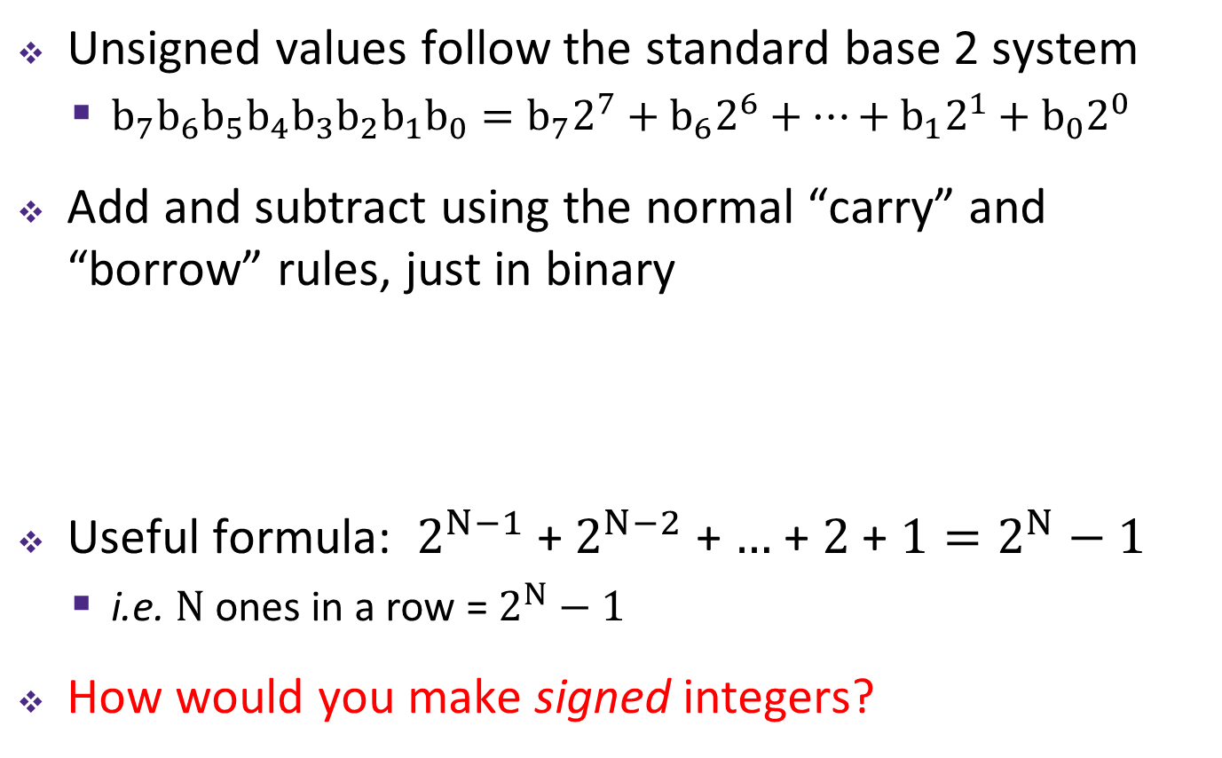
Unsigned Integers
Unsigned values follow the standard base 2 system
  $b_{7}b_{6}b_{5}b_{4}b_{3}b_{2}b_{1}b_{0}=b_{7}2^{7}+b_{6}2^{6}+…+b_{1}2^{1}+b_{0}2^{0}$
Add and subtract using the normal “carry” and “borrow” rules, just in binary
Useful formula: $2^{N−1}$ + $2^{N−2}$ + $…$ + $2$ + $1=2^{N}−1$
  i.e. $N$ ones in a row = $2^{N}−1$
How would you make signed integers?
63
+ 8
71
00111111
+00001000
01000111
Notes:
“1’s place”, the “2’s place”, “4’s place”…
An important use of unsigned values in C is pointers - there are no negative memory addresses
What if we want to represent negative numbers?

Slide 20
Sign and Magnitude
Most Significant Bit
Designate the high-order bit (MSB) as the “sign bit”
  sign=0: positive numbers; sign=1: negative numbers
Benefits:
  Using MSB as sign bit matches positive numbers with unsigned
  All zeros encoding is still = 0
Examples (8 bits):
  0x00 = 00000000₂ is non-negative, because the sign bit is 0
  0x7F = 01111111₂ is non-negative (+127₁₀)
  0x85 = 10000101₂ is negative (-5₁₀)
  0x80 = 10000000₂ is negative...
... zero???

Slide 21
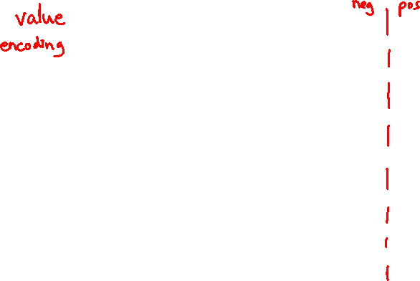
Sign and Magnitude
MSB is the sign bit, rest of the bits are magnitude
Drawbacks?
15
0
– 7
+ 0
14
1111
0000
1
– 6
1111
0000
+ 1
13
1110
0001
2
– 5
1110
0001
+ 2
1101
0010
1101
0010
12
1100
0011
3
– 4
1100
0011
+ 3
Sign and Magnitude
Unsigned
11
1011
0100
4
– 3
1011
0100
+ 4
1010
0101
1010
0101
10
1001
0110
5
– 2
1001
0110
+ 5
9
1000
0111
6
– 1
1000
0111
+ 6
8
7
– 0
+ 7
Notes:
To help visualize these numbers, we’ll use this number wheel
See how we start with +0 – +7 on right side
Then the left side, which starts with 1, are all negative, starting with -0 .. -7

Slide 22
Sign and Magnitude
MSB is the sign bit, rest of the bits are magnitude
Drawbacks:
  Two representations of 0 (bad for checking equality)
– 7
+ 0
– 6
1111
0000
+ 1
– 5
1110
0001
+ 2
1101
0010
– 4
1100
0011
+ 3
Sign and Magnitude
– 3
1011
0100
+ 4
1010
0101
– 2
1001
0110
+ 5
– 1
1000
0111
+ 6
– 0
+ 7

Slide 23
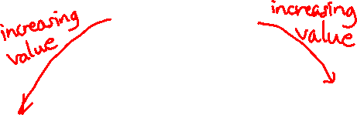
Sign and Magnitude
MSB is the sign bit, rest of the bits are magnitude
Drawbacks:
  Two representations of 0 (bad for checking equality)
  Arithmetic is cumbersome
    Example: 4-3 != 4+(-3)
    Negatives “increment” in wrong
    direction!
– 7
+ 0
– 6
1111
0000
+ 1
– 5
1110
0001
+ 2
4
- 3
1
0100
- 0011
0001
4
+ -3
-7
0100
+ 1011
1111
1101
0010
– 4
1100
0011
+ 3
Sign and Magnitude
– 3
1011
0100
+ 4
✓
✗
1010
0101
– 2
1001
0110
+ 5
– 1
1000
0111
+ 6
– 0
+ 7
Notes:
Arithmetic is cumbersome
4 – 3 should be 1, as we see on the left
But 4 + -3 should be equivalent, but if we naively add the two together, it doesn’t work
We have to make sure we change all plus-negatives to subtractions
So, how do we solve these problems?
It turns out there’s a really clever other way of interpreting the MSB

Slide 24
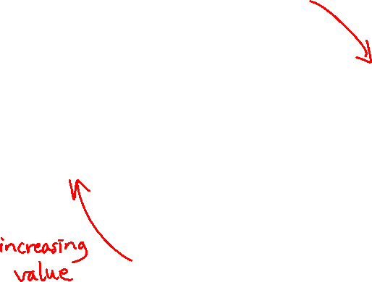
Two’s Complement
Let’s fix these problems:
  “Flip” negative encodings so incrementing works
– 0
+ 0
– 1
1111
0000
+ 1
– 2
1110
0001
+ 2
1101
0010
– 3
1100
0011
+ 3
– 4
1011
0100
+ 4
1010
0101
– 5
1001
0110
+ 5
– 6
1000
0111
+ 6
– 7
+ 7

Slide 25
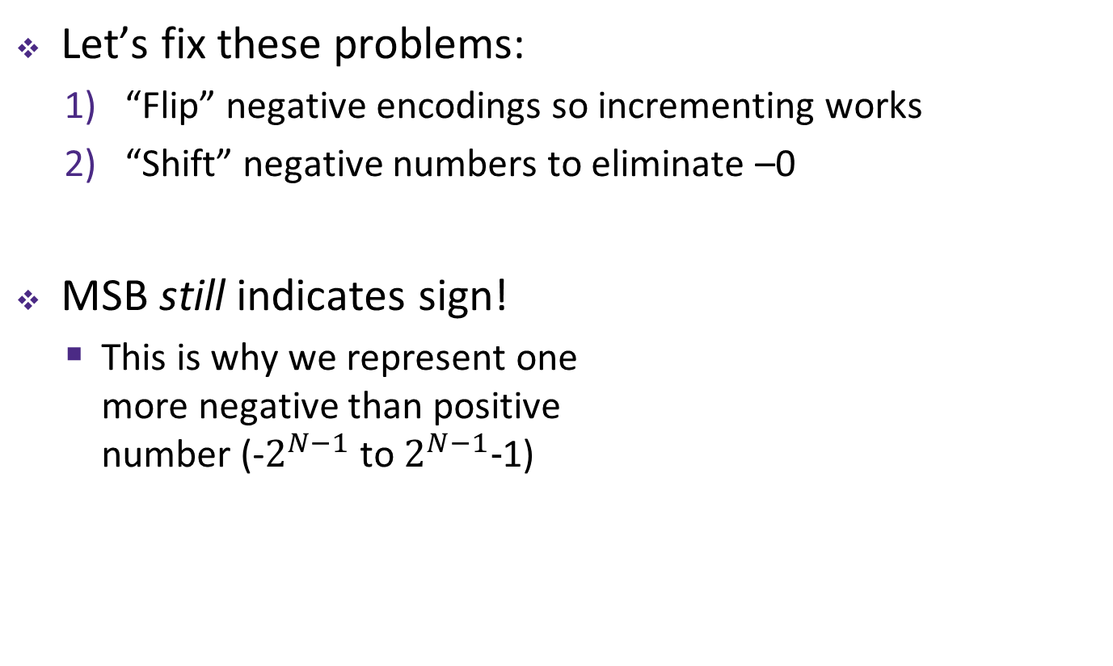
Two’s Complement
Let’s fix these problems:
  “Flip” negative encodings so incrementing works
  “Shift” negative numbers to eliminate –0
MSB still indicates sign!
  This is why we represent one
  more negative than positive
  number (-$2^{N−1}$ to $2^{N−1}−$1)
– 1
+ 0
– 2
1111
0000
+ 1
– 3
1110
0001
+ 2
1101
0010
– 4
1100
0011
+ 3
– 5
1011
0100
+ 4
1010
0101
– 6
1001
0110
+ 5
– 7
1000
0111
+ 6
– 8
+ 7

Slide 26
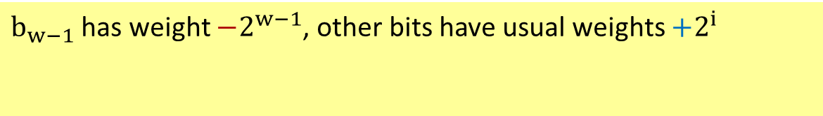
Two’s Complement Negatives
Accomplished with one neat mathematical trick!
  4-bit Examples:
    1010₂ unsigned:
    1*2³+0*2²+1*2¹+0*2⁰ = 10
    1010₂ two’s complement:
    -1*2³+0*2²+1*2¹+0*2⁰ = –6
  -1 represented as:
  1111₂ = -2³+(2³ – 1)
    MSB makes it super negative, add up
    all the other bits to get back up to -1
$b_{w−1}$ has weight $−2^{w−1}$, other bits have usual weights $+2^{i}$
b_{w-1}
b_{w-2}
. . .
b₀
– 1
+ 0
– 2
1111
0000
+ 1
– 3
1110
0001
+ 2
1101
0010
– 4
1100
0011
+ 3
Two’s
Complement
– 5
1011
0100
+ 4
1010
0101
– 6
1001
0110
+ 5
– 7
1000
0111
+ 6
– 8
+ 7

Slide 27
Why Two’s Complement is So Great
Roughly same number of (+) and (–) numbers
Positive number encodings match unsigned
Single zero
All zeros encoding = 0
Simple negation procedure:
  Get negative representation
  of any integer by taking
  bitwise complement and
  then adding one!
  ( ~x + 1 == -x )
– 1
+ 0
– 2
1111
0000
+ 1
– 3
1110
0001
+ 2
1101
0010
– 4
1100
0011
+ 3
Two’s
Complement
– 5
1011
0100
+ 4
1010
0101
– 6
1001
0110
+ 5
– 7
1000
0111
+ 6
– 8
+ 7

Slide 28
Polling Question
Take the 4-bit number encoding x = 0b1011
Which of the following numbers is NOT a valid interpretation of x using any of the number representation schemes discussed today?
  Unsigned, Sign and Magnitude, Two’s Complement
  Vote at http://pollev.com/rea
-4
-5
11
-3
We’re lost…

Slide 29
Summary
Bit-level operators allow for fine-grained manipulations of data
  Bitwise AND (&), OR (|), and NOT (~) different than logical AND (&&), OR (||), and NOT (!)
  Especially useful with bit masks
Choice of encoding scheme is important
  Tradeoffs based on size requirements and desired operations
Integers represented using unsigned and two’s complement representations
  Limited by fixed bit width
  We’ll examine arithmetic operations next lecture

