Slide 1
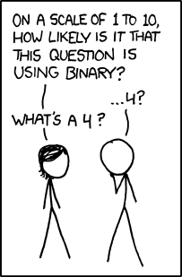
Memory, Data, & Addressing I
CSE 351 Winter 2020
Instructor:
Ruth Anderson
Teaching Assistants:
Jonathan Chen
Justin Johnson
Porter Jones
Josie Lee
Jeffery Tian
Callum Walker
Eddy (Tianyi) Zhou
http://xkcd.com/953/

Slide 2
Administrivia
Pre-Course Survey and hw0 due tonight @ 11:59 pm
  All other hw due at 11:00 am
hw1 due Friday (1/10) at 11:00 am
Lab 0 due Friday (1/10) at 11:59 pm
  This lab is exploratory and looks like a hw; the other labs will look a lot different
hw2 (on this lecture) due Monday (1/13) at 11:00 am
Can also enroll in CSE391 – Unix Tools
  Anyone taking this course, including non-CSE majors

Slide 3

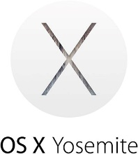

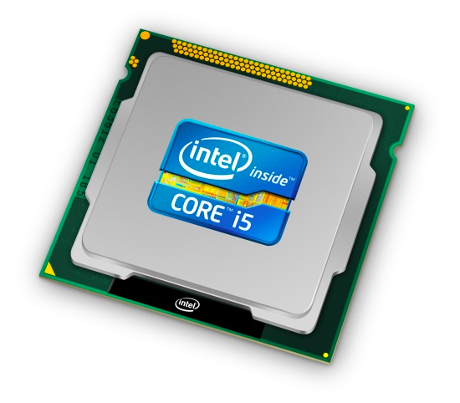
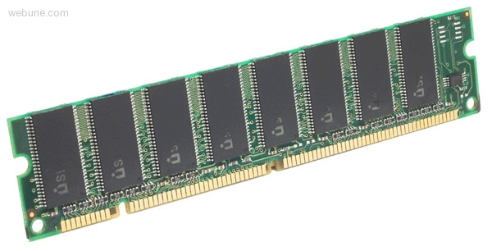
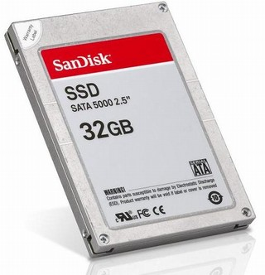
Roadmap
C:
Java:
Memory & data
Integers & floats
x86 assembly
Procedures & stacks
Executables
Arrays & structs
Memory & caches
Processes
Virtual memory
Memory allocation
Java vs. C
car *c = malloc(sizeof(car));
c->miles = 100;
c->gals = 17;
float mpg = get_mpg(c);
free(c);
Car c = new Car();
c.setMiles(100);
c.setGals(17);
float mpg =
c.getMPG();
Assembly language:
get_mpg:
pushq %rbp
movq %rsp, %rbp
...
popq %rbp
ret
OS:
Machine code:
0111010000011000
100011010000010000000010
1000100111000010
110000011111101000011111
Computer system:
Notes:
Today we’ll be talking about the basic execution model, and focusing on how data gets stored in memory and addressed

Slide 4
Memory, Data, and Addressing
Hardware - High Level Overview
Representing information as bits and bytes
  Memory is a byte-addressable array
  Machine “word” size = address size = register size
Organizing and addressing data in memory
  Endianness – ordering bytes in memory
Manipulating data in memory using C
Boolean algebra and bit-level manipulations

Slide 5
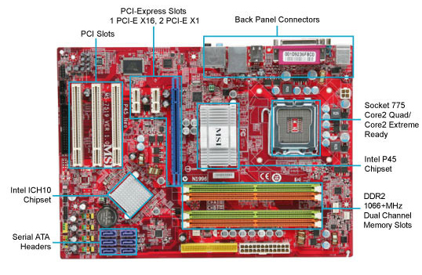
Hardware: Physical View
USB…
Bus connections
CPU
(empty slot)
I/O
controller
Memory
Storage connections
Notes:
CPU
Looks funny because of heat sink

Slide 6
Hardware: Logical View
Memory
CPU
Bus
Disks
USB
Etc.
Net
Notes:
CPU: all computations done here
Memory: big array of bytes
Big pipe between CPU and memory, in order to keep CPU fed
Bus: connect everything else to each other
Bus just means you broadcast on it (to everyone)
Same root as the other kind of “bus”
Disks bigger storage, slower, farther away, persistent
Network, etc.

Slide 7
Hardware: 351 View (version 0)
Memory
?
CPU
The CPU executes instructions
Memory stores data
Binary encoding!
  Instructions are just data
How are data and instructions represented?
Notes:
The CPU and Memory are what this course focuses on.

Slide 8
Aside: Why Base 2?
Electronic implementation
  Easy to store with bi-stable elements
  Reliably transmitted on noisy and inaccurate wires
Other bases possible, but not yet viable:
  DNA data storage (base 4: A, C, G, T) is a hot topic
  Quantum computing
0
1
0
3.3V
2.8V
0.5V
0.0V
Notes:
adenine (A), cytosine (C), guanine (G), or thymine (T)

Slide 9
Binary Encoding Additional Details
Because storage is finite in reality, everything is stored as “fixed” length
  Data is moved and manipulated in fixed-length chunks
  Multiple fixed lengths (e.g. 1 byte, 4 bytes, 8 bytes)
  Leading zeros now must be included up to “fill out” the fixed length
Example: the “eight-bit” representation of the number 4 is 0b00000100
Least Significant Bit (LSB)
Most Significant Bit (MSB)

Slide 10
Hardware: 351 View (version 0)
Memory
instructions
?
data
CPU
To execute an instruction, the CPU must:
  Fetch the instruction
  (if applicable) Fetch data needed by the instruction
  Perform the specified computation
  (if applicable) Write the result back to memory
Notes:
The CPU and Memory are what this course focuses on.

Slide 11
Hardware: 351 View (version 1)
Memory
instructions
i-cache
take 469
data
CPU
registers
More CPU details:
  Instructions are held temporarily in the instruction cache
  Other data are held temporarily in registers
Instruction fetching is hardware-controlled
Data movement is programmer-controlled (assembly)
Notes:
Take EE/CSE469 to learn about the internal workings and design of the CPU, but we will reveal a few more details here.

Slide 12
Hardware: 351 View (version 1)
Memory
instructions
i-cache
take 469
data
CPU
registers
We will start by learning about Memory
How does a program find its data in memory?

Slide 13
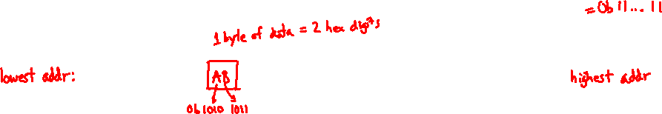
An Address Refers to a Byte of Memory
0x0…00
0xF…FE
0x0…01
0xF…FF
 |  |  |  |  |  | • • •
Conceptually, memory is a single, large array of bytes,
each with a unique address (index)
  Each address is just a number represented in fixed-length binary
Programs refer to bytes in memory by their addresses
  Domain of possible addresses = address space
  We can store addresses as data to “remember” where other data is in memory
But not all values fit in a single byte… (e.g. 351)
  Many operations actually use multi-byte values
Notes:
House analogy: each byte is a house, which has a unique address/number. Address space is the block, size of address space is how many houses are on this block.
Each byte can be read and written
Address space determined by how many bits in the address
So what if things don’t fit in a single byte?
How many things does 1 byte allow us to address?

Slide 14
Polling Question
If we choose to use 4-bit addresses, how big is our address space?
  i.e. How much space can we “refer to” using our addresses?
  Vote at http://PollEv.com/rea
16 bits
16 bytes
4 bits
4 bytes
We’re lost…

Slide 15
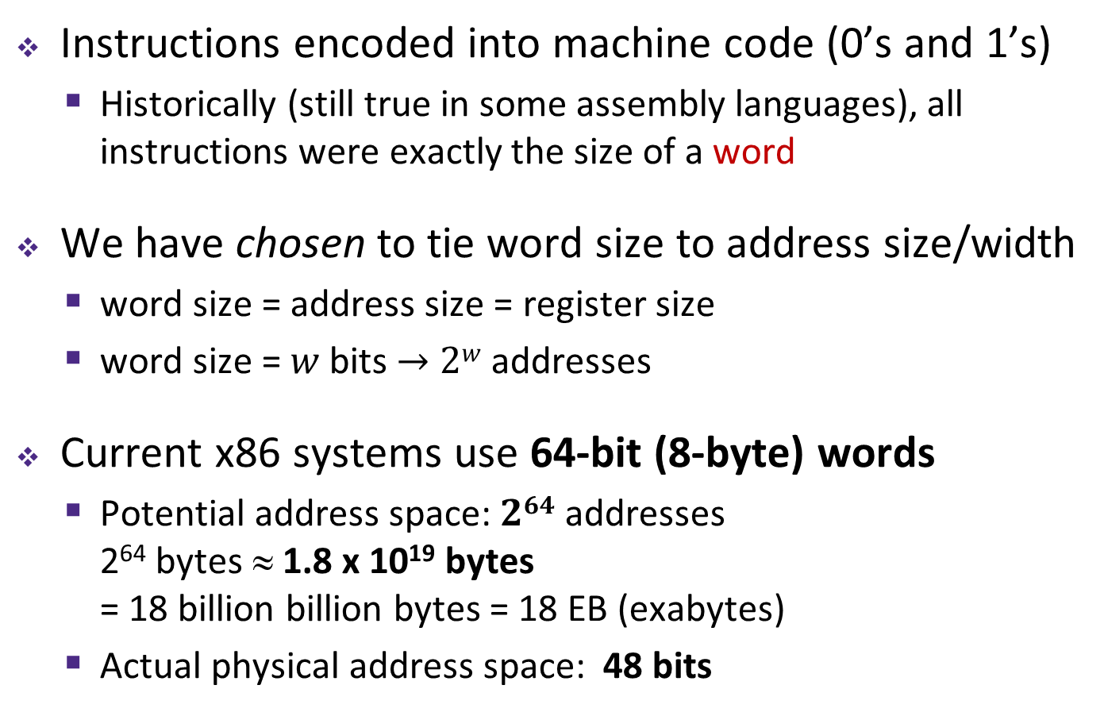
Machine “Words”
Instructions encoded into machine code (0’s and 1’s)
  Historically (still true in some assembly languages), all instructions were exactly the size of a word
We have chosen to tie word size to address size/width
  word size = address size = register size
  word size = $w$ bits $→$ $2w$ addresses
Current x86 systems use 64-bit (8-byte) words
  Potential address space: $264$ addresses
  2⁶⁴ bytes ≈ 1.8 x 10¹⁹ bytes
  = 18 billion billion bytes = 18 EB (exabytes)
  Actual physical address space: 48 bits
Notes:
Instead, we typically talk about addresses in terms of “words”
Use same word size anywhere that you typically store addresses
You could count the world population with 33 fingers (using population number of 7.454 billion)

Slide 16
Word-Oriented View of Memory
64-bit
Words
32-bit
Words
Addr.
(hex)
Addresses still specify
locations of bytes in memory, but we can choose to view memory as a series of word-sized chunks of data instead
  Addresses of successive words differ by word size
  Which byte’s address should we use for each word?
Bytes
0x00
Addr
=
??
0x01
0x02
Addr
=
??
0x03
0x04
Addr
=
??
0x05
0x06
0x07
0x08
Addr
=
??
0x09
0x0A
Addr
=
??
0x0B
0x0C
Addr
=
??
0x0D
0x0E
0x0F
Notes:
What do we use to address bigger chunks of bytes?

Slide 17
Address of a Word = Address of First Byte in the Word
64-bit
Words
32-bit
Words
Addr.
(hex)
Addresses still specify
locations of bytes in memory, but we can choose to view memory as a series of word-sized chunks of data instead
  Addresses of successive words differ by word size
  Which byte’s address should we use for each word?
The address of any chunk of memory is given by the address of the first byte
  To specify a chunk of memory, need both its address and its size
Bytes
0x00
Addr
=
??
0x01
0x02
0000
Addr
=
??
0x03
0x04
0000
Addr
=
??
0x05
0x06
0004
0x07
0x08
Addr
=
??
0x09
0x0A
Addr
=
??
0008
0x0B
0008
0x0C
Addr
=
??
0x0D
0x0E
0012
0x0F
Notes:
Use the first byte of the word
Still count by bytes
Aside: isn’t this wasteful?
Yes, but remember how much we can address with 64 bits? Probably don’t need to worry too much.

Slide 18
Alignment
64-bit
Words
32-bit
Words
Addr.
(hex)
The address of a chunk of
memory is considered aligned
if its address is a multiple of its size
  View memory as a series of consecutive chunks of this particular size and see if your chunk doesn’t cross a boundary
Bytes
0x00
Addr
=
??
0x01
0x02
0000
Addr
=
??
0x03
0x04
0000
Addr
=
??
0x05
0x06
0004
0x07
0x08
Addr
=
??
0x09
0x0A
Addr
=
??
0008
0x0B
0008
0x0C
Addr
=
??
0x0D
0x0E
0012
0x0F
Notes:
Use the first byte of the word
Still count by bytes
Aside: isn’t this wasteful?
Yes, but remember how much we can address with 64 bits? Probably don’t need to worry too much.

Slide 19
A Picture of Memory (64-bit view)
A “64-bit (8-byte) word-aligned” view of memory:
  In this type of picture, each row is composed of 8 bytes
  Each cell is a byte
  An aligned, 64-bit
  chunk of data will
  fit on one row
one word
Address
0x00
0x01
0x02
0x03
0x04
0x05
0x06
0x07
0x00
0x08
0x10
0x18
0x20
0x28
0x30
0x38
0x40
0x48
Notes:
In this course, we’ll be doing everything in 64-bits
What’s the second row’s address going to be?
0x08
Third?
0x10

Slide 20
A Picture of Memory (64-bit view)
A “64-bit (8-byte) word-aligned” view of memory:
  In this type of picture, each row is composed of 8 bytes
  Each cell is a byte
  An aligned, 64-bit
  chunk of data will
  fit on one row
one word
Address
0x00
0x01
0x02
0x03
0x04
0x05
0x06
0x07
0x00
0x08
0x10
0x08
0x09
0x0A
0x0B
0x0C
0x0D
0x0E
0x0F
0x18
0x20
0x28
0x30
0x38
0x40
0x48

Slide 21
Addresses and Pointers
64-bit example
(pointers are 64-bits wide)
big-endian
An address refers to a location in memory
A pointer is a data object that holds an address
  Address can point to any data
Value 504 stored at
address 0x08
  504₁₀ = 1F8₁₆
  = 0x 00 ... 00 01 F8
Pointer stored at
0x38 points to
address 0x08
Address
0x00
0x08
00
00
00
00
00
00
01
F8
0x10
0x18
0x20
0x28
0x30
0x38
00
00
00
00
00
00
00
08
0x40
0x48
Notes:
Note that everything is just padded with extra 0s

Slide 22
Addresses and Pointers
64-bit example
(pointers are 64-bits wide)
big-endian
An address refers to a location in memory
A pointer is a data object that holds an address
  Address can point to any data
Pointer stored at
0x48 points to
address 0x38
  Pointer to a pointer!
Is the data stored
at 0x08 a pointer?
  Could be, depending
  on how you use it
Address
0x00
0x08
00
00
00
00
00
00
01
F8
0x10
0x18
0x20
0x28
0x30
0x38
00
00
00
00
00
00
00
08
0x40
0x48
00
00
00
00
00
00
00
38
Notes:
Note that everything is just padded with extra 0s

Slide 23
Data Representations
Sizes of data types (in bytes)
Java Data Type | C Data Type | 32-bit (old) | x86-64
boolean | bool | 1 | 1
byte | char | 1 | 1
char |  | 2 | 2
short | short int | 2 | 2
int | int | 4 | 4
float | float | 4 | 4
 | long int | 4 | 8
double | double | 8 | 8
long | long long | 8 | 8
 | long double | 8 | 16
(reference) | pointer * | 4 | 8
(reference) | pointer * | 4 | 8
address size = word size
To use “bool” in C, you must #include <stdbool.h>
Notes:
This mapping is mostly an arbitrary historical artifact except for address sizes.

Slide 24
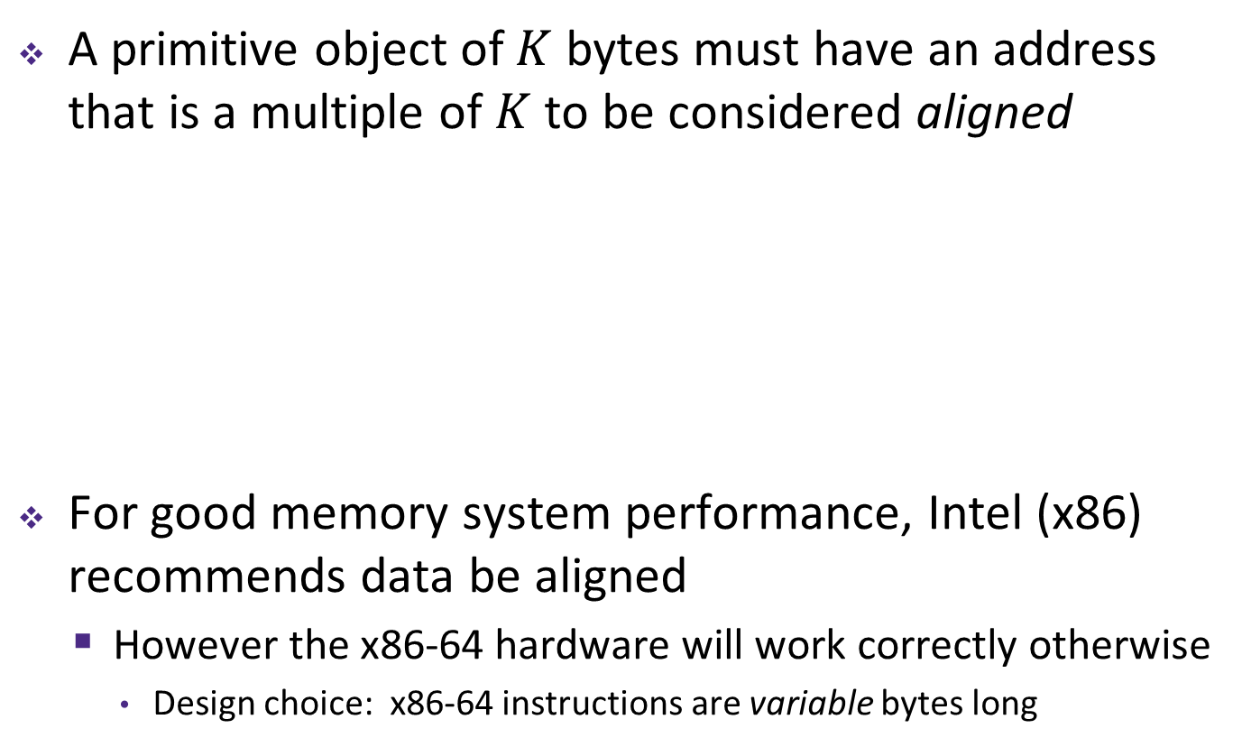
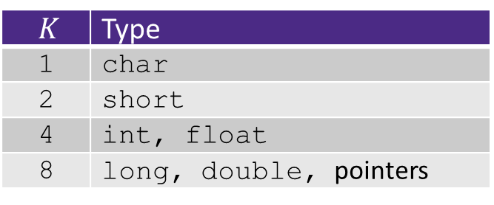
Memory Alignment Revisited
A primitive object of $K$ bytes must have an address that is a multiple of $K$ to be considered aligned
For good memory system performance, Intel (x86) recommends data be aligned
  However the x86-64 hardware will work correctly otherwise
    Design choice: x86-64 instructions are variable bytes long
$K$ | Type
1 | char
2 | short
4 | int, float
8 | long, double, pointers

Slide 25
Byte Ordering
How should bytes within a word be ordered in memory?
  Want to keep consecutive bytes in consecutive addresses
  Example: store the 4-byte (32-bit) int:
  0x a1 b2 c3 d4
By convention, ordering of bytes called endianness
  The two options are big-endian and little-endian
    In which address does the least significant byte go?
    Based on Gulliver’s Travels: tribes cut eggs on different sides
    (big, little)

Slide 26
Byte Ordering
Big-endian (SPARC, z/Architecture)
  Least significant byte has highest address
Little-endian (x86, x86-64)
  Least significant byte has lowest address
Bi-endian (ARM, PowerPC)
  Endianness can be specified as big or little
Example: 4-byte data 0xa1b2c3d4 at address 0x100
0x100
0x101
0x102
0x103
Big-Endian
01
23
45
67
0x100
0x101
0x102
0x103
Little-Endian
67
45
23
01
Notes:
Big Endian
Most significant is first
Little Endian
Looks backwards
Let’s look at some more examples…

Slide 27
Byte Ordering
Big-endian (SPARC, z/Architecture)
  Least significant byte has highest address
Little-endian (x86, x86-64)
  Least significant byte has lowest address
Bi-endian (ARM, PowerPC)
  Endianness can be specified as big or little
Example: 4-byte data 0xa1b2c3d4 at address 0x100
0x100
0x101
0x102
0x103
Big-Endian
01
a1
23
b2
45
c3
67
d4
0x100
0x101
0x102
0x103
Little-Endian
67
d4
45
c3
23
b2
01
a1
Notes:
Big Endian
Most significant is first
Little Endian
Looks backwards
Let’s look at some more examples…

Slide 28
Byte Ordering Examples
Decimal: 12345
Binary: 0011 0000 0011 1001
Hex: 3 0 3 9
IA32, x86-64
(little-endian)
SPARC
(big-endian)
int x = 12345;
// or x = 0x3039;
0x00
39
00
0x00
0x01
30
00
0x01
0x02
00
30
0x02
0x03
00
39
0x03
long int y = 12345;
// or y = 0x3039;
(A long int is
the size of a word)
32-bit
IA32
64-bit
x86-64
32-bit
SPARC
64-bit
SPARC
0x00
39
39
0x00
0x00
00
00
0x00
0x01
30
30
0x01
0x01
00
00
0x01
0x02
00
00
0x02
0x02
30
00
0x02
0x03
00
00
0x03
0x03
39
00
0x03
00
0x04
00
0x04
00
0x05
00
0x05
00
0x06
30
0x06
00
0x07
39
0x07

Slide 29
Polling Question
We store the value 0x 01 02 03 04 as a word at address 0x100 in a big-endian, 64-bit machine
What is the byte of data stored at address 0x104?
  Vote at http://pollev.com/rea
0x04
0x40
0x01
0x10
We’re lost…

Slide 30
Endianness
Endianness only applies to memory storage
Often programmer can ignore endianness because it is handled for you
  Bytes wired into correct place when reading or storing from memory (hardware)
  Compiler and assembler generate correct behavior (software)
Endianness still shows up:
  Logical issues: accessing different amount of data than how you stored it (e.g. store int, access byte as a char)
  Need to know exact values to debug memory errors
  Manual translation to and from machine code (in 351)

Slide 31
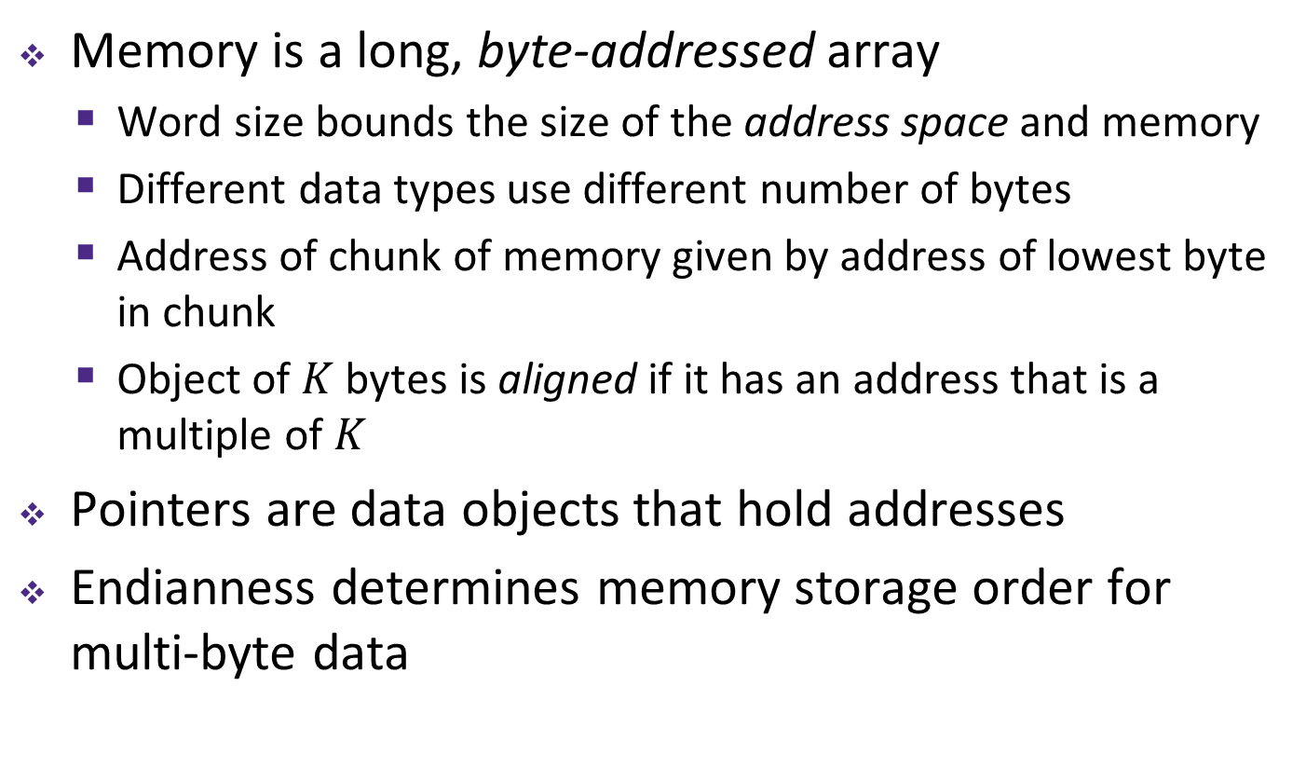
Summary
Memory is a long, byte-addressed array
  Word size bounds the size of the address space and memory
  Different data types use different number of bytes
  Address of chunk of memory given by address of lowest byte in chunk
  Object of $K$ bytes is aligned if it has an address that is a multiple of $K$
Pointers are data objects that hold addresses
Endianness determines memory storage order for multi-byte data

