Slide 1
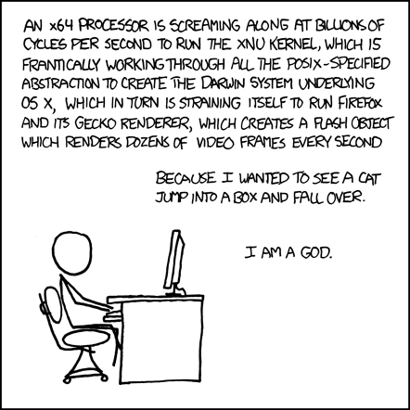
The Hardware/Software Interface CSE 351 Winter 2020
Instructor:
Ruth Anderson
Teaching Assistants:
Jonathan Chen
Justin Johnson
Porter Jones
Josie Lee
Jeffery Tian
Callum Walker
Eddy (Tianyi) Zhou
http://xkcd.com/676/
Notes:
This comic illustrates how complex computer systems are, and all the things that have to happen for a program to execute
By the end of this course, you’ll understand, mm, almost half of that, but it’s the good bits

Slide 2
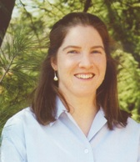
Introductions: Course Staff
Instructor: Ruth Anderson
Learn more about me and the staff on the course website!
TAs:
Available in section, office hours, and on Piazza
An invaluable source of information and help
Get to know us
We are here to help you succeed!

Slide 3
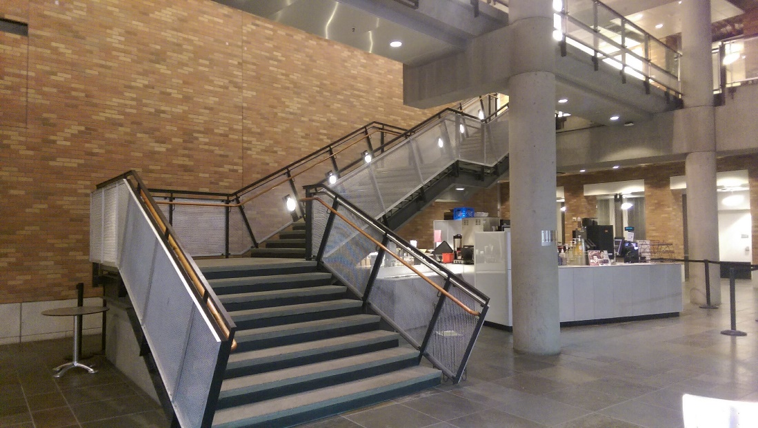
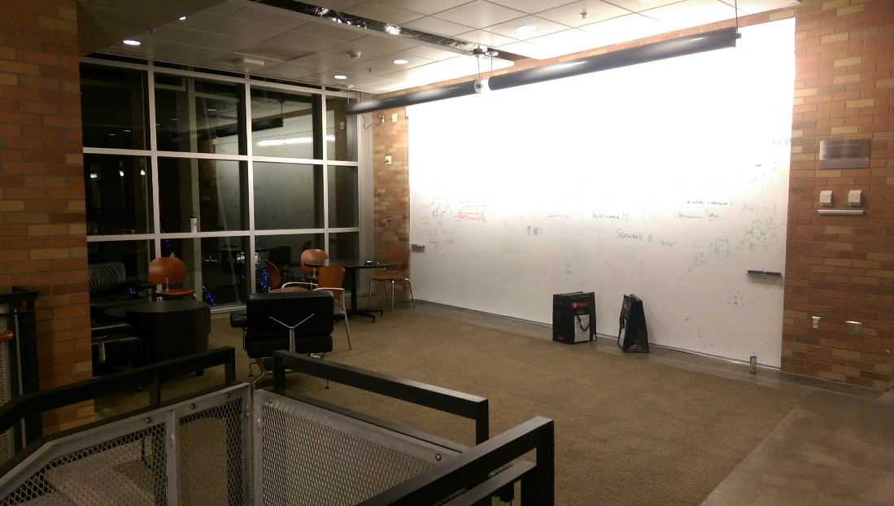
TA Office Hours – in Allen Center (CSE)
CSE 2nd floor breakout
Up the stairs in the CSE Atrium (next to the café)
At the top of that first flight, the open area with the whiteboard wall is the 2nd floor breakout!

Slide 4
Introductions: You!
~150 students registered
CSE majors, EE majors, and more
Most of you will find almost everything in the course new
Get to know each other and help each other out!
Learning is much more fun with friends
Working well with others is a valuable life skill
Diversity of perspectives expands your horizons

Slide 5
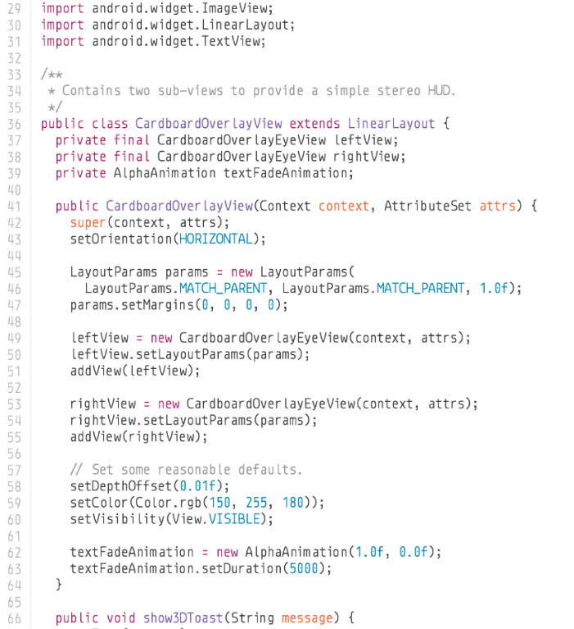
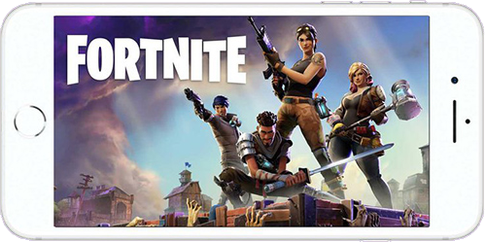
Welcome to CSE351!
1000001101111100001001000001110000000000
0111010000011000
10001011010001000010010000010100
10001011010001100010010100010100
100011010000010000000010
1000100111000010
110000011111101000011111
11110111011111000010010000011100
10001001010001000010010000011000
1000001101111100001001000001110000000000
0111010000011000
10001011010001000010010000010100
10001011010001100010010100010100
100011010000010000000010
1000100111000010
110000011111101000011111
11110111011111000010010000011100
Our goal is to teach you the key abstractions “under the hood”
How does your source code become something that your computer understands?
What happens as your computer is executing one or more processes?
HW/SW Interface

Slide 6
Welcome to CSE351!
1000001101111100001001000001110000000000
0111010000011000
10001011010001000010010000010100
10001011010001100010010100010100
100011010000010000000010
1000100111000010
110000011111101000011111
11110111011111000010010000011100
10001001010001000010010000011000
1000001101111100001001000001110000000000
0111010000011000
10001011010001000010010000010100
10001011010001100010010100010100
100011010000010000000010
1000100111000010
110000011111101000011111
11110111011111000010010000011100
This is an introduction that will:
Profoundly change/augment your view of computers and programs
Leave you impressed that computers ever work
HW/SW Interface

Slide 7
Code in Many Forms
if (x != 0) y = (y+z)/x;
High Level Language
(e.g. C, Java)
Assembly Language
Machine Code
Compiler
cmpl $0, -4(%ebp)
je .L2
movl -12(%ebp), %eax
movl -8(%ebp), %edx
leal (%edx,%eax), %eax
movl %eax, %edx
sarl $31, %edx
idivl -4(%ebp)
movl %eax, -8(%ebp)
.L2:
Assembler
1000001101111100001001000001110000000000
0111010000011000
10001011010001000010010000010100
10001011010001100010010100010100
100011010000010000000010
1000100111000010
110000011111101000011111
11110111011111000010010000011100
10001001010001000010010000011000
Notes:
All program fragments are equivalent
You’d rather write C! (more human-friendly)
Hardware executes strings of bits
In reality everything is voltages
The machine instructions are actually much shorter than the number of bits we would need to represent the characters in the assembly language

Slide 8
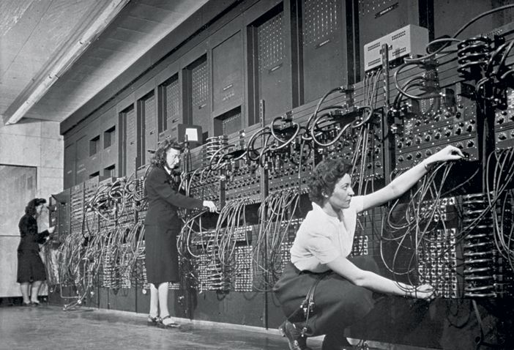
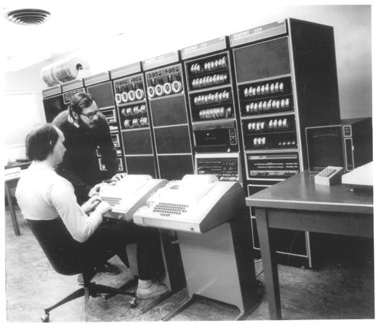
HW/SW Interface: Historical Perspective
Hardware started out quite primitive
1940s
1970s
Jean Jennings (left), Marlyn Wescoff (center), and Ruth Lichterman program ENIAC at the University of Pennsylvania, circa 1946. Photo: Corbis
http://fortune.com/2014/09/18/walter-isaacson-the-women-of-eniac/
https://s-media-cache-ak0.pinimg.com/564x/91/37/23/91372375e2e6517f8af128aab655e3b4.jpg
Notes:
In 1946, programming meant changing where a bunch of wires were plugged in
By 1970, these guys (one of whom is Ritchie, who wrote the C book), are typing instructions into a PDP-11

Slide 9
HW/SW Interface: Historical Perspective
Hardware started out quite primitive
Programmed with very basic instructions (primitives)
e.g., a single instruction for adding two integers
Software was also very basic
Closely reflected the actual hardware it was running on
Specify each step manually
Architecture Specification (Interface)
Hardware
Notes:
Everything the computer can do, exposed as instructions
This meant software is also pretty simple, basically lists of instructions to execute
Manually specify each instruction
As computers got more complex, we needed help

Slide 10
HW/SW Interface: Assemblers
Life was made a lot better by assemblers
1 assembly instruction = 1 machine instruction
More human-readable syntax
Assembly instructions are character strings, not bit strings
Can use symbolic names
Assembler specification
User program in assembly language
Assembler
Hardware
Notes:
Someone realized they could write a program that would turn scripts into programs
Easier to write
Still basically a one-to-one mapping
As we got more sophisticated, built more sophisticated languages…

Slide 11
HW/SW Interface: Higher-Level Languages
Higher level of abstraction
1 line of a high-level language is compiled into many (sometimes very many) lines of assembly language
C language specification
User program in C
C Compiler
Assembler
Hardware
Notes:
Translation from higher-level languages down to machine code.
New features: functions! Data structures! Classes!

Slide 12
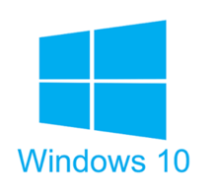
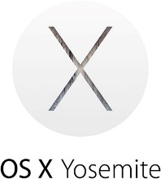
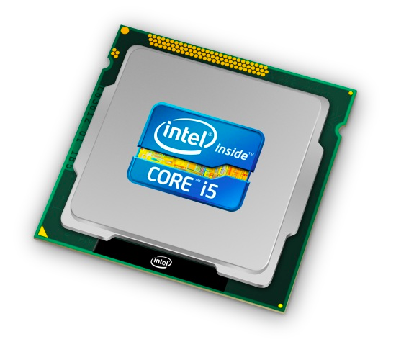
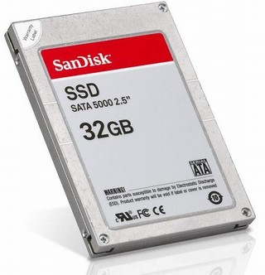
Roadmap
How does your source code become something that your computer understands?
C:
Java:
Memory & data
Integers & floats
x86 assembly
Procedures & stacks
Executables
Arrays & structs
Memory & caches
Processes
Virtual memory
Memory allocation
Java vs. C
car *c = malloc(sizeof(car));
c->miles = 100;
c->gals = 17;
float mpg = get_mpg(c);
free(c);
Car c = new Car();
c.setMiles(100);
c.setGals(17);
float mpg = c.getMPG();
Assembly language:
get_mpg:
pushq %rbp
movq %rsp, %rbp
...
popq %rbp
ret
OS:
Machine code:
0111010000011000
100011010000010000000010
1000100111000010
110000011111101000011111
Computer system:

Slide 13
Roadmap
What happens as your computer is executing one or more processes?
C:
Java:
Memory & data
Integers & floats
x86 assembly
Procedures & stacks
Executables
Arrays & structs
Memory & caches
Processes
Virtual memory
Memory allocation
Java vs. C
car *c = malloc(sizeof(car));
c->miles = 100;
c->gals = 17;
float mpg = get_mpg(c);
free(c);
Car c = new Car();
c.setMiles(100);
c.setGals(17);
float mpg = c.getMPG();
Assembly language:
get_mpg:
pushq %rbp
movq %rsp, %rbp
...
popq %rbp
ret
OS:
Machine code:
0111010000011000
100011010000010000000010
1000100111000010
110000011111101000011111
Computer system:

Slide 14
Course Perspective
CSE351 will make you a better programmer
Purpose is to show how software really works
Understanding of some of the abstractions that exist between programs and the hardware they run on, why they exist, and how they build upon each other
Understanding the underlying system makes you more effective
Better debugging
Better basis for evaluating performance
How multiple activities work in concert (e.g. OS and user programs)
“Stuff everybody learns and uses and forgets not knowing”
CSE351 presents a world-view that will empower you
The intellectual and software tools to understand the trillions+ of 1s and 0s that are “flying around” when your program runs
Notes:
Not just a course for hardware enthusiasts!
What every programmer needs to know (plus many more details)

Slide 15
Lecture Outline
Course Introduction
Course Policies
https://courses.cs.washington.edu/courses/cse351/20wi/syllabus/
Binary

Slide 16
Bookmarks
Course Website: http://cs.uw.edu/351
Schedule, policies, materials, videos, assignments, etc.
Discussion: http://piazza.com/washington/winter2020/cse351
Announcements made here
Ask and answer questions – staff will monitor and contribute
Gradescope: https://www.gradescope.com/courses/75879
Assignment submissions
Canvas: https://canvas.uw.edu/courses/1352194
Gradebook
Poll Everywhere: http://pollev.com/rea
In-lecture voting

Slide 17
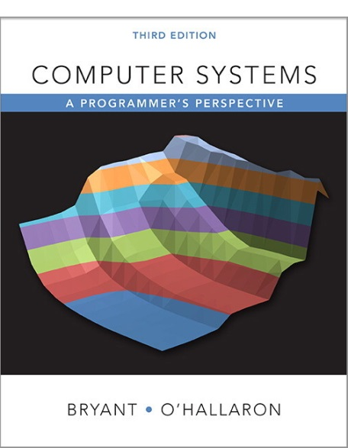
Textbooks
Computer Systems: A Programmer’s Perspective
Randal E. Bryant and David R. O’Hallaron
Website: http://csapp.cs.cmu.edu
Must be (North American) 3rd edition
http://csapp.cs.cmu.edu/3e/changes3e.html
http://csapp.cs.cmu.edu/3e/errata.html
This book really matters for the course!
Lecture readings
Practice problems and homework
A good C book – any will do
The C Programming Language (Kernighan and Ritchie)
C: A Reference Manual (Harbison and Steele)

Slide 18
Grading
Homework: 20% total
Autograded; unlimited submission attempts
Group work encouraged
Labs: 30% total
Graded by TAs; last submission graded
Individual work only
Exams: Midterm (15%) and Final (30%)
Many old exams on course website
EPA: Effort, Participation, and Altruism (5%)

Slide 19
Lab Collaboration and Academic Integrity
All submissions are expected to be yours and yours alone
You are encouraged to discuss your assignments with other students (ideas), but we expect that what you turn in is yours
It is NOT acceptable to copy solutions from other students or to copy (or start your) solutions from the Web (including Github)
Our goal is that *YOU* learn the material so you will be prepared for exams, interviews, and the future

Slide 20
EPA
Encourage class-wide learning!
Effort
Attending office hours, completing all assignments
Keeping up with Piazza activity
Participation
Making the class more interactive by asking questions in lecture, section, office hours, and on Piazza
Peer instruction voting
Altruism
Helping others in section, office hours, and on Piazza

Slide 21
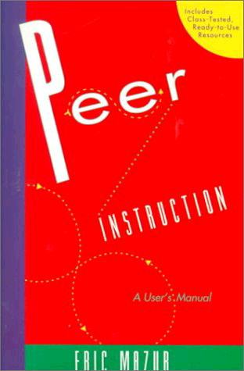
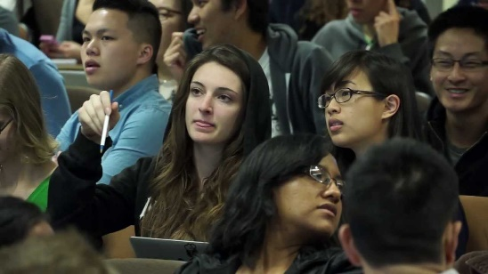
Lecture Polling
Increase real-time learning in lecture, test your understanding, increase student interactions
Lots of research supports its effectiveness
Multiple choice question during lecture
1 minute to decide on your own
2-4 minutes in pairs to reach consensus
Learn through discussion & teaching
Vote using
Use website (https://www.polleverywhere.com) or app
Linked to your UWNetID

Slide 22
Some fun topics that we will touch on
Which of the following seems the most interesting to you? (vote at http://pollev.com/rea)
What is a GFLOP and why is it used in computer benchmarks?
How and why does running many programs for a long time eat into your memory (RAM)?
What is stack overflow and how does it happen?
Why does your computer slow down when you run out of disk space?
What was the flaw behind the original Internet worm, the Heartbleed bug, and the Cloudbleed bug?
What is the meaning behind the different CPU specifications? (e.g. # of cores, # and size of cache, supported memory types)

Slide 23
Tips for Success in 351
Attend all lectures and sections
Avoid devices during lecture except for Poll Everywhere
Do the textbook readings ahead of time
Learn by doing
Can answer many questions by writing small programs
Visit Piazza often
Ask questions and try to answer fellow students’ questions
Go to office hours
Even if you don’t have specific questions in mind
Find a study and homework group
Start assignments early
Don’t be afraid to ask questions
Notes:
http://www.npr.org/2016/04/17/474525392/attention-students-put-your-laptops-away

Slide 24
To-Do List
Admin
Explore/read website thoroughly: http://cs.uw.edu/351
Check that you are enrolled in Piazza; read posts
Log in to Poll Everywhere
Get your machine set up for this class (VM or attu) as soon as possible
Make sure you’re also enrolled in CSE391! (EEs included)
TOMORROW, Tuesday 2:30-3:20 in SIG 134
Assignments
Pre-Course Survey and hw0 due Wednesday (1/08) – 11:59pm ←
hw1 due Friday (1/10) – 11am & Lab 0 due Friday (1/10) – 11:59pm
hw2 due Monday (1/13) – 11am
hw3 due Wednesday (1/15) – 11am, etc.
Special case!

Slide 25
Lecture Outline
Course Introduction
Course Policies
Binary
Decimal, Binary, and Hexadecimal
Base Conversion
Binary Encoding

Slide 26
Decimal Numbering System
Ten symbols: 0, 1, 2, 3, 4, 5, 6, 7, 8, 9
Represent larger numbers as a sequence of digits
Each digit is one of the available symbols
Example: 7061 in decimal (base 10)
7061₁₀ = (7 $×$ 10³) + (0 $×$ 10²) + (6 $×$ 10¹) + (1 $×$ 10⁰)
Notes:
Ones digit, Tens digit, Hundreds digit, etc.

Slide 27
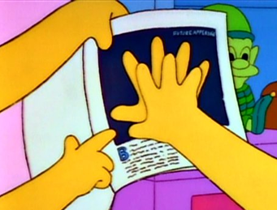
Octal Numbering System
Eight symbols: 0, 1, 2, 3, 4, 5, 6, 7
Notice that we no longer use 8 or 9
Base comparison:
Base 10: 0, 1, 2, 3, 4, 5, 6, 7, 8, 9, 10, 11, 12…
Base 8: 0, 1, 2, 3, 4, 5, 6, 7, 10, 11, 12, 13, 14…
Example: What is 7061₈ in base 10?
7061₈ = (7 $×$ 8³) + (0 $×$ 8²) + (6 $×$ 8¹) + (1 $×$ 8⁰) = 3633₁₀

Slide 28
Warmup Question
What is 34₈ in base 10?
No voting for this question
32₁₀
34₁₀
7₁₀
28₁₀
35₁₀

Slide 29
Binary and Hexadecimal
Binary is base 2
Symbols: 0, 1
Convention: 2₁₀ = 10₂ = 0b10
Example: What is 0b110 in base 10?
0b110 = 110₂ = (1 $×$ 2²) + (1 $×$ 2¹) + (0 $×$ 2⁰) = 6₁₀
Hexadecimal (hex, for short) is base 16
Symbols? 0, 1, 2, 3, 4, 5, 6, 7, 8, 9, …?
Convention: 16₁₀ = 10₁₆ = 0x10
Example: What is 0xA5 in base 10?
0xA5 = A5₁₆ = (10 $×$ 16¹) + (5 $×$ 16⁰) = 165₁₀
9, A, B, C, D, E, F

Slide 30
Polling Question
Which of the following orderings is correct?
0xC < 0b1010 < 11
0xC < 11 < 0b1010
11 < 0b1010 < 0xC
0b1010 < 11 < 0xC
0b1010 < 0xC < 11
Think on your own for a minute, then discuss with your neighbor(s)
Vote at http://pollev.com/rea

Slide 31
Converting to Base 10
Can convert from any base to base 10
0b110 = 110₂ = (1 $×$ 2²) + (1 $×$ 2¹) + (0 $×$ 2⁰) = 6₁₀
0xA5 = A5₁₆ = (10 $×$ 16¹) + (5 $×$ 16⁰) = 165₁₀
We learned to think in base 10, so this is fairly natural for us
Challenge: Convert into other bases (e.g. 2, 16)

Slide 32
Challenge Question
Convert 13₁₀ into binary
Hints:
2³ = 8
2² = 4
2¹ = 2
2⁰ = 1
Discuss with your neighbor(s)
No voting for this question

Slide 33
Converting from Decimal to Binary
Given a decimal number N:
List increasing powers of 2 from right to left until $≥$ N
Then from left to right, ask is that (power of 2) $≤$ N?
If YES, put a 1 below and subtract that power from N
If NO, put a 0 below and keep going
Example: 13 to binary
2⁴=16 | 2³=8 | 2²=4 | 2¹=2 | 2⁰=1

Slide 34
Converting from Decimal to Base B
Given a decimal number N:
List increasing powers of B from right to left until $≥$ N
Then from left to right, ask is that (power of B) $≤$ N?
If YES, put how many of that power go into N and subtract from N
If NO, put a 0 below and keep going
Example: 165 to hex
16²=256 | 16¹=16 | 16⁰=1

Slide 35
Converting Binary $↔$ Hexadecimal
Hex $→$ Binary
Substitute hex digits, then drop any leading zeros
Example: 0x2D to binary
0x2 is 0b0010, 0xD is 0b1101
Drop two leading zeros, answer is 0b101101
Binary $→$ Hex
Pad with leading zeros until multiple of 4, then substitute each group of 4
Example: 0b101101
Pad to 0b 0010 1101
Substitute to get 0x2D
Base 10 | Base 2 | Base 16
0 | 0000 | 0
1 | 0001 | 1
2 | 0010 | 2
3 | 0011 | 3
4 | 0100 | 4
5 | 0101 | 5
6 | 0110 | 6
7 | 0111 | 7
8 | 1000 | 8
9 | 1001 | 9
10 | 1010 | A
11 | 1011 | B
12 | 1100 | C
13 | 1101 | D
14 | 1110 | E
15 | 1111 | F

Slide 36
Binary $→$ Hex Practice
Convert 0b100110110101101
How many digits?
Pad:
Substitute:
Base 10 | Base 2 | Base 16
0 | 0000 | 0
1 | 0001 | 1
2 | 0010 | 2
3 | 0011 | 3
4 | 0100 | 4
5 | 0101 | 5
6 | 0110 | 6
7 | 0111 | 7
8 | 1000 | 8
9 | 1001 | 9
10 | 1010 | A
11 | 1011 | B
12 | 1100 | C
13 | 1101 | D
14 | 1110 | E
15 | 1111 | F

Slide 37
Base Comparison
Why does all of this matter?
Humans think about numbers in base 10, but computers “think” about numbers in base 2
Binary encoding is what allows computers to do all of the amazing things that they do!
You should have this table memorized by the end of the class
Might as well start now!
Base 10 | Base 2 | Base 16
0 | 0000 | 0
1 | 0001 | 1
2 | 0010 | 2
3 | 0011 | 3
4 | 0100 | 4
5 | 0101 | 5
6 | 0110 | 6
7 | 0111 | 7
8 | 1000 | 8
9 | 1001 | 9
10 | 1010 | A
11 | 1011 | B
12 | 1100 | C
13 | 1101 | D
14 | 1110 | E
15 | 1111 | F

Slide 38
Numerical Encoding
AMAZING FACT: You can represent anything countable using numbers!
Need to agree on an encoding
Kind of like learning a new language
Examples:
Decimal Integers: 0$→$0b0, 1$→$0b1, 2$→$0b10, etc.
English Letters: CSE$→$0x435345, yay$→$0x796179
Emoticons: 😃 0x0, 😞 0x1, 😎 0x2, 😇 0x3, 😈 0x4, 🙋 0x5
Notes:
Base 2 is too hard for humans to read, so we use base 16 as a convenient way to hold what is effectively binary data in our brains.

Slide 39
Binary Encoding
With N binary digits, how many “things” can you represent?
Need N binary digits to represent $n$ things, where 2^{N} $≥n$
Example: 5 binary digits for alphabet because 2⁵ = 32 > 26
A binary digit is known as a bit
A group of 4 bits (1 hex digit) is called a nibble
A group of 8 bits (2 hex digits) is called a byte
1 bit $→$ 2 things, 1 nibble $→$ 16 things, 1 byte $→$ 256 things

Slide 40
So What’s It Mean?
A sequence of bits can have many meanings!
Consider the hex sequence 0x4E6F21
Common interpretations include:
The decimal number 5140257
The characters “No!”
The background color of this slide
The real number 7.203034 $×$ 10⁻³⁹
It is up to the program/programmer to decide how to interpret the sequence of bits

Slide 41
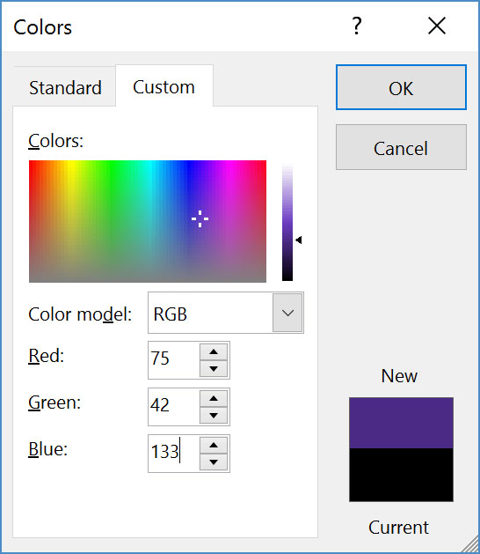
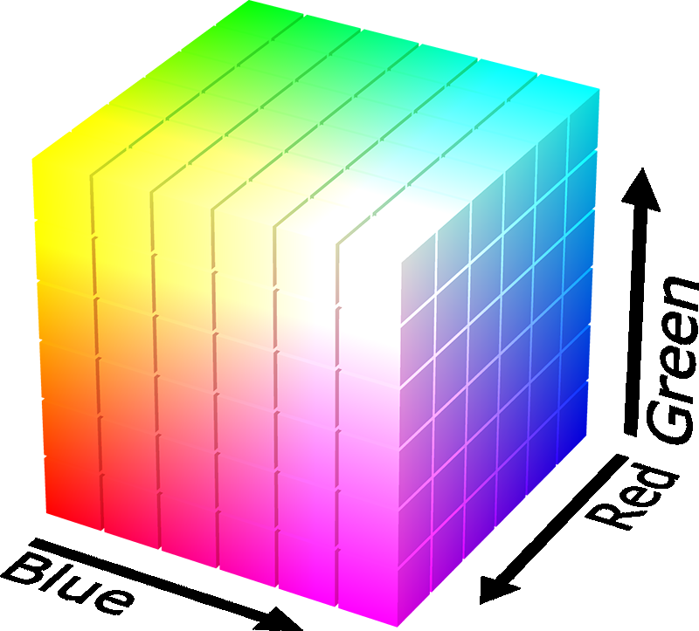
Binary Encoding – Colors
RGB – Red, Green, Blue
Additive color model (light): byte (8 bits) for each color
Commonly seen in hex (in HTML, photo editing, etc.)
Examples: Blue$→$0x0000FF, Gold$→$0xFFD700, White$→$0xFFFFFF, Deep Pink$→$0xFF1493

Slide 42
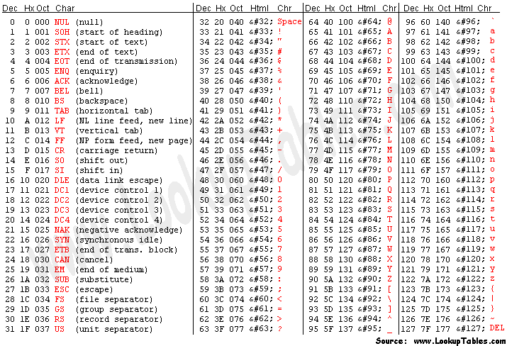
Binary Encoding – Characters/Text
ASCII Encoding (www.asciitable.com)
American Standard Code for Information Interchange
Notes:
Also: man ascii

Slide 43
Binary Encoding – Files and Programs
At the lowest level, all digital data is stored as bits!
Layers of abstraction keep everything comprehensible
Data/files are groups of bits interpreted by program
Program is actually groups of bits being interpreted by your CPU
Computer Memory Demo (if time)
From vim: %!xxd
From emacs: M-x hexl-mode

Slide 44
Summary
Humans think about numbers in decimal; computers think about numbers in binary
Base conversion to go between them
Hexadecimal is more human-readable than binary
All information on a computer is binary
Binary encoding can represent anything!
Computer/program needs to know how to interpret the bits

