Slide 1
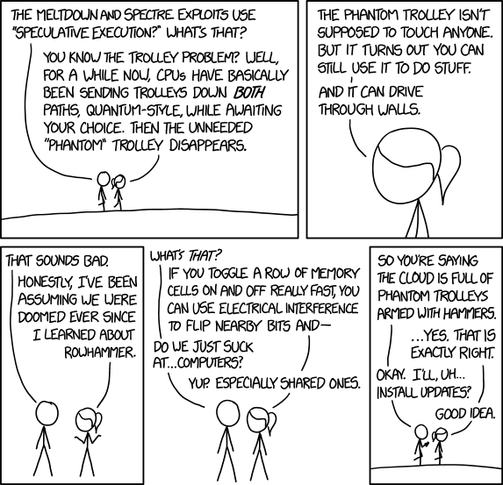
Section 9: TA Choice! CSE 351, Summer 2020
Sam Wolfson
Tim Mandzyuk
https://xkcd.com/1938/

Slide 2
Course Evaluations
This is the part where we bug you to also fill out course evals for section.
This feedback is super valuable to us
Help your TAs become better TAs
Help us make improvements to CSE 351 in the future
You’ve heard it all before (but it’s still true)
https://uw.iasystem.org/survey/228938

Slide 3
Speculative Execution
We haven’t quite been honest with you this quarter…
Modern Intel (and other) CPUs actually work hundreds of instructions ahead of what your program is doing at any given time
Branch prediction: CPU tries to predict which branch your program will take, and executes those instructions ahead of time (“speculatively”)
Based on past program behavior
while(1) {
if (rand() > 0.9) {
// <code A>
} else {
// <code B>
}
}
CPU will eventually figure out that code A is usually executed, and, after a few loop iterations, will speculatively execute code A before the if statement is reached!
Notes:
Branch prediction is its own really interesting field: https://danluu.com/branch-prediction/
You would also learn more about this in Computer Architecture

Slide 4
Speculative Execution
If the CPU predicts incorrectly, the results are discarded before the program knows they exist.
Maintains correctness, just loses a little speed
However…
Instructions executed speculatively do not trigger exceptions for access to privileged memory locations
And, these instructions affect the cache
Notes:
See where this is going?

Slide 5
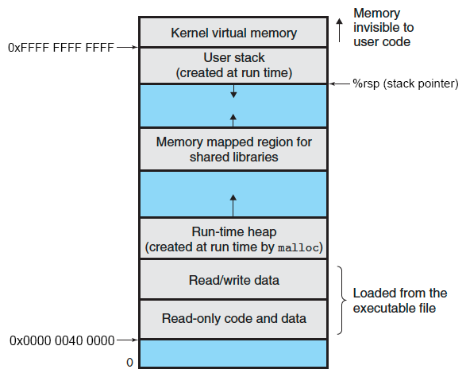
Reminder: Virtual Memory Layout
Notes:
Common practice to map all of physical memory somewhere in the kernel’s address space. Normally a user process cannot access this, since it will cause a segfault. But what if it didn’t?

Slide 6
Reminder: Virtual Memory Layout
Physical Memory
Modern operating systems map kernel memory into each process’s VA space.
Speeds up system calls
Kernel memory often contains mapping for the computer’s entire physical memory
Notes:
Common practice to map all of physical memory somewhere in the kernel’s address space.
Normally a user process can address this (after all, the data is in the address space), but it cannot actually access it, since that will cause a segfault. But what if it didn’t?

Slide 7
Meltdown Example
#define N <time to access cache>
#define PAGE_SIZE 4096
char array[256 * PAGE_SIZE];
flushCache();
// <train branch predictor>
if (<condition that is always false>) {
char data = *(<kernel address>);
char ignored = array[data * PAGE_SIZE];
}
for (int i = 0; i < 255; i++)
if (accessTime(array[i * PAGE_SIZE]) <= N)
return i;
Recall that kernel memory maps entire physical memory!
Only executed speculatively
Notes:
Set up array that is large enough to span 256 pages
Possible values for a byte: 0-255
Train branch predictor to execute code inside conditional
Speculatively try to access (dereference) a byte from kernel memory
Use that as an index into the array, multiplied by PAGE_SIZE to ensure that adjacent accesses are not cached together
This means that the memory location arr+(data * PAGE_SIZE) will be cached!
Try to access each array index (separated by PAGE_SIZE) and time how long it takes.
The index that took much less time corresponds to the secret data!
Notice that we never directly knew the value of the variable “ignored” – actually trying to dereference the kernel address would have caused a segfault.
We re-discover this value indirectly by tricking the CPU into caching it as the index of an array in memory that we do have access to

Slide 8
Meltdown Example
Look for unusually fast accesses to the array
for (int i = 0; i < 255; i++)
if (accessTime(array[i * PAGE_SIZE]) <= N)
return i;
Only executed speculatively
Notes:
The access which runs much more quickly was cached – that was the value that we stashed in the array!

Slide 9
How to Perform An Attack with Meltdown
Set up an array that is large enough to span 256 pages
So we can index into it using a byte
Speculatively try to access a byte from kernel memory
Use that as an index into the array, multiplied by your system’s page size to ensure that adjacent accesses are not cached together
Try to access each array index (separated by the page size) and time how long it takes.
The index that took much less time to access corresponds to the secret data!

Slide 10
How to Mitigate Meltdown
Don’t map kernel memory into user address space
This means that system calls are slower, because they require switching out page tables
Linux: KAISER
Separate page tables for user process and kernel
“Shadow” page tables accessible from user processes have extremely limited access to kernel memory, just enough to make system calls
https://lwn.net/Articles/738975/
Further reading
https://meltdownattack.com/
https://medium.com/@mattklein123/meltdown-spectre-explained-6bc8634cc0c2

Slide 11
Computer Networks
Connecting computers to share resources
Most common network is… Internet!
Open System Interconnection (OSI) is an architectural model for open networking systems
7 Layers
Notes:
OSI Model helps make a universally accepted networking protocol, although not every network communication system follows the “idealized” model

Slide 12
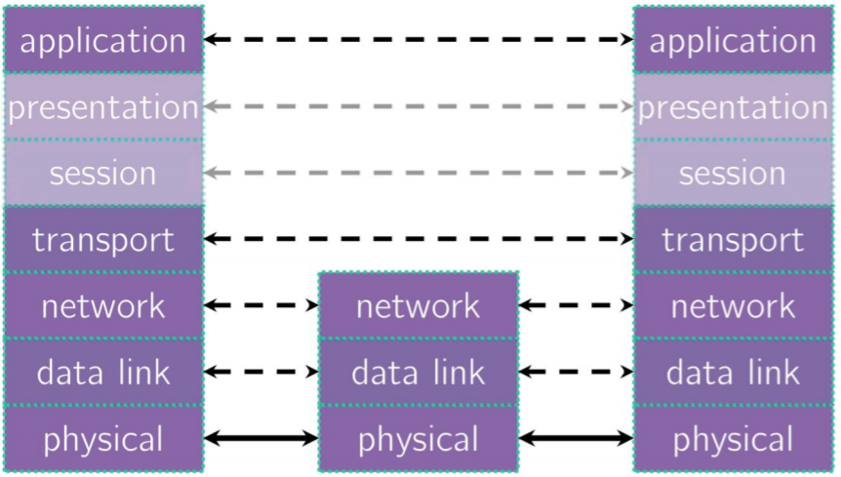
Computer Networks: ISO 7 Layers

Slide 13
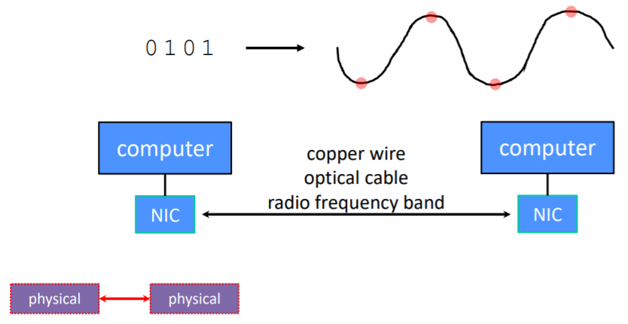
Computer Networks: Physical Layer
Individual bits are modulated onto a wire or transmitted over radio
Physical layer specifies how bits are encoded at a signal level
Encoding depending on the system
“1” as +1v, “0” as -1v
“0” as +1v, “1” as -1v
Notes:
Defines network transmission media, signaling methods, bit synchronization, architecture(e.g. Ethernet), cabling, NICS interact with media (cabling). Deals with the actual 1s and 0s sent through networks. NIC is a card that plugs into system bus of computer and allows computer to send and receive signals on a network

Slide 14
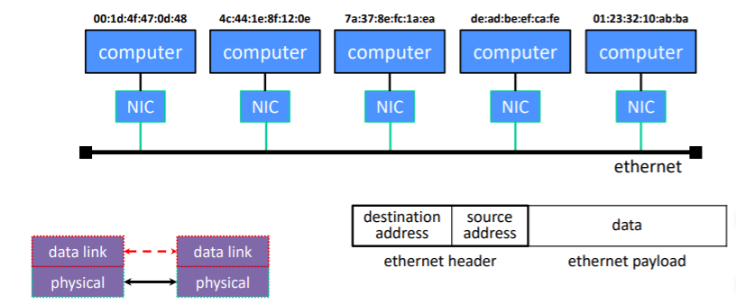
Computer Networks: Data Link Layer
Multiple computers on a Local Area Network (LAN) contend for the network medium
Media Access Control (MAC) specifies how computers cooperate
Link layer also specifies how bits are “packetized” and Network Interface Controllers (NIC) are addressed
Notes:
Specifies how data bits are grouped into frames as well as the frame formats. Responsible for hardware addressing, flow control, error correction, and how devices switch operations. Divides into LLC layer and MAC layer

Slide 15
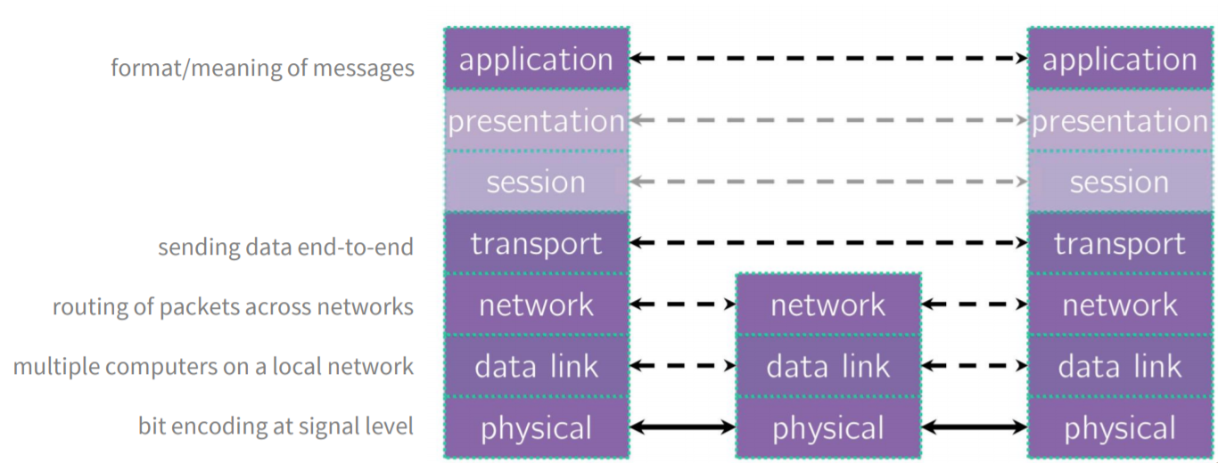
Computer Networks: OSI 7 Layers
Classes to take
CSE 333
CSE 461
Further reading
https://networkencyclopedia.com/

Slide 16
Courses: What’s Next?
Staying near the hardware/software interface:
EE271/CSE369: Digital Design – basic hardware design using FPGAs
EE/CSE474: Embedded Systems – software design for microcontrollers
Systems software
CSE341: Programming Languages (or CSE413 for non-majors)
CSE332: Data Structures and Parallelism (or CSE373 for non-majors)
CSE333: Systems Programming – building well-structured systems in C/C++ (or CSE374 for non-majors)
Looking ahead
CSE401: Compilers (pre-reqs: 332) (or CSE413 for non-majors)
CSE451: Operating Systems (pre-reqs: 332, 333)
CSE461: Networks (pre-reqs: 332, 333)
= course that Tim has taken
= course that Sam has taken

Slide 17
Personal Recommendations
YouTube Channel: Computerphile
Videos about lots of computing topics, many relevant to 351
https://www.youtube.com/channel/UC9-y-6csu5WGm29I7JiwpnA
YouTube Channel: The 8-Bit Guy
Videos about old computers and how things worked before we built up all the abstractions that we now take for granted
https://www.youtube.com/channel/UC8uT9cgJorJPWu7ITLGo9Ww
TV Series: Halt and Catch Fire
Drama series about design of IBM PC clone
Article: “Everything Is Broken”
“C is good for two things: being beautiful and creating catastrophic 0days in memory management.”
https://medium.com/message/everything-is-broken-81e5f33a24e1
Article: “Programming Sucks”
“Not a single living person knows how everything in your five-year-old MacBook actually works.”
https://www.stilldrinking.org/programming-sucks
Notes:
Articles seem pretty pessimistic, but maybe they’ll inspire you to actually write code that is better than what they describe!
Better appreciation for all the complexity
There are a lot of youtube channels that are super interesting and talk about the reasoning behind why computers these days work the day that they do.

Slide 18
Ask Us Anything!

