Slide 1
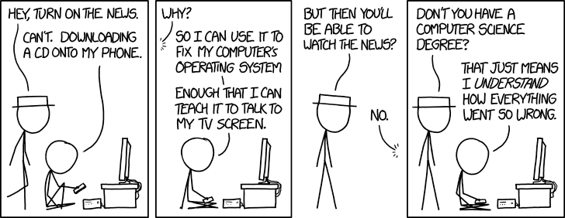
Java and C (part II) + Course Wrap-Up CSE 351 Summer 2020
Instructor: Teaching Assistants:
Porter Jones Amy Xu
Callum Walker
Sam Wolfson
Tim Mandzyuk
https://xkcd.com/1760/

Slide 2
Administrivia
Questions doc: https://tinyurl.com/CSE351-8-21
Can still do hw19 (it’s optional/not for credit)
hw23 due Monday (8/24) – 10:30am
Cover most of the material today, a few more things Friday
Lab 5 and Unit Summary 3 due tonight!(Friday 8/21)
Cutoff is tomorrow, Saturday 8/22 @11:59pm (only one late day can be used!)

Slide 3
Course Evaluation Reminder Meme
Reminder to please fill out your course evaluations!! (you should have received a couple emails with a link to the eval)

Slide 4
Virtual Machine Model
High-Level Language Program (e.g. Java, C)
Bytecode compiler (e.g. javac Foo.java)
Ahead-of-time compiler
compile time
Virtual Machine Language (e.g. Java bytecodes)
run time
Virtual machine (interpreter) (e.g. java Foo)
JIT compiler
Native Machine Language (e.g. x86, ARM, MIPS)

Slide 5
Java Bytecode
Holds pointer this
Like assembly code for JVM, but works on all JVMs
Hardware-independent!
Typed (unlike x86 assembly)
Strong JVM protections
Other arguments to method
Other local variables
0
1
2
3
4
n
variable table
operand stack
constant pool

Slide 6
JVM Operand Stack
Holds pointer this
Other arguments to method
Other local variables
JVM:
0
1
2
3
4
n
variable table
‘i’ = integer,
‘a’ = reference,
‘b’ for byte,
‘c’ for char,
‘d’ for double, ...
operand stack
constant
pool
Bytecode:
iload 1 // push 1st argument from table onto stack
iload 2 // push 2nd argument from table onto stack
iadd // pop top 2 elements from stack, add together, and // push result back onto stack
istore 3 // pop result and put it into third slot in table
Compiled
to (IA32) x86:
mov 8(%ebp), %eax
mov 12(%ebp), %edx
add %edx, %eax
mov %eax, -8(%ebp)
No registers or stack locations!
All operations use operand stack

Slide 7
A Simple Java Method
Method java.lang.String getEmployeeName()
0 aload 0 // "this" object is stored at 0 in the var table
1 getfield #5 <Field java.lang.String name>
// getfield instruction has a 3-byte encoding
// Pop an element from top of stack, retrieve its
// specified instance field and push it onto stack
// "name" field is the fifth field of the object
4 areturn // Returns object at top of stack
Byte number:
0
1
4
aload_0
getfield
00
05
areturn
As stored in the .class file:
2A
B4
00
05
B0
http://en.wikipedia.org/wiki/Java_bytecode_instruction_listings
Notes:
a prefix on aload, areturn indicates reference (see previous slide).
getfield is the bytecode instruction to get a field’s value for a particular object; to get a static value for a particular class, the getstatic bytecode instruction is used.

Slide 8
Class File Format
Every class in Java source code is compiled to its own class file
10 sections in the Java class file structure:
Magic number: 0xCAFEBABE (legible hex from James Gosling – Java’s inventor)
Version of class file format: The minor and major versions of the class file
Constant pool: Set of constant values for the class
Access flags: For example whether the class is abstract, static, final, etc.
This class: The name of the current class
Super class: The name of the super class
Interfaces: Any interfaces in the class
Fields: Any fields in the class
Methods: Any methods in the class
Attributes: Any attributes of the class (for example, name of source file, etc.)
A .jar file collects together all of the class files needed for the program, plus any additional resources (e.g. images)
Notes:
http://en.wikipedia.org/wiki/Java_class_file#Sections

Slide 9
Disassembled Java Bytecode
Compiled from Employee.java
class Employee extends java.lang.Object {
public Employee(java.lang.String,int);
public java.lang.String getEmployeeName();
public int getEmployeeNumber();
}
Method Employee(java.lang.String,int)
0 aload_0
1 invokespecial #3 <Method java.lang.Object()>
4 aload_0
5 aload_1
6 putfield #5 <Field java.lang.String name>
9 aload_0
10 iload_2
11 putfield #4 <Field int idNumber>
14 aload_0
15 aload_1
16 iload_2
17 invokespecial #6 <Method void storeData(java.lang.String, int)>
20 return
Method java.lang.String getEmployeeName()
0 aload_0
1 getfield #5 <Field java.lang.String name>
4 areturn
Method int getEmployeeNumber()
0 aload_0
1 getfield #4 <Field int idNumber>
4 ireturn
Method void storeData(java.lang.String, int)
…
> javac Employee.java
> javap -c Employee
http://en.wikipedia.org/wiki/Java_bytecode_instruction_listings
Notes:
The first opcode instruction at location 0, aload_0, pushes the this reference onto the operand stack. (Remember, the first entry of the local variable table for instance methods and constructors is this reference.)
The next opcode instruction at location 1, invokespecial, calls the constructor of this class's superclass. Because all classes that do not explicitly extend any other class implicitly inherit from java.lang.Object , the compiler provides the necessary bytecode to invoke this base class constructor. During this opcode, the top value from the operand stack, this, is popped.
The next two opcodes, at locations 4 and 5 push the first two entries from the local variable table onto the operand stack. The first value to be pushed is the this reference. The second value is the first formal parameter to the constructor, strName . These values are pushed in preparation for the putfield opcode instruction at location 6.
The putfield opcode pops the two top values off the stack and stores a reference to strName into the instance data name of the object referenced by this .
The next three opcode instructions at locations 9, 10, and 11 perform the same operation with the second formal parameter to the constructor, num , and the instance variable, idNumber .
The next three opcode instructions at locations 14, 15, and 16 prepare the stack for the storeData method call. These instructions push the this reference, strName , and num , respectively. The this reference must be pushed because an instance method is being called. If the method was declared static, the this reference would not need to be pushed. The strName and num values are pushed since they are the parameters to the storeData method. When the storeData method executes, the this reference, strName , and num , will occupy indexes 0, 1, and 2, respectively, of the local variable table contained in the frame for that method.

Slide 10
Other languages for JVMs
JVMs run on so many computers that compilers have been built to translate many other languages to Java bytecode:
AspectJ, an aspect-oriented extension of Java
ColdFusion, a scripting language compiled to Java
Clojure, a functional Lisp dialect
Groovy, a scripting language
JavaFX Script, a scripting language for web apps
JRuby, an implementation of Ruby
Jython, an implementation of Python
Rhino, an implementation of JavaScript
Scala, an object-oriented and functional programming language
And many others, even including C!
Originally, JVMs were designed and built for Java (still the major use) but JVMs are also viewed as a safe, GC’ed platform
Notes:
http://en.wikipedia.org/wiki/List_of_JVM_languages

Slide 11
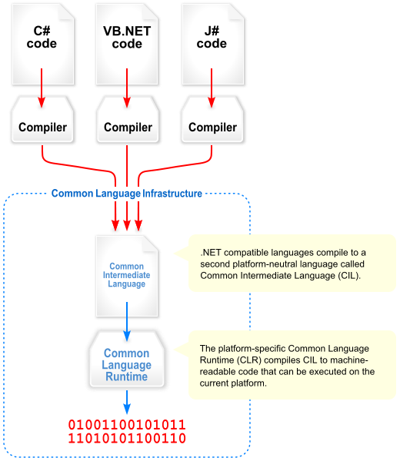
Microsoft’s C# and .NET Framework
C# has similar motivations as Java
Virtual machine is called the Common Language Runtime
Common Intermediate Language is the bytecode for C# and other languages in the .NET framework

Slide 12
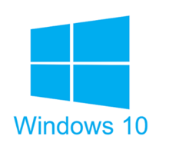
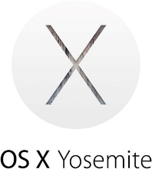
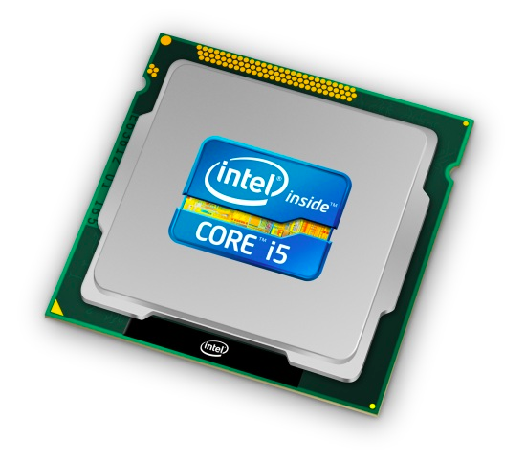
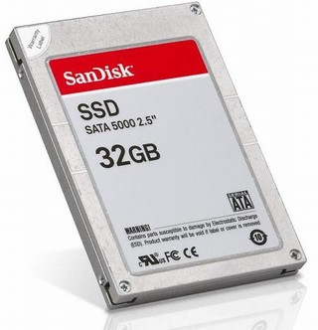
We made it! ☺
C:
Java:
Memory & data
Integers & floats
x86 assembly
Procedures & stacks
Executables
Arrays & structs
Memory & caches
Processes
Virtual memory
Memory allocation
Java vs. C
car *c = malloc(sizeof(car));
c->miles = 100;
c->gals = 17;
float mpg = get_mpg(c);
free(c);
Car c = new Car();
c.setMiles(100);
c.setGals(17);
float mpg = c.getMPG();
Assembly language:
get_mpg:
pushq %rbp
movq %rsp, %rbp
...
popq %rbp
ret
OS:
Machine code:
0111010000011000
100011010000010000000010
1000100111000010
110000011111101000011111
Computer system:

Slide 13
Today
End-to-end Review
What happens after you write your source code?
How code becomes a program
How your computer executes your code
Victory lap and high-level concepts (key points)
More useful for “5 years from now” than “next week’s final”

Slide 14
C: The Low-Level High-Level Language
C is a “hands-off” language that “exposes” more of hardware (especially memory)
Weakly-typed language that stresses data as bits
Anything can be represented with a number!
Unconstrained pointers can hold address of anything
And no bounds checking – buffer overflow possible!
Efficient by leaving everything up to the programmer
“C is good for two things: being beautiful and creating catastrophic 0days in memory management.” (https://medium.com/message/everything-is-broken-81e5f33a24e1)

Slide 15
C Data Types
C Primitive types
Fixed sizes and alignments
Characters (char), Integers (short, int, long), Floating Point (float, double)
C Data Structures
Arrays – contiguous chunks of memory
Multidimensional arrays = still one continuous chunk, but row-major
Multi-level arrays = array of pointers to other arrays
Structs – structured group of variables
Struct fields are ordered according to declaration order
Internal fragmentation: space between members to satisfy member alignment requirements (aligned for each primitive element)
External fragmentation: space after last member to satisfy overall struct alignment requirement (largest primitive member)

Slide 16
C and Memory
Using C allowed us to examine how we store and access data in memory
Endianness (only applies to memory)
Is the first byte (lowest address) the least significant (little endian) or most significant (big endian) of your data?
Array indices and struct fields result in calculating proper addresses to access
Consequences of your code:
Affects performance (locality)
Affects security
But to understand these effects better, we had to dive deeper…

Slide 17
How Code Becomes a Program
text
C source code
Compiler (gcc –Og -S)
text
Assembly files
Assembler (gcc -c or as)
binary
Object files
Static libraries
Linker (gcc or ld)
binary
Executable program
Loader (the OS)
Hardware

Slide 18
Instruction Set Architecture
Source code
Compiler
Architecture
Hardware
Different applications
or algorithms
Perform optimizations,
generate instructions
Instruction set
Different implementations
Intel Pentium 4
C Language
Program A
Intel Core 2
GCC
x86-64
Intel Core i7
Program B
CISC
AMD Opteron
Clang
AMD Athlon
Your program
RISC
ARMv8 (AArch64/A64)
ARM Cortex-A53
Apple A7
Notes:
Different programs written in C, have different algorithms
Compilers figure out what instructions to generate
do different optimizations
Different architectures expose different interfaces
Hardware implementations have different performance

Slide 19
Assembly Programmer’s View
CPU
Memory
Registers
Addresses
PC
Code
Data
Stack
Data
Condition
Codes
Instructions
Programmer-visible state
PC: the Program Counter (%rip in x86-64)
Address of next instruction
Named registers
Together in “register file”
Heavily used program data
Condition codes
Store status information about most recent arithmetic operation
Used for conditional branching
Memory
Byte-addressable array
Huge virtual address space
Private, all to yourself…

Slide 20
Program’s View
CPU
Memory
Registers
%rip
2^{N}-1
High addresses
Stack
local variables; procedure context
Condition
Codes
Dynamic Data (Heap)
variables allocated with new or malloc
Static Data
static variables
(global variables in C)
Literals
Large constants (e.g., “example”)
Instructions
0
Low addresses

Slide 21
Program’s View
Instructions
Data movement
mov, movz, movz
push, pop
Arithmetic
add, sub, imul
Control flow
cmp, test
jmp, je, jgt, ...
call, ret
Operand types
Literal: $8
Register: %rdi, %al
Memory: D(Rb,Ri,S) = D+Rb+Ri*S
lea: not a memory access!
Memory
2^{N}-1
High addresses
Stack
local variables; procedure context
Dynamic Data (Heap)
variables allocated with new or malloc
Static Data
static variables
(global variables in C)
Literals
Large constants (e.g., “example”)
Instructions
0
Low addresses

Slide 22
Program’s View
Procedures
Essential abstraction
Recursion…
Stack discipline
Stack frame per call
Local variables
Calling convention
How to pass arguments
Diane’s Silk Dress Costs $89
How to return data
Return address
Caller-saved / callee-saved registers
Memory
2^{N}-1
High addresses
Stack
local variables; procedure context
Dynamic Data (Heap)
variables allocated with new or malloc
Static Data
static variables
(global variables in C)
Literals
Large constants (e.g., “example”)
Instructions
0
Low addresses

Slide 23
Program’s View
Heap data
Variable size
Variable lifetime
Allocator
Balance throughput and memory utilization
Data structures to keep track of free blocks
Garbage collection
Must always free memory
Garbage collectors help by finding anything reachable
Failing to free results in memory leaks
Memory
2^{N}-1
High addresses
Stack
local variables; procedure context
Dynamic Data (Heap)
variables allocated with new or malloc
Static Data
static variables
(global variables in C)
Literals
Large constants (e.g., “example”)
Instructions
0
Low addresses

Slide 24
But remember… it’s all an illusion! 😮
CPU
Memory
Registers
%rip
2^{N}-1
High addresses
Stack
local variables; procedure context
Condition
Codes
Context switches
Don’t really have CPU to yourself
Virtual Memory
Don’t really have 2⁶⁴ bytes of memory all to yourself
Allows for indirection (remap physical pages, sharing…)
Dynamic Data (Heap)
variables allocated with new or malloc
Static Data
static variables
(global variables in C)
Literals
Large constants (e.g., “example”)
Instructions
0
Low addresses

Slide 25
But remember… it’s all an illusion! 😮
Process 3
Process 2
CPU
Memory
%rip
Registers
2^{N}-1
CPU
High addresses
Stack
Registers
Condition
Codes
Memory
%rip
2^{N}-1
Stack
High addresses
Condition
Codes
Dynamic Data (Heap)
Dynamic Data (Heap)
Static Data
Static Data
Literals
Instructions
0
Literals
Low addresses
Instructions
fork
Creates copy of the process
execv
Replace with new program
wait
Wait for child to die (to reap it and prevent zombies)
0
Low addresses
Process 1
CPU
Memory
%rip
Registers
2^{N}-1
High addresses
Stack
Condition
Codes
Dynamic Data (Heap)
Static Data
Literals
Hardware
Instructions
0
Low addresses

Slide 26
Virtual Memory
CPU Chip
TLB
2
PTE
VPN
3
Cache/
Memory
MMU
CPU
VA
PA
1
4
Data
5
Address Translation
Every memory access must first be converted from virtual to physical
Indirection: just change the address mapping when switching processes
Luckily, TLB (and page size) makes it pretty fast

Slide 27
But Memory is Also a Lie! 😮
“Memory”
L3 Cache
Main Memory
DRAM
CPU
L2 Cache
Registers
L1 Cache
%rip
Condition
Codes
Illusion of one flat array of bytes
But caches invisibly make accesses to physical addresses faster!
Caches
Associativity tradeoff with miss rate and access time
Block size tradeoff with spatial and temporal locality
Cache size tradeoff with miss rate and cost

Slide 28
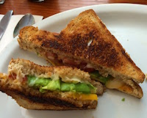
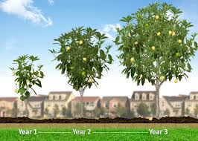
Memory Hierarchy
<1 ns
5-10 s
registers
1 ns
on-chip L1
cache (SRAM)
Smaller,
faster,
costlier
per byte
5-10 ns
off-chip L2
cache (SRAM)
1-2 min
Larger,
slower,
cheaper
per byte
100 ns
main memory
(DRAM)
15-30 min
150,000 ns
SSD
31 days
local secondary storage
(local disks)
10,000,000 ns (10 ms)
Disk
66 months = 5.5 years
1-150 ms
remote secondary storage
(distributed file systems, web servers)
1 - 15 years
Notes:
Going to SSD is like walking down to California to get an avocado
Disk is like waiting a year for a new crop of avocados
Going across the world is like waiting for an avocado tree to grow up from a seed…

Slide 29
Review of Course Themes
Review course goals
They should make much more sense now!

Slide 30
Big Theme: Abstractions and Interfaces
Computing is about abstractions
(but we can’t forget reality)
What are the abstractions that we use?
What do you need to know about them?
When do they break down and you have to peek under the hood?
What bugs can they cause and how do you find them?
How does the hardware relate to the software?
Become a better programmer and begin to understand the important concepts that have evolved in building ever more complex computer systems

Slide 31
Little Theme 1: Representation
All digital systems represent everything as 0s and 1s
The 0 and 1 are really two different voltage ranges in the wires
Or magnetic positions on a disc, or hole depths on a DVD, or even DNA…
“Everything” includes:
Numbers – integers and floating point
Characters – the building blocks of strings
Instructions – the directives to the CPU that make up a program
Pointers – addresses of data objects stored away in memory
Encodings are stored throughout a computer system
In registers, caches, memories, disks, etc.
They all need addresses (a way to locate)
Find a new place to put a new item
Reclaim the place in memory when data no longer needed

Slide 32
Little Theme 2: Translation
There is a big gap between how we think about programs and data and the 0s and 1s of computers
Need languages to describe what we mean
These languages need to be translated one level at a time
We know Java as a programming language
Have to work our way down to the 0s and 1s of computers
Try not to lose anything in translation!
We encountered C language, assembly language, and machine code (for the x86 family of CPU architectures)

Slide 33
Little Theme 3: Control Flow
How do computers orchestrate everything they are doing?
Within one program:
How do we implement if/else, loops, switches?
What do we have to keep track of when we call a procedure, and then another, and then another, and so on?
How do we know what to do upon “return”?
Across programs and operating systems:
Multiple user programs
Operating system has to orchestrate them all
Each gets a share of computing cycles
They may need to share system resources (memory, I/O, disks)
Yielding and taking control of the processor
Voluntary or “by force”?

Slide 34
Course Perspective
CSE351 will make you a better programmer
Purpose is to show how software really works
Understanding the underlying system makes you more effective
Better debugging
Better basis for evaluating performance
How multiple activities work in concert (e.g., OS and user programs)
Not just a course for hardware enthusiasts!
What every CSE major needs to know (plus many more details)
See many patterns that come up over and over in computing (like caching)
“Stuff everybody learns and uses and forgets not knowing”
CSE351 presents a world-view that will empower you
The intellectual and software tools to understand the trillions+ of 1s and 0s that are “flying around” when your program runs

Slide 35
Topics: What’s Next?
Even if CSE 351 wasn’t for you, I would encourage you to explore topics that build on its material!
I know plenty of people who hated 351 but ended up loving a future topic
Here are a few topics that build on the material we talked about in this course.
UW has many courses that align with these topics, other universities might too!
You can also research these on your own, plenty of information online!
Staying near the hardware/software interface:
Digital Design – basic hardware design and circuit logic
Computer Architecture – hardware design of CPUs
Embedded Systems – software design for microcontrollers
Systems software
Programming Languages and Compilers
Data Structures and Parallelism
General Systems Programming – building well-structured systems in C/C++
Operating Systems
Networks
Security

Slide 36
Thanks for a great quarter!
Huge thanks to your awesome TAs!
Don’t be a stranger!
Feel free to send us emails with questions about anything in the future!

